Slide 1



RECENT PROGRESS OF ZINC AND ZINC ALLOY COATED STEEL SHEETS IN KOREA
J.S. Kim*, T.C. Kim and S.K. Lee
*Graduate Institute of Ferrous & Energy Materials Technology

Slide 2
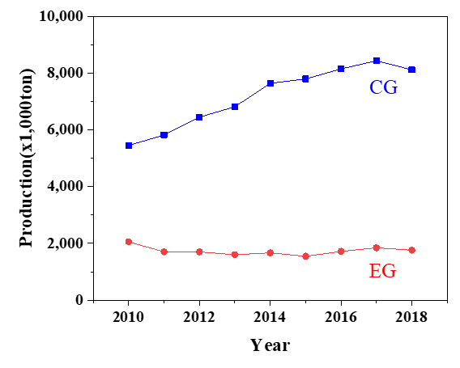
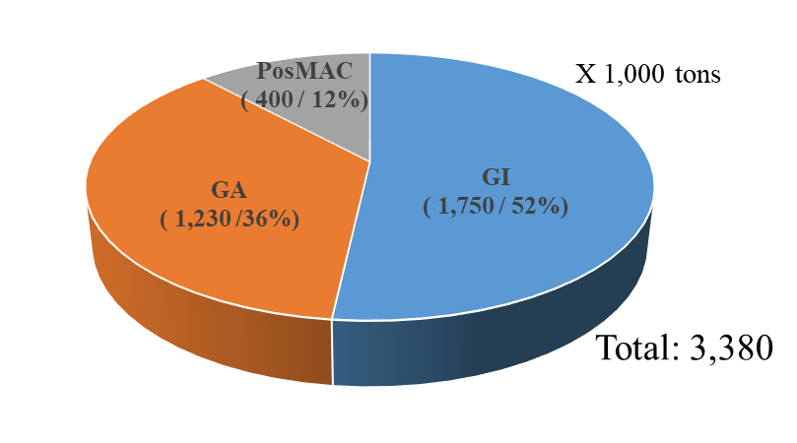
Production of Zn coated steels in Korea
Production of Zn coated steel in POSCO

Slide 3
Current status for development of AHSS in Korea
Steels |  | Tensile Strength (Minimum TS guaranteed, MPa)
 |  | 590 | 780 | 980 | 1180 | 1470 | 1800 | 2000
DP | CG | ● | ● | ●
TRIP | CG | ● | ● | ● | ●
CP | CG |  | ● | ● | ●
HPF | CG |  |  |  | ○ | ● | ○ | ○
○ Developed, ● Commercialized

Slide 4
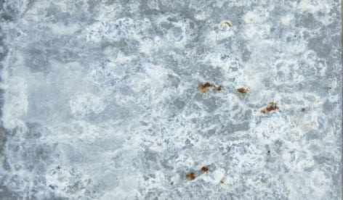
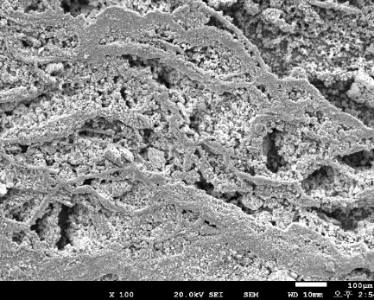
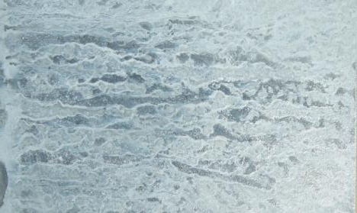
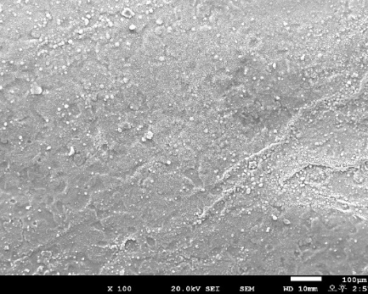
■ Development of ZnMgAl coating
GI(Zn)
Zn(OH)₂
(porous)
Corrosion
products
SimonKolleite (dense)
LDH (dense)
GI (Zn)
PosMAC (ZnMgAl)
steels
steels
steels
PosMAC® (Zn-Mg-Al)
Mg in the Zn coating helps to
form compact corrosion products
- Simonkolleite [Zn₅(OH)₈Cl₂•H₂O]
- Layer Double Hydrooxide (LDH)
[M(Ⅱ)_{x}M(Ⅲ)_{y}(A)_{m}(OH)_{n}CO₃•zH₂O]
→ Enhance corrosion resistance
Surface appearance & SEM images
after Salt Spray Test(SST) in 110 hr

Slide 5
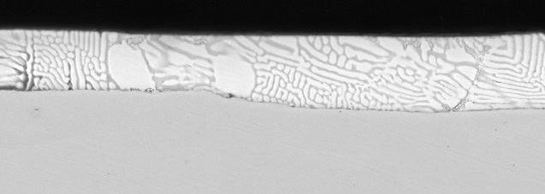
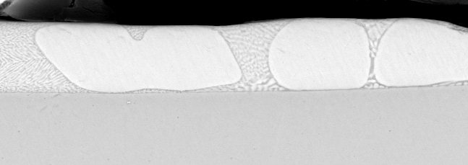
■ ZnMgAl Coated Steels of POSCO
Better
Corrosion
5
For severe environment
3
PosMAC3.0
Mg(%)
(a) PosMAC 3.0
PosMAC1.5
1
For excellent surface
application
Better
Surface
GI
1
3
5
(a) PosMAC 1.5
Better
Welding
Al (%)
Better
Corrosion
Cross sections of PosMAC steel

Slide 6
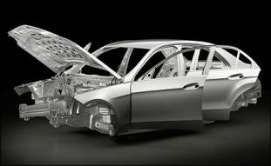
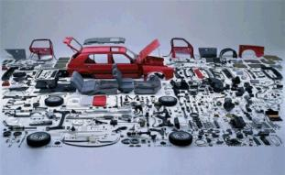



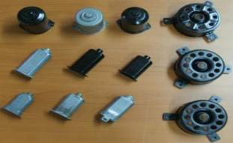

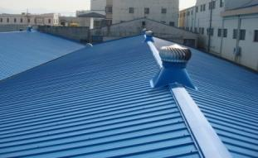
PosMAC® steels for industrial purpose
○ PosMAC® 1.5 (1~2%Mg) : Excellent surface quality, prefer to apply automotive and appliances
○ PosMAC® 3.0 (≒ 3%Mg) : Excellent corrosion resistance for construction and energy utilities
Automotive & Appliance Parts
(PosMAC®1.5)
Construction & Utilities
(PosMAC®3.0)
Automotive
Car component
Construction
Agricultural material
Home appliances
Motor housing
Solar cell frame
Coil coating

Slide 7
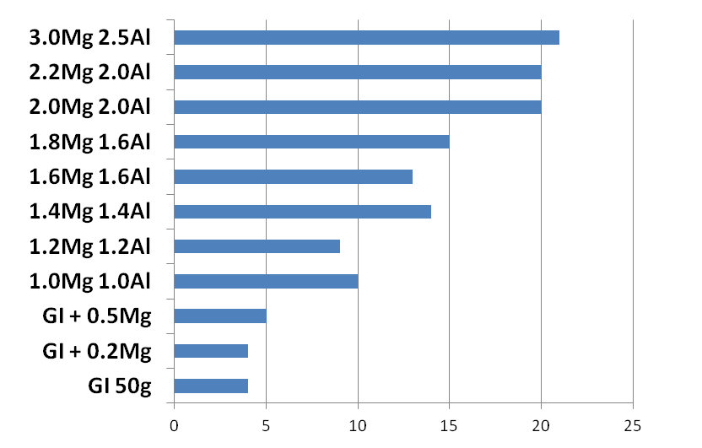
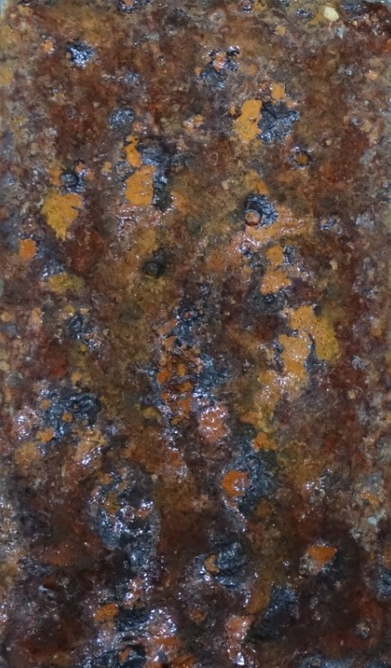
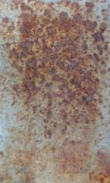
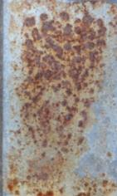
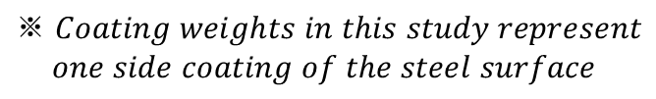
■ Corrosion of ZnMgAl coating
Red Rust Appearance
Appearance after CCT 25 cycles
≒ 3%Mg
(x 5 than GI)
1~2%Mg
(x 3 than GI)
GI
1.2Mg1.2Al
1.6Mg1.6Al
(50g/m²)
(35g/m²)
$$※ Coating weights in this study represent$$
$$one side coating of the steel surface$$
CCT (cycle/day)
* CCT (Automotive) GI 50g/m², ZM 35g/m²

Slide 8
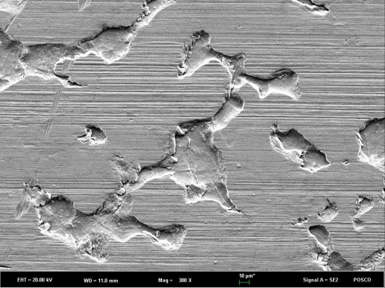
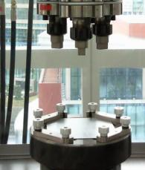
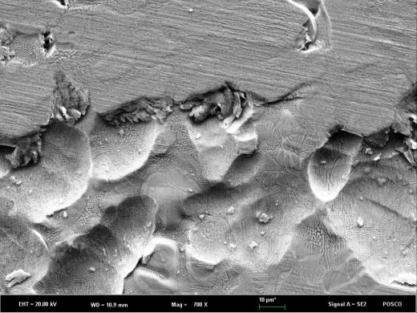
■ Friction of ZnMgAl coating
GI
GI
Friction coefficient
PosMAC®1.5
PosMAC®1.5/3.0
Tool pass (No.)
Friction coefficient with repeated tool pass
Surface morphology after friction test

Slide 9
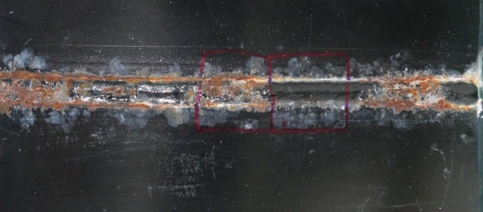
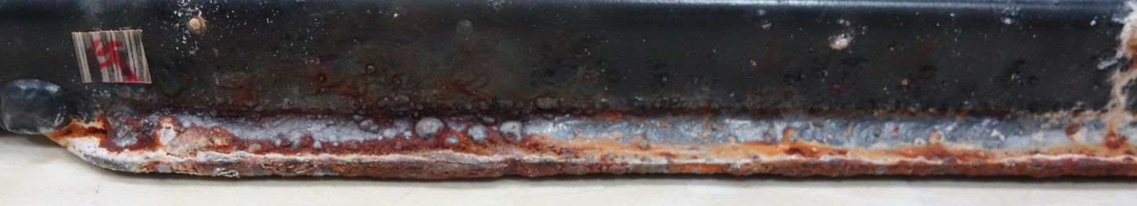
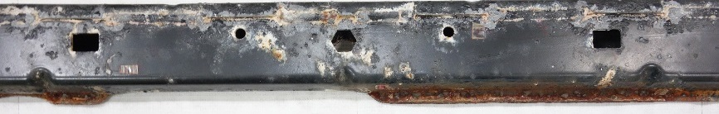
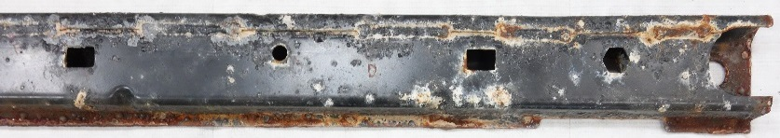
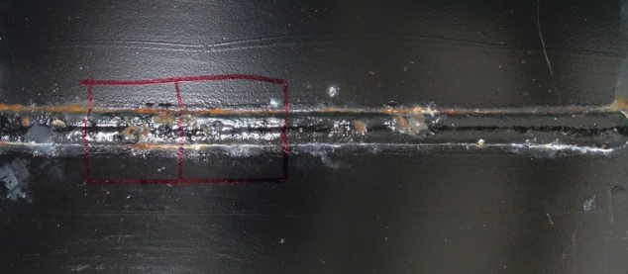
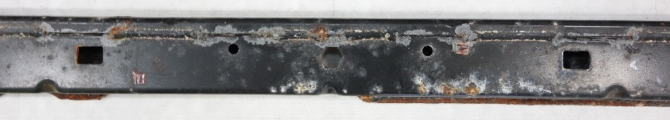
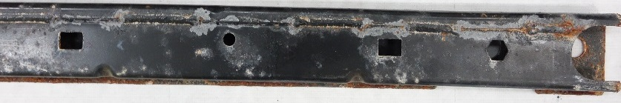
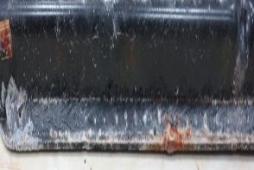
■ Corrosion of ZnMgAl coating after chipping test
GI
60g
Weld bead
Flange edge
PosMAC1.5
35g
Corrosion appearance of the tested samples after chipping test

Slide 10
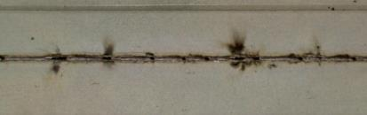
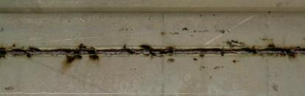
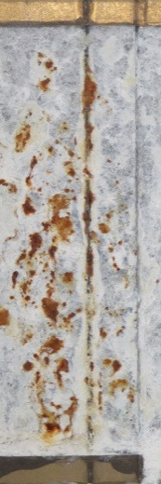
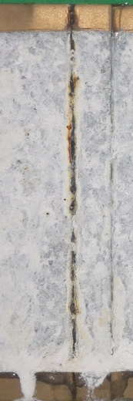
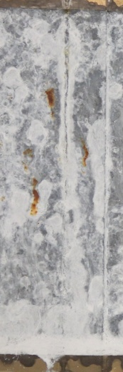
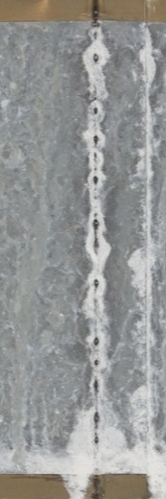
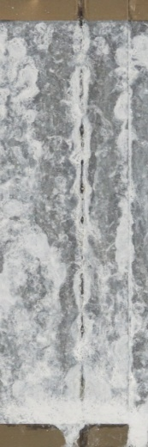
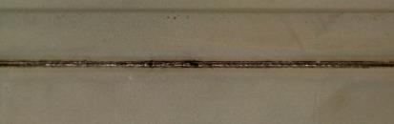
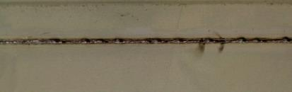
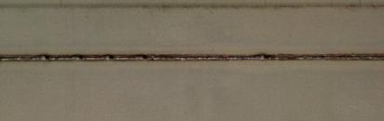
Laser Welding Performance
Pit defects
GI
PosMAC®1.5
60g
GI
8mpm
60g
120g
35g
40g
45g
120g
5mpm
35g
10mpm
40g
PosMAC®1.5
9mpm
45g
Appearance of welded samples after SST 120h
10mpm
※ Laser welding speed 5~10mpm
(Zero Gap and Max. speed)

Slide 11
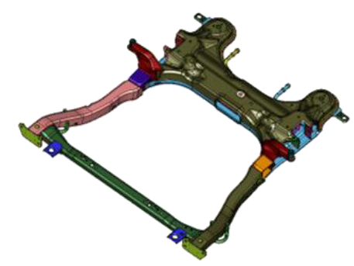
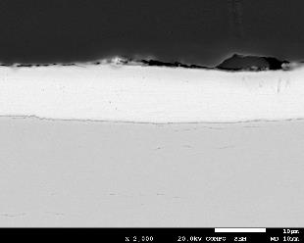
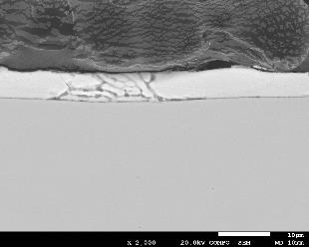
Arc Welding Performance
Side rail
(420Y,1.5t)
Cross bar
(340Y,1.5t)
GI (60g)
PosMAC1.5 (35g)
[FR Subframe]
[Cross sections of the material]
Parts | Conventional spec. | New candidate | Benefits / Targets
Side rail | GI (60g) | PosMAC1.5 (35g) | Improve the Arc welding Enhanced Corrosion Protection Thinner ED coating
Cross bar | GI (60g) | PosMAC1.5 (35g)

Slide 12
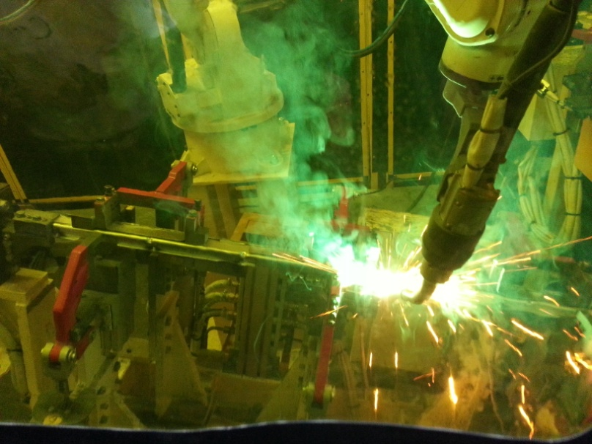
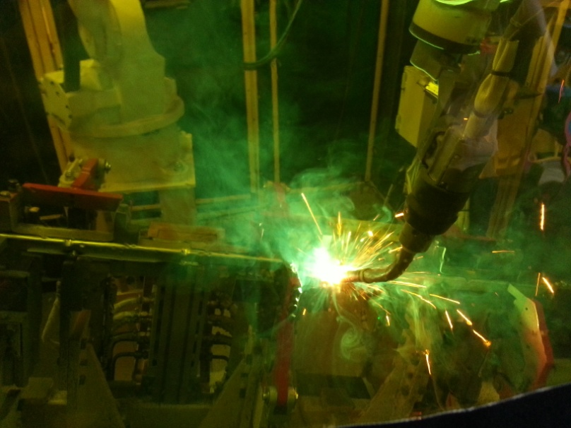
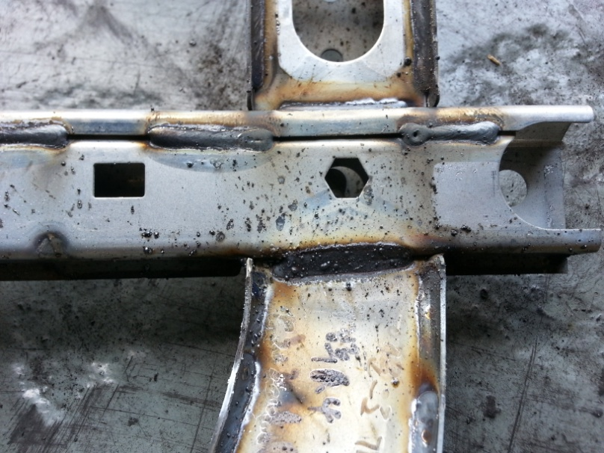
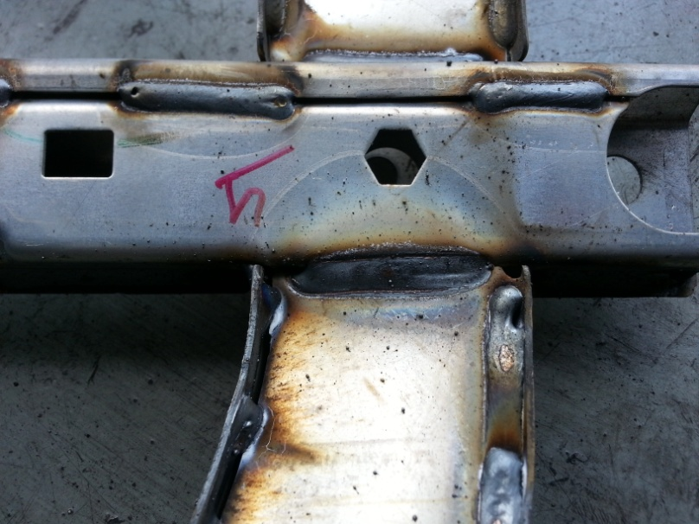
Arc Welding Application
Coatings | Welding speed | Currents | Spatters | Deviation | Remarks
GI (60g) | 45 cm/min | 113~120A | Much | High | -
PosMAC1.5 (35g) | 60 cm/min | 120~150A | Less | Stable | 30% speed up
 | GI (60g) | PosMAC 1.5 (35g)
Arc welding
Welded parts
With better quality and productivity, PosMAC® offers advanced materials for the chassis.

Slide 13

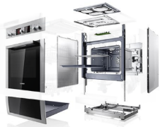
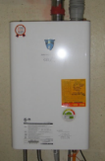
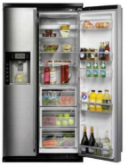
■ Application for appliance of PCM
Top coat.
Primer coat.
Top coat.
Pre treatment
Primer coat.
PosMAC
PosMAC 1.5
Steel
steel
Schematics of PCM coated PosMAC
Cross section of PCM PosMAC1.5
Various products of appliances by using PCM sheets

Slide 14
■ Bending test of PCM
 | GI PCM (reference) (110g) | PosMAC 1.5 PCM (75g)
0T (25℃)
3T (0℃)

Slide 15
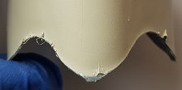
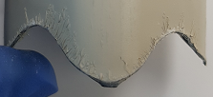














■ Corrosion resistance of PCM
 |  | Drawing cup |  | Cross cut | X cut
 |  | SST 72 hr | SST 720hr | SST 480hr | SST 480hr
 | 60g
 | 75g
 | 90g
 | 110g
samples
Coat.
weight
PosMAC1.5
GI

Slide 16


■ PVD Products
PVD products and cross-sectional view of PVD ZM with triple layer coating

Slide 17

■ Hydrogen embrittlement of PVD Products
U-bending test specimens after immerging in 0.1N HCL solution for 300h

Slide 18

■ Conventional printing process
● Roll print process ● Silk screen process
* Resolution : 100dpi * Resolution : 100~300dpi

Slide 19

■ Inkjet printing(PosART)

Slide 20














■ Application of Ink Jet printing(PosART)

Slide 21
Conclusion
Hot-dip galvanized steel production has increased steadily for the past 10 years, at around 6% per year, in Korea, but due to the economic downturn, 2018 production has declined by 4% over the previous year. On the other hand, in the case of electro-galvanized steel, it shows a tendency to decrease.
To overcome the oversupply of steel products, POSCO has completed the launch of new surface treatment products.
POSCO has developed AHSS coated steel with improved properties and commercially produced ZnAlMg coated steel sheets(PosMAC) for construction, automotive and appliance market.
PosPVD pilot plant, a physical vapor deposition, is trying to explore the home appliances and automotive market.
PosART product, an aesthetic inkjet coating steel sheet, has been mass produced since 2018 and have been continuously produced as high-end building internal and external materials.

