Slide 1
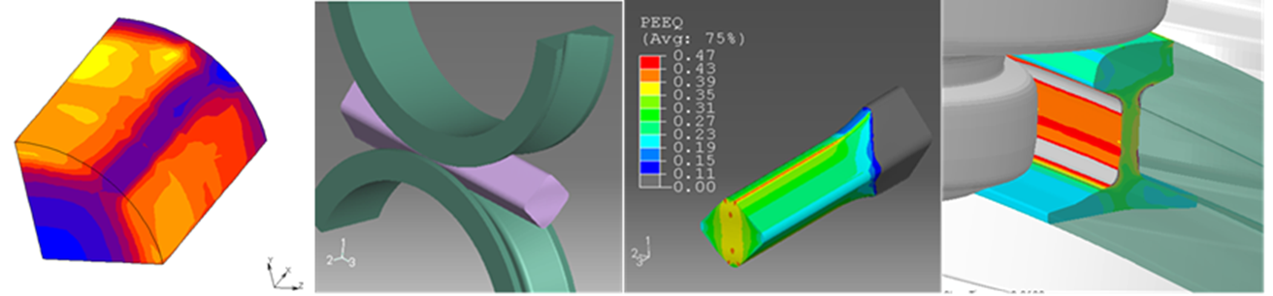
F. Avellino
L. Langellotto
S. Mancini
AUTOMATIC UNSTRUCTURED QUADRILATERAL MESH GENERATOR BASED ON DIRECT METHOD

Slide 2
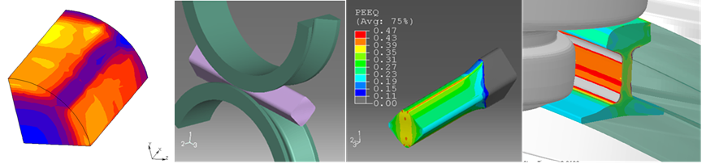
FEM simulation in hot rolling of long product
FEM for the simulation of the hot rolling processes of long products has been object of research over the last three decades.
The long product rolling process is fully 3D, so the conventional 2D method can’t give good predictions for cross section. With the evolution of computing capabilities, the 3D FEM were widely used, at both European and worldwide level, with and without metallurgical coupling.
Updated Lagrangian formulation provides good agreement between experimental and predicted values. Implicit codes consume much more computing time than the explicit codes but the results are similar.
Almost all the European projects on long product rolling have applied, even partially, a FE simulation tools. In general, these tools are commercial and based on updated Lagrangian formulation.
3D analysis with Lagrangian method is very efficient to manage non-linear problems: in order to reduce the mesh distortion problems, several techniques for automatic remeshing has been developed.

Slide 3
State of art in generation of FEM unstructured quadrilateral mesh
Methods for unstructured quadrilateral mesh;:
Indirect:
  Decomposition of the domain of interest in simpler regions, which allow a natural decomposition into quadrilaterals
Direct:
  Previously meshing the physical domain into triangles which are subsequently converted into quadrilaterals element using a specific algorithm
Baehmann et al.:
A quadtree technique based on a spatial decomposition for quadrilateral meshing. In this technique a 2D space is subdivided into a quadtree division, then quadrilaterals are fitted into quadtree cells, and nodes are adjusted to conform to the domain boundary.
Talbert:
The domain is subdivided into simpler polygonal shapes.
Tam & Armstrong:
Introduced the generation of quadrilateral meshes employing medial axis decomposition to decompose the area into simpler regions, in each of which are generated quadrilateral elements.
Joe:
decomposition algorithm to divide a given two-dimensional domain into convex polygons.
…

Slide 4
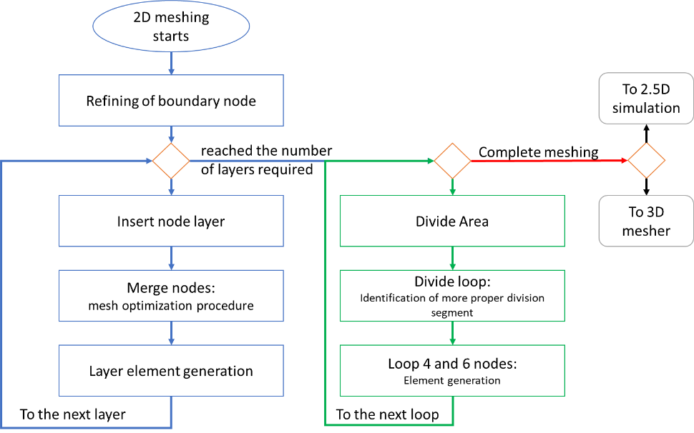
Overview of the meshing algorithm

Slide 5
Overview of the meshing algorithm
Refine boundary nodes
This procedure generates further nodes along the feedstock edge. The new nodes are generated considering the average element length inputted by the user through the boundary element dimension.

Slide 6
Overview of the meshing algorithm
Insert node layer
This routine generates a new layer of nodes. This new layer is positioned at an average distance of the first one equal to the “Boundary element thickness” inputted by the user using the interface or the code line.

Slide 7
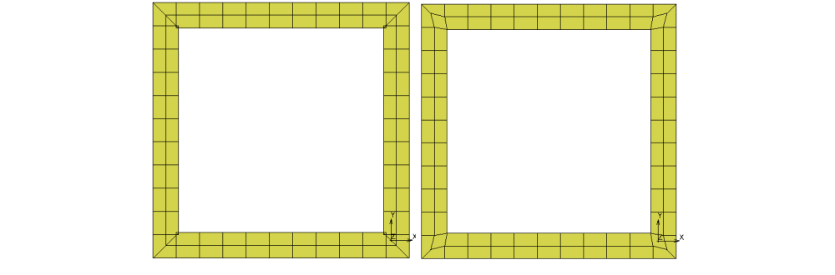
Overview of the meshing algorithm
Merge nodes
This procedure analyses the new nodes and identifies all the nodes that would lead to the generation of elements upside down, distorted, cross element, and with zero volume.

Slide 8
Overview of the meshing algorithm
Layer element generation
This procedure generates the new element layer starting from the node layer.

Slide 9
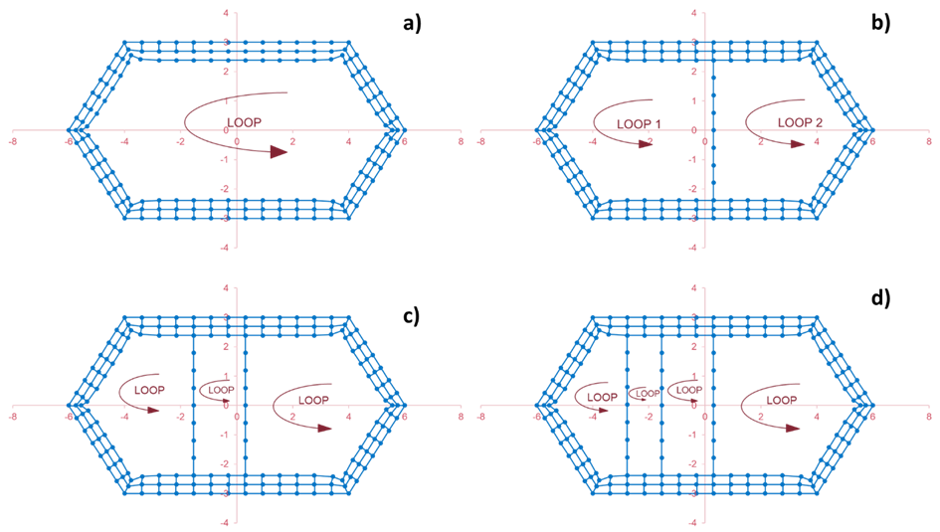
Algorithm and loops description
After the construction of boundary layers, the meshing algorithms start the recursive procedure of internal domain subdivision with the divide routines.
The mesh generator is based on a recursive decomposition of the domain until only quadrilaterals are left.
After the initial boundary is processed, it is transformed into a simple closed polygonal line.
The possible splitting lines must have their endpoints over two non-consecutive nodes of this polygon.
Once the optimal line has been chosen, its corresponding new nodes are generated (in the node placement phase); this leads to two new singly closed polygonal lines, where the recursively of the algorithm is exploited. The splitting line cannot be arbitrary, moreover, the optimal one should be chosen.
In order to find the best splitting line, an objective function (cost function) is defined.

Slide 10
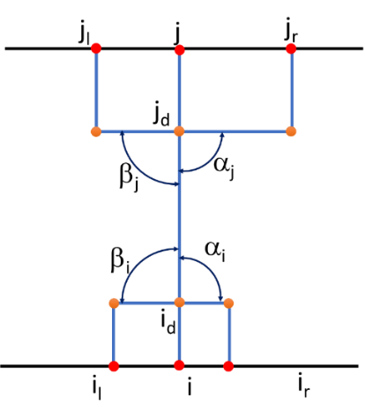



Objective function
The definition of the objective function is a basic point to ensure proper results:
$$S=W_{a}dev+W_{l}L+W_{e}epsil$$
where Wa, Wl, and We, are weight coefficients which sum is 1.
Wa=0.5, Wl =0.3, and We=0.2 (Talbert and Parkinson).
Relative deviation of the angles αi, βi, αj, βj from the right angle:
$$dev={\left(\left|90°−α_{i}\right|+\left|90°−α_{j}\right|+\left|90°−β_{i}\right|+\left|90°−β_{j}\right|\right)}/{360}$$
Non-rhombicity coefficient of the elements:
$$epsil={\left({\left|l_{e}−l_{de}\right|}/{l_{e}}+{\left|l_{b}−l_{db}\right|}/{l_{b}}\right)}/2$$
Where:
le, is a half sum of the distances between nodes jr, and j, and between nodes jl, and j;
lb is a half sum of the distances between nodes ir, and i, and between nodes il, and i;
lde is the distances between nodes jd, and j;
ldb is the distances between nodes id, and i;
Segment j-th relative length:
$$L=\frac{L_{j}}{L_{max}}$$

Slide 11
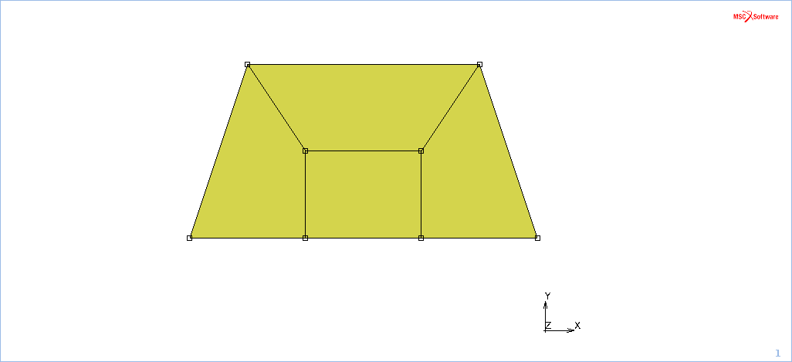
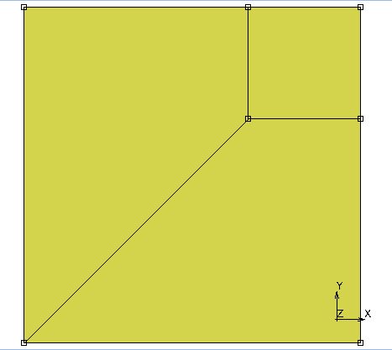
Examples of loop closure
The subdivision algorithm is carried out until reaching 6 nodes per element.
Depending on the situation, each 6-node element can be reduced to one or more 4-node elements.
Examples of patterns to close a loop from 6-node to 4-node element are shown in the following figure for different element geometry.

Slide 12
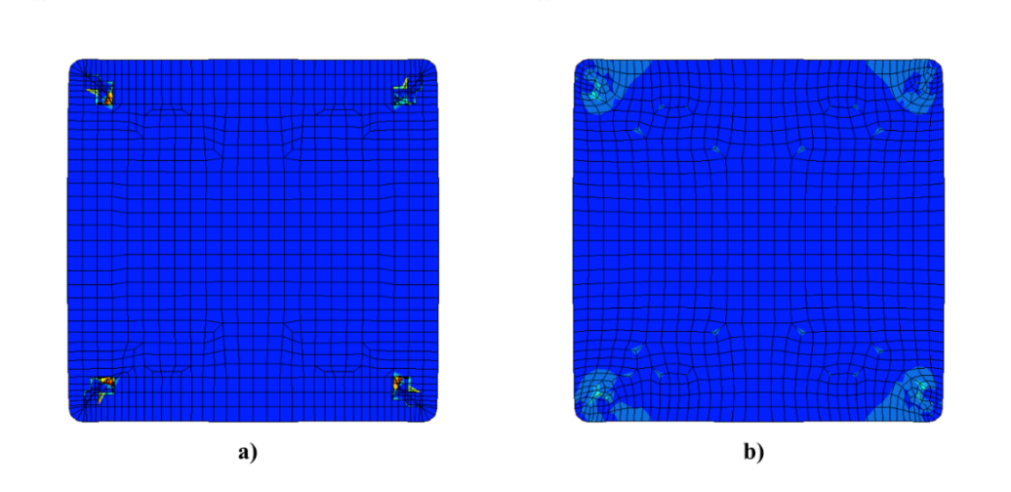
Mesh results
Element distortion of the mesh affects not only the interpolation functions in the physical domain and convergence rates, but can also reduce the accuracy of an analysis.
A parameter that measures the distortion to understand when and where to re-mesh because of excessive distortion was proposed and refined.
ALGORITHM

Slide 13
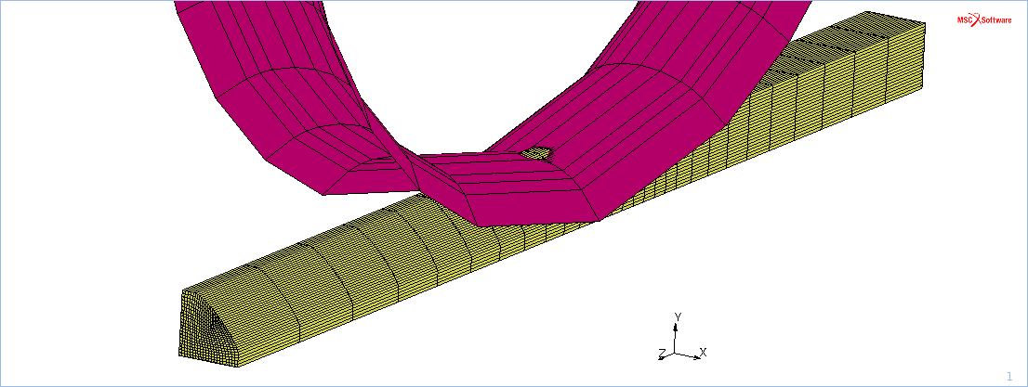
3D mesh generation
3D mesh algorithm simply extrudes and models the 2D transversal mesh along rolling direction considering the position of the roll. In Figure 10 is shown an example of 3D mesh results.

Slide 14
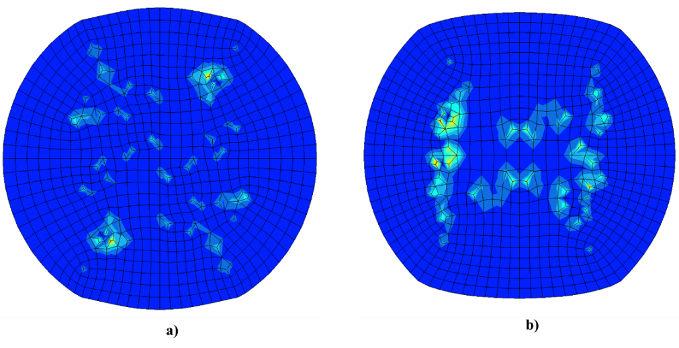
Discussions and conclusions
DISCUSSIONS
The algorithm works for different types of square, rectangular and round profiles, typical sections of hot rolling of long steel products. Where the algorithm does not return a mesh of acceptable quality, the rezoning algorithm produces excellent results in correctly repositioning the nodes.
CONCLUSIONS
An algorithm for the meshing of the most used sections in hot rolling has been implemented and optimized, both in 2D and 3D. The meshes generated with this procedure have been used in various FEM applications for the simulation of the rolling processes of long steel products.

Slide 15
CONTACTS
filippo.avellino@rina.org
luigi.langellotto@rina.org
silvia.mancini@studenti.unipg.it

