Slide 1



„Development of galvanized and galvannealed 3rd Gen. AHSS“
Effect of Si and Al on retained austenite stabilization during Q&P and galvannealing process
Matthias Wallner^{a,c}, K. Steineder^{b}, R. Schneiderª, C. Sommitsch^{c}
ªDepartment for Materials Technology, University of Applied Sciences Upper Austria, Wels, Austria;
^{b}Research & Development and Innovation, voestalpine Steel GmbH, Linz, Austria;
^{c}Institute of Material Science, Joining and Forming, Graz University of Technology, Graz, Austria

Slide 2
Introduction
2nd Gen. AHSS (TWIP)
60
mild steel
(IF, LC)
50
40
3rd Gen. AHSS
(Medium-Mn, TBF, Q&P)
TE [%]
30
HSS
(HSIF, Isotrop,
BH, HSLA, CMn)
20
10
1st Gen. AHSS
(TRIP, DP, CP)
martensitic steel
0
0
200
400
600
800
1000
1200
1400
TS [MPa]

Slide 3
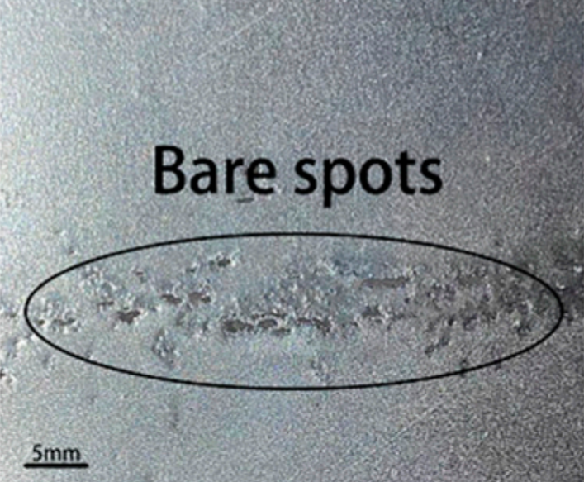
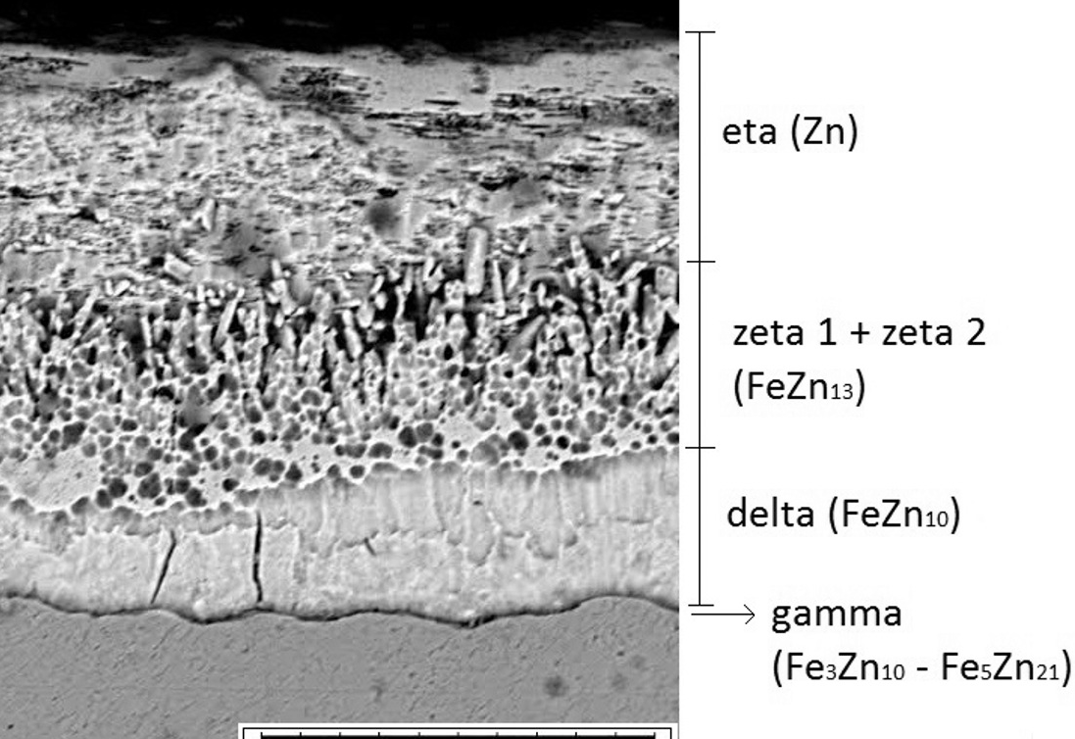
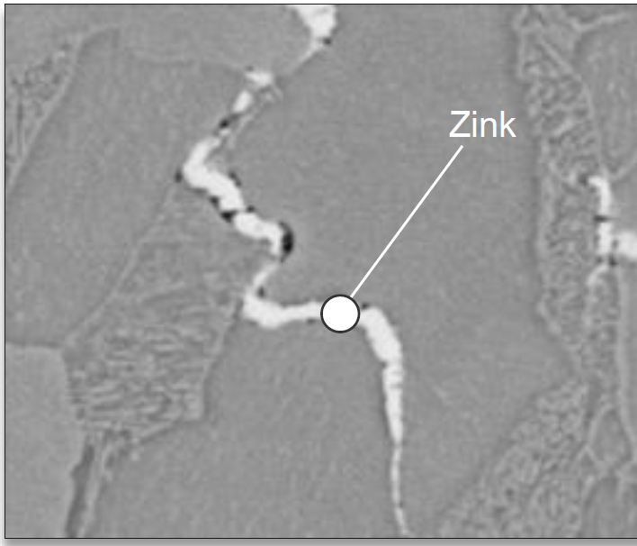
Introduction
+ high product of TS×TE
(crash safety)
+ balance global to local ductility
(deep drawing to bending)
- galvanizeability (selective surface oxides)
- slow galvannealing (Fe-Zn) reactions
- poor weldability due to LME
2nd Gen. AHSS (TWIP)
60
mild steel
(IF, LC)
50
40
3rd Gen. AHSS
(Medium-Mn, TBF, Q&P)
TE [%]
30
HSS
(HSIF, Isotrop,
BH, HSLA, CMn)
20
10
1st Gen. AHSS
(TRIP, DP, CP)
martensitic steel
Due to Si↑
0
0
200
400
600
800
1000
1200
1400
TS [MPa]

Slide 4
Experimental procedure
T↑
Inductor
Aim:
Influence of a fully substitiution of Si by Al on
Carbide precipitation in α‘₁
RA stabilisation to room temperature
RA stabilisation during GA
during Q&P with subsequent GAlvannealing
T[°C]
A_{c3}
A_{c1}
GA
480-560°C
(20s)
Zn
-50K/s
400°C – 40s
Small scaled steels | C [%] | Mn [%] | Si [%] | Al [%] | A_{c1} [°C] | A_{c3} [°C] | M_{S} [°C]
0.2C-4Mn-1.5Si | 0.2 | 4 | 1.5 | 0 | 722 | 820 | 314
0.2C-4Mn-1.5Al | 0.2 | 4 | 0 | 1.5 | 738 | 885 | 334
M_{S}
T_{q}
X_{phase}
[vol.%]
Q₁ vs. Q₂
t[s]
Methods:
- Microstructure – SEM/EBSD
- Tempering behavior of martensite – derivation of rel. length change (dilatometer) & heat flow (DSC)
C
RA
CR
C
α‘₂
γ
α_{B}
α‘_{1(Tq)}
α‘₁
t[s]
RA…retained austenite ; α‘₁…tempered martensite
α_{B}…bainitic ferrite; α‘₂…fresh martensite

Slide 5
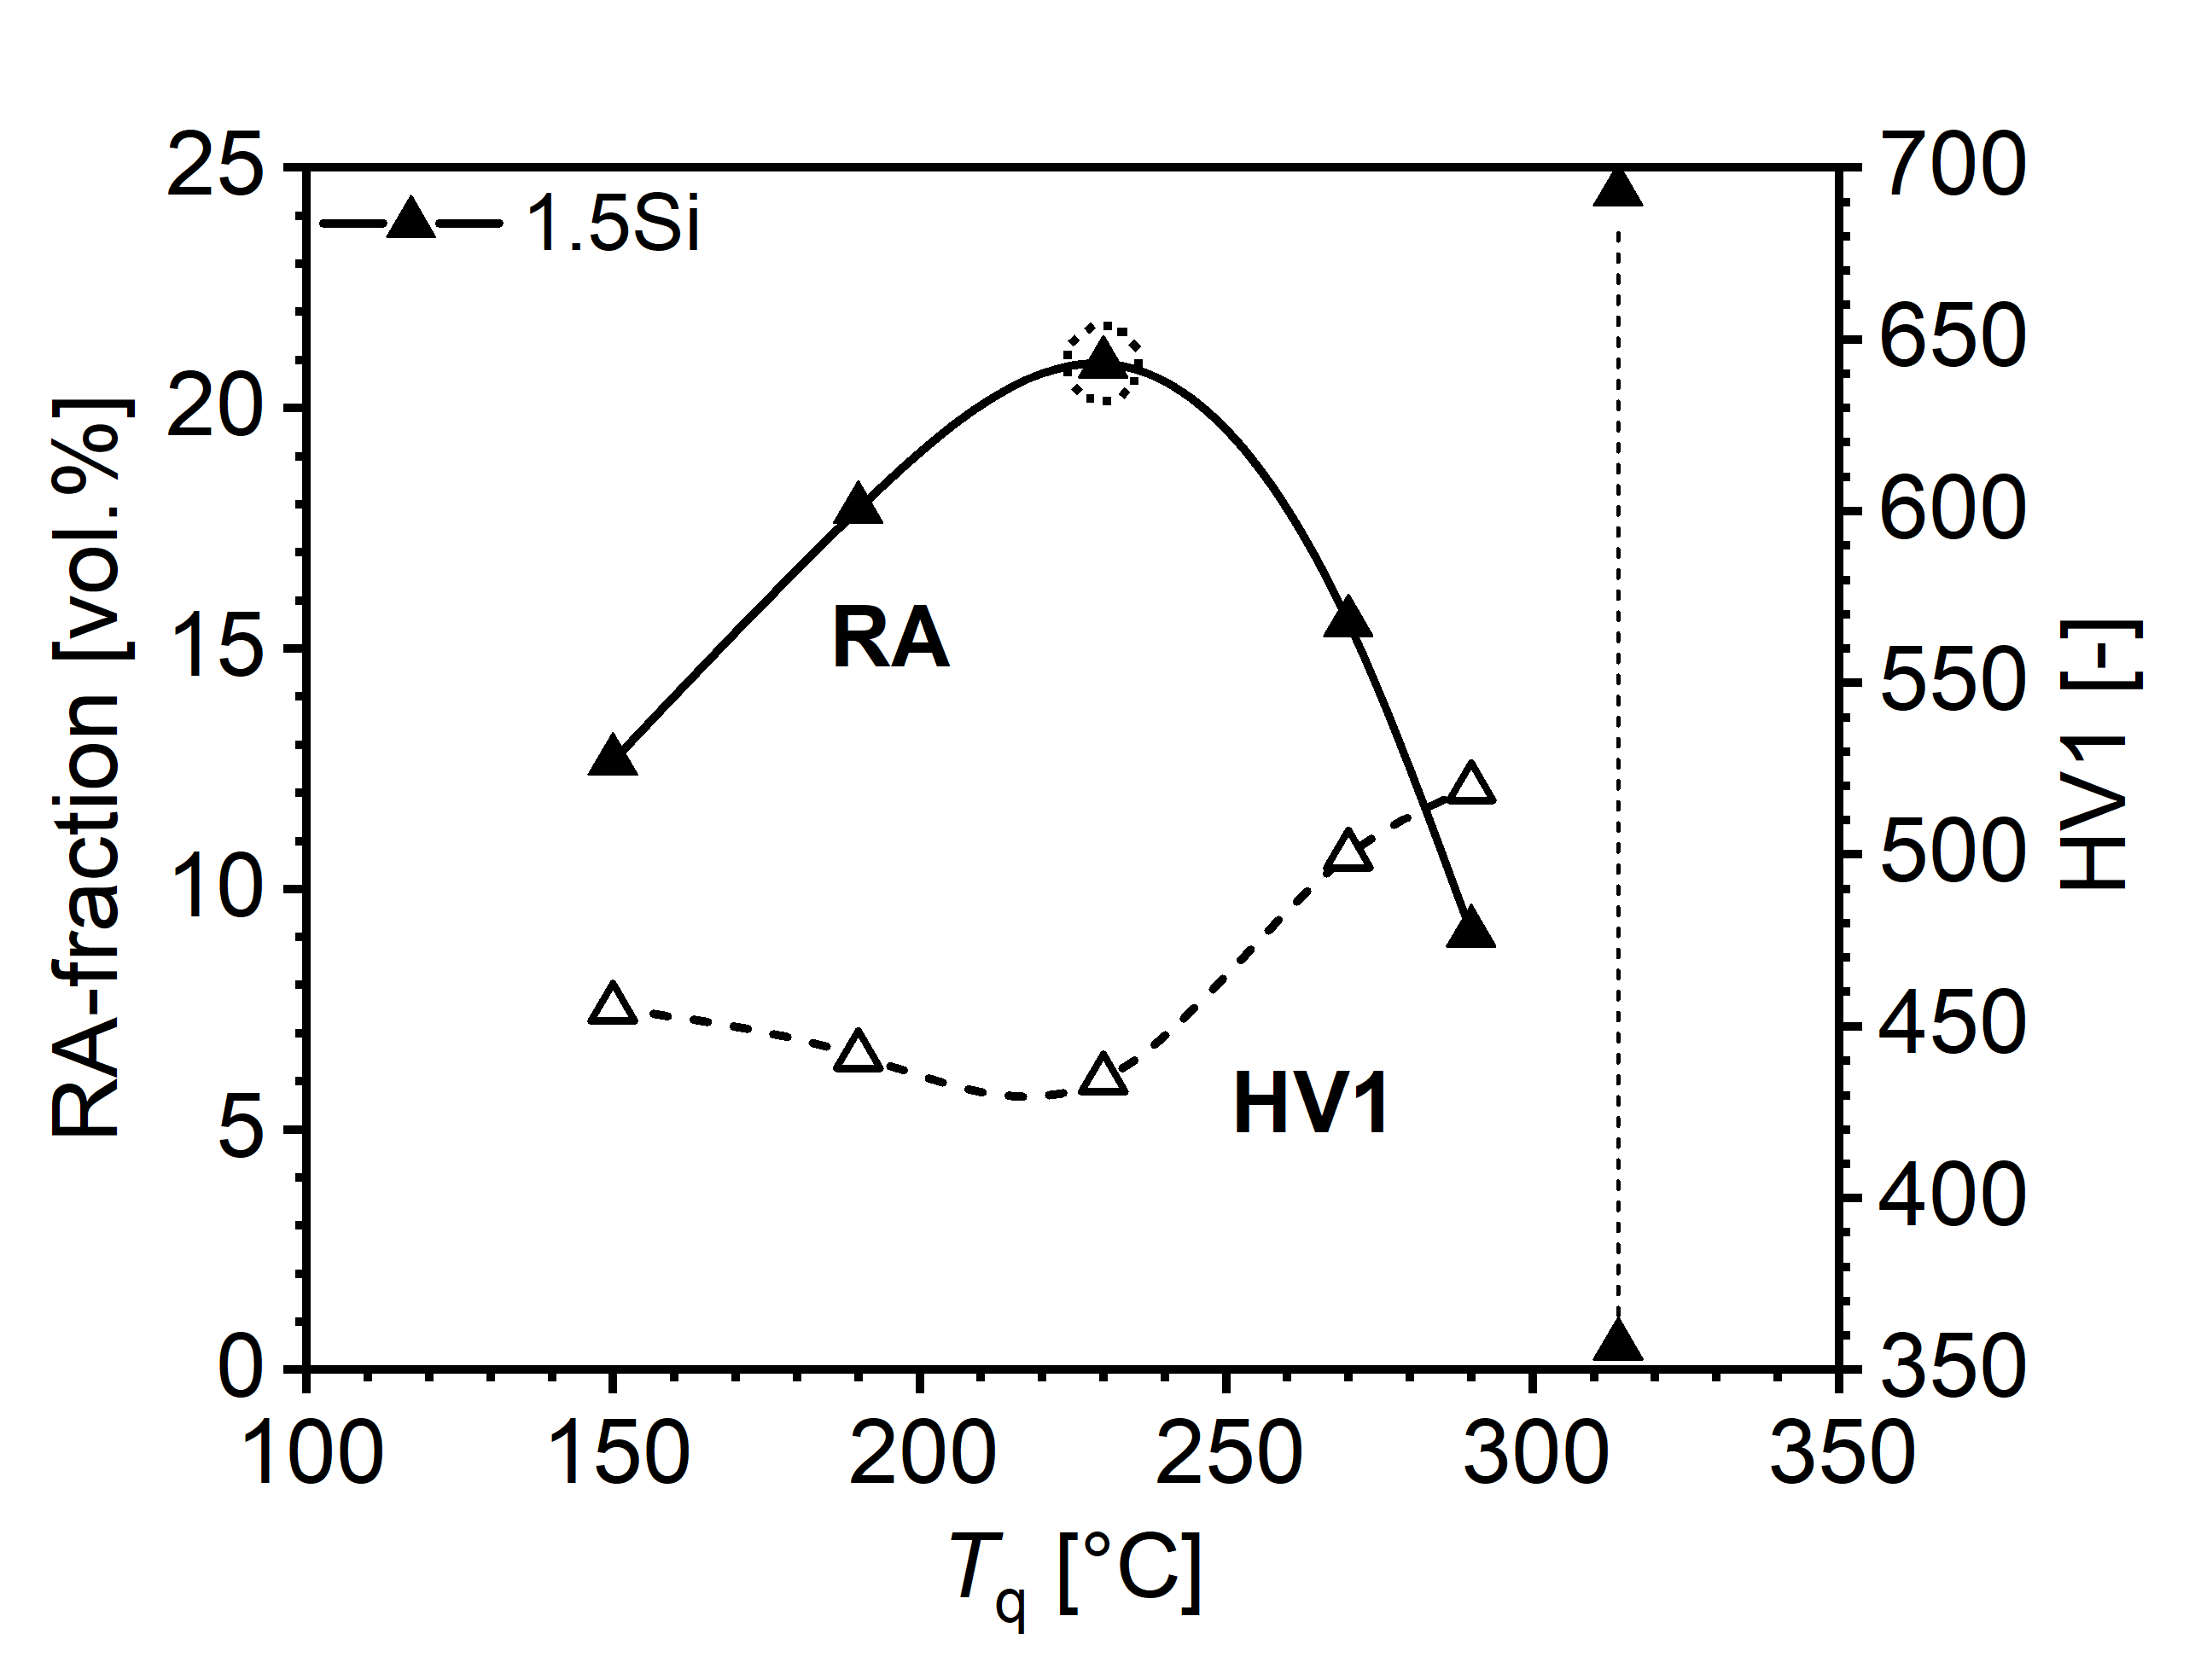
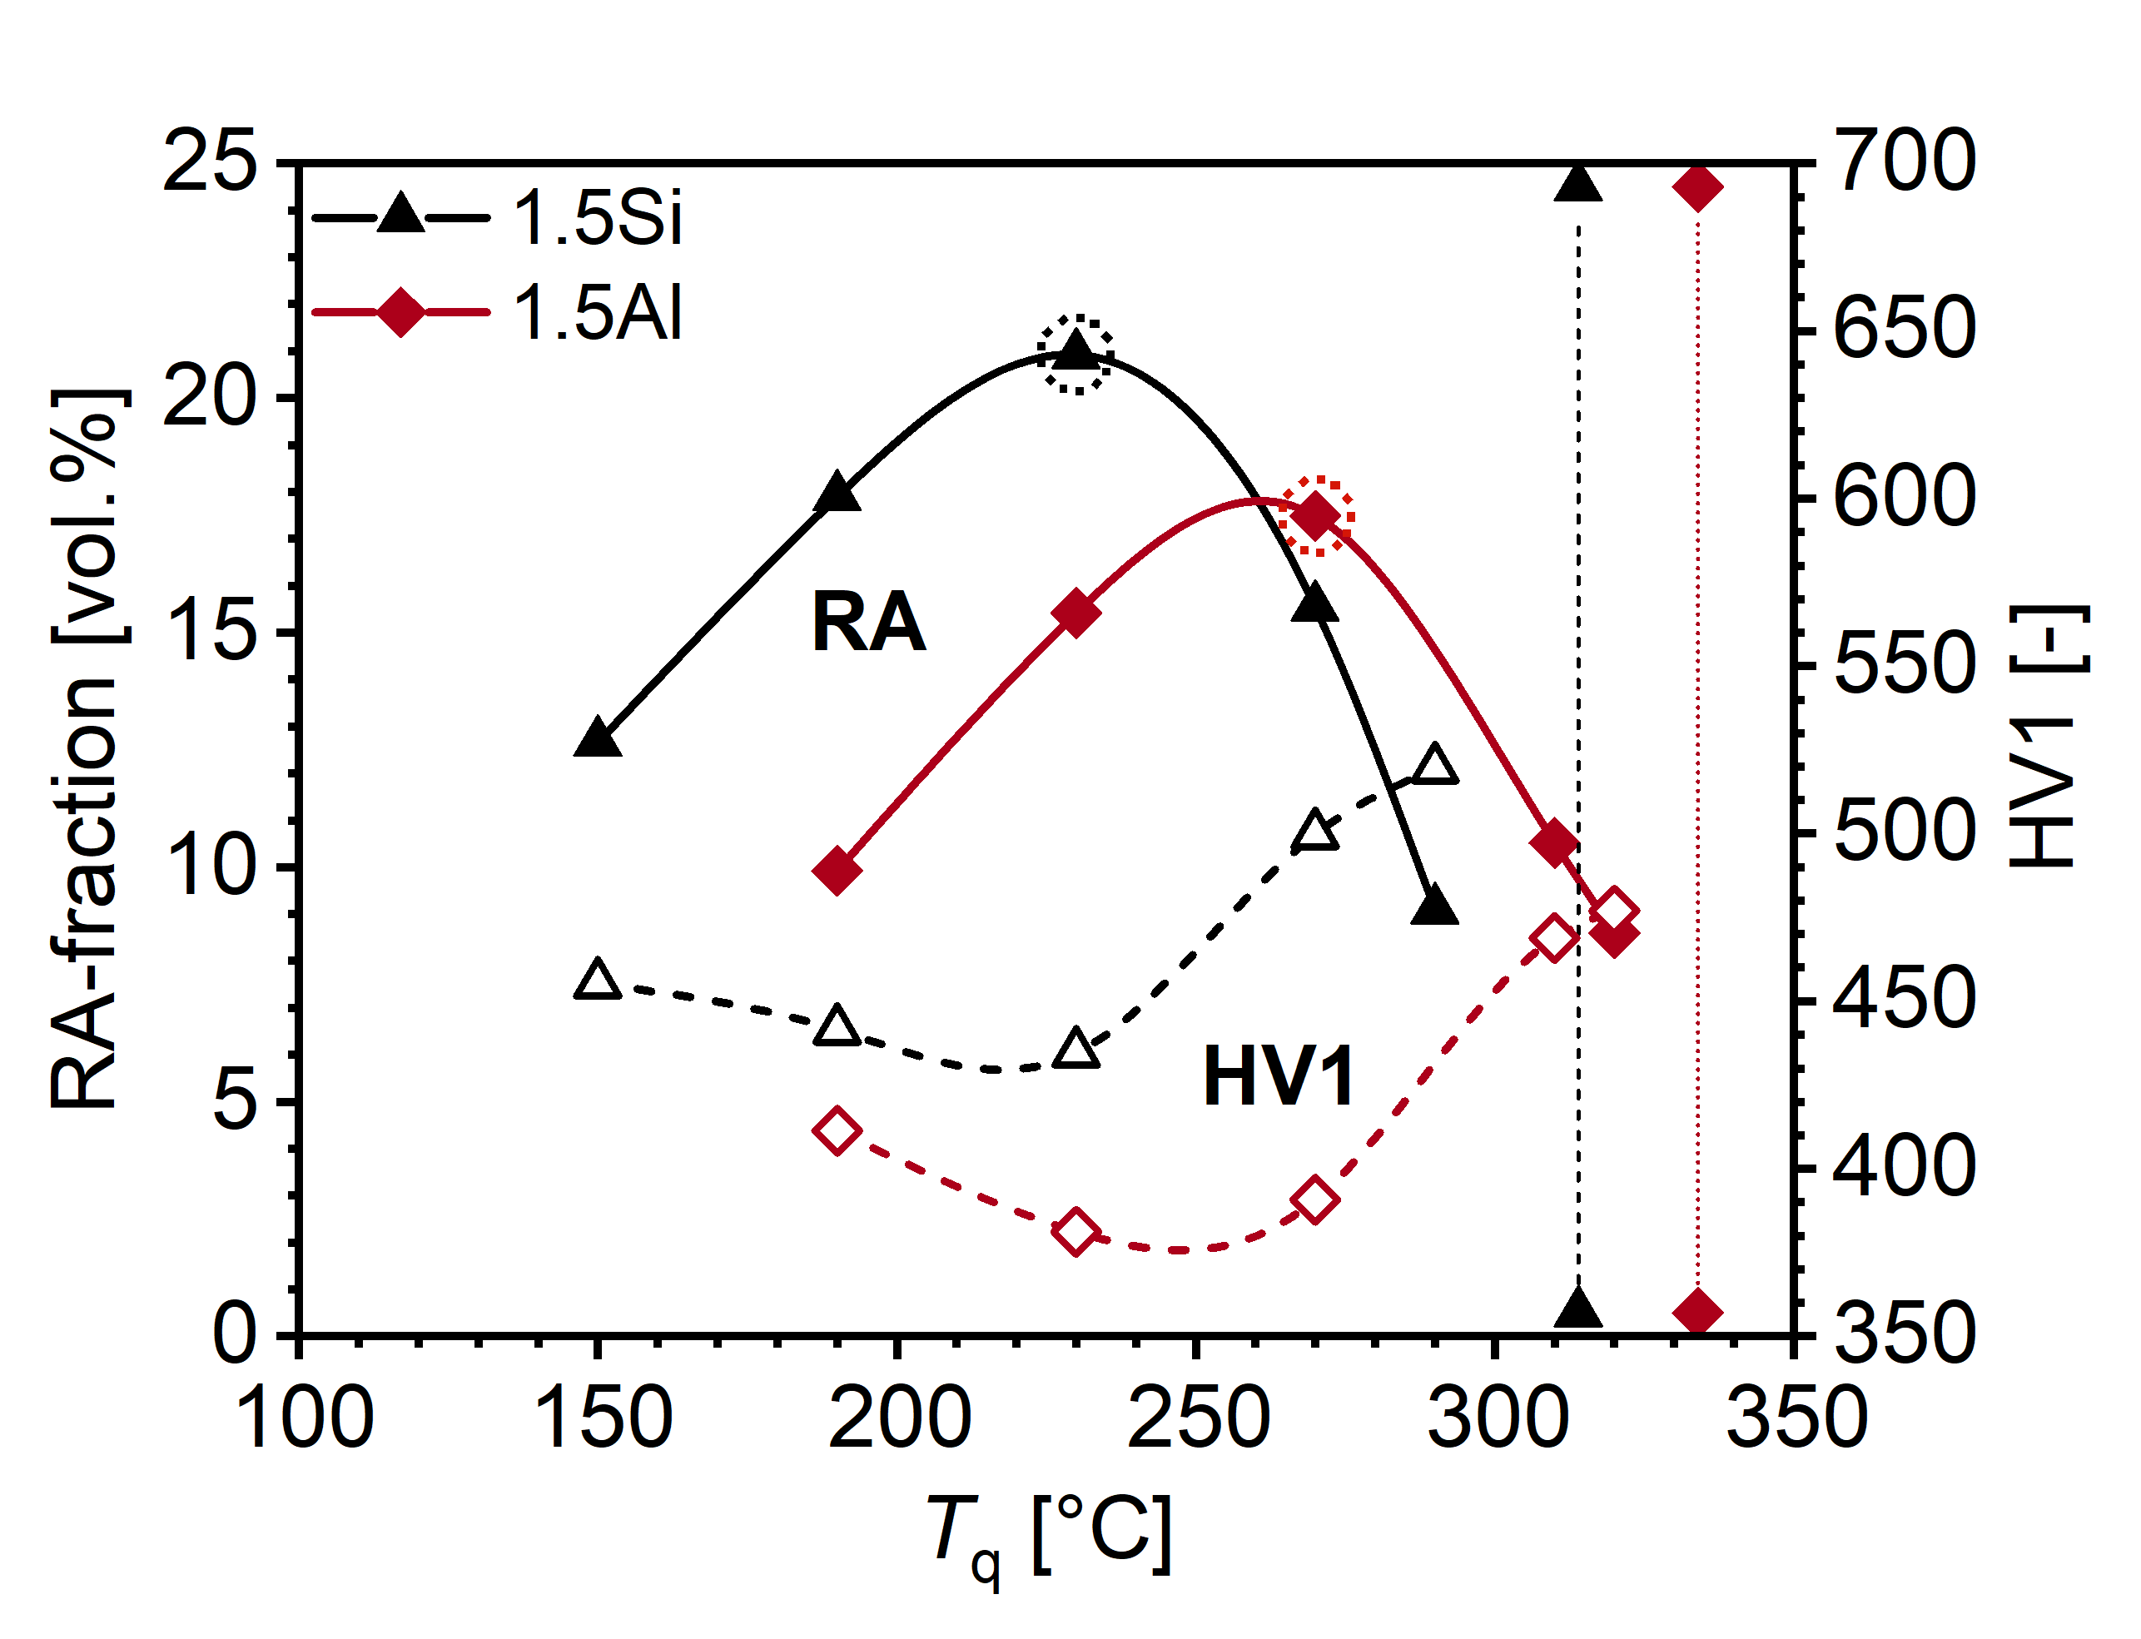
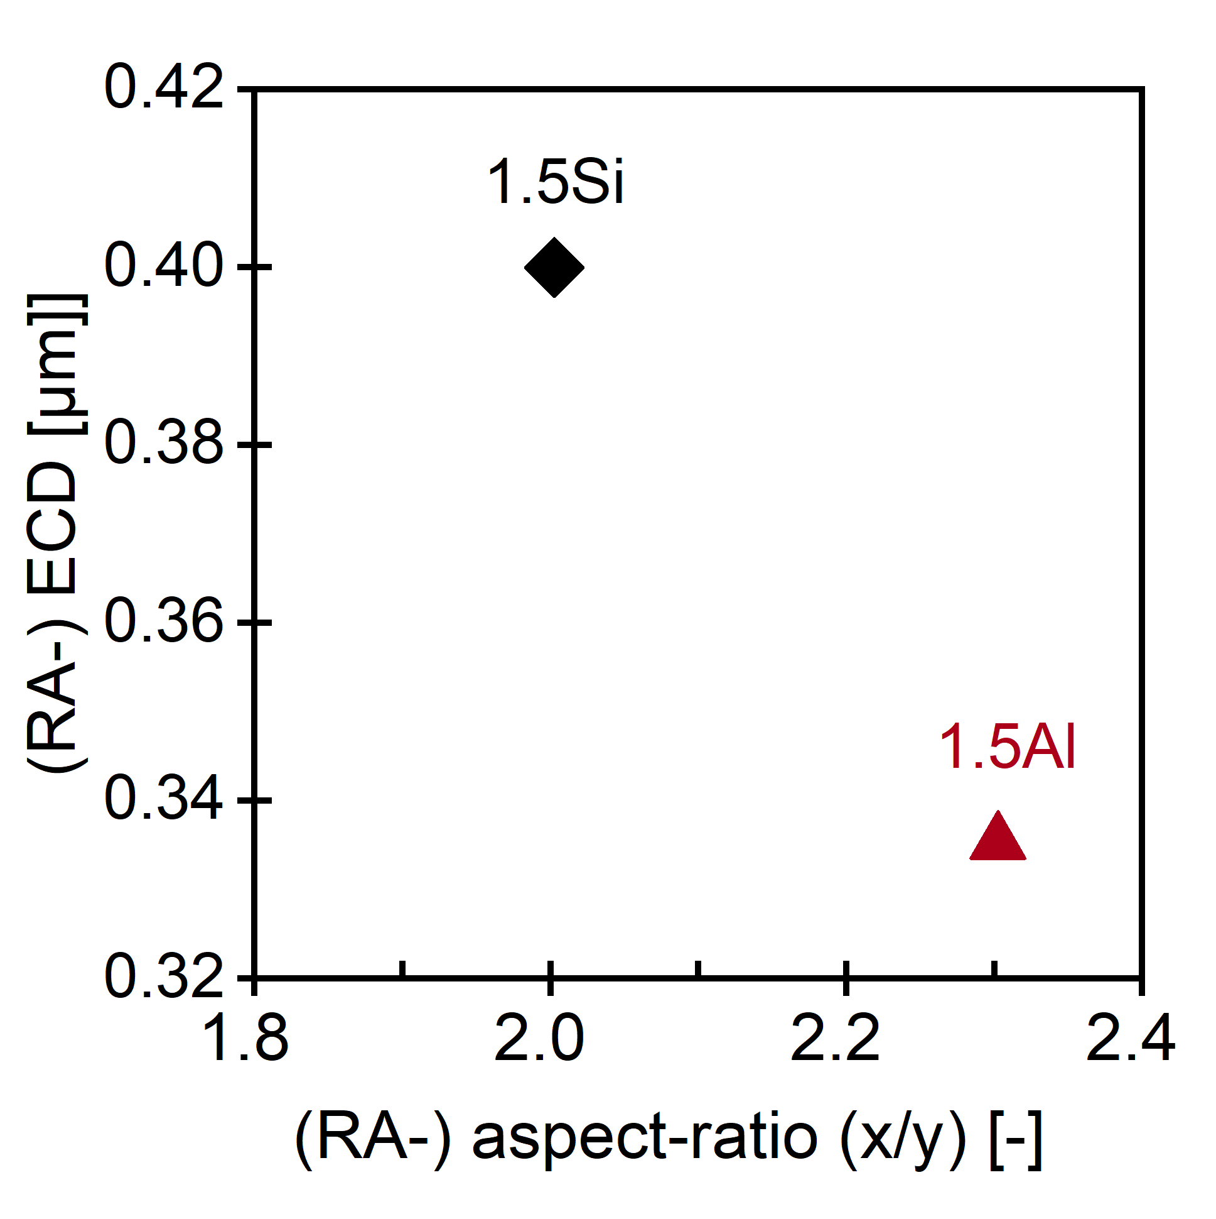
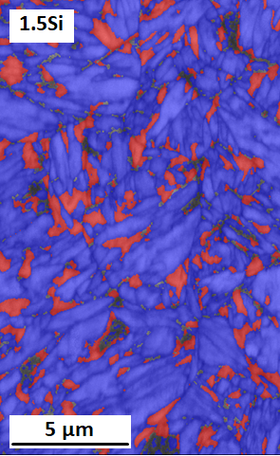
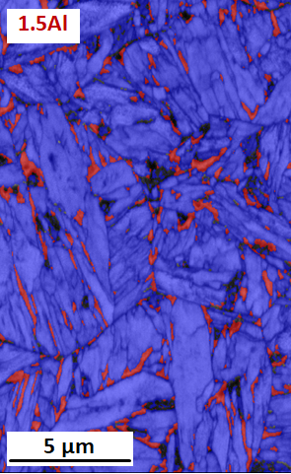
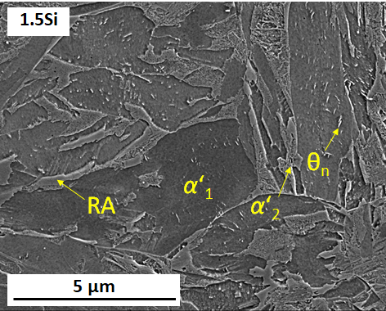
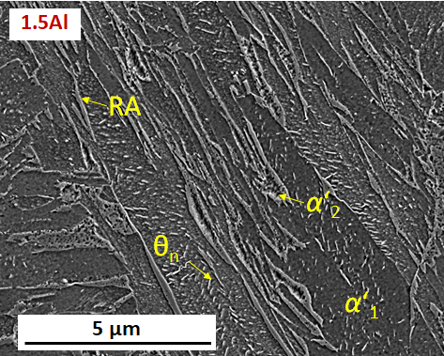
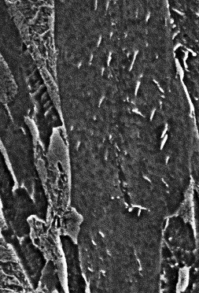
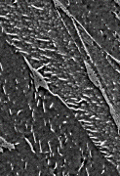
RA-Austenite stabilization during Q&P
T[°C]
y
A_{c3}
X
M_{S}
T_{q}
t[s]
230°C
270°C
(RA; α‘₁; α‘₂)
size
1.5Si
1.5Al
lath-like shape
400°C
40s
~60% α‘₁
~60% α‘₁
1µm
1µm
 | α‘₁ [%] | α_{B} [%] | α‘₂ [%] | RA [%] | C_{RA}^{[1]} [wt.%] | PAGS [µm]
0.2C-4Mn-1.5Si | 60 | 9 | 10 | 21 | 0.79 | 5.5
0.2C-4Mn-1.5Al | 63 | 14 | 6 | 17 | 0.88 | 12.3
→ Carbide precipitation during α‘₁-tempering reduces C-partitioning → RA ↓
→ Influence of Si & Al on tempering behavior of α‘₁?
(LeverRule)
M. Wallner, et. al., Mater. Sci. Tech. 37 (2021) 182-189
[1] N.H. van Dijk; Acta Mater. 53 (2005) 5439–5447

Slide 6
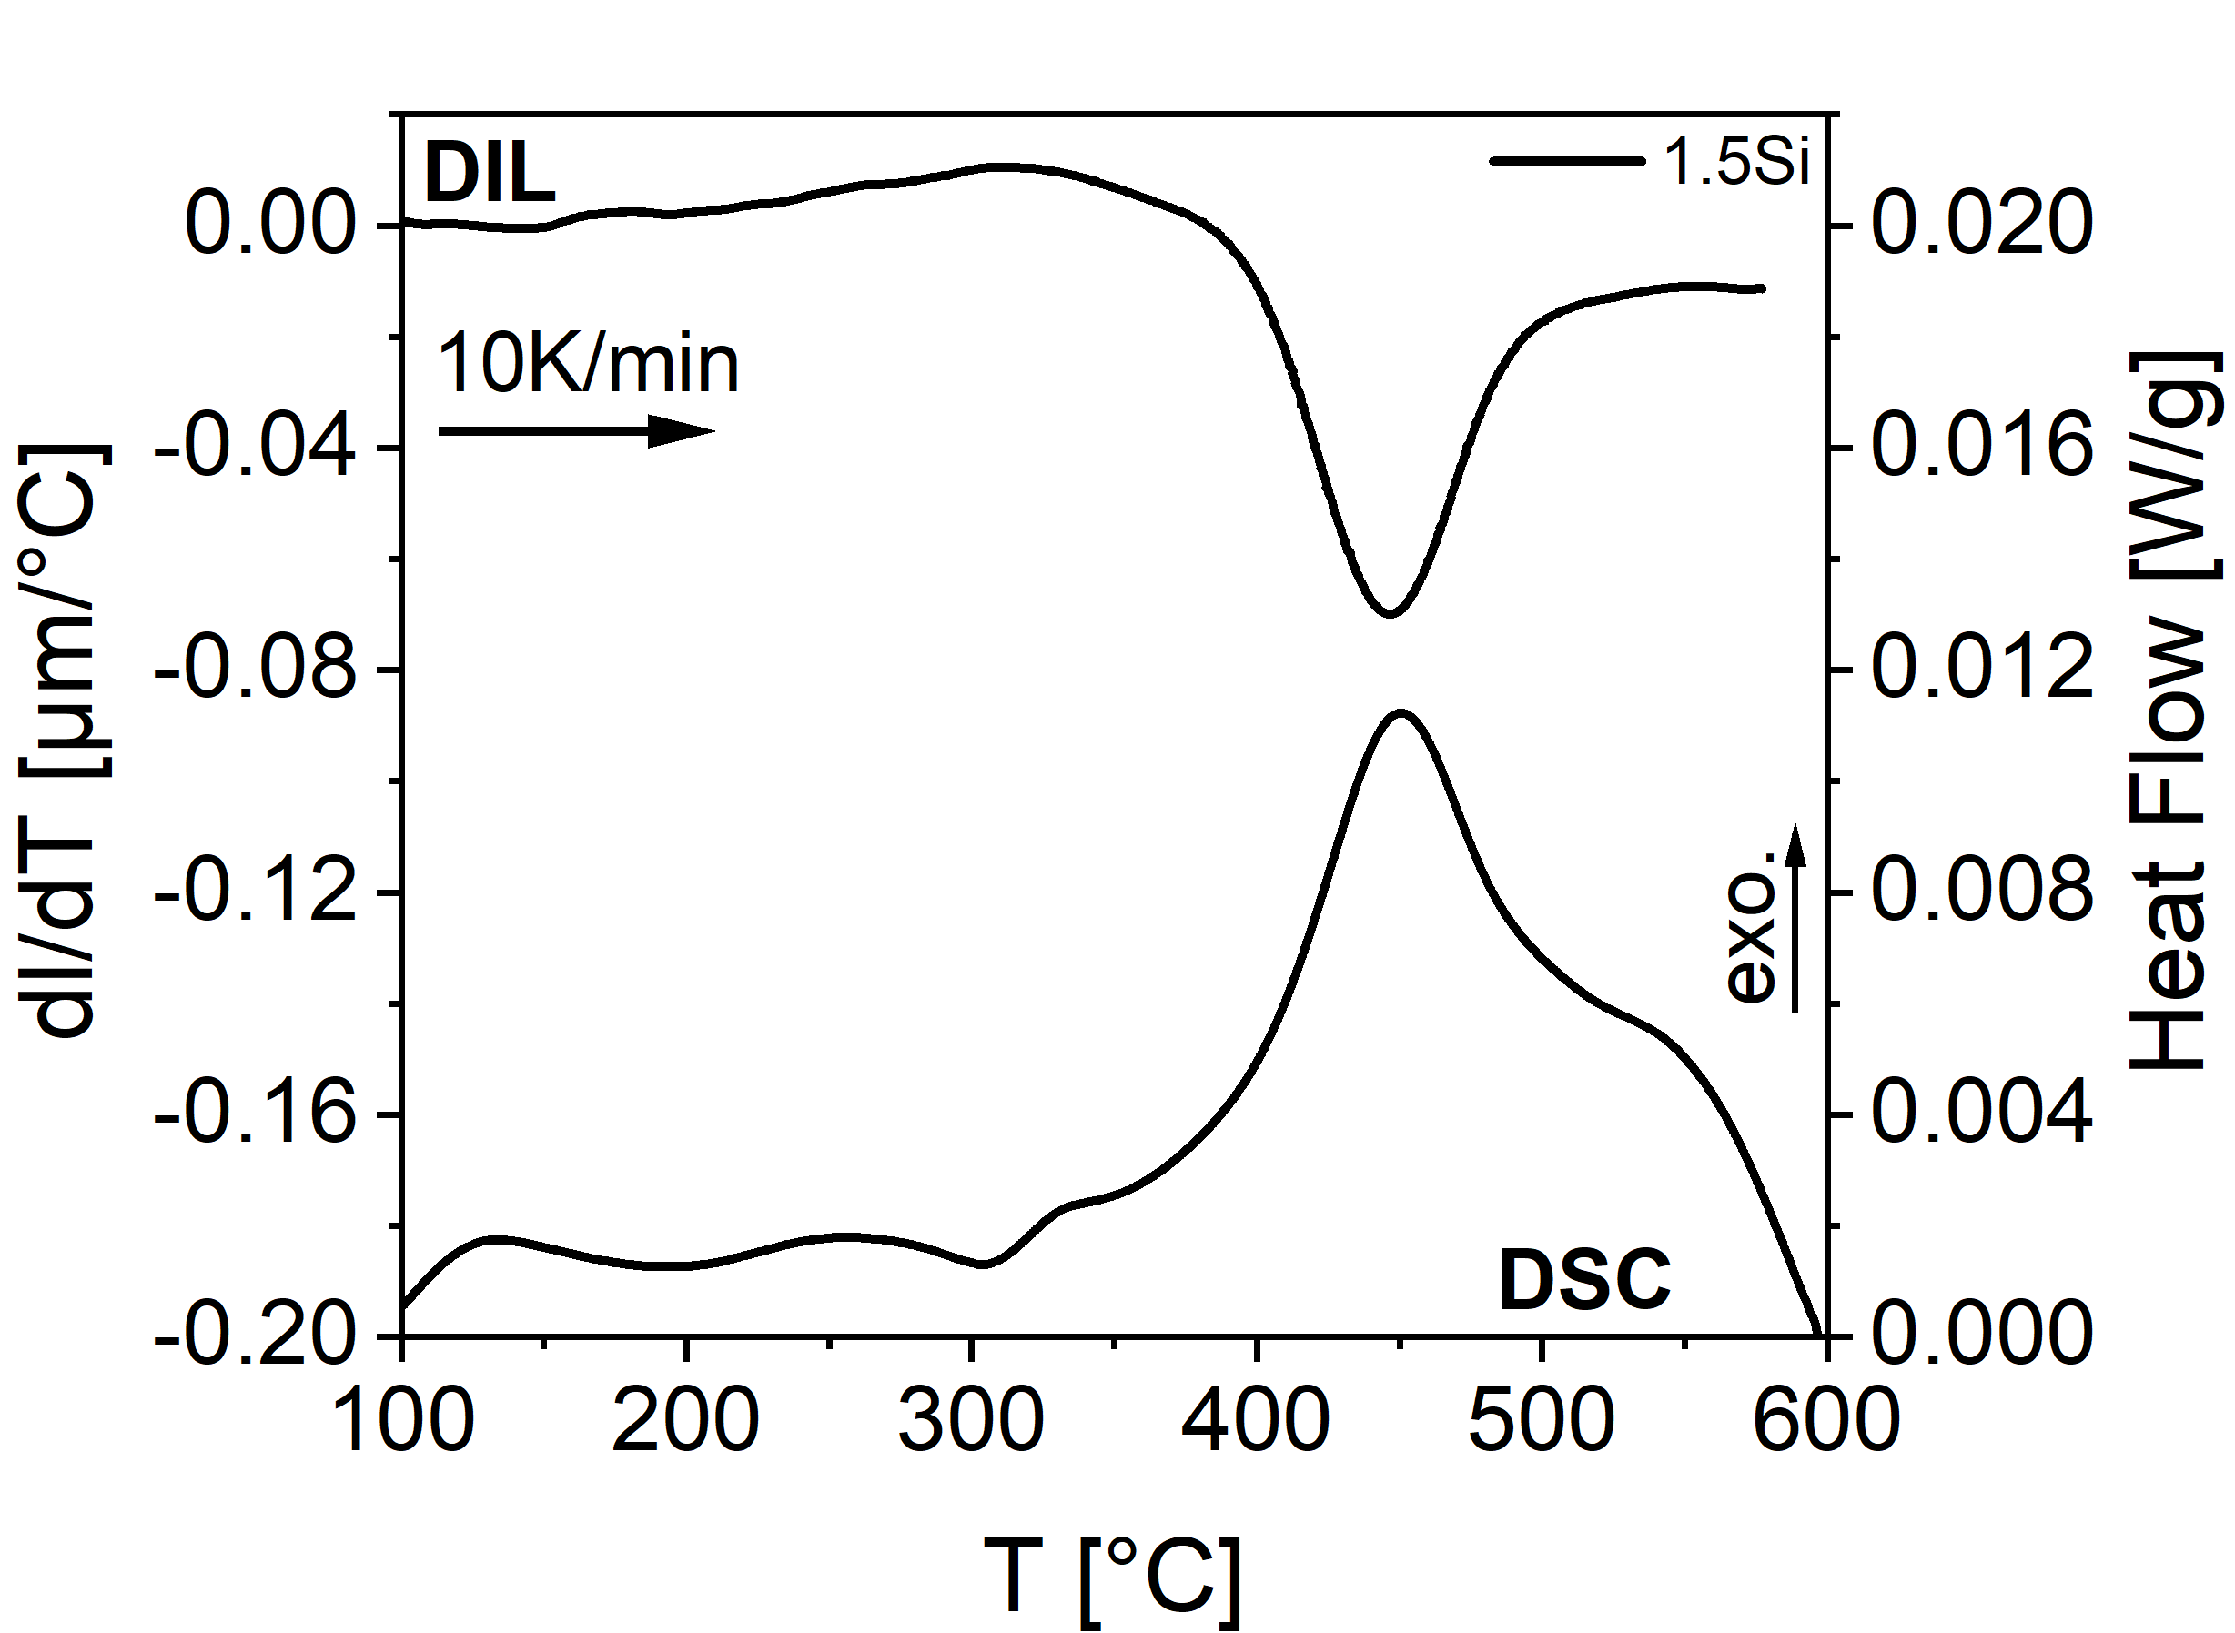
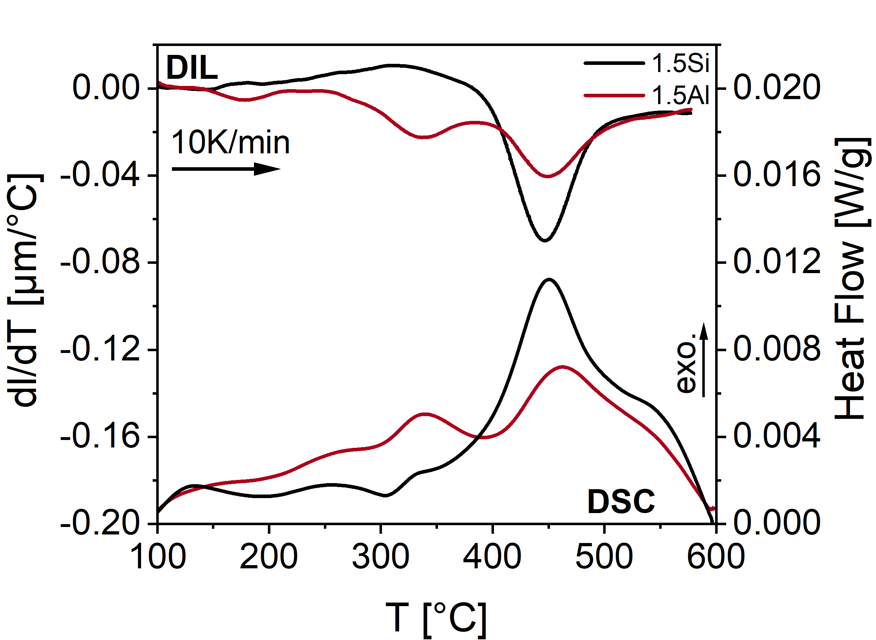
Influence of Si vs. Al on carbide precipitaton in α‘₁
Tempering of fully martensitic microstructure 10K/min
- Dilatometer – dl/dT (H₁-H₂) – carbide prec. = contraction & RA-decomposition = expansion
- Differential Scanning Calorimetry – heat flow (H₁-H₂)
H₁ - H₂
DIL: dl₁/dT - dl₂/dT
DSC: heat flow₁ - heat flow₂
Start of carbide precipitation
T[°C]
A_{c3}
ε_{prec}
RA_{dec}
Fe₃C
600°C
600°C
Fe₃C
M_{S}
10K/min
10K/min
C-seg/
clust.
RA_{dec}
RX
t[s]
α‘ ~98%

Slide 7
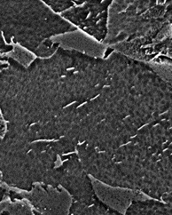
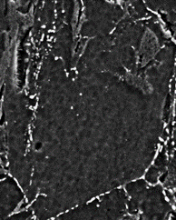
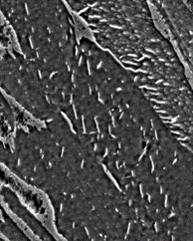
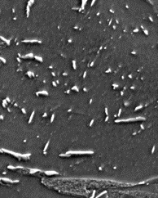
Influence of Si vs. Al on carbide precipitaton in α‘₁
T[°C]
A_{c3}
M_{S}
t[s]
~ amount of carbides precipitate during partitiong??
1.5Si Q&P
1.5Si Q&P+
GA560
ε_{prec} → Fe₃C & coarsening
1.5Al Q&P
1.5Al Q&P+
GA560
Start of carbide precipitation
θ_{n}
θ_{n}
θ_{sp}
θ_{n}
ε_{prec}
RA_{dec}
Fe₃C
θ_{acc}
1µm
1µm
1µm
1µm
θ_{sp}
Fe₃C
C-seg/
clust.
RA_{dec}
Needle shaped carbides spherolize & accumulate at α‘₁ lath & at PAG-boundarys
Carbides spherolize, but most maintain needle shaped and coarse
RK

Slide 8
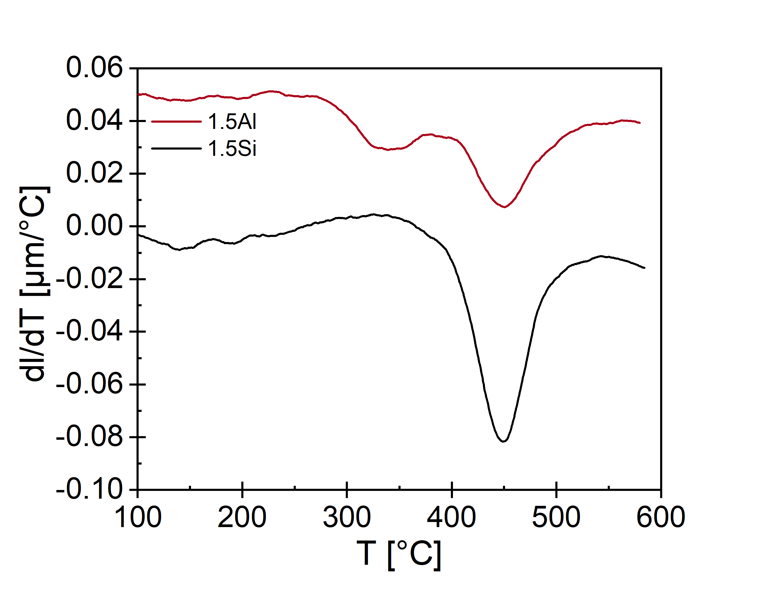
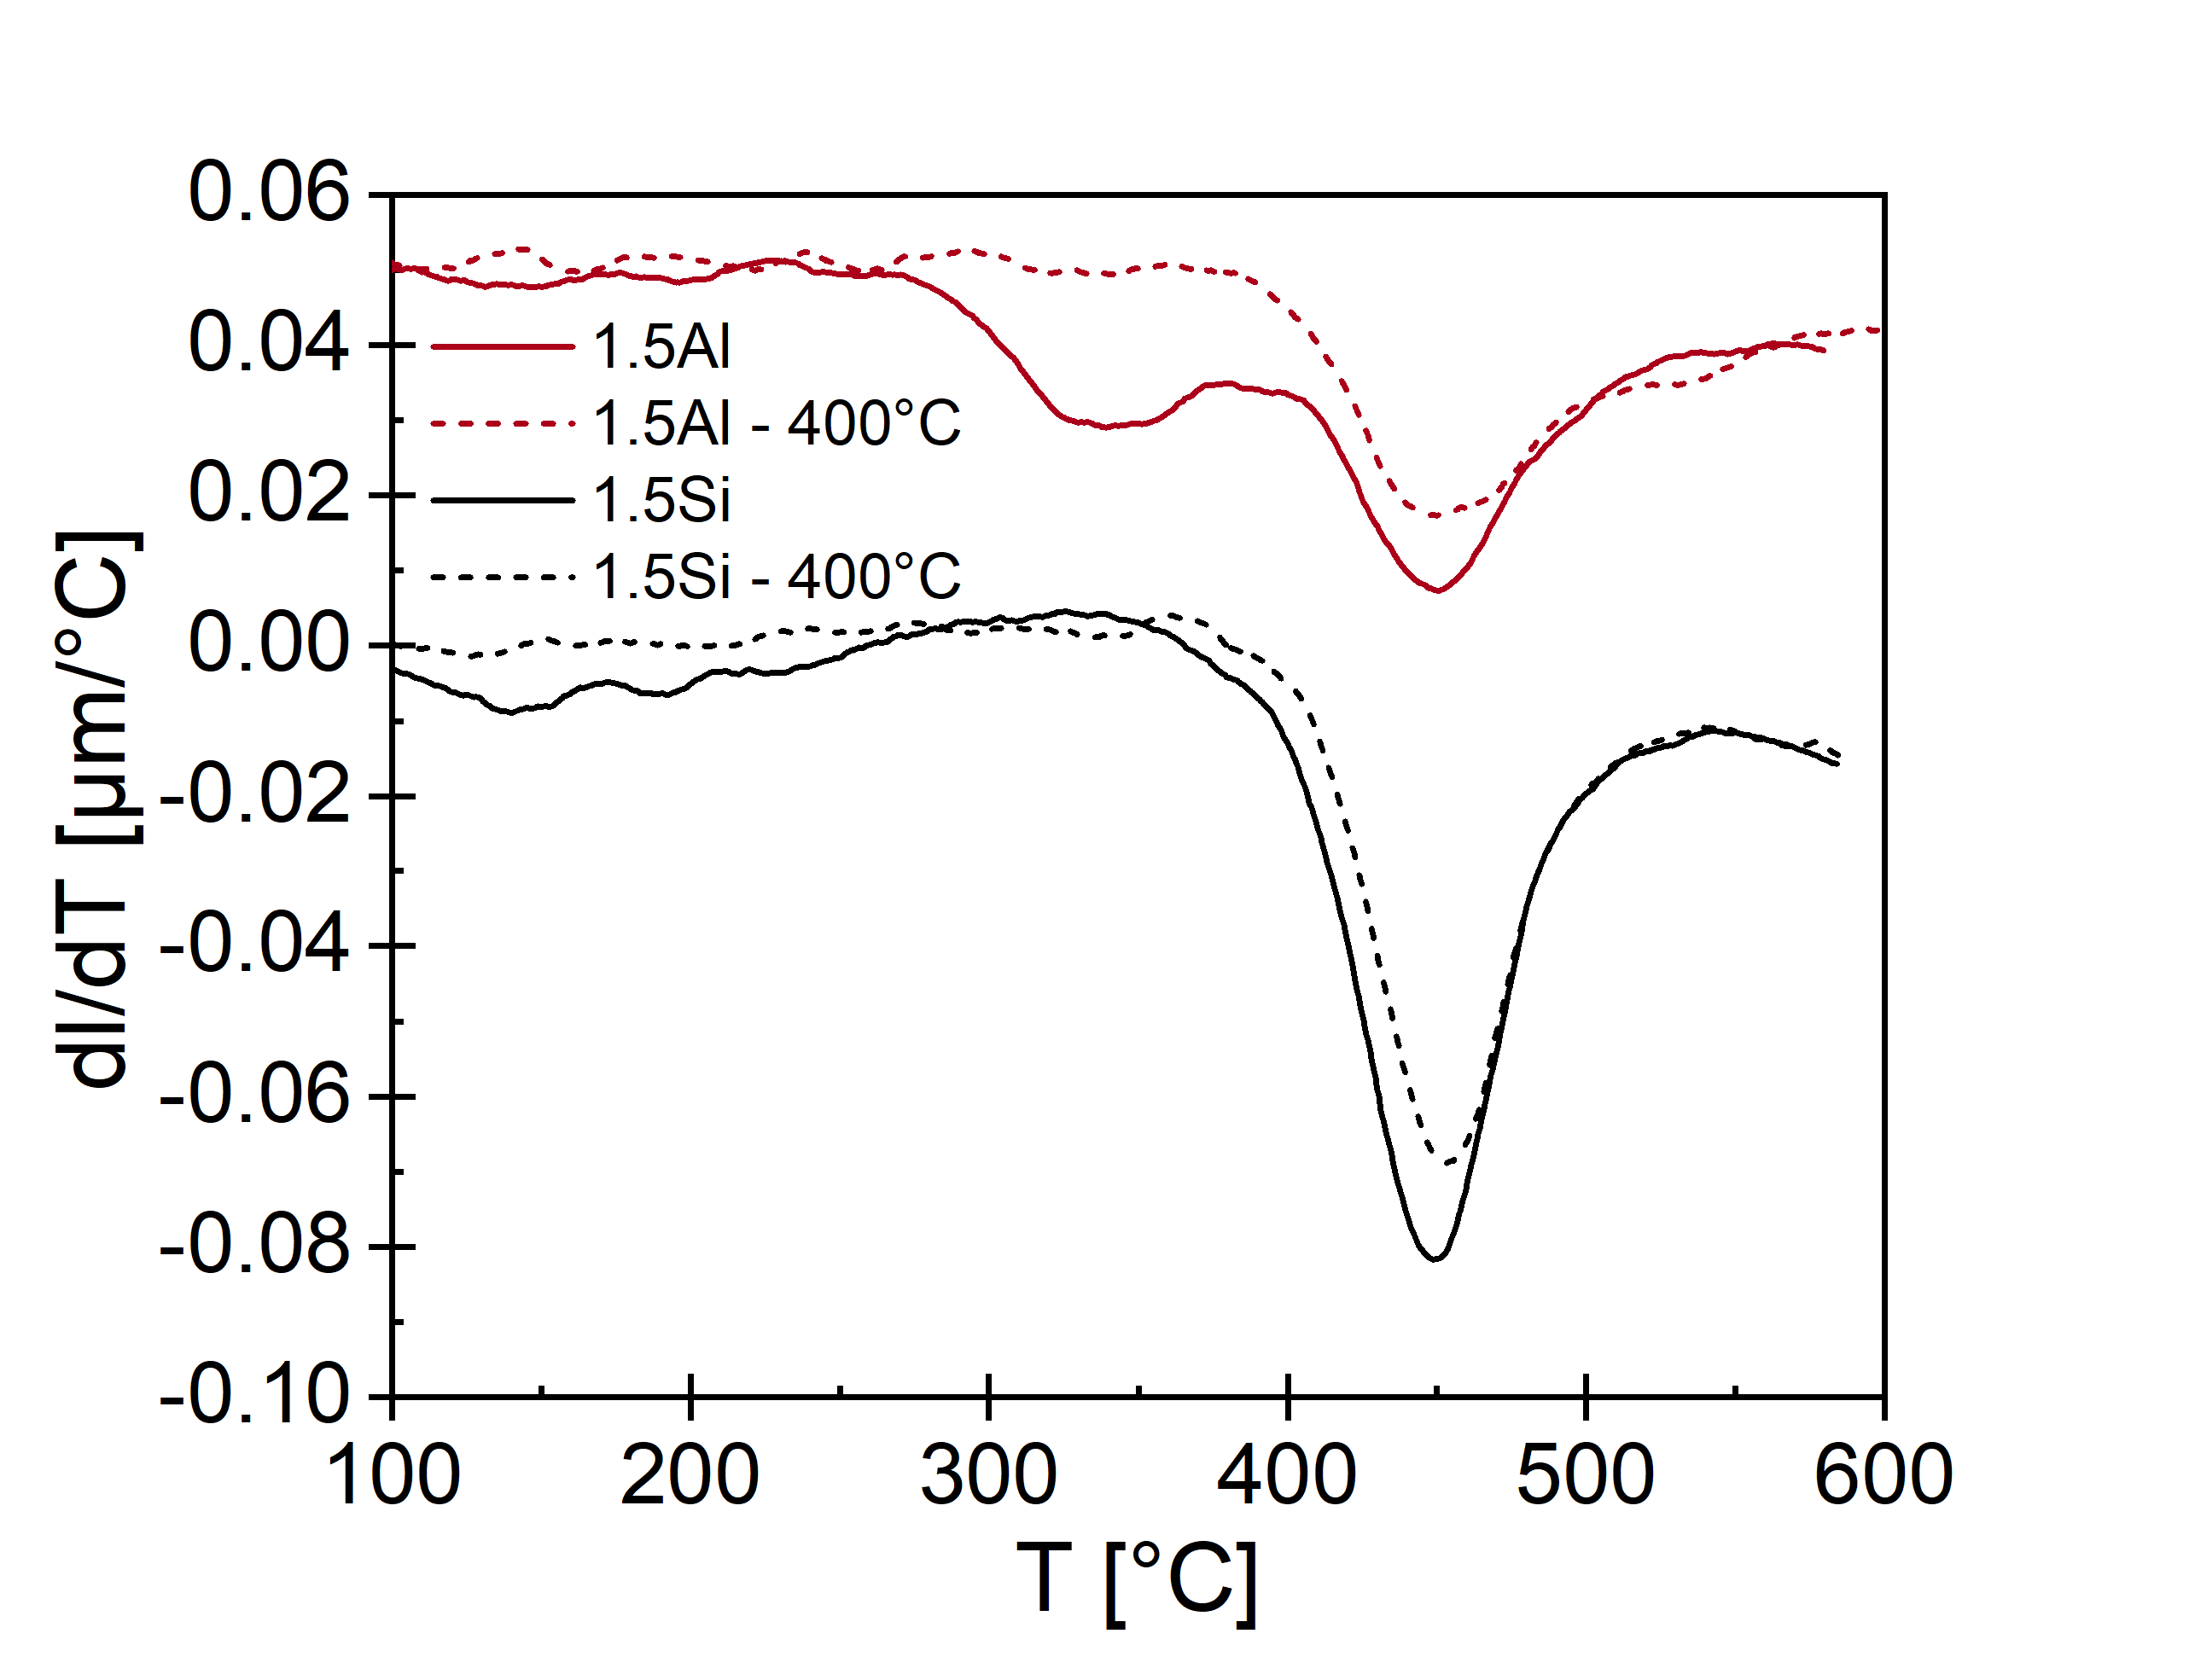
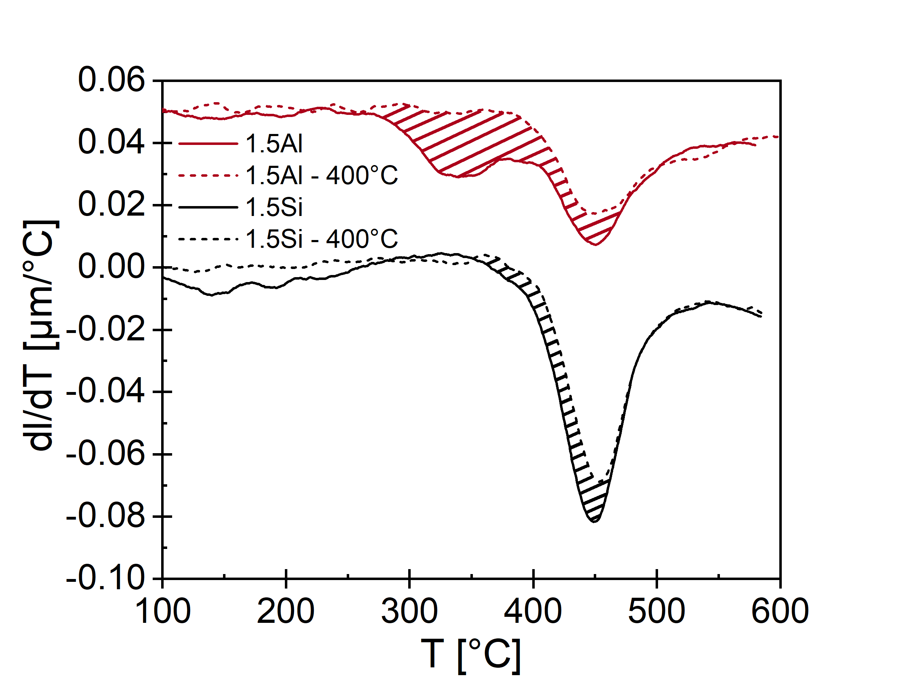
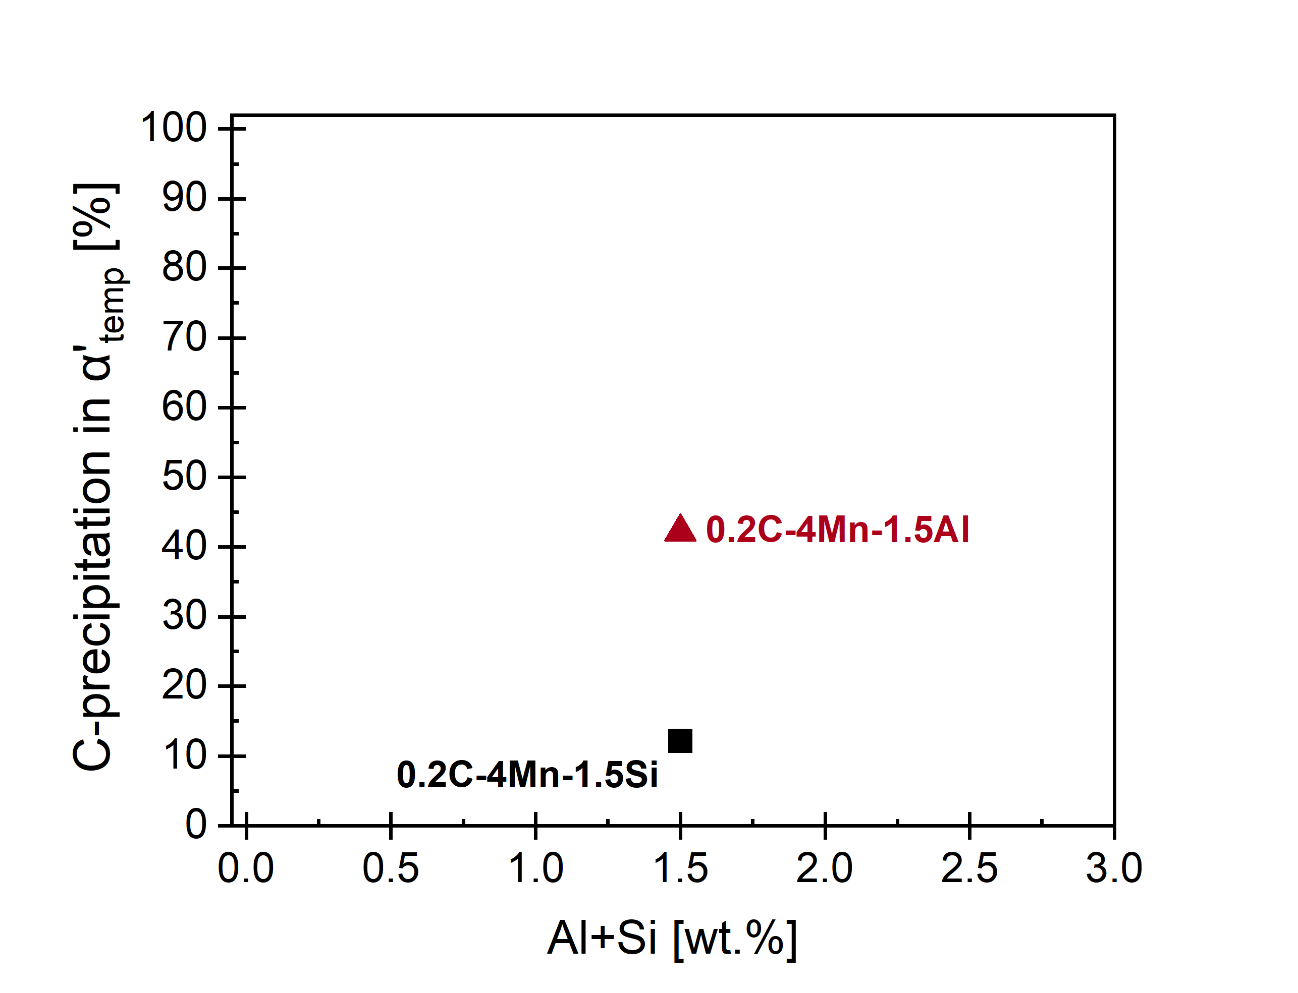

Influence of Si vs. Al on carbide precipitaton in α‘₁
~ amount of carbides precipitate during partitioning??
$$C_{\text{α}\text{‘1}}\sim \frac{A_{400}}{A_{RT}}$$
How much carbon precipitate already due to isothermal annealing at 400°C ?
Approximation of amount of C precipitation in α‘₁
T[°C]
400°C
A_{c3}
x%Al
10K/min
A_{RT}
x%Si
M_{S}
A₄₀₀
α‘ ~98%
20K/s - 400°C – 40s
t[s]

Slide 9
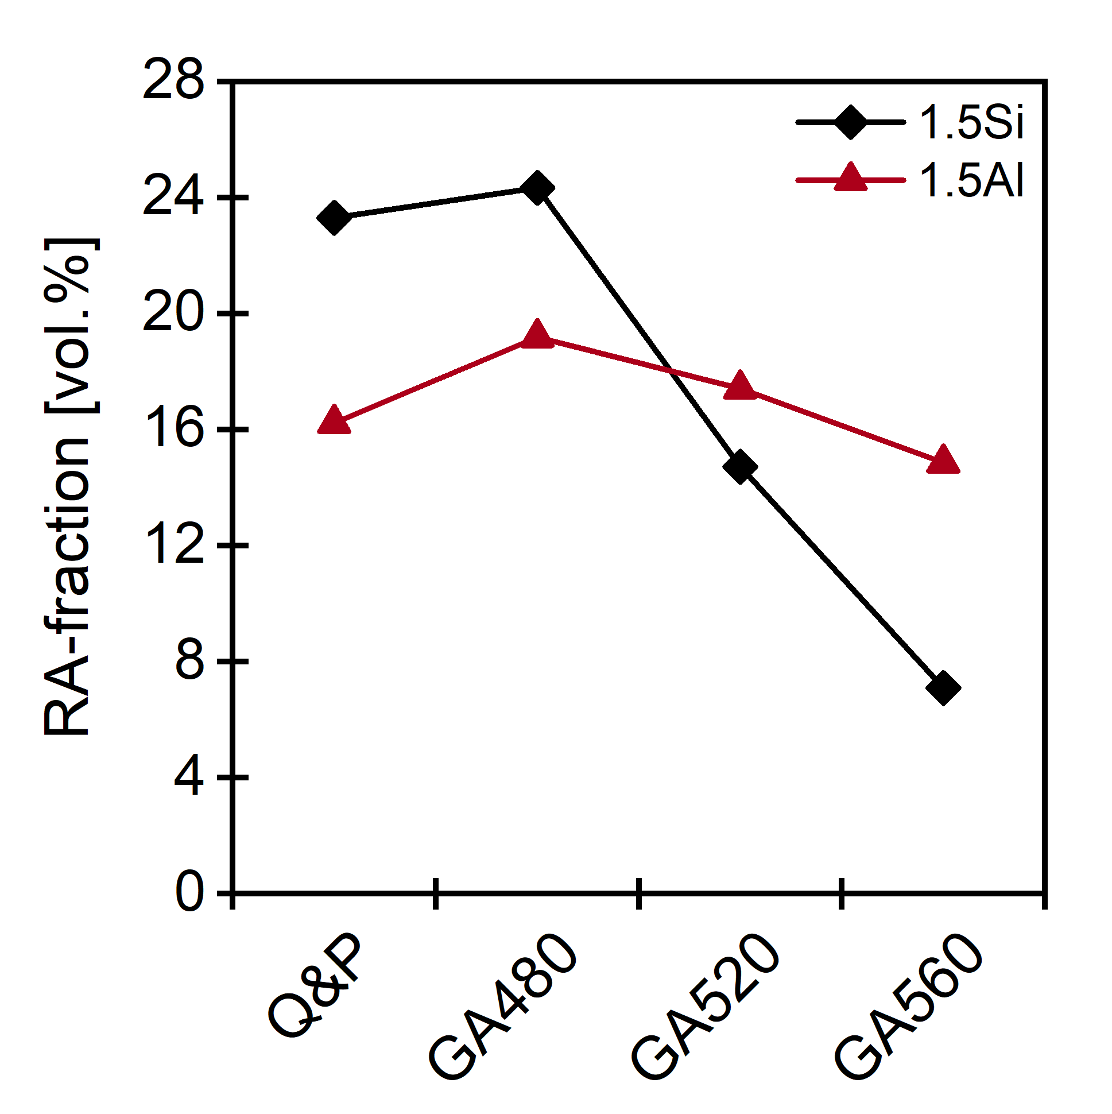
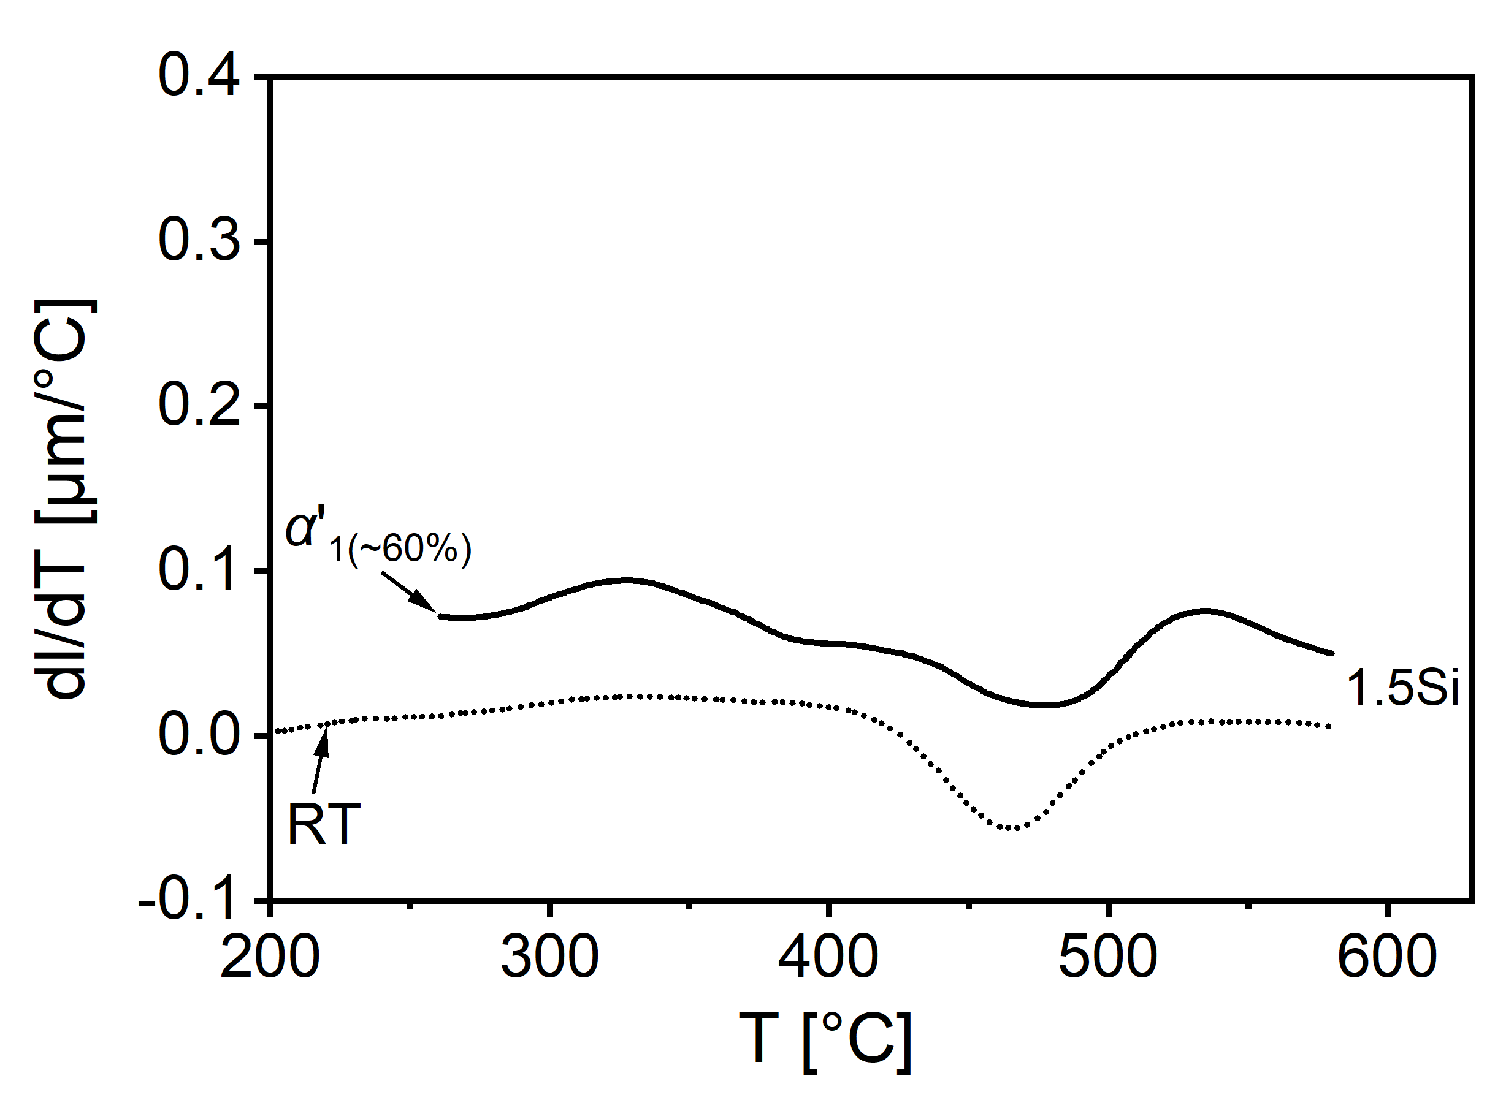
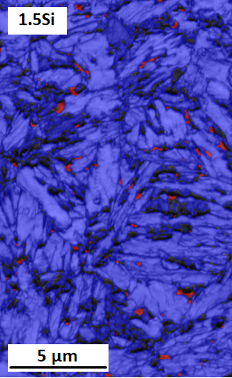
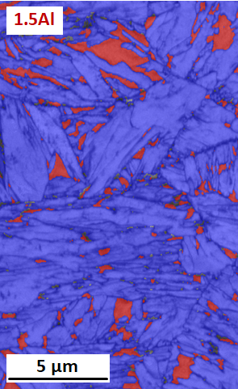
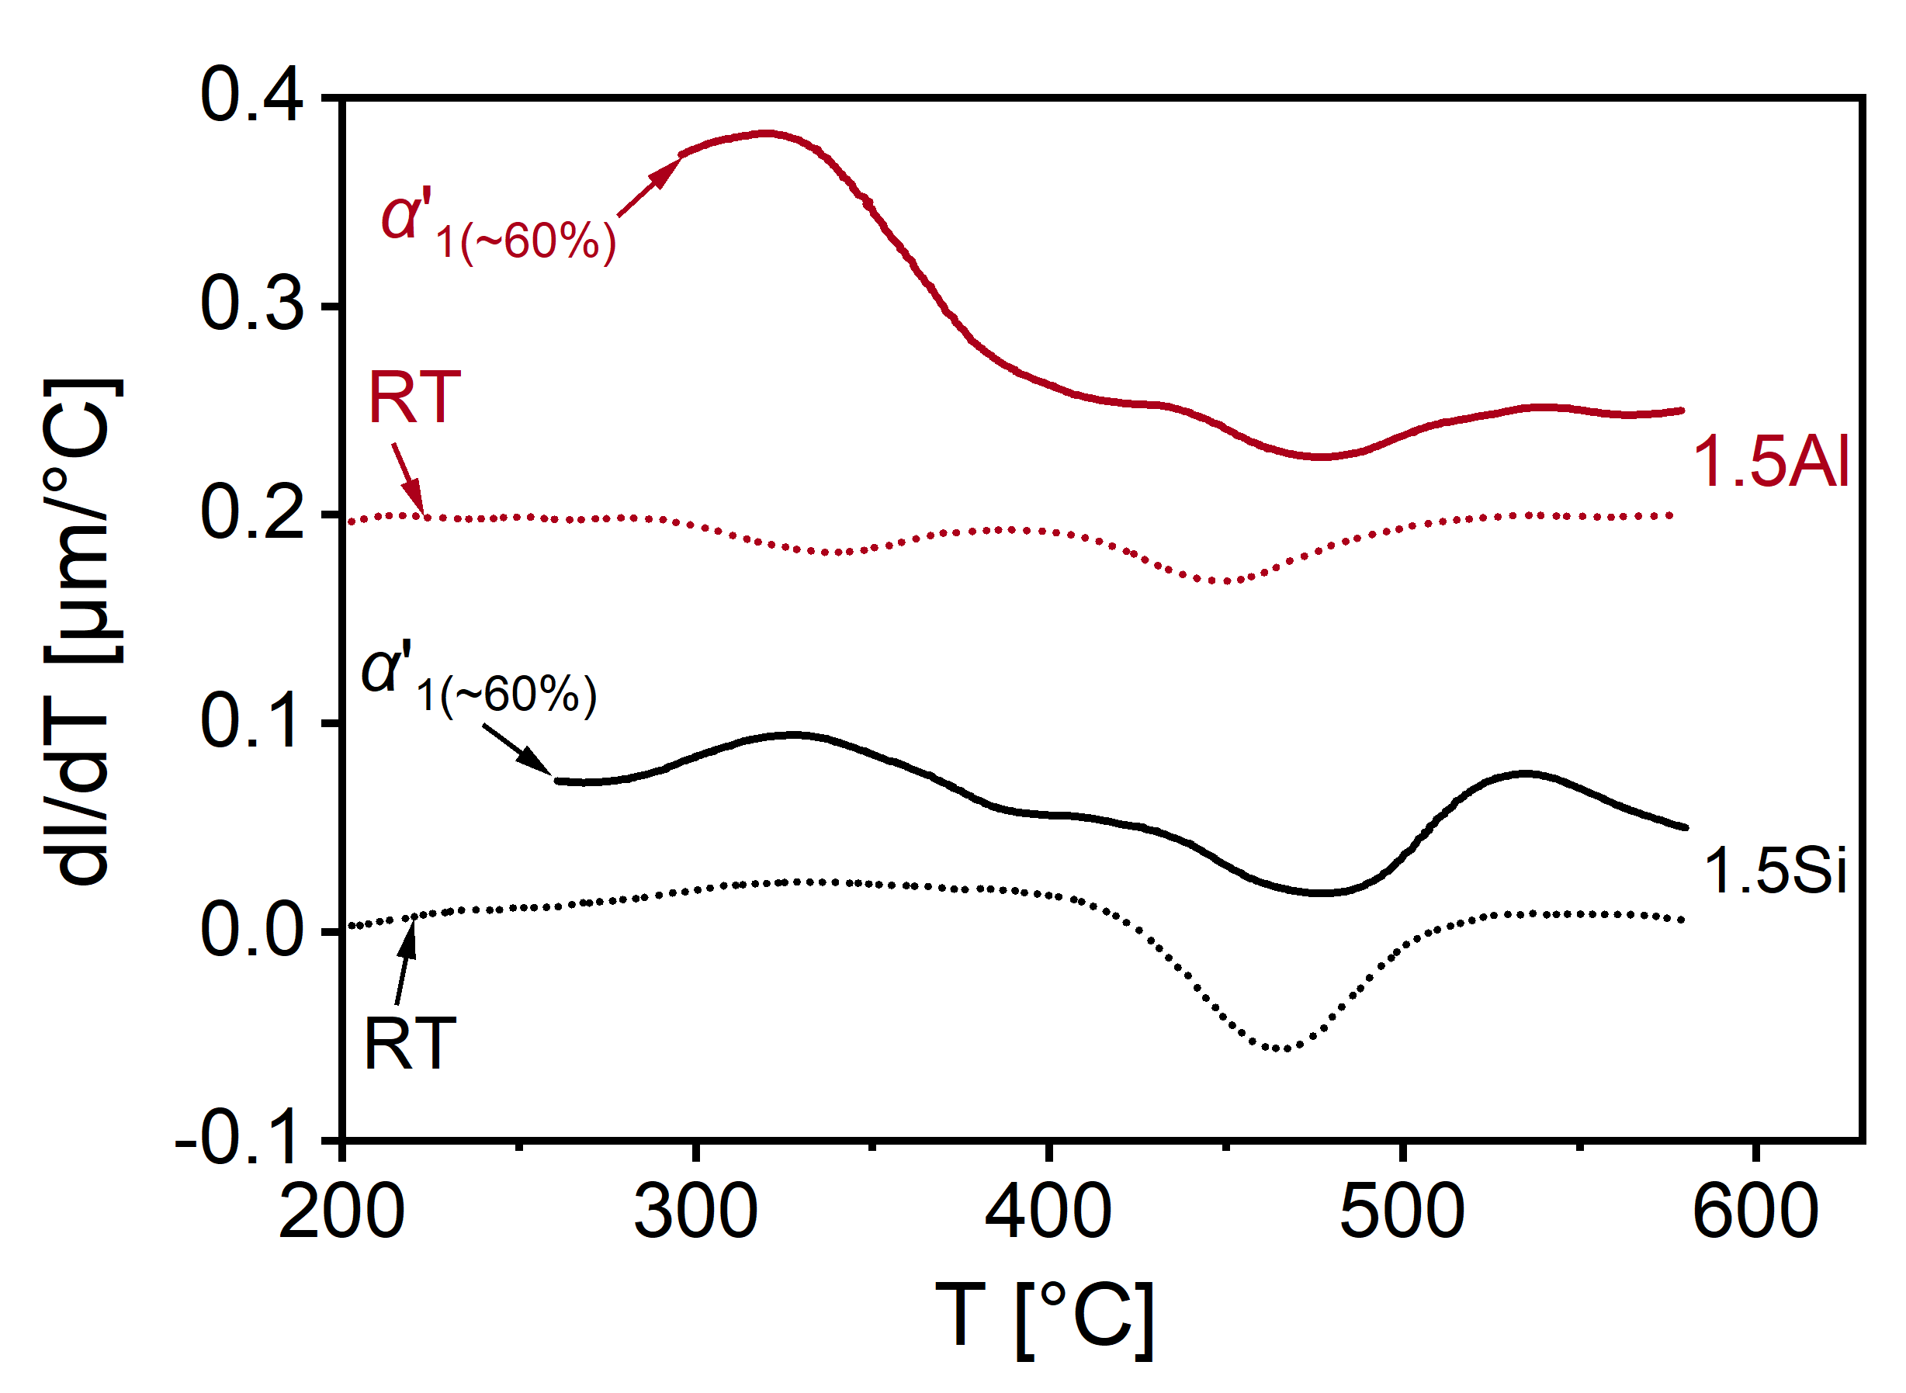
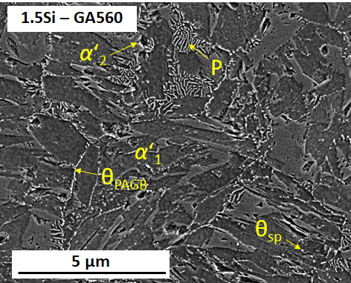
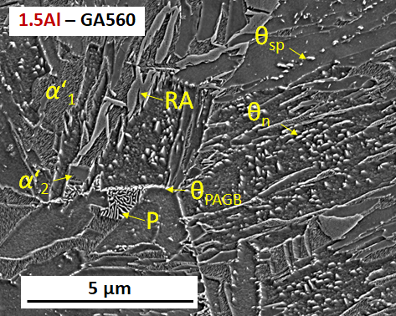
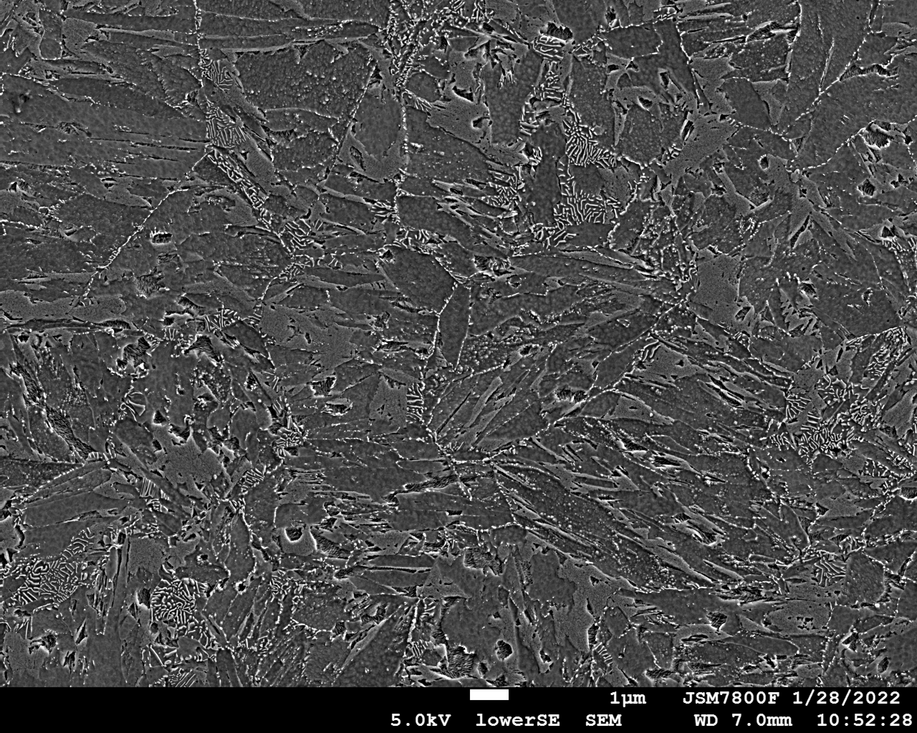
Influence of Si vs. Al on RA during GA
T[°C]
T[°C]
A_{c3}
_{GA560}
A_{c3}
_{GA520}
10K/min
_{GA480}
M_{S}
M_{S}
T_{q}
t[s]
t[s]
T↓
T↑
α_{B}
Fe₃C (α‘₁)
α_{B} + Fe₃C
Pearlite
Fe₃C (α‘₁)
α_{B}
α_{B} + Fe₃C
Pearlite
P
α‘₂
What happens with RA during tempering?
T↓ RA-decomposition effects
- Carbide precipitation Al > Si
- Bainite transformation Al > Si
T↑ RA-decomposition effects
- Perlite transformation Si > Al
→ Increasing the temperature stability of RA by Al due to retarding pearlite formation
M. Wallner, et. al., Mater. Sci. Tech. 37 (2021) 182-189

Slide 10
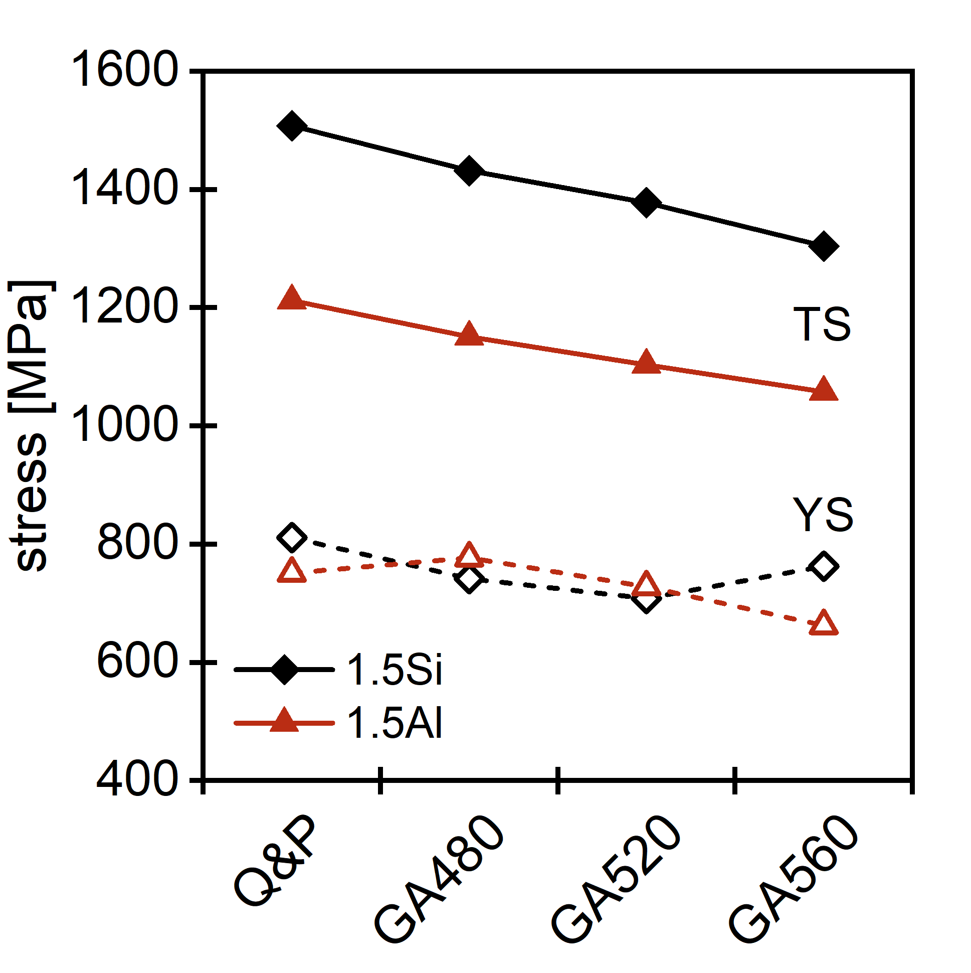
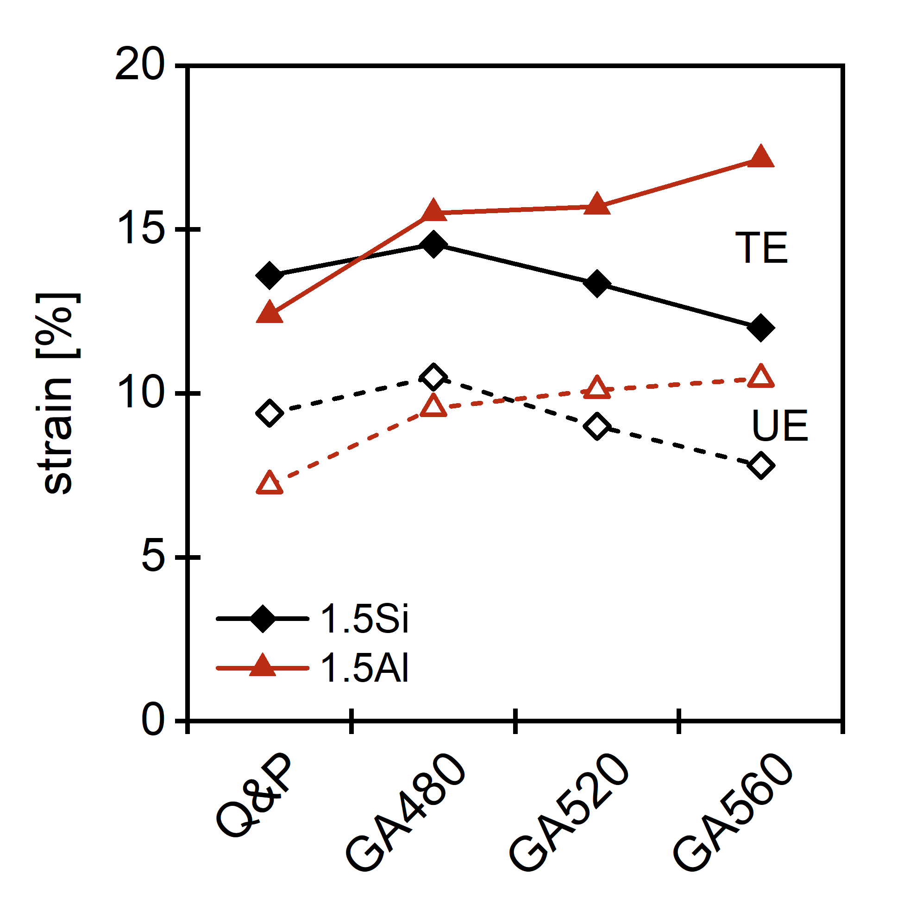
Influence of Si vs. Al on RA during GA
T[°C]
T[°C]
A_{c3}
_{GA560}
A_{c3}
_{GA520}
10K/min
_{GA480}
M_{S}
M_{S}
T_{q}
t[s]
t[s]
T↓
T↑
α_{B}
Fe₃C (α‘₁)
α_{B} + Fe₃C
Pearlite
Fe₃C (α‘₁)
α_{B}
α_{B} + Fe₃C
Pearlite
What happens with RA during tempering?
T↓ RA-decomposition effects
- Carbide precipitation Al > Si
- Bainite transformation Al > Si
T↑ RA-decomposition effects
- Perlite transformation Si > Al
M. Wallner, et. al., Mater. Sci. Tech. 37 (2021) 182-189

Slide 11
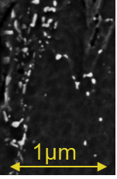
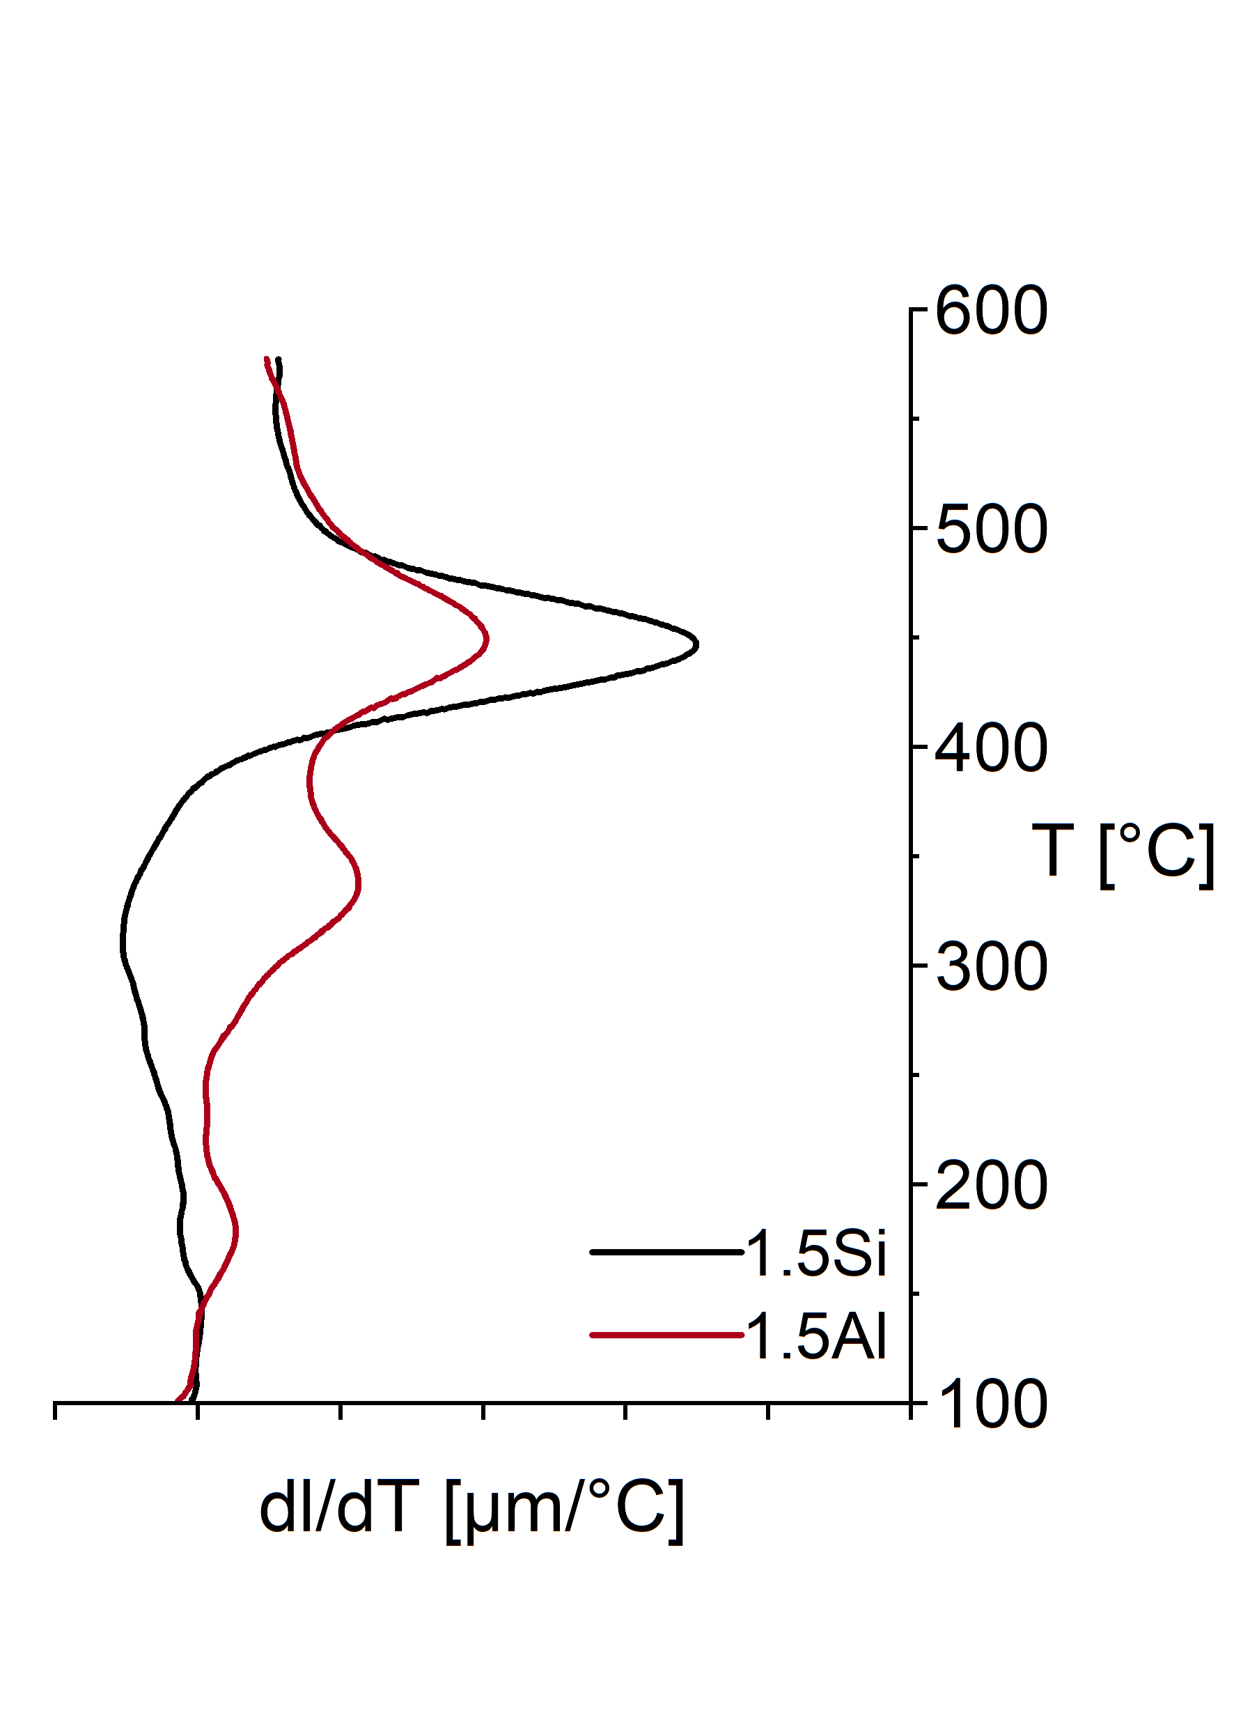
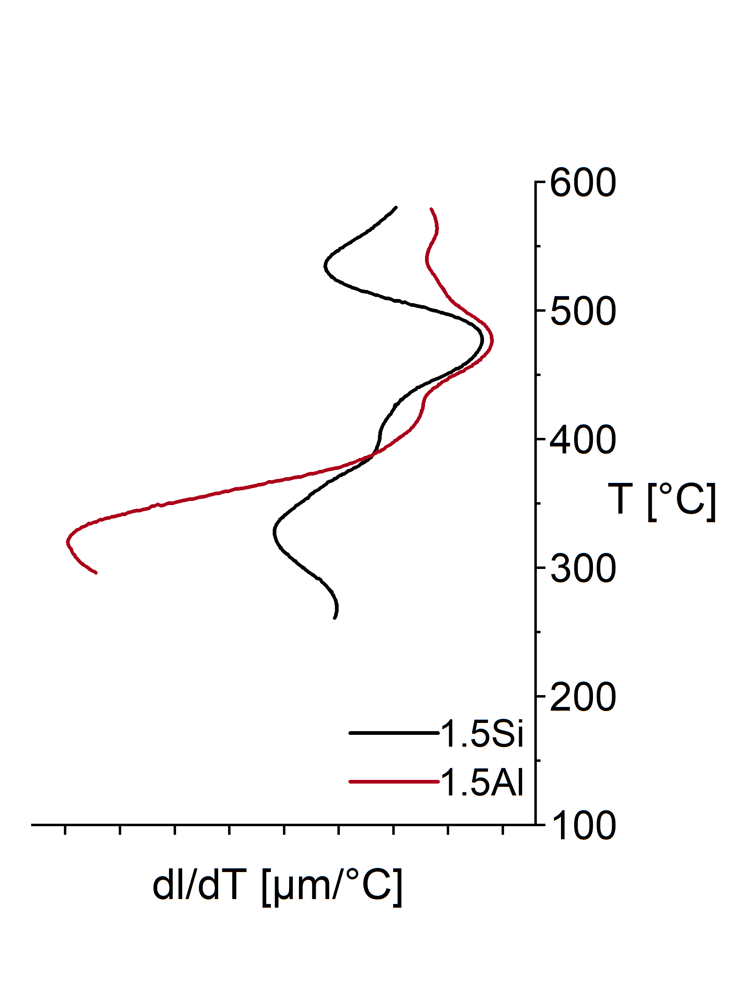
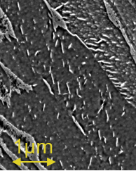
Conclusion
Q&P-process substitiution of Si by Al due to high carbide precipitation in α‘₁ not sufficient
Only Si → high TS×TE after Q&P but increased decomposition of RA during GA
Only Al → low TS & work hardening, but increasing the thermal stability of RA during GA
→ For Q&P + GA process optimum Si:Al ratio required
T[°C]
A_{c3}
α‘-tempering
60%-α‘- + 40% austenite temp.
1µm
M_{S}
1.5Al
1.5Al α_{B}↑
t[s]

Slide 12
Thank you for your attention!
Matthias Wallner^{a,c}, K. Steineder^{b}, R. Schneiderª, C. Sommitsch^{c};
ªDepartment for Materials Technology, University of Applied Sciences Upper Austria, Wels, Austria;
^{b}Research & Development and Innovation, voestalpine Steel GmbH, Linz, Austria;
^{c}Institute of Material Science, Joining and Forming, Graz University of Technology, Graz, Austria
The authors sincerely acknowledge the support of the Austrian Research Promotion Agency (FFG) related to the frontrunner project No. 860188 “Upscaling of medium Mn-TRIP steels”.

