Slide 1
Development of a novel in- situ alloying 3D printing procedure
exemplified on the permanent magnetic Fe-Cr-Co alloy system
S. Arneitz, R. Buzolin, S. Rivoirard, C. Sommitsch MAMC 2021

Slide 2
Table of Contents
Introduction
  Our machine
  In- situ alloying: a novel process
Development of the in- situ alloying process
  Melt Pool Studies
  Study on the Influence of Powder Quality
  Influence of printing parameters on the homogeneity
  Materials Characterisation
  Determination of the miscibility gap
  Magnetic measurements of selected samples

Slide 3
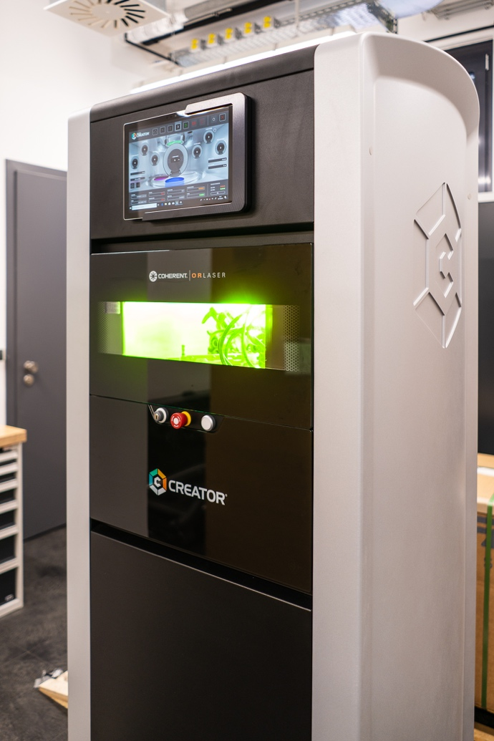
Our machine: ORLAS Creator
Size: 0.9 x 0.9 x 2 m³
Weight: 470 kg
Power Consumption: 1.2 kW
Materials: Steel allloys, aluminum alloys, Titanium alloys,
novel reactive and non- reactive materials except Mg
Minimum Powder Requirements:
100-200g (Melt Pool tests),
0.7-1.5 kg (Parameter Studies)
Build Volume: ⌀ 110mm x 100mm
Materials Properties are reproducible
over the whole build volume!

Slide 4
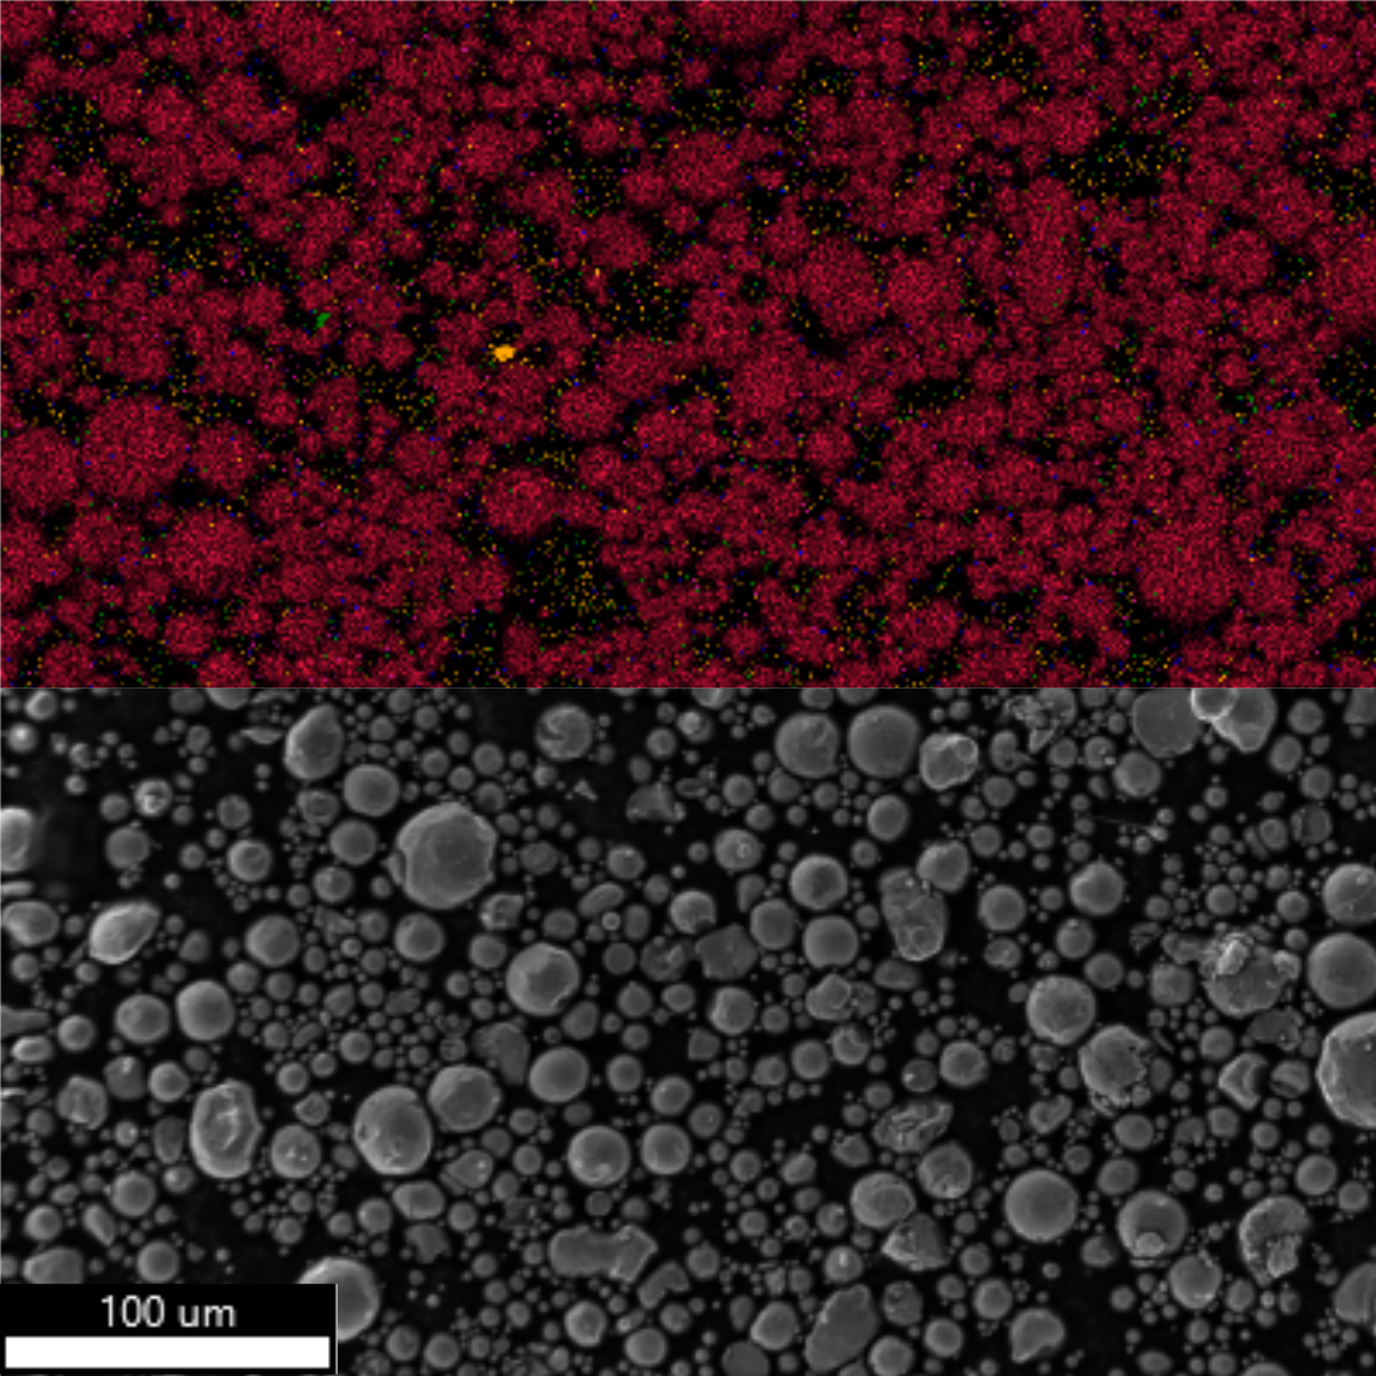
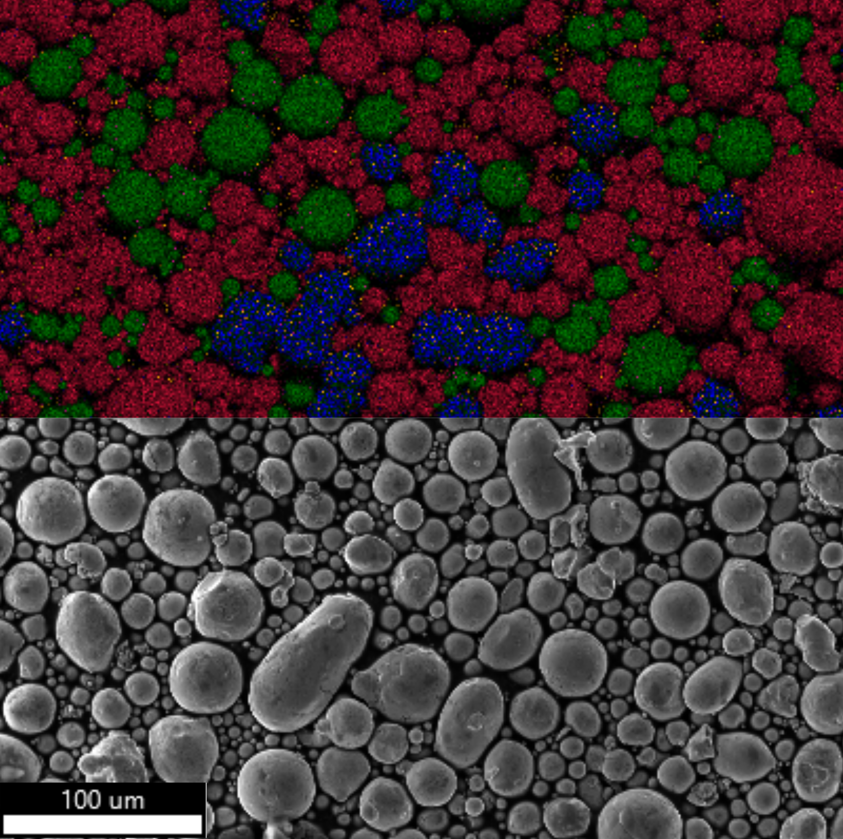
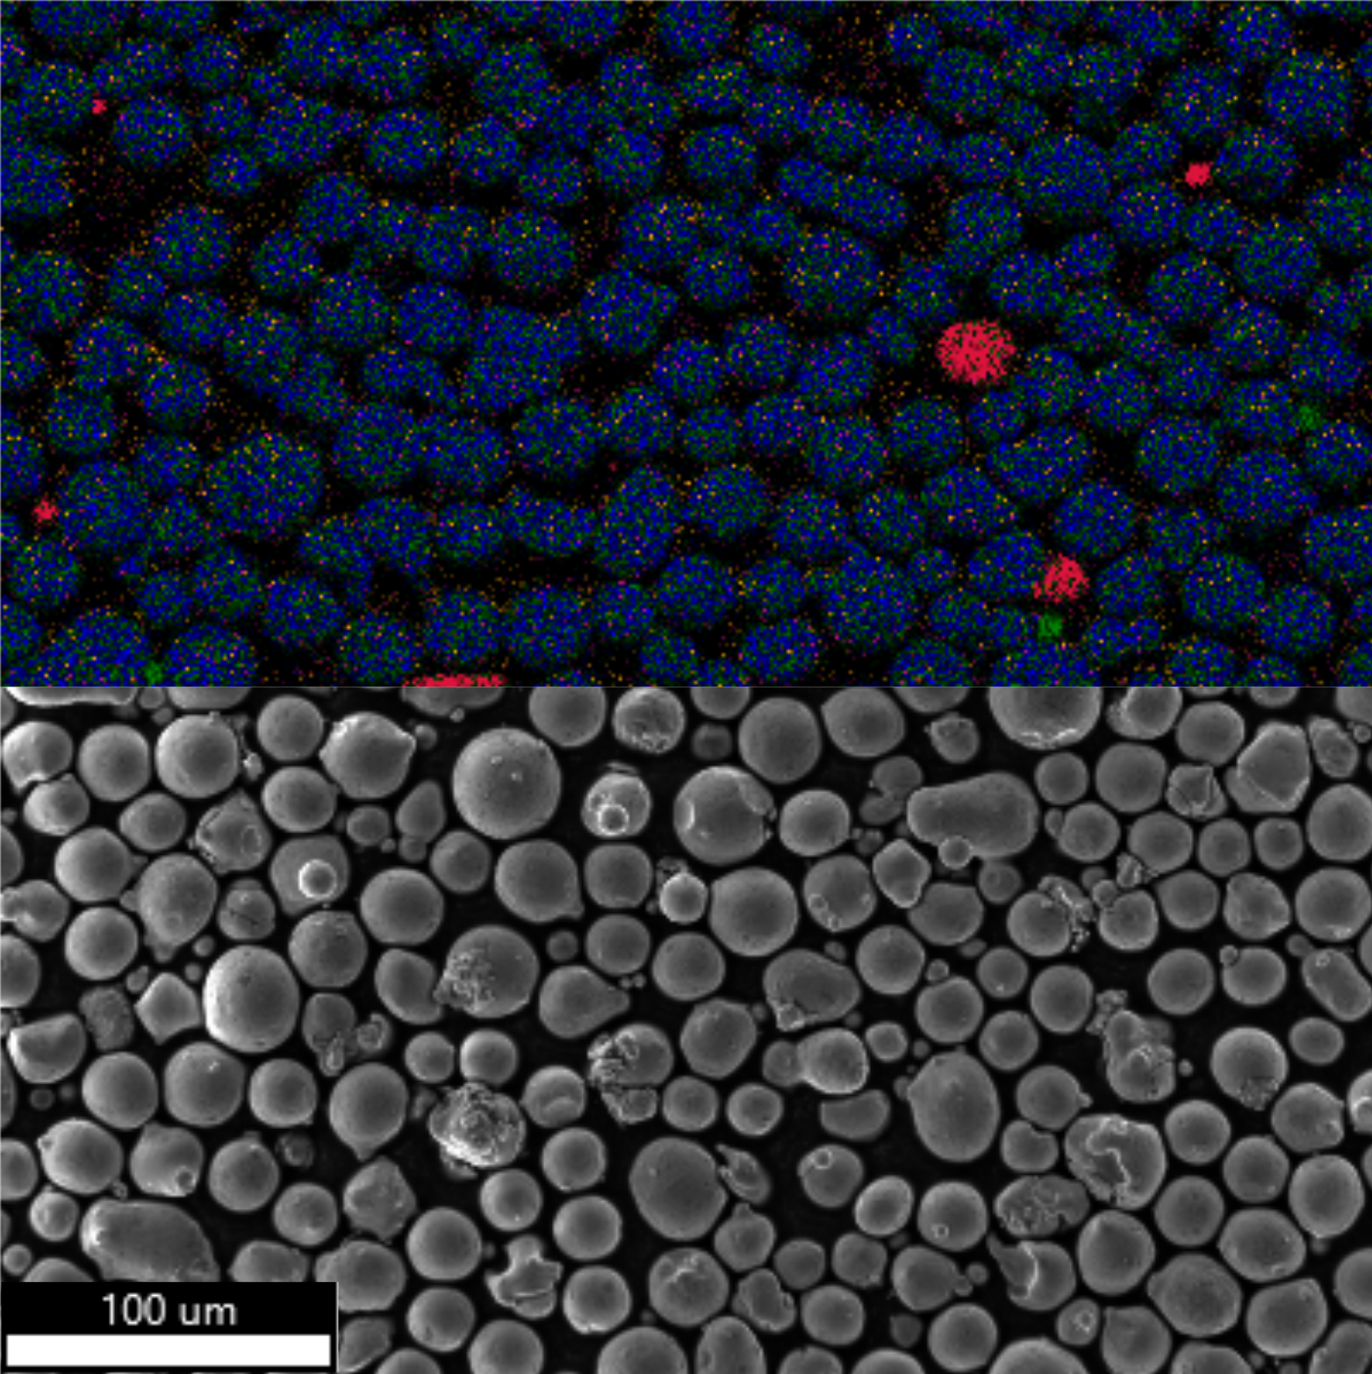
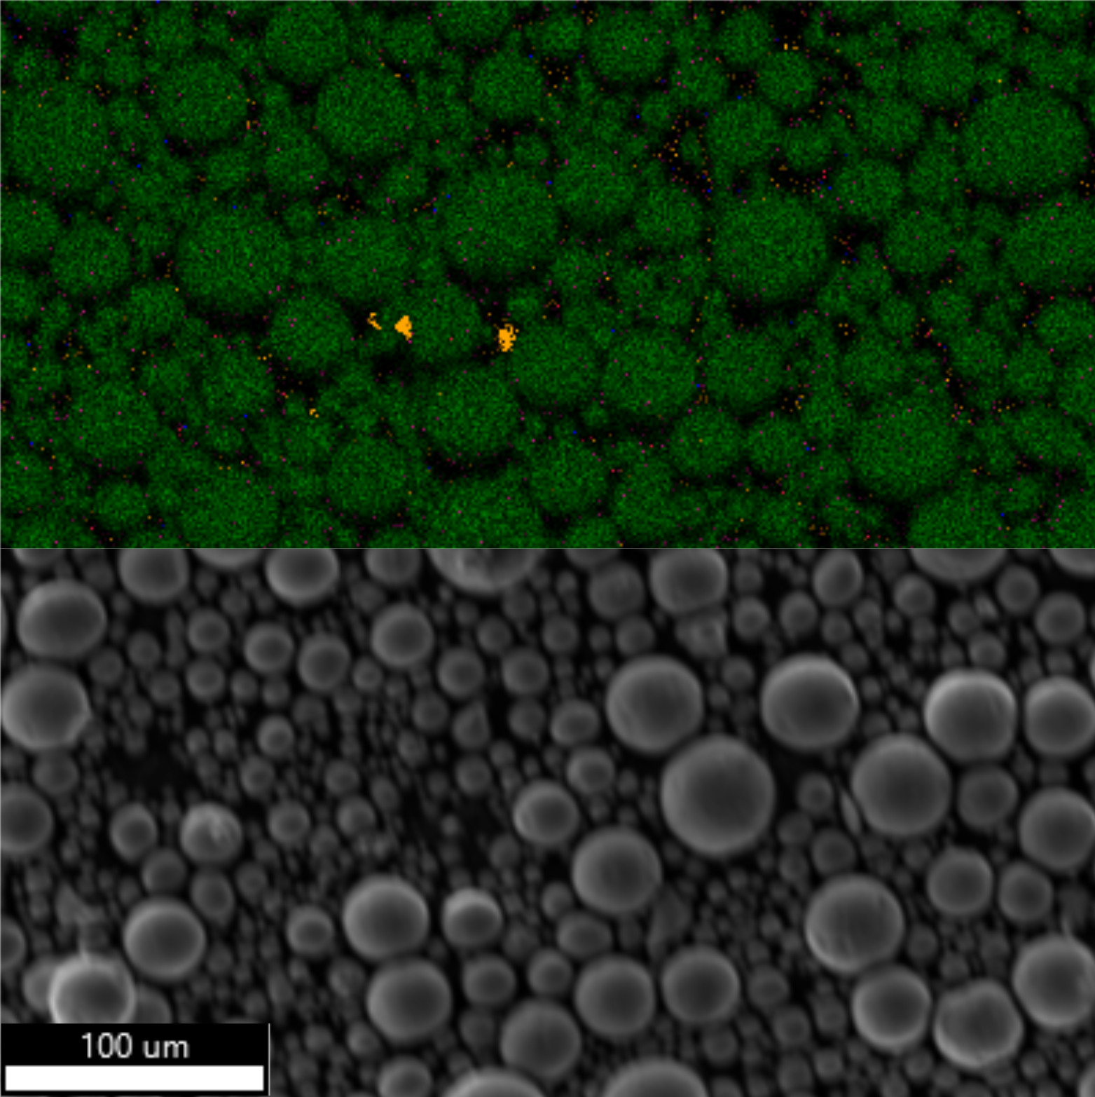
In- situ alloying: a novel technique
Fe
Cr
Co
Mischen, 1h
Mischhilfe:
Edelstahlkugeln

Slide 5
Development of the in- situ alloying process

Slide 6
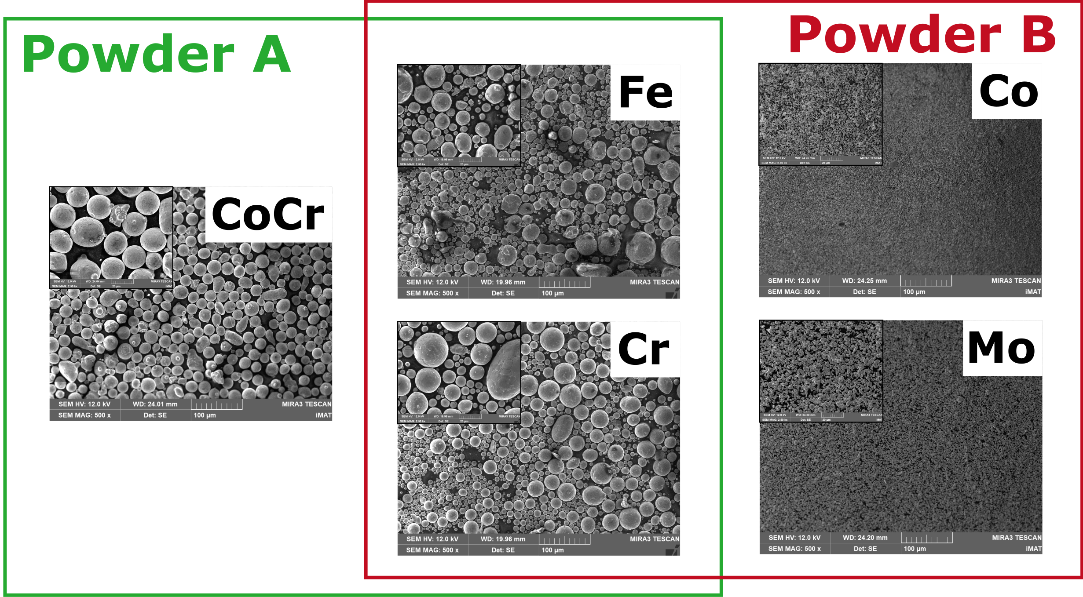
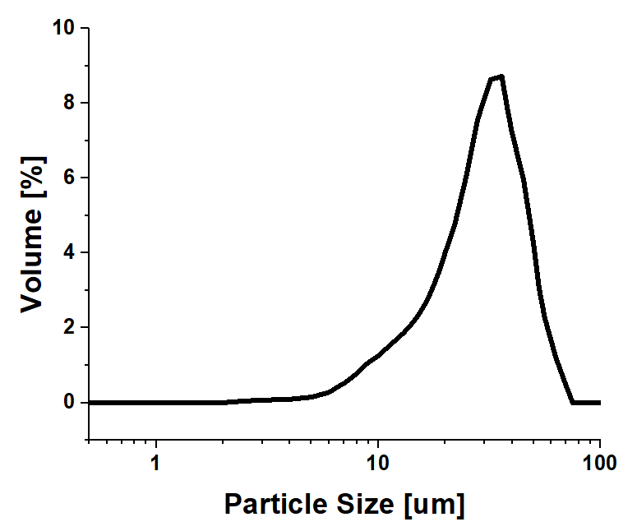
Development of the Printing Process: Powders
Mo < 800nm
Co < 10µm
Fe
Cr
CoCr

Slide 7
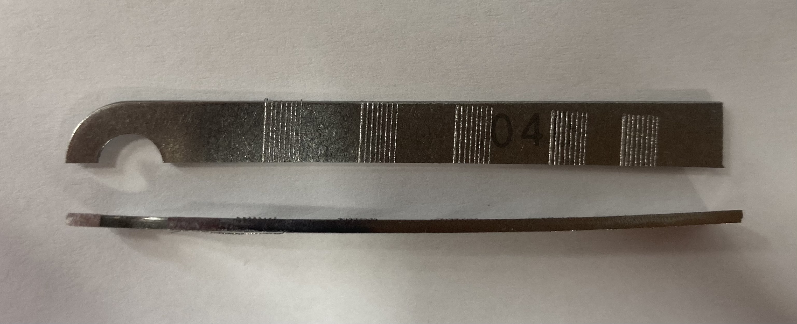
Melt Pool Studies: Implementation
Investigated Parameter
Laser Power / W | 25, 65, 105, 145, 190, 240
Speed / mm/s | 100, 300, 500, 700, 900, 1100, 1300
Layer height / um | 25
Spot size / um | 50

Slide 8
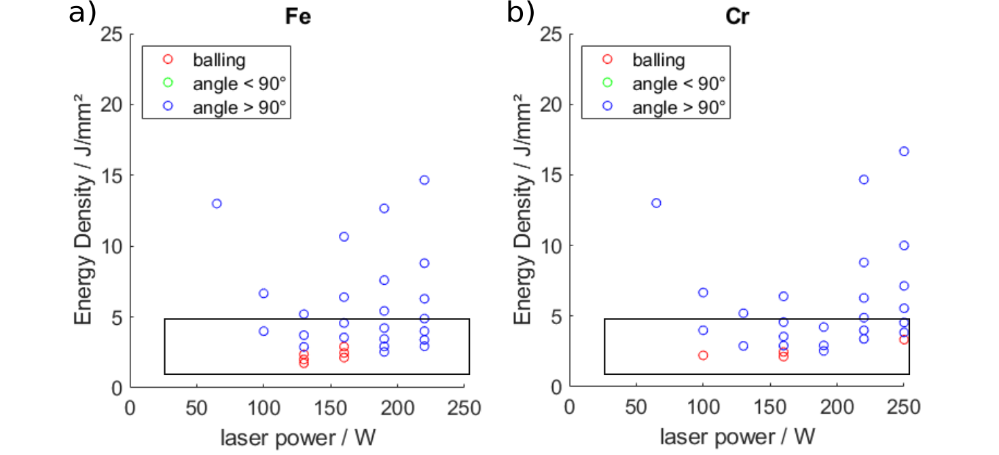
Melt Pool Studies: Results

Slide 9
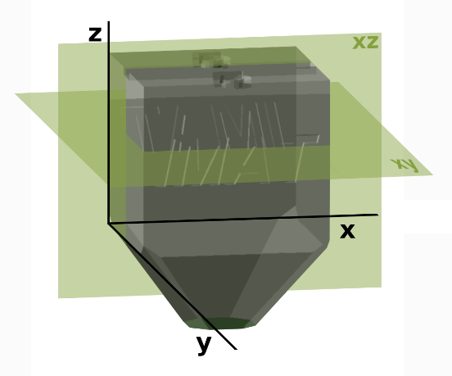
Parameter Study: Sample Geometry

Slide 10
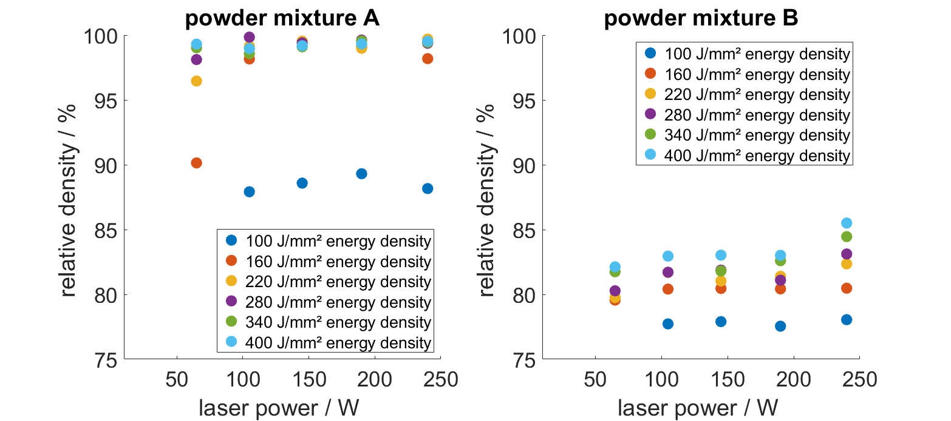
Parameter Study: Densities

Slide 11
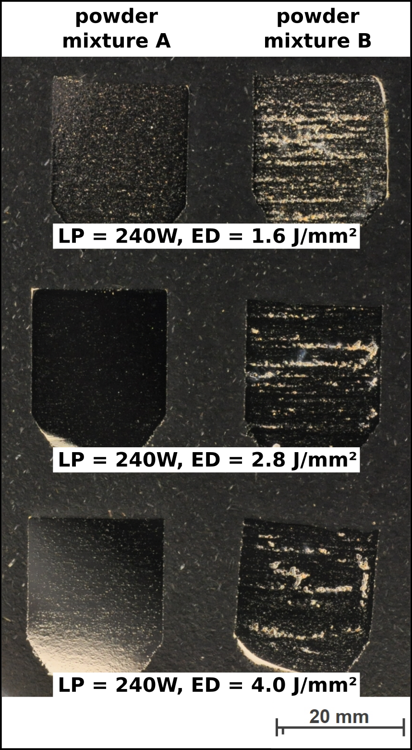
Parameter Study: Porosity

Slide 12
Parameter Study: Chemical Homogeneity
Parameter
Laser Power / W | 65, 105, 145, 190, 240
Energy Density / J/mm² | 1.60, 2.80, 4.00

Slide 13
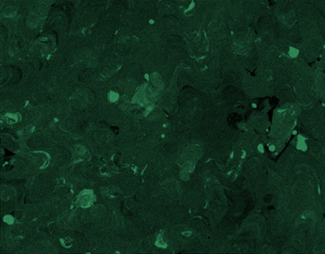
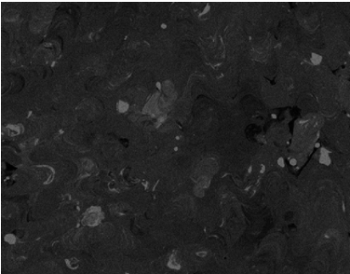
Parameter Study: Chemical Homogeneity – Code for the analysis

Slide 14

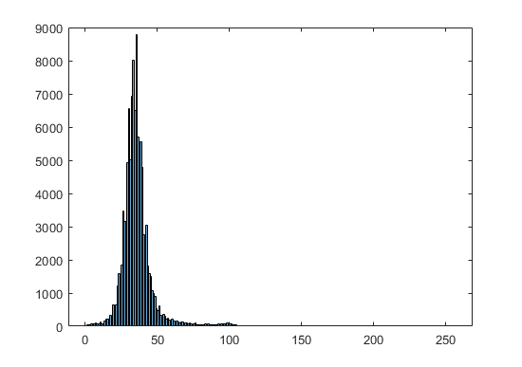
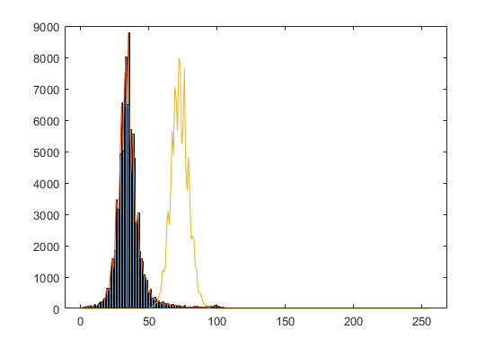
Parameter Study: Chemical Homogeneity – Code for the analysis
1
2
2
1
Frequency
1 fully homogenized reference
2 sample (Cr 65W ED400)
Luminance value

Slide 15
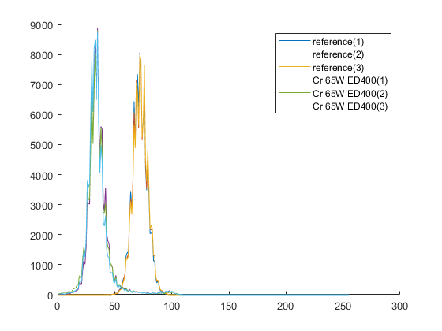
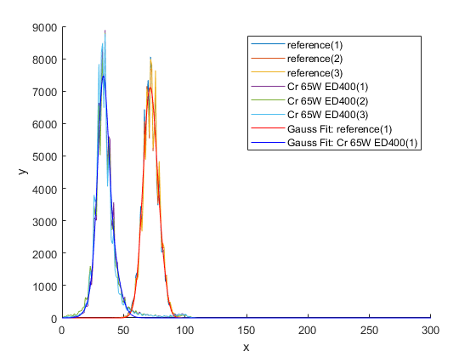
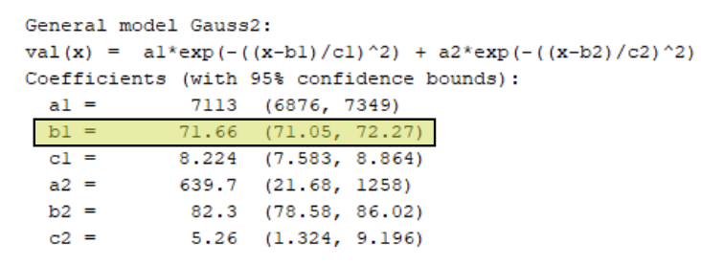
Parameter Study: Chemical Homogeneity – Code for the analysis
Frequency
Frequency
Luminance value
Luminance value

Slide 16
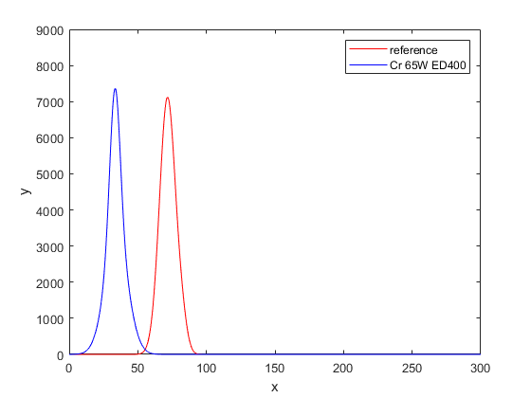
Parameter Study: Chemical Homogeneity – Code for the analysis
value of
inhomogeneity
2
1
Frequency
Frequency
1 fully homogenized reference
2 sample (Cr 65W ED400)
Luminance value
Luminance value

Slide 17
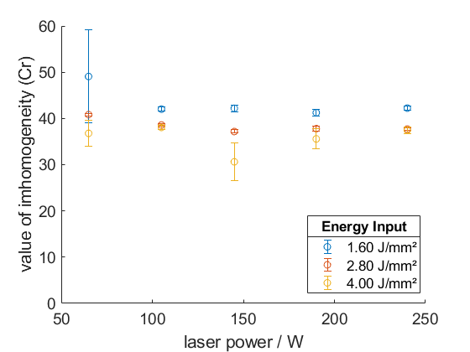
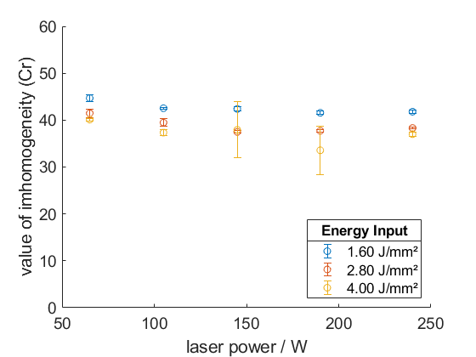
Parameter Study: Chemical Homogeneity
xy direction
xz direction

Slide 18
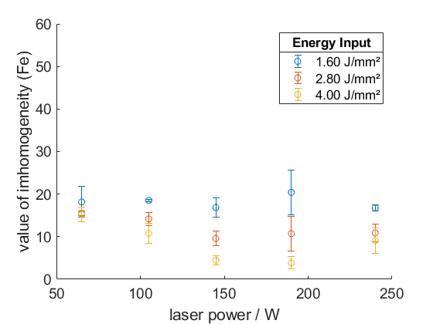
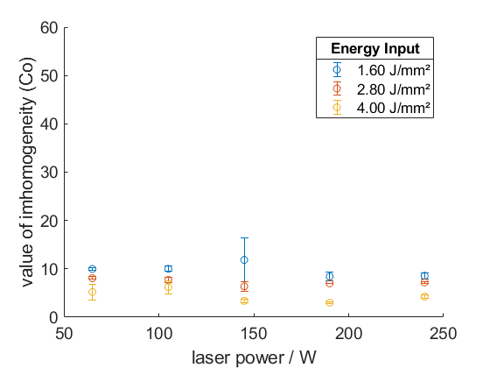
Parameter Study: Chemical Homogeneity
T_{m} = 1538 ºC
T_{m} = 1907 ºC
T_{m} = 1495 ºC

Slide 19
Materials Characterisation

Slide 20
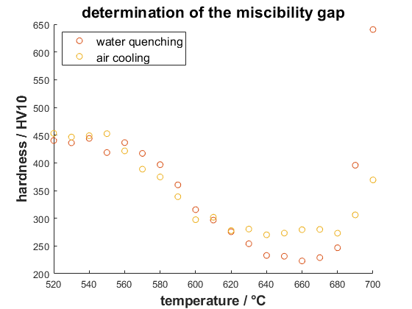
Materials Characterisation: Determination of the miscibility gap
Reference | Reported T
Minowa et.al.¹ | ~660°C
~ 620 ºC
~ 660 ºC
275HV

Slide 21
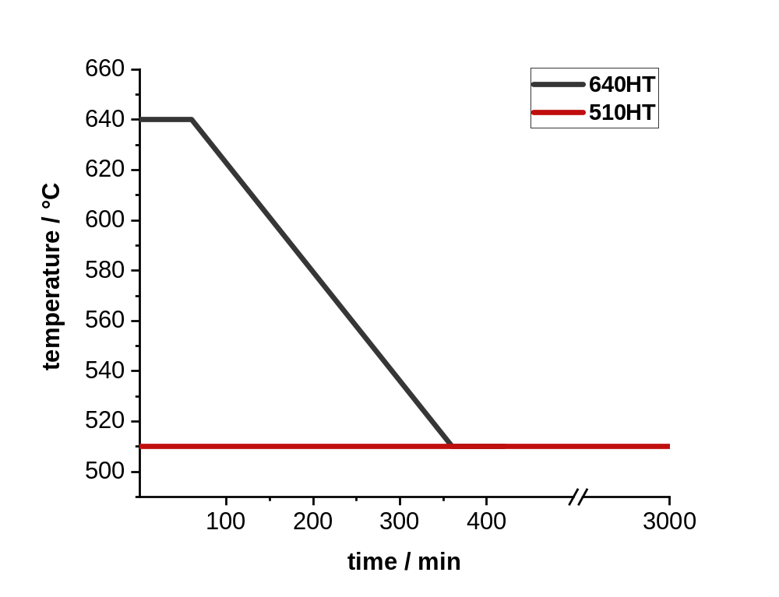
Materials Characterisation: Magnetic Measurements
Sample # | Laser power / W | Energy density / J/cm² | Heat Treatment
1 | 240 | 400 | AB – 640HT
2 | 240 | 400 | Hom – 640HT
3 | 240 | 400 | Hom – 510HT
4 | 240 | 160 | Hom – 640HT
5 | Repetition sample 2
6 | Repetition sample 4
640ºC : 1h
Cooling rate: 26K/h
510ºC : 50h
510ºC : 1h

Slide 22
Materials Characterisation: Magnetic Measurements
Sample # | Laser Power [W] | Energy density [J/mm²] | Homogenisation | Heat treatment | µ₀H_{c} (kA/m) | µ₀M_{r} (T) | BH_{max} (kJ/m³) | Anisotropy
1 | 240 | 400 | No | 640HT | 22 | 0.42 | 0.08 | No
2 | 240 | 400 | 1100°C – 1h | 640HT | 19 | 0.47 | 0.08 | No
3 | 240 | 400 | 1100°C – 1h | 510HT | 1 | 0.10 | 0.08 | No
4 | 240 | 160 | 1100°C – 1h | 640HT | 19 | 0.52 | 0.08 | Yes

Slide 23
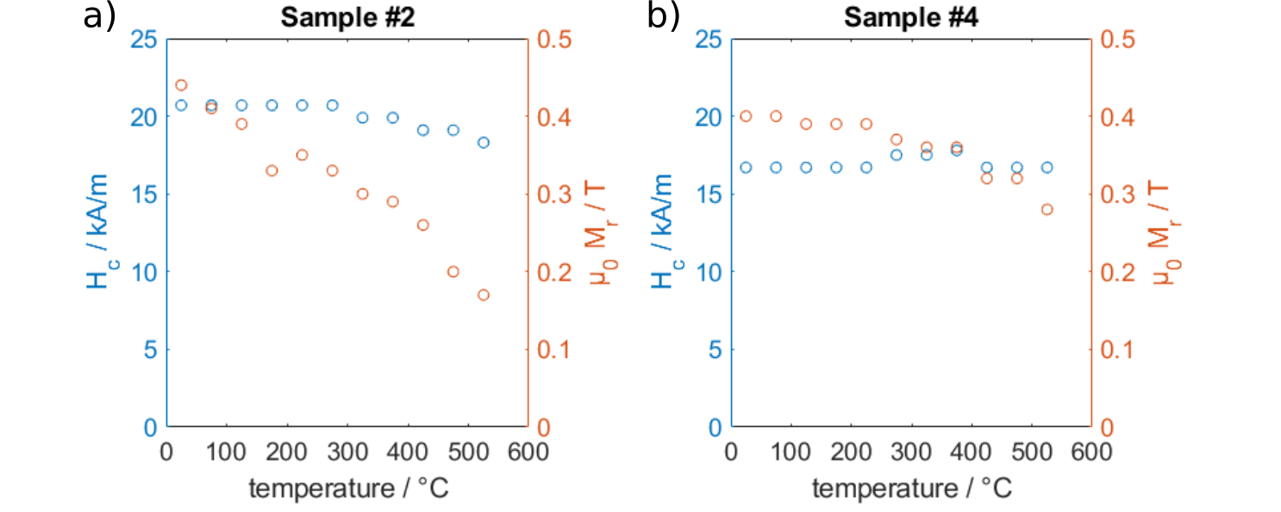
Materials Characterisation: Thermal Stability of magnetic properties

Slide 24
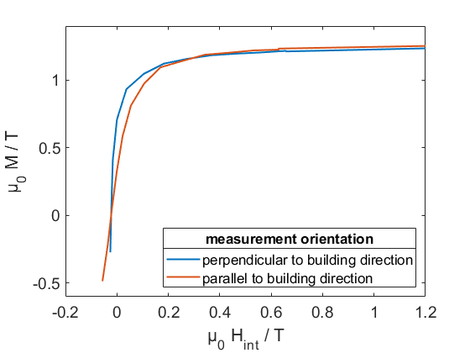
Materials Characterisation: Anisotropy of magnetic properties

Slide 25
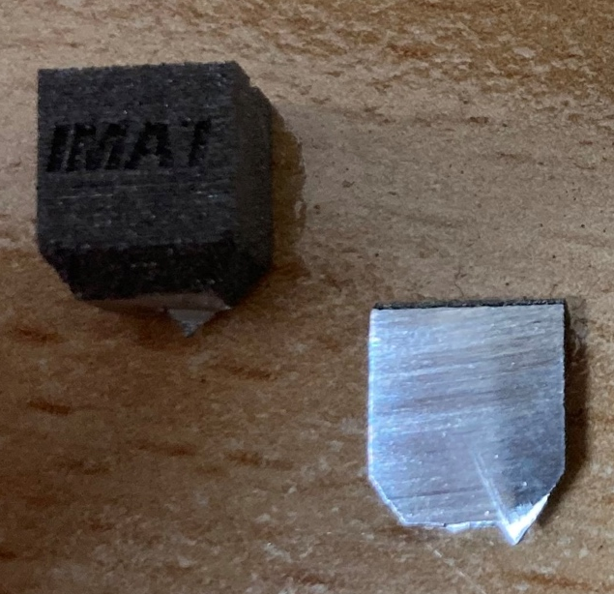
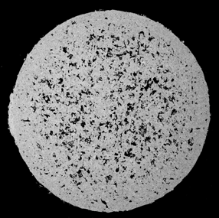
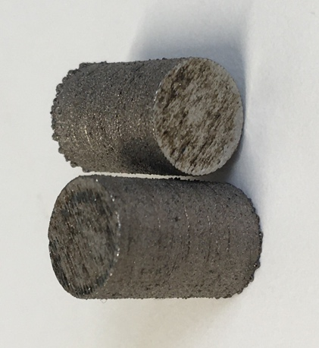
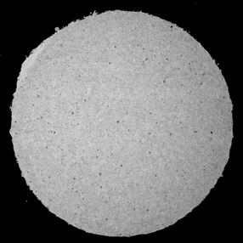
Outlook: In- situ alloying and magnetic alloys
Fe- Cr- Co system
High Entropy alloys:
  Fe-Cr-Co-Ni
  Fe-Cr-Co-Ni-Al
Shape memory alloys:
  Ni-Ti
  Ni-Ti-Zr
AlSi10Mg + additive
AA5024 + additive
Nd- Fe- B system (conventional and recycled powders)
10 mm

Slide 26
Thank you for your attention

