Slide 1
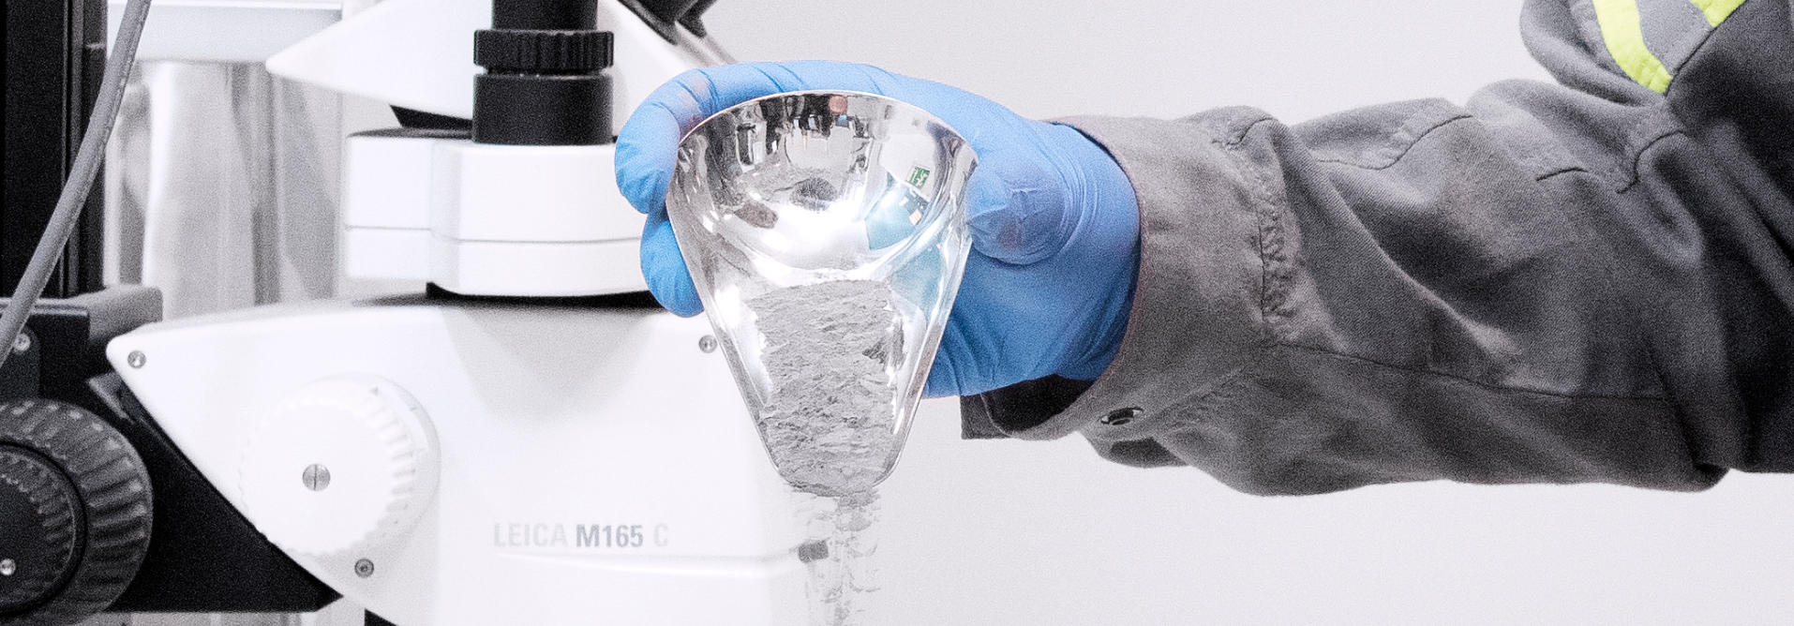
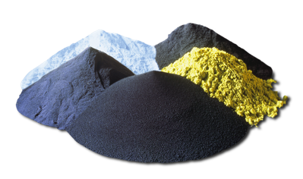
Microstructure and mechanical performance of Sandvik Osprey Inconel 625 produced via laser powder bed fusion
Leandro Feitosa, PhD
R&D Engineer
ADDITIVE BY SANDVIK
PLAN IT – PRINT IT – PERFECT IT

Slide 2
agenda
Introduction
  About Sandvik
  IN625 alloys
Powder characteristics
methodology
  Process and parameter development
  Post processing
Mechanical properties
ConclusionS

Slide 3
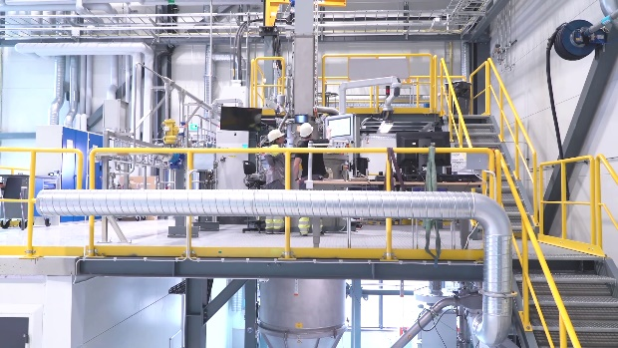


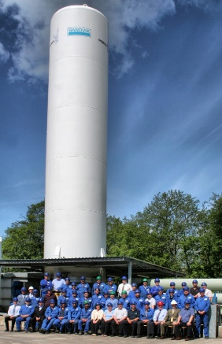
GAS ATOMIZED POWDER MANUFACTURING
BY SANDVIK
SANDVIKEN, SWEDEN
NEATH,
UNITED
KINGDOM
Notes:
Introduction to Sandvik AM Powder production units
PU Neath
Particle size: 5 – 80 micron
8 Inert Gas Atomisation (IGA)
Argon and Nitrogen atomising
Powder sizing
One plant dedicated to Aluminium alloy powders
AS9100D (Aerospace)
PU Sandviken
Particle size: 20 – 200 micron
1 Vacuum Gas Atomisation (VIGA)
1 EIGA Titanium powder plant
Argon and Nitrogen Atomising
Powder sizing
AS9100D (Aerospace)
ISO 13485:2016 Medical Certification

Slide 4
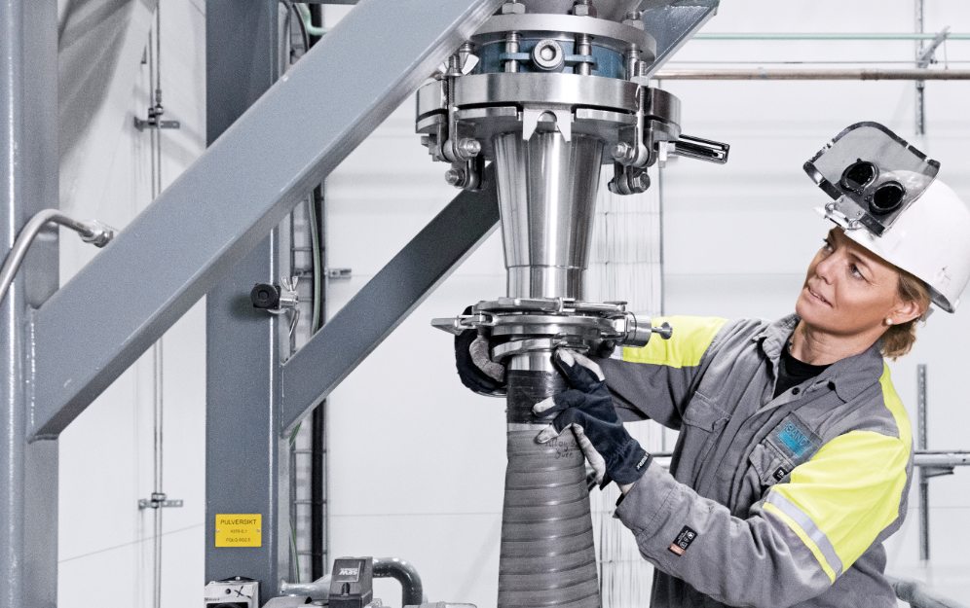

WORLD LEADER
IN METAL POWDERS
OUR PROGRAM OF OSPREY®
METAL POWDER INCLUDES:
Maraging steels; 18NI300 & MAR-60HRC
Tool steels; M2 & H13
Stainless steels; 17-4PH & 316L
Nickel free SS; X15 CrMnMoN 17-11-3
Low alloy steels
Duplex steels
Cobalt alloys
Copper alloys
Controlled expansion alloys
Soft magnetic alloys
Binary alloys
High temperature materials
Nickel-based superalloys
Aluminium alloys
Titanium alloys
OSPREY®
METAL
POWDERS
MORE THAN
2000
GRADES
FIRST YEAR OF
POWDER SALES
1979
Notes:
Ti-6Al-4V was one of the first titanium alloys developed and remains the predominant titanium alloy in the aerospace industry, because of its balanced and robust property set.
CoCr alloy offer for Medtech

Slide 5
The Inconel 625 alloy
The Inconel 625 is a nickel-based superalloy, used in different applications due to its high strength, corrosion resistance, good fabricability and weldability. The good mechanical properties are obtained from the solid solution strengthening of elements such as Mo and Nb.
The IN625 is a solid-solution matrix stiffened FCC alloy, which may contain carbides, inherent in this type of alloy. The carbides that can be found are MC, M6C (rich in Ni, Nb, Mo and C) and M23C6, a Cr-rich carbide that is usually present in solution-treated material at lower temperatures.
A disadvantage of this highly alloyed material is its difficulty in being machined, due to the high hardness, low thermal conductivity and high work hardening rates

Slide 6
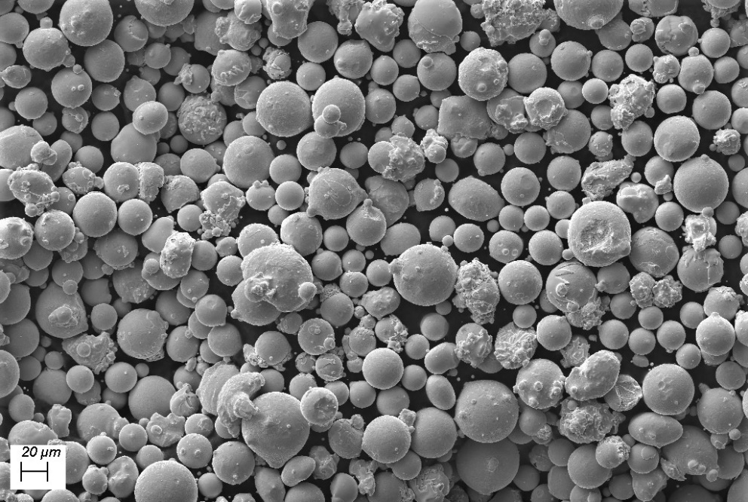
Vacuum atomization of in625
In625 powder morphology
Osprey® Alloy 625-AM is a nickel base precipitation hardened superalloy.
Manufactured by melting under vacuum as powder by Inert Gas Atomisation (VIGA).
Attractive mechanical properties at elevated temperatures up to ~540°C

Slide 7
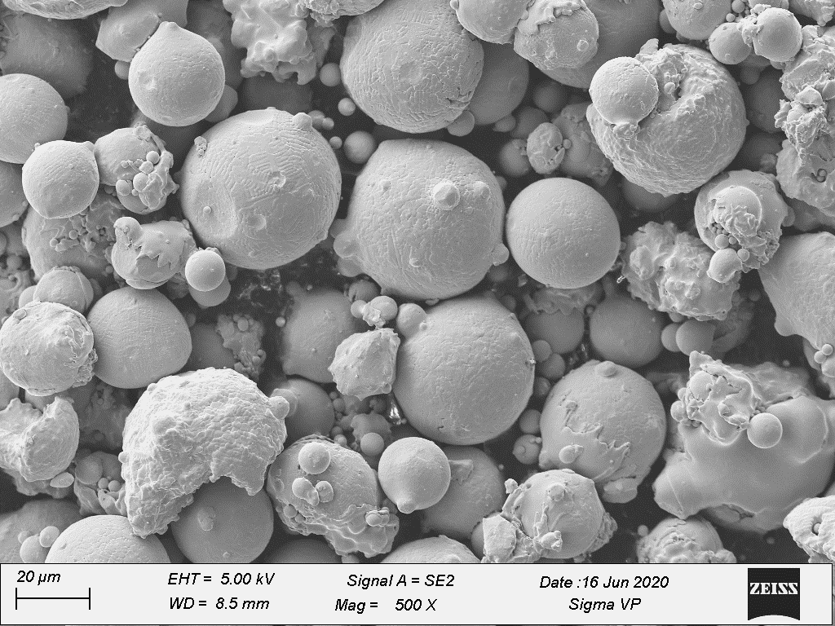
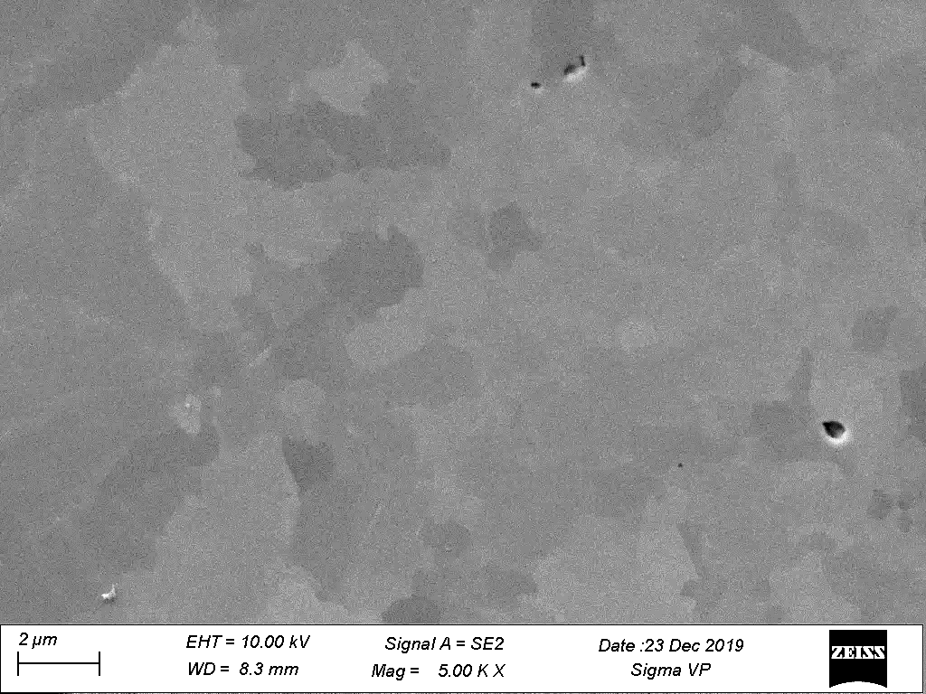
IN625 powder characteristics
VIGA
 | Flow time 50g (s) | Size by laser (µm)
VIGA | 3.4 (Carney) | d₁₀=24.8 d₅₀=36.8 d₉₀=57.3
Notes:
Leandro

Slide 8
Methods
 | %wt.
C | 0.022
N | 0.006
O | 0.0049
Al | 0.15
Si | 0.05
P | 0.003
S | 0.009
Cr | 20.83
Mn | 0.01
Fe | 3.85
Co | 0.01
Ni | 62.15
Nb | 3.83
Mo | 9.05
Ti | 0.1
MATERIAL TESTED:
IN625 Osprey VIGA
OPTIMIZATION OF PROCESS PARAMETERS
Renishaw AM400, 30µm layer thickness
High density and crack free
SEM CHARACTERIZATION:
Microstructure
MECHANICAL PROPERTIES:
Tensile (RT and 540 °C)
Impact toughness (RT)
Hardness
Notes:
Leandro

Slide 9
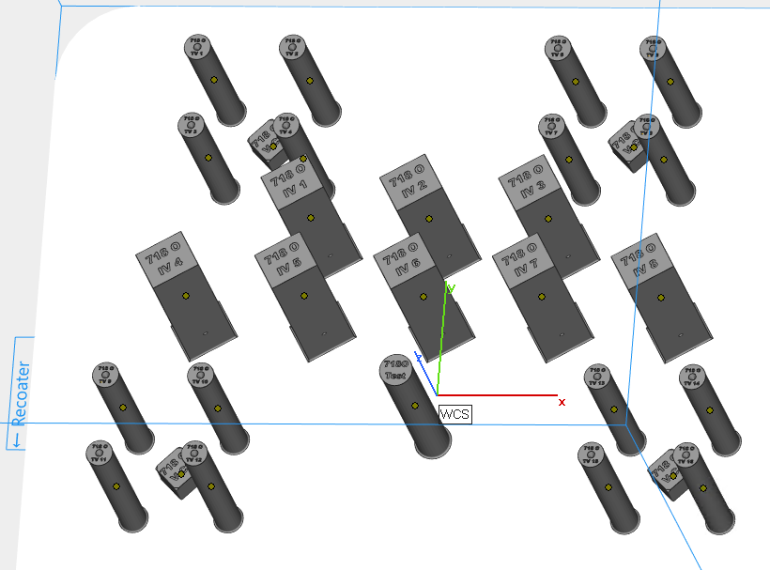
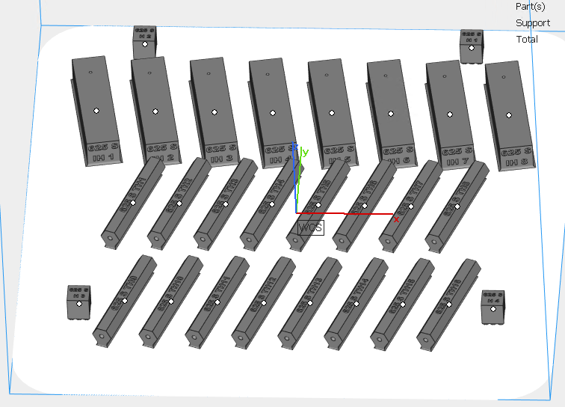
Build Plate Setups
    1048°C / 1h -> AC
    1000°C / 1h -> AC
    1048°C / 1h -> WQ
Notes:
Fabio

Slide 10
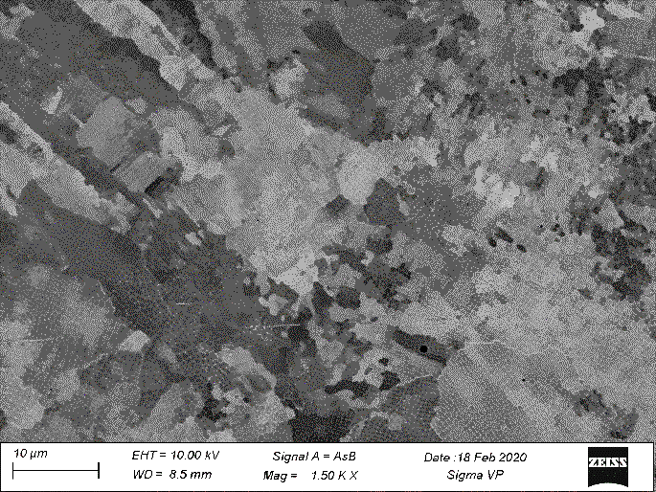
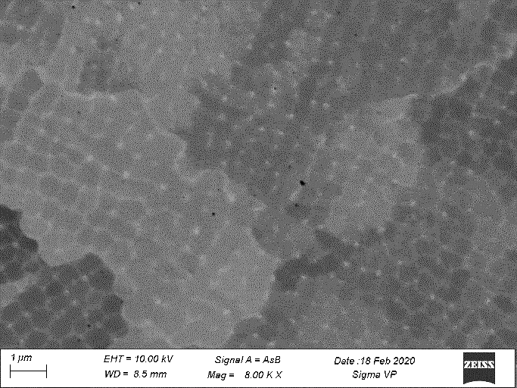
As-built microstructure
Fine cellular microstructure with segregation of alloying elements along boundaries
Nb tend to segregate into inter-dendritic regions due to low solubility of these elements in the FCC matrix
Formation of phases such as Ni₃Nb, Laves and Nb/Mo-based carbides and oxides common
Notes:
Fabio

Slide 11
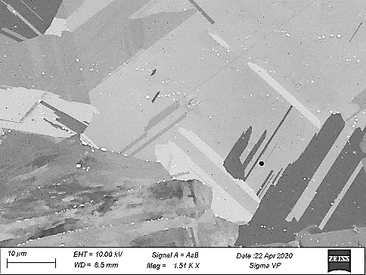
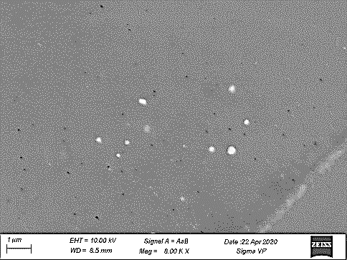
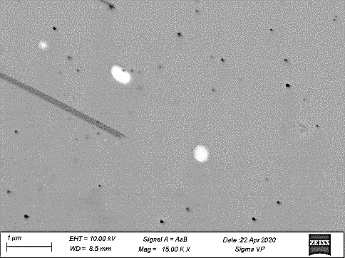
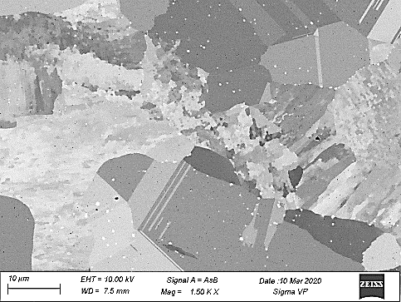
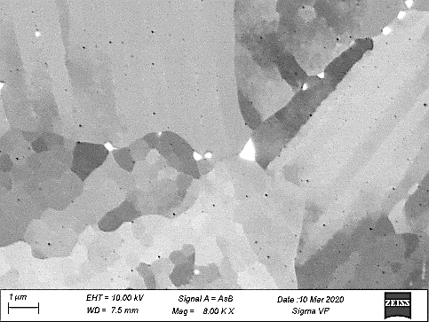
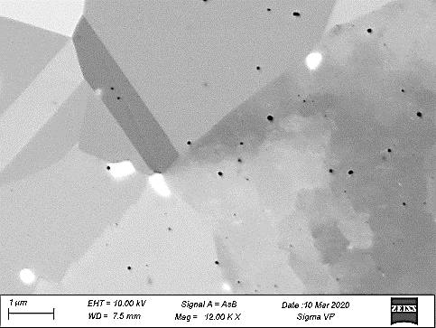
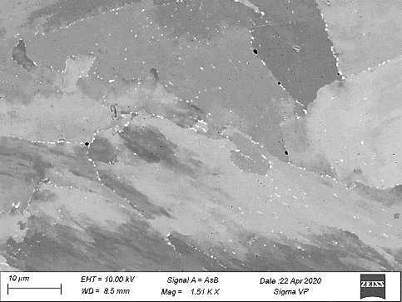
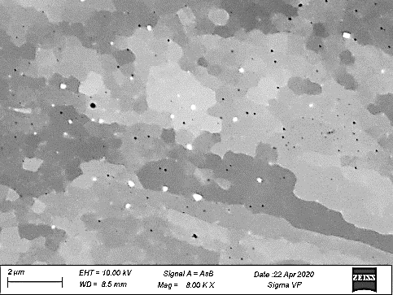
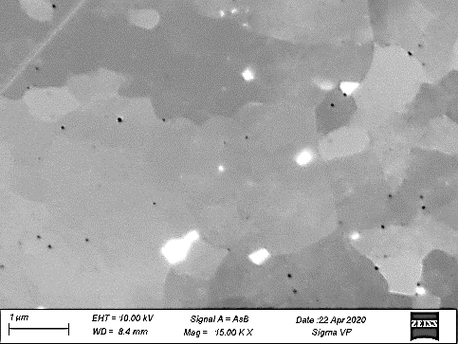
Heat treated microstructure
1048°C_1h_AC
1048°C _1h_WQ
1000 °C _1h_WQ
Notes:
Fabio

Slide 12
Mechanical properties at RT
Rp_{0.2} (MPa) / Horizontal
UTS (MPa) / Horizontal
1048 °C, 1h, AC
1048 °C, 1h, WQ
1000 °C, 1h, AC
1048 °C, 1h, AC
1048 °C, 1h, WQ
1000 °C, 1h, AC
Impact toughness (J)
Hardness (HV_{0.5})
Horizontal
Vertical
As Built
1048 C 1h,
AC
1048 C 1h,
WQ
1048 °C, 1h, AC
Notes:
Eleonora

Slide 13
Mechanical properties at 540 °C
Rp_{0.2} (MPa)
UTS (MPa)
Horizontal
Vertical
Horizontal
Vertical
1048 °C, 1h, AC
1048 °C, 1h, AC
Elongation (%)
Horizontal
Vertical
1048 °C, 1h, AC
Notes:
Eleonora

Slide 14
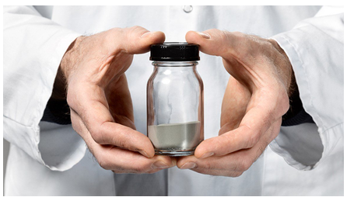
summary
Advantages of Powder Metallurgy are well-established
  Manufactured using Clean Vacuum Induction Melting Technology
  Good morphology and flowability, resulting in high density
  parts after printing.
As-built microstructure showed to be a key factor for the microstructure evolution following different annealing conditions, as it controls the formation of δ-phase and oxides.
At 1048°C, higher tensile for air cooled specimens, due to higher fraction of secondary phases, while 1000°C poor recrystallization but high strength due to precipitation, internal stresses and grain size.
Impact toughness results indicate that secondary phases are more important than oxides. Dductility is still high despite their presence.
540°C tensile evidenced good level of strength and plasticity is maintained, with secondary phase precipitations playing a more significant role.

Slide 15
Thanks for listening!
Questions?
Notes:
Eleonora

