Slide 1


Novel development of a NbC-containing powder metallurgical martensitic steel with outstanding tribocorrosion resistance
Isabel Hahn, Sabine Siebert, Werner Theisen, Sebastian Weber

Slide 2
Outline
Introduction
Experimental
Results and discussion
Conclusion

Slide 3
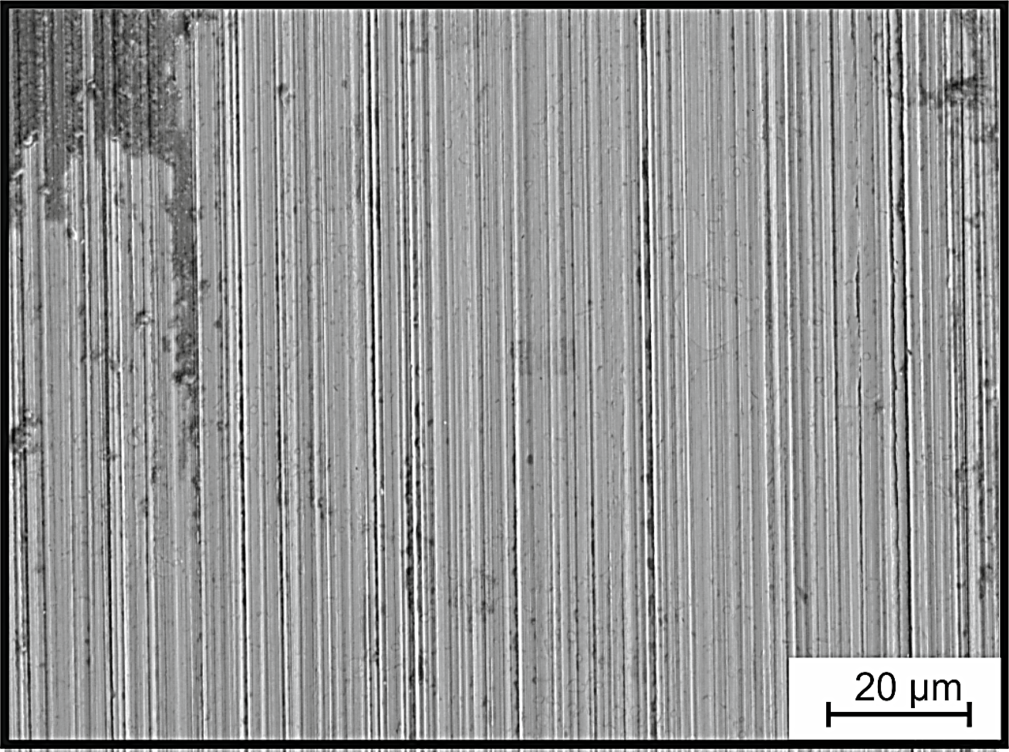
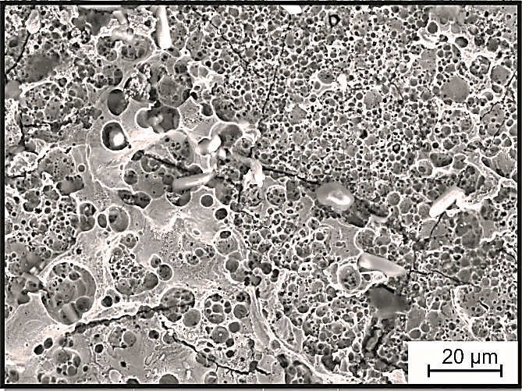
Introduction – Motivation and challenges
Tribocorrosion
Tribology/Wear
Corrosion
    Tribocorrosion: Interaction between wear and corrosion
      Wear affecting corrosion simultaneously corrosion affecting wear
      Complex phenomenon

Slide 4
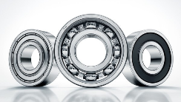

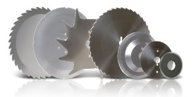
Introduction – Motivation and challenges
    seal-free bearings
source: Schaeffler AG & Co. KG
    …sustainability.
    …raised efficiency.
    Development
    of tribocorrosion resistant steels
    leads to…
    Applications,
    where
    tribocorrosion occurs:
    medical sector
    cutting tools
    …increased service life.
source: von den Steinen GmbH & Co.KG
source: Waldemar Link GmbH & Co. KG

Slide 5
Introduction – Motivation and challenges
    Wear- and corrosion resistant steels ≠ tribocorrosion resistant steels!
    Predominant: microstructure → Hard phases, alloying elements, chemical composition of the matrix…
    seal-free bearings
source: Schaeffler AG & Co. KG
    …sustainability.
    Development
    of tribocorrosion resistant steels
    leads to…
    …raised efficiency.
    Applications,
    where
    tribocorrosion occurs:
    medical sector
    cutting tools
    …increased service life.
source: von den Steinen GmbH & Co.KG
source: Waldemar Link GmbH & Co. KG

Slide 6
Introduction – Tribocorrosion resistant steels with NbC
    Advantages of NbC as hard phase
    High hardness >2000 HV
    Low solubility of Cr in NbC
    Low solubility of Nb in Fe-matrix
    Disadvantages of NbC as hard phase
    High affinity of Nb to C, formation of coarse primary carbides
    → Liquid state processing → PM
    NbC-content > 3 vol.-%
    Diffusion-alloying
    → complex and expensive
    C-free powder
    mixing
    graphite powder
    decapsulation
    encapsulation and evacuation
    HIP-process

Slide 7


Introduction – Tribocorrosion resistant steels with NbC
    Advantages of NbC as hard phase
    High hardness >2000 HV
    Low solubility of Cr in NbC
    Low solubility of Nb in Fe-matrix
    Disadvantages of NbC as hard phase
    High affinity of Nb to C, formation of coarse primary carbides
    → Liquid state processing → PM
    Aim: Development of a NbC-containing tribocorrosion resistant steel with reduced Nb- and C-contents for powder metallurgical production
    ü

Slide 8
Outline
Introduction
Experimental
Results and discussion
Conclusion

Slide 9
Experimental – Materials for tribocorrosion testing
    3 different PM-steels:
      Wear resistant steel K190: 28 vol.-% carbides
      Wear- and corrosion resistant steel M390: 21 vol.-% carbides
      Newly developed steel Nb-PMmeltC: 2.5 vol.-% carbides
      Difference in carbide-content, -type, -size
[wt.-%] | C | Si | Mn | Cr | Mo | Ni | V | Nb | Co | N | Fe
K190 | 2.80 | 0.54 | 0.31 | 11.50 | 1.03 | 0.23 | 3.60 | - | 0.03 | - | bal.
M390 | 2.70 | 0.56 | 0.28 | 18.76 | 1.00 | 0.24 | 3.62 | - | 0.06 | 0.27 | bal.
Nb-PMmeltC | 0.51 | <0.10 | 0.07 | 12.50 | 3.90 | 0.20 | 0.02 | 1.80 | 1.50 | 0.12 | bal.
    Hardened, low-tempered T = 180°C

Slide 10
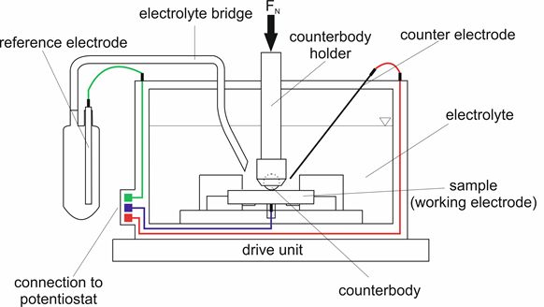
Experimental – Tribocorrosion testing
    Sliding wear
    (material loss)
    Without corrosive attack
    → pure wear
    With
    corrosive attack
    → tribocorrosion
    How does tribocorrosion affect wear resistance?
    Parameter:
      Surface pressure: 1920 MPa
      Counterbody: Si₃N₄
      Time: 30 min (sliding wear)
      Electrolyte: 0.9% NaCl-solution
    Corrosion
    (current density at OCP)
    Without
    sliding wear
    With
    sliding wear
    How does wear affect corrosion resistance?

Slide 11
Outline
Introduction
Experimental
Results and discussion
Conclusion

Slide 12
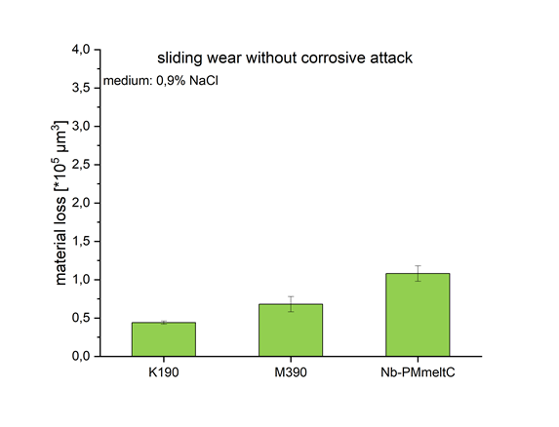
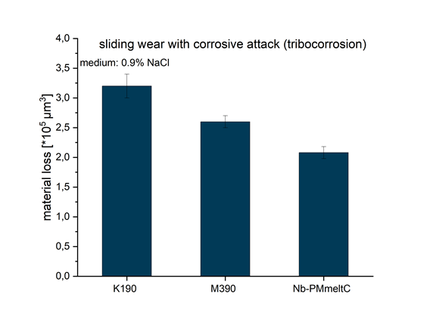
Results and discussion – Tribocorrosion behavior
How does tribocorrosion affect wear resistance?
    836±3 HV30
    839±5 HV30
    750±7 HV30
    Sliding wear resistance: K190 > M390 > Nb-PMmeltC
      → Carbide content, hardness
    Tribocorrosion resistance: K190 < M390 < Nb-PMmeltC → How does tribocorrosion occur?

Slide 13
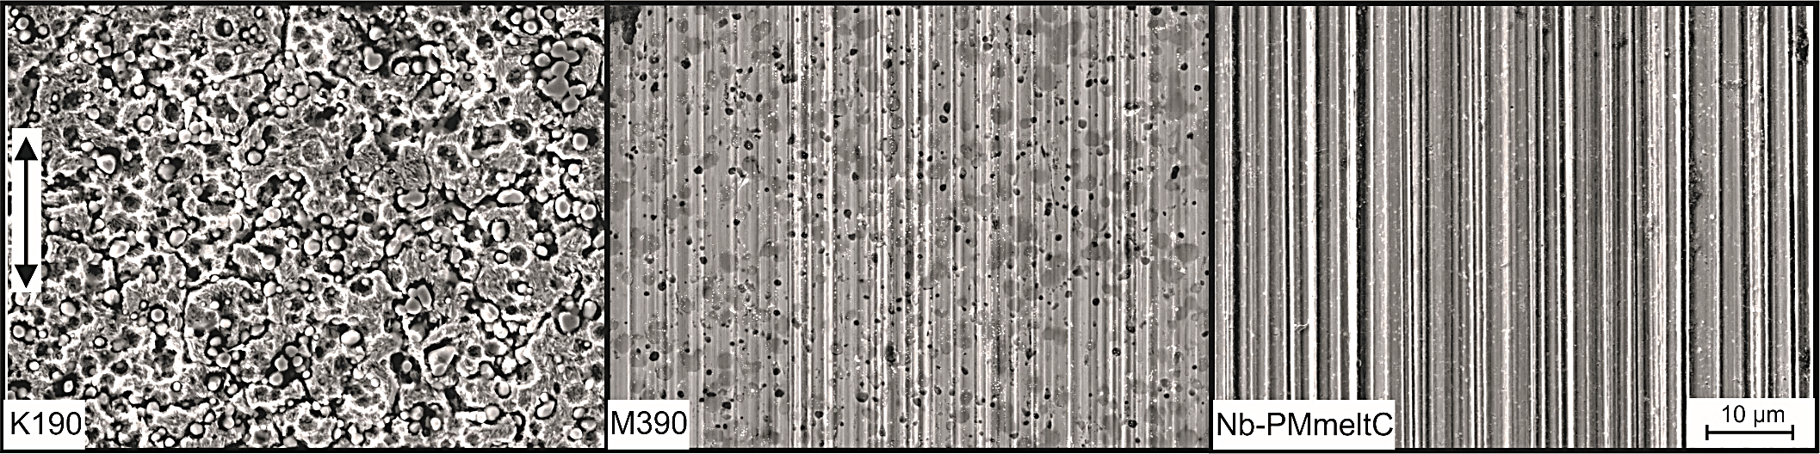
Results and discussion – Tribocorrosion behavior
    Wear tracks after sliding wear with corrosive attack (tribocorrosion)
    K190 and M390
      Corrosive attack at Cr-rich carbides
      Removed carbides → 3-body abrasive wear → tribological load is intensified
      K190: Corroding matrix facilitates the removal of the carbides
    Nb-PMmeltC
      Abrasive wear, marginally corrosion occurs
      NbC supports metal matrix
      Cr, Mo, N are distributed in
      the metal matrix → PREN

Slide 14
Results and discussion – Tribocorrosion behavior
    Wear tracks after sliding wear with corrosive attack (tribocorrosion)
    Tribocorrosion occurs differently
    Influence of corrosion on wear resistance

Slide 15
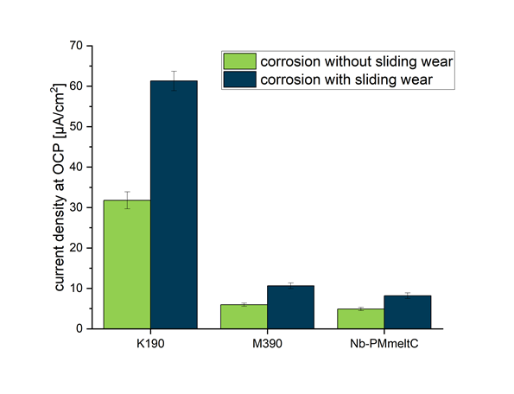
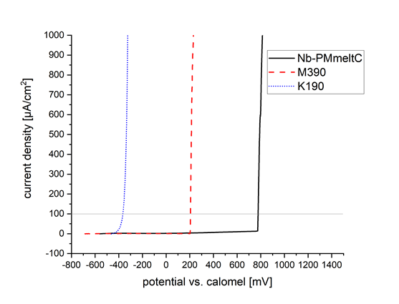
Results and discussion – Corrosion behavior
How does wear affect corrosion resistance?
    Corrosion resistance
    medium: 0.9% NaCl
    Current density under sliding wear
      Corrosive attack increases → corrosion resistance decreases
      Negative influence on tribocorrosion resistance of the steels!

Slide 16
Outline
Introduction
Experimental
Results and discussion
Conclusion

Slide 17
Conclusion
    Wear- and corrosion resistant steels ≠ tribocorrosion resistant steels
      Predominant: microstructure → Hard phase, chemical composition of the matrix…
      Tribocorrosion: Interaction between wear and corrosion
    NbC-containing steels have a high tribocorrosion resistance
      High hardness and fine dispersion of NbC in metal matrix → wear resistance
      Low solubility of alloying elements in NbC + distribution of Cr, Mo and N in metal matrix → corrosion resistance
    NbC-containing steels can be produced powder metallurgically, if Nb- and C-contents are low
      Large-scale industrial implementation is possible

Slide 18
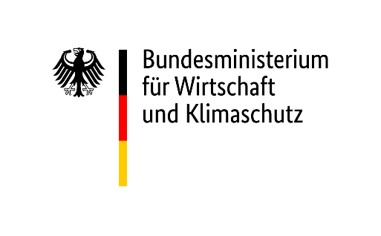
Thank you for your attention
and your questions!
This research was funded by the German Federal Ministry for Economic Affairs and Climate Action (BMWK).
Project no. FKZ 03 ET14774A-H (Poseidon II)
M.Sc. Isabel Hahn
Faculty of Mechanical Engineering
Chair of Materials Technology
Universitätsstr. 150, IC 03-325
44801 Bochum
Mail: hahn@wtech.rub.de

