Slide 1

Abrasive wear mechanism based interactive friction model for machining
Mozammel Mia, Xiao Yang, Huifeng Shi, Denis J. Politis, LiLiang Wang

Slide 2
Outline
Introduction and Motivation
Interactive friction model: Development
Interactive friction model: Calibration and COF evolution
IFM: Effects of varying sliding speed and contact pressure
IFM: Residual coating thickness and Coating depletion rate
Conclusions: Summary and Applications

Slide 3
Presenting section
Introduction and Motivation
Interactive friction model: Development
Interactive friction model: Calibration and COF evolution
IFM: Effects of varying sliding speed and contact pressure
IFM: Residual coating thickness & Coating depletion rate
Conclusions: Summary and Applications

Slide 4
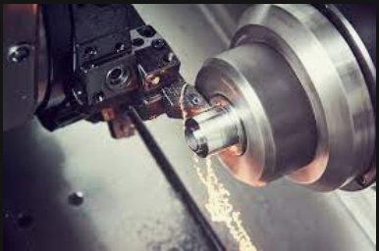
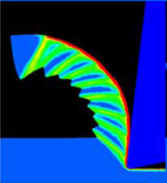
Introduction and Motivation
Research Gap: Consideration of constant COF in modeling and simulation of machining is not producing the most realistic environment – it is leading to less accurate results.
Motivation: Imperative to develop a friction model that considers the time dependent evolution of coefficient of friction and can be employed in modeling and simulation of machining.
Objectives: (i) Develop interactive friction model (ii) Sliding speed, contact pressure, and temperature into consideration (iii) tool material softening effect (iv) any sudden change of loads into consideration.
Applications: Embedded with FEA software, it can predict the outcomes (i.e., force, temperature, tool wear, tool life) of multi-pass machining runs with improved accuracy.
Constant COF
Accuracy
Compromised
Evolutionary COF
Improve
Accuracy?
Modelling &
Simulation
Chip formation, tool wear, tool life, tool deformation, stress, strain, temperature etc.

Slide 5
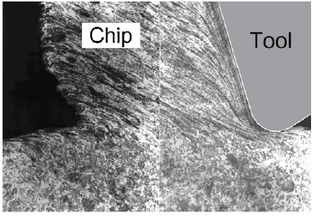
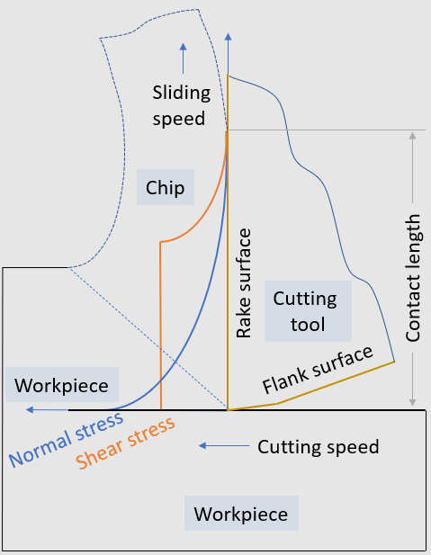
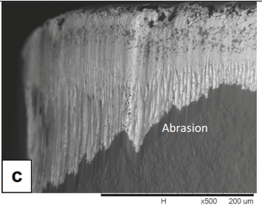
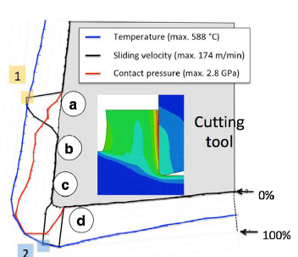
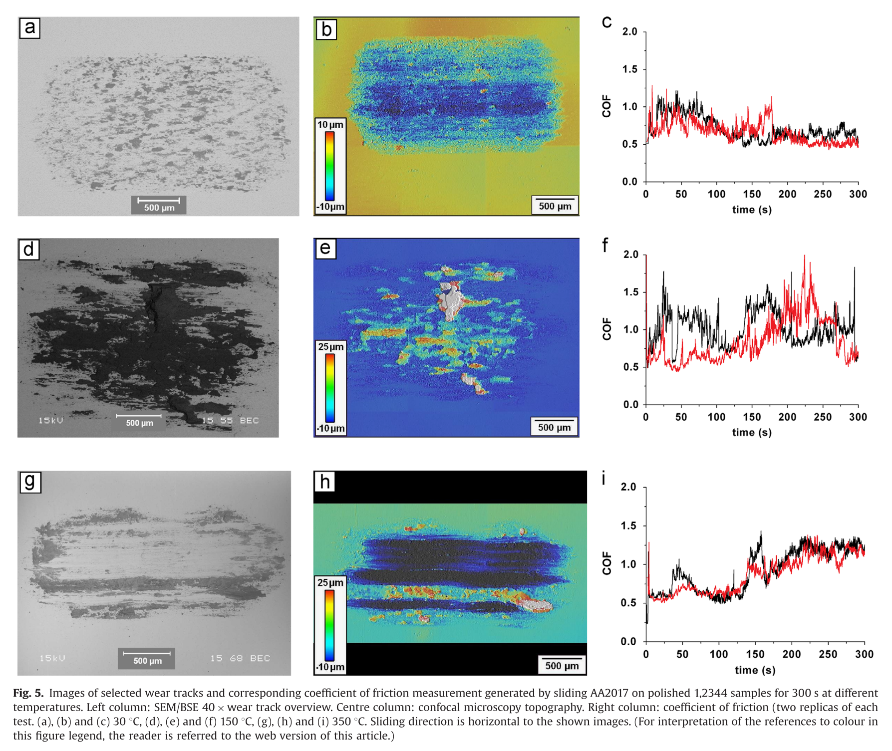
Introduction and Motivation
Traditionally, in machining, the friction at the tool-workpiece interfaces has been considered constant ^{[1]}
Owing to the dynamic nature and instantaneous changes in the interactions, the friction coefficient is not constant, rather its variable ^{[3,4]}
Friction and wear is interactive in nature ^{[6,7]} – it is the basis for the development of wear mechanism-based friction model
Abrasion is reported as a dominant wear mechanism in machining of steels ^{[8,9]}
Consideration of sliding speed, contact pressure, and temperature with tool material softening in the friction model
[2]
[9]
[5]
[8]
[1] Melkote et al. CIRP Annals. 2017;66:731-54. [2] Neugebauer et al. CIRP Annals. 2011;60:627-50. [3] Bonnet et al. CIRP Journal of Manufacturing Science and Technology. 2008;1:114-8. [4] Claudin et al. International Journal of Machine Tools and Manufacture. 2010;50:681-8. [5] Rech et al. CIRP Annals. 2018;67:65-68. [6] Ma et al. Applied Surface Science. 2015;345:109-15. [7] Hu et al. Tribology International. 2019;130:216-28. [8] Hoier et al. Wear. 2019;426-427:1548-62. [9] Diniz et al. The International Journal of Advanced Manufacturing Technology. 2016;87:3157-68.

Slide 6
Presenting section
Introduction and Motivation
Interactive friction model: Development
Interactive friction model: Calibration
Interactive friction model: Evolution of Coefficient of Friction
IFM: Effects of varying sliding speed and contact pressure
IFM: Residual coating thickness & Coating depletion rate
Conclusions: Summary and Applications

Slide 7



Interactive friction model (IFM): Development
Initial ploughing friction is due to asperity deformation
With time, ploughing friction is due to third body wear particles, both sum to the coefficient of friction
$$μ_{abr}\left(t\right)=μ_{o}+μ_{p}\left(t\right)$$
Interacting asperities
With time, more and larger wear particles entrapped between surfaces cause the rise of the friction as
$$μ_{p}\left(t\right)=μ_{p_{s}}exp\left[−{\left(k_{1}h\left(t\right)\right)}^{k_{2}}\right]$$
Here, k₁ is load dependent parameter as
$$k_{1}=k_{o}P^{I}$$
Third body ploughing
(idealized)

Slide 8
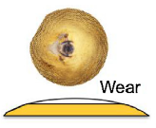


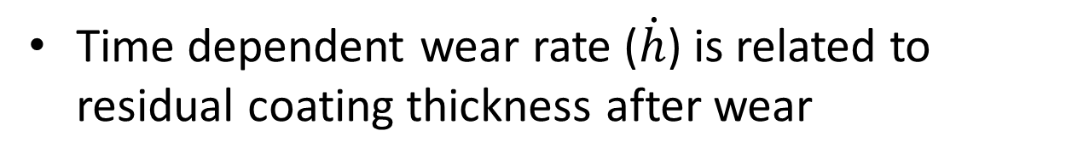

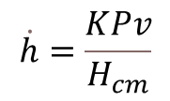
Interactive friction model (IFM): Development
Time dependent wear rate ($\dot{h}$) is related to residual coating thickness after wear
Equivalent cylindrical volumes
Spherical volumes
$$=$$
h(t)
$$h\left(t\right)= h_{o}−\dot{h}dt$$
^{[5]}
Archard’s wear rate model can be defined as function of contact pressure, sliding speed, and combined hardness of coating and substrate
$$\dot{h}=\frac{KPv}{H_{cm}}$$
Here, K is load dependent parameter as
$$K= k_{k}P^{J}$$
[5] Rech et al. CIRP Annals. 2018;67:65-68.

Slide 9
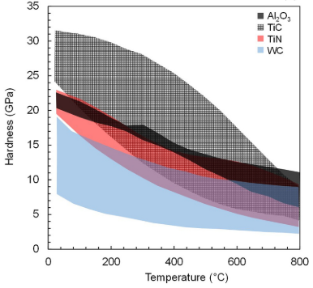
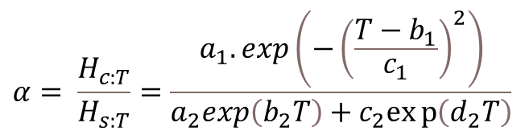
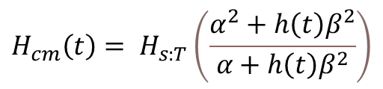
Interactive friction model (IFM): Development
Combined hardness is a function of instantaneous coating thickness
$$H_{cm}\left(t\right)= H_{s:T}\left(\frac{α^{2}+h\left(t\right)β^{2}}{α+h{\left(t\right)β}^{2}}\right)$$
Softening effect of tool material with temperature is reflected in hardness ratio parameter as
$$α= \frac{H_{c:T}}{H_{s:T}}=\frac{a_{1}.\exp\left(−{\left(\frac{T−b_{1}}{c_{1}}\right)}^{2}\right)}{a_{2}exp\left(b_{2}T\right)+c_{2}exp\left(d_{2}T\right)}$$
[8]
[8] Hoier et al. Wear. 2019;426-427:1548-62.

Slide 10
Presenting section
Introduction and Motivation
Interactive friction model: Development
Interactive friction model: Calibration and COF evolution
Interactive friction model: Evolution of Coefficient of Friction
IFM: Effects of varying sliding speed and contact pressure
IFM: Residual coating thickness & Coating depletion rate
Conclusions: Summary and Applications

Slide 11
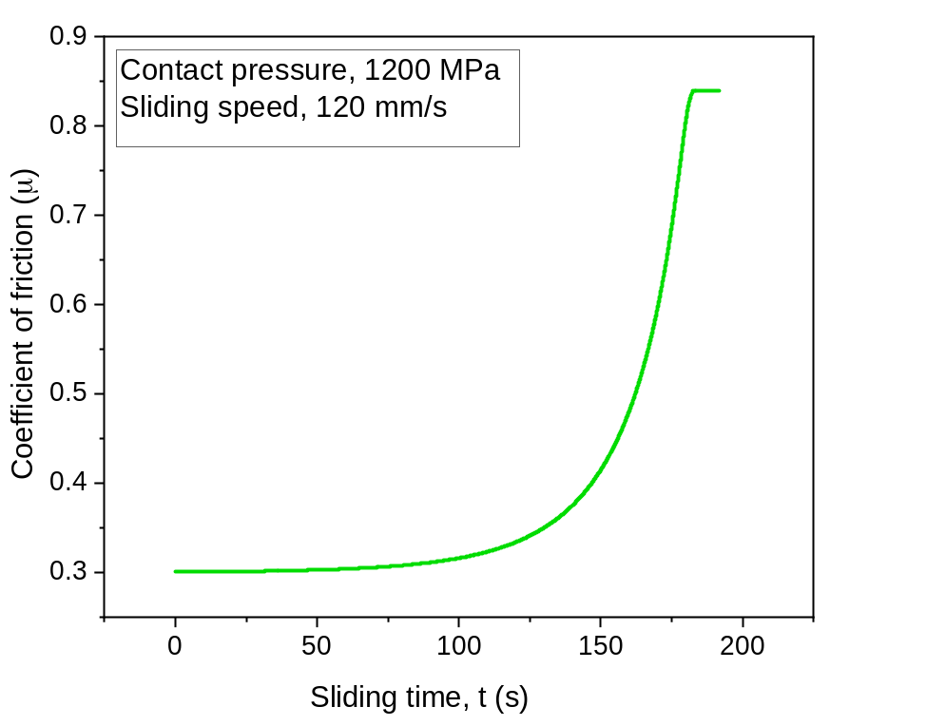
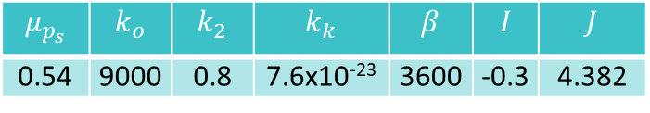
Interactive friction model (IFM): Calibration and COF evolution
Machining conditions:
Operation: Orthogonal cutting
Workpiece material: AISI 304L ^{[5]}
Cutting tool material: TiN coated WC ^{[5]}
Initial friction coefficient: 0.3
Ploughing friction coefficient: 0.54 ^{[10]}
Contact pressure: 1200 MPa ^{[5]}
Chip sliding speed: 0.12 m/s ^{[5]}
Model Parameters:
$$μ_{p_{s}}$$ | $$k_{o}$$ | $$k_{2}$$ | $$k_{k}$$ | $$β$$ | $$I$$ | $$J$$
0.54 | 9000 | 0.8 | 7.6x10⁻²³ | 3600 | -0.3 | 4.382
Peak
Accelerated
growth
Slow
growth
[5] Rech et al. CIRP Annals. 2018;67:65-8.
[10] W. Grzesik, Tribol Int. 2000; 33(2): 131-140

Slide 12
Presenting section
Introduction and Motivation
Interactive friction model: Development
Interactive friction model: Calibration and COF evolution
IFM: Effects of varying sliding speed and contact pressure
IFM: Residual coating thickness & Coating depletion rate
Conclusions: Summary and Applications

Slide 13
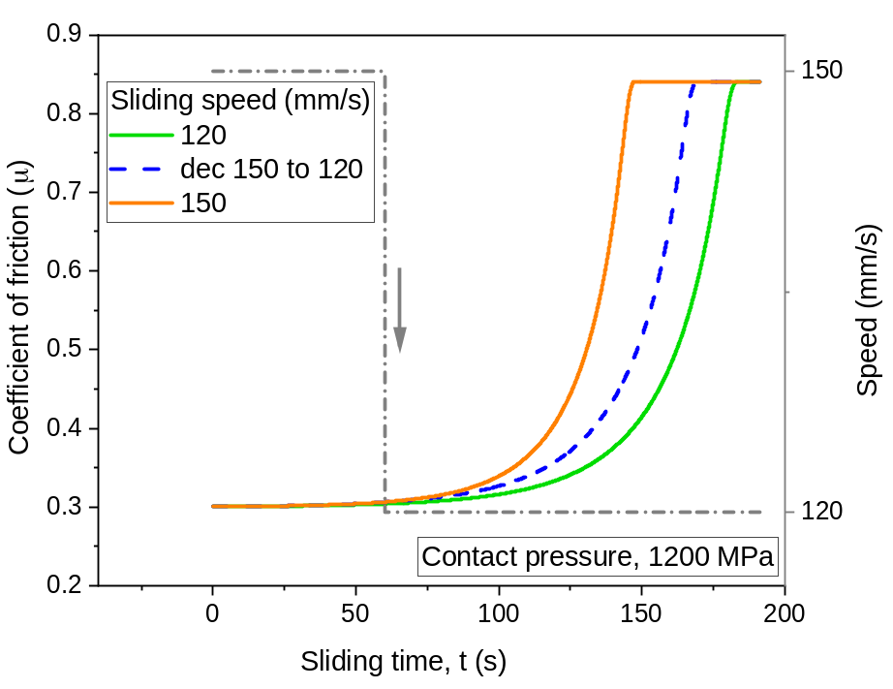
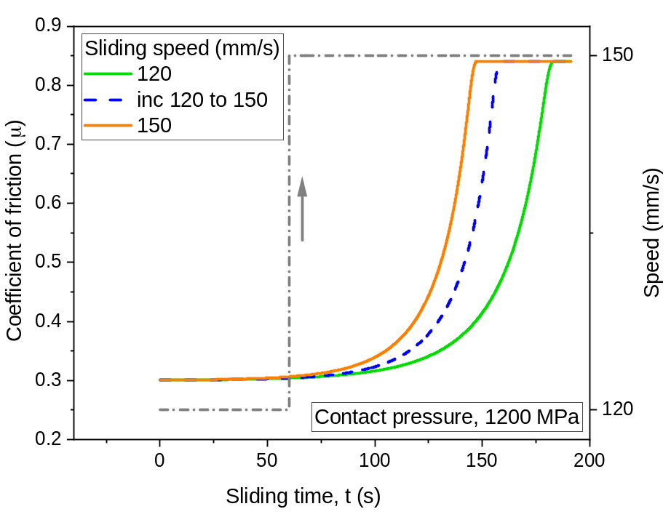
IFM: Varying sliding speed
Sudden increase in speed caused the rise of COF to occur earlier
Sudden decrease in speed caused the rise of COF to occur later
Speed change may cause changes in interaction, wear particles disintegration

Slide 14
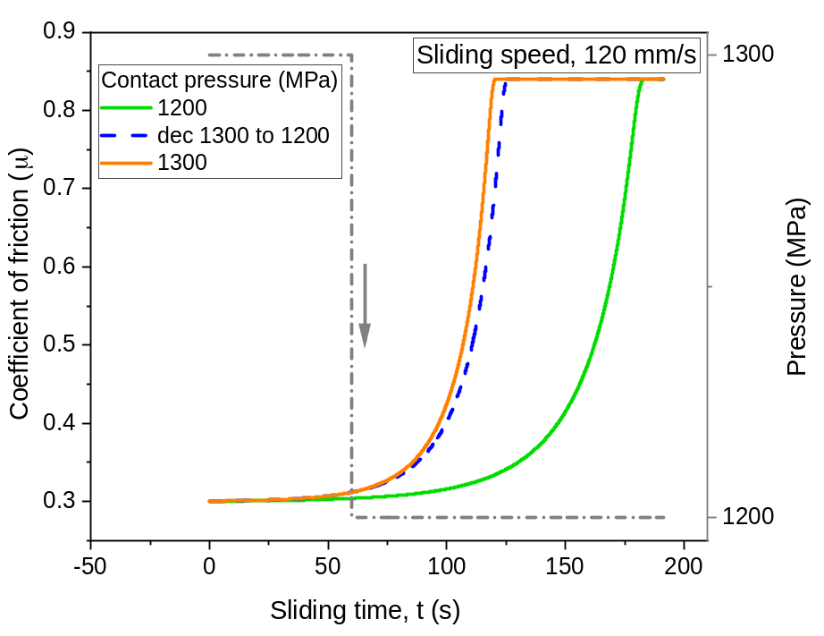
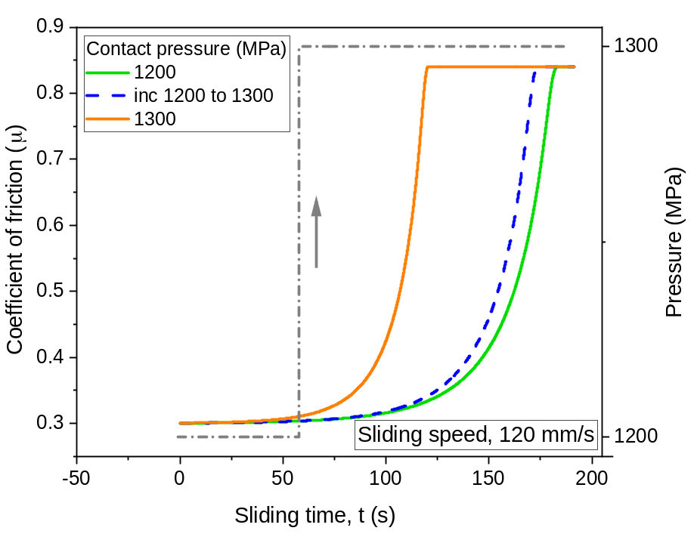
IFM: Varying contact pressure
Sudden increase in contact pressure caused the rise of COF to occur earlier
Sudden decrease in contact pressure caused the rise of COF to occur later
Contact pressure change caused changes in load on the tool

Slide 15
Presenting section
Introduction and Motivation
Interactive friction model: Development
Interactive friction model: Calibration and COF evolution
IFM: Effects of varying sliding speed and contact pressure
IFM: Residual coating thickness & Coating depletion rate
Conclusions: Summary and Applications

Slide 16
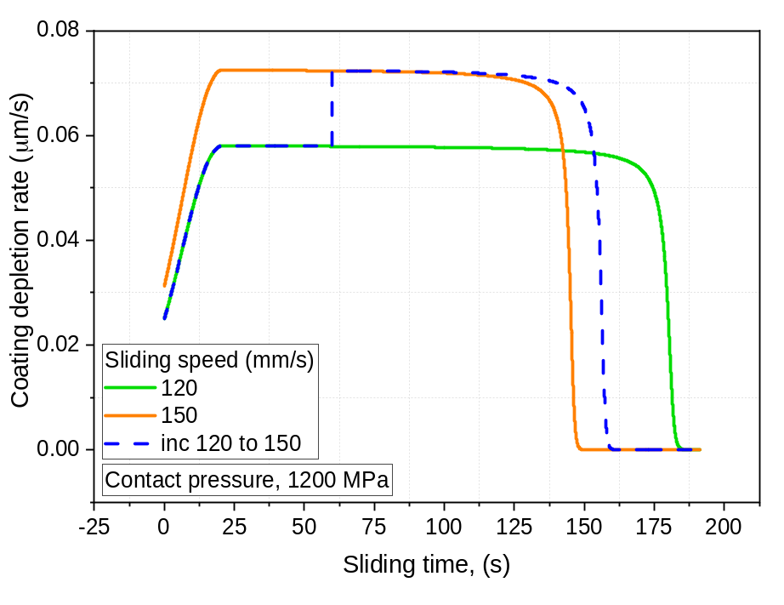
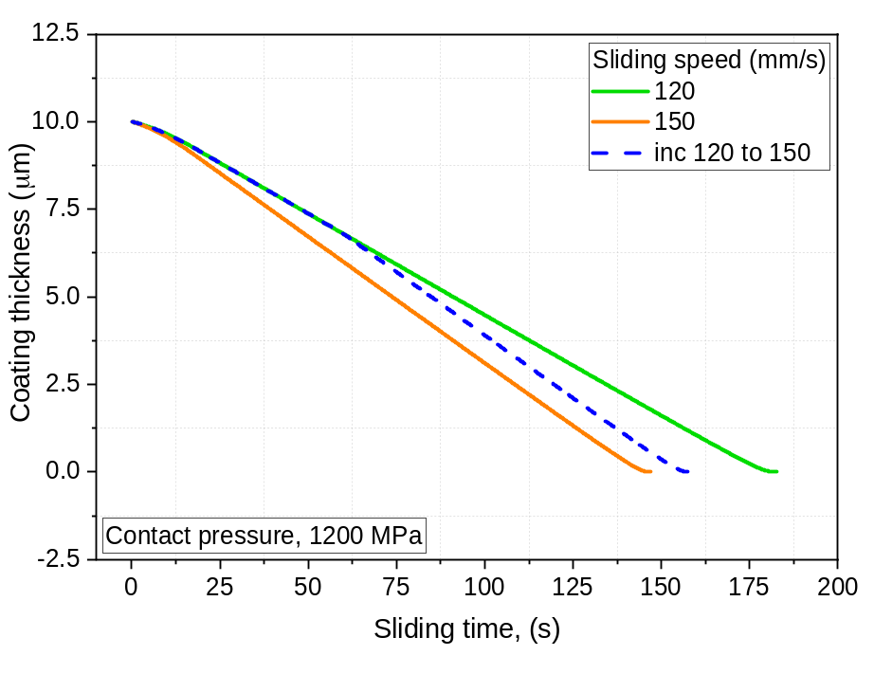
IFM: Residual coating thickness & Coating depletion rate
Residual coating decreases with sliding time
Thickness depletion rate increase, reaches peak, and declines
Sudden increase in sliding speed causes the coating to deplete more rapidly

Slide 17
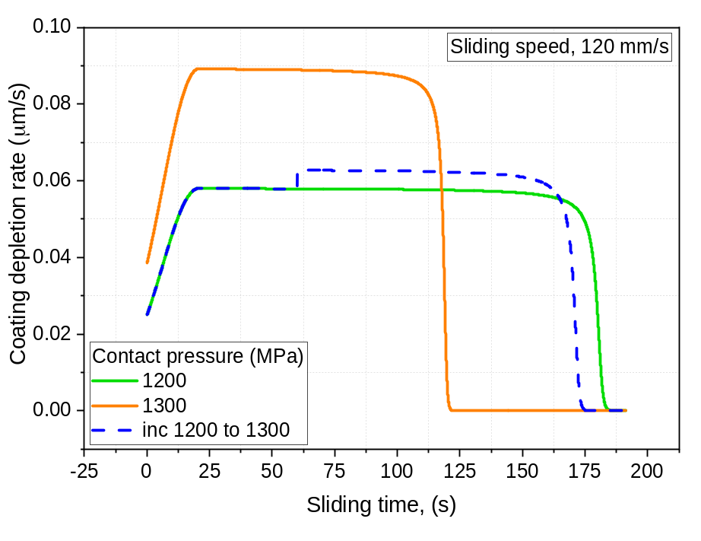
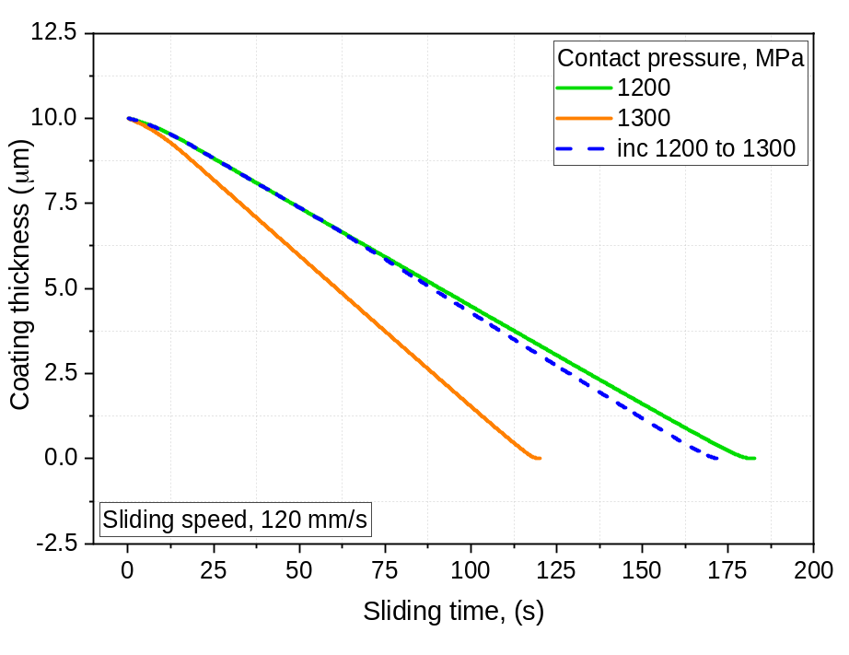
IFM: Residual coating thickness & Coating depletion rate
Sudden increase in contact pressure causes the coating to deplete more rapidly
Changes in speed or contact pressure may cause change in wear particles, less remaining coating, particle disintegration

Slide 18
Presenting section
Introduction and Motivation
Interactive friction model: Development
Interactive friction model: Calibration and COF evolution
IFM: Effects of varying sliding speed and contact pressure
IFM: Residual coating thickness & Coating depletion rate
Conclusions: Summary and Applications

Slide 19
Conclusions: Summary and Applications
Summary:
An interactive friction model has been developed for metal cutting that has taken temperature, contact pressure, sliding speed and thermal softening of tool material into consideration
The evolution of coefficient of friction with the progression of time has showed three parts – slow growth stage, acceleration stage and peak saturation stage
The model is capable of auto-adjusting any abrupt changes in loads by making appropriate changes in coating thickness and its depletion rate
Applications:
IFM embedded with FEA software can predict a more realistic machining outcomes (i.e., residual stress, temperature, tool wear, tool life, tool deformation) for multi-cycle runs

Slide 20
Questions?
Email: m.mia19@imperial.ac.uk
Thank you for your patience

