Slide 1

Retained Austenite in Tool Steels
Christoph Oberroither

Slide 2
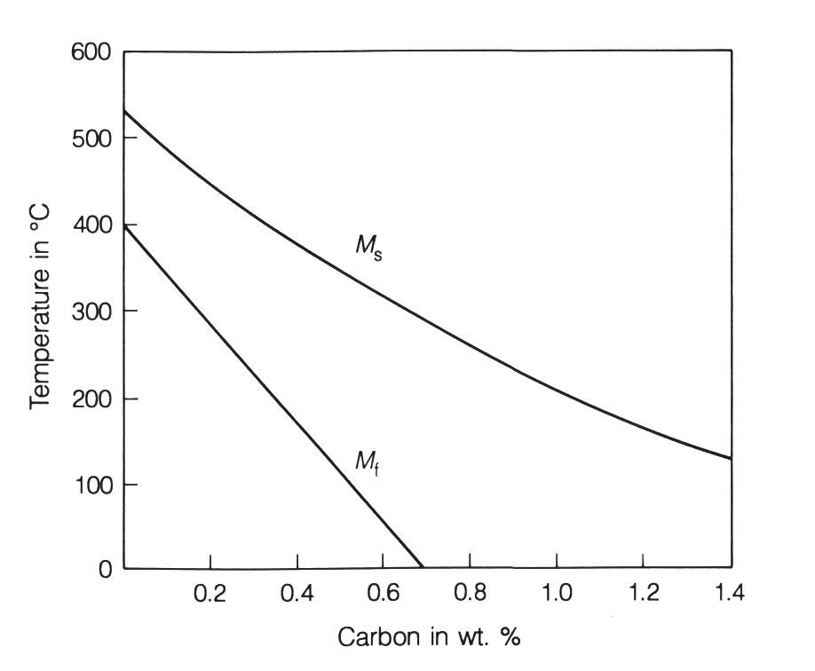
Retained Austenite in Tool Steels
Why are we talking about retained austenite in high-alloyed tool steels ?
Martensite Start Temperature (M_{s}) and Finish Temperature (M_{f}) drops with increasing C- content
At C-contents of > 0,7% the M_{f} drops below Room –Temperature
When quenched down to room temperature, metastable retained austenite may remain in the microstructure
Complete transformation from austenite into martensite takes place if quenched below room temperature or under application of adequate mechanical load

Slide 3
Retained Austenite in Tool Steels
How can we detect retained austenite ?
How can we avoid retained austenite ?
How does retained austenite effect our tool performance ?

Slide 4
How can we detect retained austenite ?
Metallographic inspection
Measurement of the magnetic saturation
Phase quantification by electron backscatter diffraction
X-ray diffraction

Slide 5
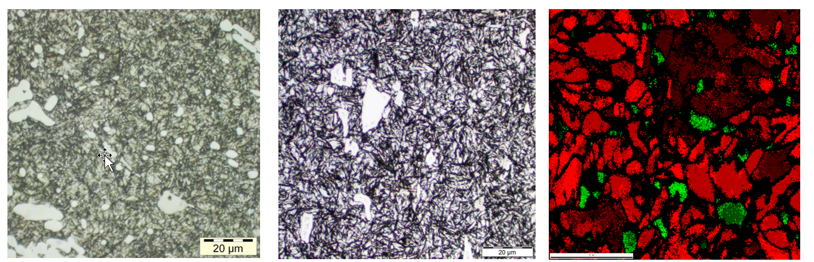
How can we detect retained austenite ?
BÖHLER K340 ISODUR
Hardened & tempered
RA 3.5 % (XRD)
BÖHLER K340 ISODUR
Hardened & tempered
RA 16 % (XRD)
BÖHLER K329
Hardened & tempered
RA 8 % (EBSD)

Slide 6
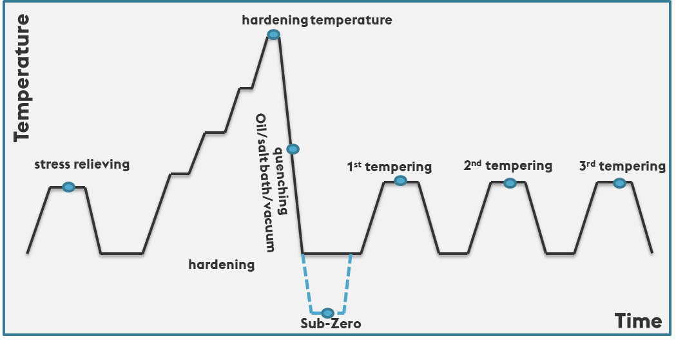
How can we avoid retained austenite?
Sub-Zero treatment
Sufficient tempering
combination
Choosing correct hardening temperature
Avoiding delays between heat treatment steps

Slide 7
How can we avoid retained austenite ?
X153CrMoV12
A Hardening 1070 °C
      30 min
T Tempering 510 °C
2 hrs
SZ Sub-Zero - 80 °C
30 min

Slide 8
How does RA effect our tool lifetime ?
• Tools are too small in size
• Tools increase in size and even crack
High volume of RA
ΔV ~ +3%
Austenite
Martensite

Slide 9
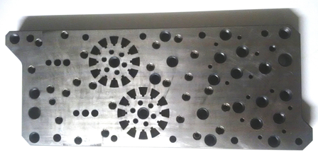
How does RA effect our tool lifetime ?
Tool: Die plate for fine blanking
Material: BÖHLER K110
(X153CrMoV12 / 1.2379 / D2)
Dimensions: 124.5 x 24.5 x 320 mm
Plates manufactured from near net
shaped hot rolled & annealed bar material
Reason of failure: Growth of longitudinal and transverse dimensions in the range of 0.02 – 0.08% during service

Slide 10
How does RA effect our tool lifetime ?
Heat treatment:
Hardening: 1070°C quenching to 70°C
Tempering: 3 x 500°C 3 - 4 h
Hardness 58,7 – 61 HRC
RA 18,3 %

Slide 11

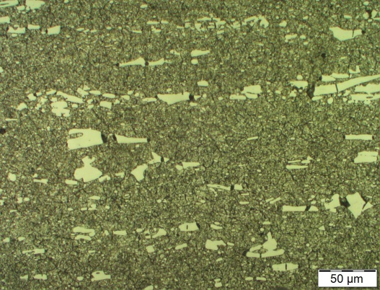
How does RA effect our tool lifetime ?
All samples show normal carbide size & distribution for a hardened and tempered microstructure
The carbide orientation is parallel to the length of the plates

Slide 12
How does RA effect our tool lifetime ?
Growth of the die plate in service is related to stress induced transformation of retained austenite during service
Die plates still show considerably high amount of retained austenite which comes from inadequate heat treatment i.e. tempering
The reported multiple tempers at around 500°C did not transform the retained austenite after hardening

Slide 13
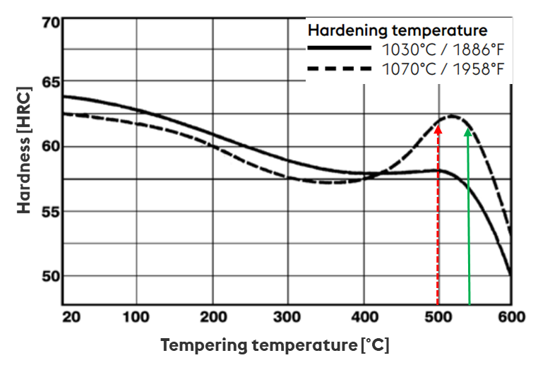
How does RA effect our tool lifetime ?
Same hardness level:
Insufficient heat treatment
Correct heat treatment
Improvement of
performance & lifetime

Slide 14
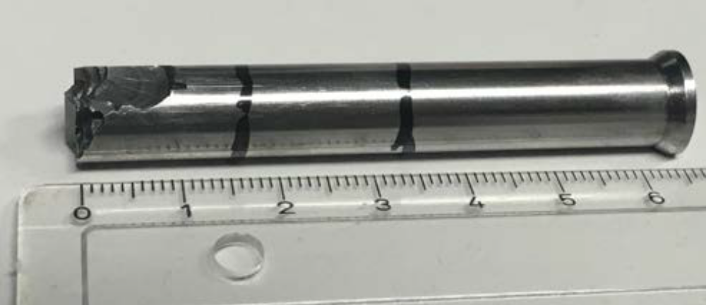
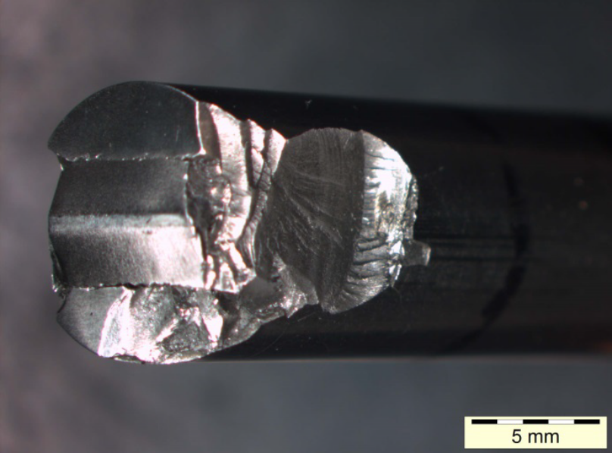
How does RA effect our tool lifetime ?
Tool: Cold forming punch
Material: HS 4-3-2 (W4Mo3Cr4VSi)
Heat treatment: not received
Reason of failure: Chipping during service

Slide 15
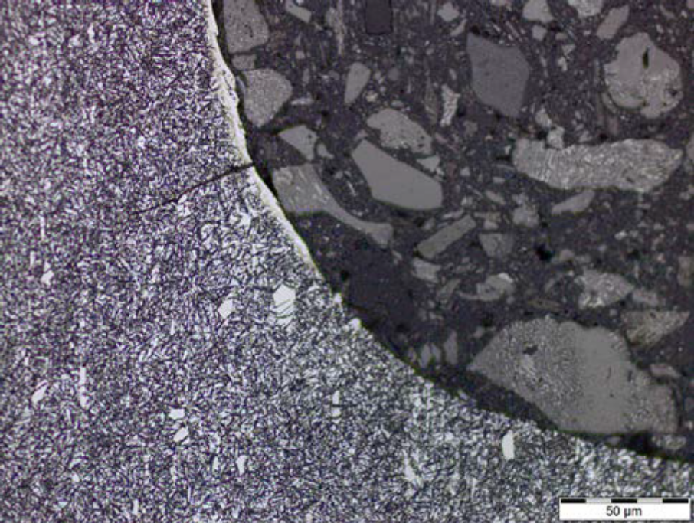
How does RA effect our tool lifetime ?
Hardness 60 HRC
Hardened and insufficiently tempered Microstructure
Thermal affection of about 3 μm was detected.
remaining EDM-layers
Abrasive wear on cutting edges
RA = 41% which is very high and not typical
EDM layer

Slide 16
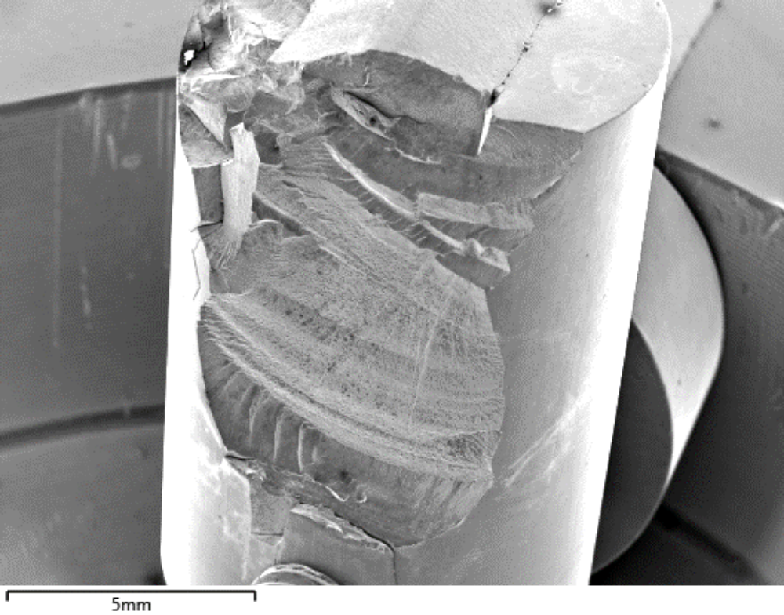
How does RA effect our tool lifetime ?
EDM surface supported the early fracture of the punches
Most likely the punches received only one temper at low temperatures which did not lead to transformation of retained austenite

Slide 17
How does RA effect our tool lifetime ?
RA is regarded as a detrimental microstructural constituent when present in high-alloyed tool steels
It is difficult to determine small volumes of RA (LOM)
A reliable method for determining the volume of RA in high-alloyed tool steels is
X-ray–diffraction
RA can be the root cause of unexpected fatal tool fracture or dimensional instability of tools in service
Unfavourable amount of retained austenite in high-alloyed tool steels can be avoided by Sub-Zero treatments or by multiple tempering at temperatures sufficiently above the secondary hardening peak
Choosing an adequate heat treatment improves the tool- & high-speed steel’s properties and leads to an increase in tool lifetime and higher performance levels

Slide 18
THANK YOU VERY MUCH FOR YOUR ATTENTION
Christoph Oberroither

