Slide 1

Cryogenic treatment as a way to optimize the hardness-toughness relation for cold work tool steels
Peter Jurči

Slide 2
LEDEBURITIC COLD-WORK TOOL STEELS
Steel grade | Chemical composition (in mass %)
 | C | Cr | V | others
AISI D2 | 1.55 | 11.90 | 0.9 | 0.8 Mo
AISI D3 | 2.2 | 12 | 1 | 1 W
AISI D6 | 2.15 | 12 | - | 0.7 W
X190CrVMo20-4 | 2 | 19.70 | 4 | 1.05 Mo
Vanadis 6 | 2.1 | 6.8 | 5.4 | 1.5 Mo

Slide 3
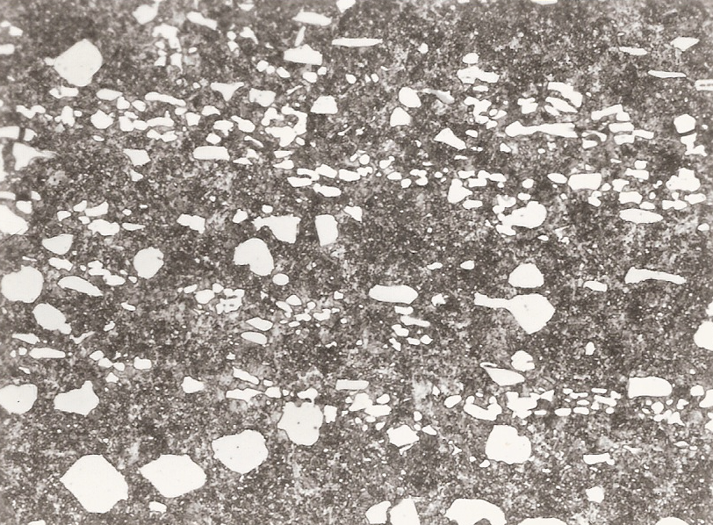
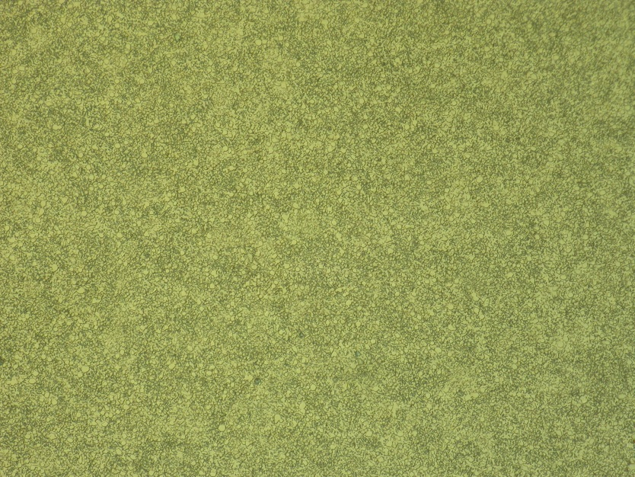
LEDEBURITIC COLD-WORK TOOL STEELS
a
30 μm
30 μm
b
A 2C-7Cr-6V ledeburitic steel made by conventional (cast and wrought) (a) and powder metallurgy (b).

Slide 4
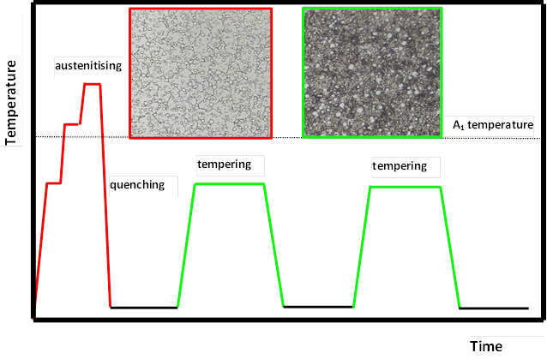
HEAT TREATMENT
A schematic of conventional heat treatment of ledeburitic cold work tool steels

Slide 5
HEAT TREATMENT – resulting properties
Hardness – 60 - 64 HRC
Excellent wear resistance
Flexural strength - ~ 2000 MPa (wrought steels), ~ 3500 MPa (powder metallurgy steels
Fracture toughness ~ 15 – 17 MPa x m^{1/2}

Slide 6
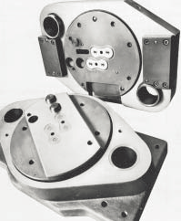
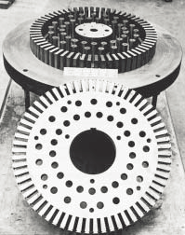
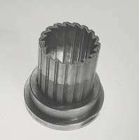
LEDEBURITIC STEELS - APPLICATIONS
fine-blanking tools
Sverker 3 blanking and piercing tool to produce lamination plates from abrasive high-silicon sheet
Powder pressing punch of Uddeholm
Vanadis 6 SuperClean.
Sverker 3 – cold work tool steel. www.uddeholm.com
Vanadis 6 Super Clean - High performance powder metallurgical cold work tool steel. www.uddeholm.com

Slide 7
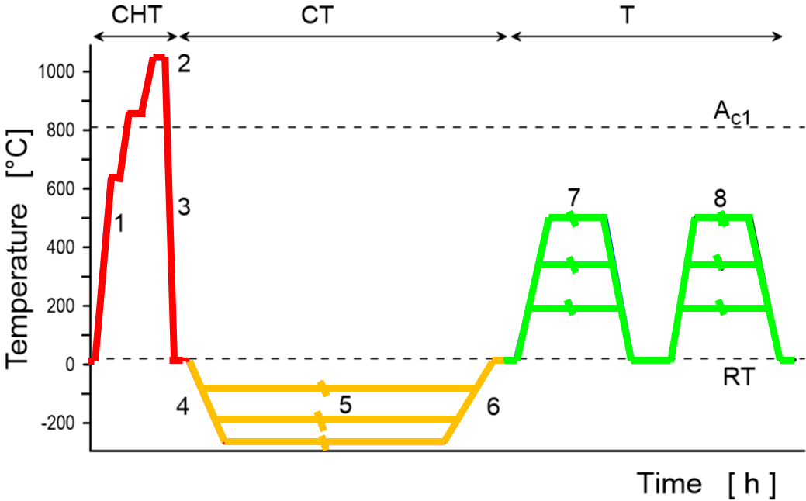
CRYOGENIC TREATMENT
A schematic of cryogenic treatment of ledeburitic cold work tool steels

Slide 8
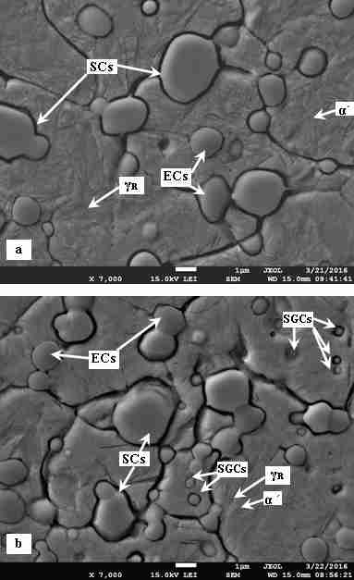
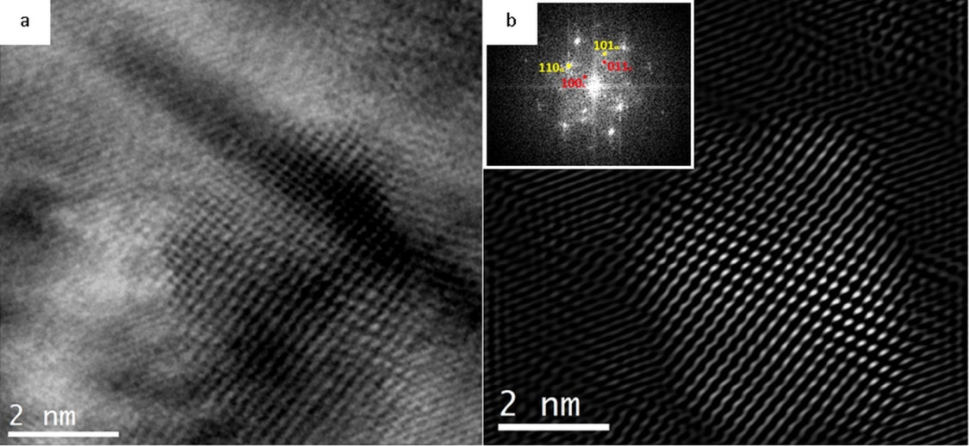
CRYOGENIC TREATMENT
Reduction of retained austenite
Formation of refined martensite
Formation of huge number of „extra“ carbides
Accelerated precipitation of transient carbides

Slide 9
EXPERIMENTAL
Experimental steel: Vanadis 6
Composition | C | Si | Mn | Cr | Mo | V | Fe
Mass. % | 2.1 | 1.0 | 0.4 | 6.8 | 1.5 | 5.4 | Bal
Austenitising 1050°C for 30 min, nitrogen gas quenching
Conventional heat treatment – no-tempering, tempering at 170, 330, 450 or 530 °C, 2 cycles for 2 h each
Cryogenic treatment - −75, -140, -196 or -269°C, for 17 h each, cooling and re-heating at a rete 1°C/min., No-tempering, tempering at 170, 330, 450 or 530 °C, 2 cycles for 2 h each

Slide 10
EXPERIMENTAL
Plane strain fracture toughness (K_{IC}) - pre-cracked (after completed heat treatment) 10 × 10 × 55 mm specimens, ISO 12137 standard
Five samples for each investigated heat treatment schedule (cryogenic treatment, tempering regime).
Fractographical analyses
Microstructure
Determination of retained austenite (XRD, ASTM E975-13 standard)
Hardness tests (Vickers HV 10)

Slide 11
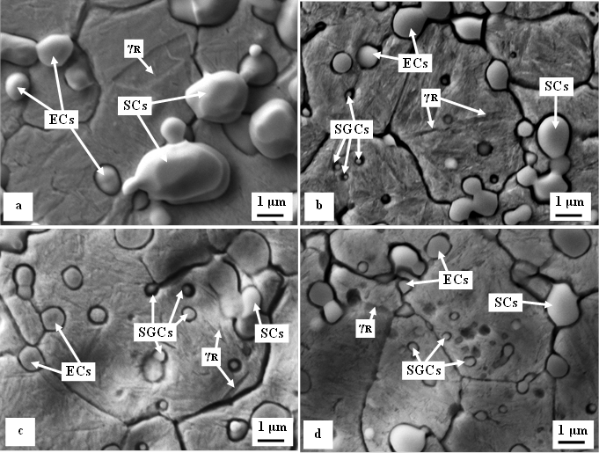
MICROSTRUCTURE
SEM micrographs showing prior-to-tempering microstructures of Vanadis 6 steel after CHT (a), and after CT −140 °C (b), -196 °C (c), and -269 °C (d).

Slide 12
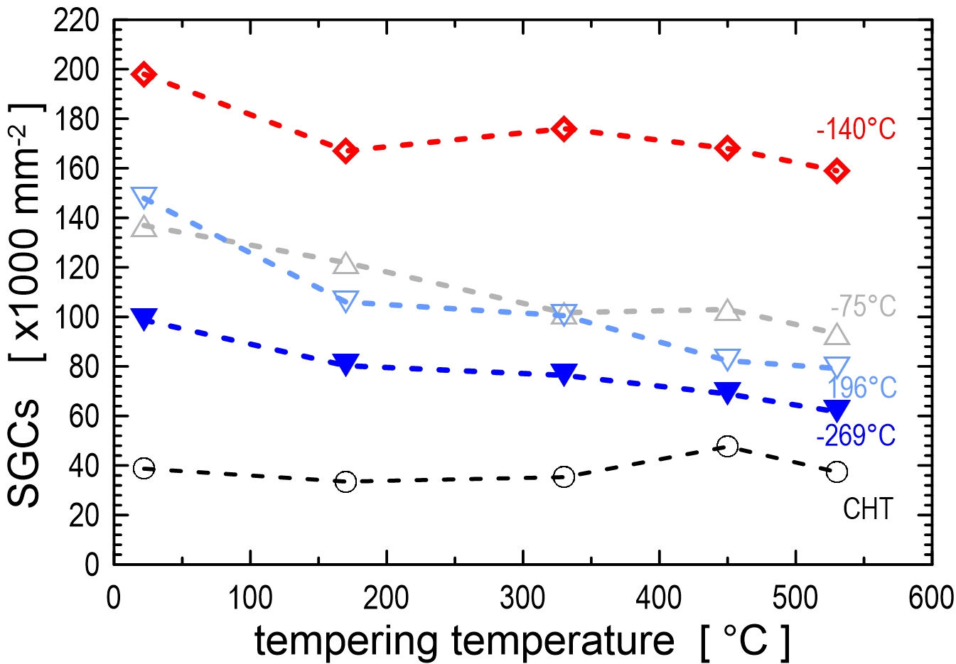
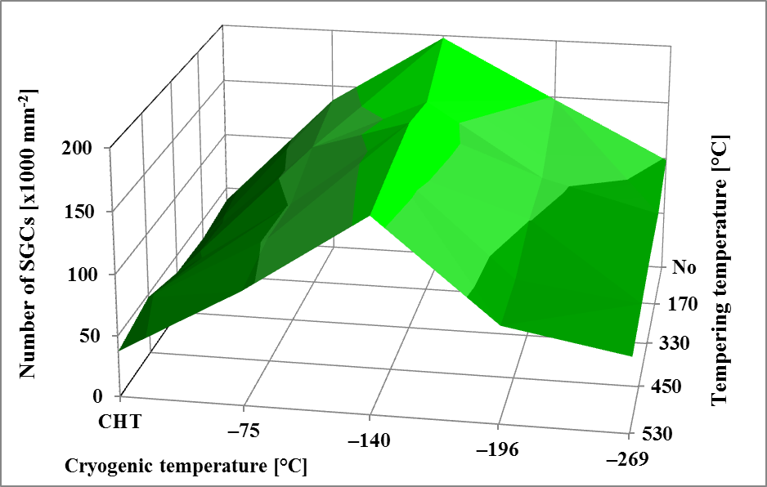
MICROSTRUCTURE
Number of SGCs in conventionally heat treated (CHT) and differently cryogenically treated Vanadis 6 steel as a function of tempering.

Slide 13
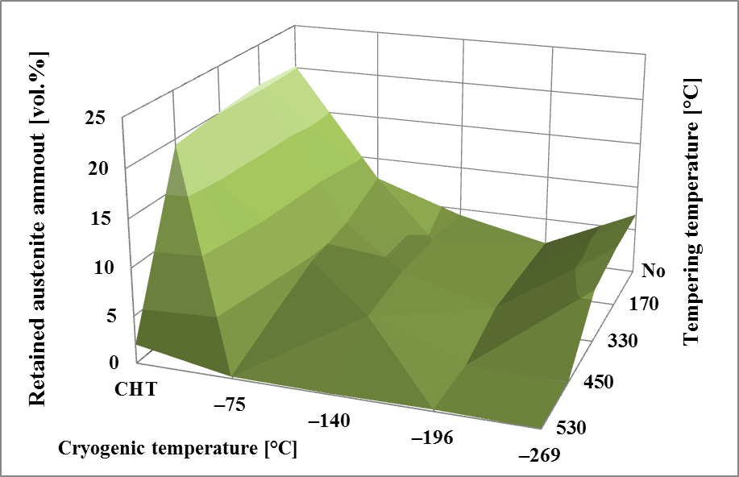
MICROSTRUCTURE
Retained austenite amounts in conventionally heat treated (CHT) and differently cryogenically treated Vanadis 6 steel as a function of tempering.

Slide 14
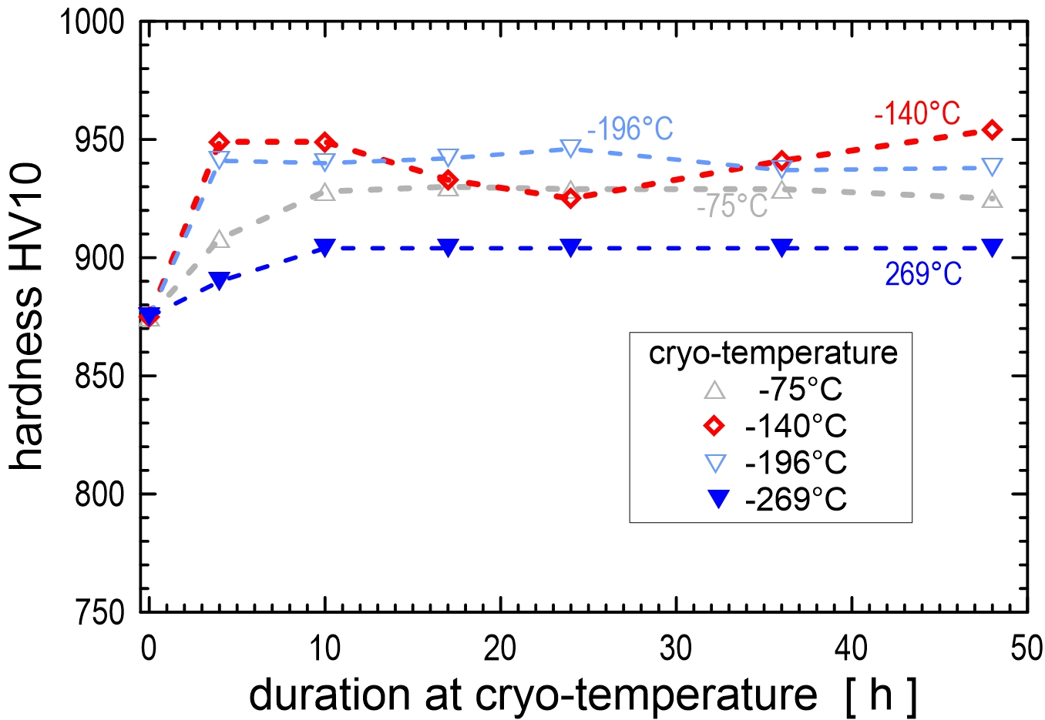
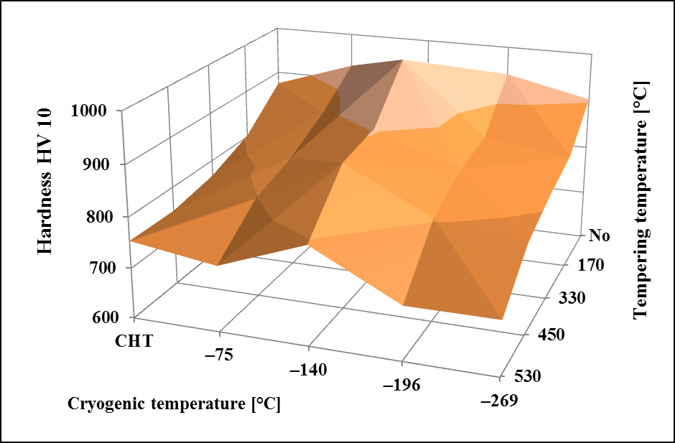
HARDNESS
Hardness HV10 dependence on the cryo-treatment duration considering four treatment temperatures. 3D diagram showing dependence of HV 10 hardness on tempering

Slide 15
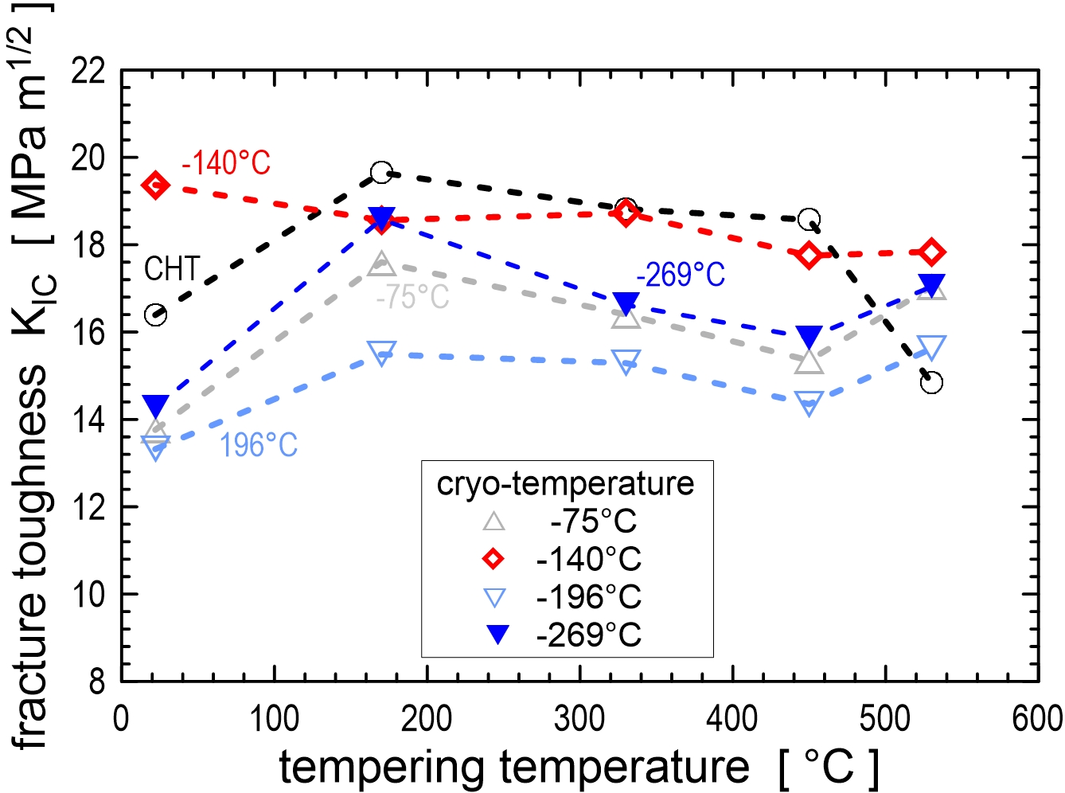
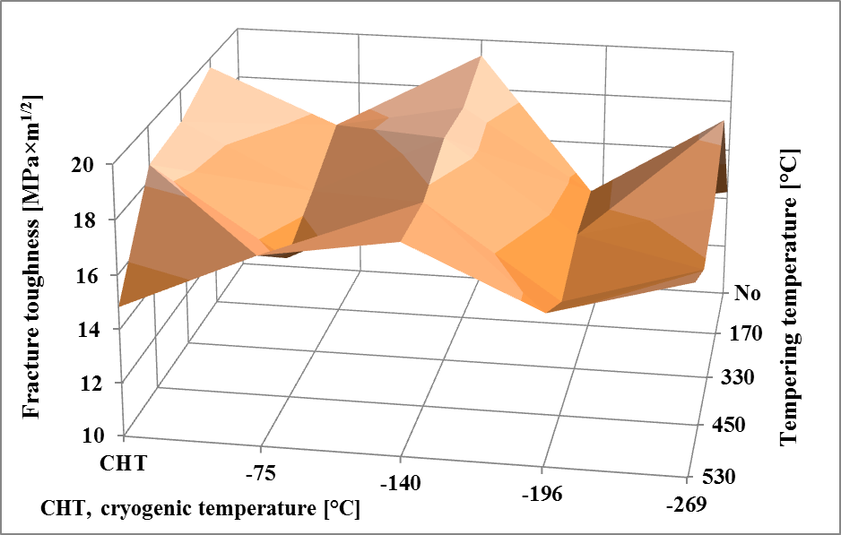
FRACTURE TOUGHNESS
Fracture toughness variations of conventionally heat treated (CHT) and differently cryogenically treated Vanadis 6 steel as a function of tempering.

Slide 16
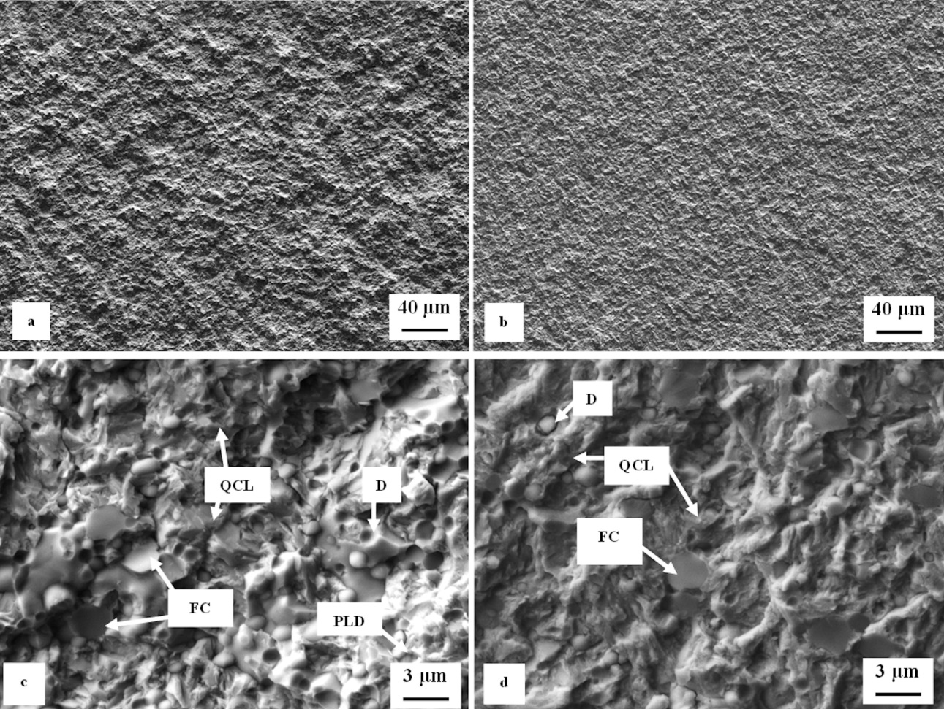
FRACTOGRAPHY
Scanning electron micrographs of the fracture surfaces of CHT fracture toughness specimens, (a) as-quenched – overview; (b) tempered at 530°C – overview; (c) as-quenched – detail; (d) tempered at 530°C – detail. PLD – plastic deformation of matrix, QCL – quasi-cleavage fracture in matrix, D – decohesive carbides, FC – fractured carbides QCL – quasi-cleavage

Slide 17
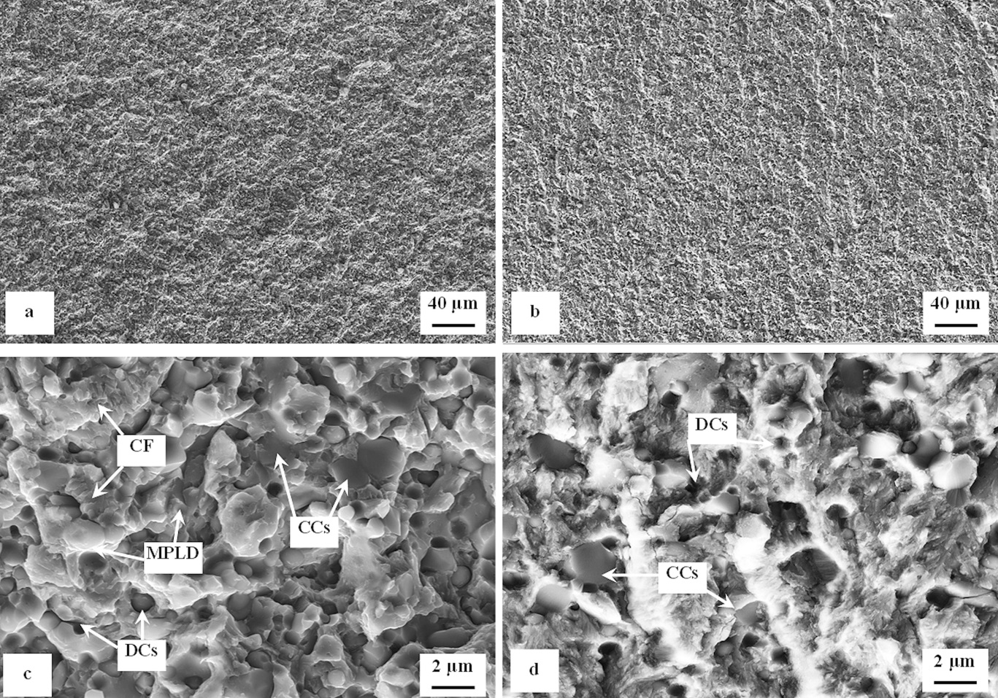
FRACTOGRAPHY
Scanning electron micrographs of the fracture surfaces of cryogenically treated (-140°C for 17 h) specimens: (a) untempered – overview; (b) tempered at 530°C – overview; (c) untempered – detail; (d) tempered at 530°C – detail. MPLD – microplastic deformation, CF-cleaved facets, DCs – decohesive carbides, CCs – cleaved carbides

Slide 18
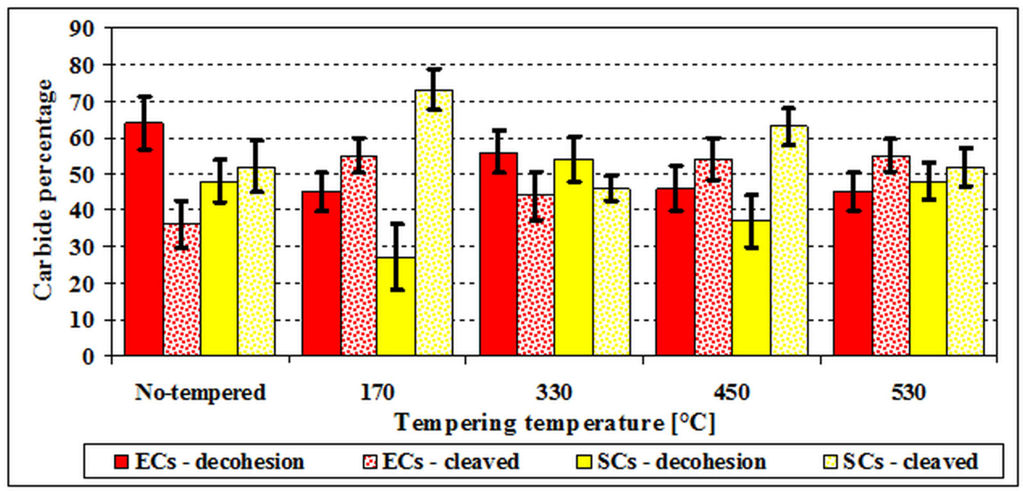
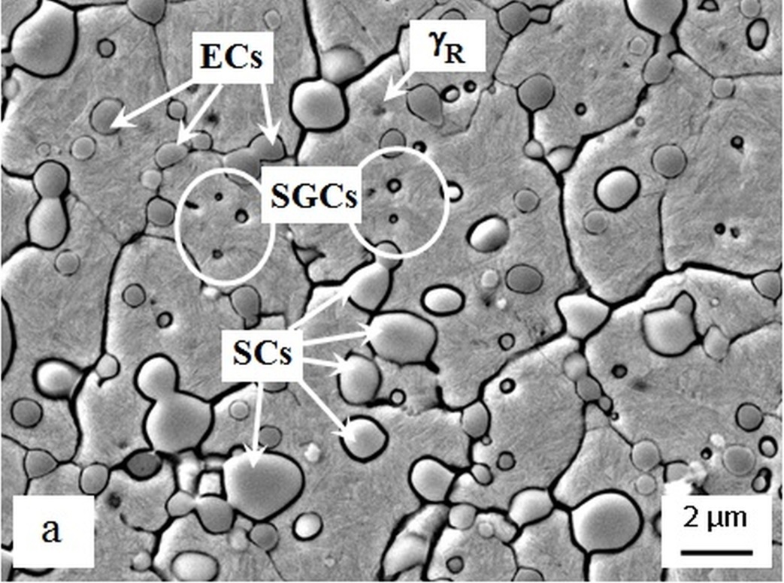
FRACTOGRAPHY
Diagram quantifying the role of different carbides (according to SEM micrograph on the right side) in the fracture micro-mechanism of CT (at -140 °C) and differently tempered specimens. SGCS (extra carbides) assist almost 100% on decohesive fracture propagation.

Slide 19
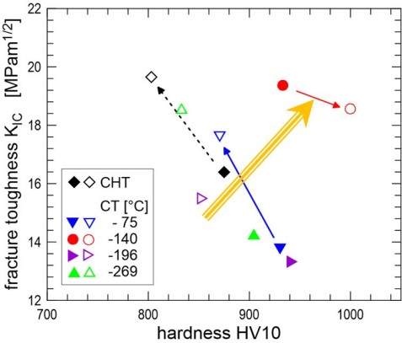
FRACTURE TOUGHNESS vs. HARDNESS
Fracture toughness-hardness relationship in untempered (filled symbols) and low-temperature tempered (170°C, empty symbols) steel. The arrows show changes due to higher tempering temperature. The "desired" goal of simultaneous fracture toughness-hardness increase is indicated by yellow arrow.

Slide 20
CONCLUSIONS
Retained austenite amounts are significantly reduced by CT; further γ_{R} reduction is induced by high-temperature tempering.
Cryogenic treatment increases the number of extra carbides; to maximize the count of these particles the treatment at -140°C should be used.
The martensite is refined by applying the cryogenic treatments; in addition, it contains lower carbon contents and enhanced number of crystal effects.
The steel hardness is increased by applying CT; this tendency is maintained also after tempering up to 450°C temperature. High-temperature tempering reduces the hardness markedly. An exception is the steel after -140°C cryogenic treatment where high hardness is maintained also after this kind of tempering.
A general fracture toughness reduction was recorded by applying CTs, except the case of high-temperature tempered steel. Only the application of -140°C cryogenic treatment resulted in comparable (with the state after CHT) or slightly higher K_{IC}.
Concomitant improvement of hardness and fracture toughness after -140°C cryogenic treatment can be related to the following distinct microstructural changes: (1) the highest number of small globular carbides (improvement of both the hardness and fracture toughness), (2) reduction of γ_{R} by transformation to martensite (improvement of hardness but reduction of fracture toughness) and (3) lower carbon content of prior-to-tempered martensite (fracture toughness increase)

Slide 21
Thank you for your attention

