Slide 1

Title: Dry sliding tribological behaviour of cryotreated Cr-V ledeburitic tool steel against CuSn6 counterpart
Authors: Venu Yarasu, Peter Jurci, Jakub Hornik.

Slide 2
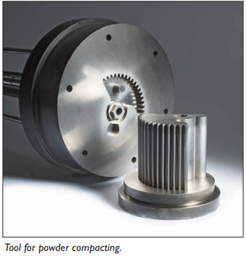
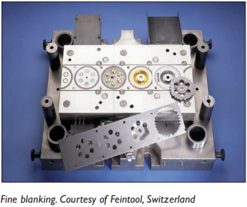
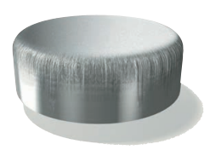
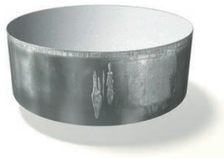
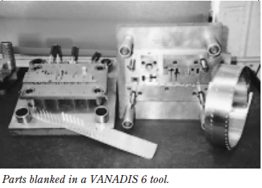
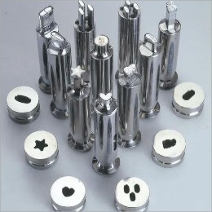
1. Introduction
Also known as Vanadis 6
Fabricated by PM route
Popular in Cold Work applications
Supplied in soft annealed condition
Applications:
Cr-V ledeburitic tool steel
Powder compaction
Blanking
Failures or Wear types:
Punches, etc
3. a combination of both
1. Abrasive
2. Adhesive or Galling
Motivation
Source: UDDEHOLM TOOL STEELS
Source: UDDEHOLM TOOL STEELS
Source: IndiaMarket

Slide 3
1. Introduction: Heat treatment
Conventional Heat-treatment
Cryogenic Treatment
CHT
CT
Austenitization
Austenitization
Vacuum gas quenching
Temperature
Vacuum gas quenching
Temperature
Tempering
Tempering
Tempering
Tempering
Time
Time
Cryogenic Treatment
Concern of CHT:
Higher amounts of retained austenite (γ_{R}).
About 20-30 %.
Advantages of CT:
Reduction of retained austenite (γ_{R}) amount.
Refinement of martensite.
Increase in population density of small globular carbides (SGCs).
And finally, increase in the amount of nano-sized transient carbide precipitates.

Slide 4
2. Material and Treatments: Process conditions
Material composition
%C | %Si | %Mn | %Cr | %Mo | %V | Fe
2.1 | 1.0 | 0.4 | 6.8 | 1.5 | 5.4 | Bal.
Hardening
Austenitization
1050 °C
Gas quenching
5 bar
30 mins
Cryogenic treatment
-75 °C
-140 °C
-196 °C
17 hrs
170 °C
530 °C
Double Tempering
2 hrs

Slide 5
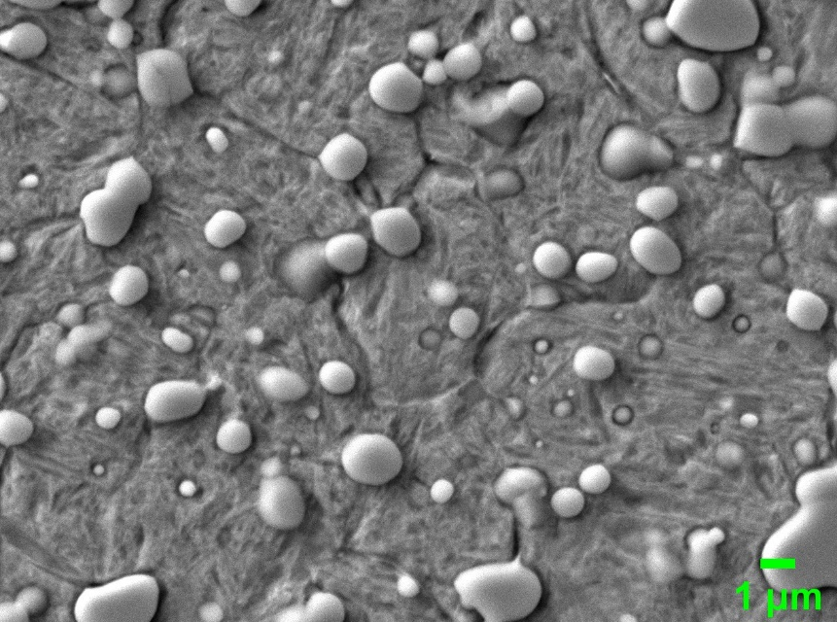
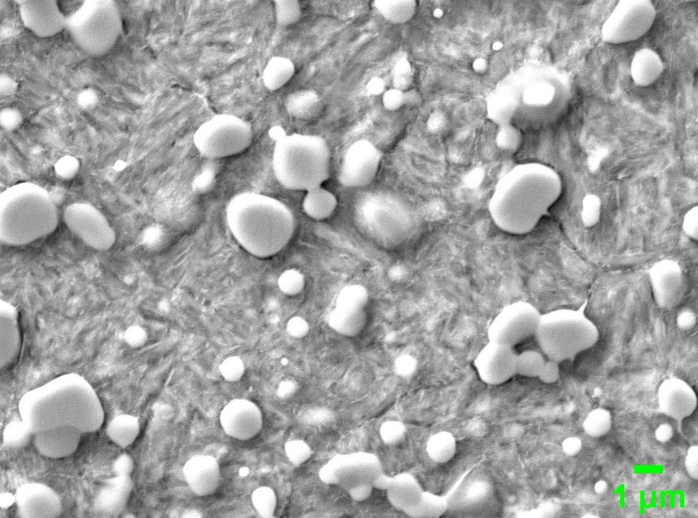
2. Material and Treatments: Microstructure
Microstructure after tempering at 170 °C
Microstructure after tempering at 530 °C
-75 °C
-75 °C
TM
SGCs
SCs
TM
SGCs
SCs
ECs
ECs
a)
b)
TM: Tempered martensite
SCs: Secondary carbides (M₇C₃, Cr-rich)
ECs: Eutectic carbides (MC, V-rich)
SGCs: Small globular carbides (M₃C, cementite)

Slide 6
2. Material and Treatments: Hardness
Mean Hardness
Change over CHT
HV.10
%
STD.D
Range: ± 2-6

Slide 7
2. Material and Treatments: Small Globular Carbides (SGCs)
Population densities of SGCs (x1000 mm⁻²)
Improvement over CHT in %
STD.D
Range: ± 0.4-2.8
Source:
Materials Characterization 134 (2017) 398–415
Vacuum 170 (2019) 108977 & Materials 2019, 12, 3827

Slide 8
3. Experimental Procedures
PIN-ON-DISK WEAR TESTING
01
CuSn6 6 mm diameter balls
Sliding distance of 100 Meters
Dry sliding wear tests at room temperature
OPTIMIZATION TECHNIQUE
02
Taguchi Method
L18 orthogonal design
Lower the better quality
CONTROL FACTROS
Cryogenic temperature
Tempering temperature
Sliding velocity
Load
03
Level | Tempering temp (°C) | Sub-zero temp (°C) | Sliding velocity (m/s) | Load (N)
1 | 170 | -75 | 0.064 | 1
2 | 530 | -140 | 0.128 | 5
3 |  | -196 | 0.1885 | 10
FACTOR LEVELS
04
Mixed levels

Slide 9
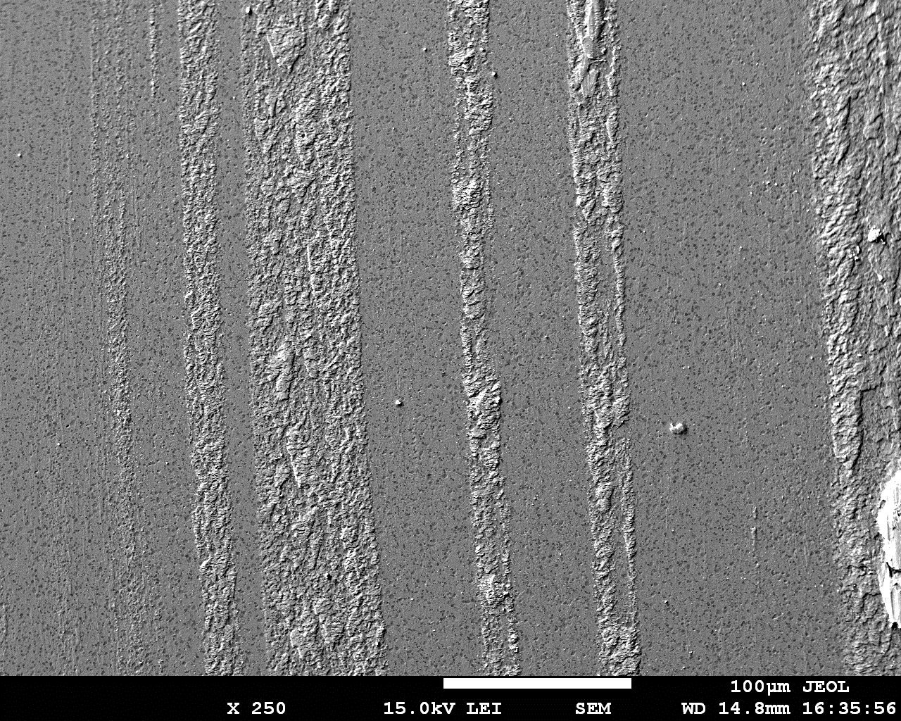
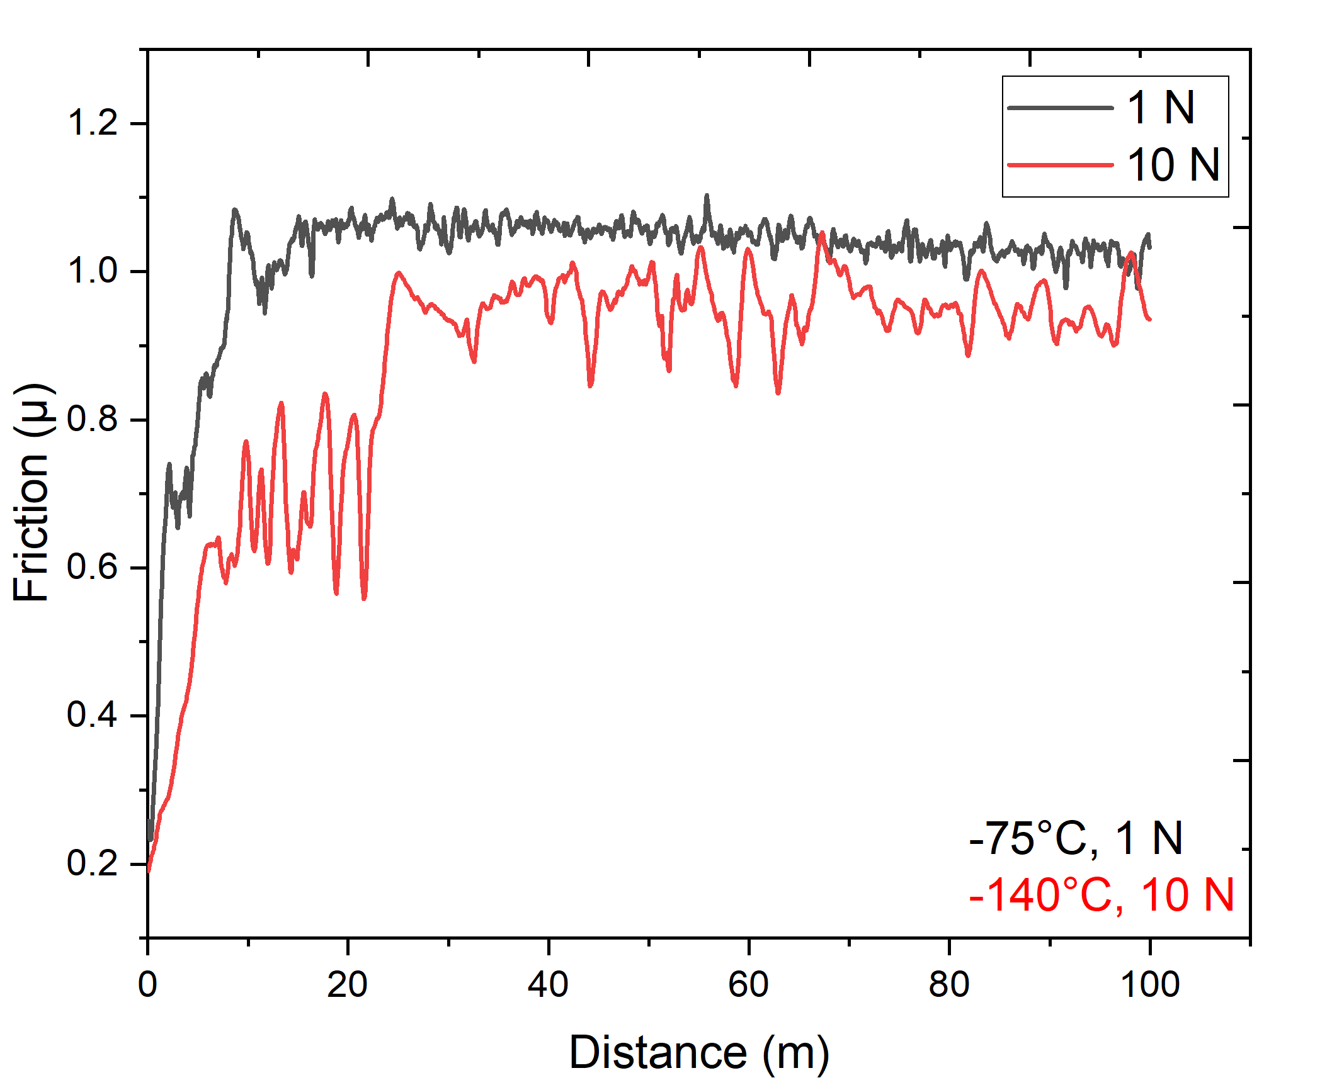
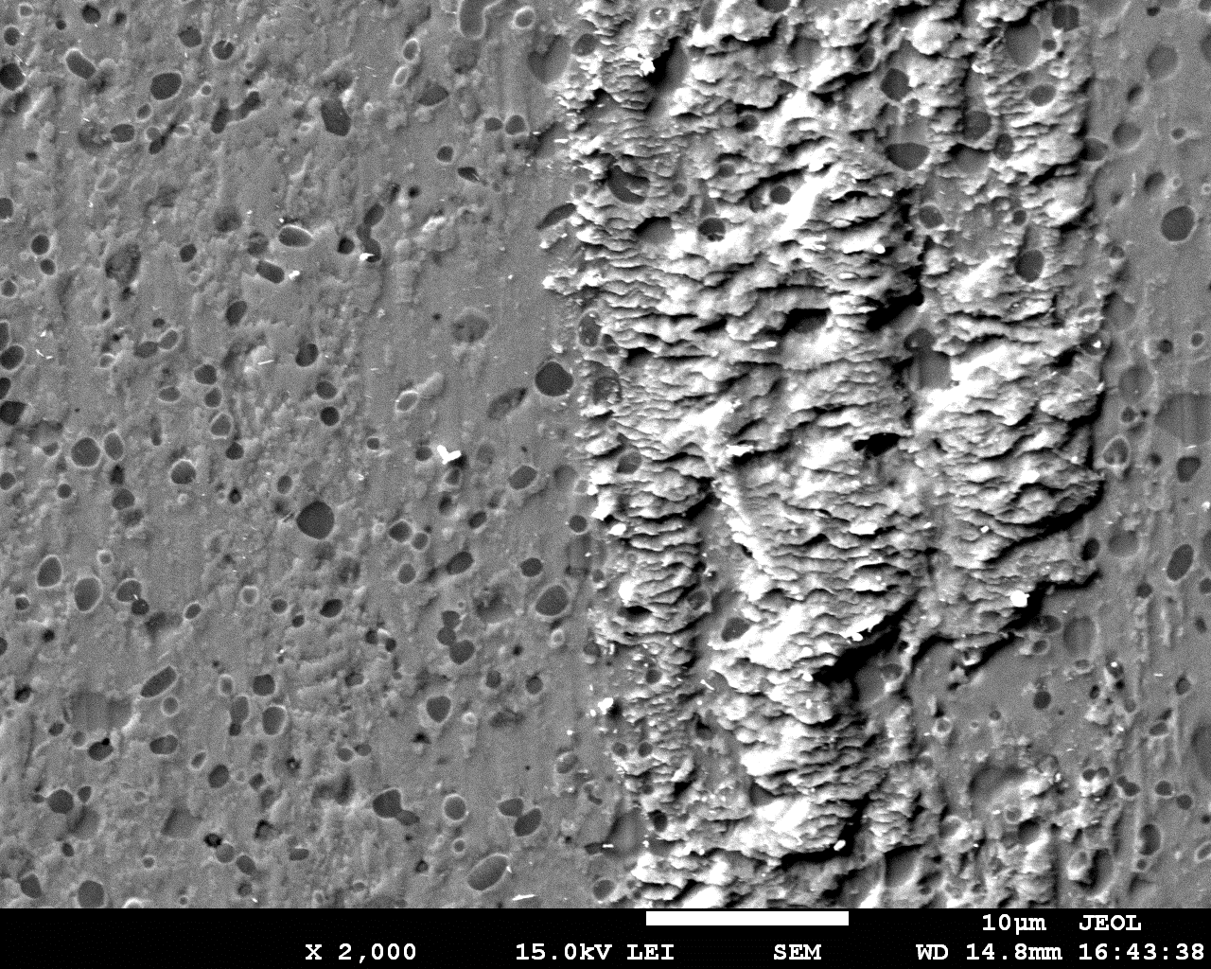

4. Results
Friction Coefficient (µ) – Response 1
Adhesion (% ) – Response 2
Friction Coefficient (µ)
Where:
F = Frictional force
N = Normal applied load
$$μ=\frac{F}{N}$$
Estimated on:
12 random SEM images of wear tracks
Area % covered by counterpart material

Slide 10
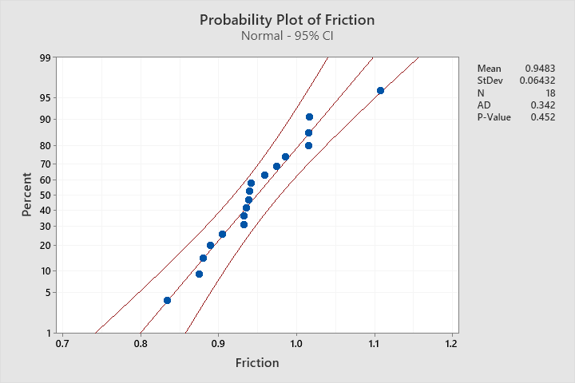
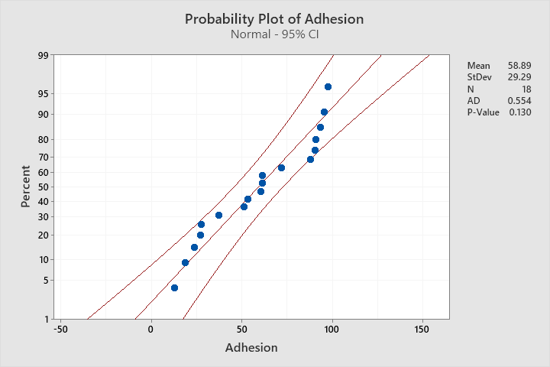
4. Results: Normality tests
Friction Coefficient (µ)
Adhesion (%)

Slide 11
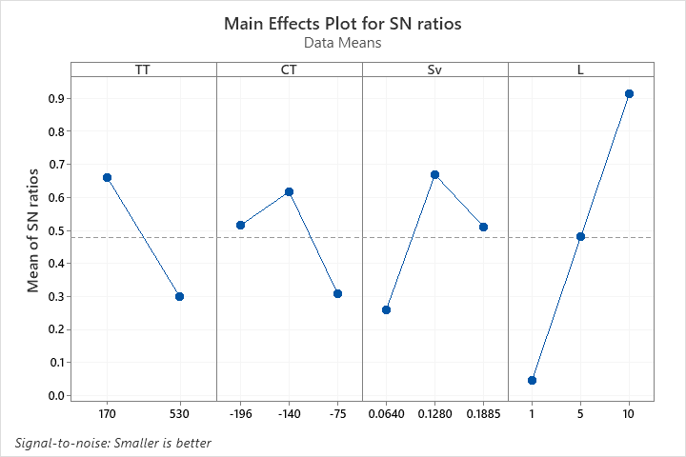
4. Results: SN Ratios
Experimental Result's
Main Effects Plot for SN ratios
FC
FC
Tempering (°C) | Cryotreatment (°C) | Sliding Velocity (m/s) | Load (N) | Friction Coefficient (µ)
170 | -75 | 0.064 | 1 | 1.107
170 | -75 | 0.128 | 5 | 0.904
170 | -75 | 0.1885 | 10 | 0.834
170 | -140 | 0.064 | 1 | 0.932
170 | -140 | 0.128 | 5 | 0.889
170 | -140 | 0.1885 | 10 | 0.875
170 | -196 | 0.064 | 5 | 0.932
170 | -196 | 0.128 | 10 | 0.880
170 | -196 | 0.1885 | 1 | 1.016
530 | -75 | 0.064 | 10 | 0.941
530 | -75 | 0.128 | 1 | 1.015
530 | -75 | 0.1885 | 5 | 1.015
530 | -140 | 0.064 | 5 | 0.985
530 | -140 | 0.128 | 10 | 0.939
530 | -140 | 0.1885 | 1 | 0.974
530 | -196 | 0.064 | 10 | 0.938
530 | -196 | 0.128 | 1 | 0.935
530 | -196 | 0.1885 | 5 | 0.959

Slide 12
4. Results: ANOVA
ANOVA Table
Significant Factors [p<0.05]
FC
FC
Source | DF | Seq SS | Adj SS | Adj MS | F | P | %C
TT | 1 | 0.5934 | 0.5934 | 0.5934 | 2.84 | 0.123 | 10.3
CT | 2 | 0.2996 | 0.2996 | 0.1498 | 0.72 | 0.512 | 5
Sv | 2 | 0.5106 | 0.5106 | 0.2553 | 1.22 | 0.335 | 9
L | 2 | 2.2564 | 2.2564 | 1.1282 | 5.39 | 0.026 | 39.2
Residual Error | 10 | 2.0914 | 2.0914 | 0.2091
Total | 17 | 5.7514
NOTES
DF: degrees of freedom
Seq SS: Sequential sum of squares
Adj SS: adjusted sum of squares
F: statistic
P: probability

Slide 13
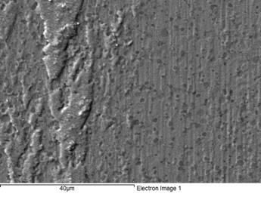
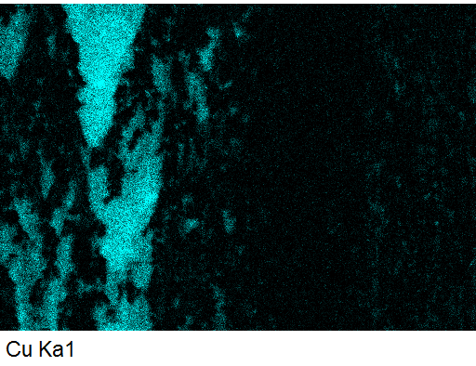
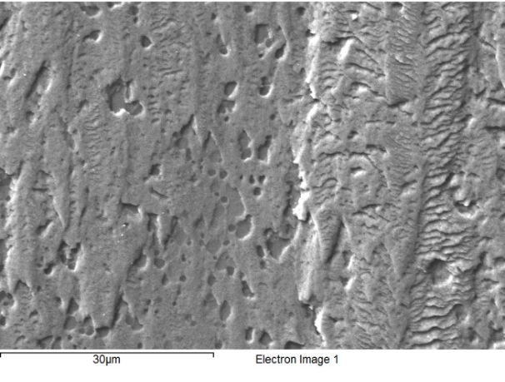
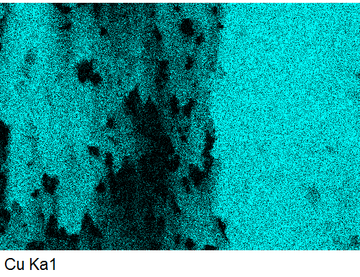
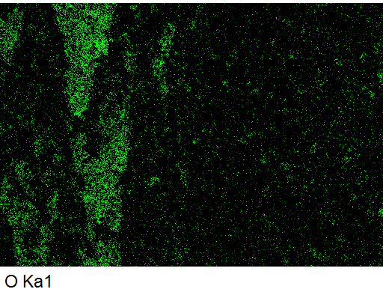
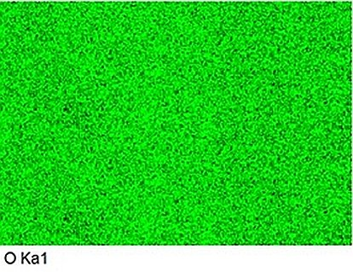
4. Results: X-ray Spectroscopy
EDS Map after tribo-test at 1 N
EDS Map after tribo-test at 10 N
FC
FC
Process
Process
CT: -196 °C
Tempering treatment: 530 °C
CT: -75 °C
Tempering treatment: 170 °C

Slide 14
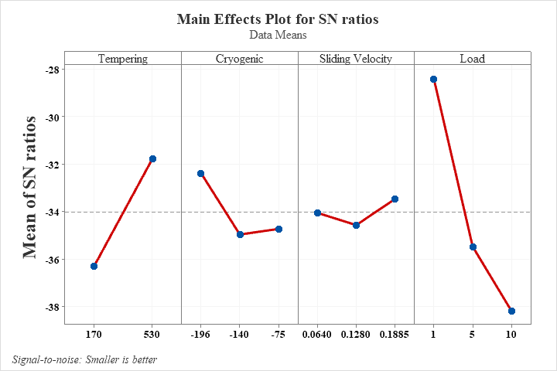
4. Results: SN Ratios
Experimental Result's
Main Effects Plot for SN ratios
Adhesion
Adhesion
Tempering (°C) | Cryotreatment (°C) | Sliding Velocity (m/s) | Load (N) | Adhesion (%) | Std.E
170 | -75 | 0.064 | 1 | 37.0 | 5.0
170 | -75 | 0.128 | 5 | 90.9 | 1.8
170 | -75 | 0.1885 | 10 | 93.2 | 0.6
170 | -140 | 0.064 | 1 | 61.0 | 2.7
170 | -140 | 0.128 | 5 | 90.3 | 1.6
170 | -140 | 0.1885 | 10 | 97.3 | 0.5
170 | -196 | 0.064 | 5 | 71.7 | 2.2
170 | -196 | 0.128 | 10 | 95.2 | 0.7
170 | -196 | 0.1885 | 1 | 18.6 | 1.0
530 | -75 | 0.064 | 10 | 60.3 | 3.1
530 | -75 | 0.128 | 1 | 27.2 | 1.3
530 | -75 | 0.1885 | 5 | 51.0 | 4.5
530 | -140 | 0.064 | 5 | 27.4 | 2.5
530 | -140 | 0.128 | 10 | 88.0 | 0.8
530 | -140 | 0.1885 | 1 | 23.8 | 1.3
530 | -196 | 0.064 | 10 | 61.4 | 4.4
530 | -196 | 0.128 | 1 | 12.5 | 0.7
530 | -196 | 0.1885 | 5 | 53.3 | 1.6

Slide 15
4. Results: ANOVA
ANOVA Table
Significant Factors [p<0.05]
Adhesion
Adhesion
Source | DF | Seq SS | Adj SS | Adj MS | F | P | %C
TT | 1 | 92.071 | 92.071 | 92.071 | 10.27 | 0.009 | 18.0
CT | 2 | 24.271 | 24.271 | 12.136 | 1.35 | 0.302 | 4.7
Sv | 2 | 3.657 | 3.657 | 1.828 | 0.2 | 0.819 | 0.7
L | 2 | 302.303 | 302.303 | 151.152 | 16.87 | 0.001 | 59.1
Residual Error | 10 | 89.621 | 89.621 | 8.962
Total | 17 | 511.924
NOTES
DF: degrees of freedom
Seq SS: Sequential sum of squares
Adj SS: adjusted sum of squares
F: statistic
P: probability

Slide 16
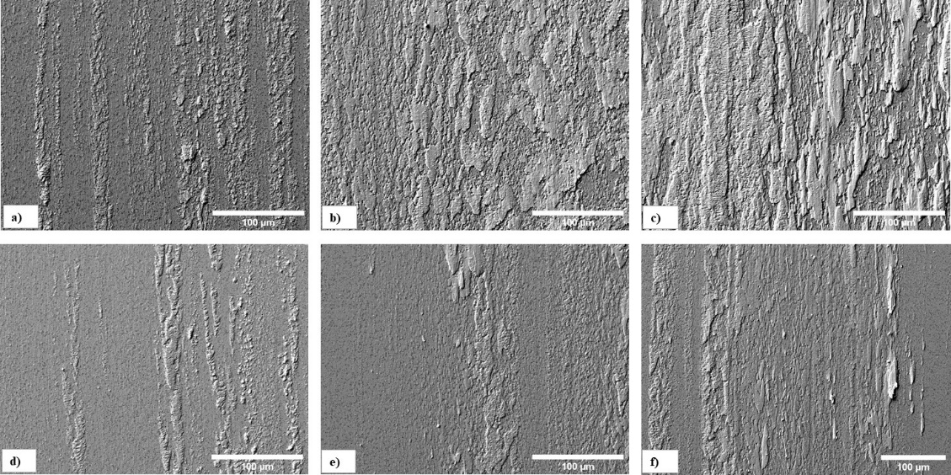
4. Results: Exposed Surface Analysis
- With increase in load, adhesion increase irrespective of SZTs.
- Adhesion decreases when higher tempering temperature used (530°C)
Figure: Plan-view SEM micrographs showing exposed surfaces of specimens treated at temperature of -75°C, and tempered at 170 °C after testing at (a) 1 N, (b) 5 N, and (c) 10 N, tempered at 530 °C (d) 1 N, (e) 5 N, and (f) 10 N.

Slide 17
5. Conclusions
Cryogenic treatment at -140°C followed by tempering at 170°C obtained higher hardness values.
Cryogenic treatment at -140°C followed by tempering at 530°C produced the lower hardness values.
Tempering temperature (170 °C), sub-zero temperature (-140 °C), sliding velocity (0.128 m/s), and load (10 N) are the best factors for friction coefficient.
  Due to, formation of continuous oxidized adhesive layer which may act as a lubricant.
The only significant factor for friction coefficient is load (39.2 %); however, tempering temperature contributes (10.3 %).

Slide 18
5. Conclusions
For counterpart adhesion, the optimum settings were: tempering temperature (530 °C), sub-zero temperature (-196 °C), sliding velocity (0.1885 m/s), and normal load (1 N).
  Mainly, attribute to lower hardness and population densities of small globular carbides (SGCs) when tempered at 530°C.
Load (59.1%) is the main significant factor for adhesion which is having highest contribution, followed by tempering temperature (18%).

Slide 19

Thank you for your attention!

