Slide 1

Direct energy deposition of H13 tool steel on CuBe alloy substrate
UNIVERSITÀ DEGLI STUDI DI TRENTO
Department of Industrial Engineering
Zhao Zhao, Massimo Pellizzari, Matteo Perini, Paolo Bosetti

Slide 2
Motivations & benefits

Slide 3
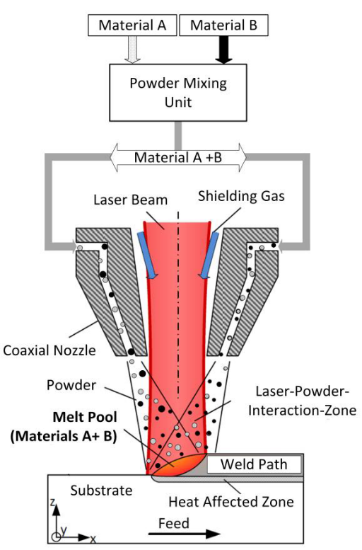
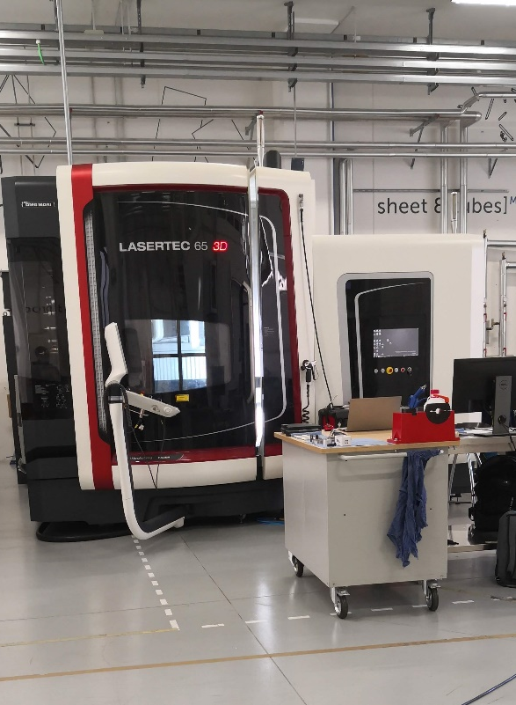
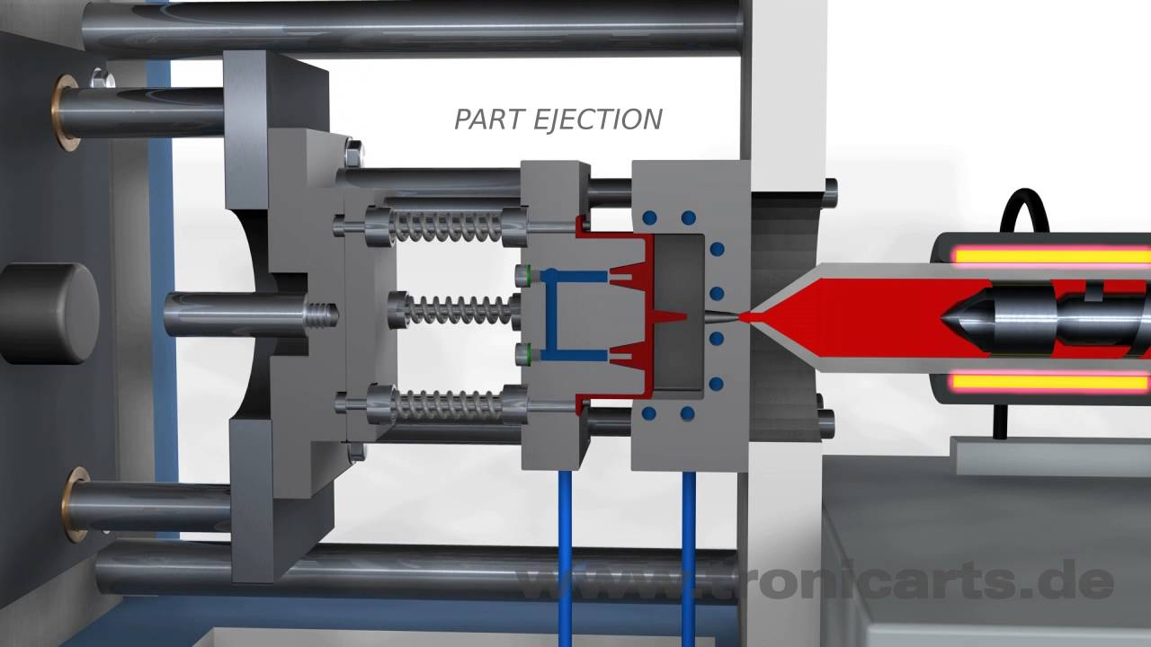
1. Background and motivations
Innovational design of plastic injection mold
Direct energy deposition (DED)
Mold

Slide 4

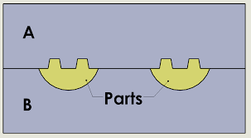
1. Background and motivations
Properties of mold materials
Comprehensive comparison of molds
 | Hardness HV0.1 | Wear Resistance | Corrosion Resistance | Thermal Conductivity W/m.K
H13 | 800 | Excellent | Poor | 26
CuBe | 400 | Medium | Excellent | 145
Schematic of the H13 tool steel cladded mold
Copper-Beryllium alloy
Redesign
H13
H13
DED
Copper-Beryllium alloy

Slide 5
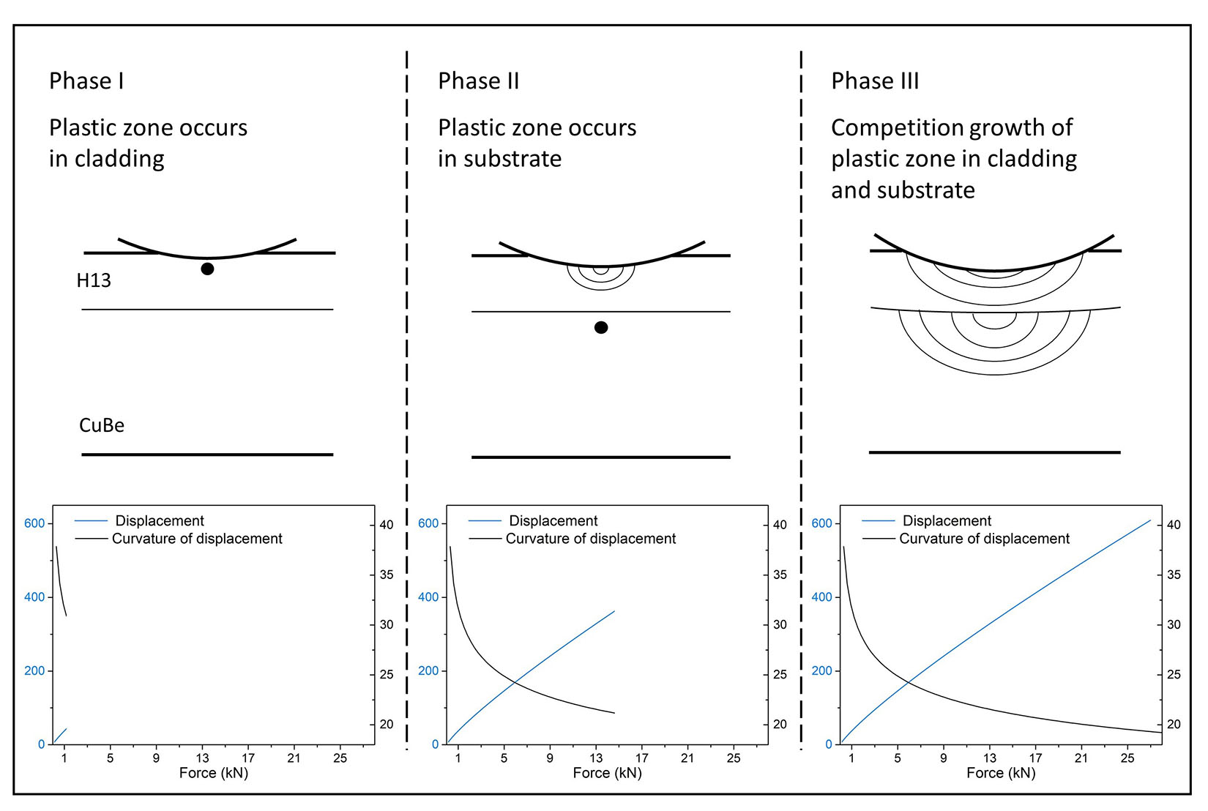
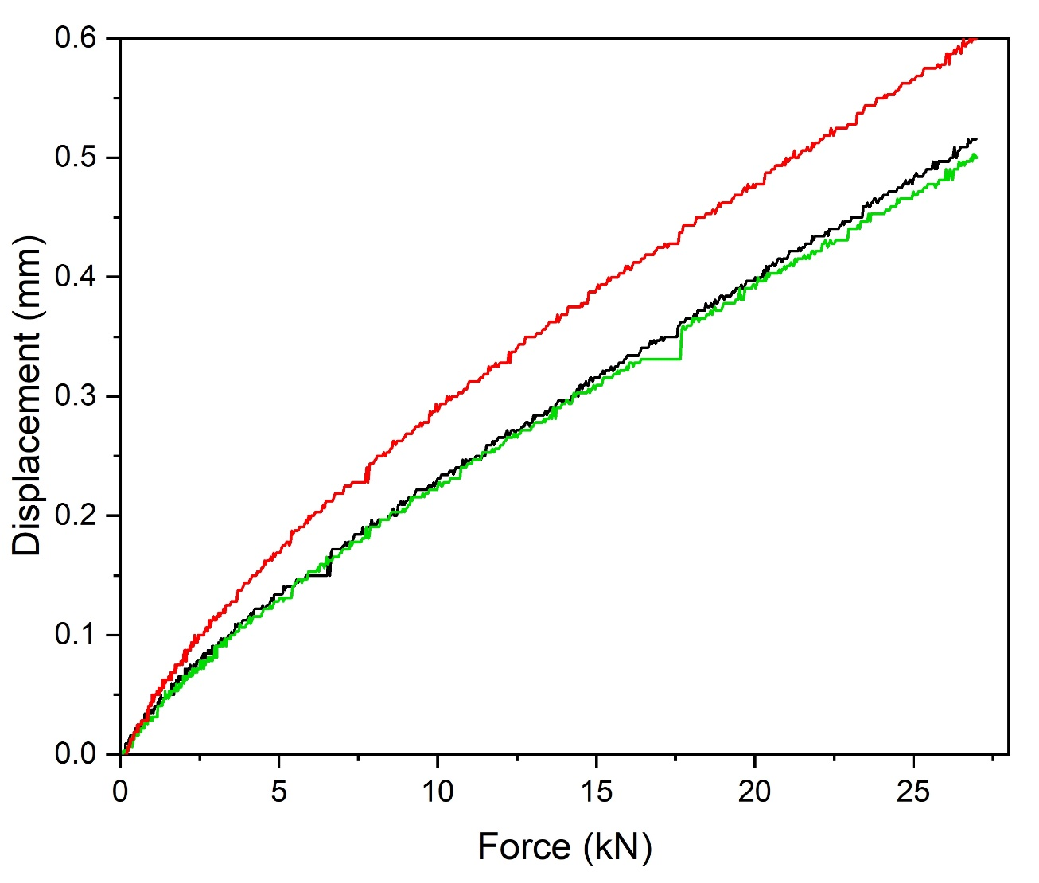
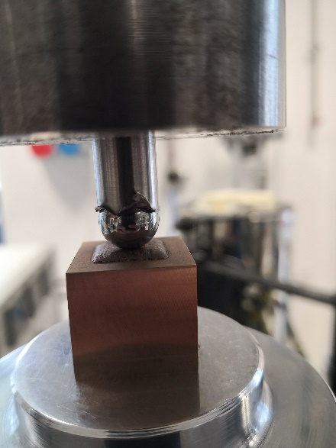
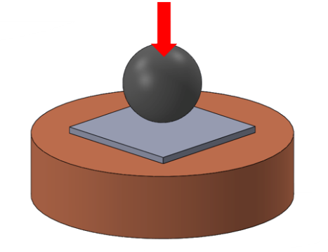
2. Load-bearing capability
CuBe
4 mm
CuBe
20 mm
4 mm cladding
H13

Slide 6
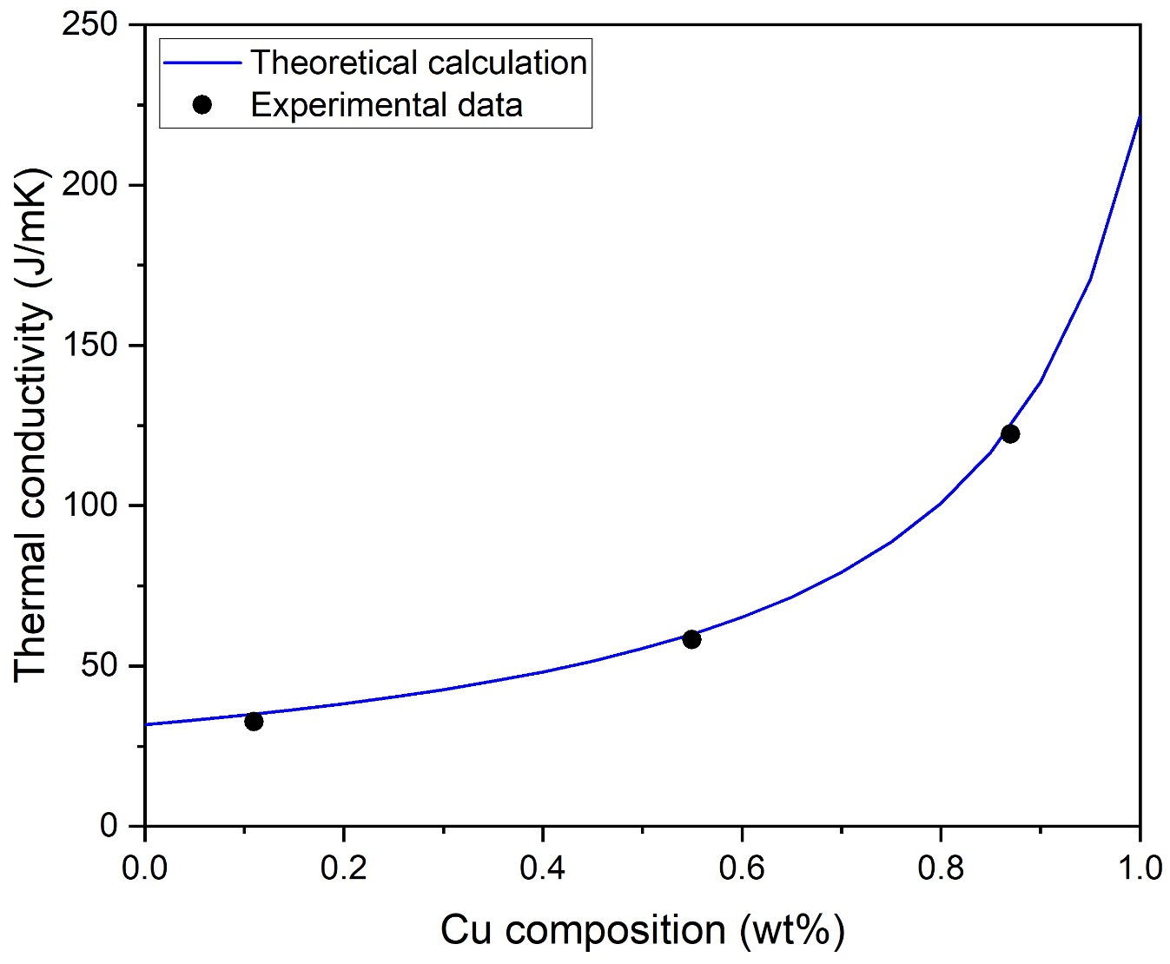


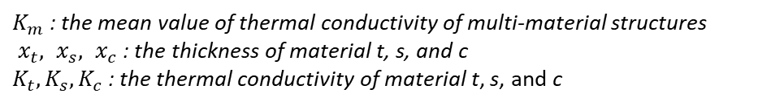


3. Thermal conductivity
t
s
c
500°C
CuBe
$$x_{t}$$
$$x_{s}$$
$$x_{c}$$
$K_{m}=\frac{K_{t}∙K_{s}∙K_{c}(x_{t}+x_{s}+x_{c})}{K_{s}∙K_{c}∙x_{t}+K_{t}∙K_{s}∙x_{c}+K_{t}∙K_{c}∙x_{s}}$ [1]
H13
$K_{m}$ : the mean value of thermal conductivity of multi-material structures
$x_{t}, x_{s}, x_{c}$ : the thickness of material t, s, and c
$K_{t}, K_{s},K_{c}$ : the thermal conductivity of material t, s, and c
[1] Zhang X, Sun C, Pan T, et al. Additive manufacturing of copper–H13 tool steel bi-metallic structures via Ni-based multi-interlayer[J]. Additive Manufacturing, 2020, 36: 101474.

Slide 7
4. Balance between lifespan and productivity
Load-bearing capability
Thermal conductivity
H13 Cladding thickness ratio
Notes:
A BOX, REMVOE

Slide 8
Challenge: cracking elimination

Slide 9
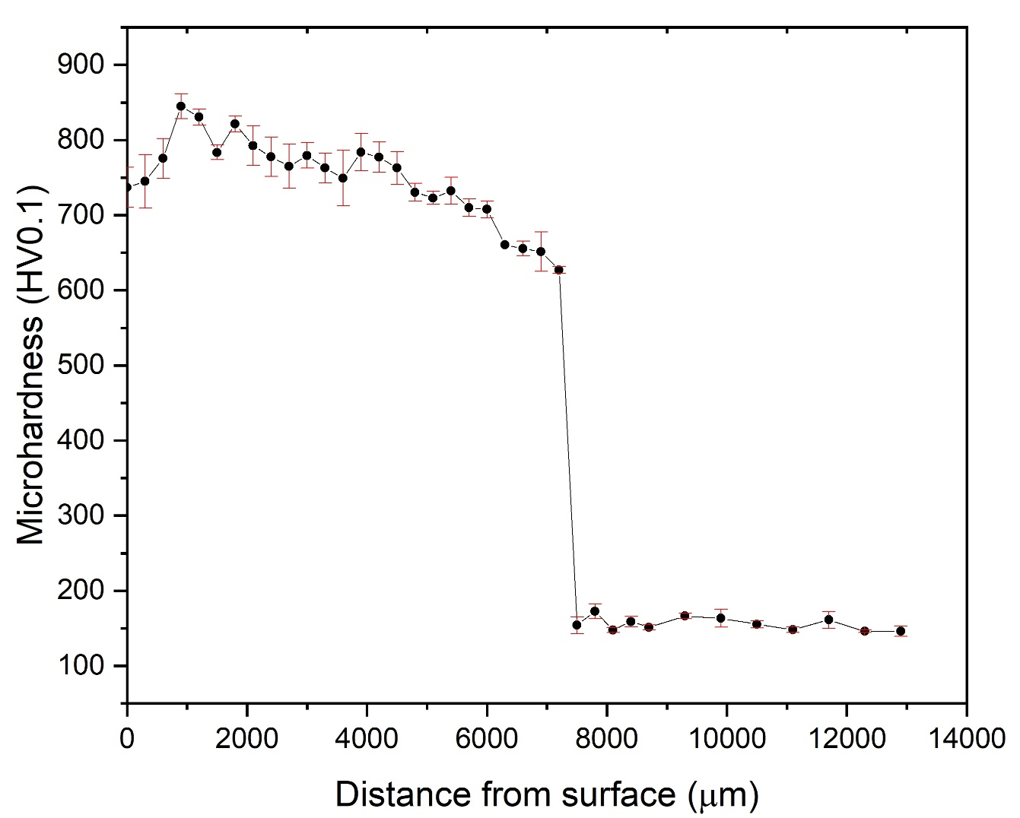
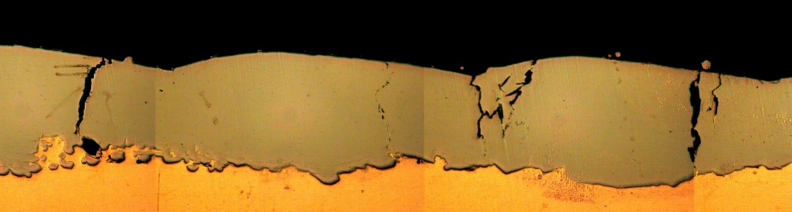
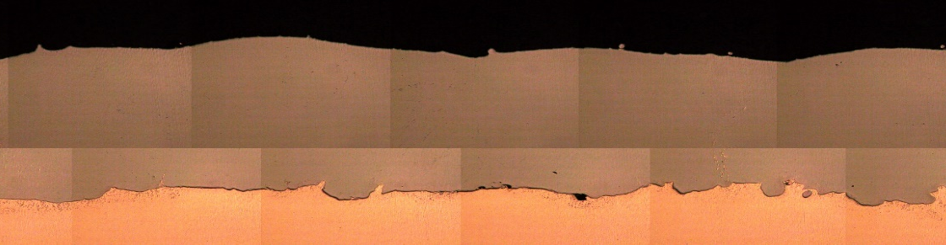
5. Cracking elimination – Substrate preheating
5-layer H13 cladding using substrate preheating at 250°C
Single-layer H13 without preheating
Average hardness of CuBe
Over aging
Single-layer H13 with 250° preheating
H13
CuBe
Notes:
CHANGE SINGLE LAYER
MOVE SOME CURVE

Slide 10

6. Experimental design – clues from preheating
Preheating:
Reduction of thermal stress during solidification
Hot cracking?
Avoiding of volumetric change induced by martensite transformation during deposition
Cold cracking?
Main driver?

Slide 11


7. Cracking investigation – SS316 buffer
Single layer
Similar coefficient of thermal expansion: SS316 vs CuBe
SS316L
CuBe Substrate
Less thermal stress
No martensite transformation in SS316
Verifying the cracking mechanism
Double layer
H13
SS316L
H13
SS316L
CuBe Substrate
Martensite transformation plays no role on cracking

Slide 12
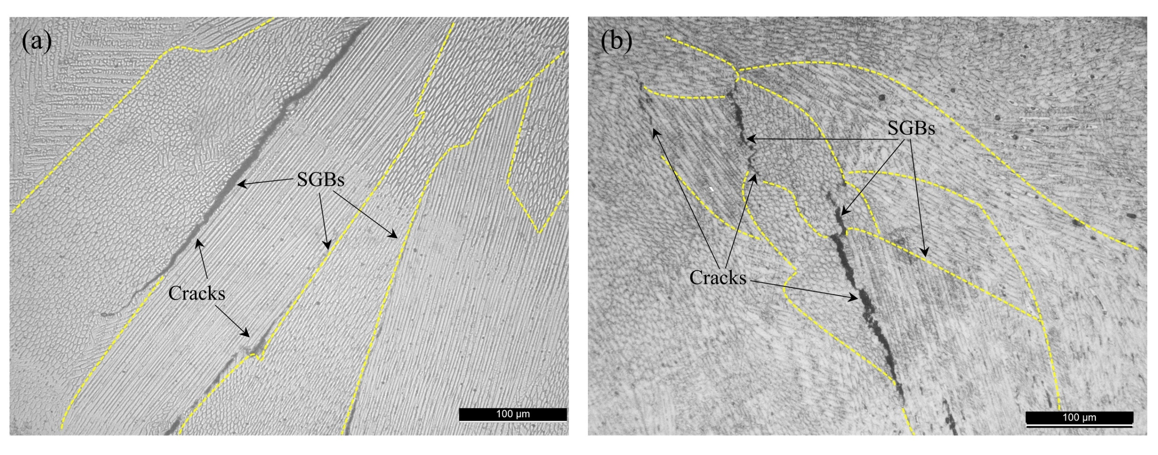
7. Cracking investigation – H13 vs SS316L
SL-2 SS316L cladding
DL-5 H13 cladding

Slide 13
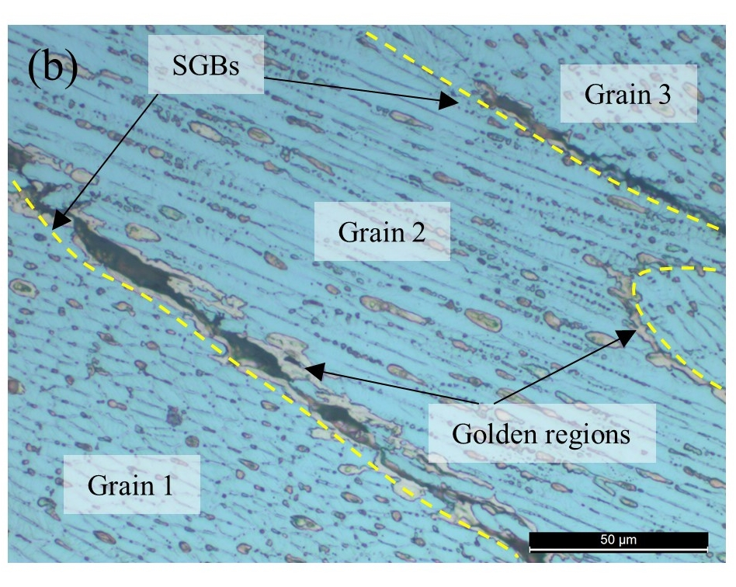
7. Cracking investigation – existence of liquid film
EDS map in H13 cladding
Fe
Cr
Cu

Slide 14
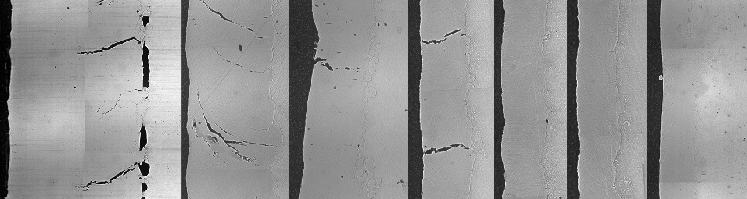
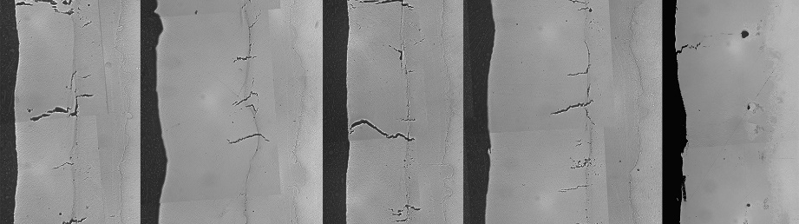
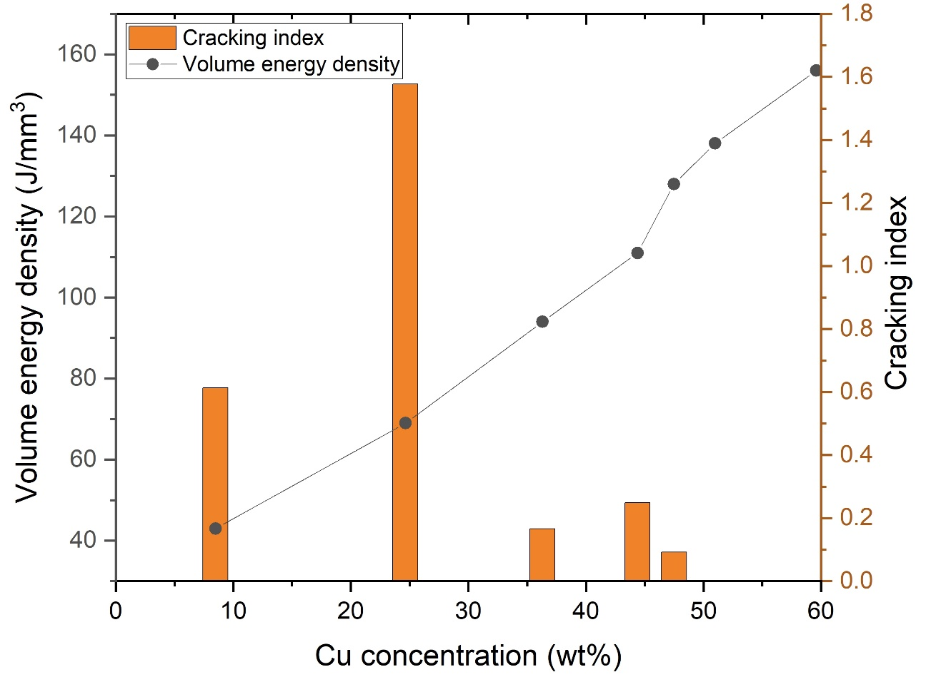
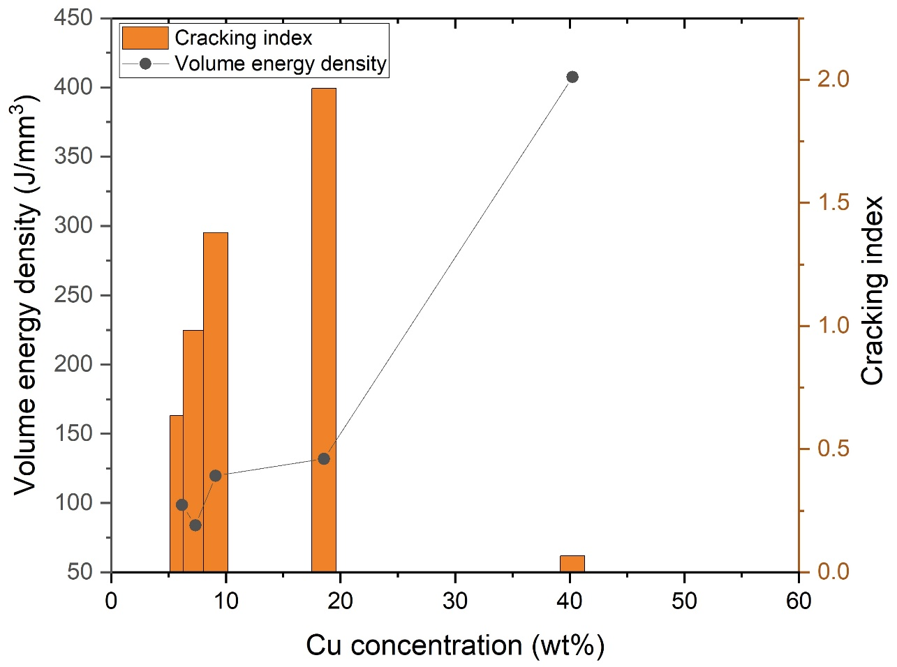
7. Cracking investigation – dimensionless cracking index
SS316
H13
Cu concentration increases
Cu concentration increases
Crack free
Notes:
CHANGE THE PLOT

Slide 15
7. Cracking investigation – Clues
Martensite transformation has no effect on cracking
Cracking exists both in SS316 and H13
The cracking tendency in SS316 and H13 is similar
Main elements are Fe and Cu
Cracks are located at solidification grain boundaries
Existence of liquid film
Cracks occur during solidification in the liquid state
Solidification cracking

Slide 16
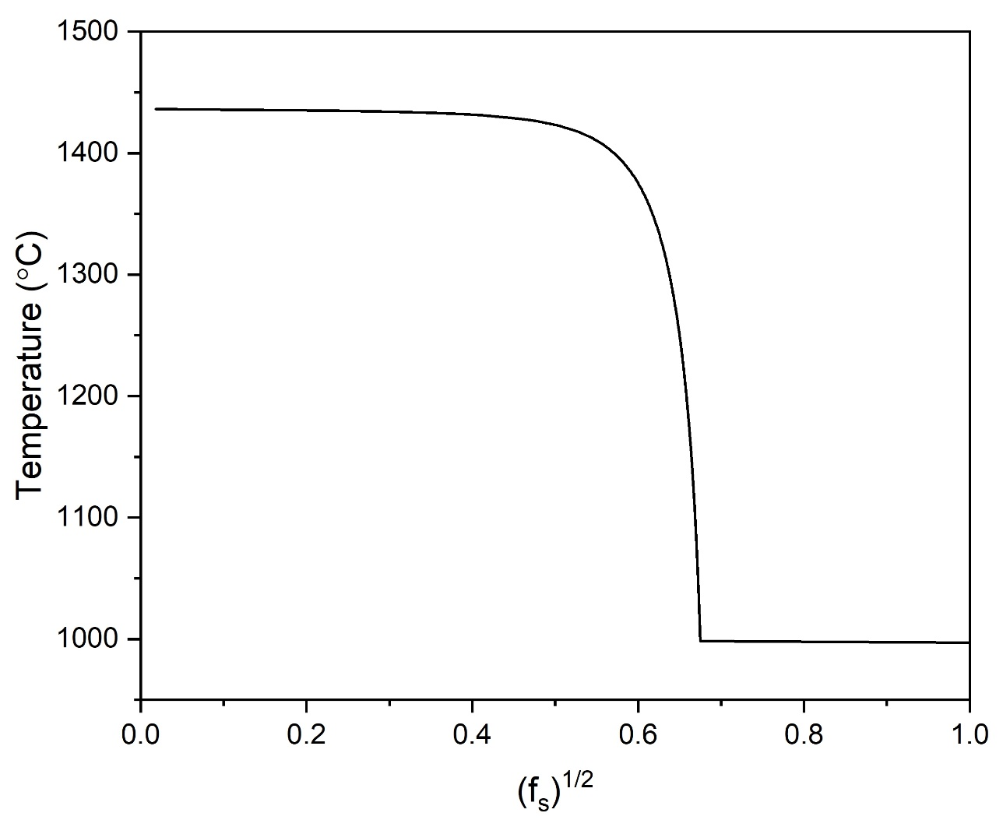
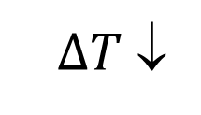

7. Cracking investigation – cracking tendency
Scheil solidification model – Fe-Cu binary system
$∆T$ ↓
Terminal liquid ↑
Solidification temperature range $∆T$
Terminal liquid
Cracking tendency ↓
40Fe-60Cu
Kou S. A criterion for cracking during solidification[J]. Acta Materialia, 2015, 88: 366-374.

Slide 17
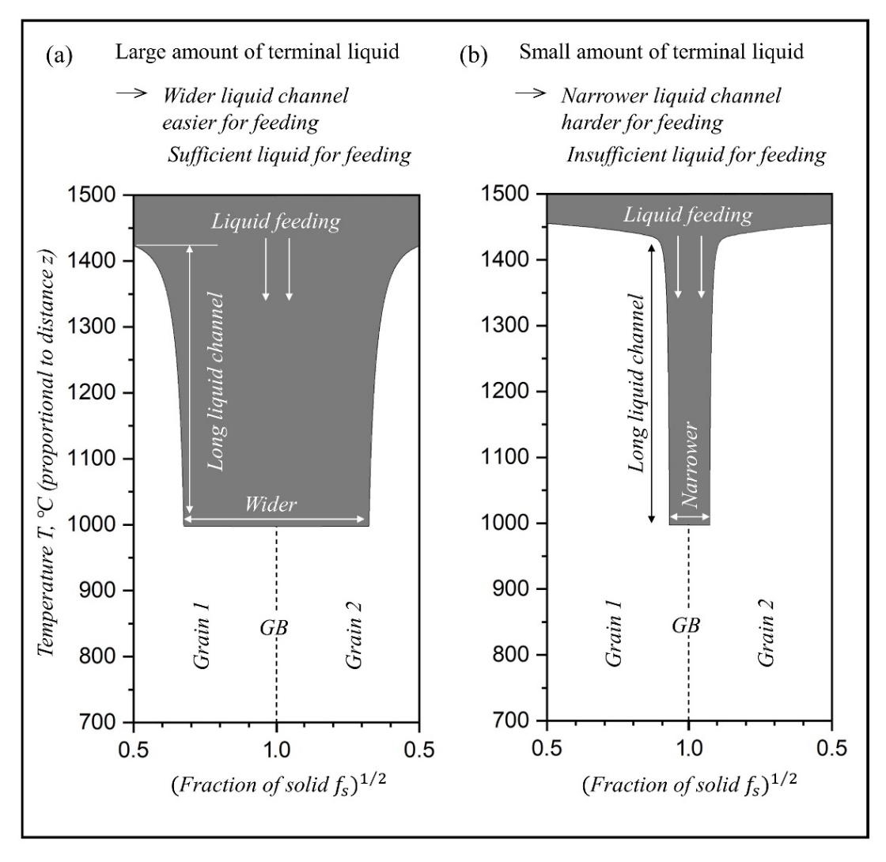
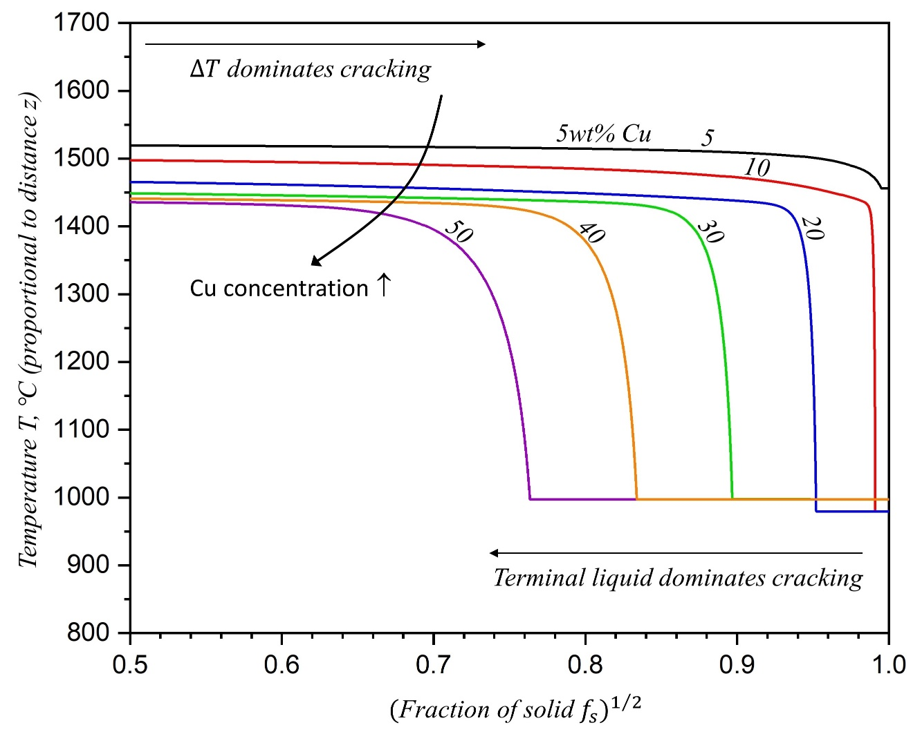
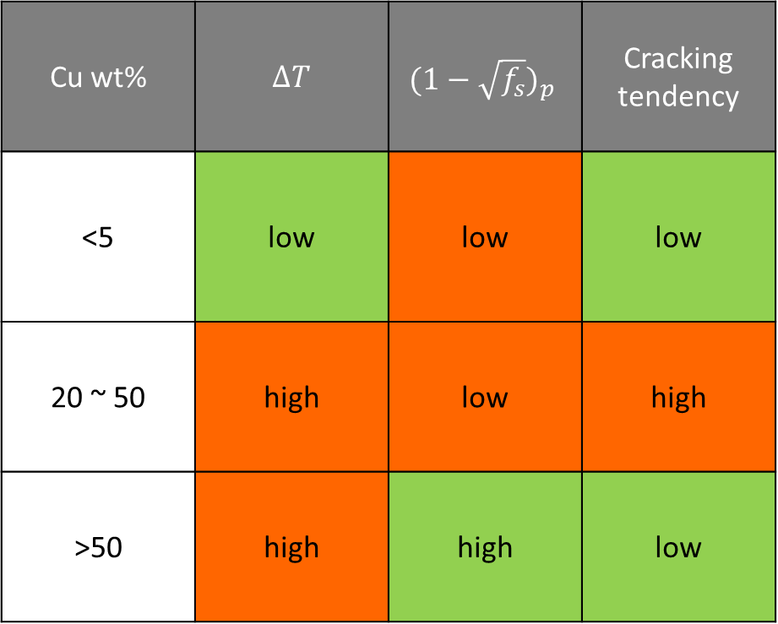
7. Cracking investigation – the effect of Cu composition
Cu wt% | $∆T$ | $${(1−\sqrt{f_{s}})}_{p}$$ | Cracking tendency
<5 | low | low | low
20 ~ 50 | high | low | high
>50 | high | high | low
Crack-free
Crack

Slide 18

8. Cracking investigation – conclusion
Direct joint
Functionally graded material
Pure Ni buffer

Slide 19

Thank you for attention!
Zhao Zhao
PhD student
University of Trento
Email: zhao.zhao@unitn.it
UNIVERSITÀ DEGLI STUDI DI TRENTO
Department of Industrial Engineering

Slide 20
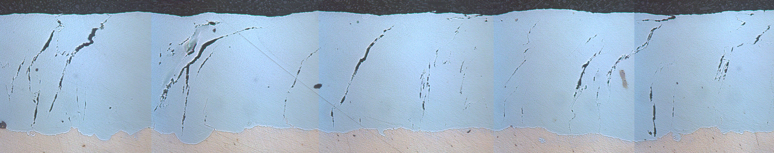
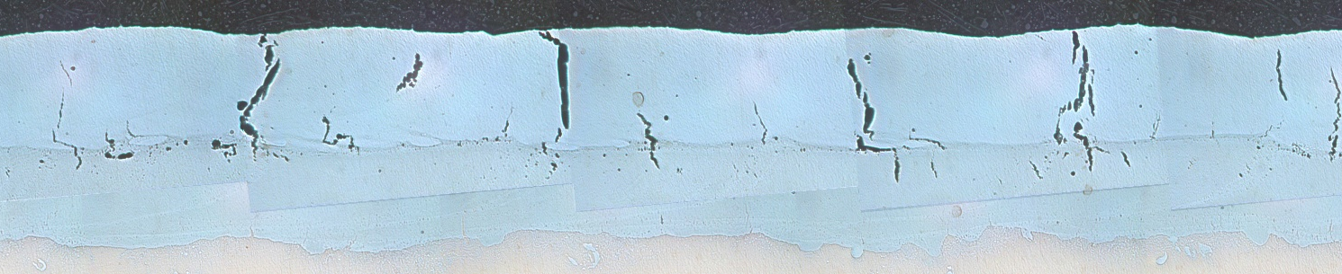

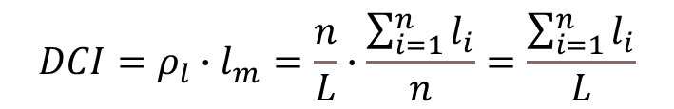


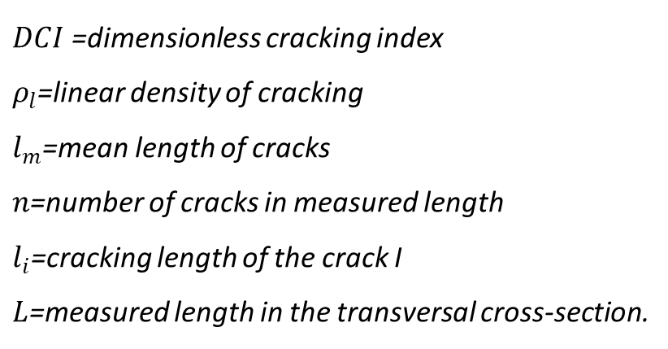

Cracking investigation – Dimensionless cracking index
Transversal cross-section of the single-layer SS316L
$$DCI=ρ_{l}∙l_{m}=\frac{n}{L}∙\frac{\sum_{i=1}^{n}{l_{i}}}{n}=\frac{\sum_{i=1}^{n}{l_{i}}}{L}$$
$$l_{i}$$
SS316L
$$L$$
$DCI$ =dimensionless cracking index
$ρ_{l}$=linear density of cracking
$l_{m}$=mean length of cracks
$n$=number of cracks in measured length
$l_{i}$=cracking length of the crack I
$L$=measured length in the transversal cross-section.
Transversal cross-section of the second-layer H13
$$l_{i}$$
H13
$$L$$
SS316

Slide 21
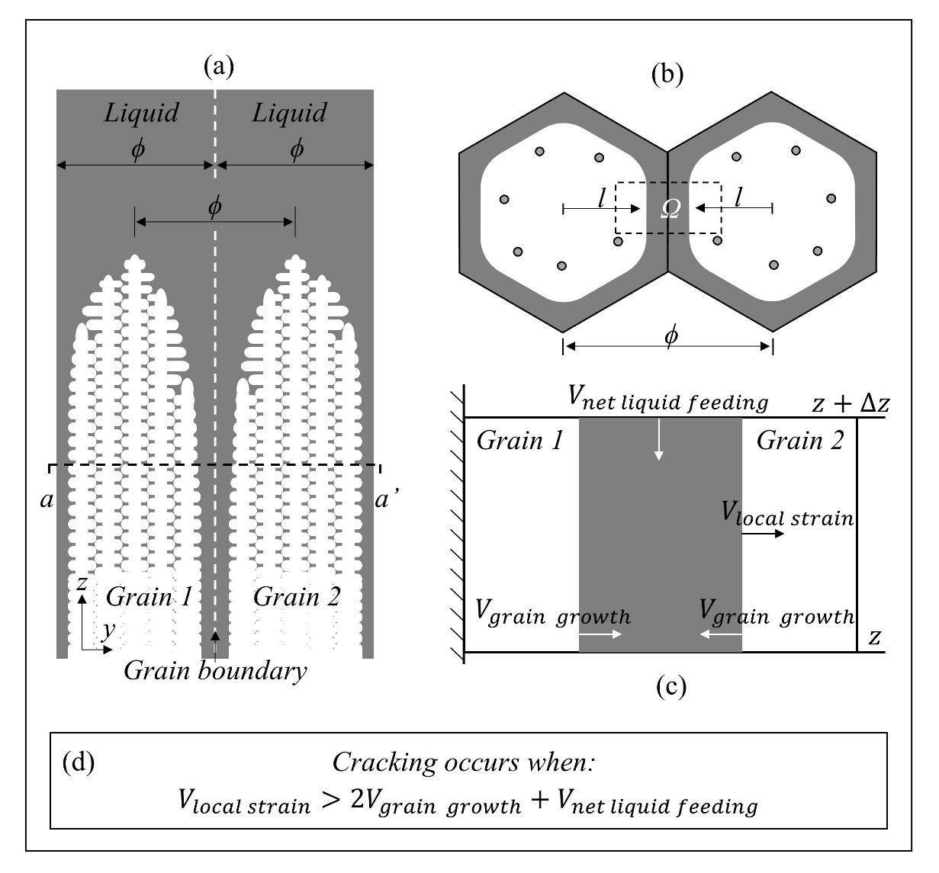
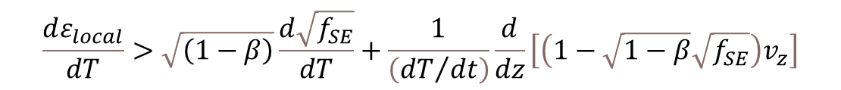
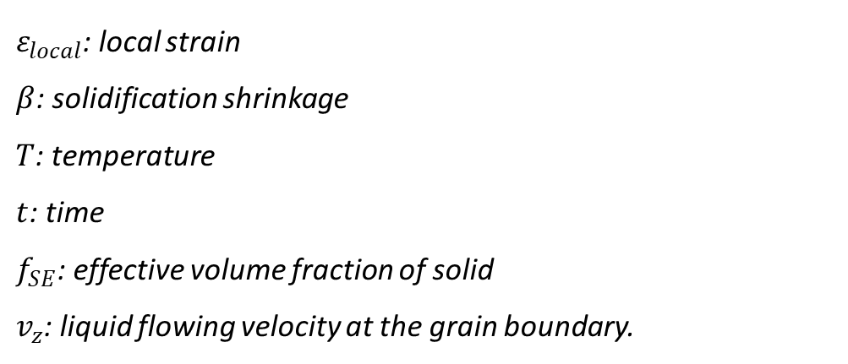
Cracking investigation – Solidification cracking model
$$\frac{dε_{local}}{dT}>\sqrt{\left(1−β\right)}\frac{d\sqrt{f_{SE}}}{dT}+\frac{1}{\left({dT}/{dt}\right)}\frac{d}{dz}\left[\left(1−\sqrt{1−β}\sqrt{f_{SE}}\right)v_{z}\right]$$
(Separation)
(Growth)
(Feeding)
$ε_{local}$: local strain
$β$: solidification shrinkage
$T$: temperature
$t$: time
$f_{SE}$: effective volume fraction of solid
$v_{z}$: liquid flowing velocity at the grain boundary.
Kou S. A criterion for cracking during solidification[J]. Acta Materialia, 2015, 88: 366-374.

Slide 22
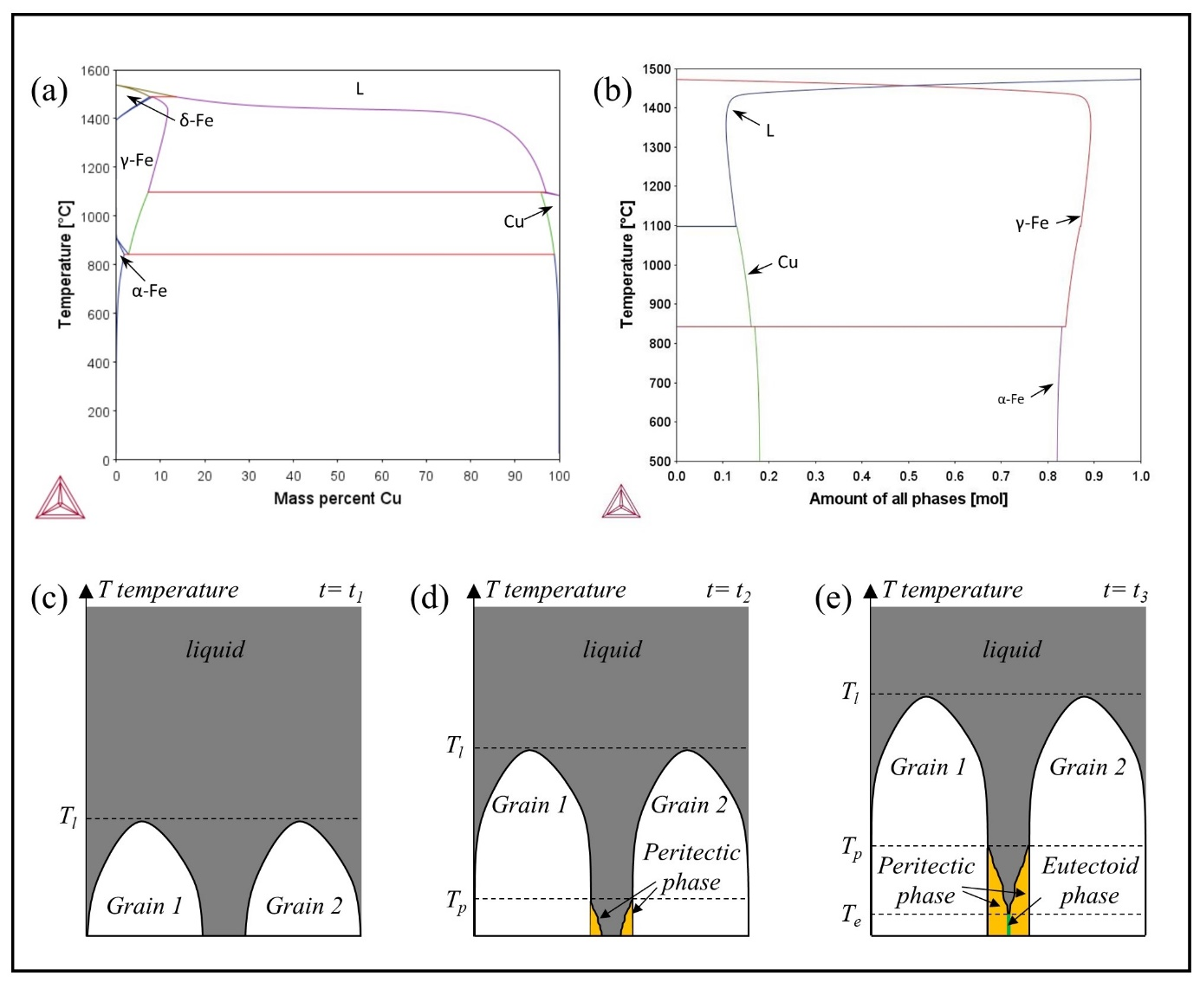
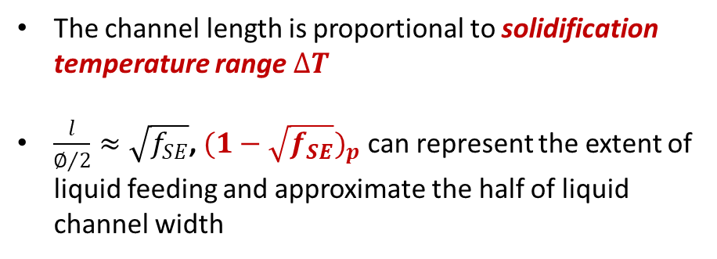
Cracking investigation – grain growth investigation
The channel length is proportional to solidification temperature range $∆T$
$\frac{l}{∅/2}≈\sqrt{f_{SE}}$, ${(1−\sqrt{f_{SE}})}_{p}$ can represent the extent of liquid feeding and approximate the half of liquid channel width

