Slide 1

Effect of cleanliness on fatigue resistance of PM-HSS
Stefan Sundin & Nicklas Reis, Erasteel Kloster AB, PEARL lab Söderfors

Slide 2
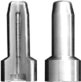
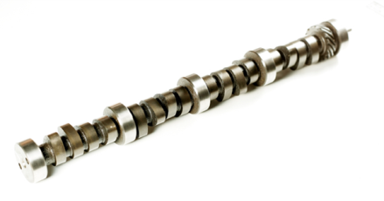
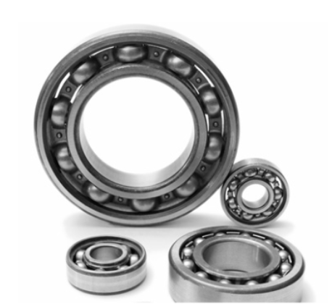
Background
Use of high cleanliness PM-HSS in demanding applications in aeronautic and automotive
These components are under cyclic load. Fatigue data and good fatigue strength are asked for by customer
Injectors
Cam shaft
Bearings

Slide 3
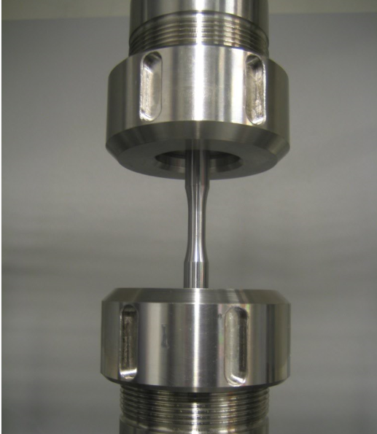
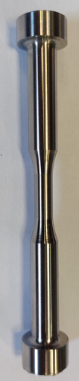
Fatigue testing at Erasteel
Fatigue testing
Simcotec Power Swing 100kN using pull-pull cyclic variation of the tensile load σ from 10% (σ_{min}) to 100% (σ_{max}). The σ_{max} tensile load is selected
Samples with fatigue fracture initiated from surface our outside the waist was excluded and re-run
The waist is 6 mm Ø and 12 mm long, i.e. a volume of ca 340 mm³ is tested
Manufacturing of fatigue sample
Soft machining
Heat treated, hardening and tempering
Hard turning to final shape => surface with Ra 0.2-0.4 µm and a ca 50 µm layer of compressive stresses
Purpose is to test PM-HSS material, not surface, not geometry etc
Fatigue test and fatigue sample

Slide 4
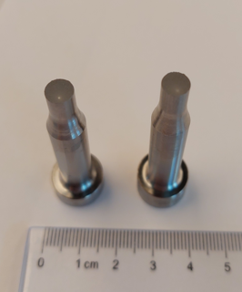
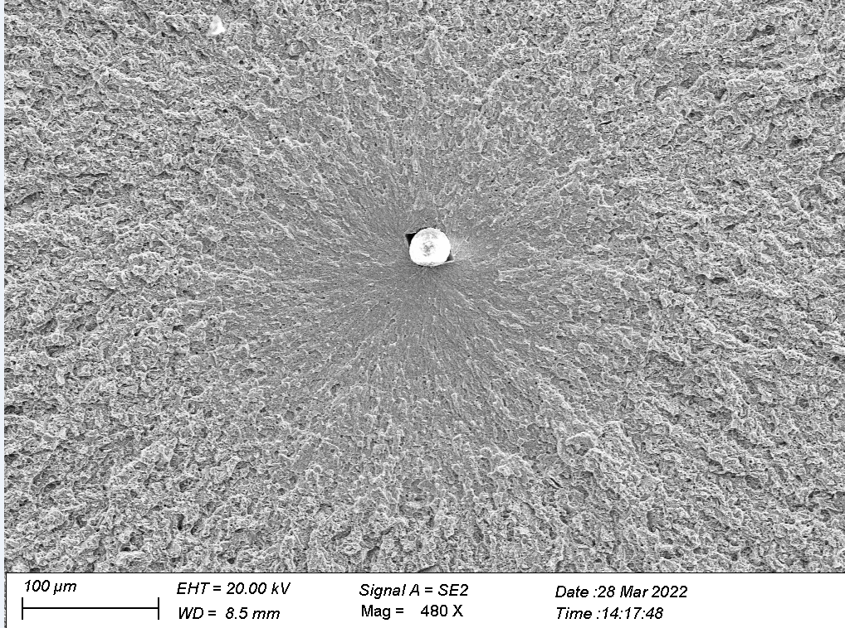
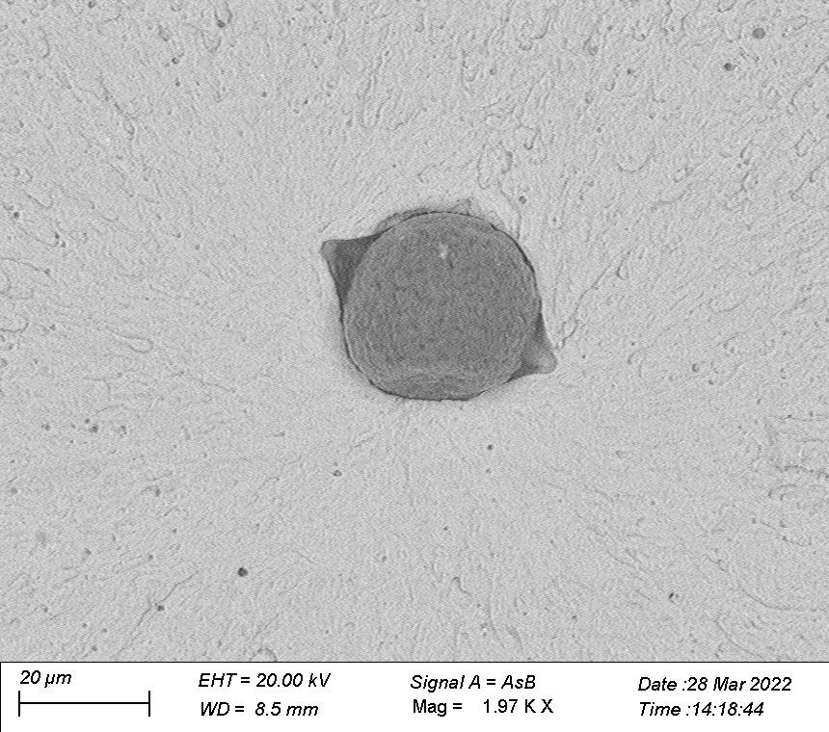
Analyses of fatigue sample with SEM
SEM is used to measure size and analyse material defect that initiated fatigue fracture

Slide 5
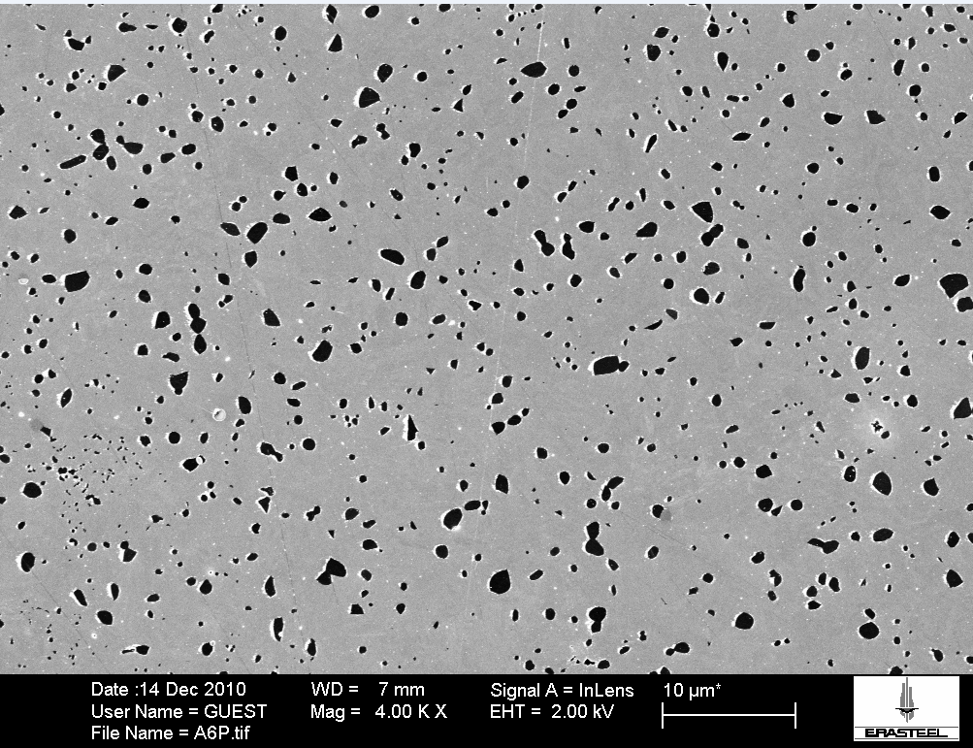

Influence from cleanliness, materials
PM-HSS, ASP®2005, from bars 13.8 mm Ø
Three different generations/batches of three different cleanliness levels tested. Judged from DIN50602 method K
  Material A K0=4.3
  Material B K0=0.9
  Material C K0=0.2
Heat treated 1180°C and tempered 3x560°C resulting in 64-65 HRC
Fatigue test using staircase method
Composition of ASP®2005
C | Cr | Mo | W | Co | V
1.5 | 4.0 | 2.5 | 2.5 | - | 4.0
10 µm
SEM micrograph of ASP®2005

Slide 6
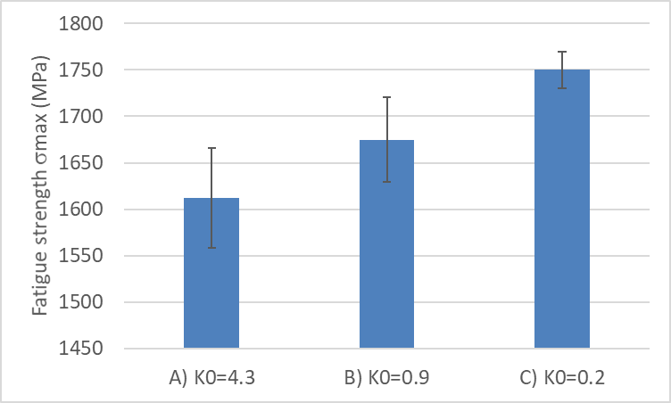
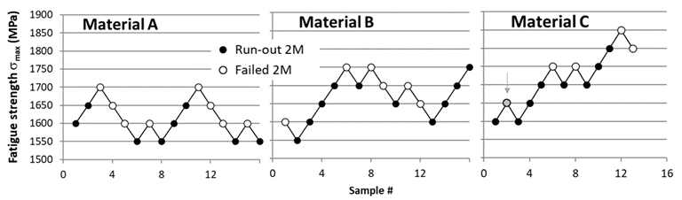
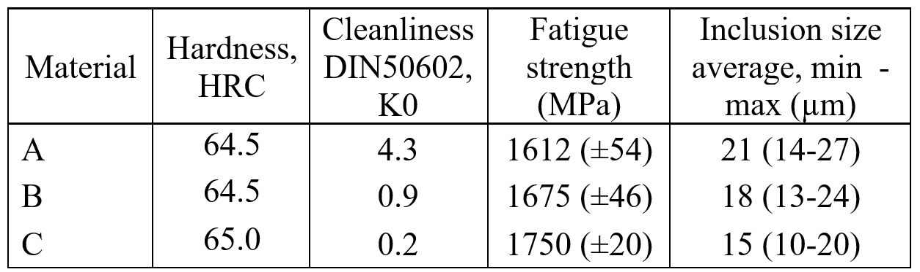
Influence from cleanliness, results
K0=4.3
K0=0.9
K0=0.2
*
*Failure due to surface defect
All fractures on failed samples were due to non-metallic inclusions. This is due to the fine carbide size in ASP®2005
The better the cleanliness, the smaller the largest inclusion in the waist of the fatigue sample and the better the fatigue resistance

Slide 7
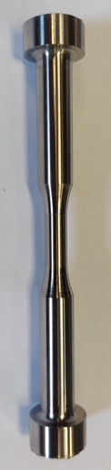
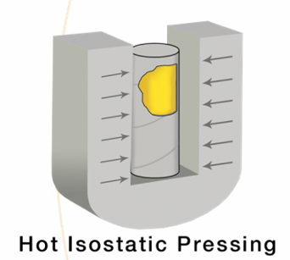
Influence from extra HIP of PM-HSS, materials
Composition corresponding to PM- HSS 6-5-3-8
30 longitudinal samples from 15 mm Ø bar
30 transversal samples from 123 mm Ø bar
50% of samples (15 from longitudinal
and 15 from transversal direction)
were HIPed an extra time at 1000bar
and 1150°C before machining.
All samples heat treated at 1150°C and tempered 3 times at 560°C for 1h each, hardness about 66 HRC
Fatigue life tested at 1650 MPa for longitudinal direction and at 1000 MPa for transversal direction
Composition of PM-HSS 6-5-3-8, equivalent of ASP®2030
C | Cr | Mo | W | Co | V
1.28 | 4.2 | 5.0 | 6.4 | 8.5 | 3.1
Rolling direction
Longitudinal direction
Transversal direction
Hard inclusion
Hot Isostatic Pressing (HIP)
Soft inclusion
Void
Void
Sketch of steel bar illustrating hard inclusion and soft inclusion and possible adjecent voids up and down stream of rolling direction. Sketch also shows how fatigue samples were taken.

Slide 8
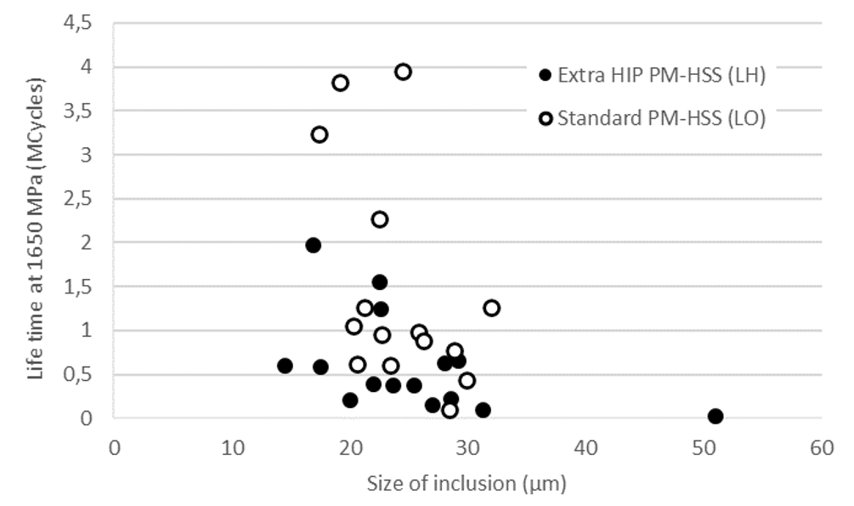
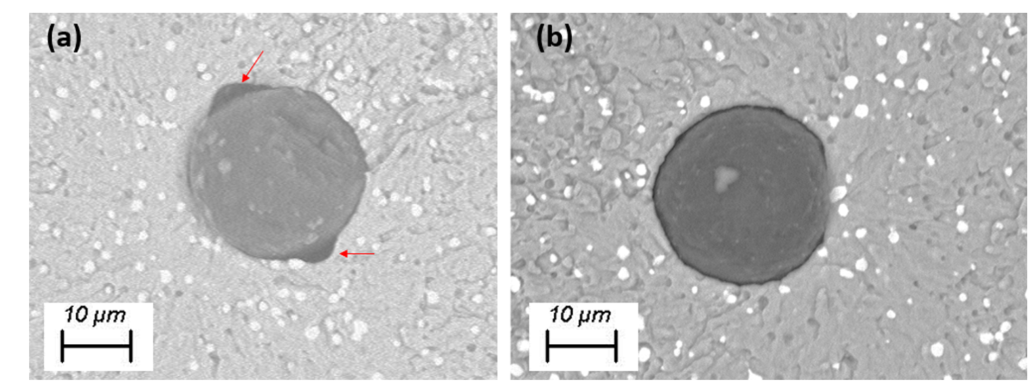
Influence from extra HIP of PM-HSS, results longitudinal direction and from bar of small diameter (15 mm)
Standard
PM-HSS
Void
Extra HIP PM-HSS
Void
Left: Example of an inclusion that initiated fracture in a standard sample
Right: Example of an inclusion that initiated fracture in an extra HIPed sample
No apparent improvment of fatigue life for samples from material HIPed an extra time after rolling
The extra HIPing seem effective to close the voids, but the cross section of the voids are probably not large enough in this direction to apparently influence fatigue life
Life time of fatigue samples tested at 1650 MPa. Solid markers are for samples HIPed an extra time and open markers are standard reference samples without extra HIP

Slide 9
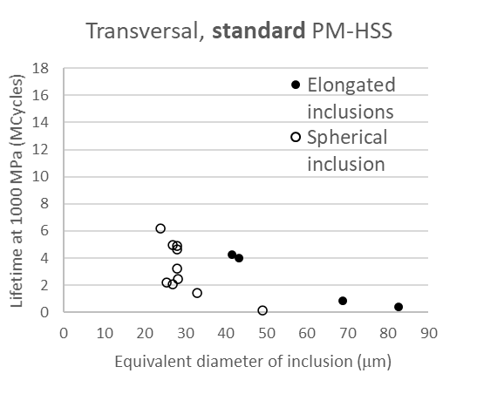
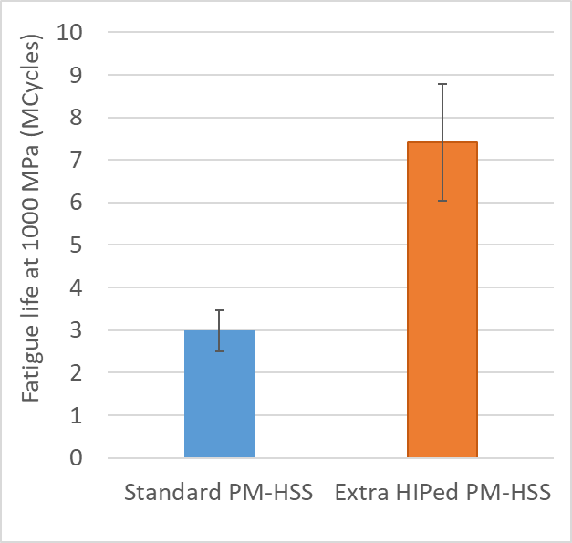
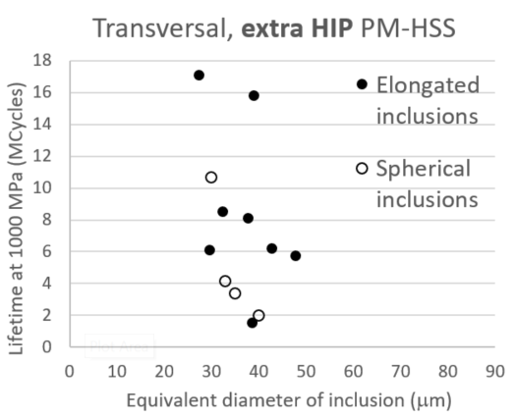
Influence from extra HIP of PM-HSS, fatigue life time transversal direction and large diameter (123 mm)
Fatigue life of standard PM-HSS material
Comparasion of fatigue life of sample from standard and extra HIP PM-HSS material
Fatigue life of sample from PM-HSS material that have been HIPed and extra time after rolling
The extra HIP after rolling has a positive effect on the fatigue life for samples cut ut in the transversal direction
Relation between inclusion size and fatigue life seems to differ if fracture initiation from elongated and spherical inclusion for standard PM-HSS but seems more similar for extra HIP PM-HSS

Slide 10
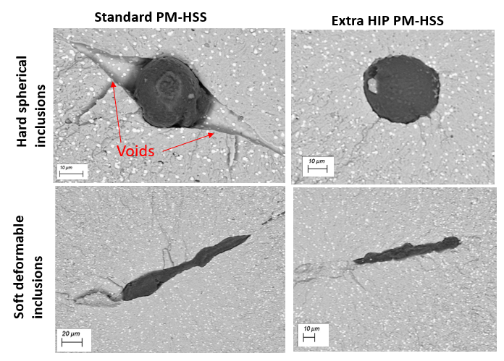
Influence from extra HIP of PM-HSS, SEM analyses transversal direction and large diameter (123 mm)
Voids next to inclusions are closed by the extra HIP
Soft deformable only shows small voids close to the inclusion
Void area should probably be included in total defect area

Slide 11
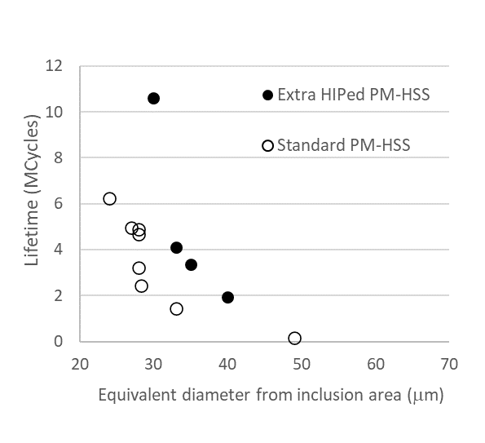
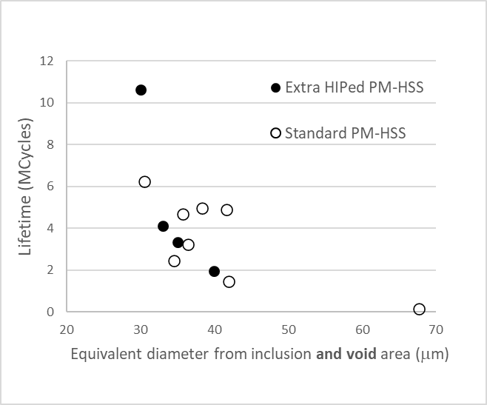
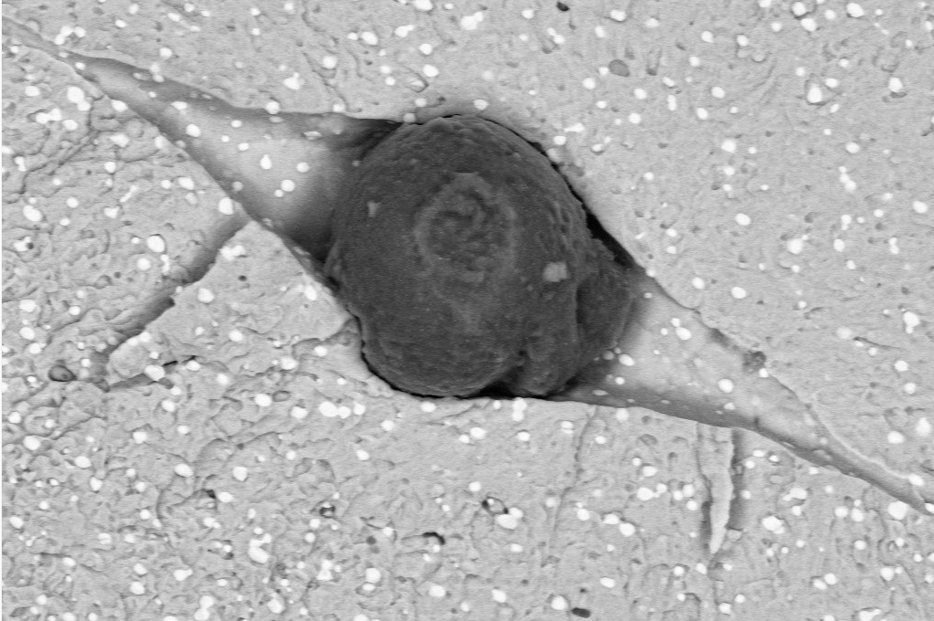
Influence from extra HIP of PM-HSS, analyses of fatigue samples that fractured from hard spherical inclusions
Rolling
direction
Defect area = inclusion area
Defect area = void + inclusion area
Void area
Transversal direction
Inclusion area
Fatigue life of samples that fractured from spherical inclusions
Including also the void area in total defect area gives similar correlation between defect size and fatigue life time for standard PM-HSS and extra HIPed PM-HSS
Sketch of bar with inclusion

Slide 12
Conclusions
Very high fatigue strength can be achieved for PM-HSS of very high cleanliness, DIN 50602 K0<1. The fractures are initiated at non-metallic inclusions provided that the carbide size is fine enough.
HIPing of rolled bars can have a positive influence on pull-pull tensile fatigue life of PM-HSS. Positive effect is mainly from closure of voids found down and up-stream rolling direction adjacent to inclusions. Largest positive effect from extra HIP is found in transversal direction and for hard and non-deformable inclusions.
These results indicate that voids are as detrimental as inclusions for fatigue life and that extra HIP has no apparent additional positive effect such as improving the bonding between metal and inclusion. Area for future studies.

