Slide 1

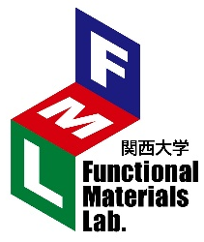
Plasma Nitriding Properties of Sintered Body Formed Using CoCrFeNiMn High-Entropy Alloy Powder by Varying Ball-Milling Duration
Kansai University
¹Graduate School of Science and Engineering,
²Department of Chemistry and Materials Engineering,
Facultry of Chemistry, Materials and Bioengineering,
Kansai University, Osaka, Japan
〇Jiaxin Peng¹ and Akio Nishimoto²
Functional Materials Lab.
Notes:
Thank you for Mr. chairman
I’m Peng Jiaxin of Kansai University in Osaka, Japan.
Now, I’d like to talk to you about Plasma Nitriding Properties of Sintered Body Formed Using CoCrFeNiMn High-Entropy Alloy Powder by Varying Ball-Milling Duration.

Slide 2
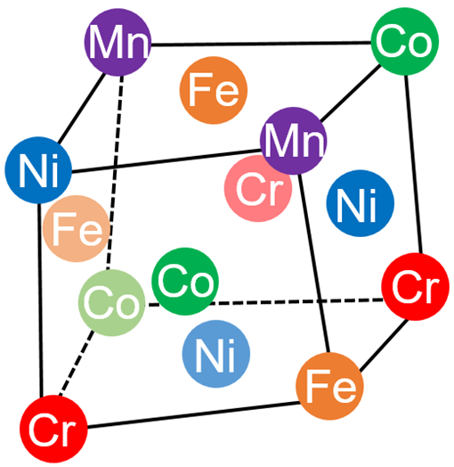
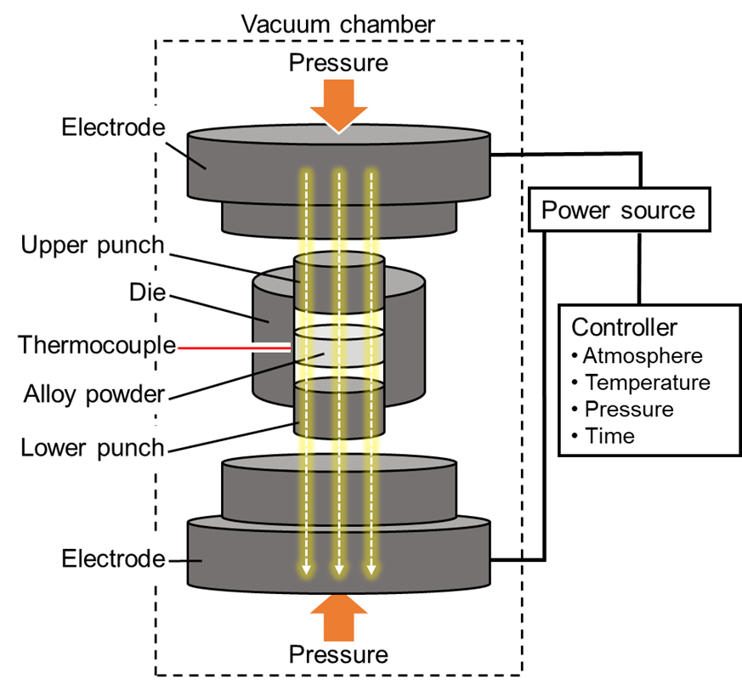
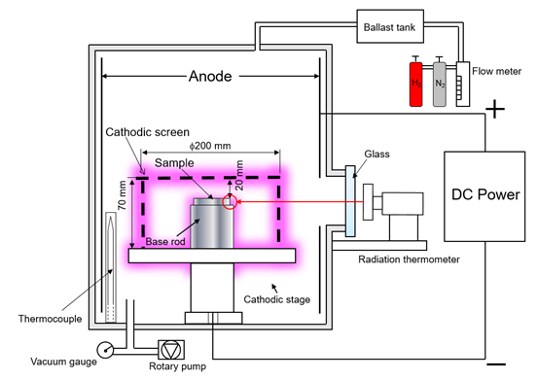
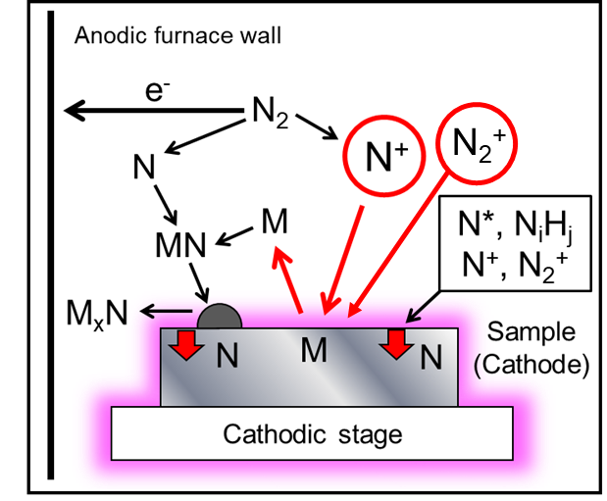
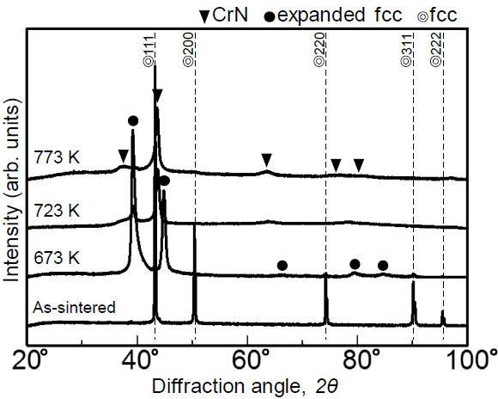
Background
High entropy alloy
Spark plasma sintering
Plasma nitriding
S-DCPN
five or more metallic elements
in the range of 5-35 at%
a single-phase solid solution
low hardness of Cantor alloy with fcc structure
short-time processing
Easy control of temperature, time, atmosphere and pressure
short-time processing
energy saving
uniform heating
increase of nitriding supply
Dislocations were introduced on the surface of an CoCrFeMn alloy powder by ball milling, and a simultaneous improvement in the strength of the sintered body and strain hardening occurred. ¹⁾
Another study revealed that an expanded fcc structure formed on the surface of Cantor alloy during plasma nitriding at 673 K. ²⁾
Experimental object
After ball milling a CoCrFeMnNi gas-atomized powder, a sintered body was prepared by the SPS method followed by plasma nitriding, and the characteristics of the surface nitrided layer were evaluated.
1) G. Li, et al. : Scr. Mater. 191 (2021) 196-201.
Fig. XRD pattern of plasma-nitride HEAs ²⁾
2) T. Karimoto and A. Nishimoto, Metals. 10 (2020) 761.
Notes:
Recently, high-entropy alloys have been developed, and they are known to three points.
The advantage of SPS is easy control of temperature, time, atmosphere and pressure. Improving the hardness of soft HEAs is extremely important, and one method is the surface treatment.
This figure shows a schematic of the plasma nitriding. S-DCPN has the advantages of uniform heating and increase of nitriding supply.
Recent years, a study found that dislocations were introduced on the surface of this HEA powder by ball milling and another study revealed that an expanded fcc structure formed on the surface of Cantor alloy at 673 K.
Experimental object on this study is shown in this.

Slide 3
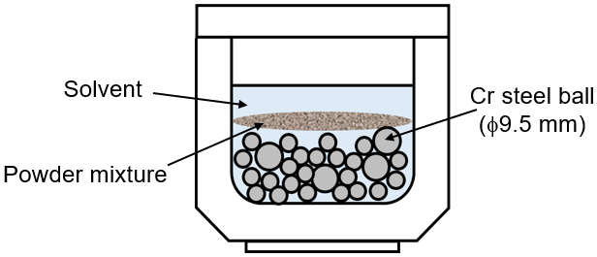
Experimental procedure
Table 1 Gas atomizing powders.
Material preparation
⇒Ball milling
Element | Co | Cr | Fe | Mn | Ni
Nominal composition (at%) | 20.00 | 20.00 | 20.00 | 20.00 | 20.00
Particle size | 53 ~150 µm
SPS processing
Table 2 Conditions of ball milling.
Milling time | 0, 5, 10, 15 h
Revolution | 300 rpm
Ball to powder ratio | 10 : 1
Solvent | n-Heptane
Atmosphere | Ar
Polishing
Plasma nitriding
Analysis
Fig. 1 Schematic illustration of the setup for ball milling.
Notes:
Next, the experiment procedure is shown.
The starting material is gas atomized powder and Table 1 shows element composition and particle size. And conditions of ball milling are shown in Table 2.

Slide 4
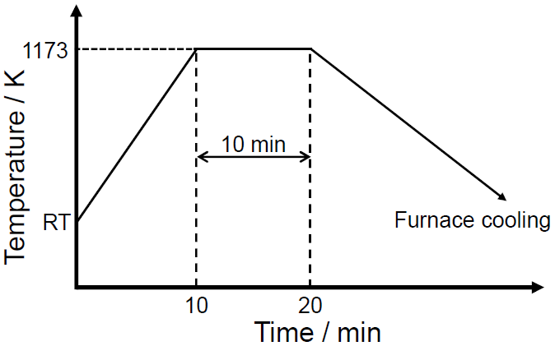
Experimental procedure
Table 3 Sintering conditions of SPS.
Material preparation
⇒Ball milling
Heating time | 10 min
Sintering temperature | 1073 K
Sintering time | 10 min
Pressure | 50 MPa
Atmosphere | < 10⁻² Pa
SPS processing
Polishing
Plasma nitriding
Analysis
Fig. 2 temperature program of SPS.
Notes:
After ball milling, powders were sintered by SPS and conditions of SPS are shown in Table 3.

Slide 5
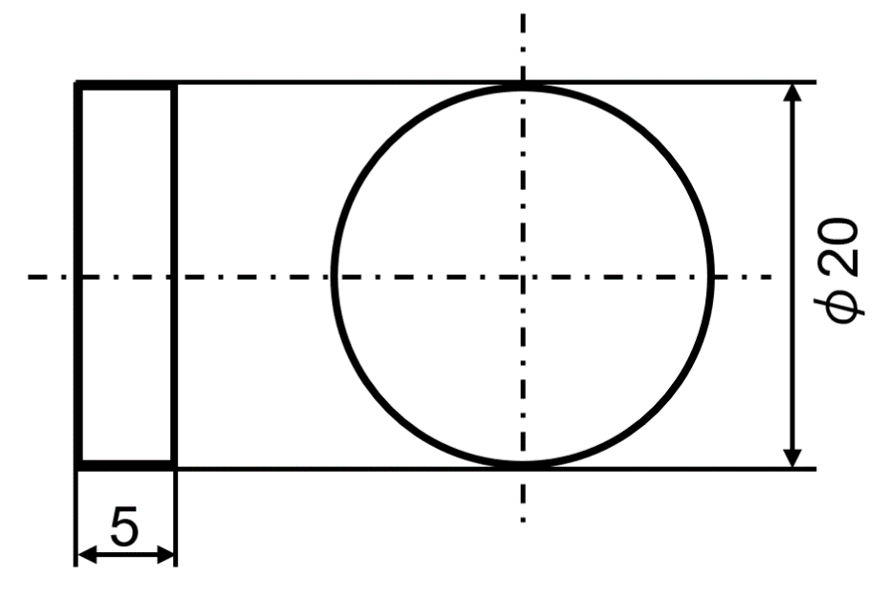
Experimental procedure
Material preparation
⇒Ball milling
SPS processing
Polishing
Fig. 3 Shape and size of sintered HEAs sample.
Table 4 Nitriding conditions of S-DCPN.
Heat treatment
⇒Nitriding (S-DCPN)
Nitriding temperature | 673 K
Nitriding time | 15 h
Total gas pressure | 200 Pa
Gas flow (N₂ : H₂) | 3 : 1
Screen | SUS316L
Analysis
Notes:
At S-DCPN treatment, shape and size of sintered HEAs sample is shown in Figure 3 and nitriding conditions are shown in Table 4.

Slide 6
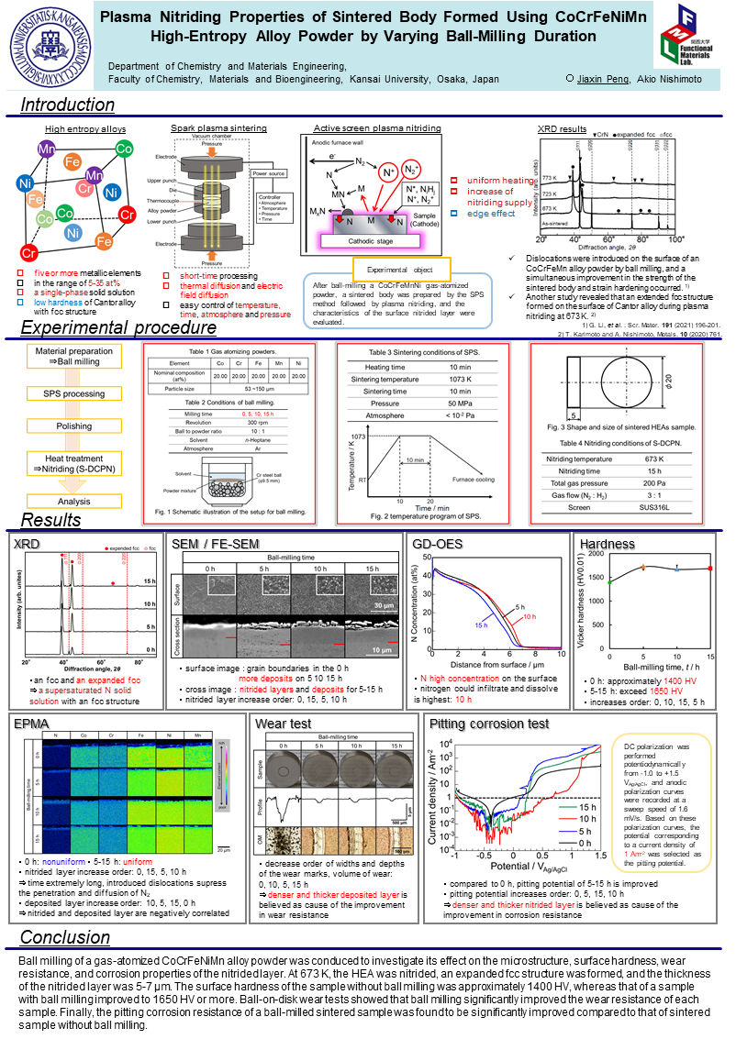
XRD, SEM, FE-SEM, GD-OES, EPMA, Vicker Hardness, Wear test, Corrosion test
Results and Conclusion
poster
Notes:
Experimental results and conclusion are announced with the poster.
Thank you for your kind attention.

