Slide 1


Kansai University
Effect of the Amount of Zr Addition on Microstructure and Mechanical Properties of CoCrFeNi High-Entropy Alloys Prepared by Mechanical Alloying and Spark Plasma Sintering
¹Graduate School of Science and Engineering, Kansai University, Osaka, Japan
²Department of Chemistry and Materials Engineering, Kansai University, Osaka, Japan
〇ZiXiang Fan¹ and Akio Nishimoto²
Notes:
Thank you, Mr. chairman.
I’m Fan of Kansai University in Osaka, Japan.
Now, I’d like to talk to you about Effect of the Amount of Zr Addition on Microstructure and Mechanical Properties of CoCrFeNi High-Entropy Alloys Prepared by Mechanical Alloying and Spark Plasma Sintering.

Slide 2
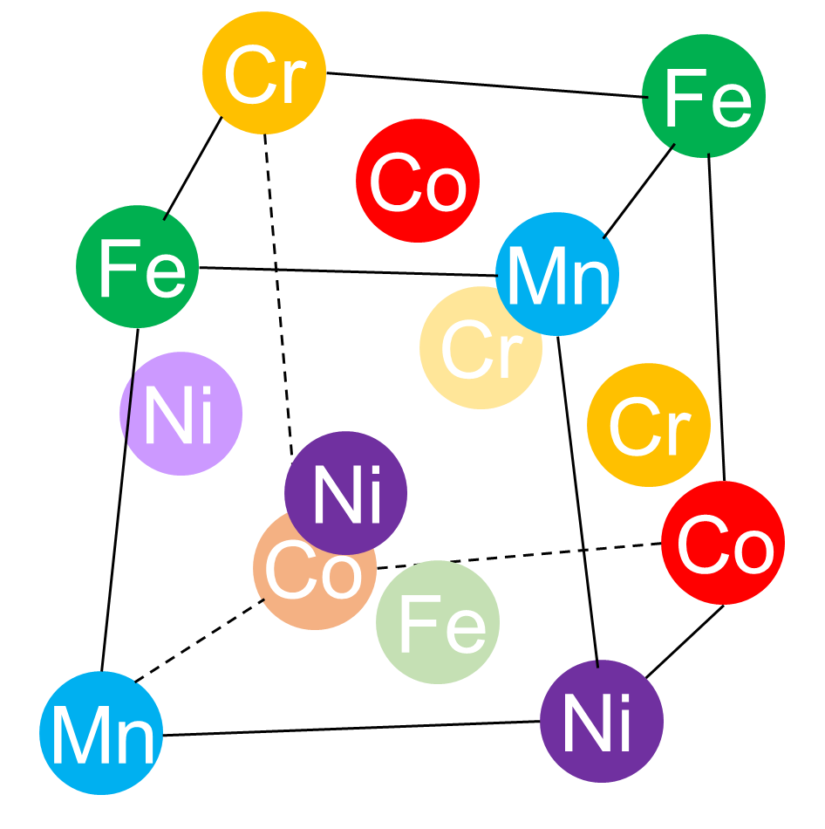
1. Introduction
High Entropy Alloys(HEAs)
A multicomponent alloy obtained by blending of least five metals with compositions of 5%-35%
⇒The introduction of large lattice distortion makes it solid solution stable.
CoCrFeNiMn HEAs
The hardness of CoCrFeNiZr-based alloys produced by the arc-melting method is approximately
150 HV to 550 HV.⁽¹⁾
Stable phase is FCC phase.
High ductility
But
Hardness (approximately 160 HV)
(1) W. Huo, H. Zhou et.al Materials and Design 134 (2017), pp. 226-233
Notes:
High Entropy Alloys (HEAs) is a multicomponent alloy obtained by blending of least five metals with compositions of 5%-35%. CoCrFeNiMn HEAs are typical HEA alloys. The stable phase of it is a single phase of FCC and has high ductility, but low hardness, approximately 160 HV. Arc melting is the typical method for making high-entropy alloys, but the hardness of CoCrFeNiZr alloys made by arc melting is also low, ranging from about 150 HV to 550 HV.

Slide 3
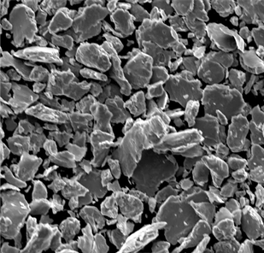
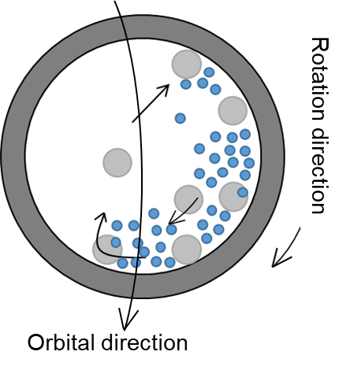
1. Introduction
CoCrFeNiZr alloy
‥ HEA with Zr added instead of conventional Mn
alloys are prepared by MA-SPS method
☞ Few reports of Zr addition to HEA
Alloyed powders with fine and uniform solid solution can be produced by mechanically alloying pure metal powders
Mechanical alloying method
20 µm
Notes:
So, in this study, HEA with Zr added instead of conventional Mn. Alloys are prepared by MA-SPS method CoCrFeNiZr alloys are prepared by the MA-SPS method to improve the mechanical properties of the alloys.

Slide 4
1. Introduction
Processing method
Pressure
In the conventional sintering method, deterioration of the mechanical properties of the matrix due to prolonged high-temperature treatment has been a problem.
Vacuum chamber
Electrode
Sheet
Spacer
Punch
Power source
Dies
Thermocouple
Sample
Punch
Controller
‣ Atmosphere
‣ Temperature
‣ Pressure
‣ Time
Spark plasma sintering （SPS） method capable of short processing time
Capable of producing sintered alloys with a dense and uniform microstructure
Diffusion by pulsed current acceleration effect is expected
Spacer
Sheet
Pulsed current
Electrode
Pressure
Notes:
The sps method allows sintering in a short time. Capable of producing sintered alloys with a dense and uniform structure.

Slide 5
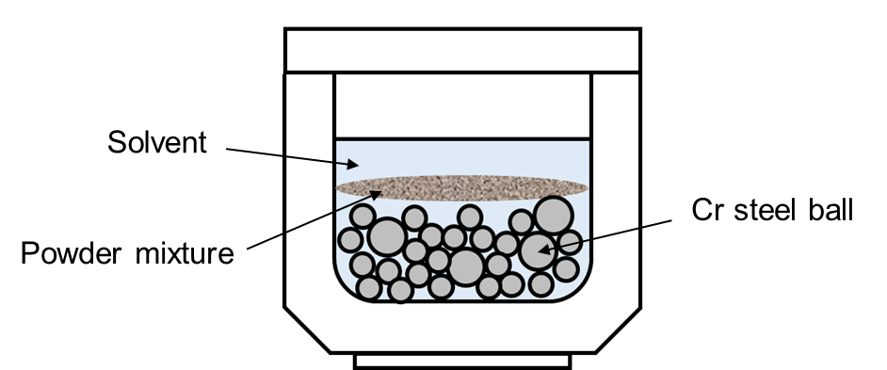
2 . Experimental procedure
Table 1. Powder composition (at%)
Powder
 | Co | Cr | Fe | Ni | Zr
CoCrFeNi | 25 | 25 | 25 | 25 | 0
CoCrFeNiZr_{0.2} | 23.81 | 23.81 | 23.81 | 23.81 | 4.76
CoCrFeNiZr_{0.4} | 22.73 | 22.73 | 22.73 | 22.73 | 9.08
CoCrFeNiZr_{0.6} | 21.74 | 21.74 | 21.74 | 21.74 | 13.04
MA
SPS processing
Polishing
Table 2. Conditions of MA processing.
Analysis
Milling time | 50 h
Revolution | 300 rpm
Ball to powder ratio | 10 : 1
Solvent | n-Heptane
Atmosphere | Ar
Notes:
Next, the experimental procedure is shown here. Table 1 shows the composition of the powders. Table 2 shows the experimental conditions for MA.

Slide 6
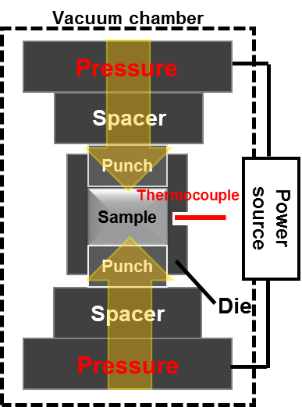
2 . Experimental procedure
Powder
MA
Table 3. Conditions of SPS processing.
Temperature,T | 1273 K
Atmosphere | ≦10⁻² Pa
Processing time | 8 min
Heating rate | 60 K / min
Pressure | 50 MPa
SPS processing
Polishing
Analysis
Notes:
Table 3 shows the experimental conditions for SPS. Sintering was performed at a heating rate of 60 Kmin⁻¹ and at a sintering temperature of 1273 K for 8 min.

Slide 7
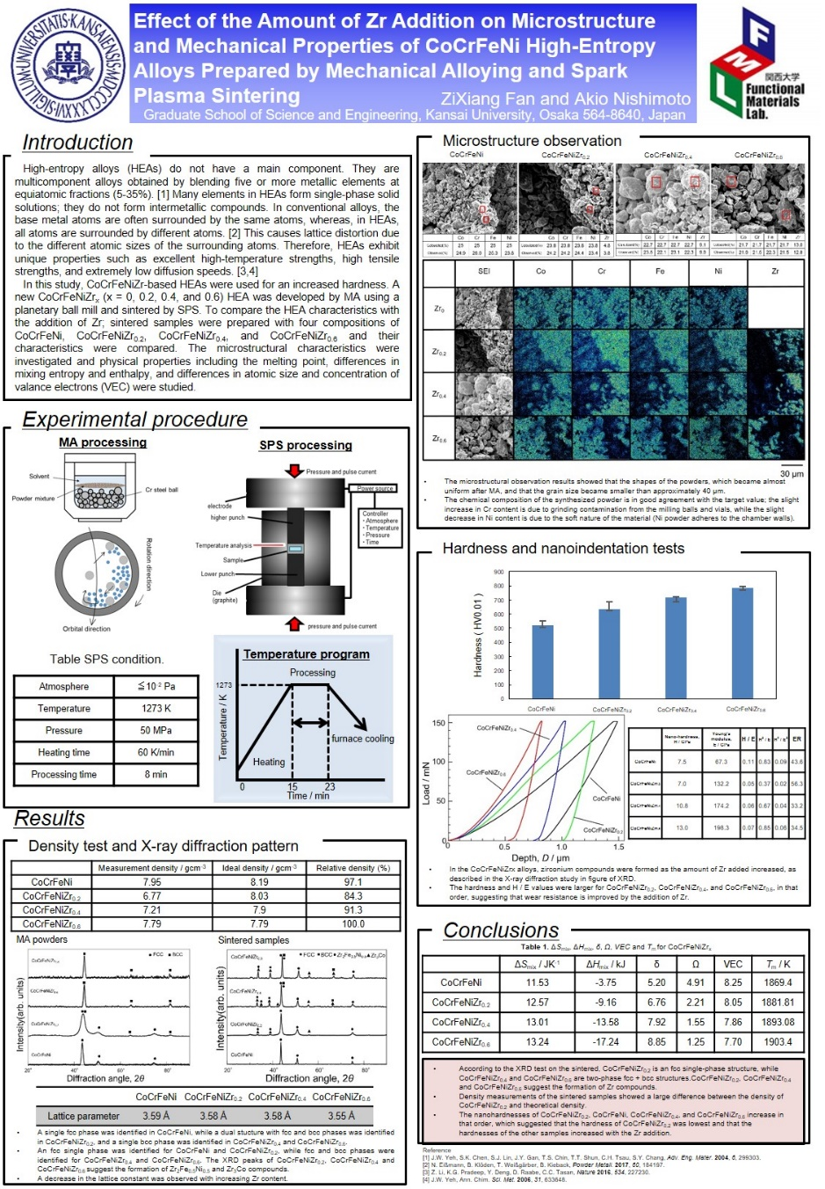
Experimental results are announced with the poster.
Thank you for your kind attention.
Notes:
Experimental results are announced with the poster.
Thank you for your kind attention.

