Slide 1




Active-Screen Plasma Nitriding and
Carburizing of an Austenitic Stainless Steel Small-Diameter Thin Pipe
Kenzo Sumiya Hatta Kogyo Co., Ltd.
Shinkichi Tokuyama Hatta Kogyo Co., Ltd.
Junichi Fukui Hatta Kogyo Co., Ltd.
Atsushi Nishiyama Mikitec Co., Ltd.
Akio Nishimoto Kansai University
Notes:
Thank you for your introduction.
Today, I want to talk about “Active-Screen Plasma Nitriding and Carburizing of an austenitic Stainless Steel Small-Diameter Thin Pipe”.

Slide 2

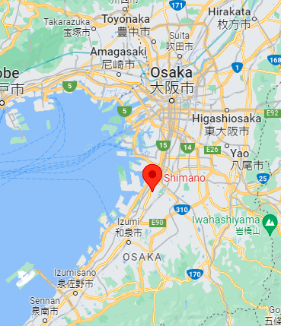


Where is Hatta Kogyo Located?
Near Kansai Airport ①
Sakai city: Shimano ②
World heritage (Mozu-Furuichi Kofun Group) ③
Shimano
World heritage
Hatta Kogyo
Kansai airport
Hatta Kogyo
Notes:
Let me introduce where our company Hatta Kogyo is located.
Hatta Kogyo is in Osaka, Sakai-city and locates near Kansai airport.
Sakai city is home to the famous company Shimano and has a World Heritage Site of Mozu-Furuichi Kofun group that is the ancient tombs constructed between the late 4th century and the late 5th century.
Please visit Sakai city and Hatta Kogyo when you come to Japan for IFHTSE congress next year.

Slide 3
Topics
□ Background, Purpose
□ Experimental Setup and Conditions
□ Experimental Results
- S phase formation
- Mechanical properties
- Corrosion resistance
□ Summary
Notes:
My presentation has four main parts.
First, I want to talk about the background and purpose of this study.
Second, I’m going to explain about the experimental setup and conditions.
Then, I want to describe the experimental results.
Finally, I’ll make summary.

Slide 4
Topics
□ Background, Purpose
□ Experimental Setup and Conditions
□ Experimental Results
- S phase formation
- Mechanical properties
- Corrosion resistance
□ Summary
Notes:
First, I want to talk about background and purpose of this study.

Slide 5
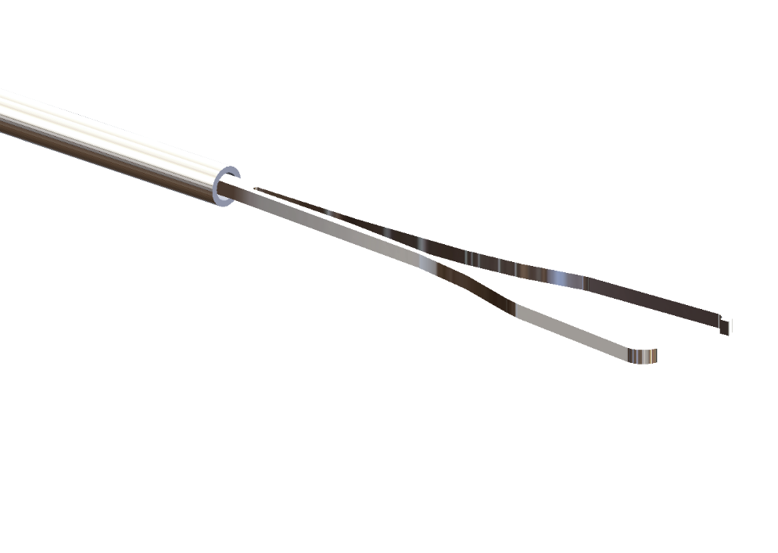
Background
Medical stainless steel pipe
- Needs : Minimizing the invasiveness ⇒ Reducing the diameter
- Problems : Low flexural rigidity
Requirement
- Improved bending strength of small-diameter thin pipes with corrosion resistance
Pipes, forceps
Notes:
Stainless steel pipes are used for medical instruments.
In recent years, there has been a demand for reducing diameters for minimizing the invasiveness.
However, there is a problem that flexural rigidity become lowered by reducing the diameter.
Therefore, there is a strong requirement of improving bending strength of small-diameter thin pipes with corrosion resistance.

Slide 6
Purpose
Purpose: Improving the bending strength of austenitic stainless steel small-diameter thin pipes for medical use
Method: Low-temperature active-screen plasma nitriding (ASPN) and carburizing (ASPC)
- Expanded austenite (S phase) formation under 723 K processing
⇒ Achieving both improving bending strength and corrosion resistance
- Active-screen plasma
⇒ Uniform processing
Evaluation of S phase formation and mechanical properties
Notes:
The purpose of this study is improving the bending strength of austenitic stainless steel small-diameter thin pipes for medical use.
For that, we utilized low-temperature active-screen plasma nitriding and carburizing.
Expanded austenite, called S phase, is formed under 723 K (Kelvin) processing temperature.
We try to achieve both improving bending strength and corrosion resistance with S phase.
（一旦、スライド7に移って、S相の説明をする）
Active screen plasma was used for uniform processing.
And we evaluated the S phase formation and mechanical properties of S phase.
（スライド8に移動）

Slide 7

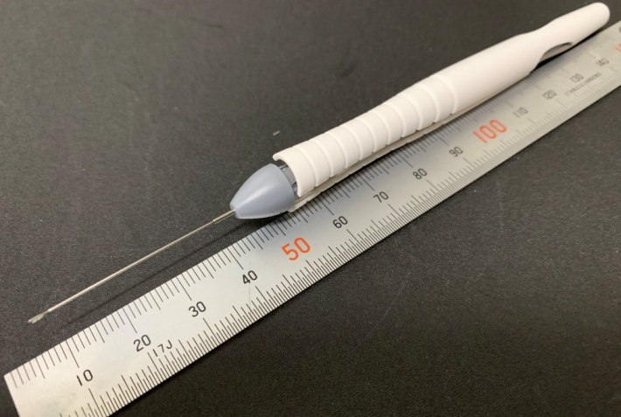
Expanded Austenite (S Phase)
Features
- Hardened layer formed by nitriding and carburizing at a low temperature under 723 K.
- Corrosion resistance is comparable to the original austenitic stainless steel (contains no Chromium compound precipitated phase).
- FCC structure with wider interstitial distance than standard austenite phase.
Problems
- Thin hardened layer due to the diffusion phenomenon at low temperatures.
⇒ Not widely spread to market products.
Our target
- Precision miniature parts
- Precise control of S phase formation
Small gears, small screws
Ophthalmic surgical instruments
Notes:
Let me briefly explain the expanded austenite phase, S Phase.
S phase is hardened layer formed by nitriding and carburizing at a low temperature below 723 K.
Corrosion resistance of S phase is comparable to the original austenitic stainless steel because it contains no Chromium compound precipitated phase.
S phase has FCC structure with wider interstitial distance than standard austenite phase.
S phase is not widely spread to market products because it is difficult to obtain thick layer due to the diffusion phenomenon at low temperature.
Here, our target is precision miniature parts such as small gear, screw, ophthalmic surgical instruments and so on. For these products, thick hardened layer is not necessary and S phase is suitable. We aim to improve the functionality of small parts by precise control of the S phase.
（スライド6に戻る）

Slide 8
Topics
□ Background, Purpose
□ Experimental Setup and Conditions
□ Experimental Results
- S phase formation
- Mechanical properties
- Corrosion resistance
□ Summary
Notes:
Next, I’m going to explain about experimental setup and conditions.

Slide 9
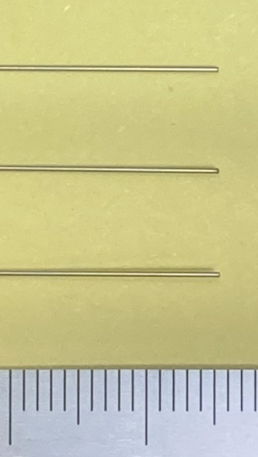
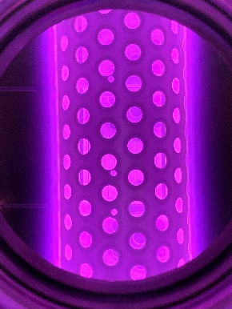
Experimental Setup and Conditions
Sample (pipe)
Small-diameter thin pipe
・Material ：SUS304
・Outer diameter：φ0.4 mm
・Inner diameter ：φ0.3 mm
・Length ：50 mm
Screen (punching metal)
・Material ：SUS304
・Dimension ：φ90 mm×400 mm
・Hole diameter：φ10 mm
・Aperture ratio ：22.7 %
Thermocouple
Jig (ring)
Screen
Sample (pipe)
Jig (ring)
Cathodic stage
Notes:
A small-diameter thin pipe composed of SUS 304 stainless steel was used as the sample material. The inner and outer diameters of the pipe were ϕ0.3 and ϕ0.4 mm (millimeter), respectively, and the pipe length was 50 mm (millimeter).
The samples of the small-diameter thin pipe were mounted at the circumference of a ring-shaped jig. The jig was suspended from a screen that was placed on the cathodic sample stage. Consequently, plasma was formed on both the sample pipe and screen. The screen material was a punching metal composed of SUS 304 stainless steel with a 22.7% open area, diameter of 90 mm (millimeter) and height of 400 mm (millimeter). The jig temperature was measured using a thermocouple and adopted as the processing temperature because measuring the temperature of a small-diameter pipe is difficult. Moreover, a pulsed power supply was used for plasma generation.

Slide 10
Experimental Setup and Conditions
Sample (pipe)
Experimental conditions
・Processing time ：4 h
・Gas pressure ：200 Pa
・Discharge voltage：-500 V
・Pulse duration ：100 ms
・Processing temp. ：578, 598, 618, 638 K
(Jig temperature)
Gas flow ratio
・Nitriding ：N₂ : H₂ = 50 : 50
・Carburizing：Ar : CH₄ : H₂ = 50 : 5 : 45
Thermocouple
Jig (ring)
Screen
Sample (pipe)
Jig (ring)
Cathodic stage
Notes:
The plasma nitriding and carburizing were conducted for 4 hours at 578–638 K (Kelvin) with a pressure of 200 Pa (Pascal). The discharge voltage and pulse duration for the plasma generation were -500 V and 100 ms (millisecond). The gas flow ratio were 50% N2–50% H2 for ASPN and 50% Ar-5% CH4-45% H2 for ASPC.

Slide 11
Topics
□ Background, Purpose
□ Experimental Setup and Conditions
□ Experimental Results
- S phase formation
- Mechanical properties
- Corrosion resistance
□ Summary
Notes:
Next, I’m going to move on the experimental result part.
At first, we investigated about S phase formation.

Slide 12
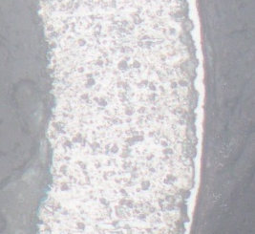
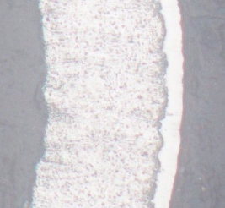
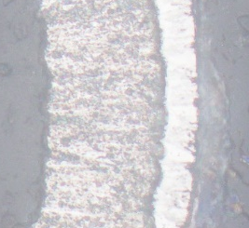
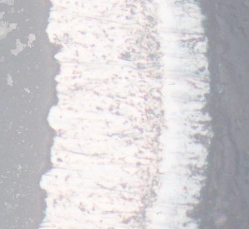
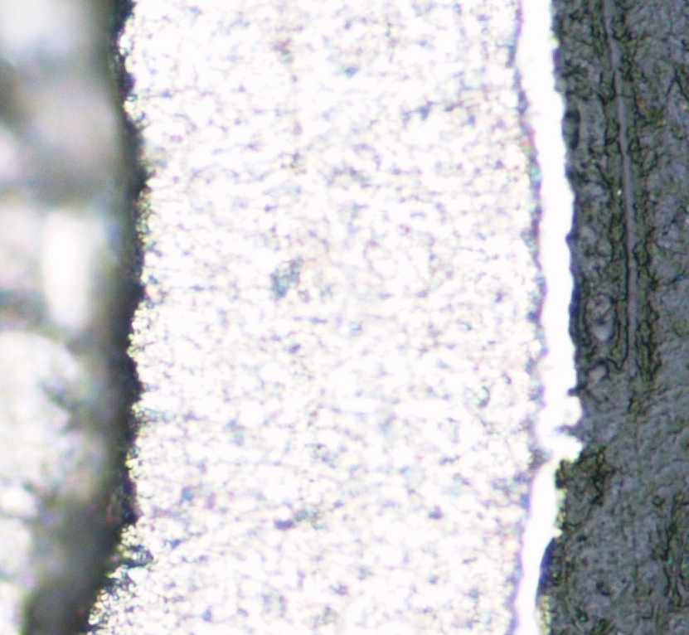
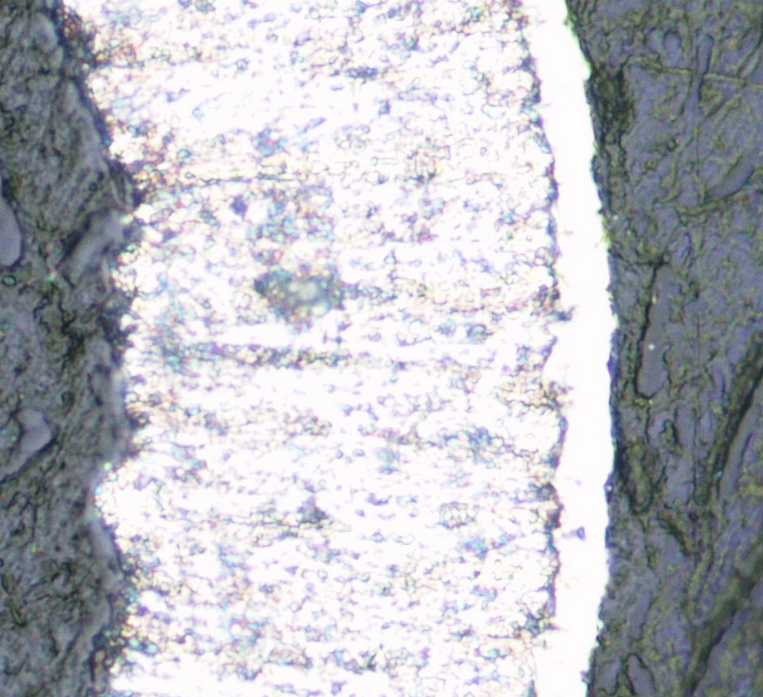
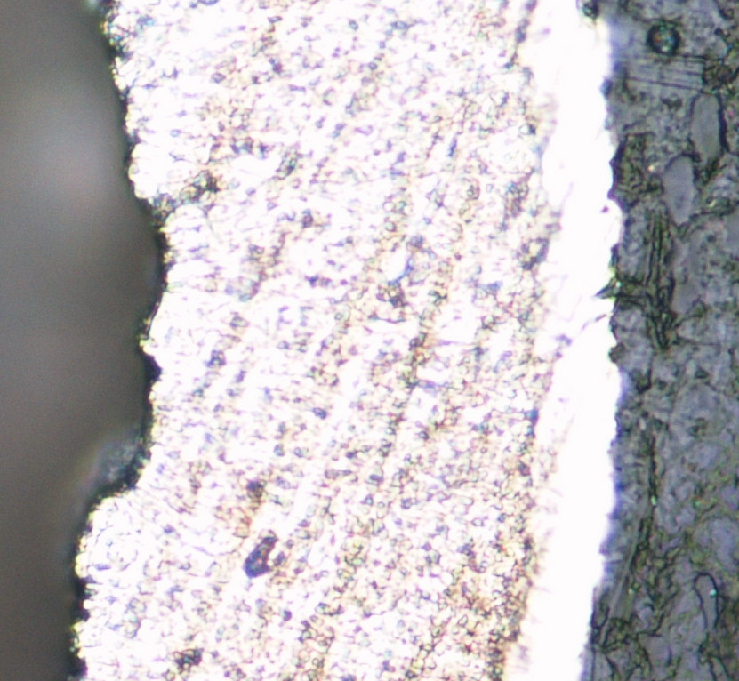
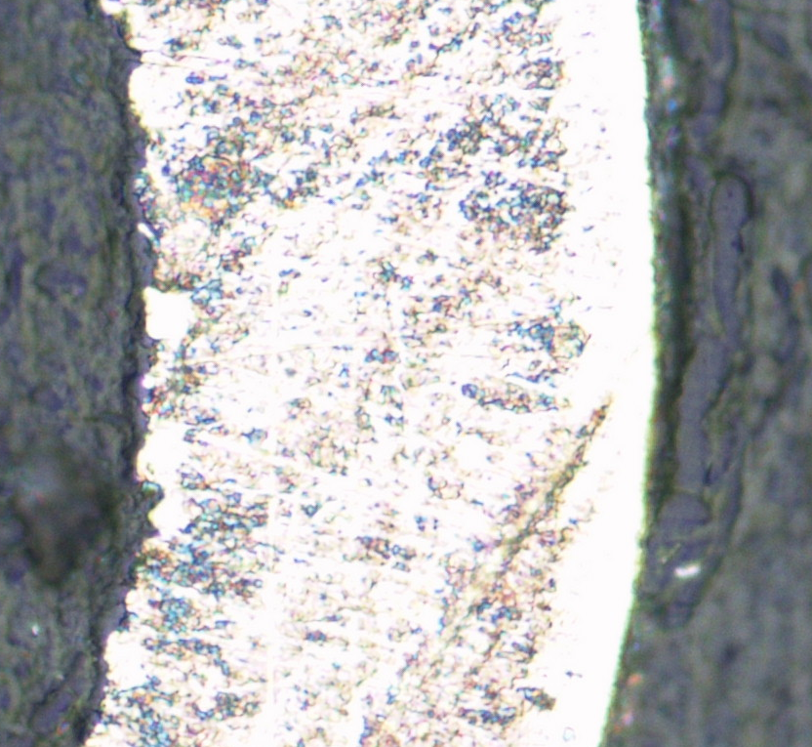
Cross-sectional Micrograph of Samples
 | Processing temperature
 | 578 K | 598 K | 618 K | 638 K
ASPN (Nitriding)
ASPC (Carburizing)
Etched area
20 μm
Processing temperature ⤴ ⇒ Layer thickness ⤴
For ASPN, the etched areas were observed at high processing temperature.
Notes:
This slide shows the micrograph of the cross sections obtained at the center position in the length direction. A white layer that was not corroded by the Marble’s reagent was generated under all processing temperature conditions. As the processing temperature increased, the white layer became thicker. The etched areas of black corrosion were scattered on the surface at nitriding temperatures of 618 and 638 K (Kelvin) for ASPN process.

Slide 13
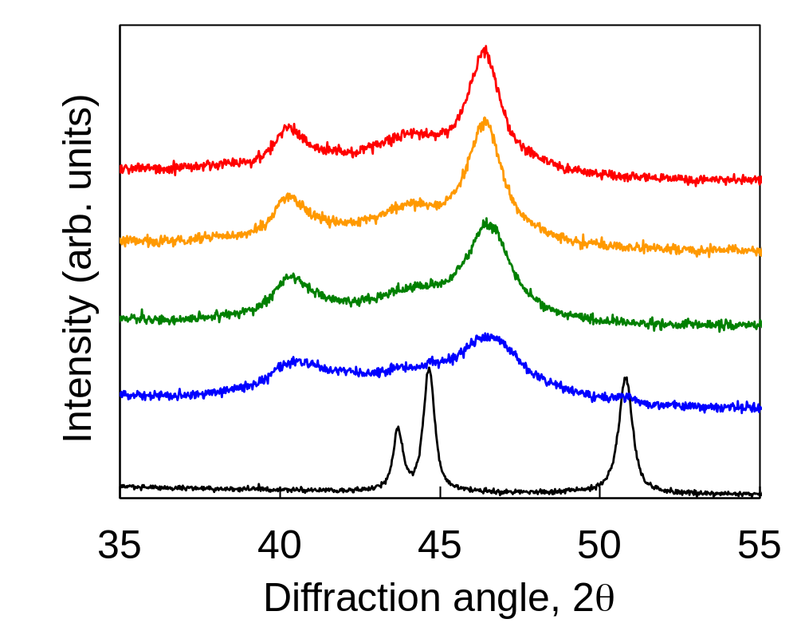
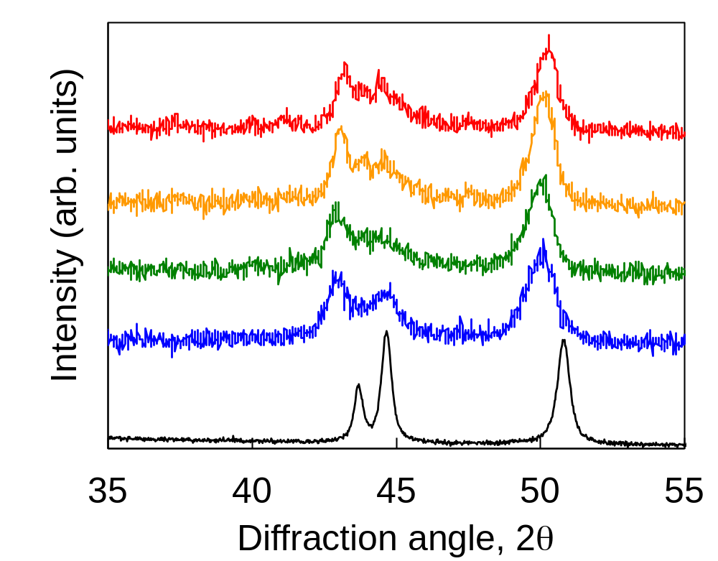
XRD Patterns
ASPN (Nitriding)
ASPC (Carburizing)
S
S
S
S
CrN
638 K
638 K
618 K
618 K
598 K
598 K
α’-Fe
578 K
578 K
γ-Fe
γ-Fe
α’-Fe
γ-Fe
Untreated
γ-Fe
Untreated
Peak shift ⇒ Lattice constant expansion width：ASPN ＞ ASPC
Half width ⇒ Strain in grain ： ASPN ＞ ASPC
Notes:
This slide shows the XRD patterns of the untreated and plasma-nitrided and carburized samples.
For untreated samples, there are three distinct peaks.
Two peaks are γ-Fe and a third peak is α’-Fe of strain-induced martensite generating during the drawing process of the pipe.
The pattern of ASPN and ASPC samples showed two wide peaks.
These peaks shifted to a low angle from the γ-Fe of the untreated samples. This indicates the formation of the S phase with nitrogen and carbon supersaturation.
ASPN has a larger peak shift and a larger half width comparing to ASPC, the lattice parameter expansion width and the strain in grain are larger than those of ASPC.

Slide 14
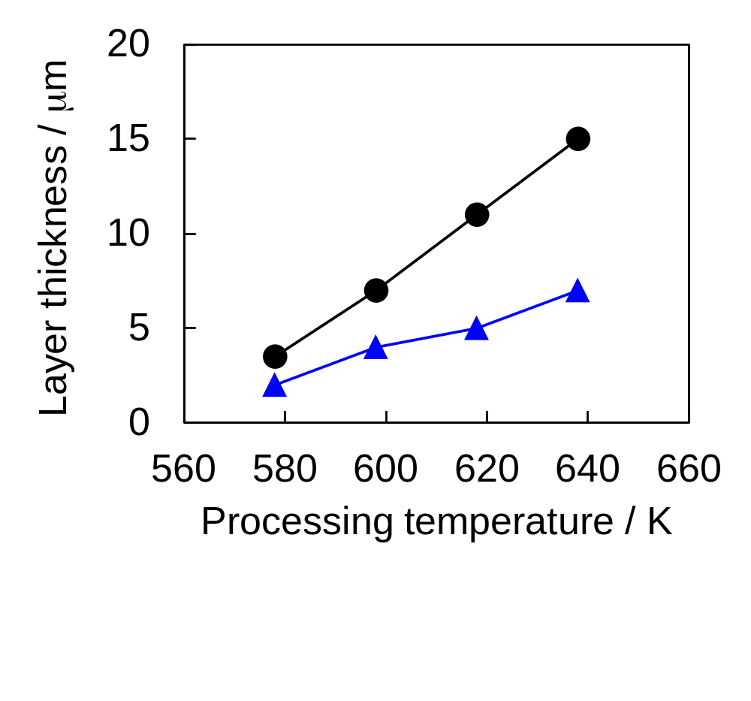
Layer Thickness
Processing temperature ⤴
Layer thickness ⤴
Layer thickness: ASPN > ASPC
ASPN (Nitriding)
ASPC (Carburizing)
Notes:
This slide shows the effect of the processing temperature on the S phase layer thickness.
The nitriding and carburizing layer thickness increased monotonically with the processing temperature.
The nitrided layer thickness was thicker than the carburized layer thickness.

Slide 15
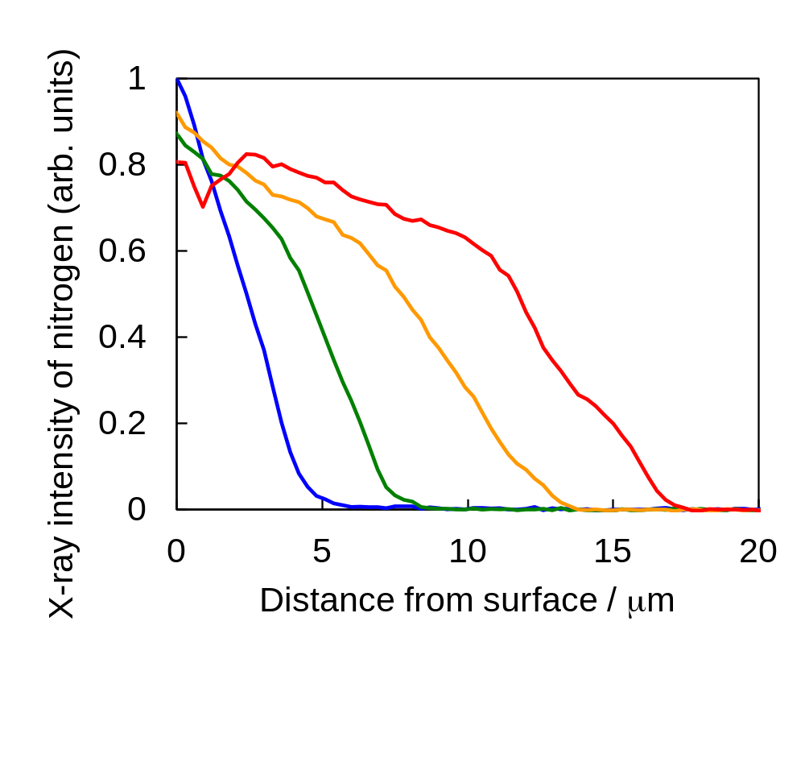
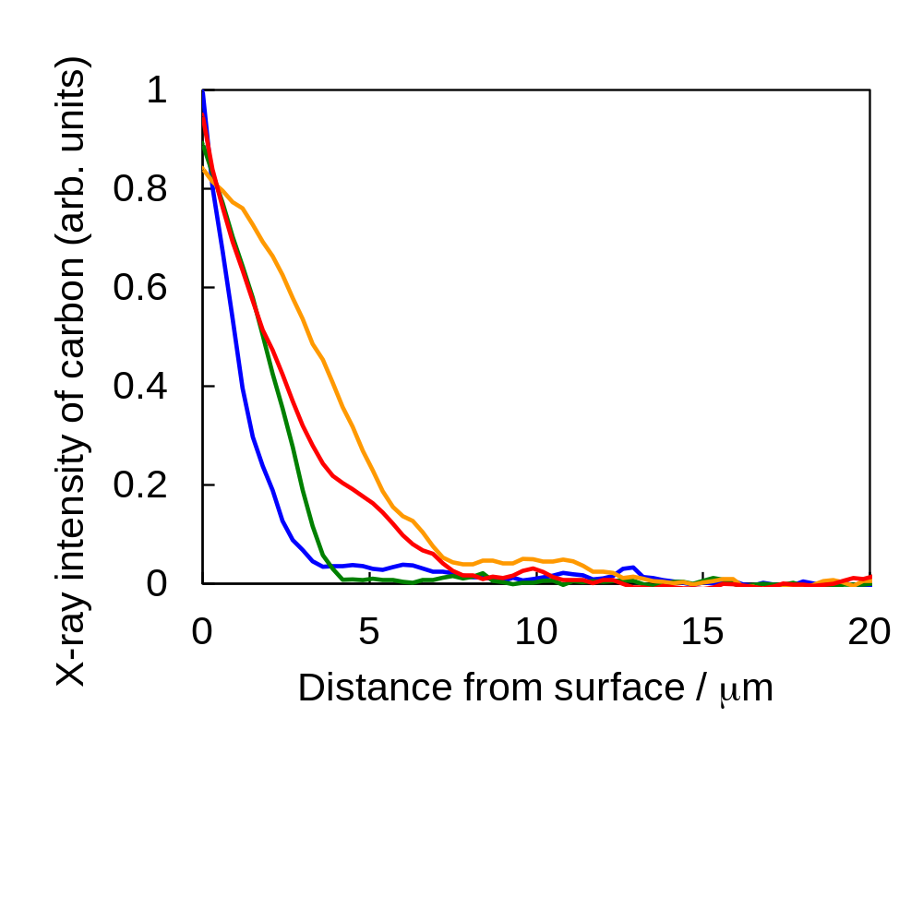
Nitrogen and Carbon Distributions
ASPN (Nitriding)
ASPC (Carburizing)
578 K
598 K
578 K
618 K
598 K
638 K
618 K
638 K
Processing temperature ⤴ ⇒ Near top surface is almost same level.
N and C diffused into the interior progressed.
Notes:
This slide shows the distribution of nitrogen and carbon concentration near the surface as measured by EPMA.
Even when the processing temperature was changed, there was no significant difference in the nitrogen and carbon concentration near the top surface.
But it was confirmed that the nitrogen and carbon diffusion into the interior progressed as the processing temperature increased, and the nitrided and carburized layer became thicker.

Slide 16
Topics
□ Background, Purpose
□ Experimental Setup and Conditions
□ Experimental Results
- S phase formation
- Mechanical properties
- Corrosion resistance
□ Summary
Notes:
Next, I want to explain about mechanical properties.

Slide 17
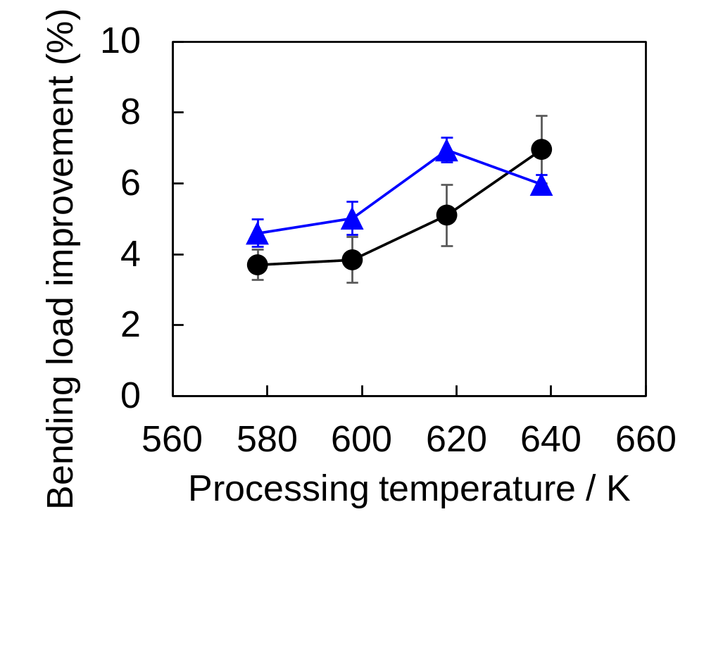
Bending Load Improvement
【Three-point bending test】
Indenter
Test sample
(Small diameter thin pipe)
0.5 mm/min
ASPC
(Carburizing)
Fulcrum
R2.5
Fulcrum
ASPN (Nitriding)
Distance between fulcrums: 30 mm
Bending load: load at a 1-mm displacement
Processing temperature ⤴
Bending load ⤴
Notes:
This slide shows the effect of the processing temperature on the bending load.
The bending load increased as the processing temperature increased. These results revealed that low temperature ASPN and ASPC is effective in improving the bending strength of small-diameter thin pipes composed of austenitic stainless steel.

Slide 18
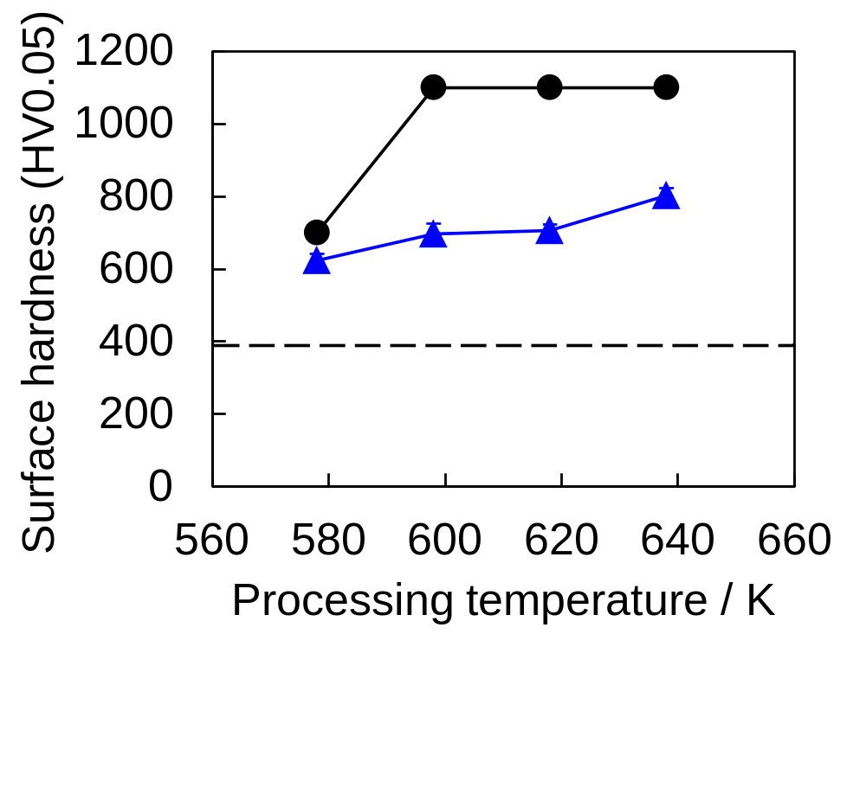
Surface Hardness
Vickers microhardness
Surface hardness
- ASPN > ASPC >> Untreated
- ASPN: Saturate at 1100 HV
ASPN (Nitriding)
ASPC (Carburizing)
Untreated
Notes:
This slide shows the effect of the processing temperature on the surface hardness.
The surface hardness was higher in the nitrided and carburized samples than in the untreated sample.
For the nitrided sample, the surface hardness increased with processing temperature and was saturated at 1100 HV owning to the N-supersaturated solid solution under nitriding temperature above 598 K (Kelvin).
At a nitriding temperature of 578 K (Kelvin), the surface hardness was influenced by the base metal because the nitrided layer was thin.
For the carburized sample, the surface hardness was lower than that of nitrided sample and reached around 800 HV after being carburized at 638 K (Kelvin).

Slide 19
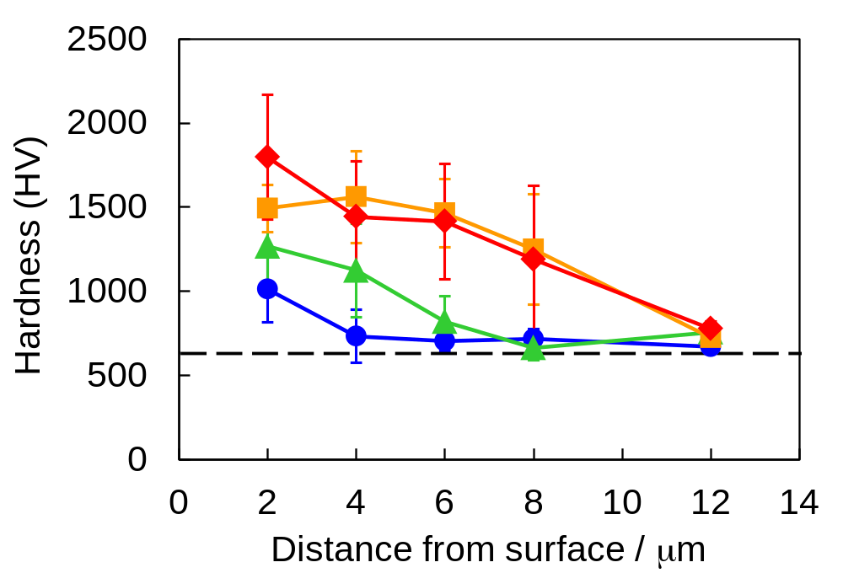
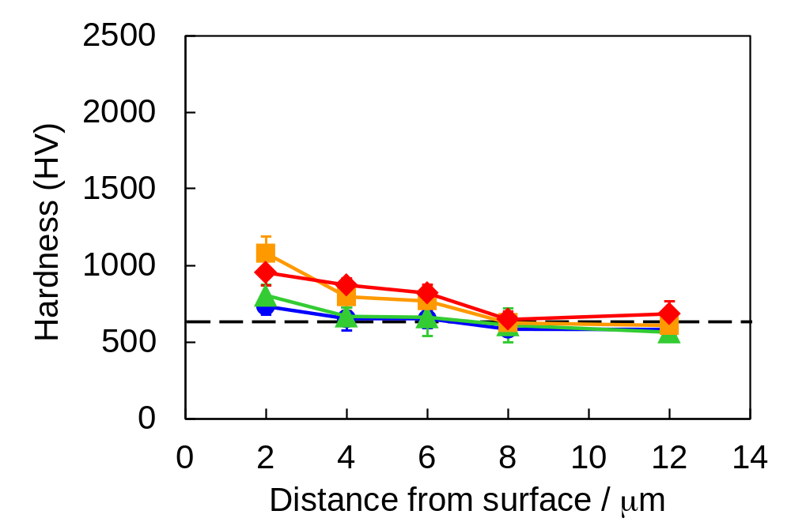
Hardness Distribution
Nanoindentation test
ASPN (Nitriding)
ASPC (Carburizing)
Nitriding temperature
578 K
598 K
618 K
638 K
Carburizing temperature
578 K
598 K
618 K
638 K
Untreated
Untreated
The hardness near the surface: increased as it got closer to the surface.
became higher with the processing temperature.
ASPN >> ASPC
Notes:
Nanoindentation was used to measure the hardness distribution and Young’s modulus distribution near the surface to investigate the mechanical properties in more detail.
This slide shows the hardness distribution near the surface.
As it got closer to the surface, the hardness increased.
Moreover, the hardness became higher with the processing temperature.
The hardness of nitrided sample was much higher than that of carburized sample.

Slide 20
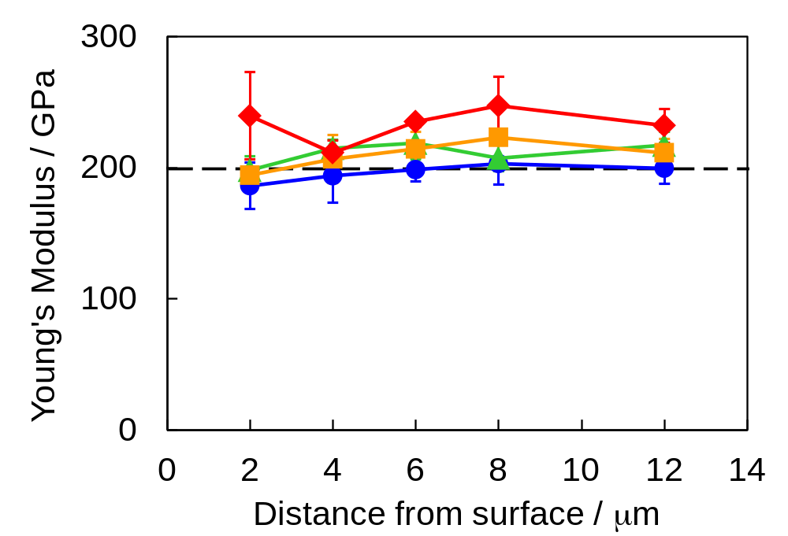
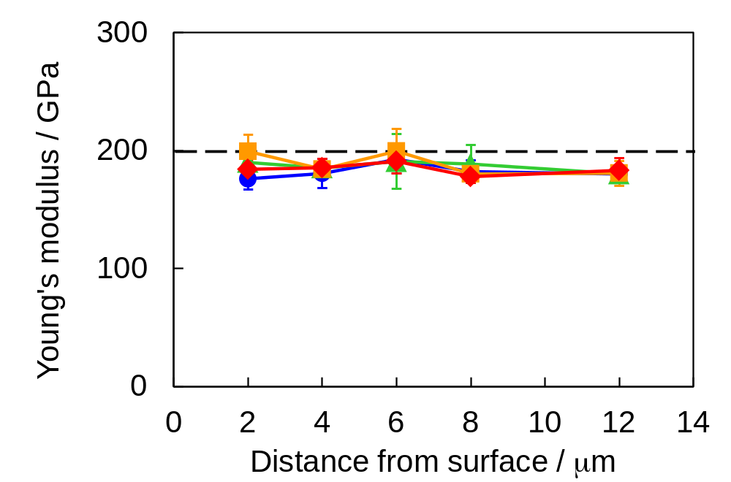
Young’s Modulus Distribution
Nanoindentation test
ASPN (Nitriding)
ASPC (Carburizing)
Untreated
Untreated
Nitriding temperature
578 K
598 K
618 K
638 K
Carburizing temperature
578 K
598 K
618 K
638 K
Young’s modulus: (ASPN) increased as the processing temperature increased.
(ASPC) almost constant and same with the untreated sample.
Notes:
This slide shows the distribution of Young’s modulus near the surface.
For the nitrided sample, Young's modulus tended to increase as the processing temperature increased.
For the carburized sample, the Young’s modulus was almost constant, with little difference from the untreated sample.
It was found that even in the S phase formed at the same processing temperature, the mechanical properties of the formed layer differ between ASPN and ASPC.

Slide 21
Topics
□ Background, Purpose
□ Experimental Setup and Conditions
□ Experimental Results
- S phase formation
- Mechanical properties
- Corrosion resistance
□ Summary
Notes:
Next, I want to talk about corrosion resistance.

Slide 22
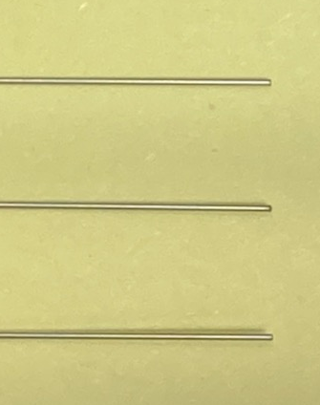
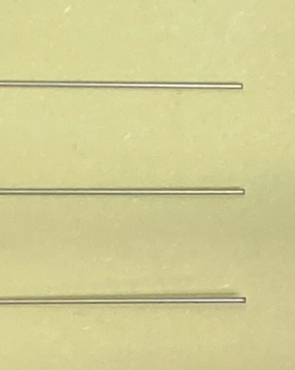
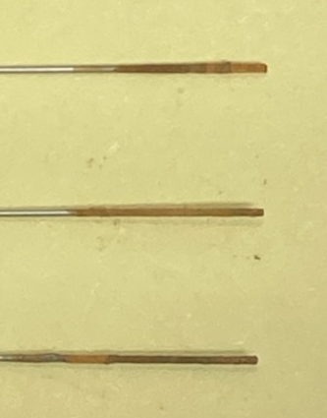
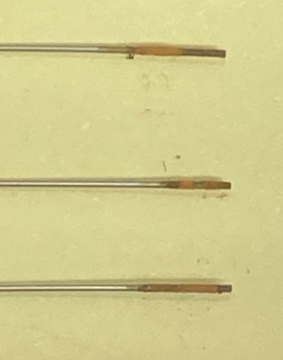
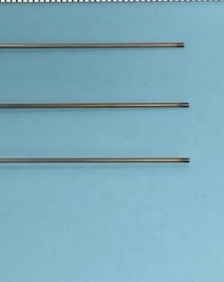
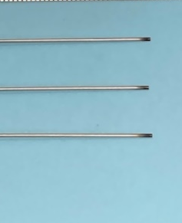
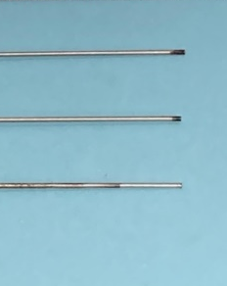
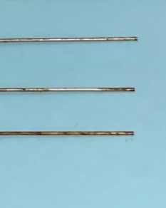
Corrosion Resistance
 | Processing temperature
 | 578 K | 598 K | 618 K | 638 K
ASPN (Nitriding)
ASPC (Carburizing)
Salt spray test
(96 hours)
Low processing temperature
⇒ No corrosion
Corrosion resistance
⇒ ASPC > ASPN
10 mm
No corrosion
Notes:
This slide shows the results of the corrosion resistance evaluation according to the salt spray test.
No corrosion was observed under low nitriding temperature conditions of 578 and 598 K (Kelvin) and low carburizing temperature ranging from 578 to 618 K (Kelvin).
At high processing temperatures of 638 K (Kelvin), corrosion was observed near the tip of the pipe; no corrosion was observed near the center of the pipe.

Slide 23
Comparison of ASPN and ASPC
Lattice constant | ASPN (Nitriding) ＞ ASPC (Carburizing) ＞ base material
Strain in grain | ASPN (Nitriding) ＞ ASPC (Carburizing) ＞ base material
Hardness | ASPN (Nitriding) ＞ ASPC (Carburizing) ＞ base material
Young’s modulus | ASPN (Nitriding) ＞ ASPC (Carburizing) ＝ base material
Corrosion resistance | ASPN (Nitriding) ＜ ASPC (Carburizing) ＜ base material
S phase characteristics | ASPN：close to compound layer (differ from base austenite phase) ASPC：close to base austenite phase
Notes:
Here, I want to compare ASPN and ASPC results.
Lattice constant, intragranular strain, and hardness became larger than base materials and ASPN results were higher than ASPC results.
The Young's modulus of ASPC was the same as that of the base material, but that of ASPN was larger than that of the base material.
The S phase characteristics of ASPC is thought to be close to the base austenite phase.
On the other hand, the S phase characteristics of ASPN is thought to be differ from base austenite phase and close to the compound layer.

Slide 24
Topics
□ Introductions
□ Background and Motivations
□ Experimental Setup and Conditions
□ Experimental Results
- S phase formation
- Mechanical properties
- Corrosion resistance
□ Summary
Notes:
Finally, I’m make summary.

Slide 25
Summary
A small-diameter thin pipe made of austenitic stainless steel was treated, and an S phase was formed by low-temperature ASPN and ASPC.
The S-phase thickness of ASPN was about twice as thick as that of ASPC.
In addition, although the Young's modulus did not change in ASPC, it was confirmed that the Young's modulus tended to increase as the processing temperature increased in ASPN.
It became clear that there is a difference in the mechanical properties of the S phase obtained between ASPN and ASPC.

Slide 26
Acknowledgments
The authors wish to express their gratitude to Dr. Motoo Egawa, ORIST (Osaka Research Institute of Industrial Science and Technology), for his valuable comments and direction.
This paper is based on a new development of results obtained from a project subsidized by Sakai City.

Slide 27
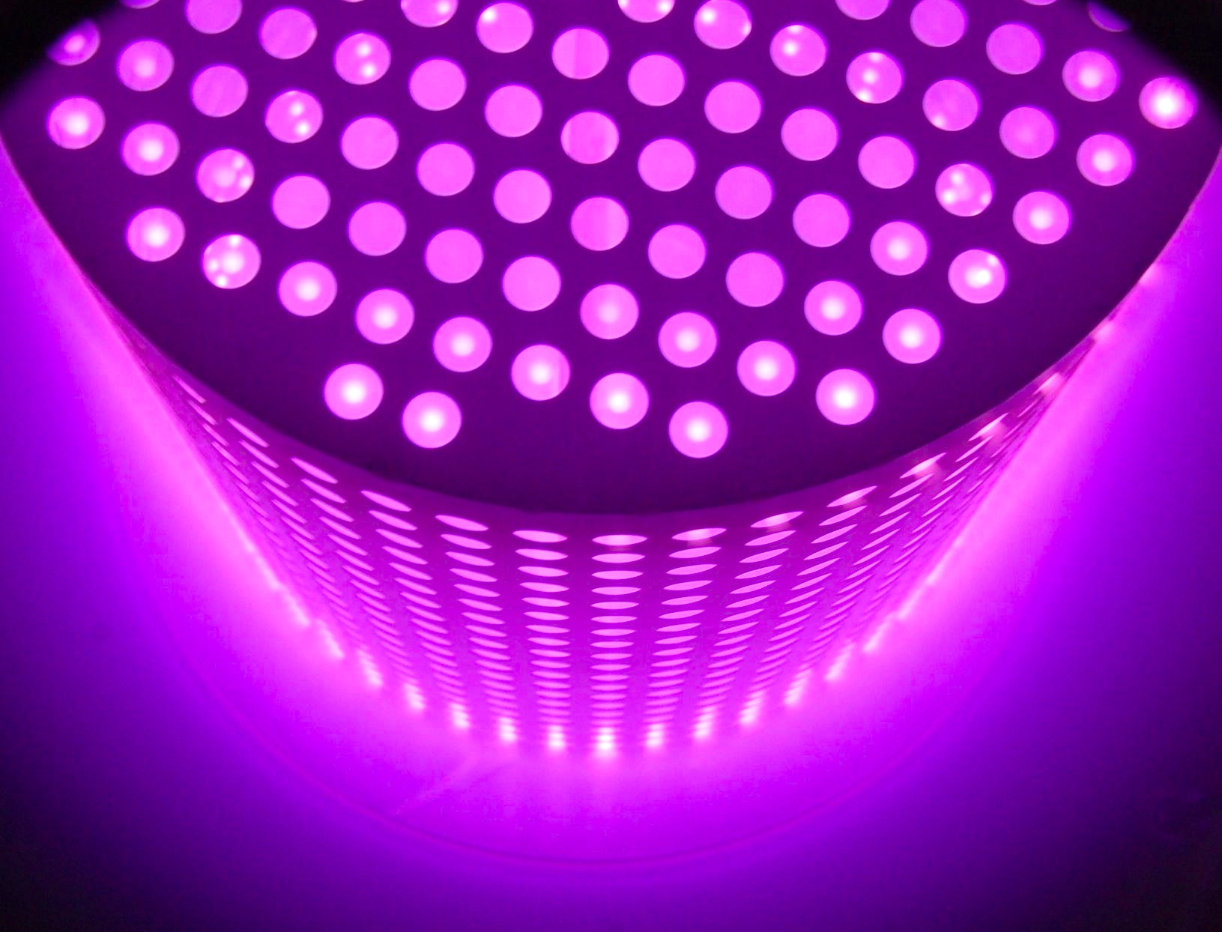
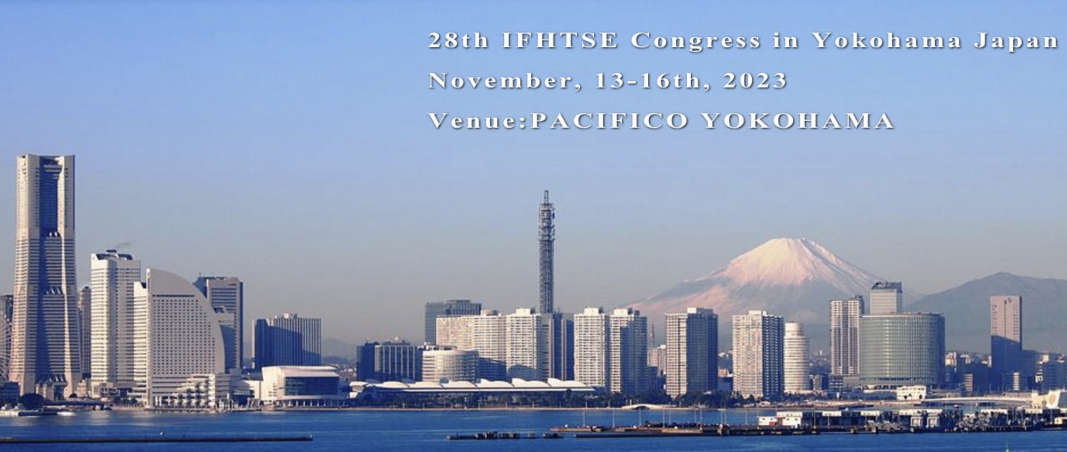

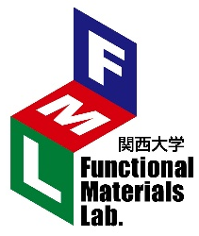
Thank you for your kind attention!
See you in next 28th Congress in Japan!
KANSAI UNIVERSITY
Functional Materials Lab.

Slide 28
Appendix

Slide 29
窒化S相と浸炭S相との比較
格子定数 | ASPN（窒化）＞ ASPC（浸炭）＞ 母材
結晶粒内の歪み | ASPN（窒化）＞ ASPC（浸炭）＞ 母材
硬度 | ASPN（窒化）＞ ASPC（浸炭）＞ 母材
ヤング率 | ASPN（窒化）＞ ASPC（浸炭）= 母材
耐食性 | ASPN（窒化）＜ ASPC（浸炭）＜ 母材
窒化S相の特性 | オーステナイト母相と異なり、化合物層に近い性質。
浸炭S相の特性 | オーステナイト母相に近い性質。

Slide 30
FCC Octahedral Structure of S Phase
Atom
Octahedral interstitial sites

Slide 31
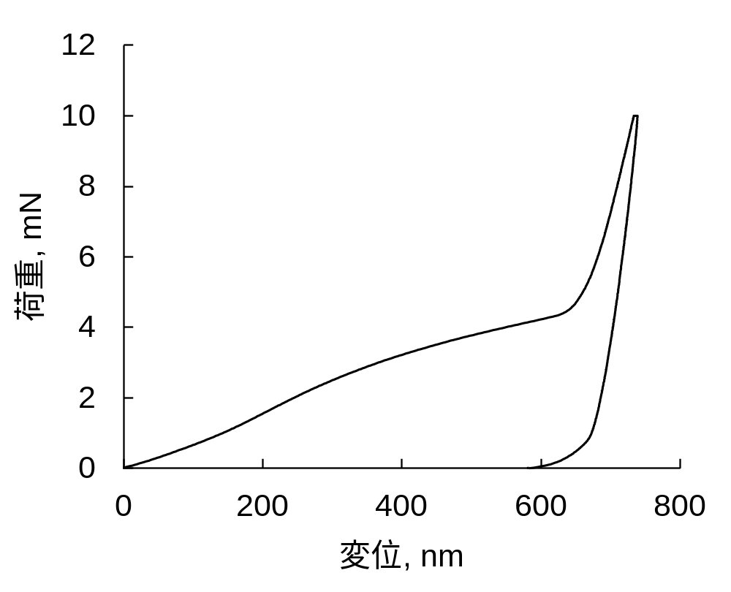
Nanoindentation Test (Load-Displacement Curve)
Processing temperature：365 ℃
Measurement point：3 μm from surface
Load, mN
Displacement, nm

Slide 32
Bending Load Measurement (3-Point Bending)
Indenter
Test sample
(Small diameter thin pipe)
0.5 mm/min
Fulcrum
Fulcrum
R2.5
Distance between fulcrums: 30 mm
Bending load
Load at a displacement of 1 mm when the pipe is pushed at a speed of 0.5 mm/min.
Comparing of bending load between untreated and treated products
Notes:
処理後のパイプは、断面組織の観察と曲げ強度の測定を行いました。
曲げ荷重測定は3点曲げで行いました。
支点間距離30 mm、支点形状2.5Rであり、0.5 mm/minの速度でパイプを押した際の変位1 mm時の荷重を測定しています。
未処理品と曲げ荷重を比較することで、曲げ荷重向上率を算出しました。

Slide 33
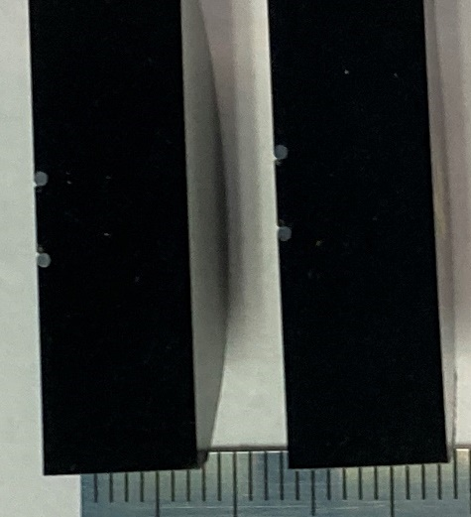
Observation of Cross-Sectional Structure
Manufacturer：OLYMPUS、 Model No.：GX71
Cut the pipe after filling it with resin.
After finishing the cut surface with emery paper and buffing, it is corroded with marble liquid.
Marble liquid
・Cupper sulfate ：4 g
・Hydrochloric acid：20 cc
・H₂O ：20 cc

Slide 34
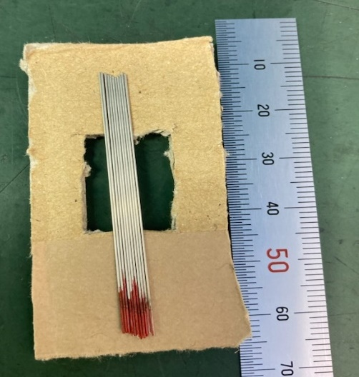
XRD Measurement
Manufacturer：Rigaku Corporation、Model No.：RINT-2500
【XRD conditions】
【XRD sample fixation】
X-ray output | 40 kV, 150 mA
Goniometer | SmartLab (In-plane)
Attachment | RxRy
Filter | Cu_K-beta
CBO selection slit | BB
Detector monochromator | None
Scan speed/counting time | 3.0000 deg/min
Scan width | 0.0200 deg
Scan axis | 2θ / θ
Scan range | 30.0000 – 60.0000 deg
Entrance slit | 2/3 deg
Longitudinal limit slit | 5.0 mm
Line up 10 pipes without gaps and fix with tape.
An aluminum plate is used during the actual test.

Slide 35
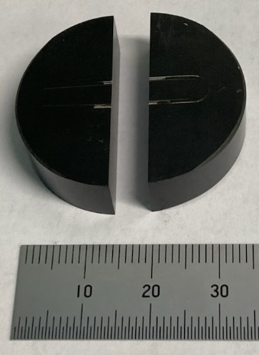
Surface Hardness Measurement
Manufacturer：Mitsutoyo、Model No.：HM-211+AT-400 (micro Vickers)
The hardness of the pipe surface is measured after it is filled with resin and buffed.

Slide 36
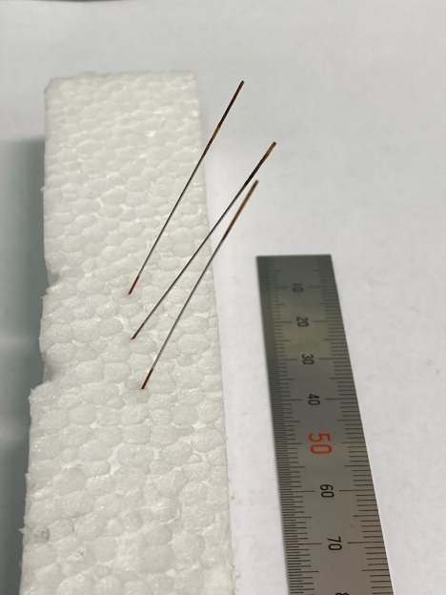
Salt Spray Test
Sodium chloride concentration of spray liquid：50 g/L±5 g/L
Amount of spray liquid (per 80 cm2 horizontal sampling area)：
1.5 mL/h±0.5 mL/h
Atomizing chamber temperature：35 ℃±2 ℃
Test time：96 hours
Reference standard：JIS Z 2371 Neutral salt spray test method
A salt spray test was performed by inserting the pipe into the polystyrene foam at an angle of about 60 degrees.

