Slide 1


Improving the properties of K490MC tool steel after hardening accompanied with deep cryogenic treatment and plasma nitriding
Darko Landek (dlandek@fsb.hr)
Filip Žanetić
University of Zagreb, Faculty of Mechanical Engineering and Naval Arhitecture, Ivana Lučića Street, No.5, Zagreb, Croatia

Slide 2
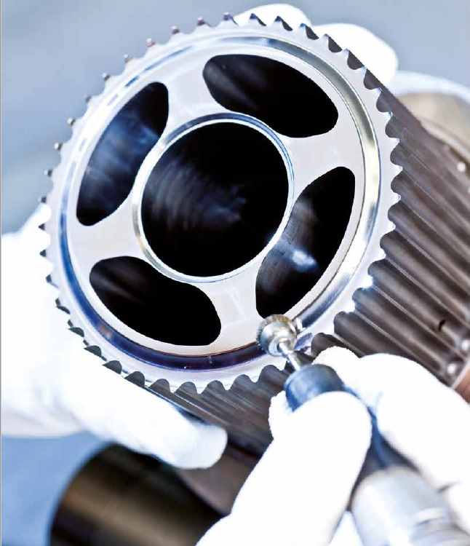
Overview
1. Introduction
2. Materials and methods
  2.1. Hardening and tempering of the tool steel BÖHLER K490 MICROCLEAN®
  2.2. Plasma nitriding
3. Results
  3.1. Tempering diagrams
  3.2. Hardness after plasma nitriding
  3.3. Microstructure and nitriding depth
4. Conclusion
1. Introduction
2. Materials and methods
3. Results
4. Conclusion

Slide 3
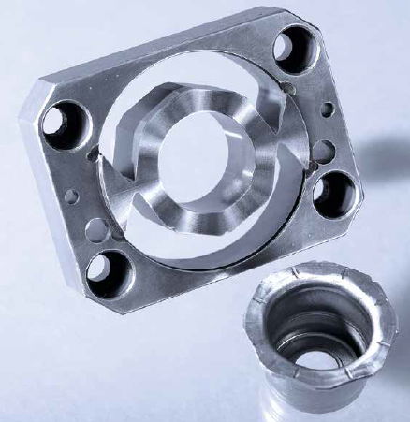
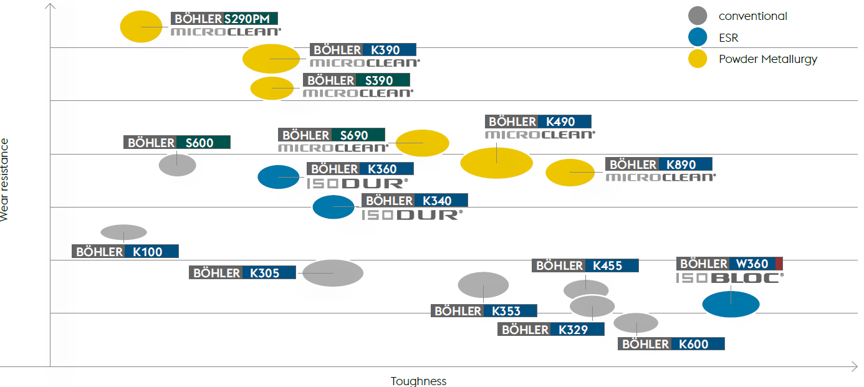
Steel BÖHLER K490 MICROCLEAN
High hardness (up to 64 HRC)
Very good toughness
High abrasive and adhesive wear resistance
Excellent hard machinability
High compressive strength
Heat treatment together with common cold work tool steels (1.2379, D2) at hardening temperatures from 1030 to 1080 °C possible
Stable mechanical properties
1. Introduction
2. Materials and methods
3. Results
4. Conclusion

Slide 4
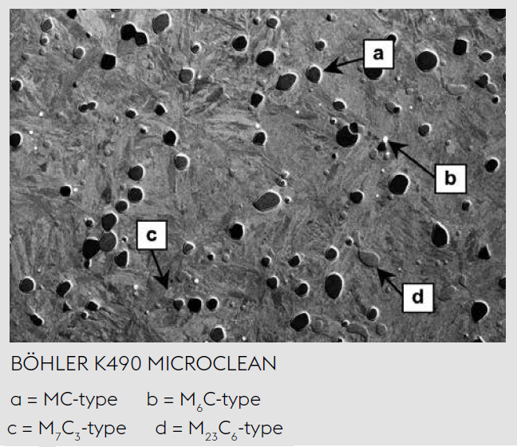
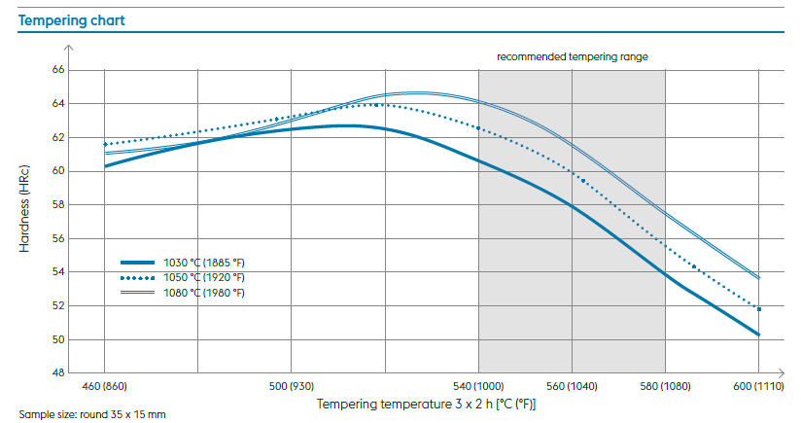
Steel BÖHLER K490 MICROCLEAN
1. Introduction
2. Materials and methods
3. Results
4. Conclusion

Slide 5
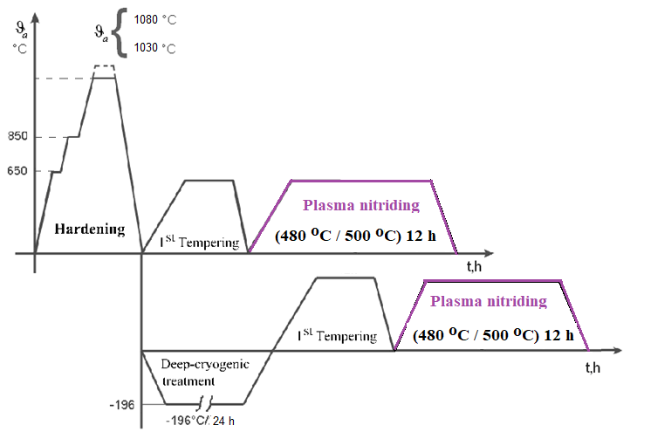
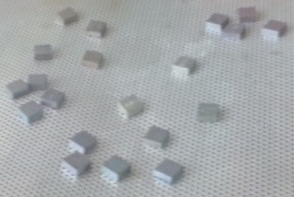
2. Materials and methods
Chemical composition of tool steel K490MC
Chemical element | C | Si | Mn | Cr | Mo | V | W | Nb
wt, % | 1.39 | 0.57 | 0.35 | 6.42 | 1.50 | 3.66 | 3.48 | 0.20
Sample label and heat treatment of tool steel K490MC
Sample label | Austenitization/ Quenching | DCT | Tempering temperature, °C
 |  |  | 500 | 525 | 550 | 575 | 600
A0 | 1030 °C/30 min/N₂ | - | A01N | A02N | A03N | A04N | A05N
B0 | 1080 °C/20 min/N₂ | - | B01N | B02N | B03N | B04N | B05N
AX | 1030 °C/30 min/N₂ | -186 °C/24 h/N₂ | AX1N | AX2N | AX3N | AX4N | AX5N
BX | 1080 °C/20 min/N₂ | -186 °C/24 h/N₂ | BX1N | BX2N | BX3N | BX4N | BX5N
Plasma nitrided
Salth bath nitrided
Heat treatment and samples of tool steel K490MC
1. Introduction
2. Materials and methods
3. Results
4. Conclusion

Slide 6
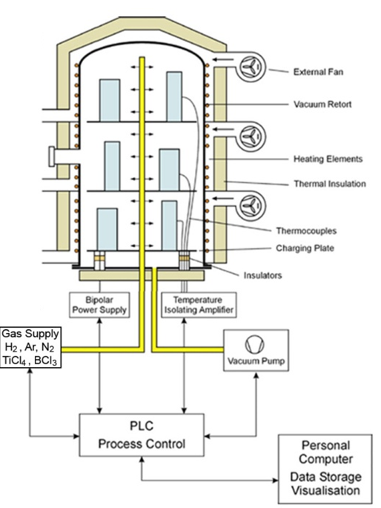
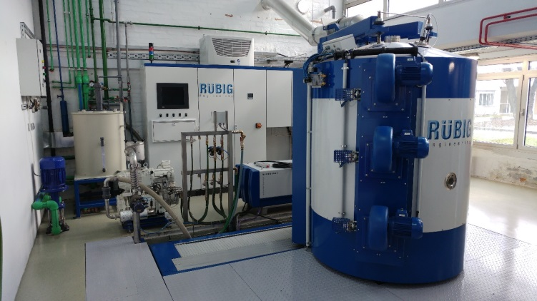
Surface modification process | Process parameters
Plasma nitriding in the Rübig PC 70/90 S system | Cleaning the surface by ions sputtering: 480 °C /2 h (2 mbar; 1800 W; 90 % H₂, 5 % N₂, 5 % Ar) Plasma nitriding: 500 °C / 10 h (2 mbar; 3000 W; 70 % H₂, 20 % N₂, 10 % Ar) Cooling: 2 mbar, 100% N₂
System for plasma nitriding and PACVD processes Rübig PC 70/90
1. Introduction
2. Materials and methods
3. Results
4. Conclusion

Slide 7
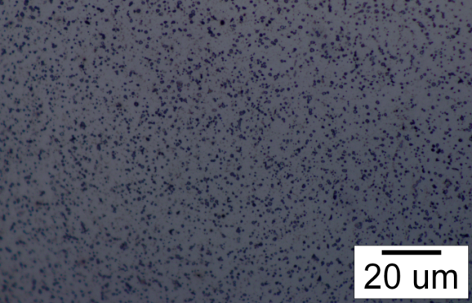
3. Results: Hardness after quenching and tempering
(a)
(c)
(b)
The tempering diagrams of hardened and tempered K490MC steel treated with an austenitization temperature of (a) 1030 °C and (b) 1080 °C, with and without application DCT. (c) Microstructure of the sample BX4 (DCT + tempering at 575 °C/2 h)
1. Introduction
2. Materials and methods
3. Results
4. Conclusion

Slide 8
3. Results: Surface hardness after plasma nitriding
(a)
(b)
The tempering diagrams of hardened and tempered K490MC steel treated with an austenitization temperature of 1030 °C before and after plasma nitriding:
conventionally heat treated samples
samples with application of DCT after quenching
1. Introduction
2. Materials and methods
3. Results
4. Conclusion

Slide 9
3. Results: Surface hardness after plasma nitriding
(a)
(b)
The tempering diagrams of hardened and tempered K490MC steel treated with an austenitization temperature of 1080 °C before and after plasma nitriding:
conventionally heat treated samples
samples with application of DCT after quenching
1. Introduction
2. Materials and methods
3. Results
4. Conclusion

Slide 10
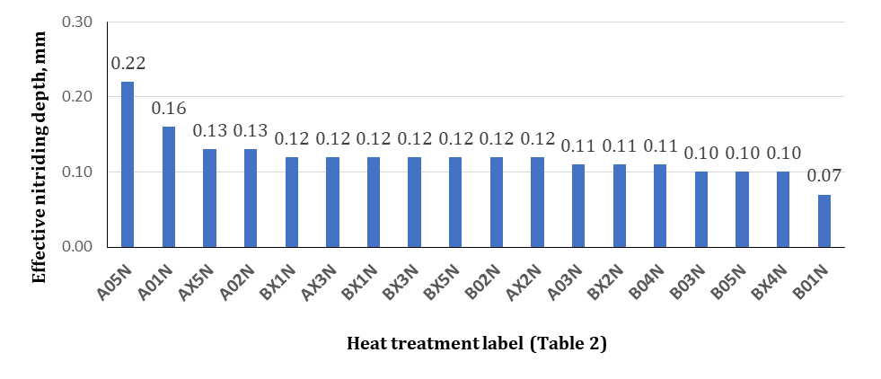
3. Results: Microstructure and nitriding depth
Samples with higher surface hardness achieved a smaller effective nitriding depth !
The effective nitriding depth of nitrided samples of steel K490 MicroClean depending on heat treatment denoted with the labels showed in Table 2
1. Introduction
2. Materials and methods
3. Results
4. Conclusion

Slide 11
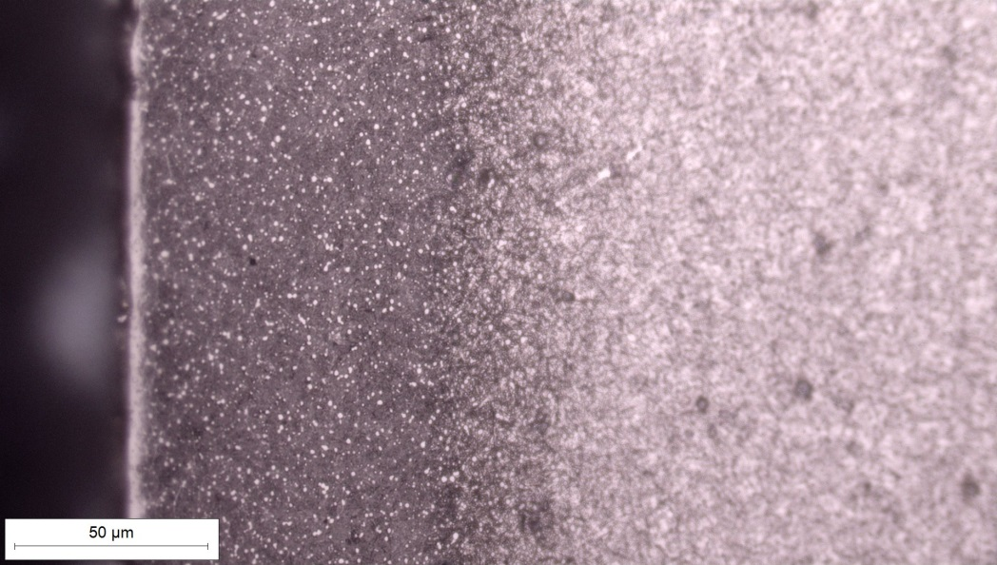
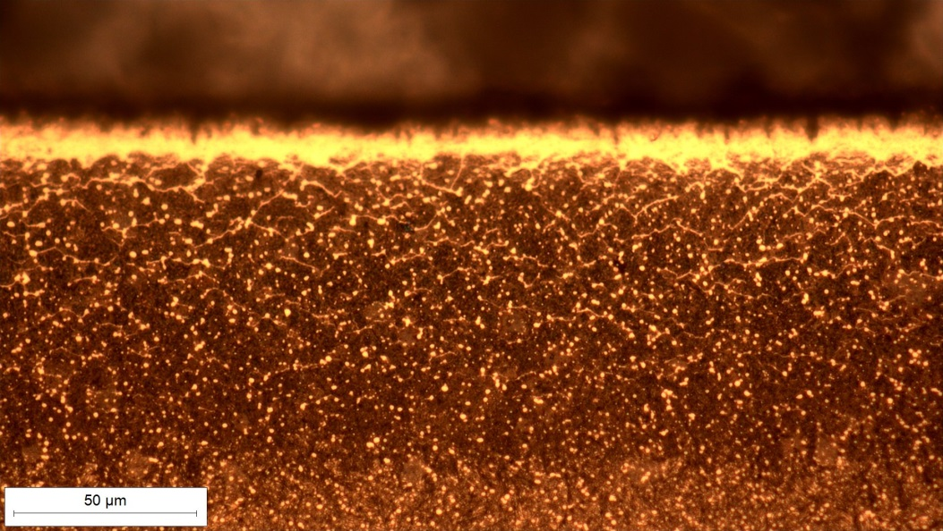
3. Results: Microstructure and nitriding depth
(a)
(b)
Surface layer of nitrided samples from steel K490 MicroClean after hardening at austenitization temperature 1080 °C, DCT procedure, single tempering and:
plasma nitriding at 500 °C / 10 h (the sample BX4N),
salt bath nitriding at 580 °C/ 2 h (the sample BX5N).
Etching microstructure with 5% NITAL
1. Introduction
2. Materials and methods
3. Results
4. Conclusion

Slide 12
4. Conclusions
Quenching of the tested steel from a temperature of 1080 °C achieves 2 HRC to 3 HRC higher hardness than quenching from austenitization temperature of 1030 °C.
The application of DCT gives the highest achievable hardness for steel K490MC in the amount of 64 HRC to 65 HRC
The steel showed good resistance to tempering up to a temperature of 600 °C
The application of plasma nitriding achieves an additional increase in the hardness on the surface of the sample regardless of the previous heat treatment
The highest value of surface hardness after plasma nitriding, up to to 1300 HV 0.1 was achieved on samples that had previously been hardened with austenitization temperature 1080 °C, deep cryogenic treated and tempered at a temperature range of 550 °C to 575 °C
The application of the salt bath nitriding also achieves high surface hardness, up to 1250 HV 0.1 and nitriding depths up to 0.2 mm, but with porous and more fragile compound zone than the nitride zone on plasma nitrided samples.
1. Introduction
2. Materials and methods
3. Results
4. Conclusion

Slide 13


Thank you for your attention
Darko Landek (dlandek@fsb.hr)
Filip Žanetić (fzanetic@fsb.hr )
University of Zagreb, Faculty of Mechanical Engineering and Naval Arhitecture, Ivana Lučića Street, No.5, Zagreb, Croatia

