Slide 1

27th IFHTSE CONGRESS & EUROPEAN CONFERENCE ON HEAT TREATMENT 2022
Analysis of shots flight inside and
outside of peening nozzle
Yusuke Saeki, Masahiro Okumiya, and Koichiro Nambu
Materials Processing Laboratory, Toyota Technological Institute,
2-12-1 Hisakata, Tenpaku-ku, Nagoya, Japan
Notes:
Hello, I’m Yusuke Saeki and I’m a graduate student at the Material Processing Laboratory in Toyota Technological Institute.
I’m delighted to be here today to talk to you about our research in Fine Particle Peening.
The theme of our research is analysis of shots flight inside and outside of peening nozzle.
The purpose of my presentation is to share with you the potential our research has for improving processing efficiency.

Slide 2

Core structure
Introduction to Fine Particle Peening
Airflow analysis by FEM
Shots flight analysis by MPS
Notes:
My talk is divided into 3 parts.
First, I’ll give you an introduction to Fine Particle Peening.
Second, I’ll briefly describe the airflow analysis inside and outside of peening nozzle using Finite Element Method simulation.
Finally, I’ll explain shots flight analysis using Moving Particle Simulation.
OK, let me begin.

Slide 3
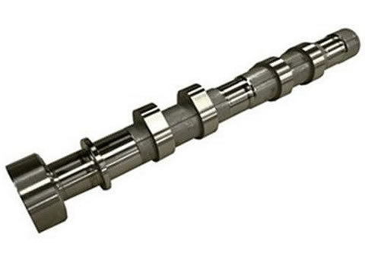
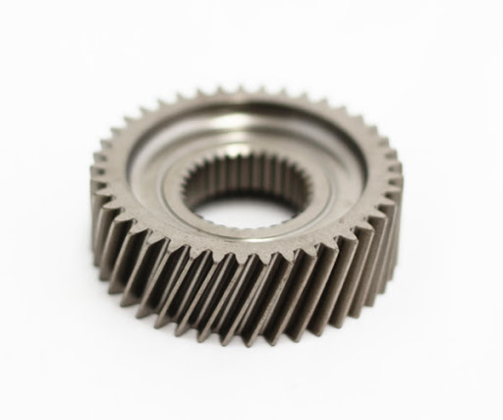
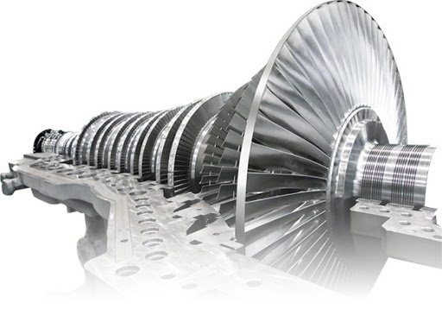
Introduction
Fine Particle Peening (FPP)
Shot
Application example
Specimen
Camshaft*¹
Gear*²
Compressive residual stress and work hardening
→Improve fatigue strength
Turbine*³
＊1 http://www.snm.co.jp/j/lecture/turbines.html ＊2 http://o-oka.jp/product/at/
＊3 https://toolnavi.jp/machinenews/newslist/ai-1
Notes:
First, I’ll give you an introduction to Fine Particle Peening.
FPP is one of the cold working process to improve fatigue strength.
FPP is used in a wide range of industries such as automobiles and airplane.
Everyone, please look at this figure on the left.
FPP is a process which a shots collide with a specimen.
The collision of the shot with the specimen results in compressive stress on the specimen surface.
After the collision, compressive stress remains on the specimen surface.
Compressive residual stress is said to be effective in improving fatigue strength because it cancels out tensile stress, which is the cause of fatigue failure.
In addition, work hardening occurs because the specimen surface is deformed when the shot collides with the specimen.
Hardness is also an important factor that greatly affects fatigue strength.
FPP improves fatigue strength by two effects, compressive residual stress and work hardening.
Therefore, it is conducted for parts that are subjected to repetitive loads such as camshaft, gear and turbine.
The following slide describe FPP issues.

Slide 4

Introduction
Issues of FPP
Optimization of FPP
There are many parameters to consider.
⇒
Trial and error takes an enormous amount of time and money.
Benefits of simulation
Significant saving in time and money
Prediction of Compressive residual stress
https://listing.cn-door.com/point/195.html
Notes:
There are many parameters to consider in FPP when optimizing FPP process.
Optimizing the process in the actual field takes a great deal of time and money due to repeated trial and error.
That’s why there is a growing interest in optimizing the process using simulation.
The use of simulation can save a great deal of time and money.
Not only that, but it can also predict the compressive residual stresses to be applied to the specimen.

Slide 5
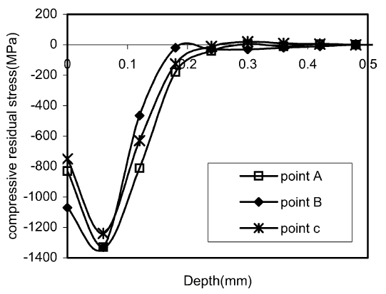
Introduction
Previous study (Residual stress)
Maximum compressive residual stress occurs inside specimen.
The magnitude of compressive residual stress is proportional to the component of shot velocity perpendicular to specimen.
＊ G.H. Majzoobi, Journal of Materials Processing Technology, 164-165, 2005, 1226-1234
Notes:
This slide shows a previous study on residual stress analysis of FPP.
Please take a look at this figure.
The maximum compressive residual stress occurs inside the specimen, not on the specimen surface, because springback allows compressive residual stress to escape from the surface.
The magnitude of the compressive residual stress is proportional to the component of shot velocity perpendicular to the specimen.
However, the increase in residual stress with increasing velocity converges at a specific value.
(In some cases, the maximum compressive residual stress also decreases with increasing velocity.
Springback is a slight return of deformation of the specimen surface due to elasticity. This causes stress release and reduces the residual stress on the specimen surface.)

Slide 6
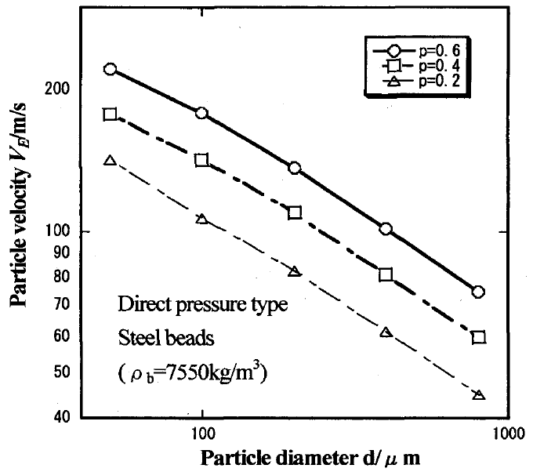
Introduction
Previous study (Shots velocity)
Velocity of shots increased as the nozzle inlet pressure increased.
The shots velocity was proportional to nozzle inlet pressure to the 0.57th power.
＊Nambu K., et al., Transaction of JSME(ver.C). 2010, 76(772), 546
Notes:
This slide shows a previous study on shot velocity analysis of FPP.
Please look at this figure.
Nambu showed the velocity of shots increased as the nozzle inlet pressure increased, and there was a linear relationship between the two.
Also, they suggested the optimal distance between nozzle outlet and the specimen.
The part where the shot was accelerated the most was the nozzle parallel section, indicating the need to consider the optimal length of the nozzle parallel section to obtain high velocity of shots.
In addition, the shot velocity was proportional to the nozzle inlet pressure to the 0.57th power in the case of direct-pressure-type peening.

Slide 7
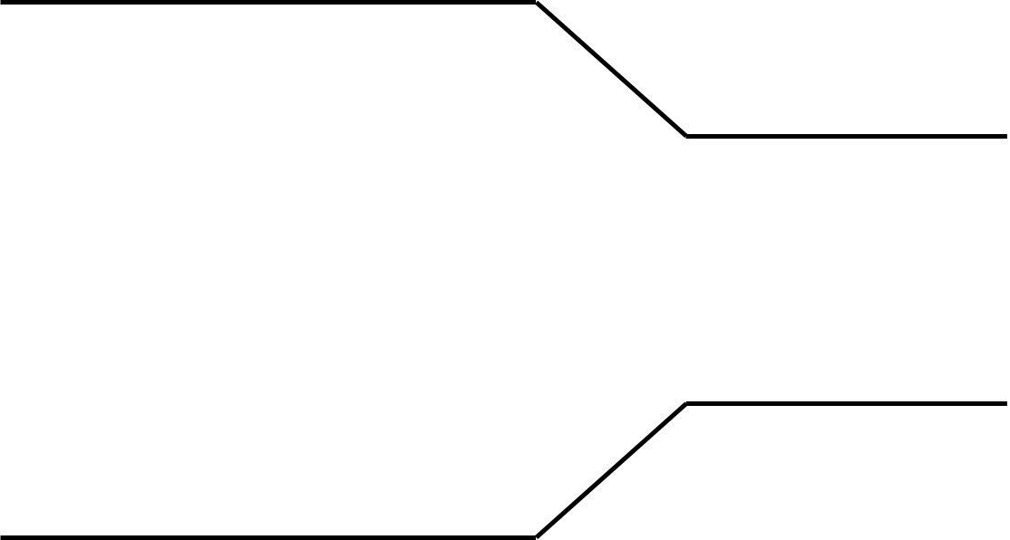
Introduction
Overview of FPP
Airflow
Shot
Nozzle
Inside of the nozzle
Outside of the nozzle
Simulate the spread and bounce of the shot
Notes:
Please take a look at this figure.
This figure shows the overview of FPP.
In FPP, the shot is released from the nozzle by an airflow.
Outside the nozzle, depending on the spread of the airflow, there is also a spread in the shots flight.
After a shot bounces off the specimen, the bounced shot collides with the flying shot.
However, to the best of my knowledge, there are no studies that analyze shot flight behavior, such as shot bounce back from the specimen or collisions between shots, and the processing conditions are determined by empirical rules at the actual processing site.
The purpose of our research is to optimize the conditions of FPP process by analyzing the series of shot flight by simulation.
Once the optimal processing conditions can be formulated, anyone can easily determine the processing conditions, which until now have relied on empirical rules.

Slide 8
Outline of the simulation
FEM software
introduce
MPS software
Nozzle
Shot
Airflow data obtained from FEM
Shots flight on airflow
Simulation of many shots flight inside and outside of the nozzle
Notes:
OK, Let’s begin.
My research was conducted in two stages.
Please take a look at these figures.
The first stage is to simulate the airflow inside and outside of peening nozzle using FEM software.
In the second stage, airflow data obtained by FEM software is introduced into MPS software to analyze shot flight behavior.
I chose this method because I wanted to observe how the shots bounced off the specimen and how they collided with each other.
I will explain the individual stages in detail on the next and subsequent slides.

Slide 9
Airflow analysis by FEM
Simulation condition
Inlet pressure
0.2MPa
Outlet diameter
4, 5, 6mm
Distance between outlet and specimen
50, 100, 150mm
500 mm
28 mm
55 mm
Physical properties
Nozzle parallel section
Cp (specific heat) [J/kg-K] | 1006.43 (constant)
Thermal Conductivity [W/m-K] | 0.0242 (constant)
Viscosity [Pa-s] | 1.7894e-5 (constant)
Molecular Weight [kg/kmol] | 28.966 (constant)
Φ20 mm
y
Outlet
( y=0 )
Inlet
Nozzle
Specimen
Notes:
First, I will describe the simulation of airflow analysis inside and outside of the nozzle using FEM software.
Please look at this diagram.
This diagram shows the dimension of the analyzed model.
The central axis of the nozzle was set as the y-axis.
(The dimensions of the specimen are 50 mm in length and width and 5 mm in thickness.)
I chose three parameters for the simulation conditions, the inlet pressure, the nozzle outlet diameter, the distance between the nozzle outlet and the specimen.
The inlet pressure is 0.2 MPa only, the nozzle outlet diameter is 4, 5, or 6 mm, and the distance between the nozzle outlet and the specimen is 50, 100, or 150 mm.
(Physical properties are shown in this table.)

Slide 10
Airflow analysis by FEM
y
y=0
Simulation results of airflow velocity
When the nozzle outlet diameter is varied
(Distance between the nozzle outlet and the specimen 100mm)
When the distance between the nozzle outlet and the specimen is varied
(Nozzle outlet diameter 5mm)
The larger the nozzle outlet diameter, the higher the velocity after the nozzle outlet.
Notes:
Now, I’ll talk about first result.
We investigated airflow velocity in y-direction distribution on the y-axis.
Please take a look at these scatter diagrams.
(The horizontal axis shows position in y-axis. The vertical axis shows y-direction velocity.)
You can see here that the airflow velocity after the nozzle outlet increases as the nozzle outlet diameter increases.
This is because the larger the nozzle outlet diameter, the greater the air flow rate at the nozzle outlet and the smaller the resistance near y-axis.
(For air with a large airflow velocity, air with a small airflow velocity becomes a resistance.
Since the airflow velocity decreases from the outside of the mainstream, the larger the mainstream area, the greater the airflow velocity near y-axis is expected to remain.)
When the distance between the nozzle outlet and the specimen was varied, there was no change in the velocity distribution near the nozzle outlet.
Now, move on to the next result.

Slide 11
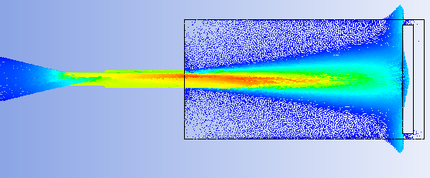
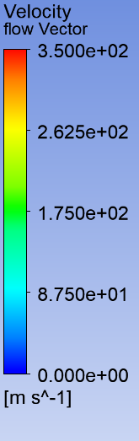

Airflow analysis by FEM
Simulation results of airflow spread
Nozzle outlet diameter 6mm
The larger the nozzle outlet diameter, the larger the area of high velocity after the nozzle outlet.
Specimen
Nozzle outlet diameter 4mm
Notes:
Next, we investigated airflow spread after the nozzle outlet.
Please look at this figure.
This figure shows airflow spread outside of the nozzle with two different nozzle outlet diameter.
You can see here that the larger the nozzle outlet diameter, the larger the area of high velocity after the nozzle outlet.
And velocity near the specimen decreased rapidly due to the bouncing of airflow.
Move on to the next simulation.

Slide 12
Shots flight analysis by MPS
Simulation condition
Airflow obtained from FEM
Shot
Diameter : 100μm
Gravity
Material : Steel
y
Density [kg/m³] | 7550
Young's modulus [GPa] | 207
Poisson's ratio | 0.3
Yield stress [GPa] | 0.27
Outlet
( y=0 )
Inlet
Nozzle
Specimen
※The physical properties of the airflow were averaged over the nozzle parallel section.
＊ Loth E., AIAA JOURNAL. 2008, 46(9), 2219
Notes:
Second, I will describe the simulation of shots flight analysis using MPS software.
Please look at this diagram.
This diagram shows the schematic of the analysis in MPS.
The airflow data obtained from FEM analysis described earlier was introduced into MPS software.
The shot diameter was 100 μm.
The material of shot was steel, and the properties of steel are shown in the table.
Gravity is assumed to act in the positive direction of the y-axis.
The physical properties of the airflow, such as density and drag coefficient, were averaged from the nozzle parallel section.
(This is because only one airflow data can be introduced. Compressibility of airflow cannot be considered in MPS.)
This is because shot velocity is most affected at the nozzle parallel section.
The kinematic viscosity was determined by calculating the viscosity coefficient from Sutherland's formula of viscosity.
The drag coefficient was determined from the paper by Loth.

Slide 13
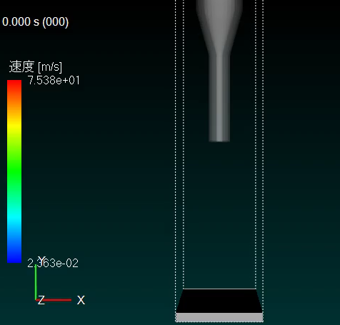
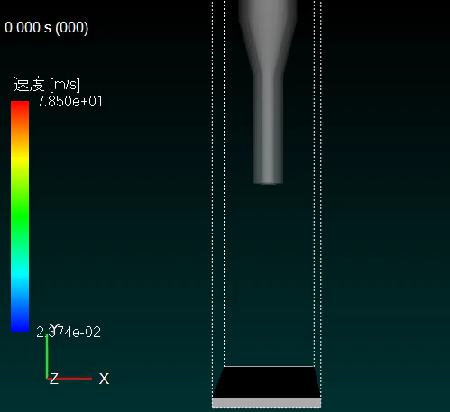
Shots flight analysis by MPS
Simulation results of shots flight
Nozzle outlet diameter 4mm
Nozzle outlet diameter 6mm
Velocity [m/s]
Velocity [m/s]
about 70 m/s
Maximum velocity
about 80 m/s
Notes:
Now, let us first look at the simulation of the shots flight by MPS.
The left side is a simulation with a nozzle outlet diameter of 4 mm and the right side is a simulation with a nozzle outlet diameter of 6 mm.
The distance between the nozzle outlet and the specimen is 100 mm for both simulations.
The simulation using MPS allowed us to see the spread and bounce of the shot.
Please notice the shot velocity.
The nozzle outlet diameter of 4 mm has a maximum velocity of about 70 m/s, while the nozzle outlet diameter of 6 mm has a maximum velocity of about 80 m/s, a difference of 10 m/s.

Slide 14
Shots flight analysis by MPS
Simulation results of shots velocity (Nozzle outlet diameter difference)
※Error bars are standard deviations
The larger the nozzle outlet diameter, the higher the average maximum velocity of shot.
The larger the nozzle outlet diameter, the greater the variation in maximum shot velocity.
Notes:
Now, I’ll talk about first result.
(We investigated average maximum velocity of shots in y-direction.)
Please take a look at this bar graph.
This graph shows the average maximum velocity of shots in the y-direction for different nozzle outlet diameters at a distance between the nozzle outlet and the specimen of 100 mm.
We randomly selected 100 shots and averaged the maximum velocity.
(Error bars in the graph are standard deviations.)
You can see here that the larger the nozzle outlet diameter, the higher the average maximum velocity of the shot.
This is because the larger the nozzle outlet diameter, the greater the airflow velocity.
The next slide shows a graph of the variation of distance between the nozzle outlet and the specimen.

Slide 15
Shots flight analysis by MPS
Simulation results of shots velocity (Distance between nozzle outlet and specimen difference)
※Error bars are standard deviations
The longer the distance between the nozzle outlet and the specimen, the higher the average maximum velocity of shot.
Notes:
Please take a look at these bar graph.
These graph show the average maximum velocity of shots in the y-direction for different distance between the nozzle outlet and the specimen at the nozzle outlet diameter of 4, 6mm.
(Error bars in the graph are standard deviations.)
You can see here that the average maximum velocity of the shot is almost constant when the distance between the nozzle outlet and the specimen exceeds 100 mm, and the variation of the maximum velocity becomes smaller as the distance between the nozzle outlet and the specimen increases.
This is because the larger the distance between the nozzle outlet and the specimen, the greater the acceleration distance due to the airflow, and the more uniform the velocity of the shot is considered to be.
(Now, move on to the next result.)

Slide 16
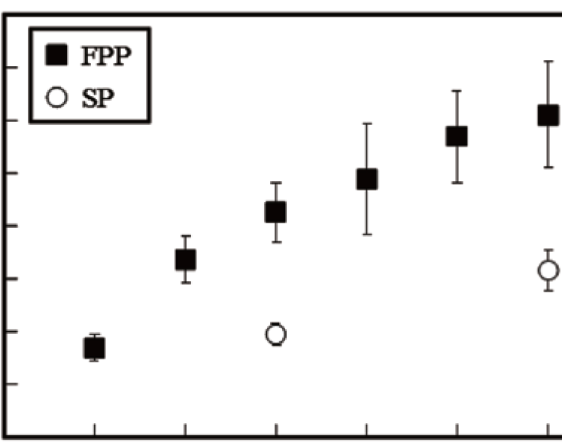
Shots flight analysis by MPS
Result comparison of experiments and simulation
Maximum velocity of shot [m/s]
Inlet pressure [MPa]
Very close value is obtained.
＊Nambu K., et al., Journal of the Japan Society for Abrassive Technology. 2015, 9(59), 525
Notes:
This slide shows a comparison of experimental and simulation results.
Please look at this figure.
This figure plots Nambu's experimental results and our simulation results.
You can see here that the values are very close, although the nozzle geometry is slightly different.
Now, move on to the next result.
(We plan to conduct our own experiments in the future to compare with the simulations.)

Slide 17
Shots flight analysis by MPS
y
y=0
Simulation results of shot velocity distribution (Nozzle outlet diameter difference)
Shot continues to accelerate after nozzle outlet and reaches maximum velocity just before specimen.
Notes:
I’ll talk about second result.
(We investigated shot velocity distribution in y-direction.)
Please take a look at this scatter diagram.
This diagram shows the shot velocity distribution in y-direction for different nozzle outlet diameters at a distance between the nozzle outlet and the specimen of 100 mm.
(The horizontal axis shows position in y-axis. The vertical axis shows y-direction velocity of shot.)
The shot with the maximum velocity close to the average maximum velocity was selected for each condition, and its velocity distribution is shown.
You can see here that the shot continues to accelerate after the nozzle outlet for all nozzle outlet diameters, reaching its maximum velocity near the specimen.
Similar to the airflow, the shot velocity increases as the nozzle outlet diameter increases.
The next slide shows a diagram of the variation of distance between the nozzle outlet and the specimen.

Slide 18
Shots flight analysis by MPS
y
y=0
Simulation results of shot velocity distribution (Distance between nozzle outlet and specimen difference)
Shot continues to accelerate after the nozzle outlet and reaches its maximum velocity at a certain point.
Notes:
Please take a look at these scatter diagram.
These diagram show the shot velocity distribution in y-direction for different distance between the nozzle outlet and the specimen at nozzle outlet diameter of 4,6mm.
You can see here that the shot velocity distribution depending on the distance between the nozzle outlet and the specimen is almost the same.
At a distance of 50mm between the nozzle outlet and the specimen, the shot didn’t accelerate fully, but at a distance of 100 mm or more between the nozzle outlet and the specimen, the shot accelerated to the maximum.

Slide 19
Shots flight analysis by MPS
y
y=0
Velocity relationship between shot and airflow (Nozzle outlet diameter difference)
The distance over which a shot can be accelerated increases as the nozzle outlet diameter increases.
Notes:
We have discussed airflow and shot velocity separately.
In this slide, we will discuss airflow and shot velocity together.
Please look at this scatter diagram.
This diagram shows the velocity distribution in y-direction of airflow and shot for different nozzle outlet diameters at a distance between the nozzle outlet and the specimen of 150mm.
(The horizontal axis shows position in y-axis. The vertical axis shows y-direction velocity of airflow and shot.)
The filled plots show the velocity distribution of the airflow, and the unfilled plots show the velocity distribution of the shot.
The point of maximum shot velocity for each condition is filled in red in the plot.
You can see here that the shot reaches its maximum velocity at the intersection of the shot and airflow velocity.
That is, the shot accelerates most at the nozzle parallel section, continues to accelerate after the nozzle outlet, and reaches its maximum velocity at the point where the velocity is equal to the airflow.
(However, while the shot reached its maximum velocity just in front of the specimen up to a distance between the nozzle outlet and the specimen of 100 mm, at a distance between the nozzle outlet and the specimen of 150 mm it reached its maximum velocity at a distance away from the specimen.)
There is a limit to the distance over which a shot can be accelerated, and it is expected that the distance over which a shot can be accelerated increases as the nozzle outlet diameter increases.
Under current conditions, the optimal distance between the nozzle outlet and the specimen is considered to be in the range of 100 to 150 mm.

Slide 20
Conclusion
We performed FPP simulation using FEM and MPS software.
The larger the nozzle outlet diameter, the greater the airflow and shot velocity.
The shot reaches its maximum velocity at the intersection of the shot and airflow velocity.
Notes:
My presentation is focused on FPP.
Those were our results.
(Our conclusions are summarized below.)
Let me now present you with our conclusions and offer some recommendations for future research.
We performed FPP simulation using FEM and MPS software.
Simulation using MPS allowed us to see the flight behavior of shots in FPP.
The larger the nozzle outlet diameter, the greater the airflow velocity and maximum shot velocity.
The larger the nozzle outlet diameter, the greater the maximum velocity of the shot, but also the greater the variation of the maximum velocity.
The acceleration of the shot after the nozzle outlet was different depending on the nozzle outlet diameter.
(The shot didn’t fully accelerate when the distance between the nozzle outlet and the specimen was 50mm. )
Due to the nature of MPS, it was impossible to simulate the nozzle inlet pressure under higher pressure conditions in this study. Improvements to the simulation method are needed to resolve this issue.

Slide 21
Q&A
Thank you for listening
Notes:
Thank you for listening.
Does anyone have any question?
1. What is the actual condition for inlet pressure?
Fine Particle Peening is performed at 0.2 to 0.6 MPa.
2. What simulation software are you using?
We are using ANSYS fluent as FEM analysis. This is finite element method software.
3. What are the difficulties of your research?
This is the point where we have to analyze two phases, gas and solid.

Slide 22
Airflow analysis by FEM
Air(ideal gas) physical properties
Cp (specific heat) [J/kg-K] | Thermal Conductivity [W/m-K] | Viscosity [Pa-s] | Molecular Weight [kg/kmol]
1006.43 (constant) | 0.0242 (constant) | 1.7894e-5 (constant) | 28.966 (constant)
Air turbulent viscosity model : k-ω SST model
Pressure of nozzle outlet : 1 atmospheric pressure = 1013.25 [hPa]
Notes:
This slide shows the physical properties of airflow in airflow analysis using FEM.
This is the default parameter of FEM software.
The turbulence viscosity model used is the k-ωSST model, which correctly captures turbulence near the nozzle wall and turbulence away from the wall.
The 1 atmospheric pressure was set to 1013.25 hPa.

Slide 23
Shots flight analysis by MPS
Shot and airflow properties
steel property
Density [kg/m³] | Young's modulus [GPa] | Poisson's ratio | Yield stress [GPa]
7550 | 207 | 0.3 | 0.27
Air physical property
Cp (specific heat) [J/kg-K] | Thermal Conductivity [W/m-K] | Viscosity [Pa-s] | Molecular Weight [kg/kmol]
1006.43 (constant) | 0.0242 (constant) | 1.7894e-5 (constant) | 28.966 (constant)
Notes:
This slide shows the mechanical properties of the shot and the physical properties of the airflow in the shot flight analysis by MPS.

Slide 24

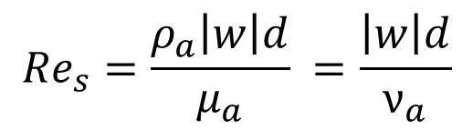





Shots flight analysis by MPS
Drag coefficient determination method*
Reynolds number of shot Re_{s}
$${Re}_{s}=\frac{ρ_{a}\left|w\right|d}{μ_{a}} =\frac{\left|w\right|d}{ν_{a}}$$
$$ρ_{a} :Density of airflow [kg/m^{3}]$$
$$d :Shot diameter [m]$$
$$\left|w\right| :w\left(t\right)=v\left(t\right)−u\left(t\right)$$
$$μ_{a} :Viscosity coefficient of airflow [Pa/s]$$
$$w\left(t\right) :Relative velocity of shot [m/s]$$
$$ν_{a} :Kinematic viscosity coefficient of airflow [m^{2}/s]$$
$$v \left(t\right) :Shot velocity [m/s]$$
$$u \left(t\right) :Airflow velocity [m/s]$$
＊ Loth E., AIAA JOURNAL. 2008, 46(9), 2219
Notes:
The next and subsequent slides show how the drag coefficient was determined.
It was calculated for each condition based on the paper by Loth E.
The Reynolds number of the shot is given by the following equation.

Slide 25

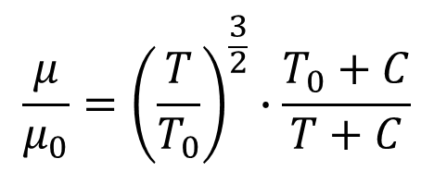






Shots flight analysis by MPS
Drag coefficient determination method*
Sutherland’s formula*
$$\frac{μ}{μ_{0}}={\left(\frac{T}{T_{0}}\right)}^{\frac{3}{2}}∙\frac{T_{0}+C}{T+C}$$
$$μ :Viscosity coefficient [Pa∙s]$$
International standard atmospheric values (μ)
$$μ_{0} :Viscosity coefficient at T_{0} [Pa∙s]$$
$$μ_{0}=1.7932×{10}^{−5}$$
$$T :Airflow temperature [K]$$
$$T_{0} :Temperature of gases at ground [K]$$
$$T_{0}=288.15$$
$$C :Sutherland^{′}s constant [K]$$
$$C =110.4$$
＊ Loth E., AIAA JOURNAL. 2008, 46(9), 2219
* Mitsuo Makino, 航空力学の基礎（第3版）
Notes:
The viscosity coefficient was calculated from Sutherland's formula.

Slide 26

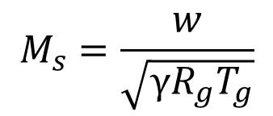




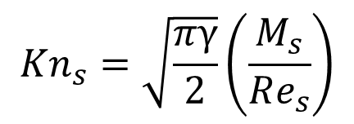
Shots flight analysis by MPS
Drag coefficient determination method*
Mach number of shot M_{s}
$$M_{s}=\frac{w}{\sqrt{γR_{g}T_{g}}}$$
$$γ : 比熱比$$
$$γ=1.4$$
$$R_{g} : 気体定数 [J/kg∙K]$$
$$R_{g}=287.1$$
$$T_{g} : 気体温度 [K]$$
Knudsen number of shot Kn_{s}
$${Kn}_{s}=\sqrt{\frac{πγ}{2}}\left(\frac{M_{s}}{Re_{s}}\right)$$
＊ Loth E., AIAA JOURNAL. 2008, 46(9), 2219
Notes:
The Mach number and Knudsen number of shots were calculated from the following equation.

Slide 27
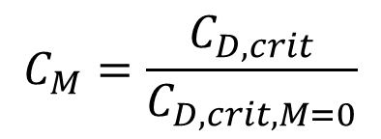

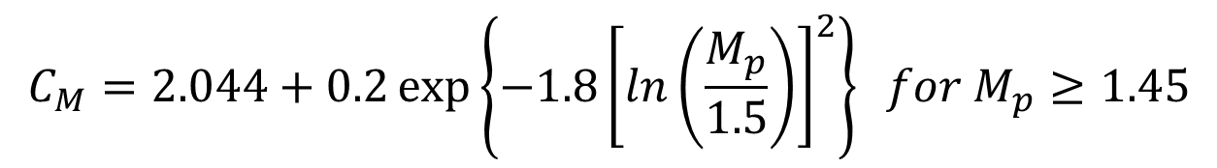
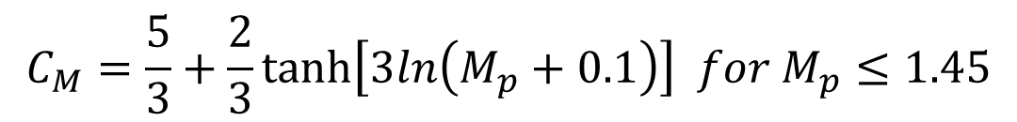
Shots flight analysis by MPS
Drag coefficient determination method*
Compression-Dominated Regime
$$C_{M}=\frac{C_{D,crit}}{C_{D,crit,M=0}}$$
$$C_{M}=\frac{5}{3}+\frac{2}{3}\tanh\left[3ln\left(M_{p}+0.1\right)\right] for M_{p}≤1.45$$
$$C_{M}=2.044+0.2\exp\left\{−1.8{\left[ln\left(\frac{M_{p}}{1.5}\right)\right]}^{2}\right\} for M_{p}≥1.45$$
$$G_{M}=1−1.525M_{p}^{4} for M_{p}<0.89$$
$$G_{M}=0.0002+0.0008\tanh\left[12.77\left(M_{p}−2.02\right)\right] for M_{p}>0.89$$
＊ Loth E., AIAA JOURNAL. 2008, 46(9), 2219
Notes:
The values we have calculated so far were substituted into the following equation to obtain the drag coefficient.

Slide 28
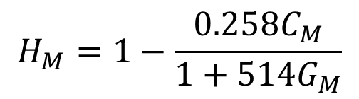
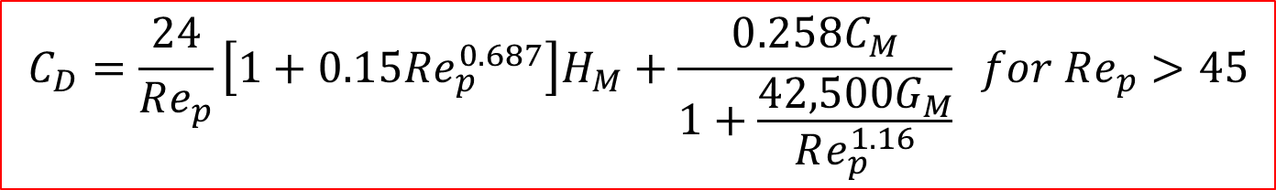
Shots flight analysis by MPS
Drag coefficient determination method*
Compression-Dominated Regime
$$H_{M}=1−\frac{0.258C_{M}}{1+514G_{M}}$$
$$C_{D}=\frac{24}{Re_{p}}\left[1+0.15Re_{p}^{0.687}\right]H_{M}+\frac{0.258C_{M}}{1+\frac{42,500G_{M}}{Re_{p}^{1.16}}} for Re_{p}>45$$
＊ Loth E., AIAA JOURNAL. 2008, 46(9), 2219

Slide 29
Shots flight analysis by MPS
List of physical properties
Polygon
Static friction coefficient
Young's modulus [GPa] | 1
Poisson's ratio | 0
Polygon | Powder | 0.3
Powder | Powder | 0.3
Dynamic friction coefficient
Powder
Polygon | Powder | 0.2
Powder | Powder | 0.2
Diameter [μm] | 100
Density [kg/m³] | 7550
Young's modulus [GPa] | 207
Poisson's ratio | 0.3
Yield stress [GPa] | 0.27
Spring constant
Polygon | Powder | 100
Powder | Powder | 100
Nozzle & Specimen : Polygon
Shot : Powder

Slide 30
Shots flight analysis by MPS
Shots flight analysis inside and outside of nozzle by MPS
How to put in shots
5 mm
Input port
Shot
5 mm
Inlet
Nozzle
Outlet
Notes:
This slide explains how to put in shots in MPS.
Please look at these diagram.
These diagram show the schematic diagram of the shot-putting method.

Slide 31
Shots flight analysis by MPS
Simulation results of shot velocity
Distance 50mm
Distance 100mm
Distance 150mm
Notes:
These bar graph show the average maximum velocity of shots in the y-direction for all conditions.

Slide 32
Shots flight analysis by MPS
Simulation results of shot velocity
Diameter 4mm
Diameter 5mm
Diameter 6mm
Notes:
These bar graph show the average maximum velocity of shots in the y-direction for all conditions.

Slide 33
Shots flight analysis by MPS
Simulation results of shot velocity distribution (Distance between nozzle outlet and specimen difference)
Nozzle outlet diameter 4mm
Nozzle outlet diameter 5mm
Nozzle outlet diameter 6mm
Notes:
These scatter diagram show the shot velocity distribution in y-direction for all conditions.

Slide 34
Shots flight analysis by MPS
y
y=0
Velocity relationship between shot and airflow (Nozzle outlet diameter difference)

Slide 35
Shots flight analysis by MPS
y
y=0
Velocity relationship between shot and airflow (Nozzle outlet diameter difference)
At all nozzle outlet diameters, the shot reaches its maximum velocity at the intersection of the shot and airflow velocity.
Notes:
Please take a look at this scatter diagram.
This diagram shows the velocity distribution in y-direction of airflow and shot for different nozzle outlet diameters at a distance between the nozzle outlet and the specimen of 100 mm.
(The horizontal axis shows position in y-axis. The vertical axis shows y-direction velocity of airflow and shot.
The filled plots show the velocity distribution of the airflow, and the unfilled plots show the velocity distribution of the shot.
The point of maximum shot velocity for each condition is filled in red in the plot.)
You can see here that the shot reaches its maximum velocity at the intersection of the shot and airflow velocity.
That is, the shot accelerates most at the nozzle parallel section, continues to accelerate after the nozzle outlet, and reaches its maximum velocity at the point where the velocity is equal to the airflow.
The next slide shows another result.

Slide 36
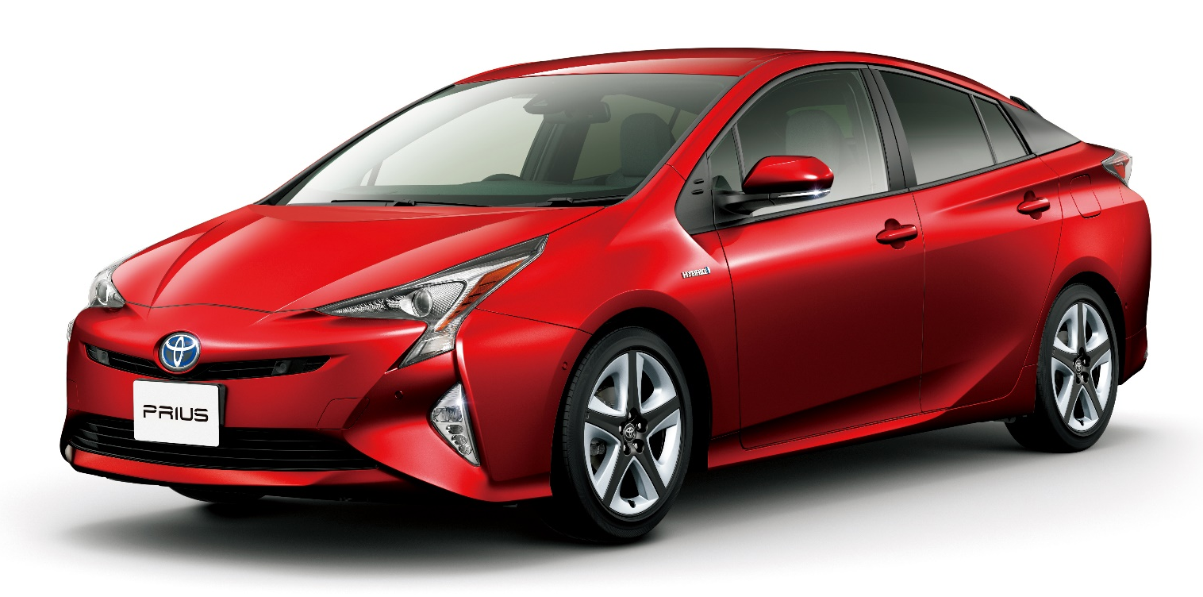
Introduction
Metal products
enrich the world
Contemporary issue
Solution
Failure due to fatigue failure
Improving fatigue strength
https://global.toyota/jp/mobility/toyota-brand/gallery/prius.html
Notes:
In the modern age, metal products are abundant in our daily lives, such as automobiles and airplanes, and enrich the world.
Fatigue strength is an important index for determining the value of metal products.
In modern society, various destructive accidents occur due to fatigue fracture.
Therefore, it is very important to improve the fatigue strength of metal products.
Therefore, FPP, which is a cold working process to improve the fatigue strength of metals, has been attracting attention.

Slide 37
Introduction
Parameters of FPP
Shot
Specimen
Others
・Mechanical
properties
・Size
Mechanical
properties
・Hardness
・Young’s modulus
・Yield stress
・Peening time
・Shot velocity
Complex with many parameters to consider
Notes:
There are a variety of FPP parameters that affect the process, including the mechanical properties and size of the shot and specimen and their interaction.
Mechanical properties of the shot and specimen include Young's modulus, hardness, and yield stress.
Other factors such as peening time, which is the processing time, and shot impact velocity are also relevant to the FPP.
As explained in the previous slide, FPP is a very complex process with many parameters to consider.

