Slide 1
Introduction to
Model Based Condition Monitoring (MBCM) and Hybrid Modelling of Physical Systems
Manfred Mücke, MCL
IC-MPPE 2022, 6.5.2022

Slide 2


Condition Monitoring - Definition
CM = Estimating a system‘s (fault relevant) state from (indirect) observations
Forward Model, $[\hat{Y},\hat{S}]=f(X)$
Stimulus (X)
State (S)
Response (Y)
Inverse Model, $[\hat{X},\hat{S}]=f^{−1} (Y)$
Physical System
⇨ Condition Monitoring is an applied inverse problem

Slide 3
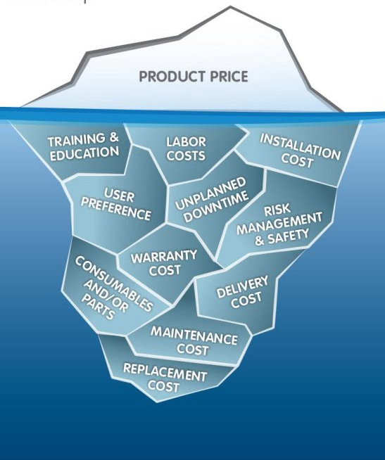
Condition Monitoring - Motivation
System owners need to minimise total cost of ownership
System monitoring can contribute to
quicker commissioning of new systems (find right parameter set)
adapting to varying process conditions (cope with unexpected changes)
Condition Monitoring can contribute to
identifying issues before equipment fails (⇨ warning time),
pinpoint the root cause of the failure (⇨ accurate fix)
schedule maintenance at the right time (⇨ service vs. downtime cost)
⇨ Condition monitoring allows for safer and more cost-efficient system operation.

Slide 4






MBCM 2018-2021 Summary
Physical System
The COMET project MBCM (2018-2021) has established
a workflow for construction of hybrid inverse models as
needed for model-based condition monitoring. The workflow
lends itself to structuring projects and consulting.
Collect Knowledge + Data
  System Understanding
  Fault types, States
  Forward models
  DOE / (Virtual) Measurements
Construct inverse model
family
  Exploratory Data Analysis
  Analytical inverse model
  Data-driven inverse model
  Hybrid inverse model
Physical System
CMS
Explore inverse model family
  Trade-off studies
  Sensor type/placement options
  Uncertainty quantification
  Model complexity
Implement inverse model
  Sensor setup & DAQ
  Bit-width estimation
  Code generation
  Proof of concept
CMS

Slide 5
Hybrid Modelling
Hybrid Modelling = Combine laws of physics with observations to yield a superior model compared to either method.
Many different approaches possible: [1-3]
[1] Johannes G. Hoffer et al., ‘Theory-Inspired Machine Learning—towards a Synergy between Knowledge and Data’, Welding in the World, 25 April 2022, https://doi.org/10.1007/s40194-022-01270-z.
[2] Laura von Rueden et al., ‘Informed Machine Learning -- A Taxonomy and Survey of Integrating Knowledge into Learning Systems’, ArXiv:1903.12394 [Cs, Stat], 12 February 2020, http://arxiv.org/abs/1903.12394;
[3] Jared Willard et al., ‘Integrating Physics-Based Modeling with Machine Learning: A Survey’, ArXiv:2003.04919 [Physics, Stat], 1 April 2020, http://arxiv.org/abs/2003.04919.

Slide 6
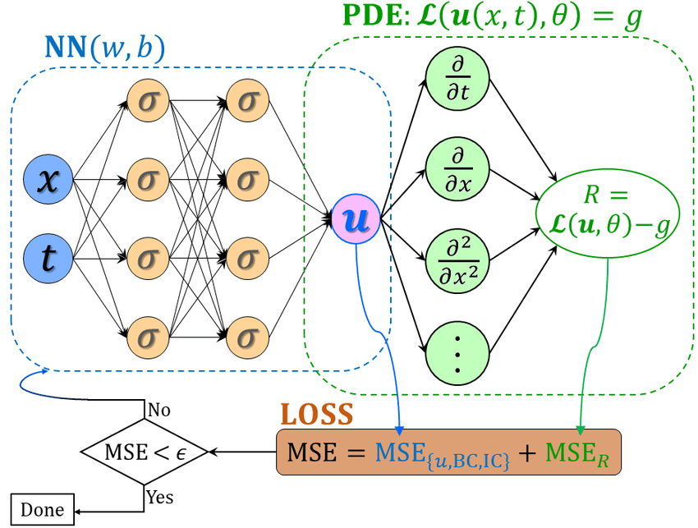
Hybrid Modelling
From Block-based to Physics-Informed ML
From Block-Based hybrid modelling to Physics-Informed ML
Parallel
Nonparametric model
compensates for deviating
parametric results
Physics-informed neural networks (PINNs, [2])
embed the knowledge of physical laws described by partial differential equations (PDEs). Laws of physics act as regularizer, limiting the space of admissible solutions.
Parametric
Nonparametric
Serial 1
Nonparametric model maps
observations onto virtual
physical input quantities.
Nonpara-metric
Para-metric
Serial 2
Parametric model preprocesses
Observations to lower complexity
of non-parametric model.
Para-metric
Nonpara-metric
[2] M. Raissi, P. Perdikaris, and G. E. Karniadakis, ‘Physics-Informed Neural Networks: A Deep Learning Framework for Solving Forward and Inverse Problems Involving Nonlinear Partial Differential Equations’, Journal of Computational Physics 378 (1 February 2019): 686–707, https://doi.org/10.1016/j.jcp.2018.10.045.
[1] Psichogios, Dimitris C., and Lyle H. Ungar. ‘A Hybrid Neural Network-First Principles
Approach to Process Modeling’. AIChE Journal 38, no. 10 (October 1992): 1499–1511. https://doi.org/10.1002/aic.690381003.

Slide 7
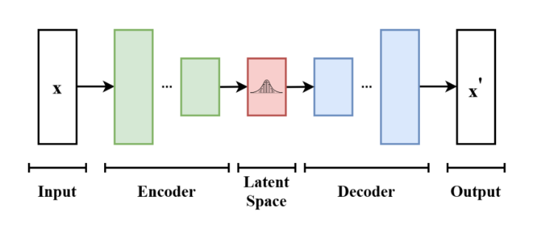

Variational Autoencoder
Explore Latent Space
Variational autoencoders (VAEs) compress the input information into a constrained multivariate latent normal distribution (information bottleneck).
VAEs are unsupervised (ie training data can be unlabeled).
The latent space exhibits relevant information about the observed system and its current state.
Constrained training can lead to interpretable latent variables -> Representation Learning
Weiheng Zhong and Hadi Meidani, ‘PI-VAE: Physics-Informed Variational Auto-Encoder for Stochastic Differential Equations’, ArXiv:2203.11363 [Cs, Stat], 21 March 2022, http://arxiv.org/abs/2203.11363.
© Taylor Denouden, https://github.com/tayden/VAE-Latent-Space-Explorer

Slide 8
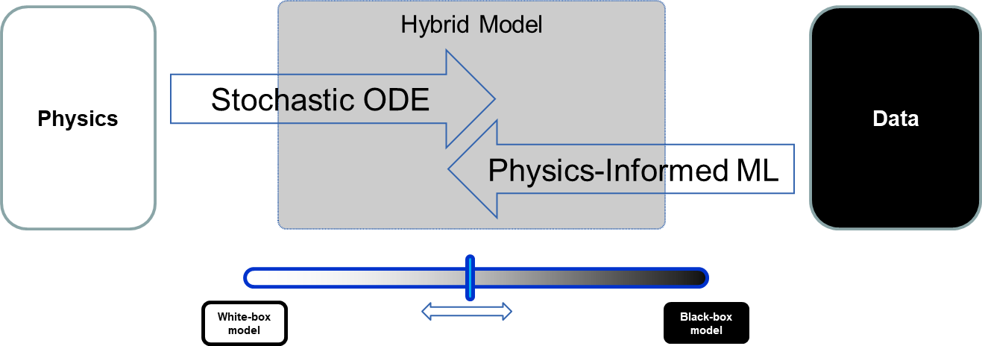
Hybrid Modelling
Find the right balance

Slide 9
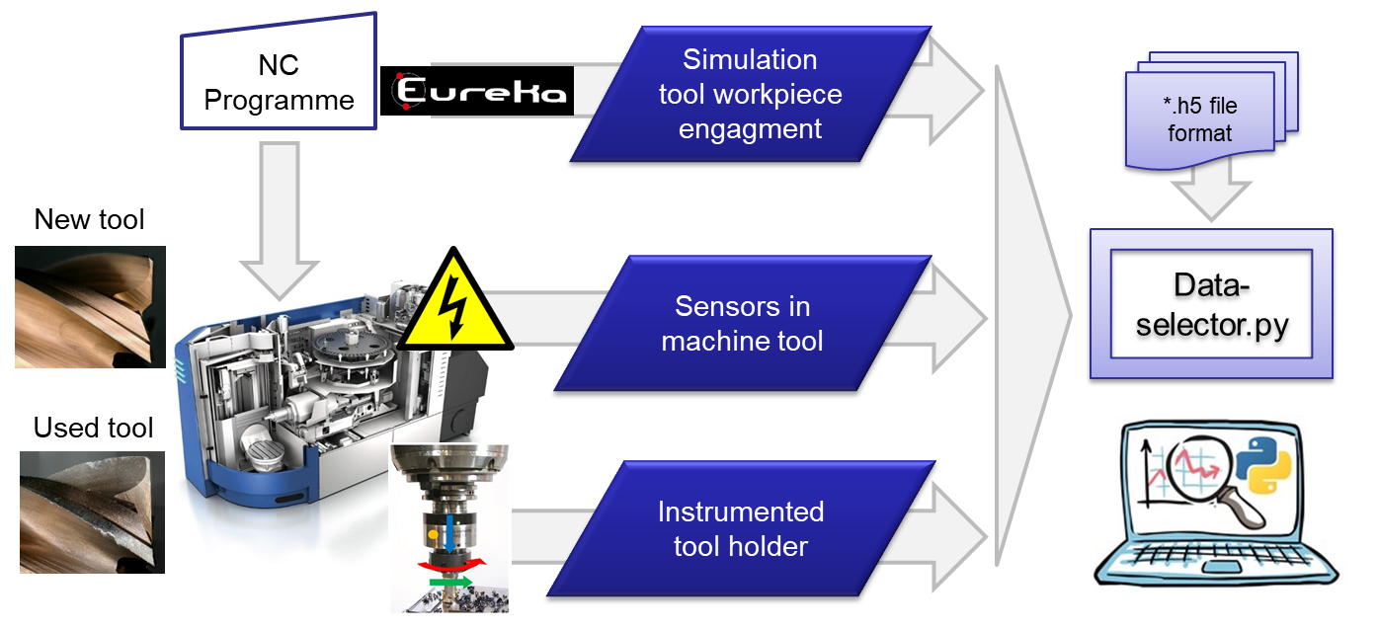
MBCM Example
Unified Experiment Data Collection, Cleaning & Fusion
Physical System
Collect Knowledge + Data
  System Understanding
  Fault types, States
  Forward models
  DOE / (Virtual) Measurements
Construct inverse model
family
  Exploratory Data Analysis
  Analytical inverse model
  Data-driven inverse model
  Hybrid inverse model
Explore inverse model family
  Trade-off studies
  Sensor type/placement options
  Uncertainty quantification
  Model complexity
Implement inverse model
  Sensor setup & DAQ
  Bit-width estimation
  Code generation
  Proof of concept
CMS
Collect, clean & fuse data from milling & drilling experiments in accordance with MBCM workflow

Slide 10


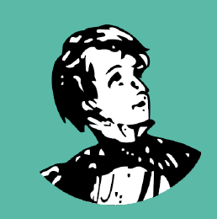
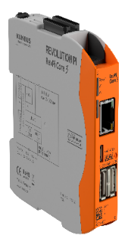
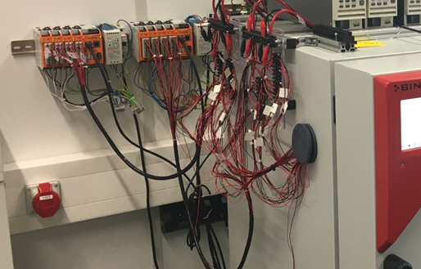
Methods – Collect Knowledge + Data
Physical System
Core bottleneck in many projects is still generating a usable data set!
Issue identified: Findability, Accessibility, Interoperability, Reusability [FAIR2016] but few practical implementations.
MBCM Method: Use machine-readable, reusable, file-based storage format
→ Tool: HDF5 + Python API
MBCM Method: Create sanity checks (assertions) and execute automatically
→ Tool: Python Great Expectations
Collect Knowledge + Data
  System Understanding
  Fault types, States
  Forward models
  DOE / (Virtual) Measurements
Construct inverse model
family
  Exploratory Data Analysis
  Analytical inverse model
  Data-driven inverse model
  Hybrid inverse model
Explore inverse model family
  Trade-off studies
  Sensor type/placement options
  Uncertainty quantification
  Model complexity
Implement inverse model
  Sensor setup & DAQ
  Bit-width estimation
  Code generation
  Proof of concept
CMS
[FAIR2016] Mark D. Wilkinson et al., ‘The FAIR Guiding Principles for Scientific Data Management and Stewardship’, Scientific Data 3, no. 1 (December 2016): 160018, https://doi.org/10.1038/sdata.2016.18.
→ MBCM partially impemented FAIR Data Principles at MCL

Slide 11

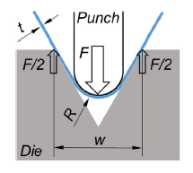
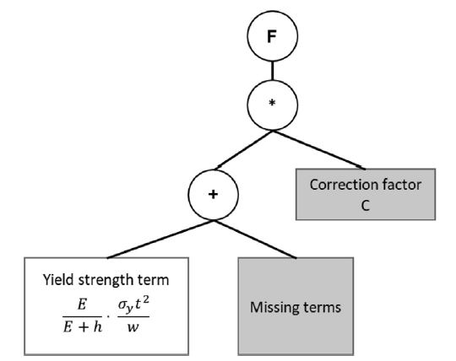
Sheet Metal Bending (LCM)
Physical System
Mechanical problem:
Collect Knowledge + Data
  System Understanding
  Fault types, States
  Forward models
  DOE / (Virtual) Measurements
theoretical solution
Construct inverse model
family
  Exploratory Data Analysis
  Analytical inverse model
  Data-driven inverse model
  Hybrid inverse model
Hybrid modelling approach:
Symbolic Regression (SR) with structure constraint
Explore inverse model family
  Trade-off studies
  Sensor type/placement options
  Uncertainty quantification
  Model complexity
Goal: estimate the required stamping force to achieve zero springback.
Implement inverse model
  Sensor setup & DAQ
  Bit-width estimation
  Code generation
  Proof of concept
CMS
→ Hybrid model allows for transfer of model to unseen materials

Slide 12
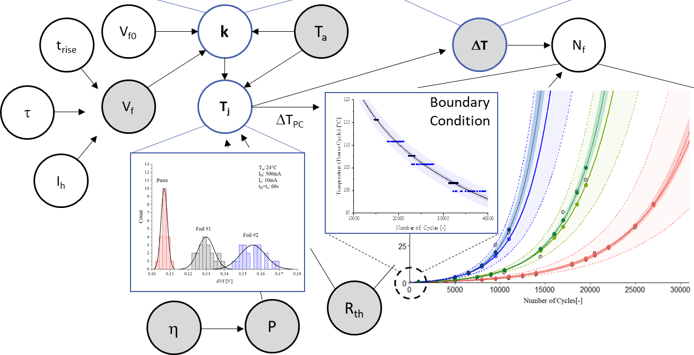
MBCM Example
Uncertainty Quantification
Physical System
Most models give point estimates only. Goal: Make models able to give and reason about prediction uncertainties (using RVs).
MBCM Method: Bayesian Hierarchical Modelling (implemented in R)
Collect Knowledge + Data
  System Understanding
  Fault types, States
  Forward models
  DOE / (Virtual) Measurements
Construct inverse model
family
  Exploratory Data Analysis
  Analytical inverse model
  Data-driven inverse model
  Hybrid inverse model
Explore inverse model family
  Trade-off studies
  Sensor type/placement options
  Uncertainty quantification
  Model complexity
Implement inverse model
  Sensor setup & DAQ
  Bit-width estimation
  Code generation
  Proof of concept
CMS
In preparation: Julien Magnien, Michaela Dvorzak, Ulrike Kleb, Manfred Mücke, Elke Kraker; Bayesian Hierarchical Model Approach for Uncertainty Quantification in Operational Thermal Resistance of LED Systems;
.
→ BHM as Structured approach to identify sources of uncertainty.

Slide 13
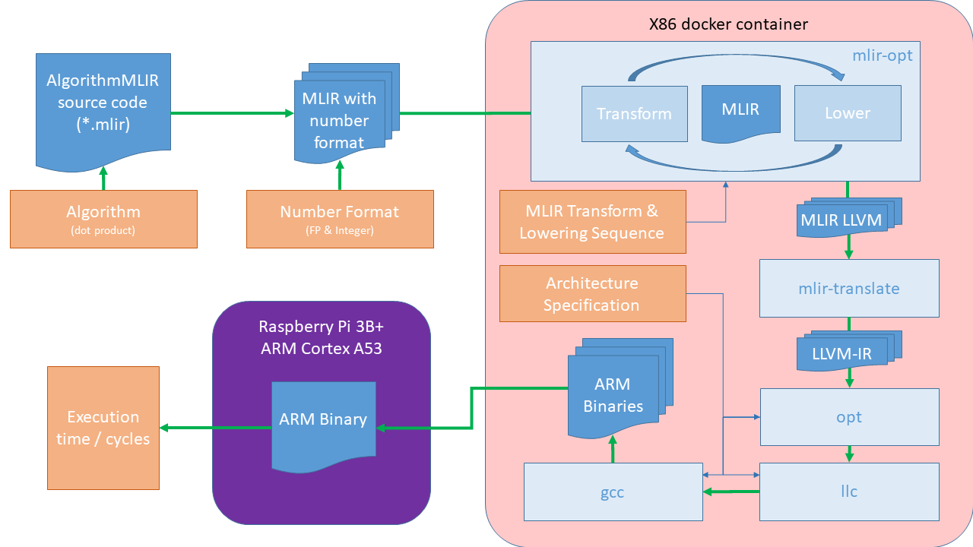
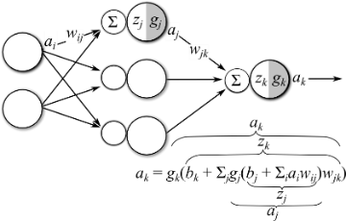

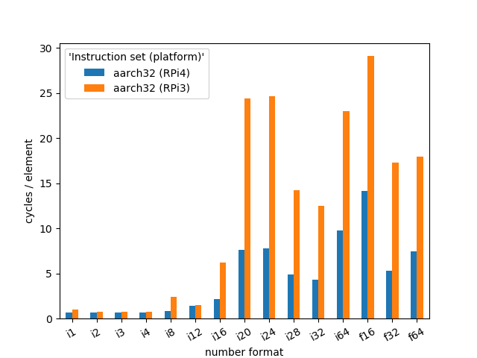
MBCM Example
Code Generation, Custom-precision support benchmarking
Physical System
It is extremely hard to predict the execution time improvement when selecting a smaller number format.
Collect Knowledge + Data
  System Understanding
  Fault types, States
  Forward models
  DOE / (Virtual) Measurements
Construct inverse model
family
  Exploratory Data Analysis
  Analytical inverse model
  Data-driven inverse model
  Hybrid inverse model
Explore inverse model family
  Trade-off studies
  Sensor type/placement options
  Uncertainty quantification
  Model complexity
Automated workflow
Implement inverse model
  Sensor setup & DAQ
  Bit-width estimation
  Code generation
  Proof of concept
CMS
We created a tool to quickly document custom-precision ML algorithm’s execution time across different MLIR versions & ARM CPUs.

Slide 14
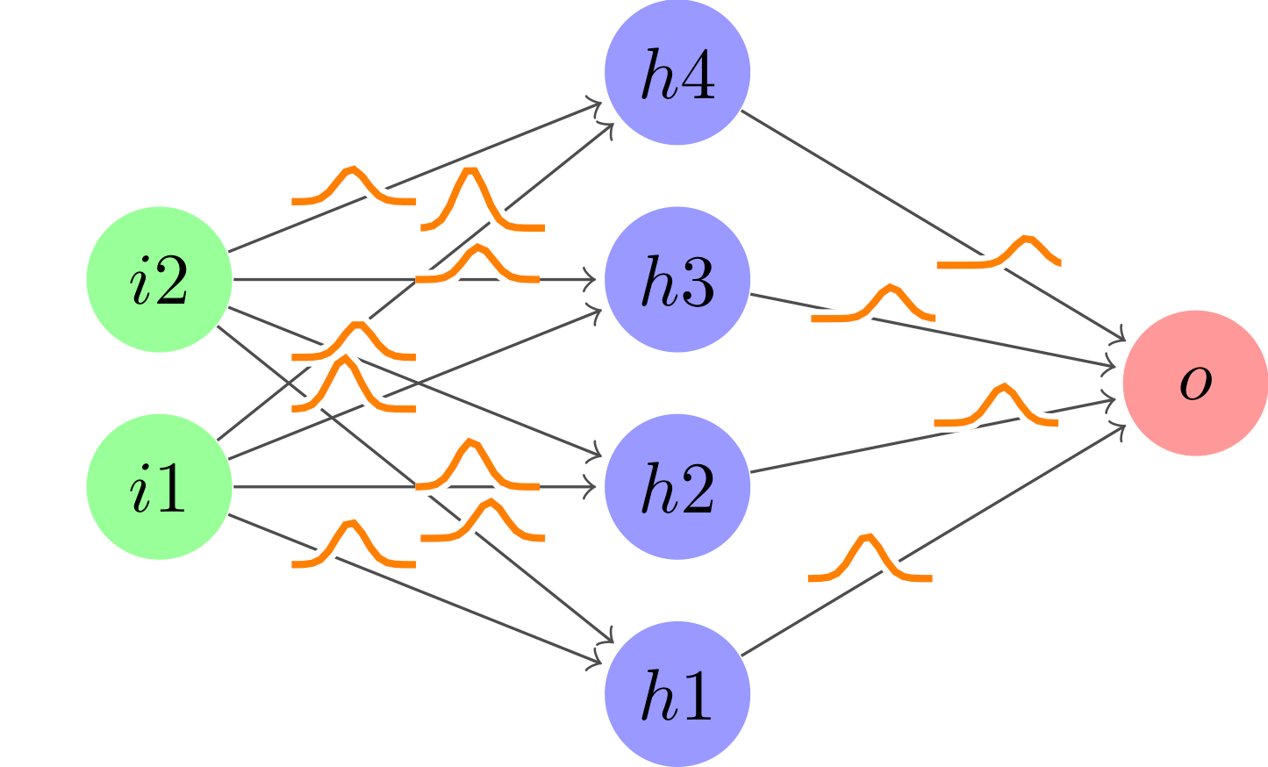
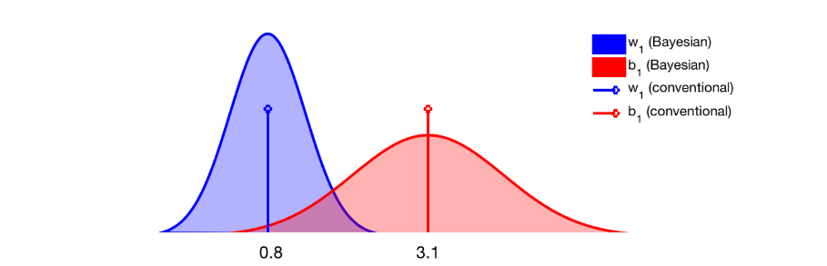
Future: Trust your models?!
Bayesian Neural Networks
Physical System
Most models give point estimates only.
In decision making, you cannot trust point estimates. A metric of uncertainty (or confidence) is needed.
Random variables, characterised by their distribution, allow for derivation of different uncertainty/confidence metrics
Collect Knowledge + Data
  System Understanding
  Fault types, States
  Forward models
  DOE / (Virtual) Measurements
Construct inverse model
family
  Exploratory Data Analysis
  Analytical inverse model
  Data-driven inverse model
  Hybrid inverse model
Explore inverse model family
  Trade-off studies
  Sensor type/placement options
  Uncertainty quantification
  Model complexity
Implement inverse model
  Sensor setup & DAQ
  Bit-width estimation
  Code generation
  Proof of concept
CMS
Make Uncertainty mandatory part of any model → Probabilistic Hybrid Model
Vikram Mullachery, Aniruddh Khera, and Amir Husain, ‘Bayesian Neural Networks’, ArXiv:1801.07710 [Cs, Stat], 23 January 2018, http://arxiv.org/abs/1801.07710.

Slide 15








Thank you for your
attention
The authors gratefully acknowledge the financial support under the scope of the COMET program within the K2 Center “Integrated Computational Material, Process and Product Engineering (IC-MPPE)” (Project 886385). This program is supported by the Austrian Federal Ministries for Climate Action, Environment, Energy, Mobility, Innovation and Technology (BMK) and for Digital and Economic Affairs (BMDW), represented by the Austrian research funding association (FFG), and the federal states of Styria, Upper Austria and Tyrol.
.

Slide 16
Dr. Manfred Mücke
Microelectronics
Manfred.Muecke@mcl.at

