Slide 1
Novel additive manufacturing techniques:
Process development and manufacturing of a functionally graded structure
S. Arneitz, R. Buzolin, C. Sommitsch MAMC 2022

Slide 2
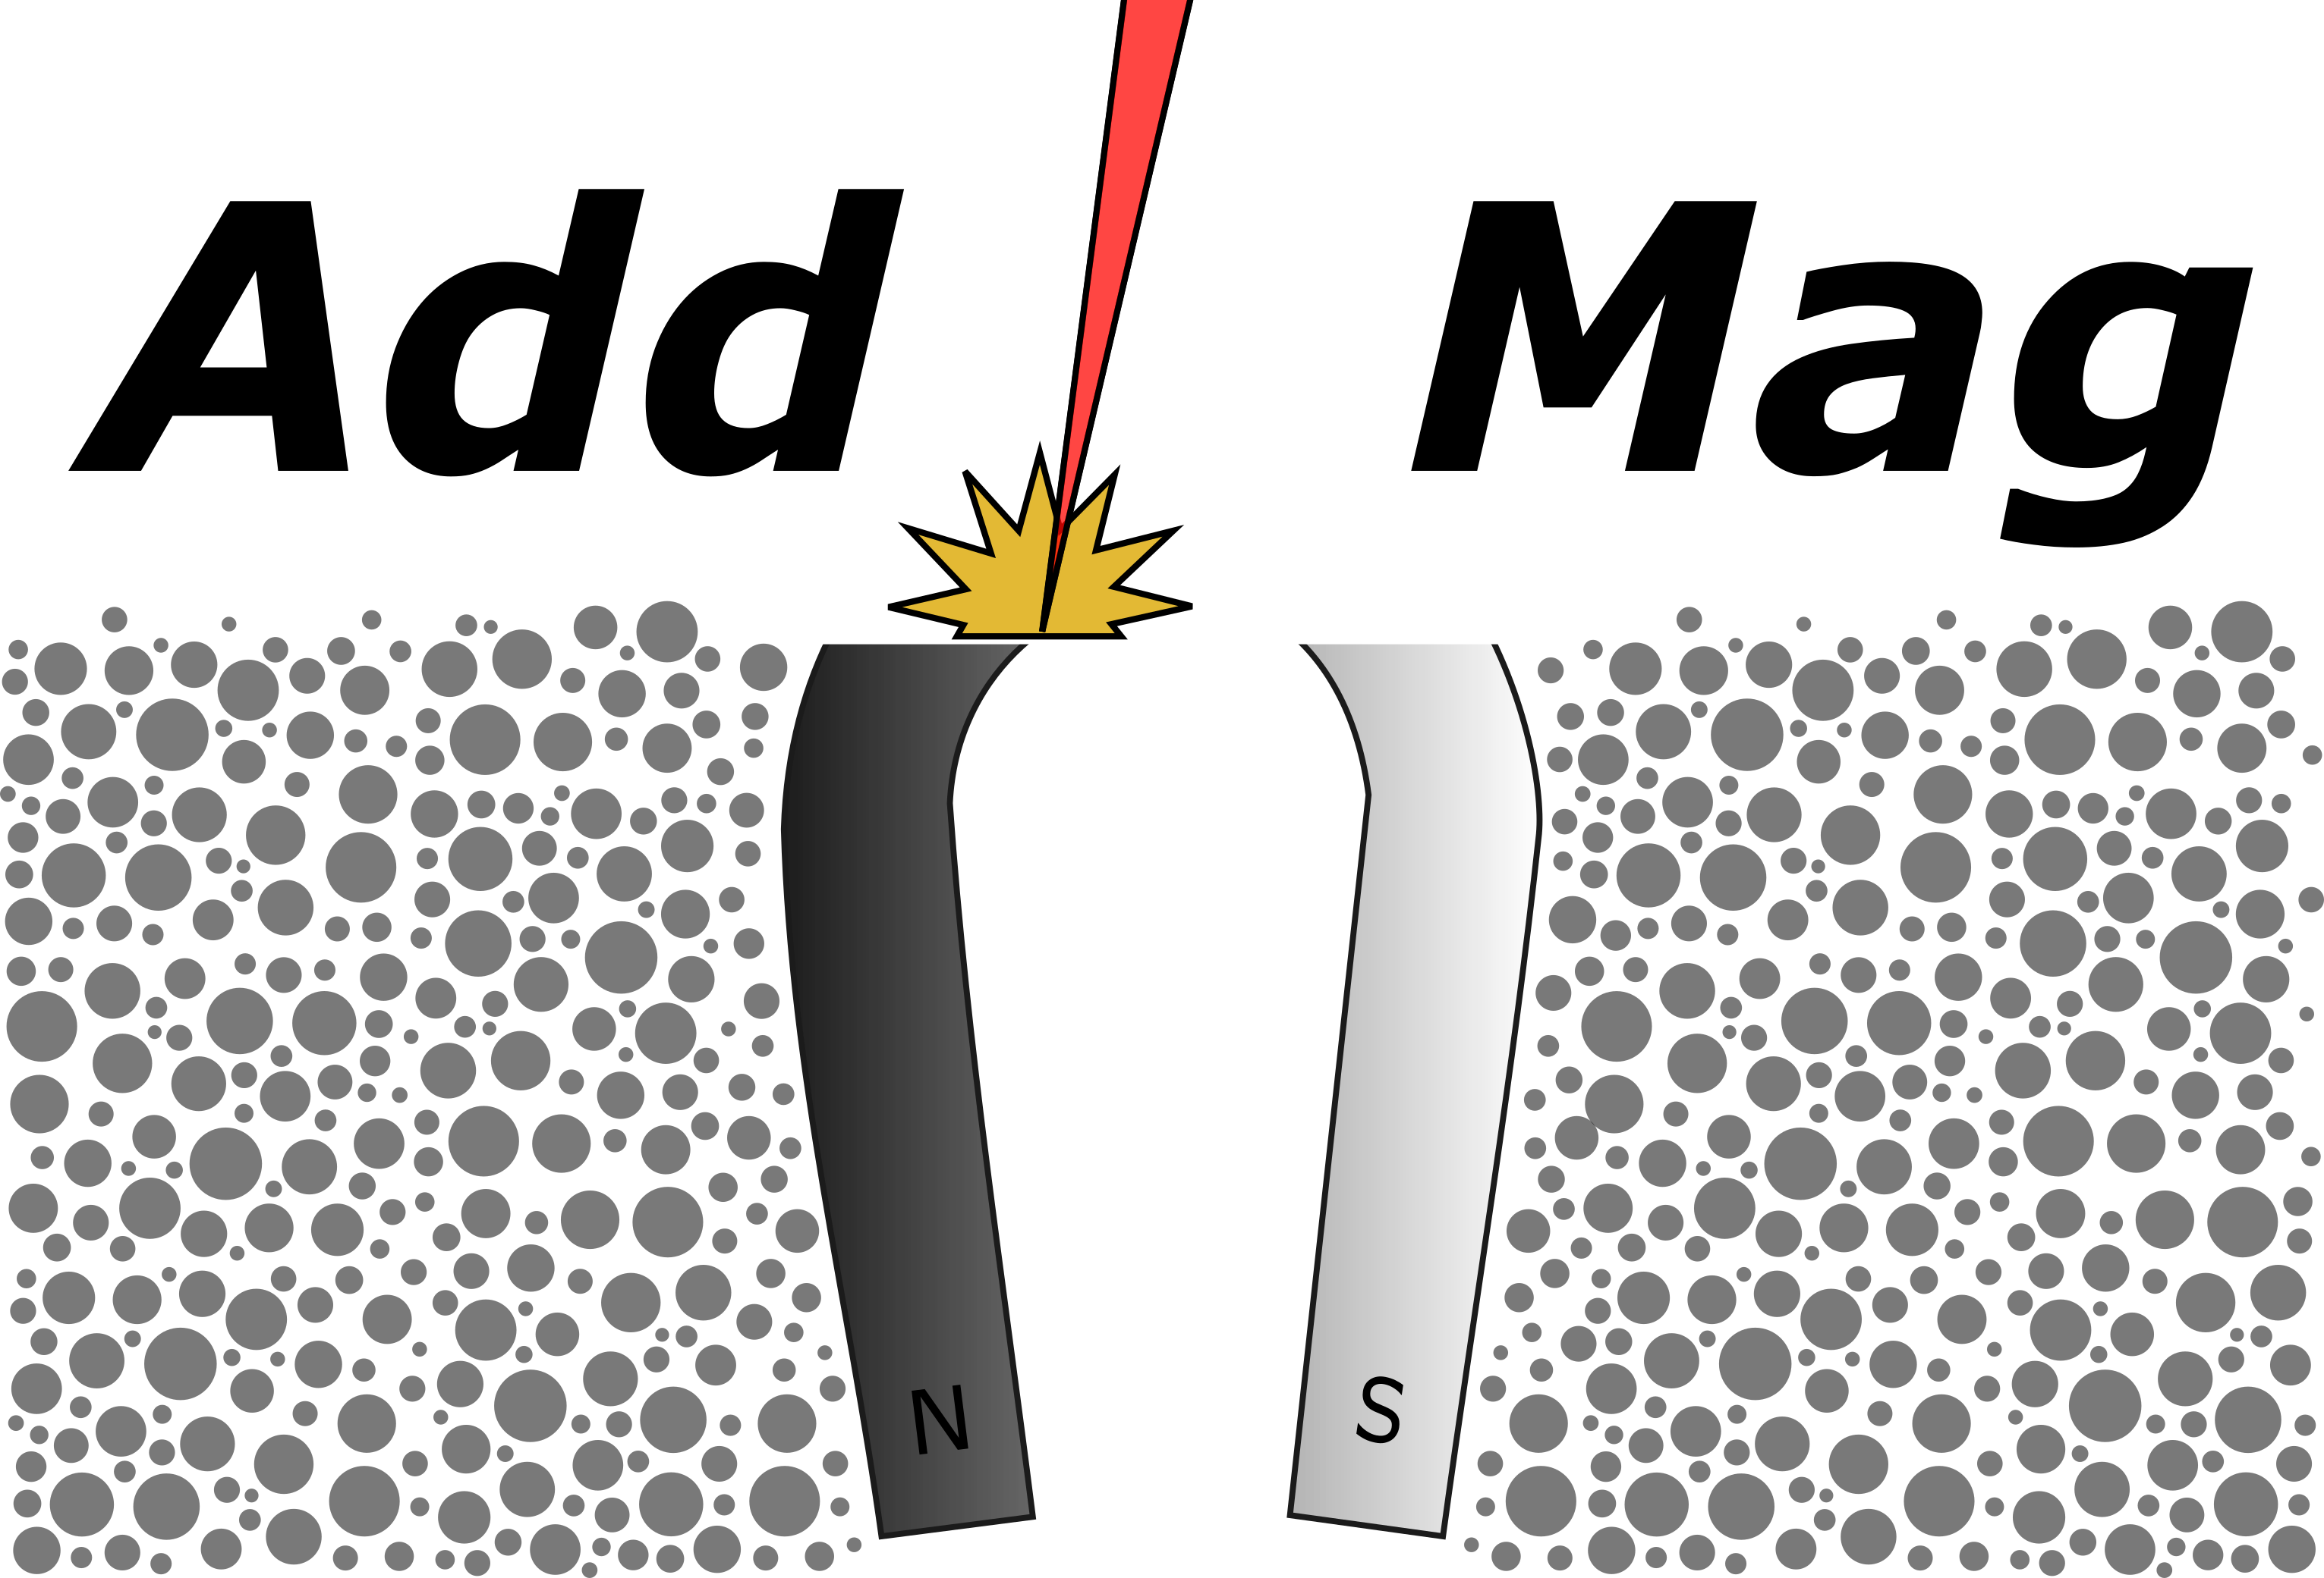










AM of the Fe-Cr-Co alloy system:
Using the in- situ alloying process to manufacture magnetic parts with a defined chemical gradient

Slide 3
Content of our presentation
Additive Manufacturing of Fe-Cr-Co: process development
  (Melt pool studies)
  (Homogeneity analysis)
  Process Design
  Characterisation of the fabricated samples

Slide 4
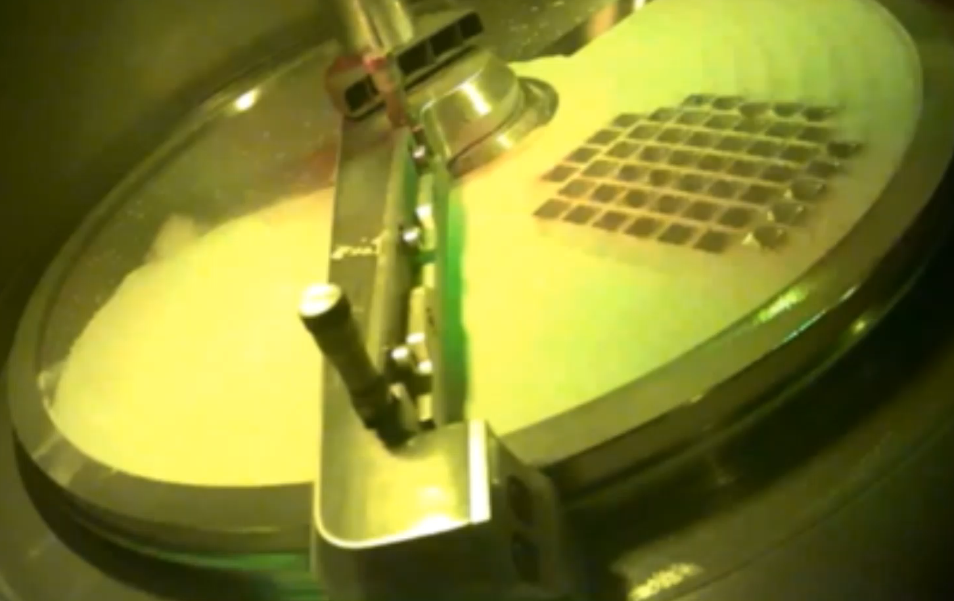
Fe-Cr-Co in the LPBF process
Fe-Cr-Co:
Semi- hard magnetic (~120kA/m)
Good printability
Strong tendency of single alpha phase formation

Slide 5
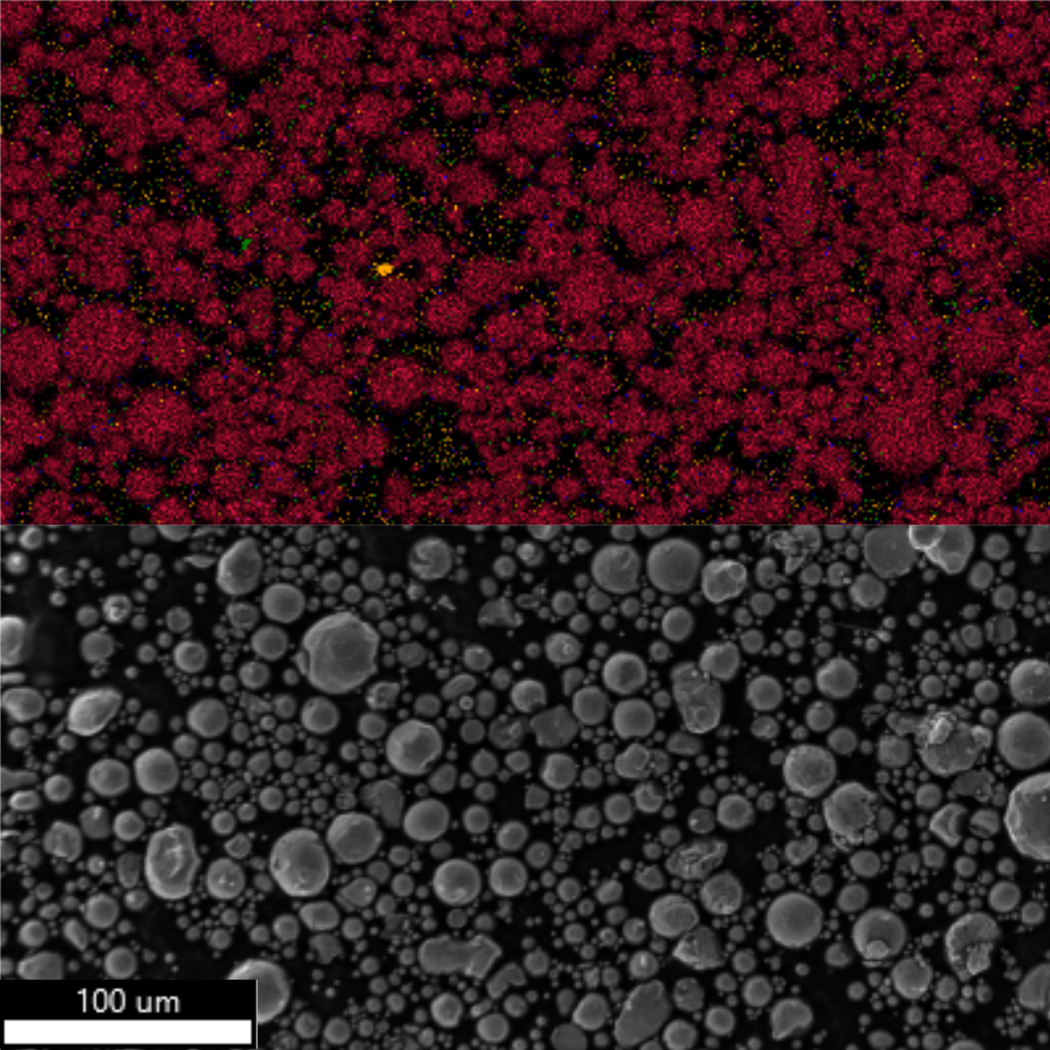
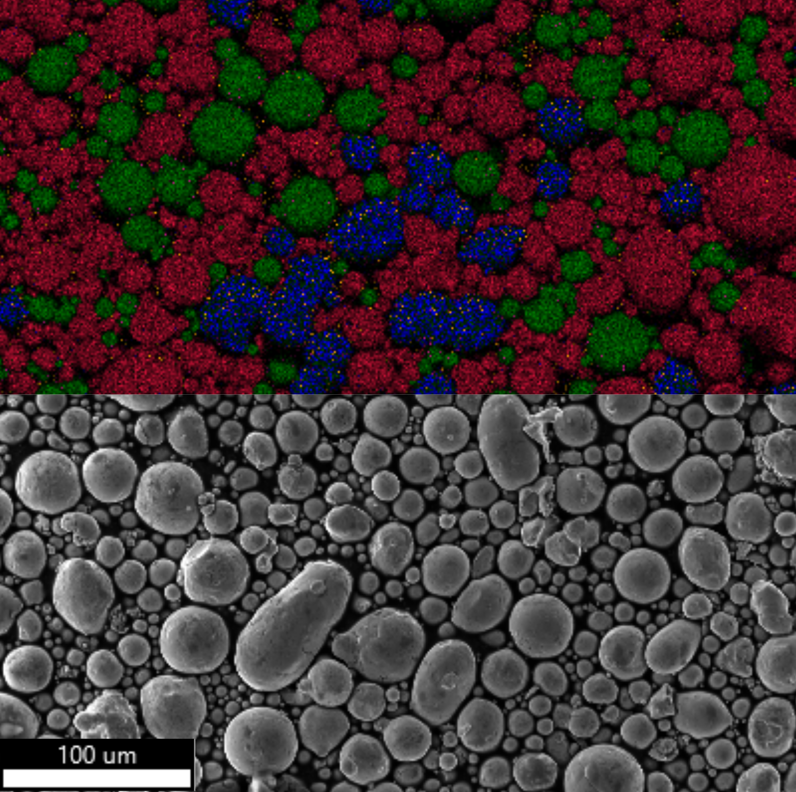
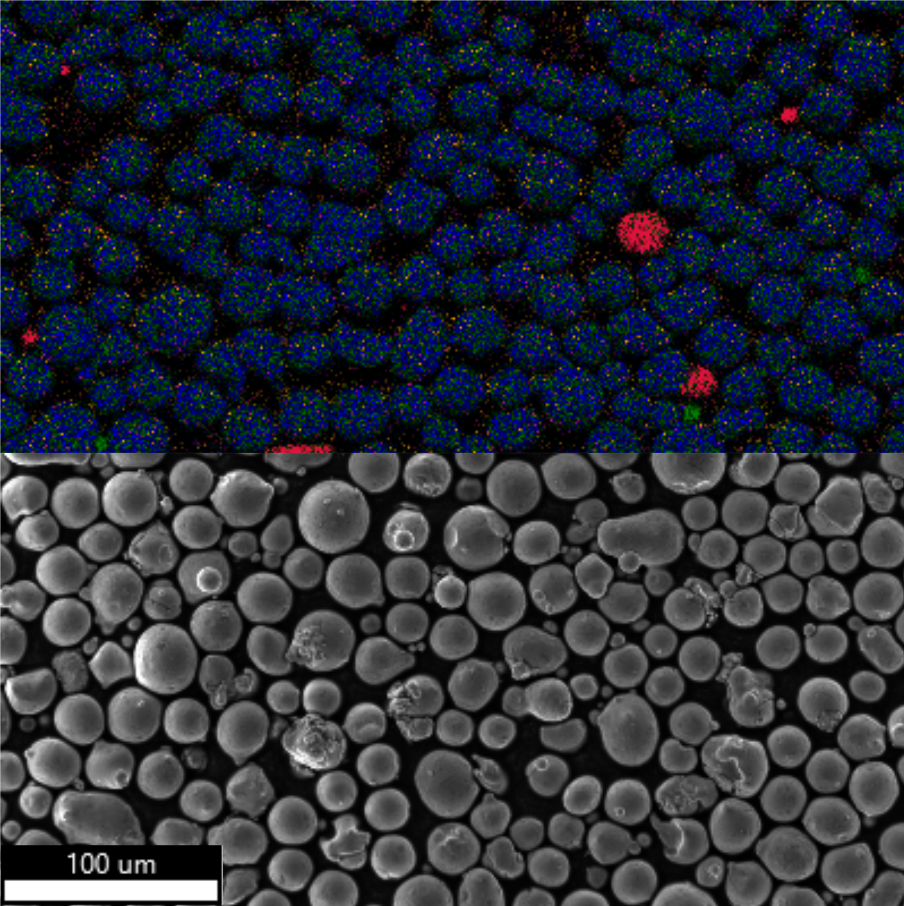
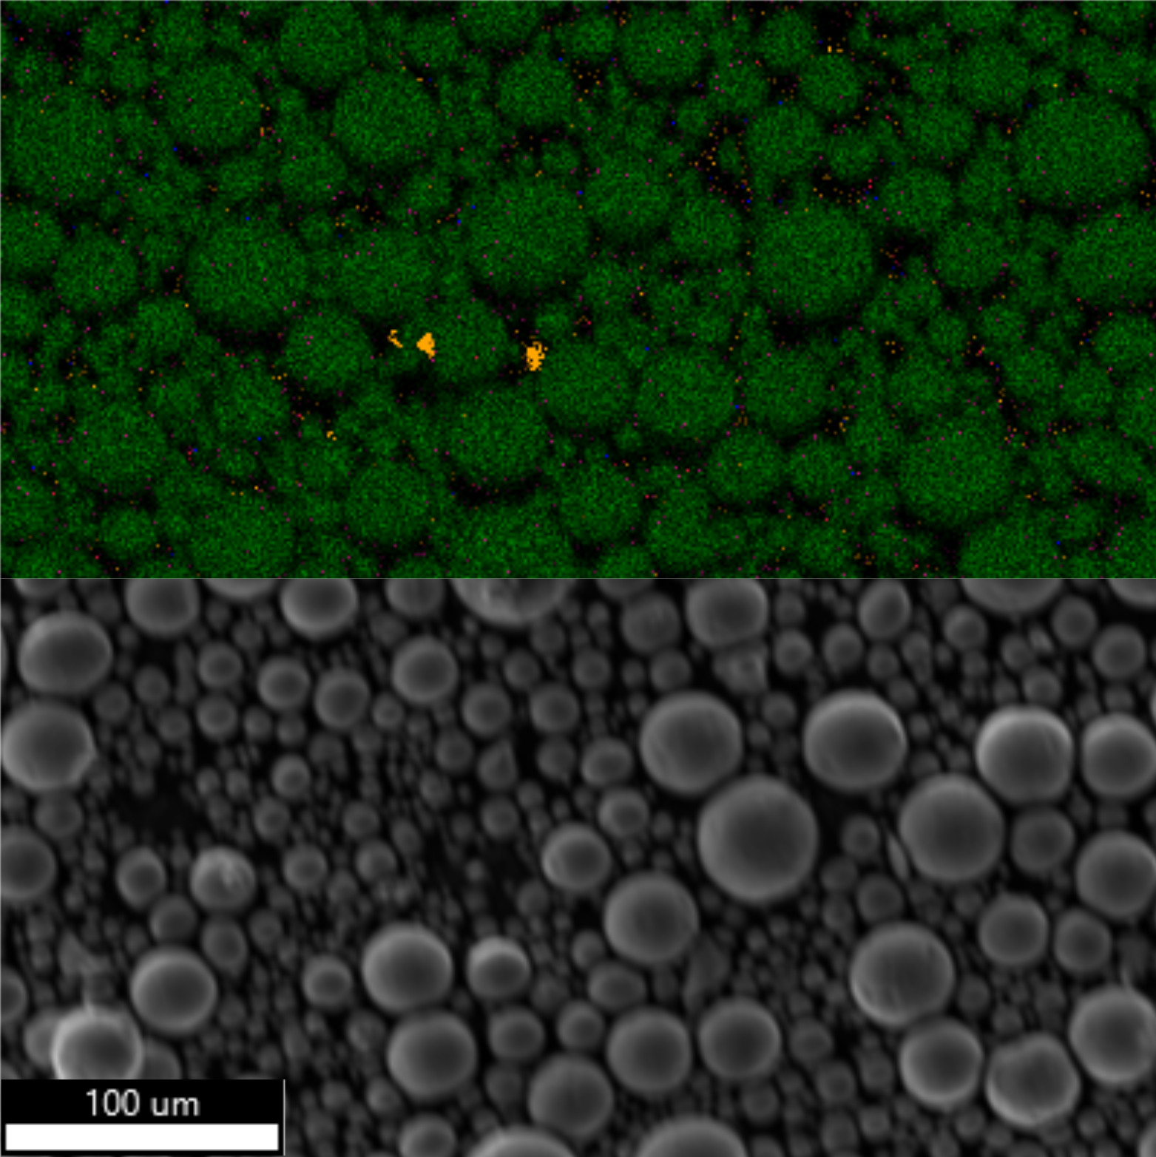
In- situ alloying: a novel technique with high potential
Fe
Cr
Co
Mixing, 1h
Mixing aid:
Stainless steel balls

Slide 6
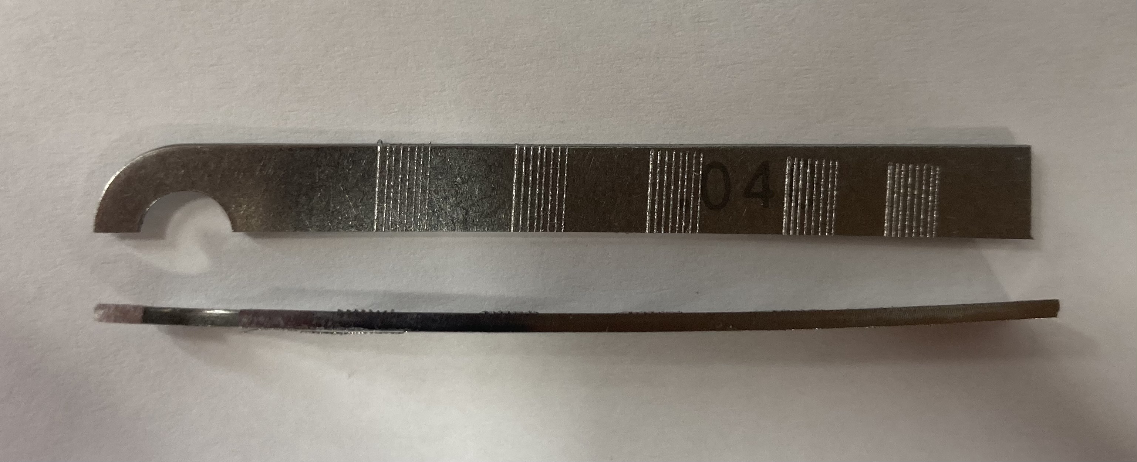


Additive manufacturing of FeCrCo: Melt pool studies
Investigated Parameter
Laser Power / W | 25, 65, 105, 145, 190, 240
Speed / mm/s | 100, 300, 500, 700, 900, 1100, 1300
Layer height / um | 25
Spot size / um | 50
$$E= \frac{LP}{v ∗hd} J/{{mm}^{2}}$$
$$E= \frac{LP}{v ∗hd∗lh} J/{{mm}^{3}}$$

Slide 7
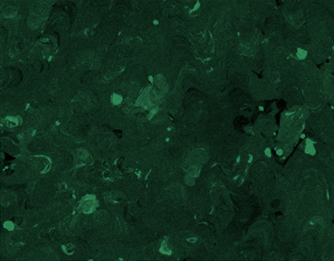
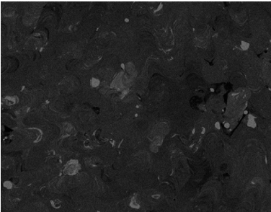
Additive manufacturing of FeCrCo: homogeneity
Parameter
Laser powder / W | 65, 105, 145, 190, 240
Energy density / J/mm² | 1.60, 2.80, 4.00

Slide 8

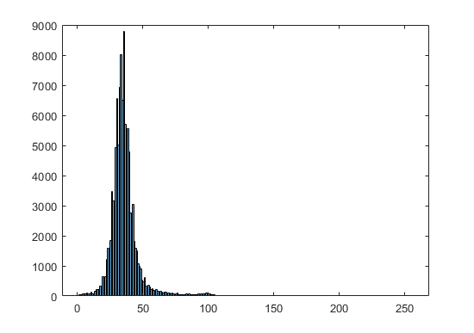
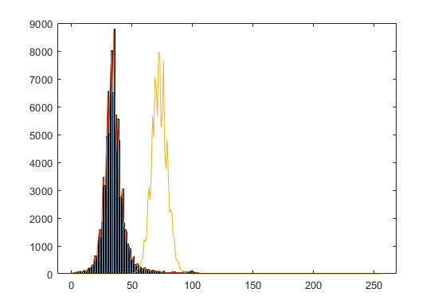
Additive manufacturing of FeCrCo: homogeneity
1
2
2
1
Frequency
1 fully homogenized reference
2 sample (Cr 65W ED400)
Luminance value

Slide 9
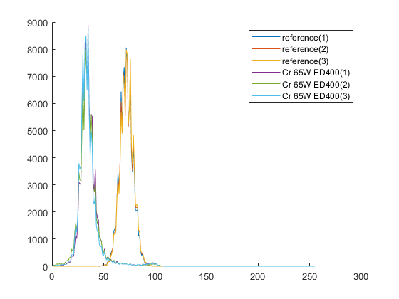
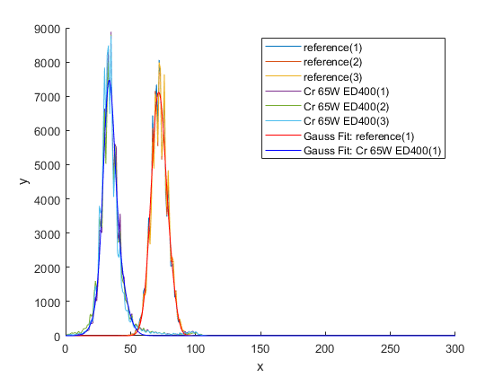
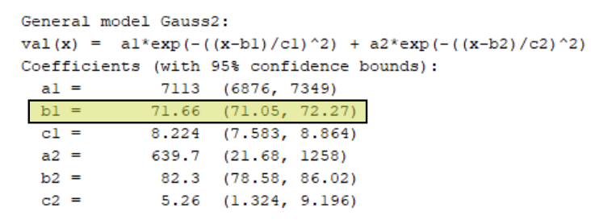
Additive manufacturing of FeCrCo: homogeneity
Frequency
Frequency
Luminance value
Luminance value

Slide 10
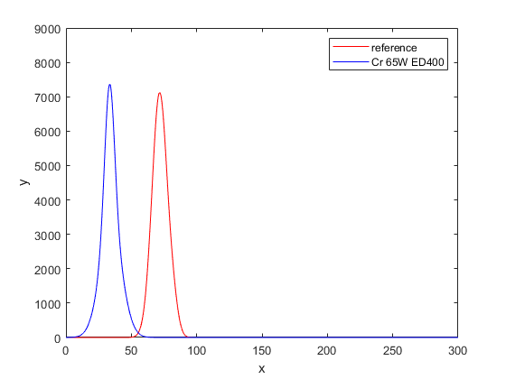
Additive manufacturing of FeCrCo: homogeneity
value of
inhomogeneity
2
1
Frequency
Frequency
1 fully homogenized reference
2 sample (Cr 65W ED400)
Luminance value
Luminance value

Slide 11
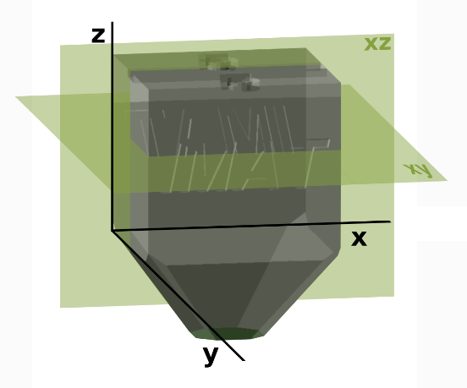
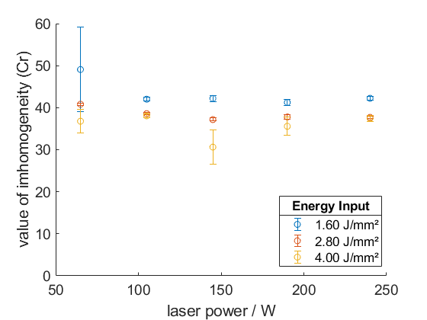
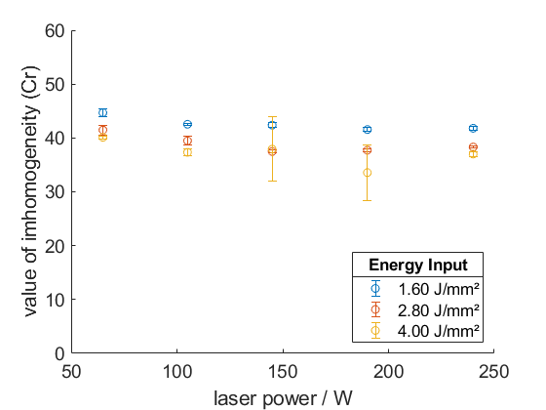
Additive manufacturing of FeCrCo: homogeneity
xy direction
xz direction

Slide 12
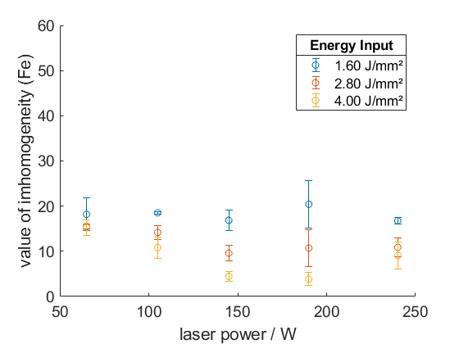
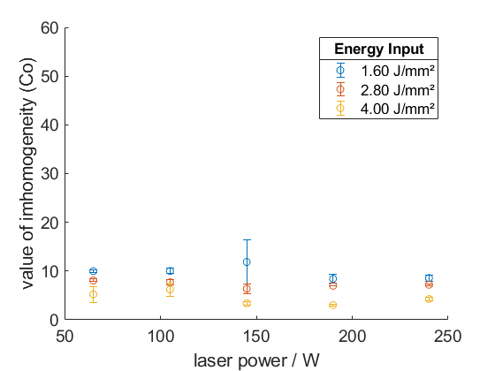
Additive manufacturing of FeCrCo: homogeneity
T_{m} = 1538 ºC
T_{m} = 1907 ºC
T_{m} = 1495 ºC

Slide 13
Functional graduation
Introduction of a chemical gradient by LPBF

Slide 14
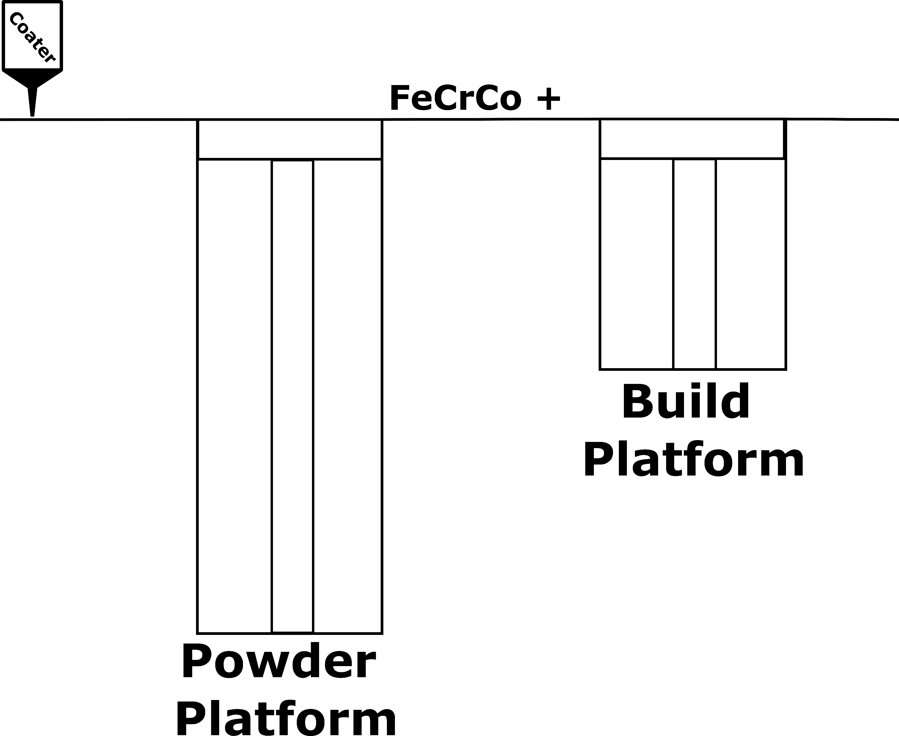
Concept: Process Development

Slide 15
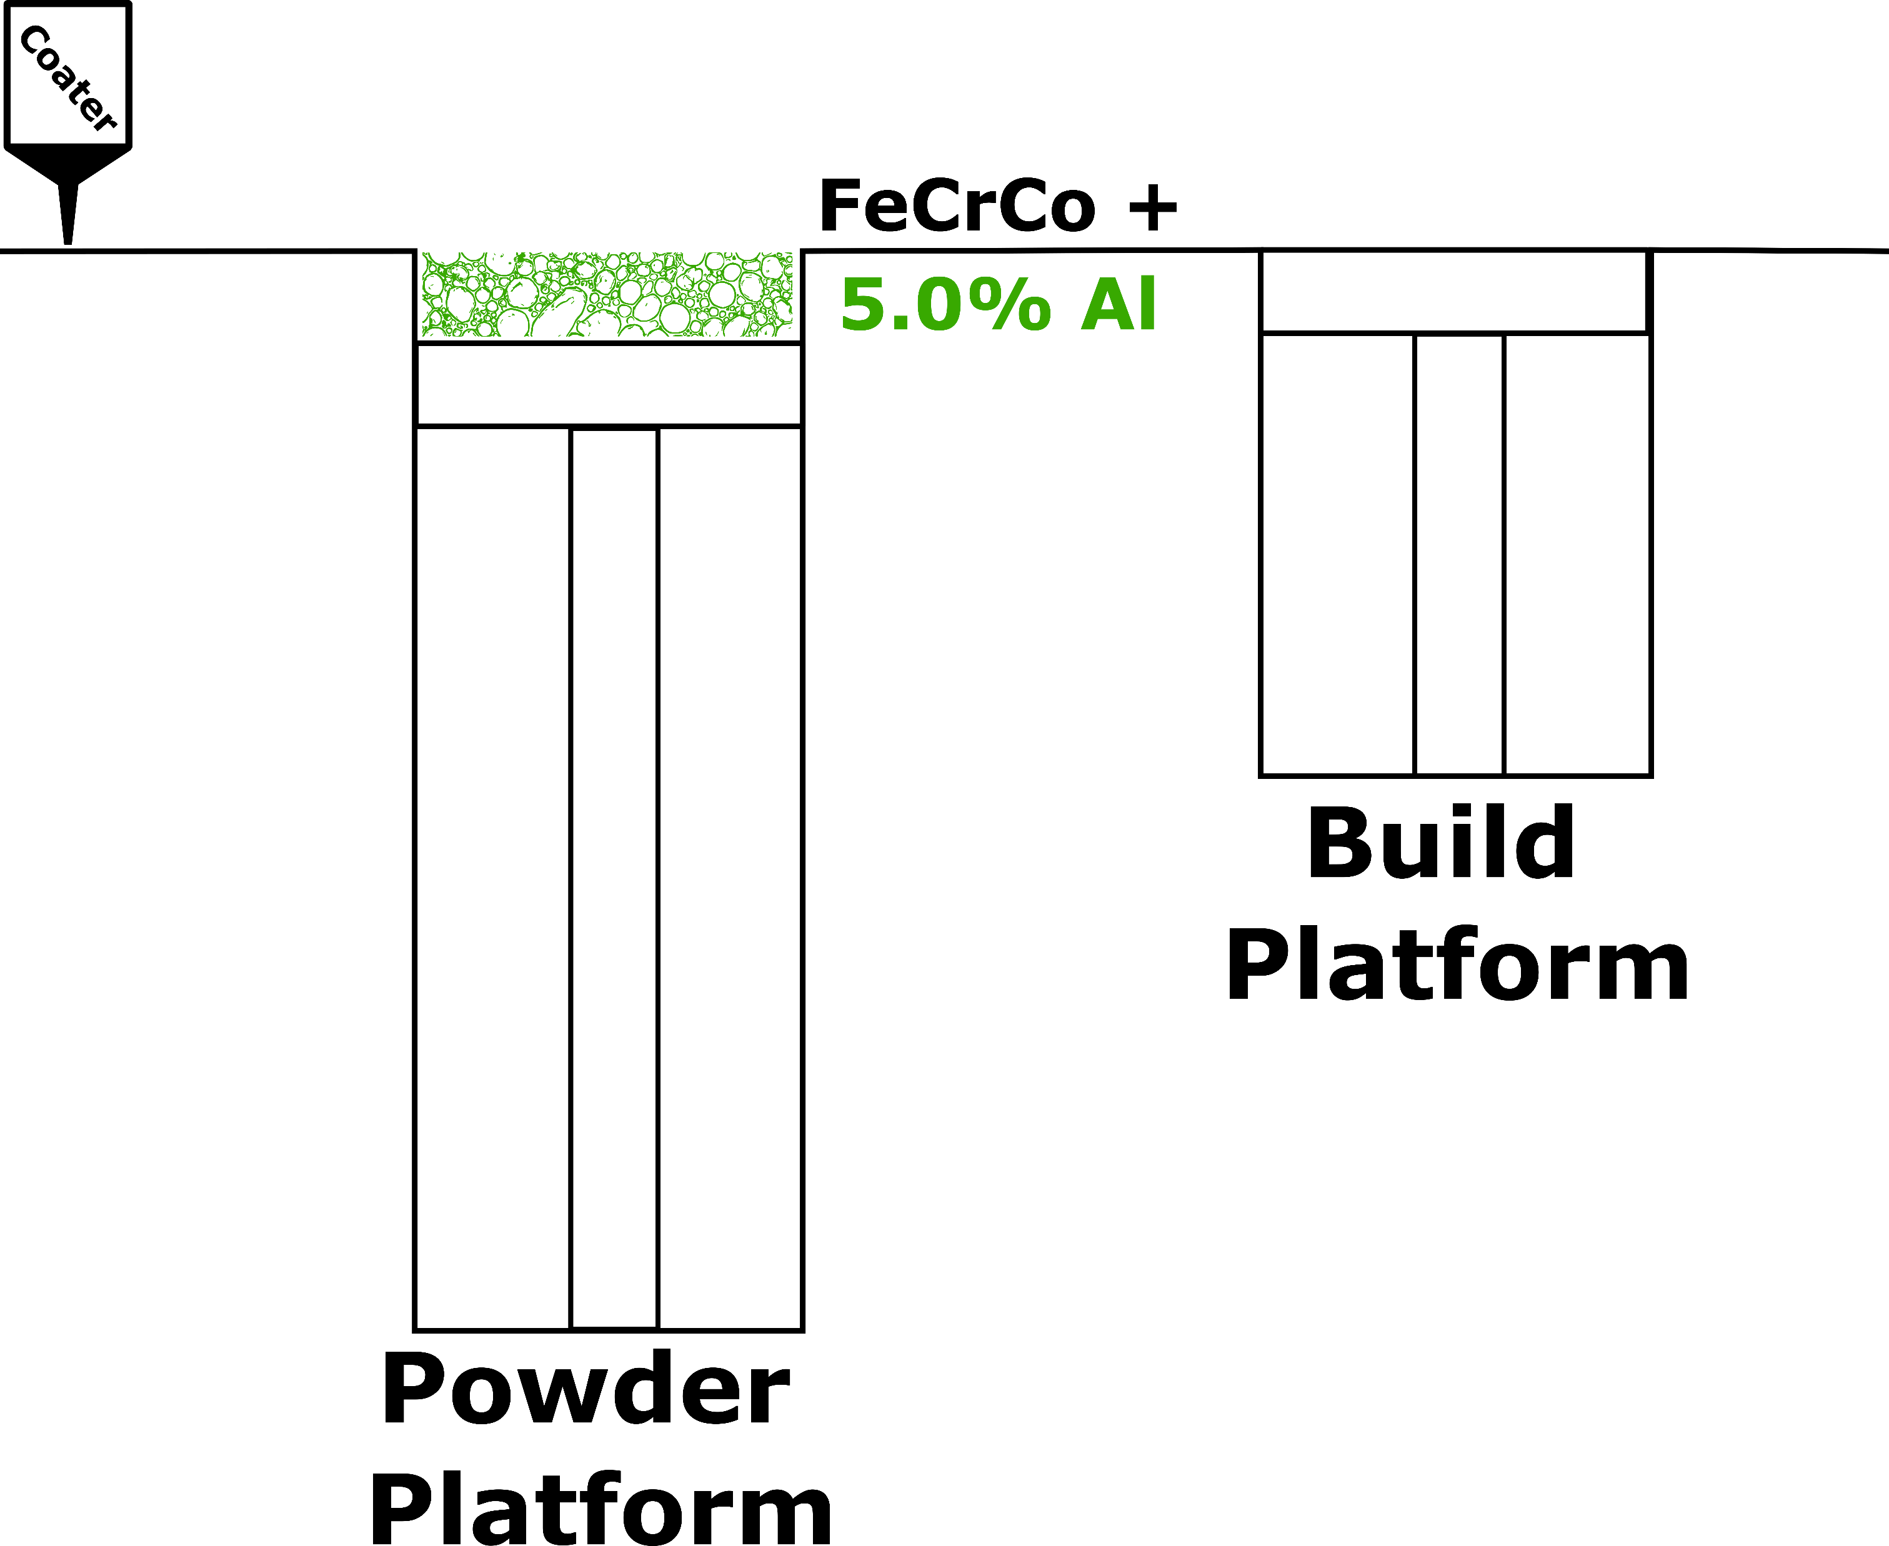
Concept: Process Development

Slide 16
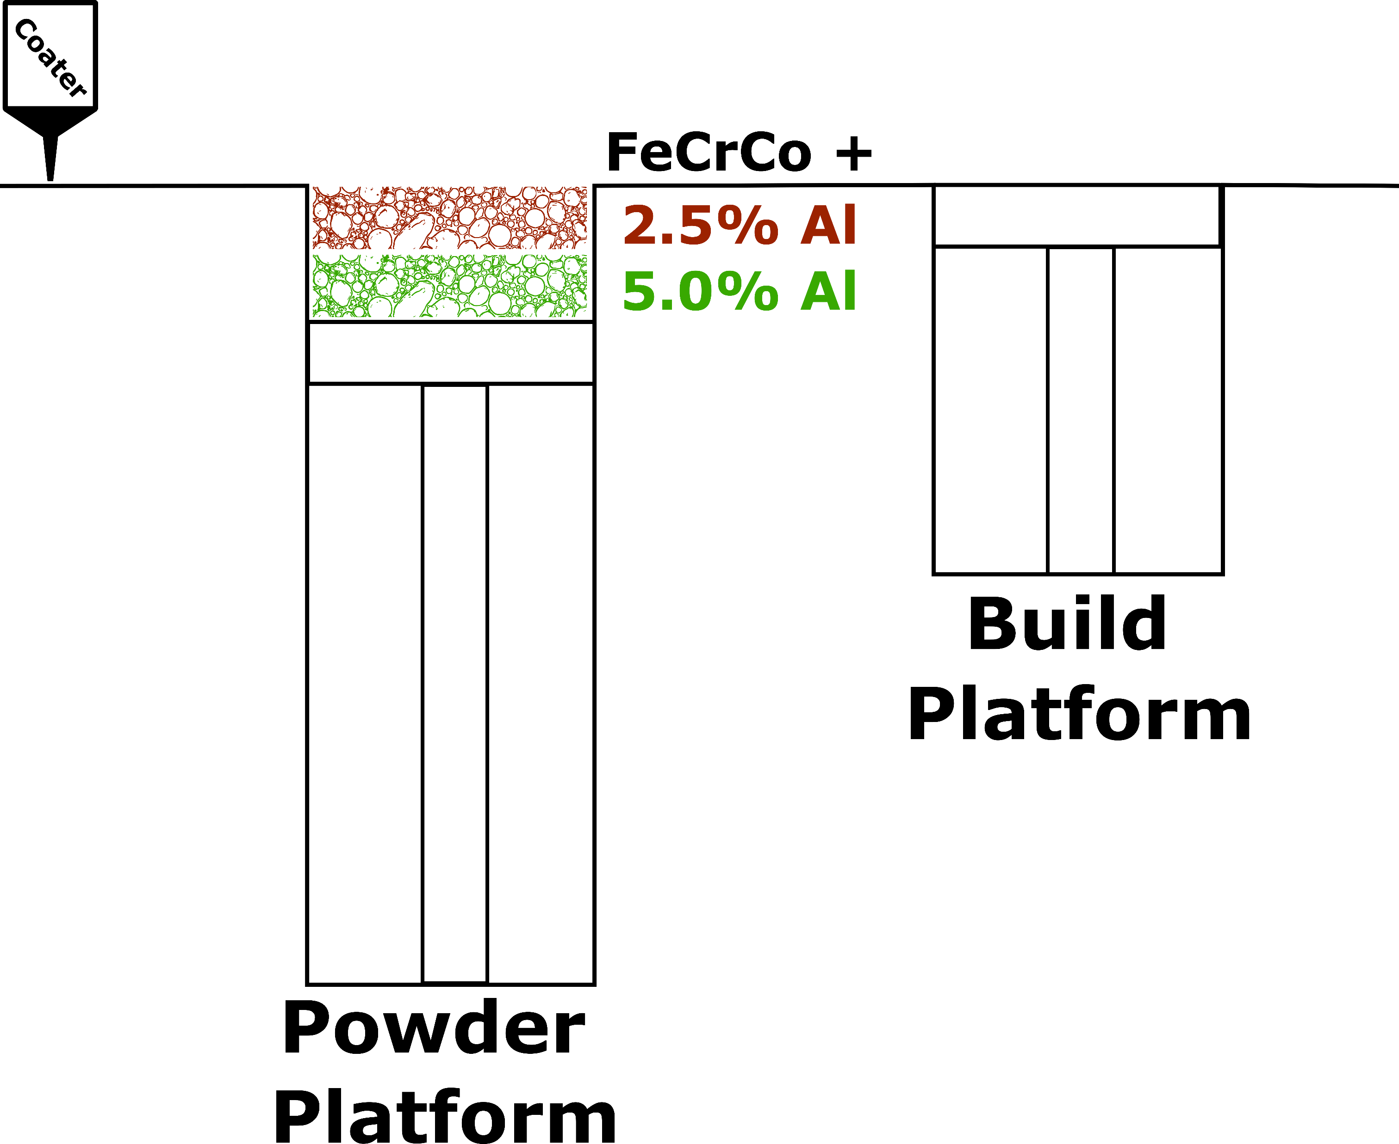
Concept: Process Development

Slide 17
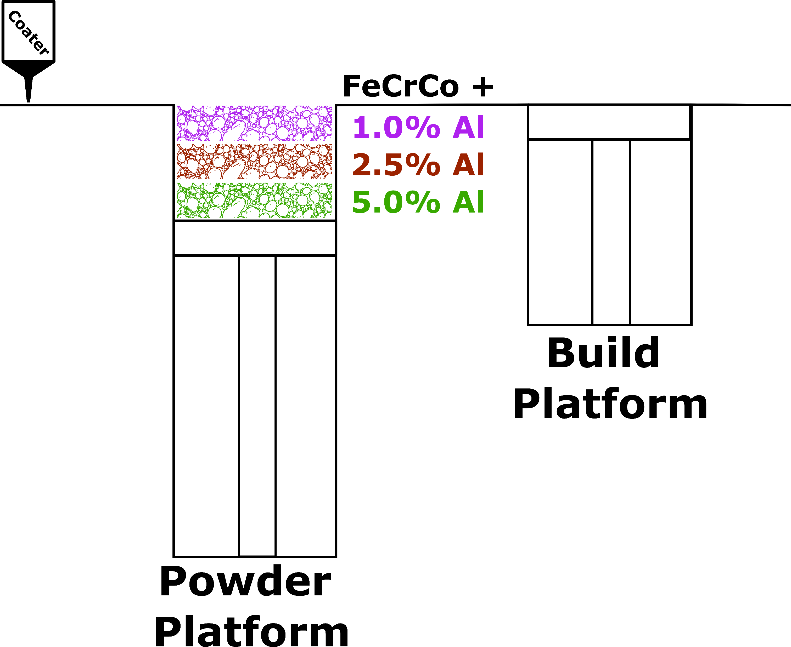
Concept: Process Development

Slide 18
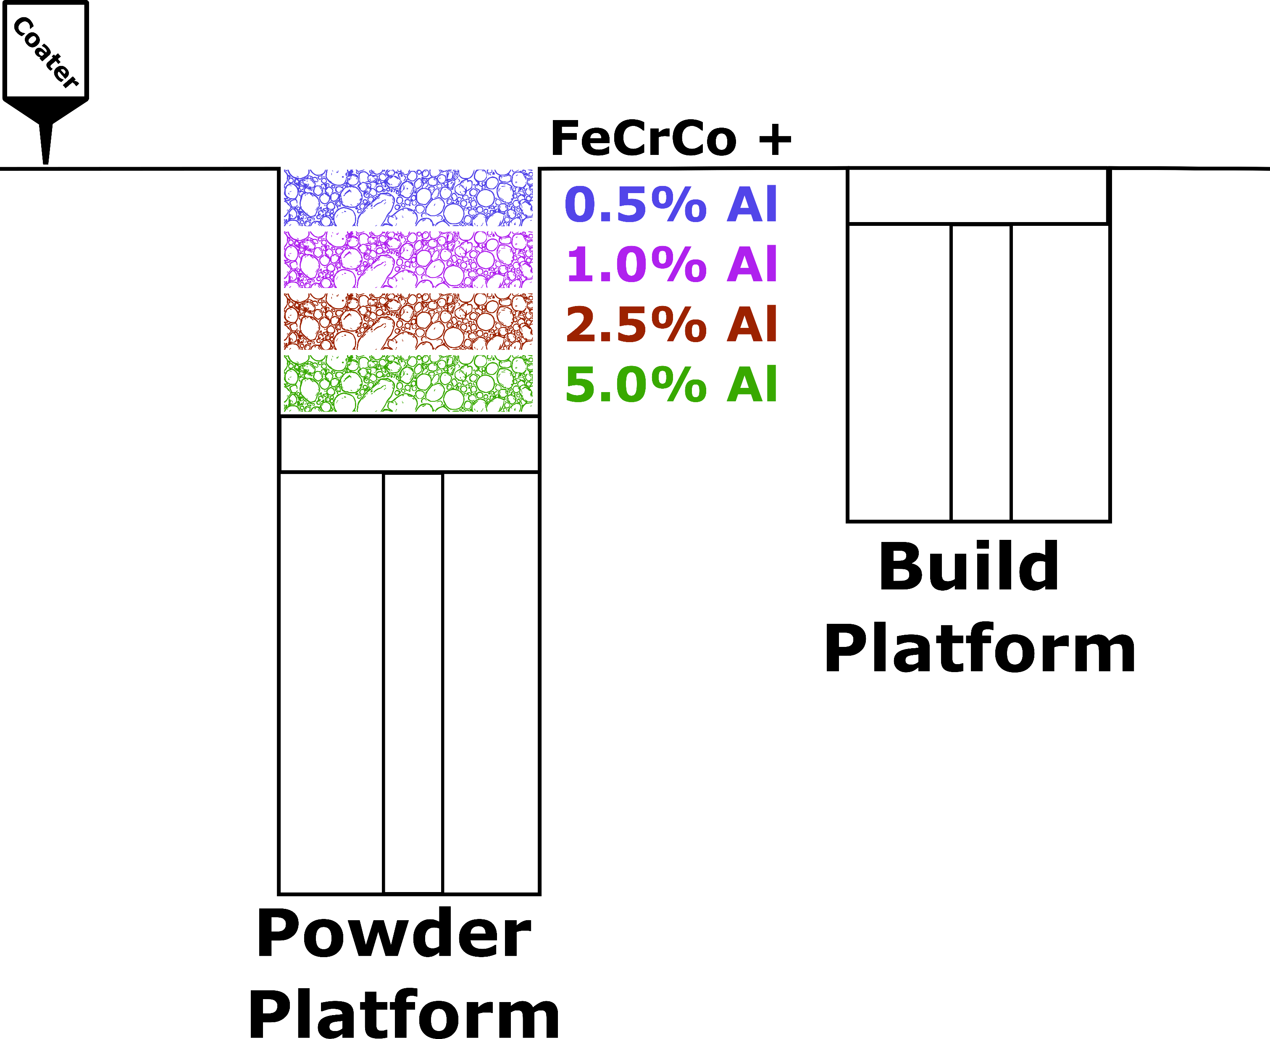
Concept: Process Development

Slide 19
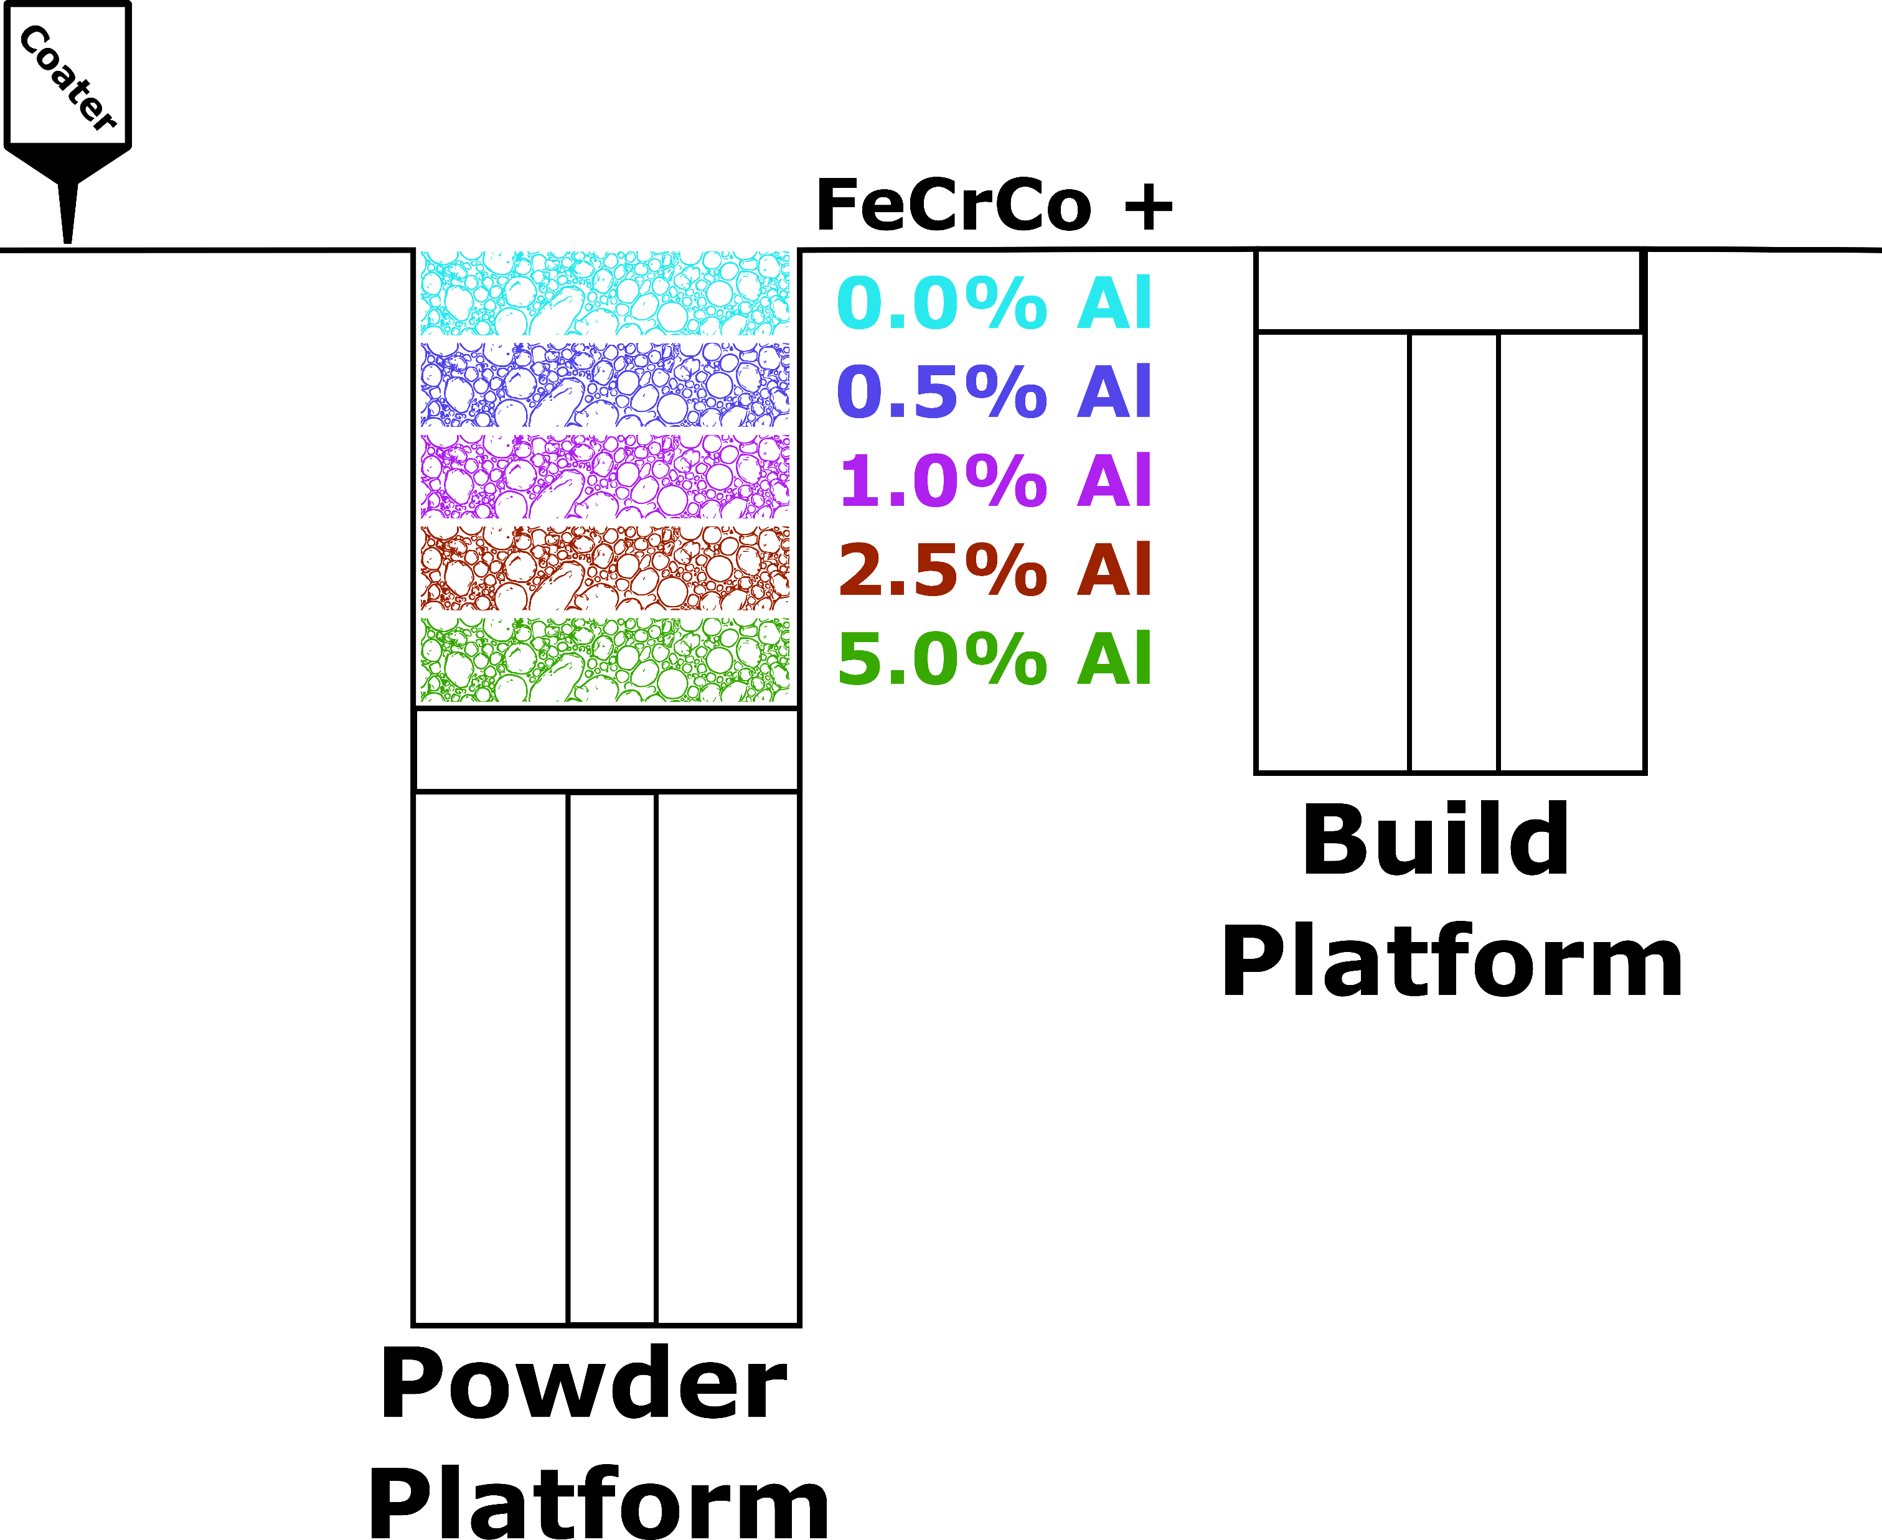
Concept: Process Development

Slide 20
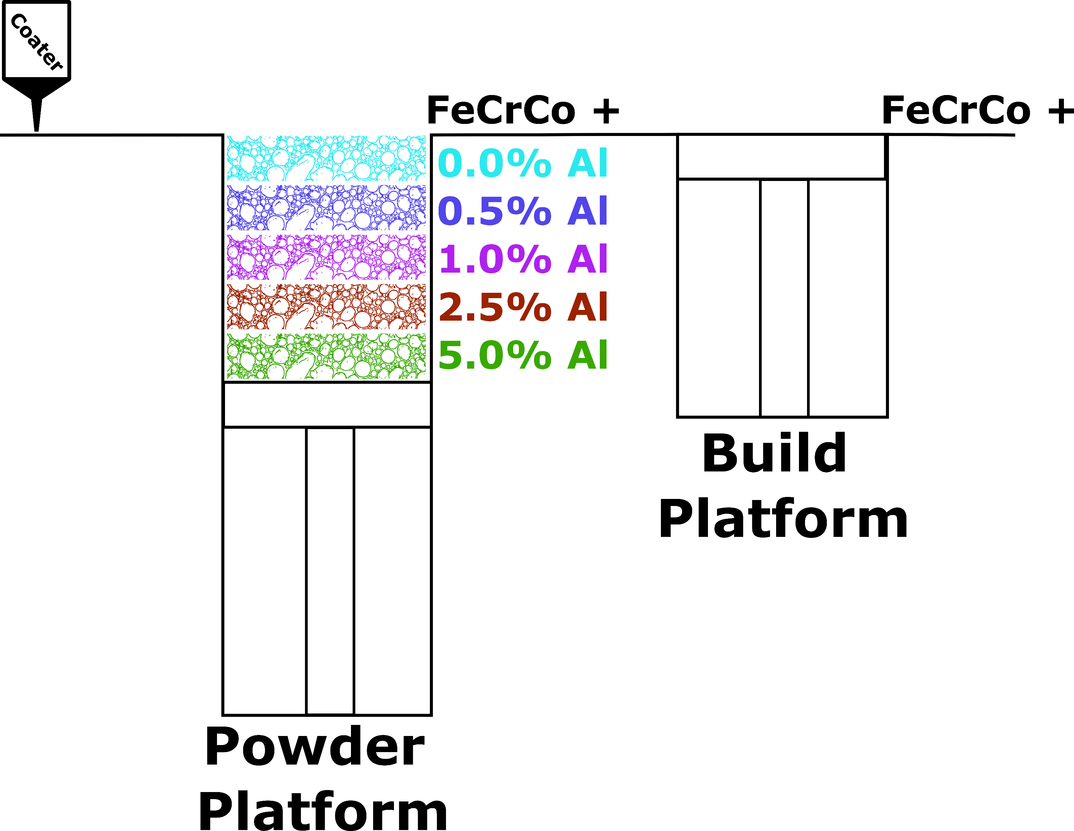
Concept: Process Development

Slide 21
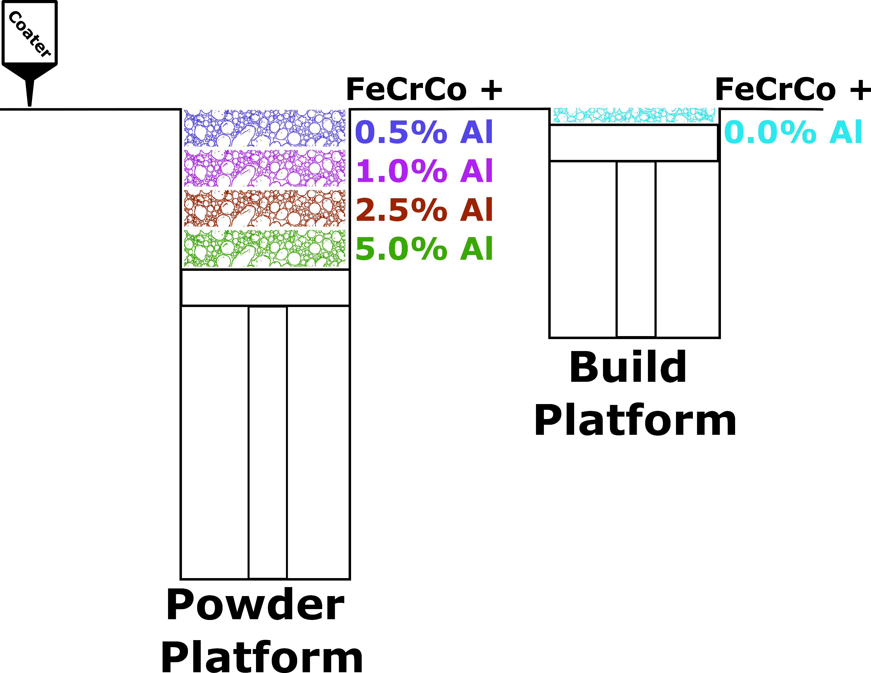
Concept: Process Development

Slide 22
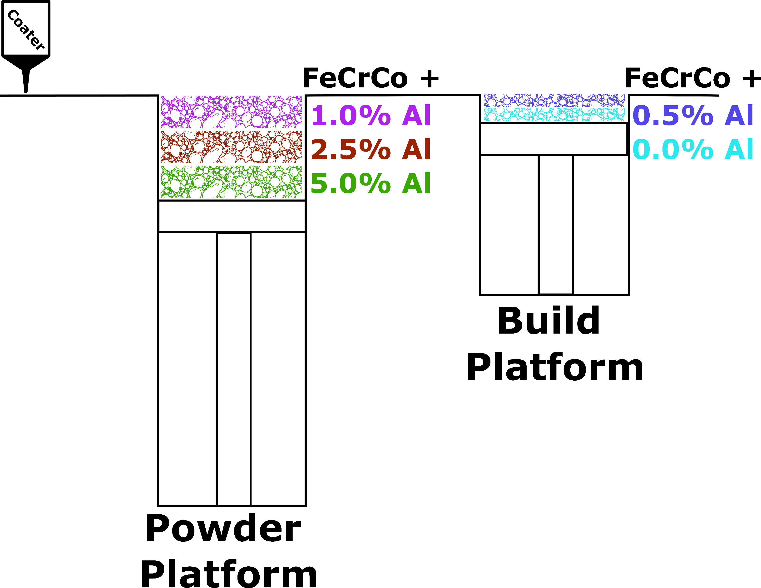
Concept: Process Development

Slide 23
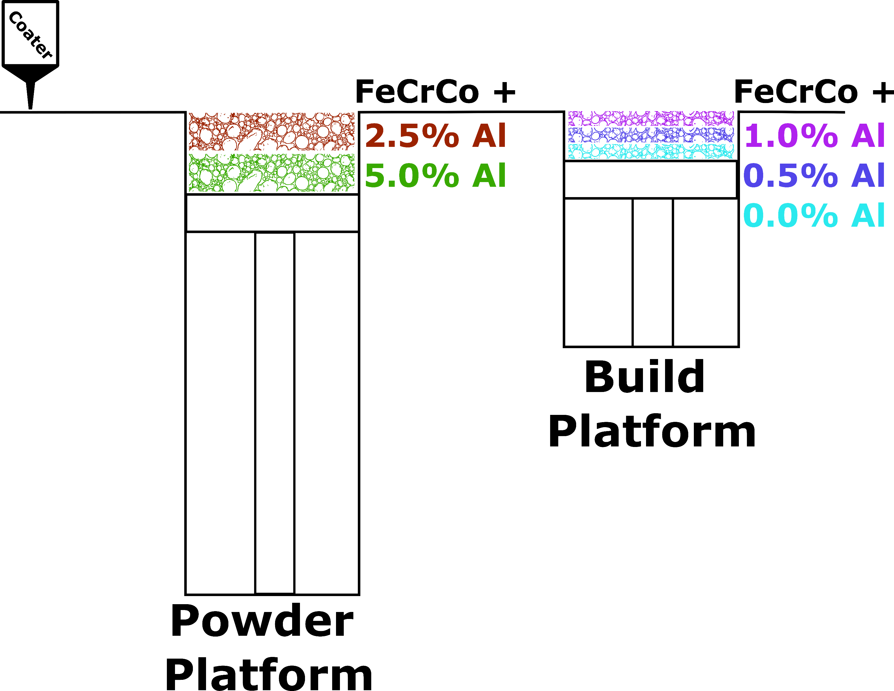
Concept: Process Development

Slide 24
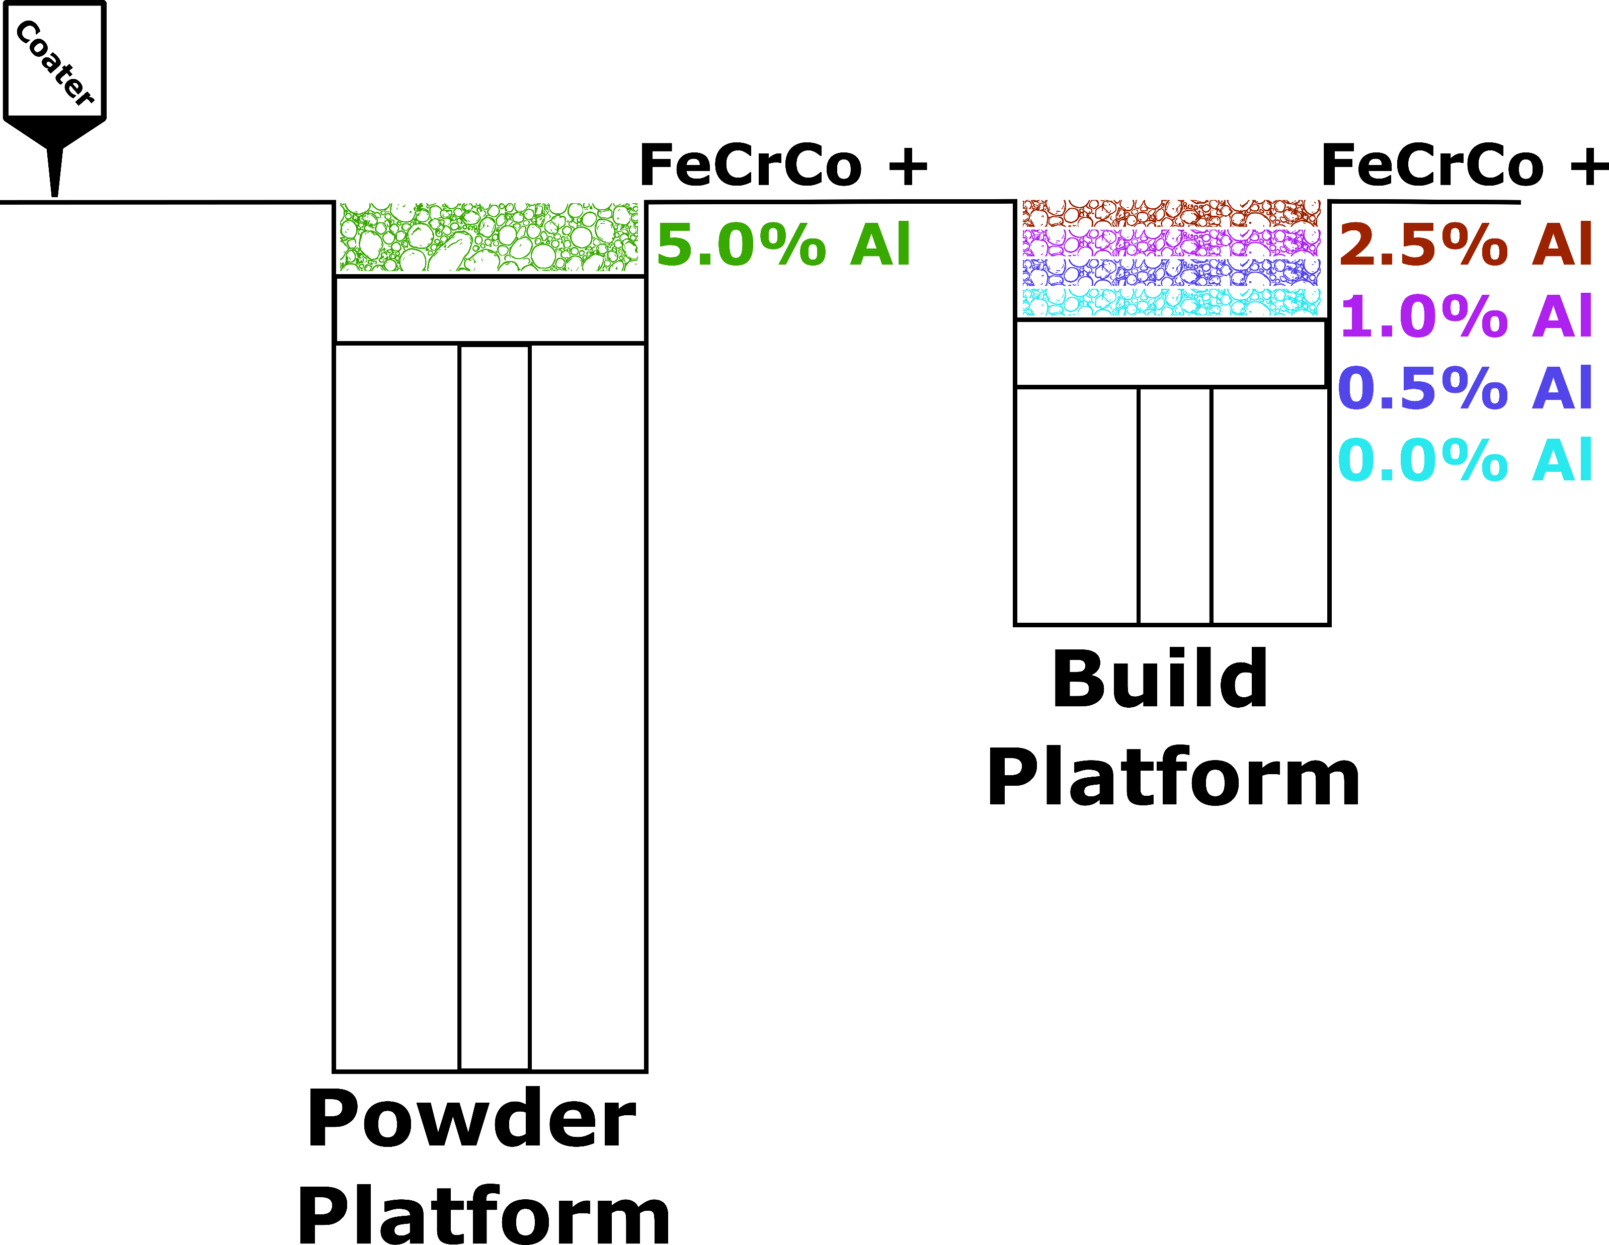
Concept: Process Development

Slide 25
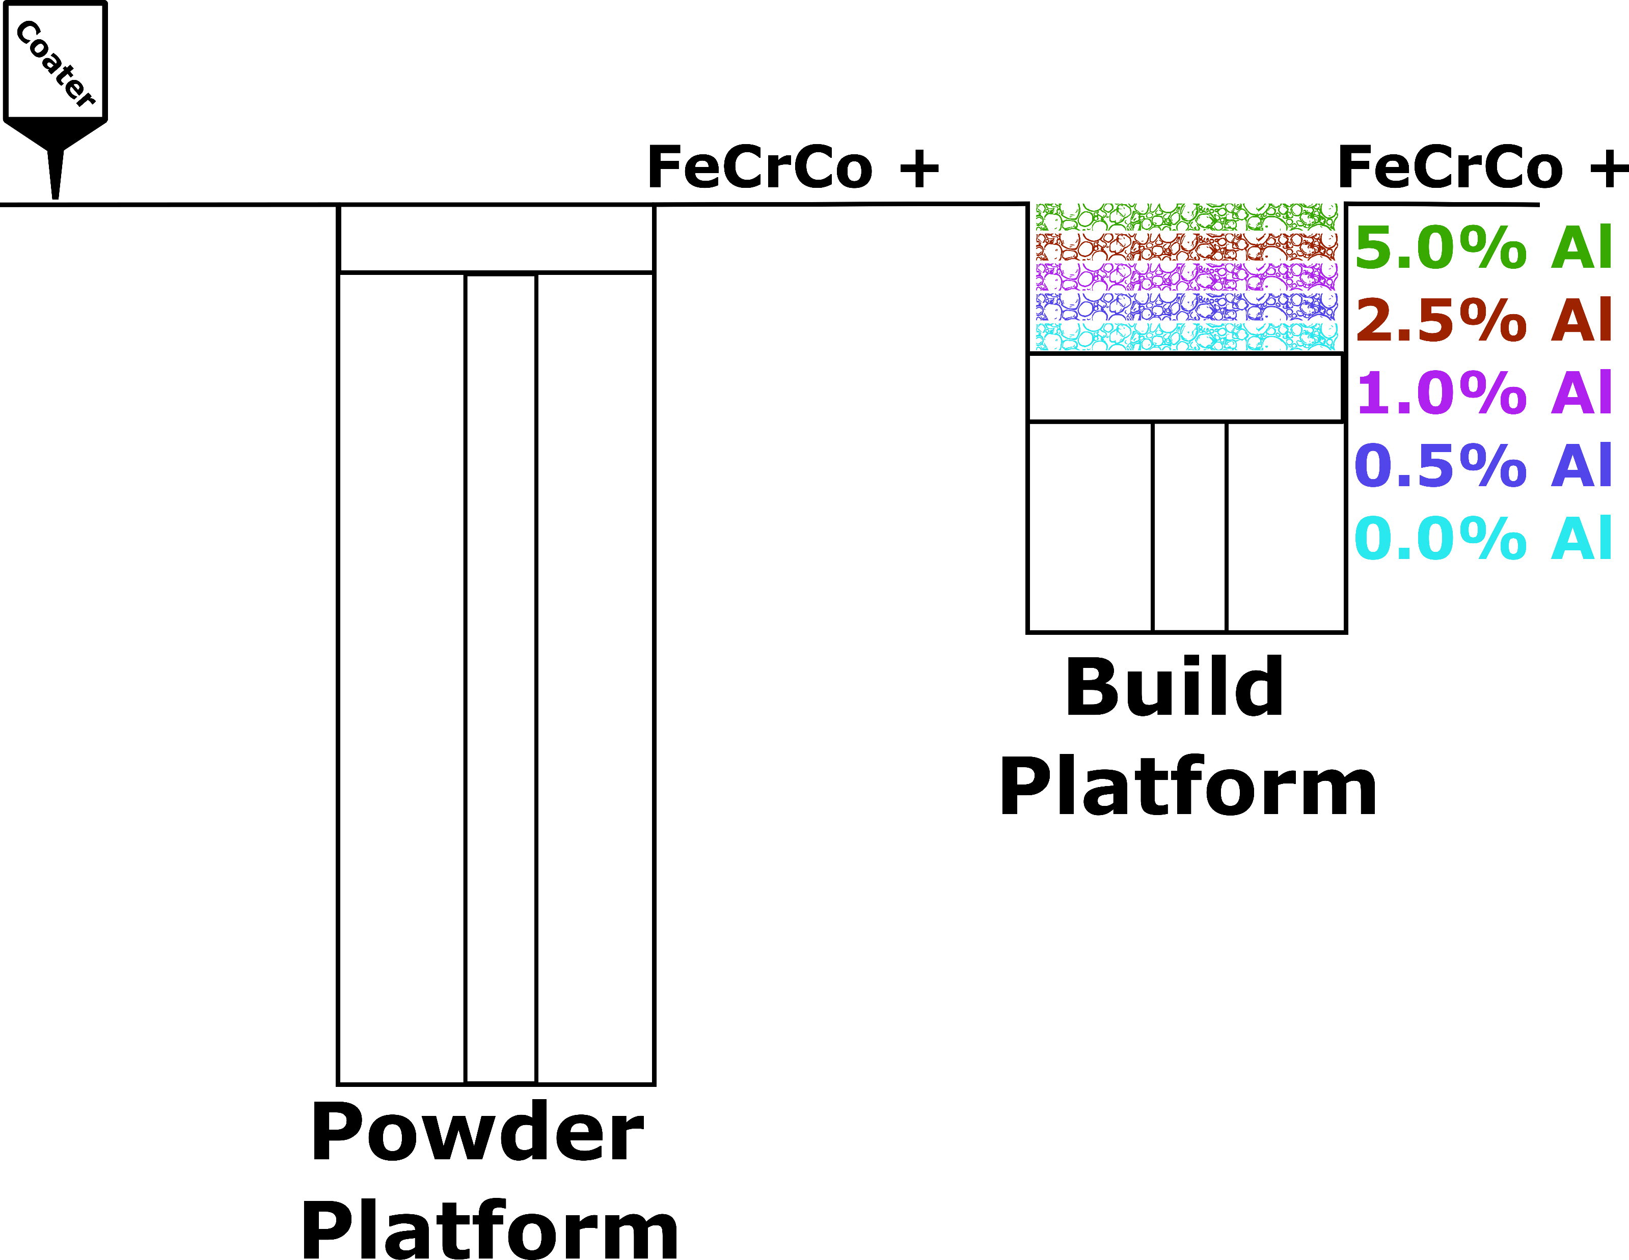
Concept: Process Development

Slide 26
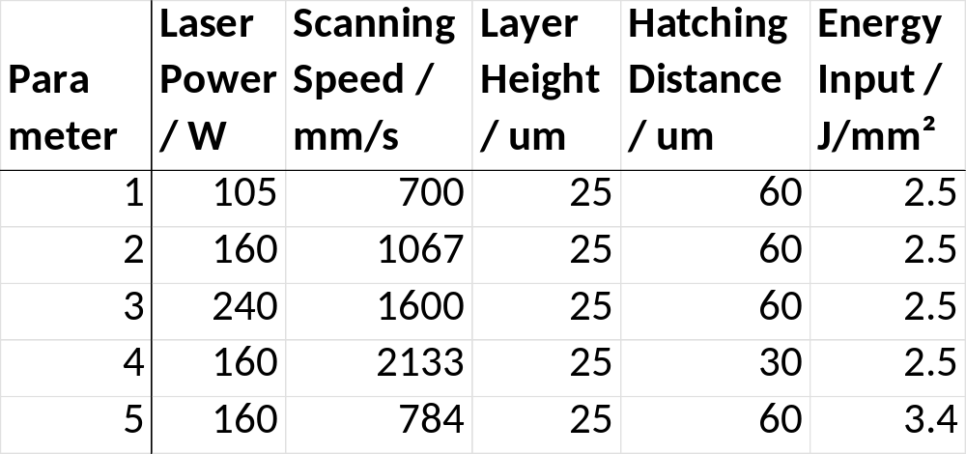
Printing Parameter

Slide 27
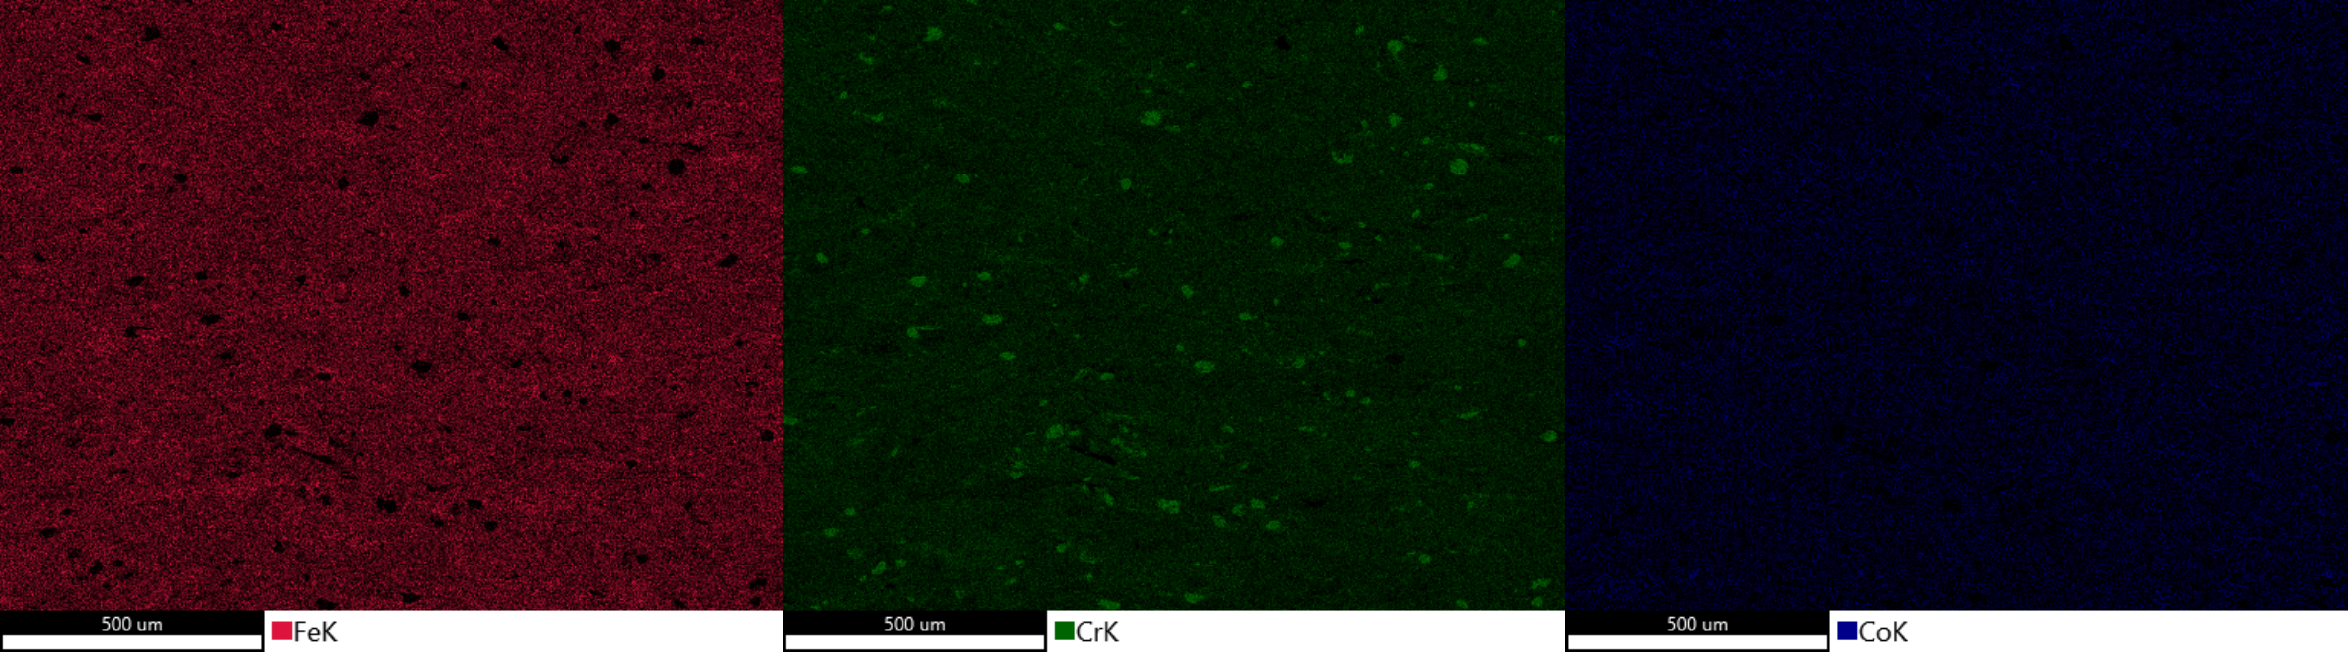
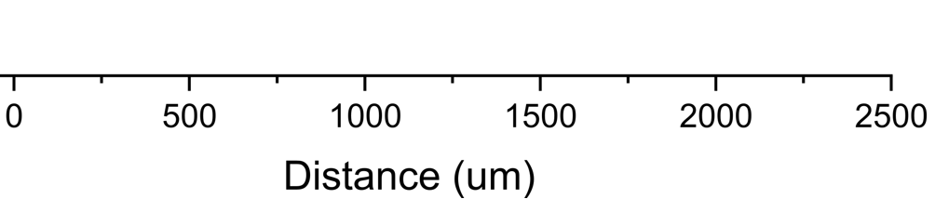
Results: Parameter 5

Slide 28
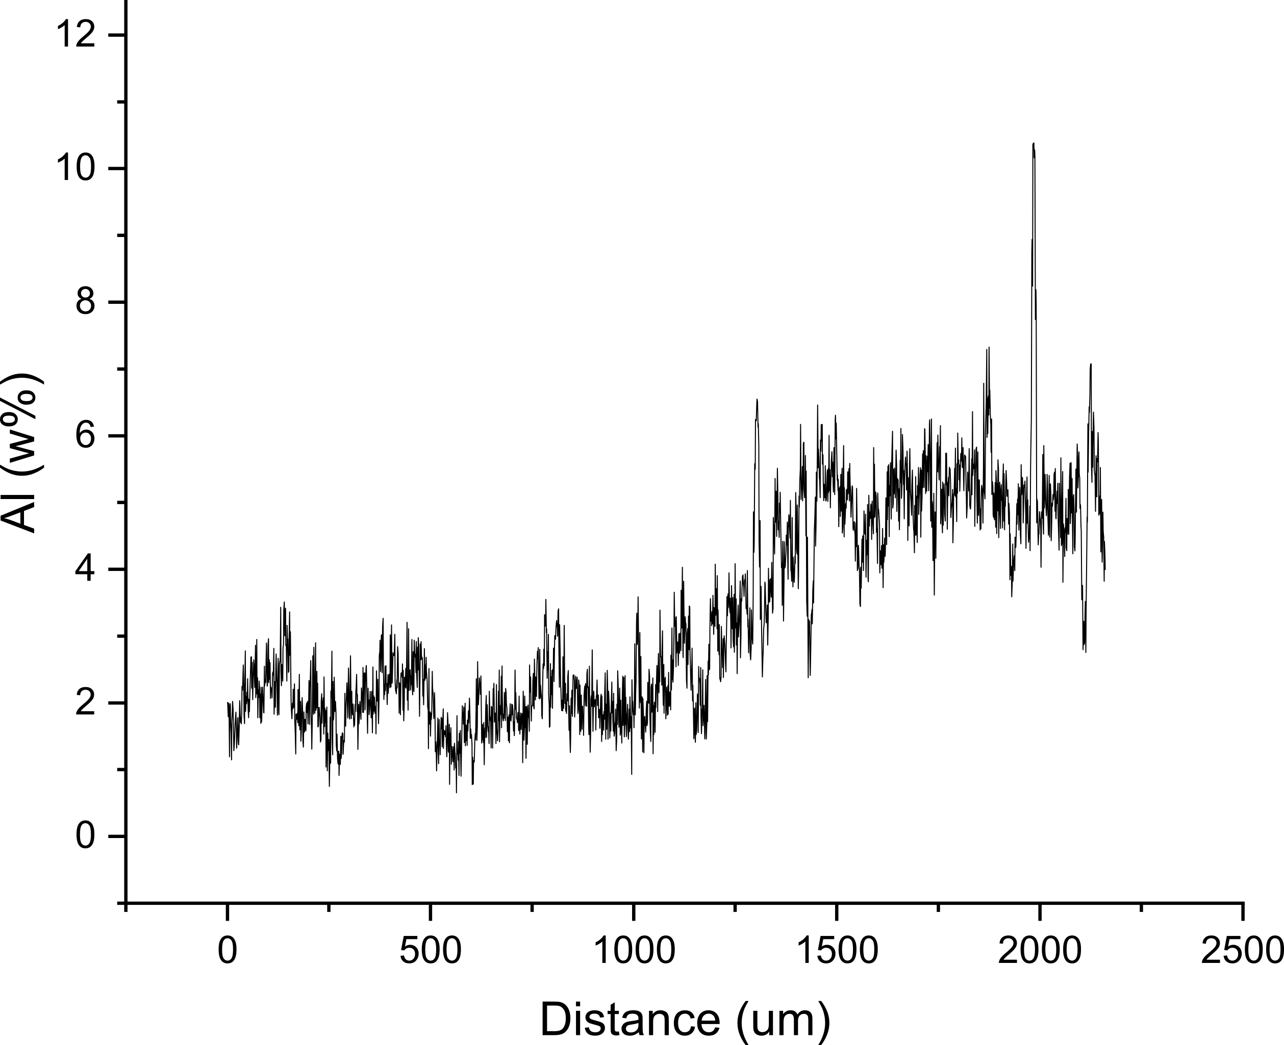
Results: Parameter 5

Slide 29
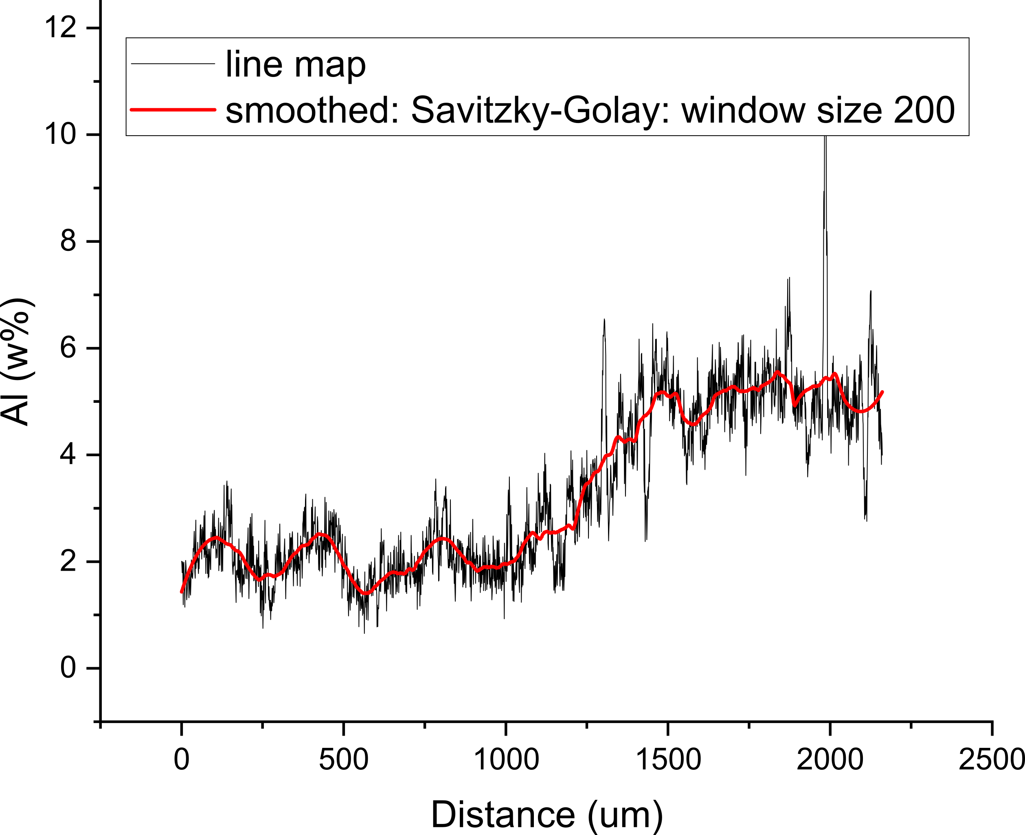
Results: Parameter 5

Slide 30
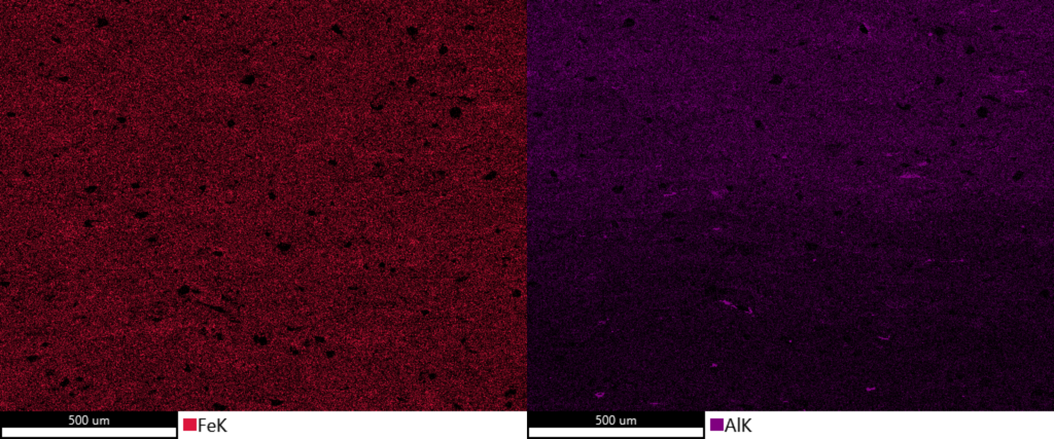
Results: Parameter 5

Slide 31
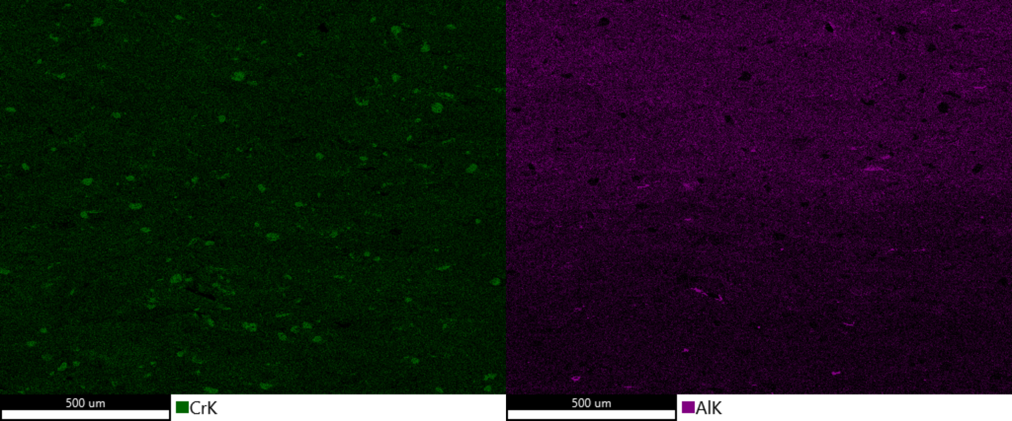
Results: Parameter 5

Slide 32
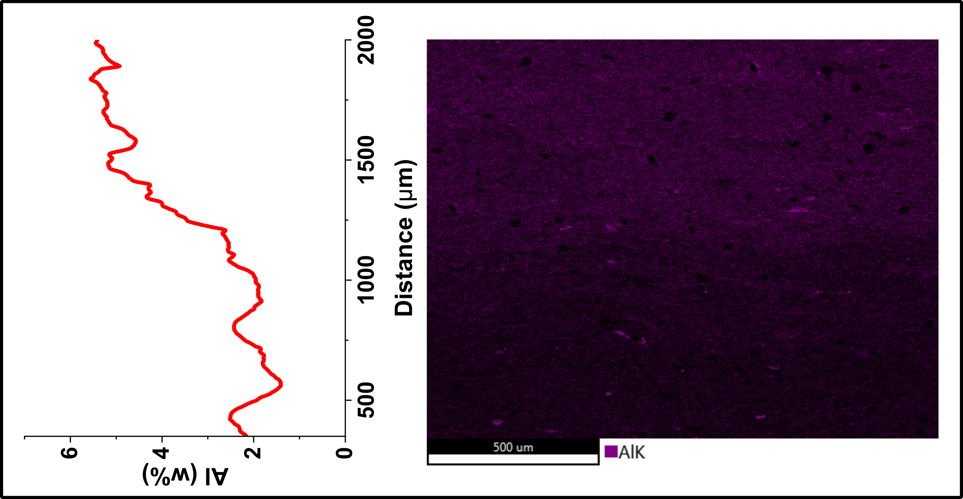
First Results: Parameter 5

Slide 33
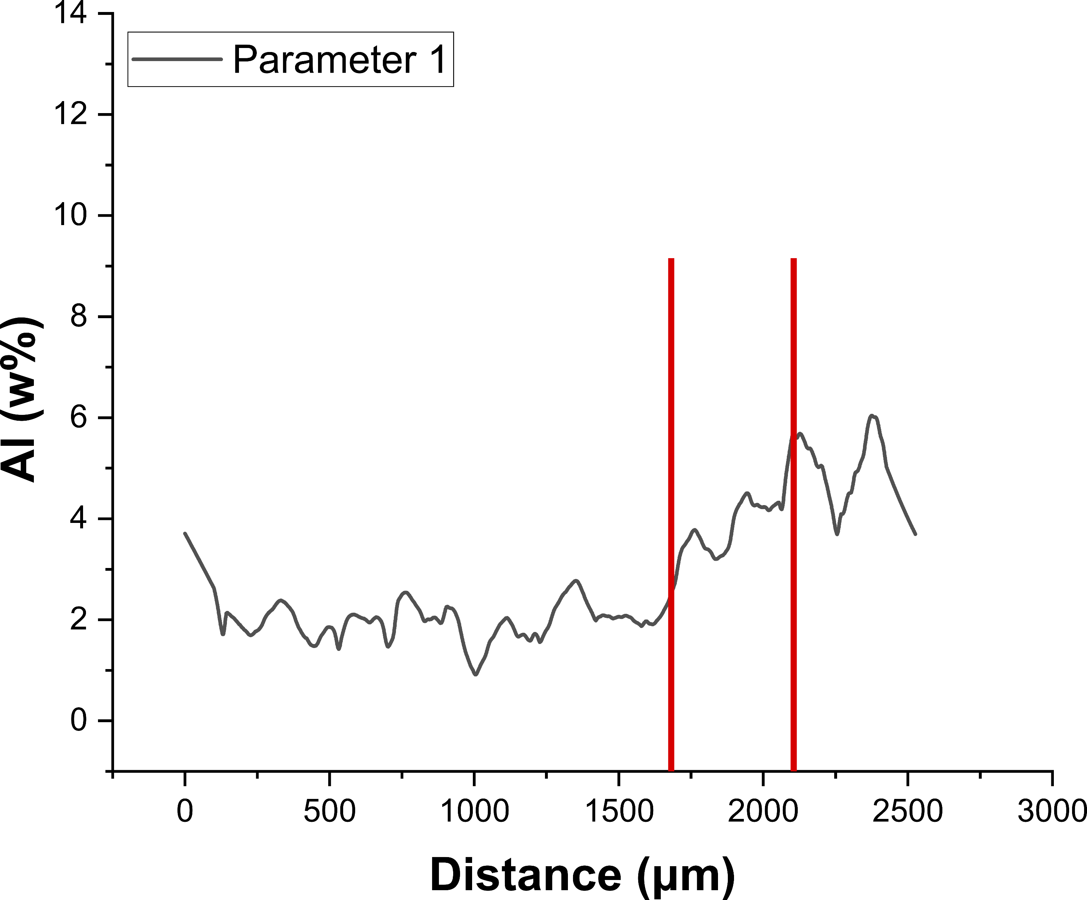
First Results: Comparison of Parameters
380µm

Slide 34
First Results: Comparison of Parameters
281µm

Slide 35
First Results: Comparison of Parameters
453µm

Slide 36
First Results: Comparison of Parameters

Slide 37
First Results: Comparison of Parameters
231µm

Slide 38
First Results: Comparison of Parameters

Slide 39
Thank you for your attention!
Siegfried Arneitz
Graz University of Technology
Institute of Materials Science, Joining and Forming
Kopernikusgasse 24/I
Graz, Austria
0043 316 873 1656
Siegfried.arneitz@tugraz.at

