Slide 1


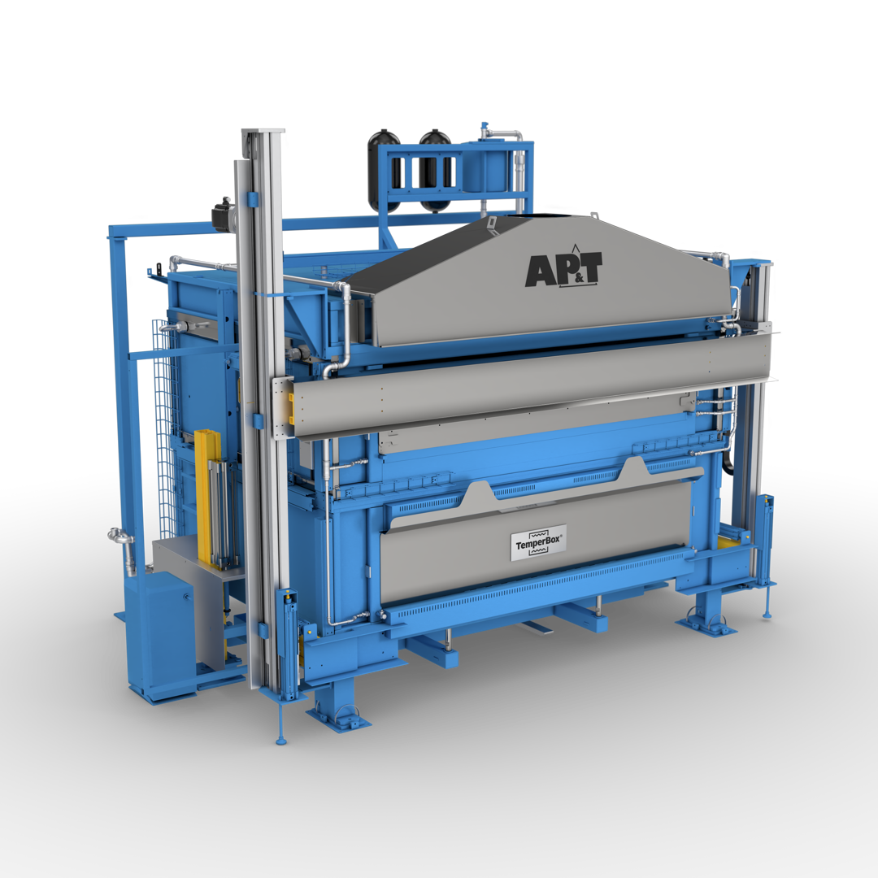
Analysis of process limits for partial hot stamping with controlled pre-cooling by radiation exchange
Hilfslinien anzeigen über Menü: Ansicht // Anzeigen // Haken bei Führungslinien setzen
Reservierte Bereiche für Stempel oder Icons
Zusatztext zur Präsentation 16 pt.
Referent, Abteilung, Ort, Datum
Wechsel zwischen weißem und schwarzem Folienlayout über Menü:
Entwurf // Designs
(Rechtsklick: Für alle Folien oder
Für ausgewählte Folien übernehmen)
Folie in Ursprungsform
bringen über Menü:
Start // Folien // Zurücksetzen
Wechsel des Folienlayouts
im Menü über:
Start // Folien // Layout
Wechsel der Textebene
im Menü über:
Start // Absatz // Listenebene erhöhen/verringern
¹Alborz Reihani, ¹Leonore Donat, ¹Sebastian Heibel, ¹Thomas Schweiker, ²Alper Güner, ²Marcus Gienger, ³Maik Winderlich, ⁴Marion Merklein
Listenebene
erhöhen
¹Mercedes-Benz AG, Sindelfingen, Germany
²AutoForm Engineering Deutschland GmbH, Dortmund, Germany
³GEDIA Gebrüder Dingerkus GmbH, Attendorn, Germany
⁴Institute of Manufacturing Technology, Friedrich-Alexander Universität Erlangen-Nürnberg, Erlangen, Germany
Listenebene
verringern
Fußzeile pro Folie oder für alle/mehrere anpassen über Menü: Einfügen // Text // Kopf- und Fußzeile
Notes:
Many thanks for the introduction… My name is Alborz Reihani. I am a PHD student working for Mercedes Benz.
Today, I am here to present my research entitled "Analysis of Process Limits for Partial Hot Stamping with Controlled Pre-cooling by Radiation Exchange." In this case, the controlled pre-cooling was realized by a special furnace chamber of the so-called TemperBox. Which you can see here on the first slide. We are using this furnace technology exclusively for research and development purposes.
This study is the result of a collaborative effort involving Gedia, AutoForm, and the Institute of Manufacturing Technology in Erlangen. I would like to express my sincere gratitude to all of them for their cooperation and support throughout this project. (1 min)

Slide 2
Analysis of process limits for partial hot stamping with controlled pre-cooling by radiation exchange
Introduction and motivation
Investigation methods and materials
Experimental setup and corresponding simulation model
Results and discussion
Summary
1.
2.
3.
4.
5.
Notes:
On this slide, I would like to share with you the agenda for my presentation today. Firstly, I will provide an introduction to the basic process steps involved in partial hot stamping with TemperBox. Additionally, I will discuss the distinctions between this technique and other tailored tempering technologies, as well as conventional hot stamping. Next, I will delve into the methods of investigation, along with the materials utilized. I will also outline the principal objectives that guided our work. Moving forward, I will present the experimental setup and the corresponding simulation model we utilized. Based on the experiments and the sim. I will share the results of our research. Lastly, I will conclude my presentation by summarizing the main results. (1 min)

Slide 3
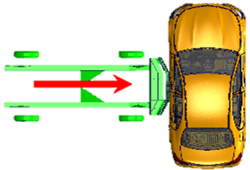
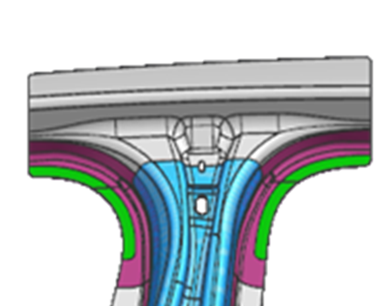
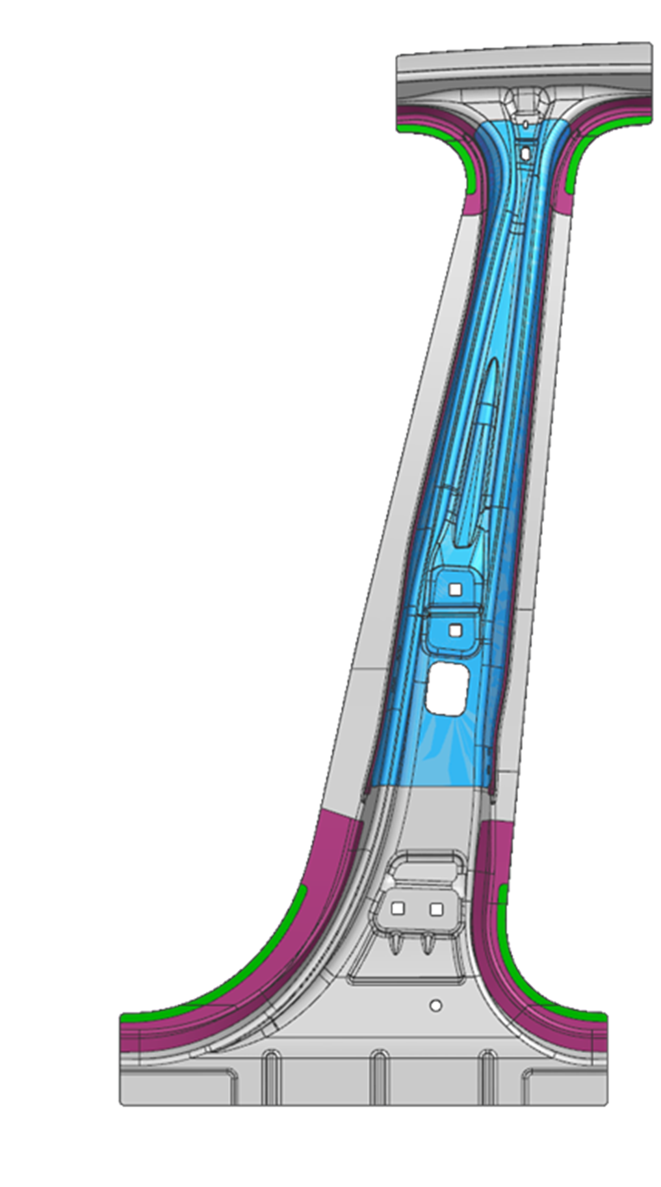
Introduction and motivation
Higher safety requirements for the car body
*IIHS old!: 50 km/h;1500 kg
Heating and
partial
austenitization
Transfer
Forming
and
quenching
Final
trimming
Trimming
Increased requirements
Targeted austenite decomposition
Ac₃
*IIHS new since 2022: 60 km/h;1900 kg
Ac₁
Softzone
Temperature T
*Insurance Institute for Highway Safety
Time t
Notes:
In general there is a growing demand for improved performance in automotive components. This is exemplified by the side-crash test conducted by the Insurance Institute for Highway Safety. Conventional hot-stamped components with homogeneous mechanical properties have served well in meeting these demands, but they are reaching their limits. Especially in the areas where spot welded joints lead to a drop in hardness. However, with innovative technology like the TemperBox, we can extend these limits by integrating soft areas into the component. So in the following I would like to explain the overall process sequence of partial hot stamping with TemperBox.
Similar to conventional hot stamping, our process begins with the trimming of the blank and heating it in a temperature range of 900 to 950 °C. The heating-process initiates the formation of an austenitic structure at the grain boundaries of the initial ferrite-pearlitic microstructure.
Once heated, the blank is positioned in the TemperBox between two cooled aluminum masks. These masks serve a dual purpose: firstly, they shield the covered areas from direct heat radiation, and secondly, they absorb the intrinsic radiation emitted by the blank, thanks to their rough surface. These combined effects lead to the targeted cooling process and the decomposition of austenite into ferrite, pearlite, and bainite. Meanwhile, the non-covered areas remain in the austenitized state.
After the partial pre-cooling stage, the partially austenitized blank is transferred to the press and positioned for forming as quickly as possible. Following this, the part undergoes a subsequent quenching process, which leads to the transformation of the remained austenitic structure into a hard martensitic structure. As a result we obtain a hot stamped part with tailored properties, enhancing crash performance and facilitating downstream joining processes.
This process is characterized by several advantages compared to alternative tailored tempering approaches: It neither requires expensively designed tempered tools and dimensional accuracy of the component is less challenging due to the lower temperature gradient after quenching. (3 min )

Slide 4
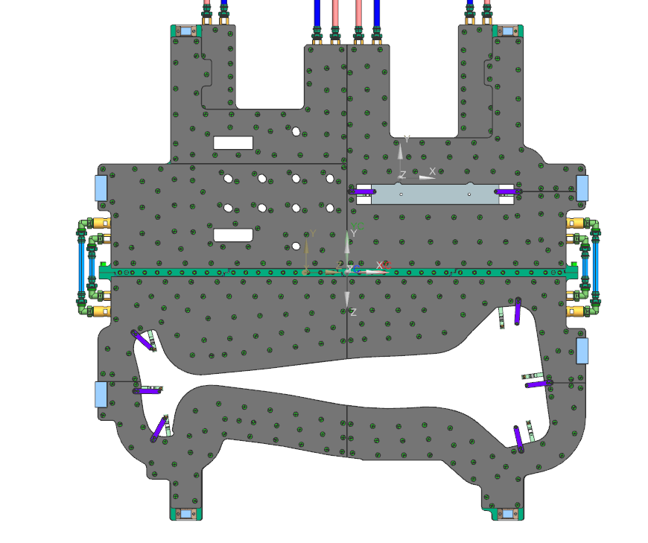
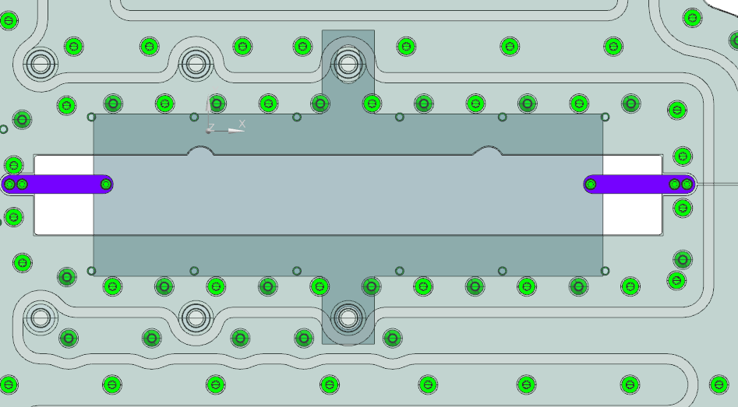
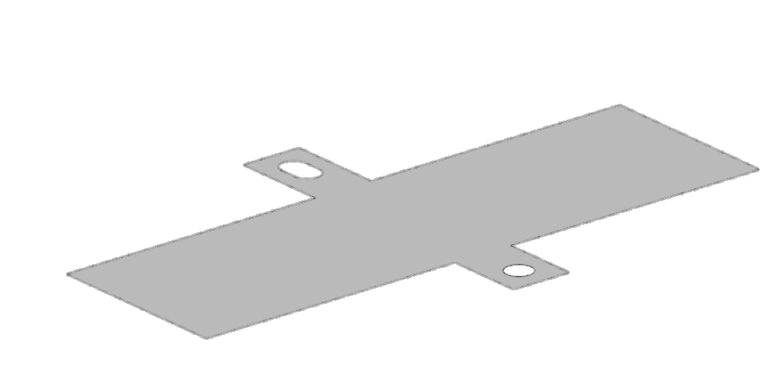
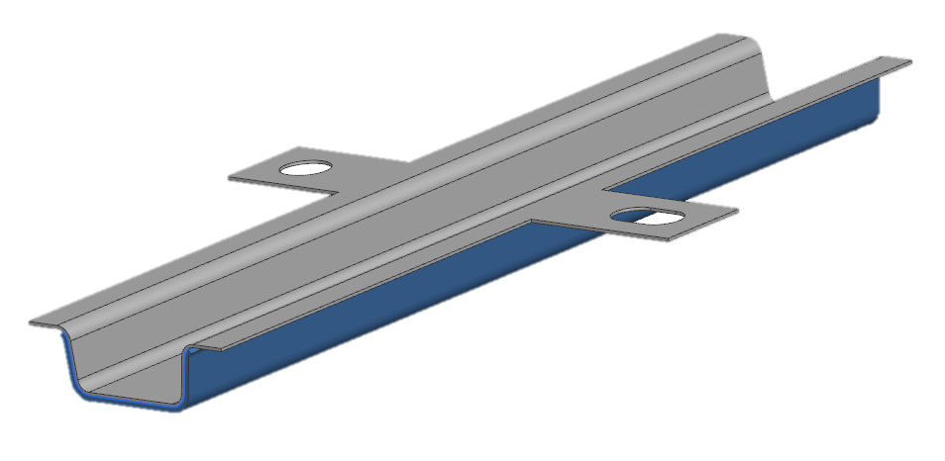
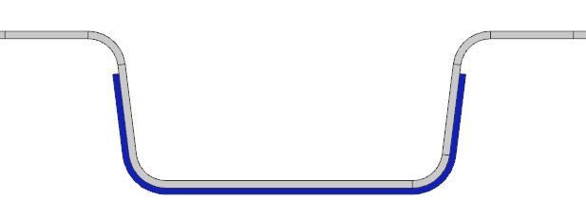
Investigation methods and materials
Investigation methods
Mask
Covered area
Experimental trials
FE-simulation with AutoForm®R10
Materials
22MnB5 AS150
8MnB7 AS150
Blank 8MnB7 and patch 22MnB5
Parameter
Sheet tickness t₀
Partial pre-cooling time t_{pre-cooling}
Blank
Patched-hat profile
Objective
Simulative and experimental analysis of phase transformation and hardness using different sheet thicknesses and materials
⇨ Elaboration of possible process limits
113
30
496
496
7°
157
49.5
Notes:
Next I would like to discuss the investigation methods. We utilized a combination of experimental trials and simulations using AutoFormR10. The materials involved in this investigation are conventional manganese boron steel 22MnB5 and 8MnB7. In this study, we investigate the sheet thickness as the main parameter. This is due to the fact that radiation exchange in the TemperBox can potentially impose limitations in the sheet thickness. In order to analyse the influence of the sheet thickness and the material on the radiaton exchange, the phasen transformation and hardness we employed two different test components. Initially, we conducted simple quenching experiments on flat blanks. To further expand the scope of our research, we investigated patched-hat profiles. In both components the flange area are covered and pre-cooled. (1 min und 30 s)

Slide 5


CCT-Diagram of 8MnB7 and 22MnB5
Shifting phase transformation areas due to chemical composition
Investigation methods and materials
22MnB5
8MnB7
Nb, Si
C, B, Cr, Mn
A→F
A→F
A→P
A→P
$${\dot{T}}_{K}$$
A→B
C, B, Cr, Mo
A→B
M_{S}
M_{S}
$${\dot{T}}_{K}$$
A→M
C, B, Cr, Mo
A→M
C, Mn
Time to cool in s
27
80
266
4000
Time to cool in s
15
27
80
266
4000
Cooling Rate in °C/s
30
10
3
0.2
Cooling Rate in °C/s
50
30
10
3
0.2
Hardness in HV
474
278
182
150
Hardness in HV
370
335
238
180
149
[1]
[2]
A: Austenite
B: Bainite
F: Ferrite
P: Pearlite
M: Martensite
M_{S} = Martensite Start Temp.
Notes:
In addition to the goal of attaining higher strength levels to fully leverage the potential for lightweight construction, there is a growing need for steels with enhanced ductility. This characteristic allows for high energy absorption in the event of a crash deformation. As a result, alongside the conventional aluminum-silicon coated 22MnB5 AS150, we have also examined 8MnB7 in our research. Notably, the lower carbon content in 8MnB7 leads to a significantly reduced hardness in the quenched area. It also causes a shift of the phase formation regions in the CCT diagram towards the left. (45 s)

Slide 6
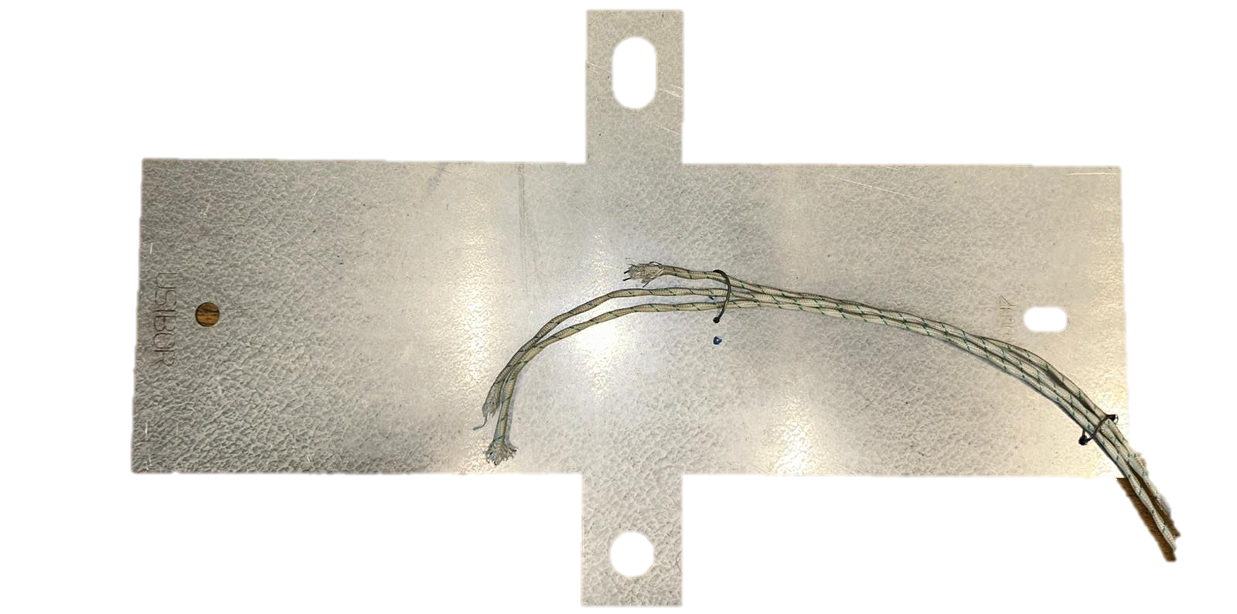
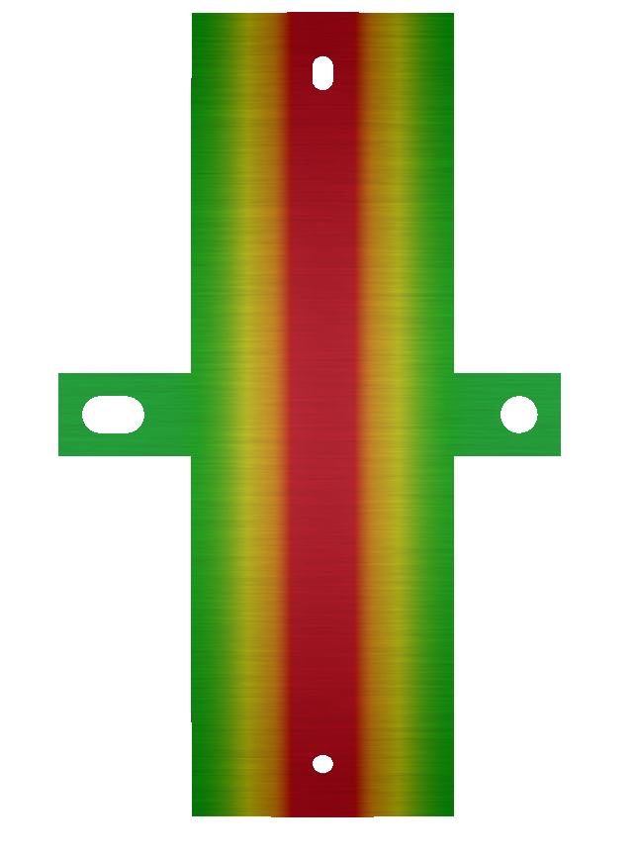
Temperature measurements and simulation of partial pre-cooling
Temperature-input for the simulation is derived from experimental measurements
Experimental setup and corresponding simulation model
1
Transfer
Positioning
Partial
Pre-cooling
Blank
removal
Measurement of the temperature profile
2
3
4
Blank
Experiment
Thermocouple
Covered area
1
4
Experimentally derived boundary conditions
3
Simulation
T_{Cooled}~600 °C
2
T_{Heated}~900 °C
Experiment Simulation
Notes:
To evaluate the efficiency of targeted cooling and simulate the phase transformation and final hardness using AutoForm, we performed temperature measurements at three positions in the covered and uncovered areas of the blank. For the simulation, we utalized the measured temperature-profile to establish thermal boundary conditions and replicate the radiation exchange within the TemperBox. As part of our testing, we selected a pre-cooling time of 75 seconds for all experiments, considering it as a realistic value in industrial production and it allows us to quantify and compare the phase transformation and final hardness across different sheet thicknesses and materials. (50 s)

Slide 7
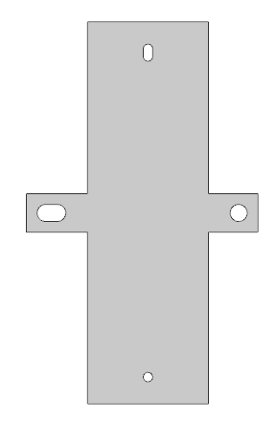
Influence of the sheet thickness – 22MnB5
Significant influence on temperature profile, cooling rate and phase transformation
Results and discussion
Covered area
Heated Cooled (20 mm from the edge) Cooled (5 mm from the edge)
0.80 mm
1.15 mm
1.50 mm
Notes:
Let's now discuss the initial findings of my investigation. On this slide, you can observe the temperature profiles at three measurement points for sheet thicknesses of 0.8 mm, 1.15 mm, and 1.50 mm. By analyzing the results, we can see that the temperature in the heated area reaches a final value of 900 °C regardless of the sheet thickness. However, distinct cooling rates can be observed for each thickness, which impact the onset and completion of latent heat during phase transformation. Comparing final temperature after the TemperBox process at different sheet thicknesses, we find that the final temperature at 1.5 mm is significantly higher than that at 0.8 mm. (50 s)

Slide 8
Hardness – 8MnB7 and 22MnB5
Sheet thickness influences the formation of soft, transition and hard areas
Results and discussion
Covered area
Measuring section
x
Simulation Experiment (8MnB7) Experiment (22MnB5)
0.80 mm
1.15 mm
1.50 mm
n = 3
t_{pre-cooling} = 75 s
n = 3
t_{pre-cooling} = 75 s
n = 3
t_{pre-cooling} = 75 s
Notes:
The hardness as a result parameter is of great importance in hot forming as it allows us to directly identify the soft, transition and hard zones. Therefore, we measured and calculated the hardness profile for the different sheet thicknesses and materials. When comparing the experimentally measured hardness curves for 8MnB7, we could not observe any significant differences, while the comparison of the hardness curves for 22Mnb5 shows that the homogeneity in the covered area decreases with increasing sheet thickness. In addition, we have a good agreement of simulation and experiment. The slight deviations between the experimental and simulation could be due to the fact, that we utilized constant thermal conductivity coefficients and heat capacity values regardless of the temperature change. (1 min und 35 s)

Slide 9
Hardness – 8MnB7 and 22MnB5
Sheet thickness influences the formation of soft, transition and hard areas
Results and discussion
Measuring section
(> 420 HV 22MNB5)
Soft zone
(< 240 HV)
Transition zone
Hard zone
(> 330 HV 8MnB7)
22MnB5
n = 3
t_{pre-cooling} = 75 s
8MnB7
n = 3
t_{pre-cooling} = 75 s
Notes:
To better illustrate the influence of sheet thickness and the materials on the formation of the soft, transition, and hard zones, a comparison of their average lengths is presented on the current slide. When examining 8MnB7, no notable differences are observed. However, with 22MnB5 it can be seen that as the sheet thickness increases, the length of the soft zone decreases, while the length of the transition zone increases. (45 s)

Slide 10
Hardness – Sheet thickness of 2.25 mm – 22MnB5
Extended pre-cooling times are required for the formation of soft areas
Results and discussion
Covered area
Measuring section
Experiment t_{pre-cooling} = 75 s
Austenite
Martensite
x
Simulation t_{pre-cooling} = 75 s
Bainite
Pearlite
Experiment t_{pre-cooling} = 105 s
Ferrite
Measuring section: 0–15 mm
Pre-cooling
n = 3
α_{air} = 25 W/m²K
0
W/m²K
Notes:
The limited effectiveness of radiation exchange with increasing sheet thickness becomes evident when analyzing the hardening curve for a sheet thickness of 2.25 mm with a pre cooling time of 75 s. To achieve soft zones with high proportion of ferrite and pearlite, longer partial pre-cooling times like 105 s are necessary. When simulating the hardness and phase transformation with a partial pre-cooling time of 75 s, we hat to take into account the the heat transfer coefficient to air in the simulation, because the decomposition of austenite is not yet complete after 75 s. Analyzing the influence of heat transfer coefficient on the average hardness in covered area reveals that a lower value leads to an increase in average hardness in the covered area of the blank. Consequently, a heat transfer coefficient of 25 W/Km2 is well-suited to simulate hardness profile in this case.
(1 min 30 s)

Slide 11
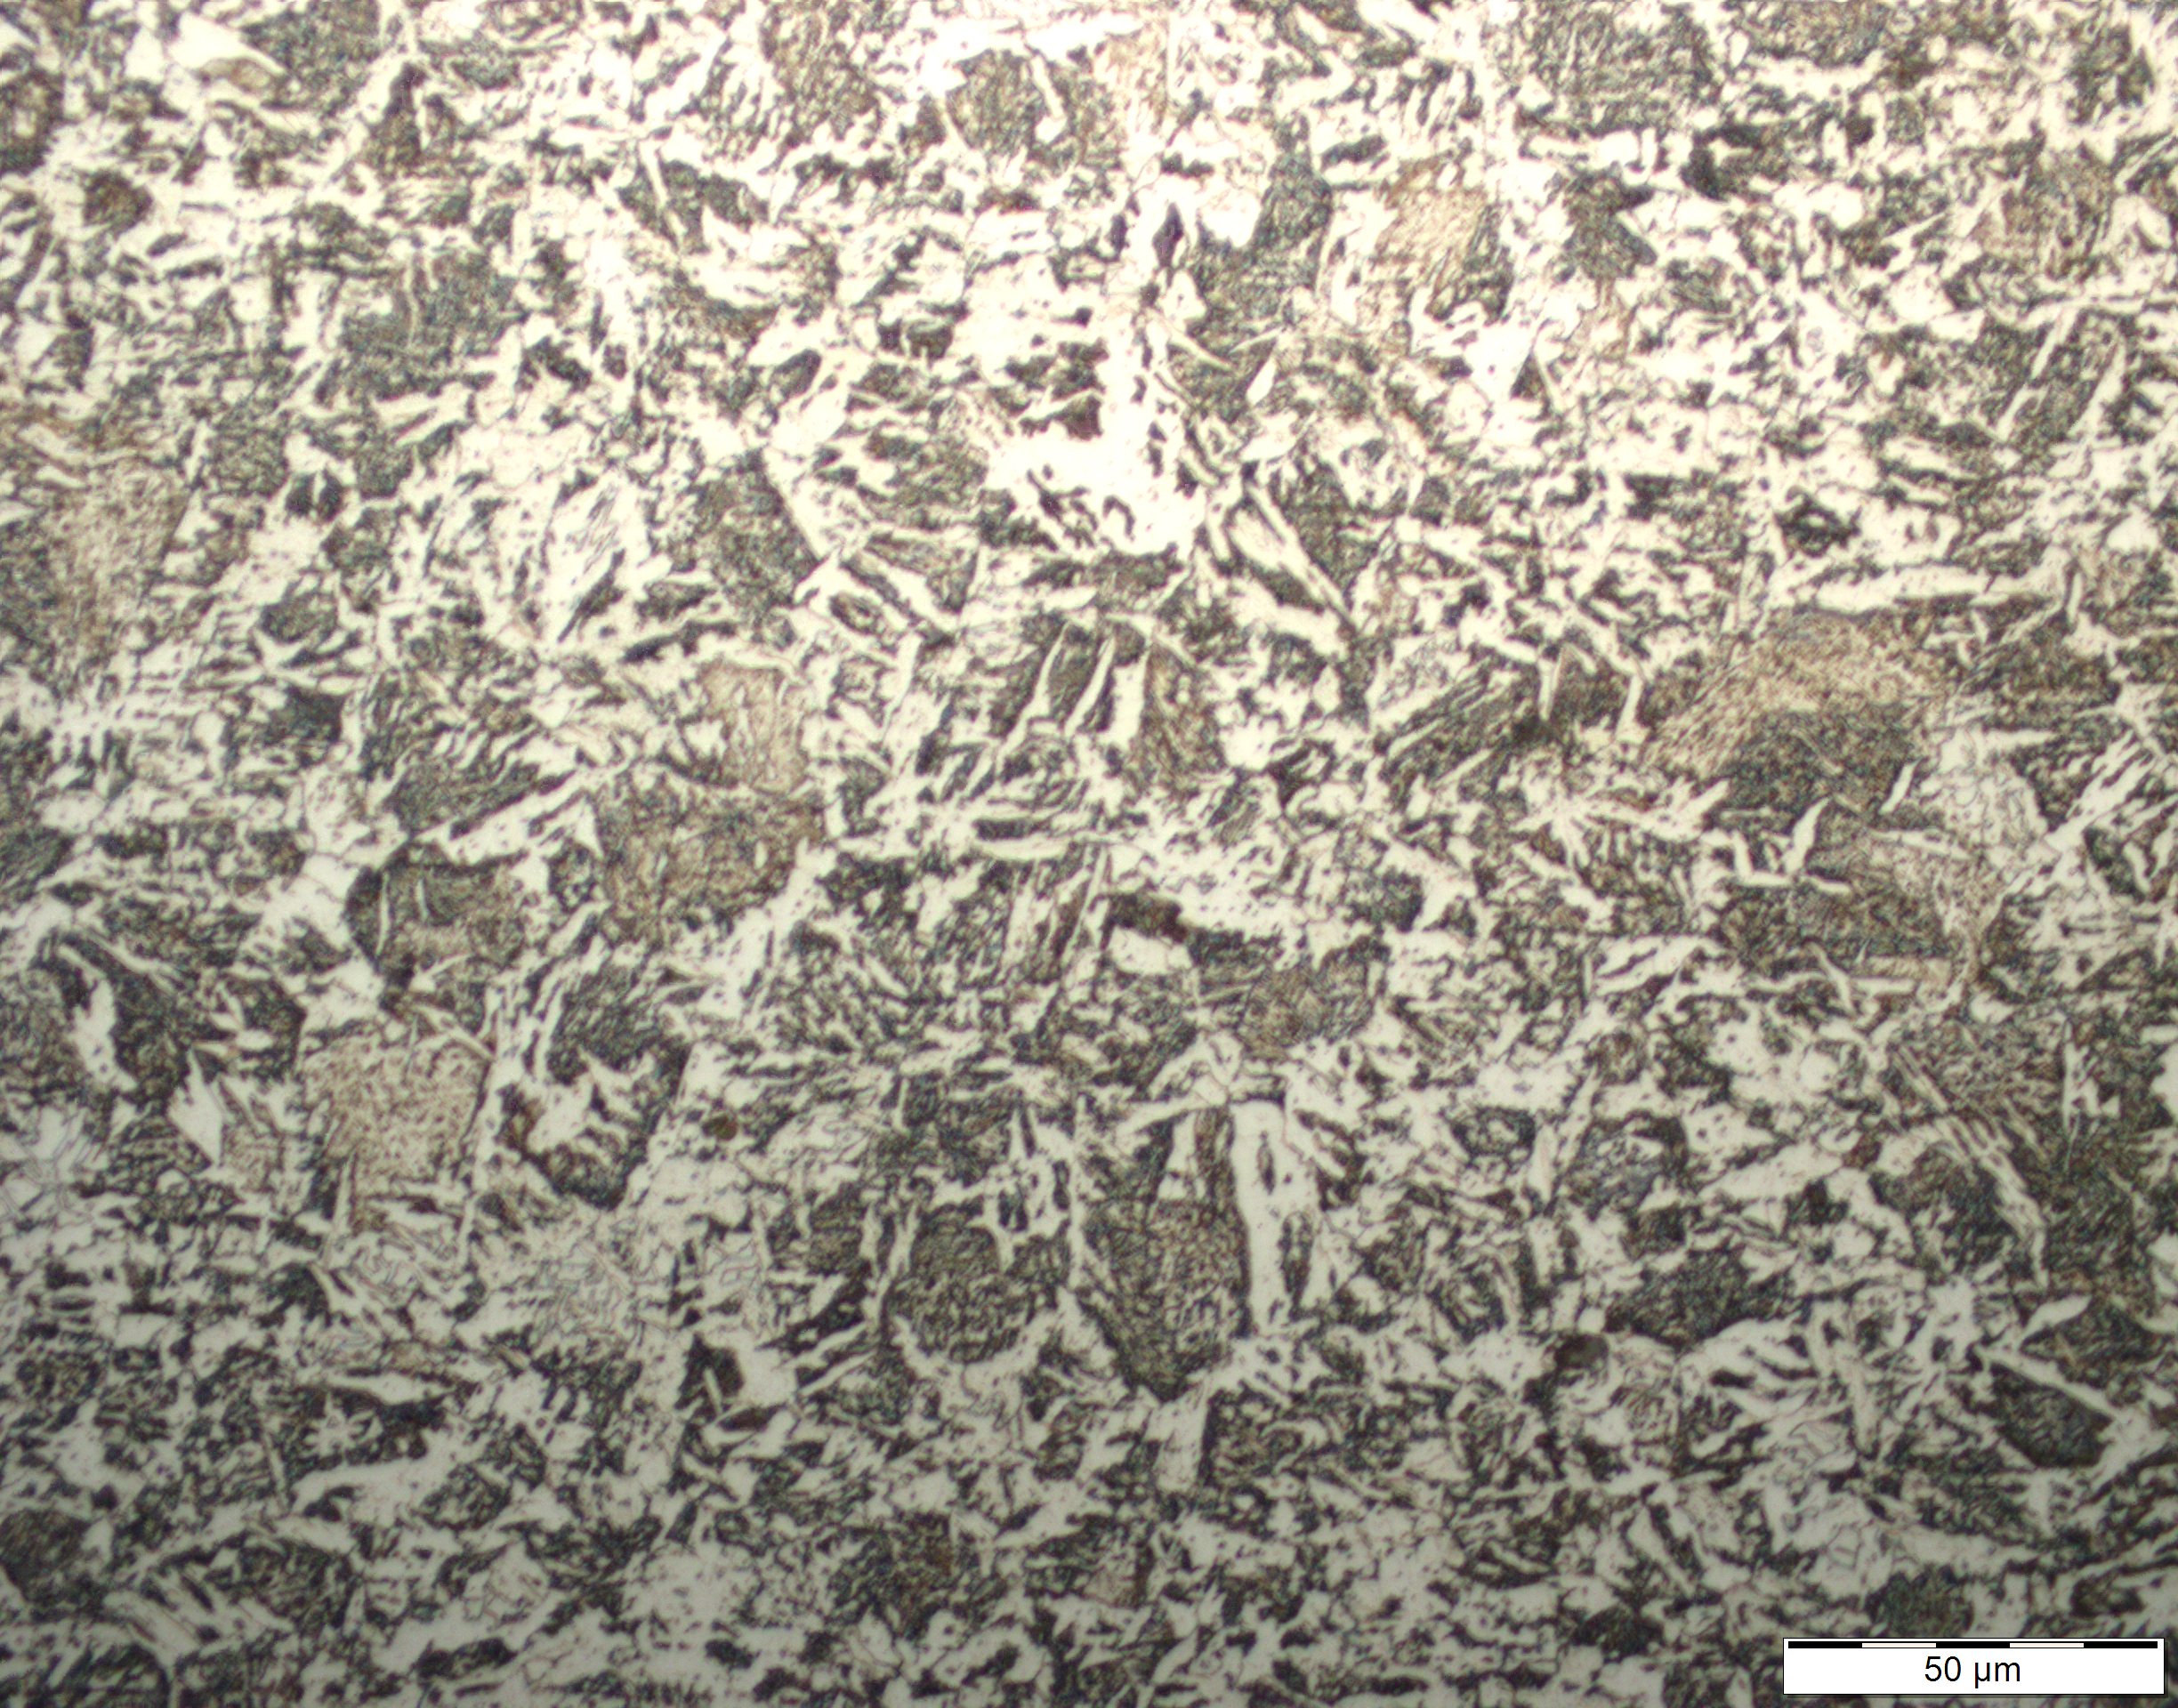
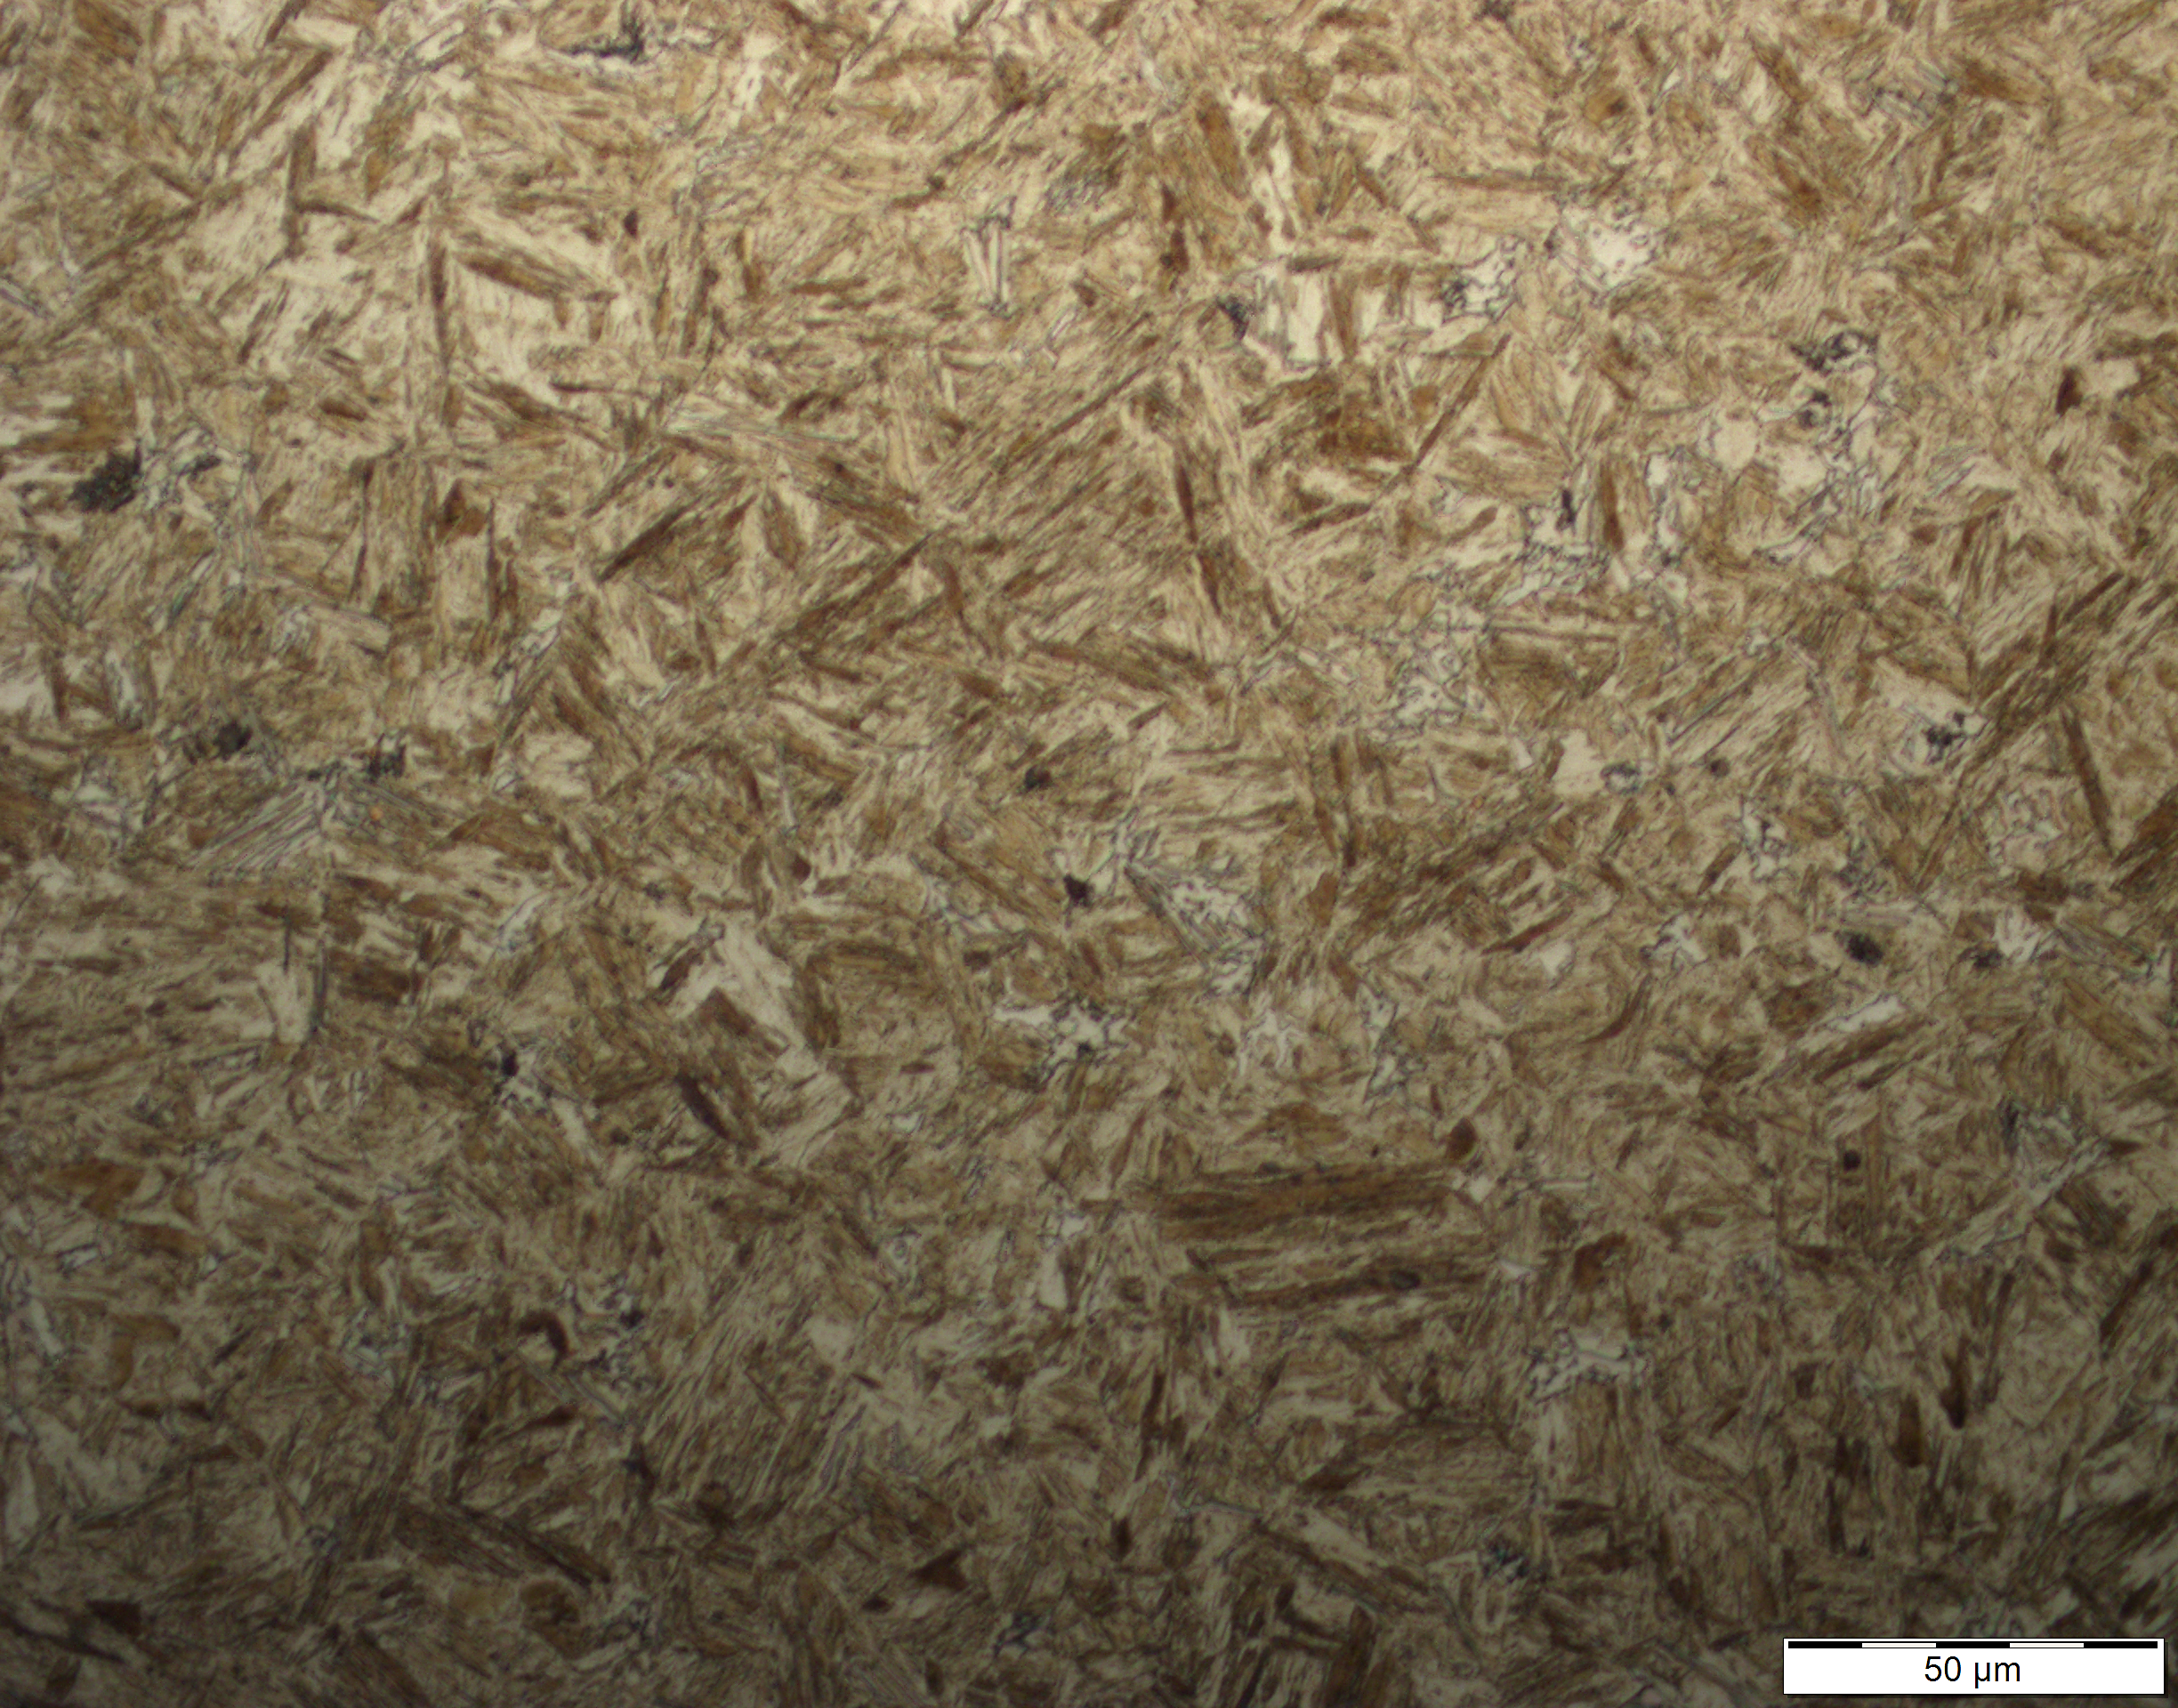
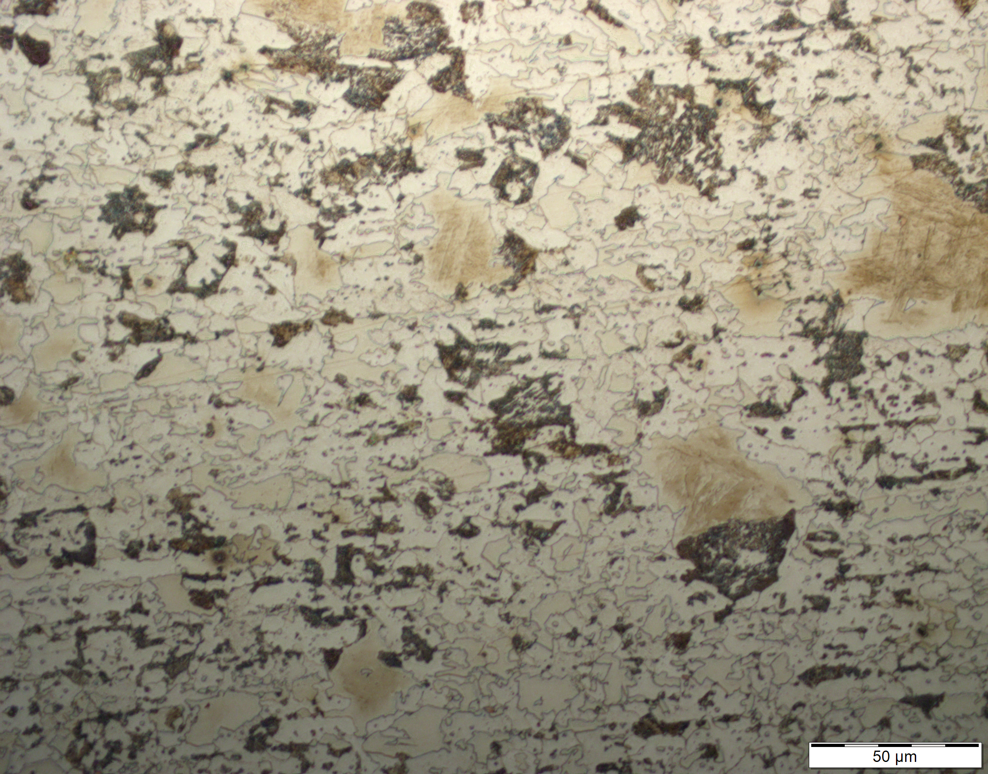
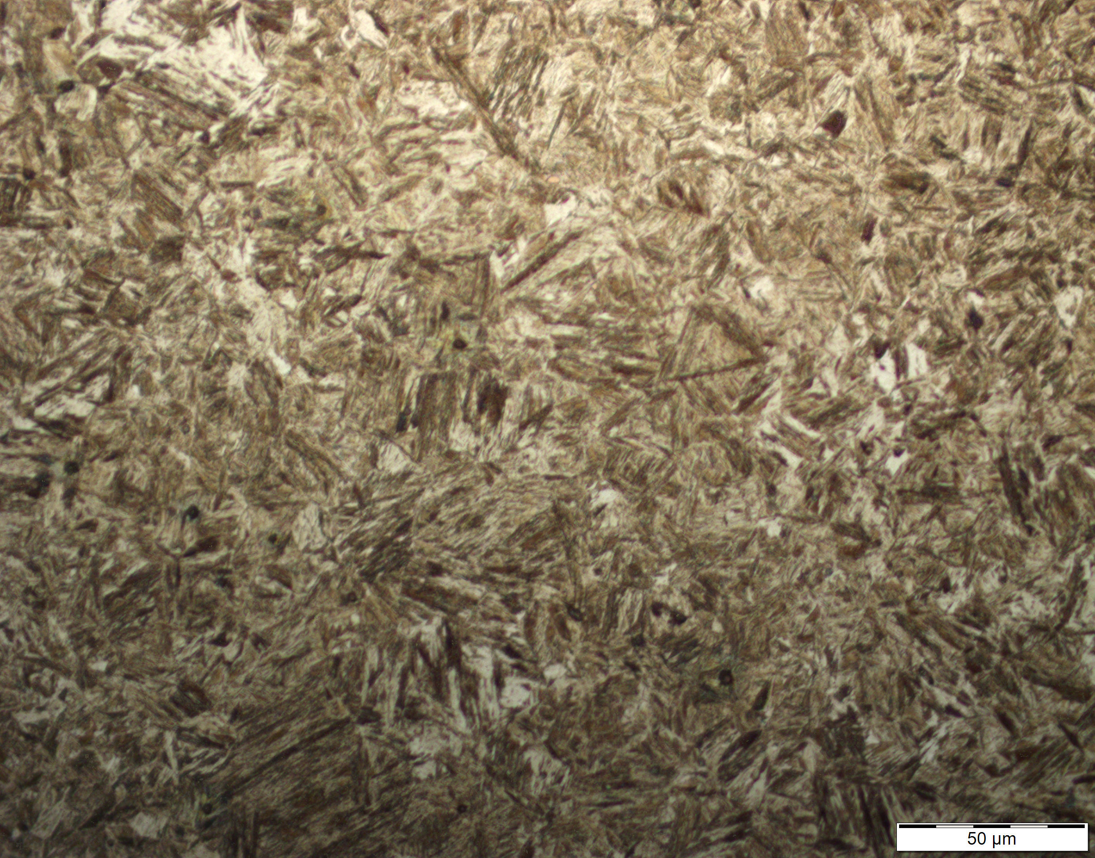
Microstructure analysis – 22MnB5
Higher proportion of hard phases in the overall microstructure at 2.25 mm
Results and discussion
0.80 mm
0.80 mm
Covered area
50 µm
50 µm
Reheated
Ferrite and Pearlite
Martensite
Pre-cooled
2.25 mm
2.25 mm
50 µm
50 µm
Ferrite, Pearlite and Bainite/Martensite
Martensite
Notes:
In addition, micrographs were obtained for sheet thicknesses of 0.8 mm and 2.25 mm in both the heated and cooled areas, for a partial pre-cooling time of 75 seconds. The micrograph of the 0.8 mm sheet thickness shows a homogeneous ferritic-pearlitic structure, whereas the micrograph of the 2.25 mm sheet thickness shows a microstructure comprising of ferrite, pearlite, bainite, and martensite. In the heated area, we observed a uniformly hardened microstructure with a significant martensite content at both 2.25 mm and 0.8 mm. These micrographs provide visual confirmation of the hardness curves presented earlier.
(40 s)

Slide 12
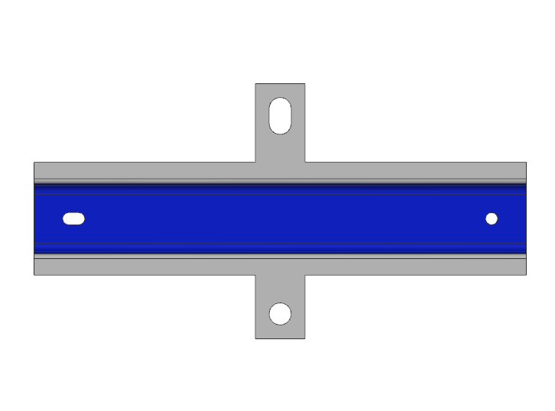
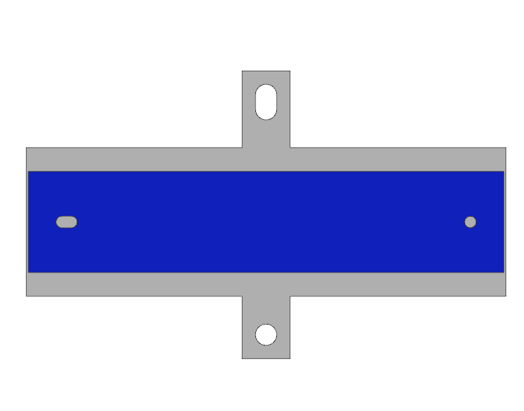
Patched-hat profile
TemperBox® process affects hardness of the patch
Results and discussion
Measuring section
Simulation
Experiment
Patch 22MnB5 (1.25 mm)
Main blank 8MnB7 (1.5 mm)
n = 3
t_{pre-cooling} = 75 s
Notes:
An extension of the previous experiments on flat blanks involves investigating patched hat profiles. In this particular case, a 22MnB5 patch was welded onto an 8MnB7 main blank. The results show that the hardness decrease of the 8MnB7 main blank plate occurs earlier due to its lower carbon content.
Moreover a noticeable decrease in hardness is observed in the covered area of the patch blank. In addition we observe a good correlation in the results of simulation and experiments; . The deviation in the transition zone can be attributed to differences in sheet thinning. (50 s)

Slide 13
Summary
Flat blank
Flat blank
Patched-hat profile
t₀ = 0.8 mm, 1.15 mm and 1.50 mm
t₀ = 2.25 mm
t_{patch} = 1.25 mm and t_{blank} = 1.50 mm
The carbon content influences the final hardness profile significantly
75 s pre-cooling time is not sufficient to form homogeneous soft areas
Partial pre-cooling slightly affects hardness of the patch
Good correlation of simulation and experiment
Simulatively the heat transfer coefficient to air is of importance
Deviation between simulation and experiment in the transition area
Notes:
This work is devided into three levels. In the initial section, we were able to demonstrate the varying influence of different materials on phase transformation and final hardness unsing the TemperBox process, This can be explained by the differences in chemical composition. Additionally, we achieved a good agreement in calculating the final hardness values in the simulation.
Moving on to a more complex stage, we examined blanks with a sheet thickness of 2.25 mm. Our results show that a partial pre-cooling time of 75 s is not sufficient to achieve uniform soft areas. To simulate the hardness curves with good agreement, the heat transfer coefficient must be considered. Lastly, we delved into the investigation of a patched hat profile. Even with a total sheet thickness of 2.75 mm, we observed an impact in the hardness of the covered area. The deviation between simulation and experiment in the transition area could be due to differences in thinning. (1 min 45 s)

Slide 14
Thank you
for your attention.
Notes:
5 s

Slide 15
References
[1] Mohrbacher H 2014 Martensitic Automotive Steel Sheet - Fundamentals and Metallurgical Optimization Strategies Advanced Materials Research 1063 130–42.
[2] Güner A, Sonntag M, Philippot C, Bittendiebel J, Sarre B, Dormegny L, Reihani A and Heibel S2022 Experimental and numerical investigation of final product properties of Ductibor® 1000 AS underdifferent process conditions, 8th Int. Conf. Hot Sheet Metal Forming of High- Performance Steel, May30th–June 2nd, Barcelona, Spain.

