Slide 1

Experimental investigation of the effect of W-temper forming process parameters on springback
Jemal Ebrahim Dessie*, Dr. Zsolt Lukács
* Jemal Ebrahim Dessie

Slide 2
Contents:
  Introduction
  Material Characterization
  Finite Element Modelling
  U-bending tests
  Result and discussion
  Conclusion

Slide 3
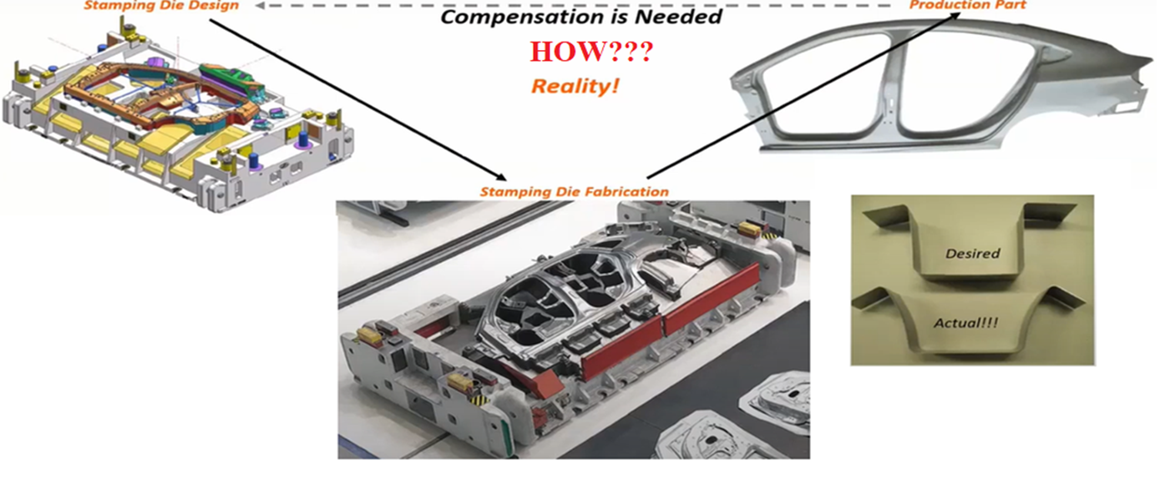
1. Introduction
  Springback is a technical challenges in cold sheet metal stamping
  Fig. 1 General stamping die design procedure
  Particularly true for stamping high strength aluminum alloys, since it tend to have large springback resulting from the lower elastic rigidity
  Warm and hot forming have been advised

Slide 4
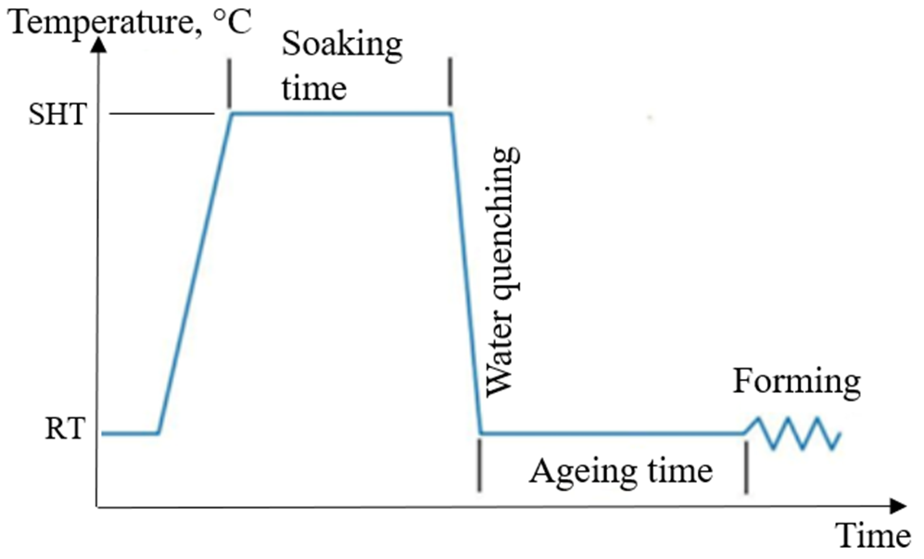
  However, warm and hot forming methods need more steps in the production process and an advanced tooling system.
  Forming sheets at room temperature in the W-temper condition is advantageous
  Numerical modelling of the kinematic hardening behaviour of W-Temper heat treated AA6082 aluminium alloy to predict springback
  Fig. 2 Temperature profile of the WT forming

Slide 5
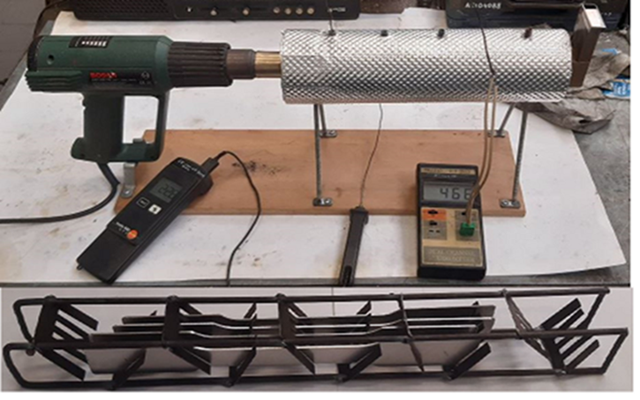
2. Material Characterization
  W-Temper heat treatment process of peak-aged 6082-T6 sheet were conducted with special furnace.
  Uniaxial tension-unloading test were conduced using universal material testing machine type MTS 810.2
  The test specimens were heated at 525 °C as SHT for 30 min, followed by water quenching to room temperature
  Ensures complete dissolution of the alloying components into the aluminium matrix.
  The uniaxial tension-unloading test was contacted at 15, 30, 90, and 120-minute ageing times (the time after quenching until forming)
  Fig. 3 Warm-air forced heating furnace

Slide 6
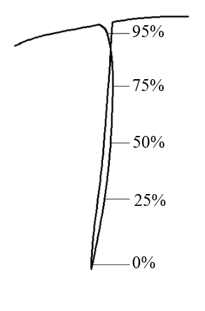
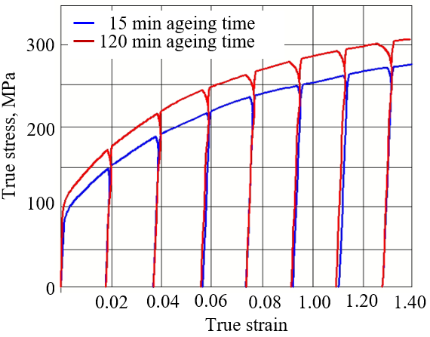
  Fig. 4 Tension-unloading test
  Fig. 5 Degradation of the elastic modulus.
  From the tension-unloading tests, a significant difference was observed in the flow stress curves

Slide 7
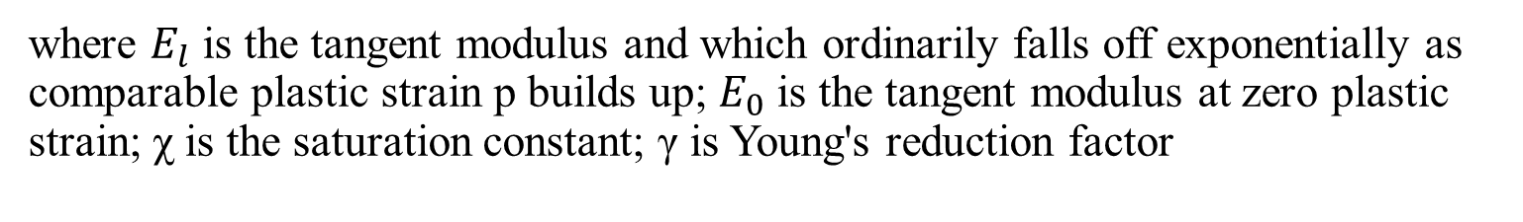
3. Finite Element Modelling
  AutoForm R8
  In the AutoForm kinematic hardening behaviour of the material is formulation by Kubli
  where $E_{l}$ is the tangent modulus and which ordinarily falls off exponentially as comparable plastic strain p builds up; $E_{0}$ is the tangent modulus at zero plastic strain; χ is the saturation constant; γ is Young's reduction factor
  The γ and χ values describing the changes in the elasticity modulus during reverse loading
  It can be find by fitting curves to these measured points
  Curve fitting module of the MATLAB program

Slide 8
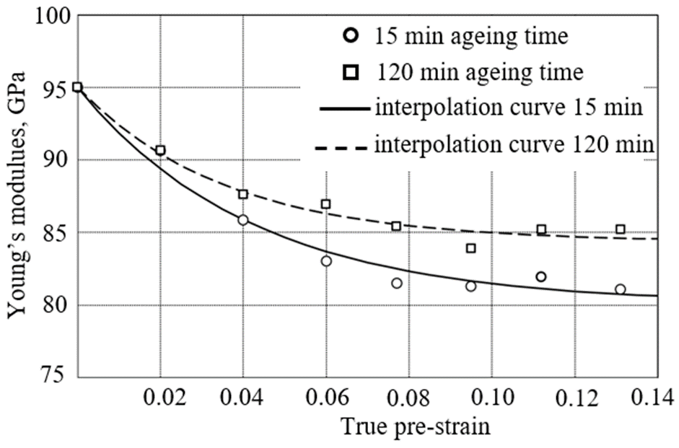
  Fig. 6 Reduction of elasticity modulus as a function of pre-strain
  Table 1. Kinematic hardening parameters
Aging time | γ | χ
15-minute | 0.157 | 23.6
120-minute | 0.112 | 28.2

Slide 9
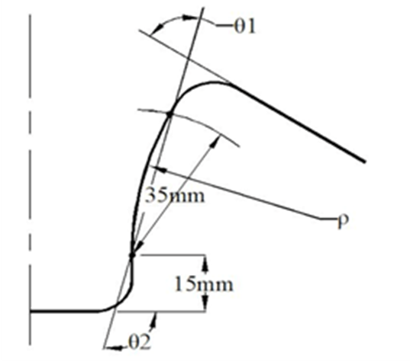
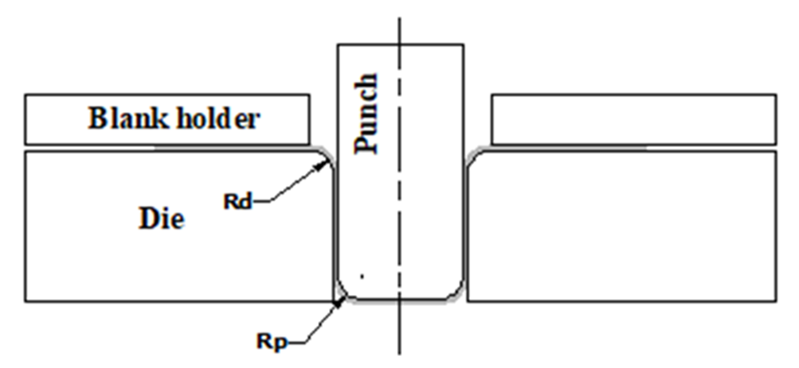
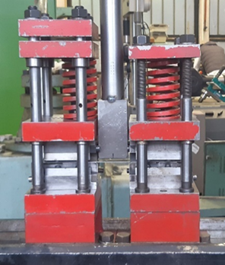
4. U-bending tests
  Fig. 7 Schematic view of 2D U-draw bending test
  Fig. 8 Parameters for springback according to NUMISHEET ’93 benchmark problem
  After the FE simulations and experiments, image files of the samples are exported and measured using AutoCAD.
  Fig. 9 U-bending test apparatus

Slide 10
  Table 2. Design variables and their level for the simulation
Parameters | Considered Value
Die and punch profile radius | 5 mm
Blank holding force (BHF) | 3, 5, 7 kN
Coefficient of friction (μ) | 0.08
  Table 3. Design variables and their level for the experiment
Parameters | Considered Value
Die and punch profile radius | 5 mm
Blank holding force (BHF) | 3, 5, 7 kN
Lubrication condition | oil lubrication

Slide 11
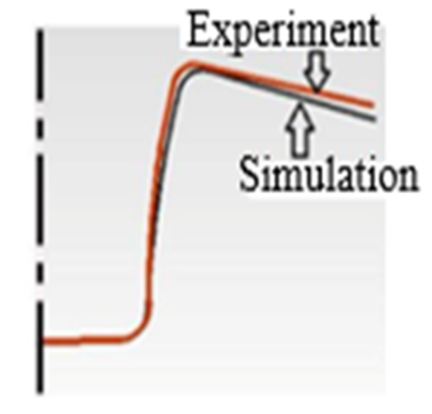
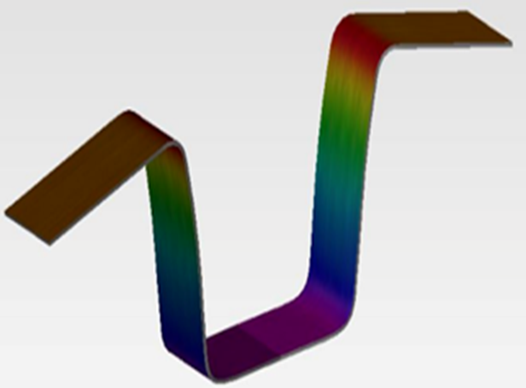
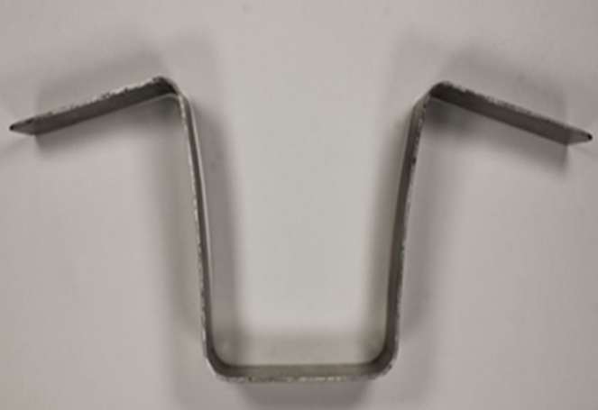
5. Result and discussion
  3D In simulation
  3D in experiment
  2D in both experiment and simulation
  Fig. 10 Springback profiles at 5kN BHF and 15-minute ageing time

Slide 12
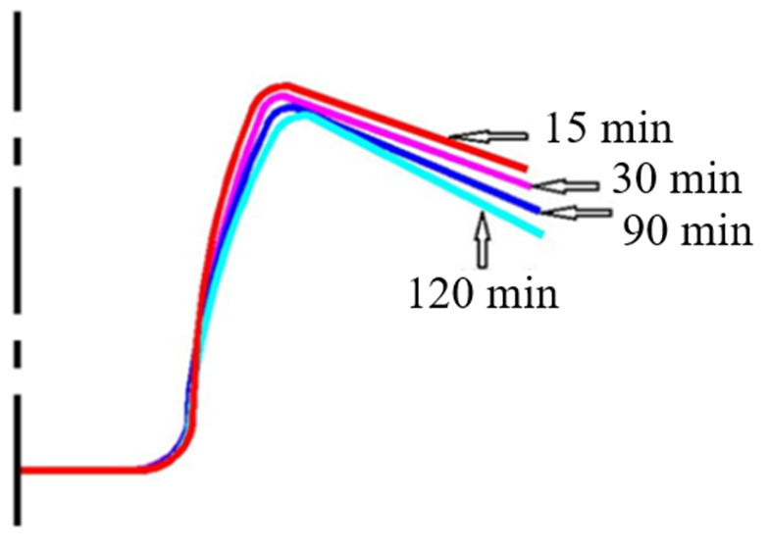
Effect of ageing time
  Fig. 11 2D profile of some physical experiments at different edging time

Slide 13
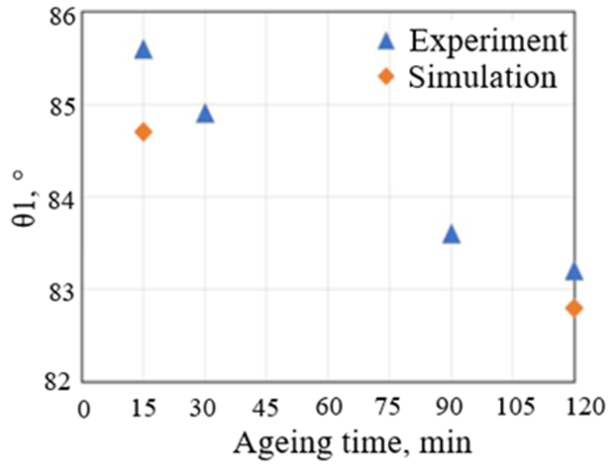
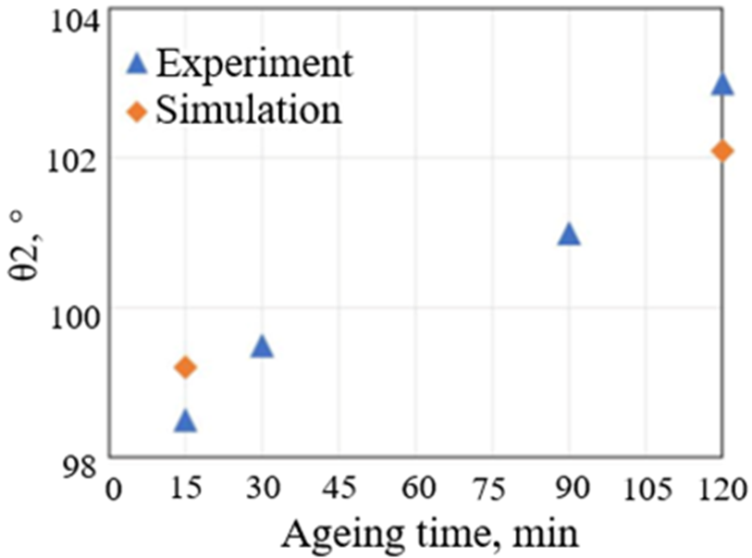
  Fig. 12 Effect of aging time at BHF=5kN
  A decrease of θ1 from 85.6° to 83.2° in the experiment and from 84.7° to 82.8° in the simulation.
  θ2 was increasing from 98.5° to 103° in the experiment and from 99.2° to 102.1° in the simulation.

Slide 14
6. Conclusion
  The W-Temper forming of high-strength aluminium alloys are a highly effective heat treatment process that can significantly improve the mechanical properties and performance of these materials.
  However, the springback effect is a serious issue that can happen during the W-Temper forming. This is because the ageing time of high strength aluminium alloys can change the properties of the material during forming.
  After the W-Temper process, the aluminium alloy is typically in a hardened state, with increased strength, hardness, and reduced ductility. If the time between the W-Temper process and forming is too long, the material may experience some degree of natural aging, which can further increase its strength and reduce its ductility.
  It is very important to specify the precise time between the rapid quenching and forming in the industrial application to stamping high strength aluminium alloys.

Slide 15
THANK YOU FOR YOUR ATTENTION

