Slide 1
Research on the evolving yielding behaviour and micro-mechanism in biaxial deformation of DP1180 sheet based on crystal plasticity finite element model
Bingying ZHOU^{1*}, Fei HAN², Xiangdong WU¹, Min WAN¹
Notes:
Good afternoon ladies and gentlemen
I am very glad to have the opportunity to present this presentation.
The subject is Research on the evolving yielding behaviour and micro-mechanism in biaxial deformation of DP1180 sheet based on crystal plasticity finite element model
My name is Bingying ZHOU, coming from Beihang University, China.

Slide 2
Contents
1. Introduction
2. Materials and experiments
3. CPFEM modeling
4. Results and discussion
5. Conclusions
6. Recent works
Notes:
There are six main aspects for this presentation.
The first is introduction.

Slide 3
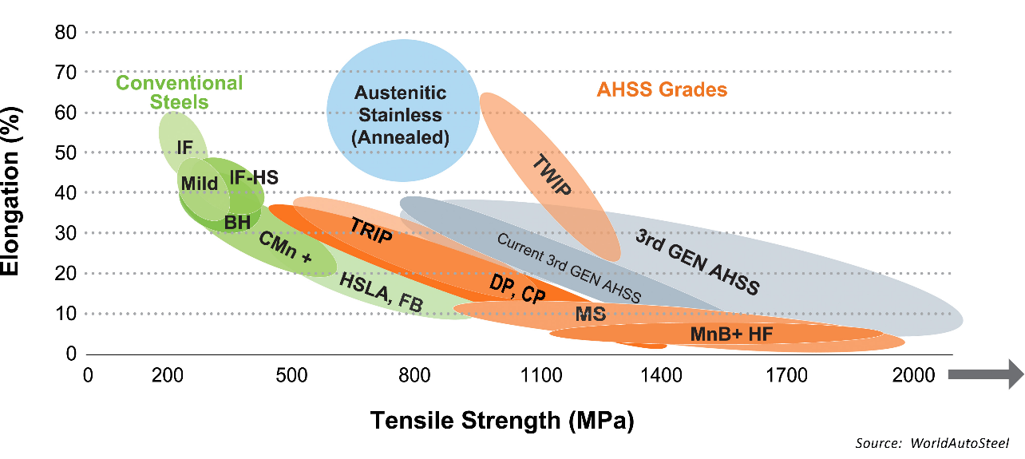
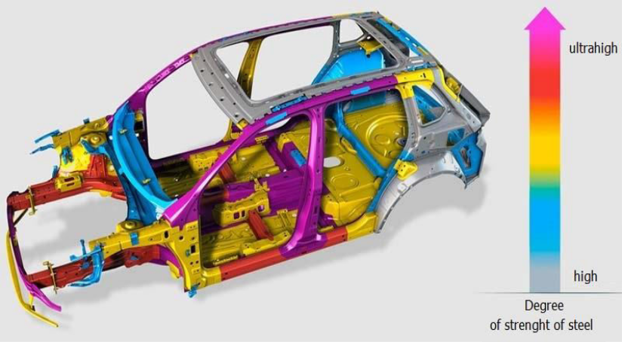
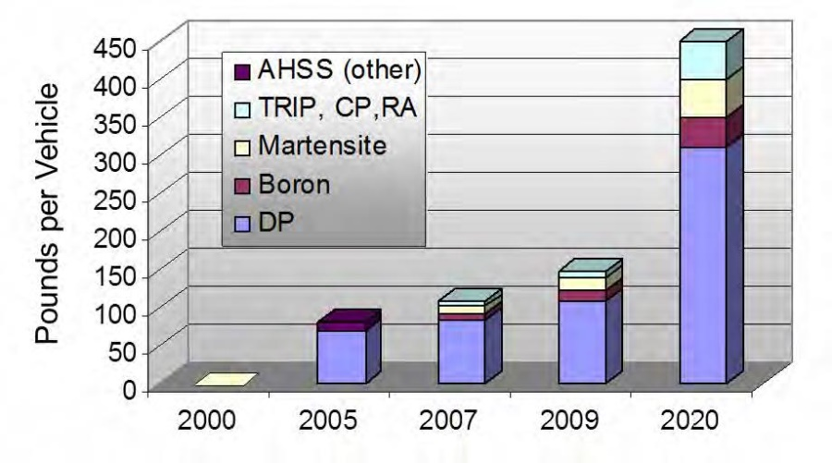
Introduction
The application of AHSS
Fig. 1 The Global Formability Diagram (2021) comparing strength and elongation of current and emerging steel grades^{[1]}
Fig. 2 Application of AHSS to automotives^{[1]}
To meet vehicle fuel-economy mandates, reduce emissions and increase passenger safety, the use of advanced high-strength steels (AHSS) has driven light-weighting solutions for automotives.
DP steel is one of the First-Gen. AHSS. It is composed of ferrite and martensite, and is currently one of the most widely used AHSS.
Fig. 3 The amount of DP steel used in automotives
1. The AHSS Application Guidelines Version 7.0. Home - AHSS Guidelines (ahssinsights.org)
Notes:
Advanced high-strength steel (AHSS) is one of the most important materials which can satisfy both the lightweight and crash safety of the automobile. Different from traditional metals, the Advanced high-strength steel has both high strength, good formability, and high strength plastic deposition.
DP steel is one of the First generation AHSS. It is composed of ferrite and martensite, and is currently one of the most widely used Advanced high-strength steels.

Slide 4
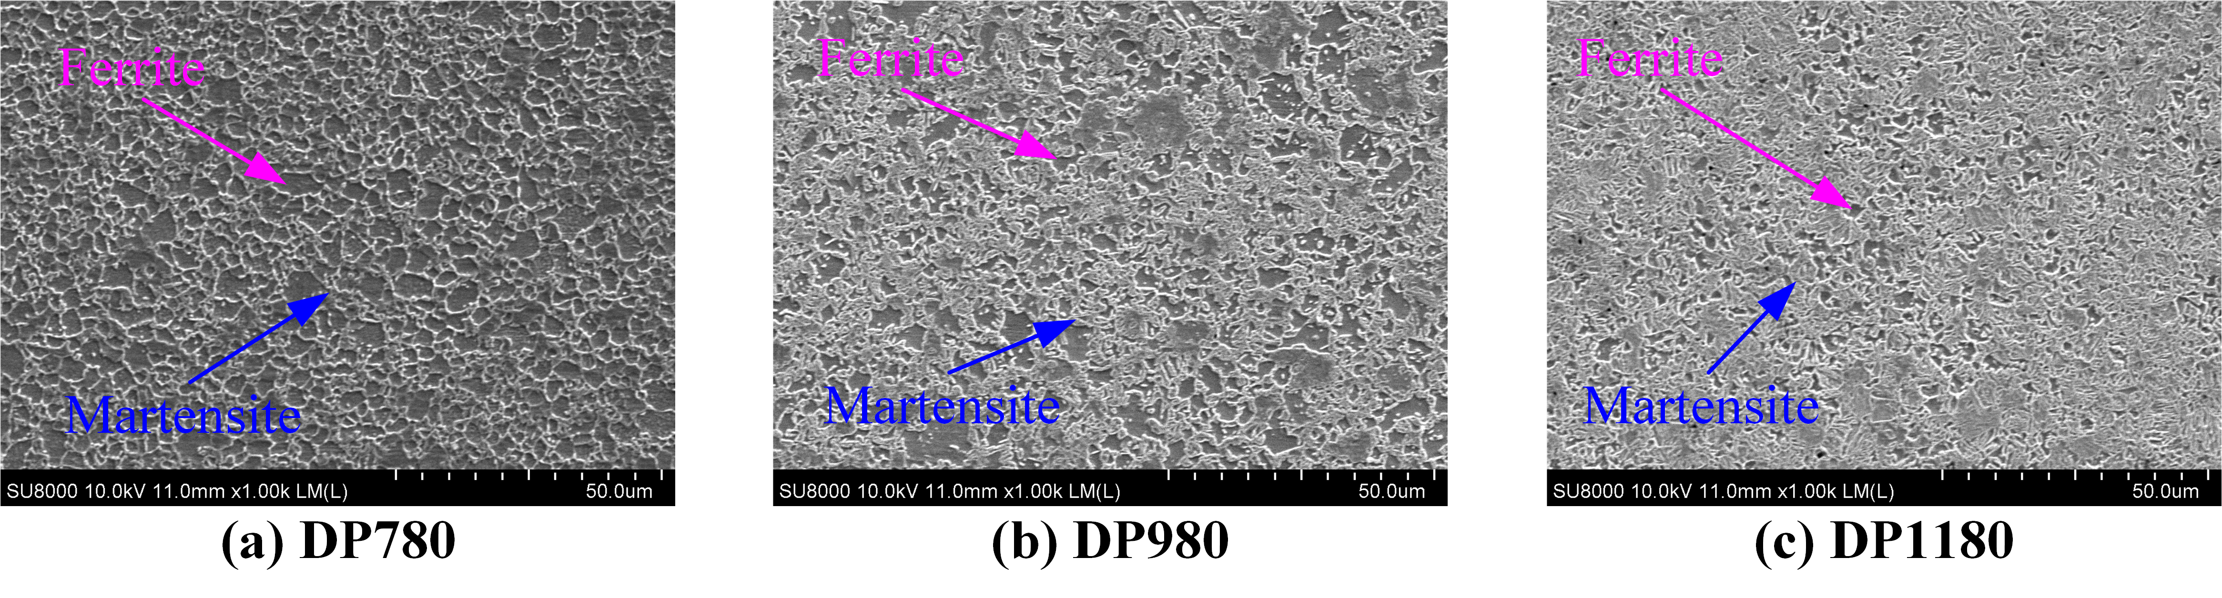
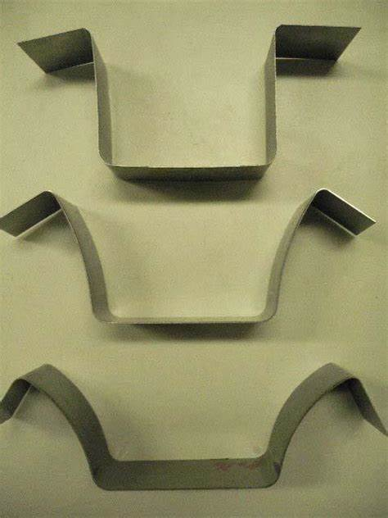
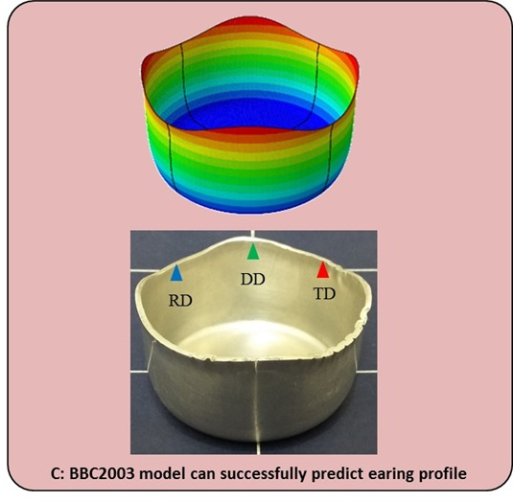
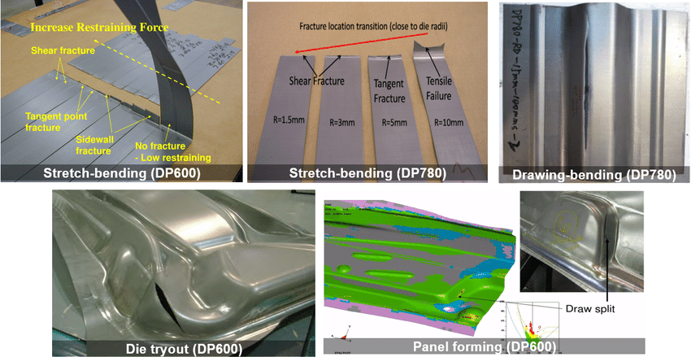
Introduction
The problems encountered in the application of DP steel
Fig. 4 The microstructure of DP980 (left) and DP1180 (right)
Fig. 5 The unexpected fracture of DP steel^{[1]}
Fig. 6 The phenomenon of springback in AHSS^{[2]}
Fig. 7 The phenomenon of anisotropy in AHSS^{[3]}
The multiphase microstructure in AHSS
Complex micro-mechanism of deformation and fracture
Traditional phenomenological models can not well predict and reveal the mechanism of deformation and fracture in AHSS, especially under complex loading conditions.
1. N. Park, Anisotropic Fracture Limit for the Failure Prediction of Advanced High-Strength Steel Sheets, Korea Advanced Institute of Science and Technology, Korea (2017).
2. Springback of High Strength Steel with PAM-STAMP. http://www.esi.com.au/software/pamstamp-features/springback-hss/
3. S. Izadpanah, S. H. Ghaderi and M. Gerdooei, Journal of Computational & Applied Research in Mechanical Engineering (JCARME) 6, 47-55 (2017).
Notes:
Because of the multiphase microstructure, the DP steel usually has good performance with both strength and plastic deformation ability, but the micro-mechanism of deformation and fracture is quite different from traditional materials.
And the traditional macroscopic phenomenological yield, strengthening, and fracture models can not well predict and reveal the deformation and fracture of advanced high-strength steel at the micro level, especially under complex loading conditions.
It is thus becoming increasingly important to complement the resource consuming step of material processing and testing with modeling and simulation to address this challenge.

Slide 5
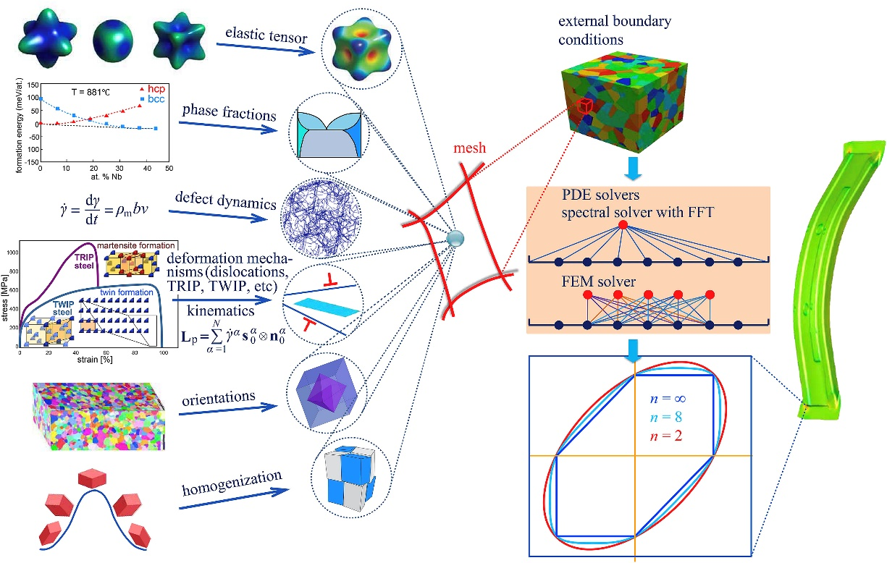
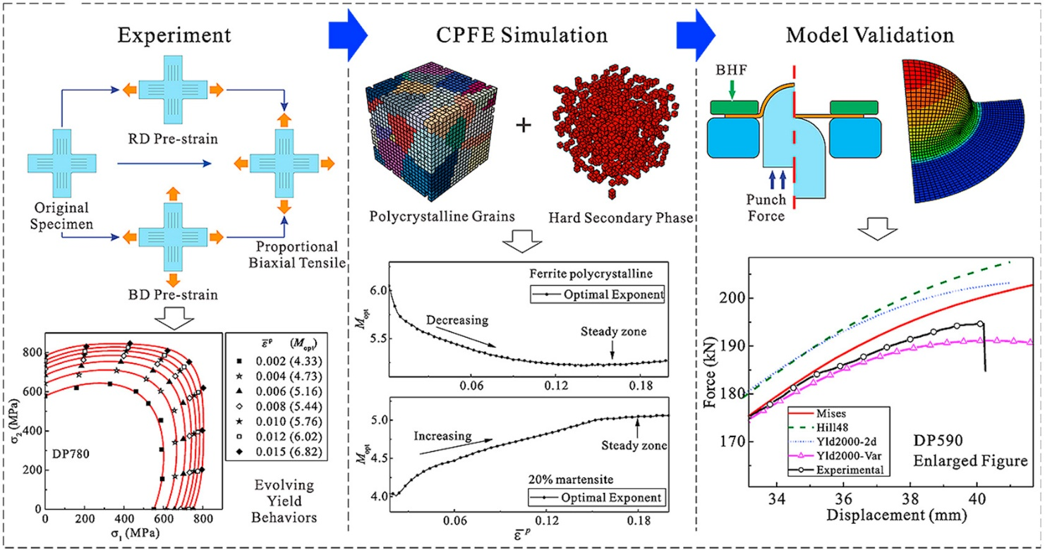
Introduction
The research on yielding behavior based on CPFEM
Fig. 8 The framework of CPFEM proposed by DAMASK^{[1]}
Fig. 9 The abstract of yield behavior combined with CPFEM^{[2]}
Crystal plastic finite element method (CPFEM) has been greatly developed in the recent twenty years.
Based on the CPFE simulation, the evolving plastic yielding behaviors of DP steels have been studied^{[2]}. The concept of a virtual laboratory using CPFEM to determine the yield surface was proposed by Zhang^{[3]}.
[1] ROTERS F, DIEHL M, SHANTHRAJ P, et al. Comput Mater Sci, 2019, 158: 420-78.
[2] CAI Z Y, MENG B, WAN M, et al. Int J Plast, 2020, 129: 102707.
[3] H. Zhang, M. Diehl, F. Roters and D. Raabe, Int. J. Plast. 80, 111-138 (2016).
Notes:
CPFEM is a special constitutive model that describes the deformation at the grain level, which belongs to the meso-scale. It can be a bridge linking the macroscale and microscale of materials. It has been greatly developed in the recent twenty years.
As for the plastic yielding behavior, Zhang has proposed a concept of a virtual laboratory which could be used to determine the yield surface. However, the evolving plastic yielding behavior of DP steel is still rarely studied by CPFEM. And the anisotropy mechanism of DP steel has also been rarely explored.

Slide 6
Introduction
The aim of this research:
The evolving yielding behavior of the DP1180 steel sheet based on the CPFEM with RVE model.
The micro-mechanism of anisotropy in the DP1180 steel sheet.
Notes:
So the aim of this research is to predict the yield behavior of DP1180 steel sheet by CPFEM with RVE model and deeply explore the micro-mechanism of anisotropy of DP1180 steel sheet.

Slide 7
Contents
1. Introduction
2. Materials and experiments
3. CPFEM modeling
4. Results and discussion
5. Conclusions
6. Recent works
Notes:
Ok, let’s go on.
The next is Materials and experiments.

Slide 8
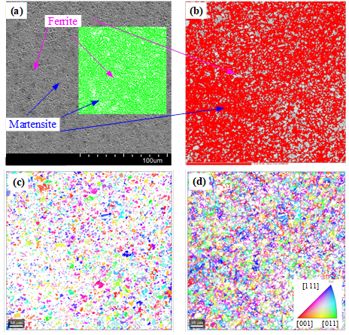
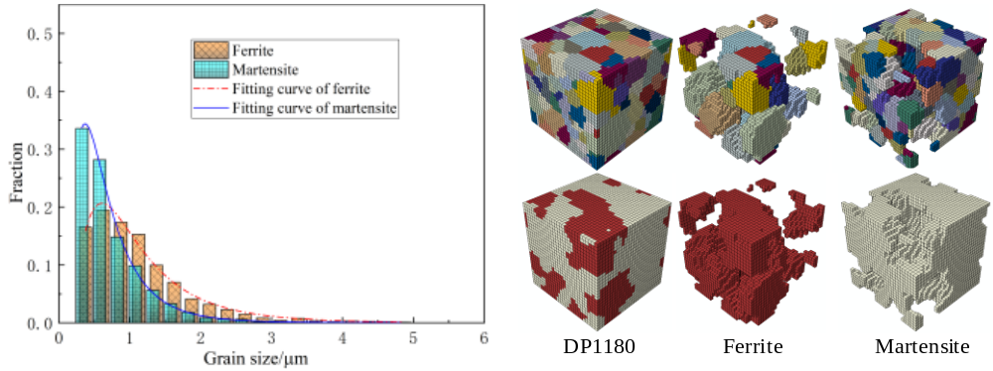
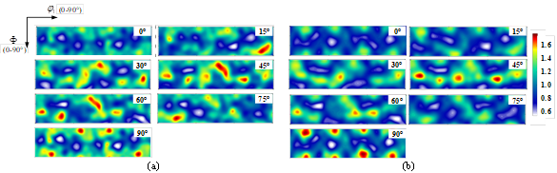
Materials and experiments
Data analysis of DP1180 based on the SEM and EBSD tests
Fig. 11 The fitting of grain sizes and RVE models of DP1180 steel
Fig. 10 The SEM and EBSD figures of DP1180 steel
Fig. 12 The ODF of ferrite (left) and martensite (right) in DP1180 steel
Notes:
This page shows the data analysis of DP1180 based on the SEM and EBSD tests. The volume fraction of ferrite and martensite in DP1180 was determined by the SEM figure. The ferrite and martensite in the EBSD figure was separated by BC value. The grain sizes of ferrite and martensite was analyzed and fitted by the log-normal distribution function. And the RVE model was built based on the log-normal distribution’s fitting parameters by the open-source software DREAM. 3D. Figure 12 shows the orientation distribution function of ferrite and martensite in DP1180.

Slide 9
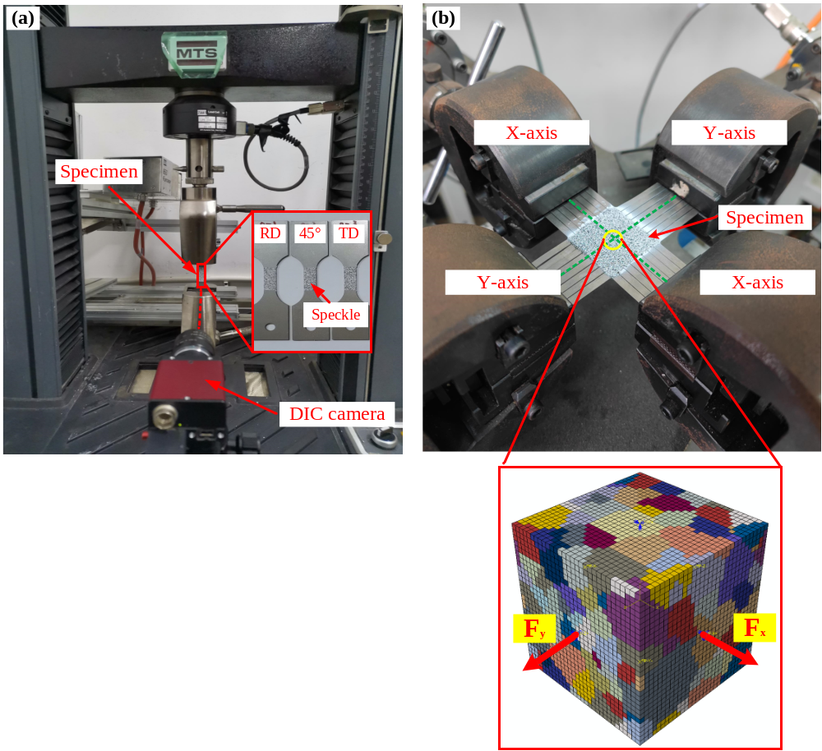
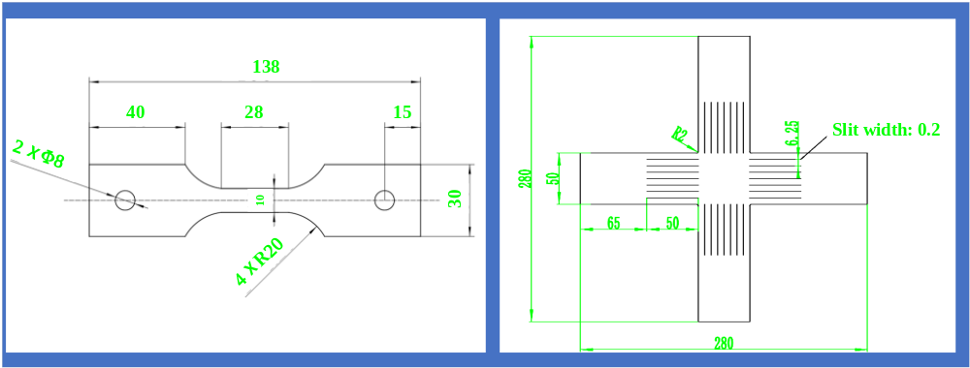
Materials and experiments
Application of AHSS
Fig. 14 The specimen sizes of uniaxial and biaxial tension tests
Loading rate in X-axis to Y-axis
Fx : Fy = 0:4, 1:4, 2:4, 3:4, 4:4, 4:3, 4:2, 4:1, 4:0
A digital image correlation (DIC) system was used to measure the full-field strain. The cruciform specimen with slit arms was used to lower the shear stress in the middle area.
Fig. 13 The uniaxial and biaxial tension tests of DP1180 steel sheet
Notes:
The uniaxial tension tests were conducted on the MTS testing machine. And the biaxial tension tests were conducted on the biaxial tension testing machine developed by Beihang University.
A digital image correlation (DIC) system was used to measure the full-field strain. The biaxial tensile tests were conducted under linear loading path to obtain the yield loci in the normal stress space. The cruciform specimens were used to lower the shear stress in the middle area

Slide 10
Contents
1. Introduction
2. Materials and experiments
3. CPFEM modeling
4. Results and discussion
5. Conclusions
6. Recent works
Notes:
Then, the next is the CPFEM modeling.

Slide 11

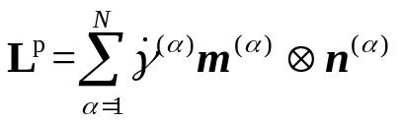
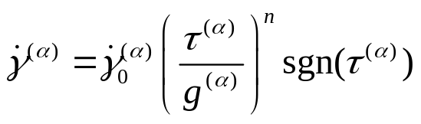





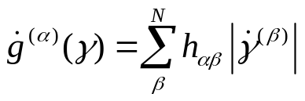





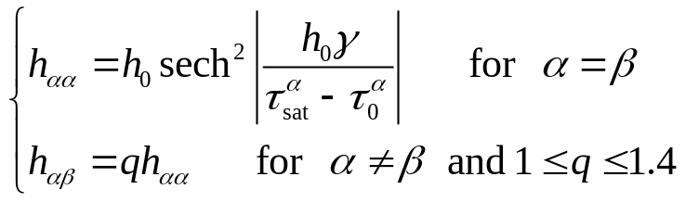
CPFEM modeling
[1] H. Yonggang, A user-material subroutine incorporating single crystal plasticity in the ABAQUS finite element program, Harvard Univ(1991).
[2] C. C. Tasan, M. Diehl, D. Yan, C. Zambaldi, P. Shanthraj, F. Roters and D. Raabe, Acta Mater. 81, 386-400 (2014).
[3] Q. Li, H. Zhang, F. Chen, D. Xu, D. Sui and Z. Cui, International Journal of Mechanical Sciences 1762020).
The framework of crystal plasticity finite element method (CPFEM)^{[1]}
The deformation gradient can be multiplicatively decomposed into elastic and plastic components as
The plastic part of the velocity gradient is due to crystallographic slip on N slip systems and is expressed as
Table. 1 Material parameters based on Ref. [2-3] for ferrite and martensite in DP1180 steel.
The rate dependent flow law is used to describe the plastic flow as
Property | Ferrite | Martensite | Unit
 | 233.3 | 417.4 | GPa
 | 135.5 | 242.4 | GPa
 | 118.0 | 211.1 | GPa
 | 1e(-3) | 1e(-3) | ms⁻¹
 | 95 | 406 | MPa
 | 222 | 873 | MPa
 | 96 | 457 | MPa
 | 412 | 971 | MPa
 | 1 | 563 | GPa
 | 1.4 | 1.4
 | 20 | 20
The evolution equation of slip resistance has the following form
The instantaneous strain hardening matrix can be described as
Notes:
The framework of crystal plasticity finite element method (CPFEM) is based on the single crystal material subroutine written by Professor Yonggang Huang in 1991. Based on the reference of Tasan and Li., the material parameters for ferrite and martensite in DP1180 steel were slightly adjusted by comparing with the uniaxial tension tests on RD and TD directions.

Slide 12
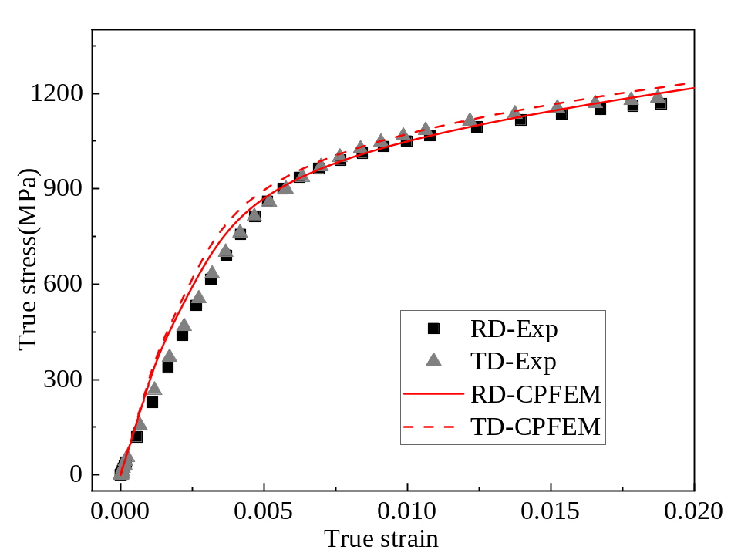
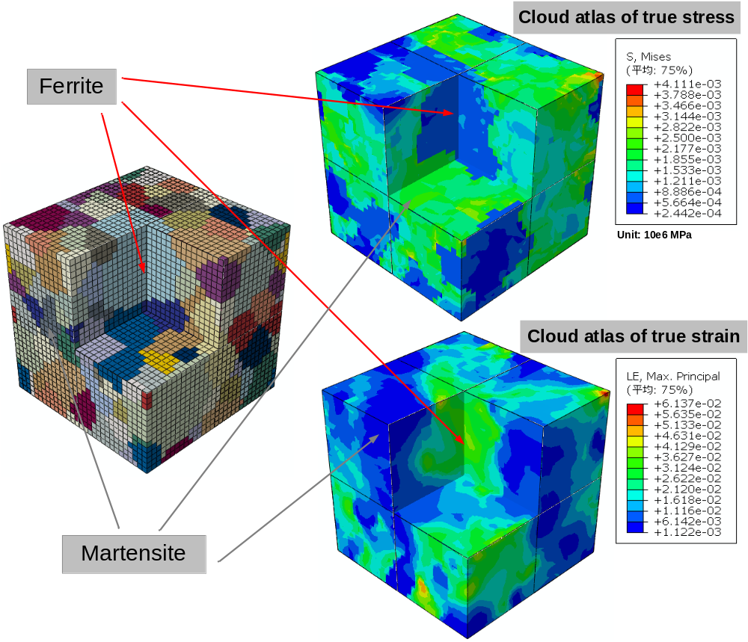
CPFEM modeling
The calibration of CPFEM parameters
Fig. 15 The comparison of uniaxial tension tests and CPFEM on RD and TD for DP1180 steel sheet
Fig. 16 The microstructure of DP980 (up) and DP1180 (down)
Notes:
The calibration of CPFEM parameters was conducted by comparing the uniaxial tension simulation on RD and TD with tests. The cloud atlas of stress and strain is shown in Figure 5, and it indicted that the stress in martensite was much bigger than that in ferrite, while the strain is opposite.

Slide 13
Contents
1. Introduction
2. Material and experimental procedure
3. CPFEM modeling
4. Results and discussion
5. Conclusions
6. Recent works
Notes:
Then, the next are the results and discussion.

Slide 14
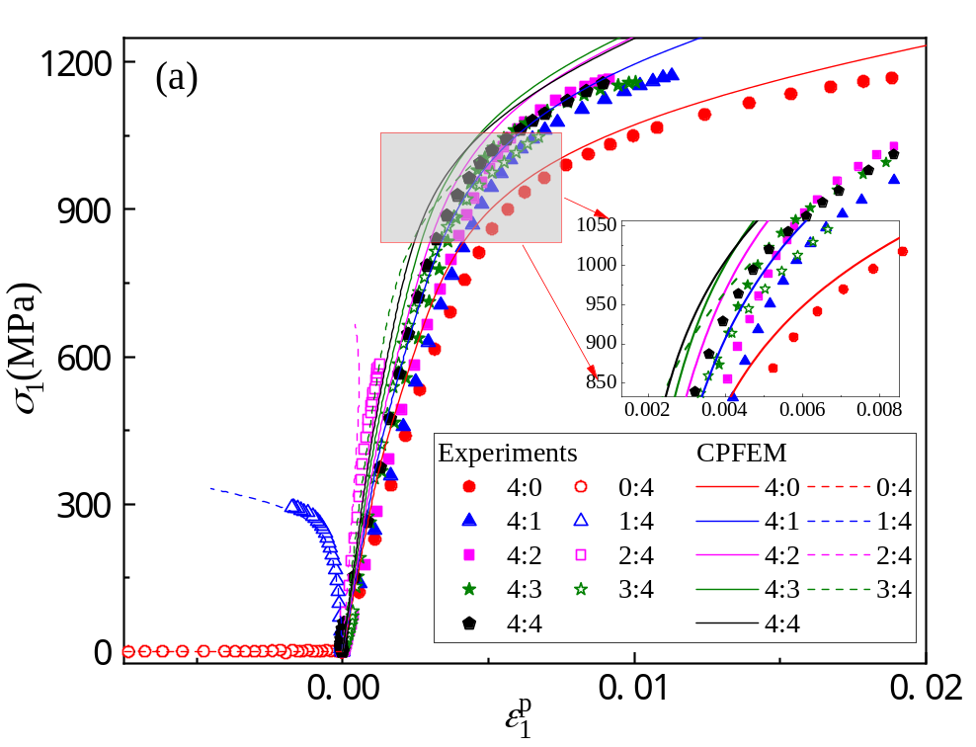
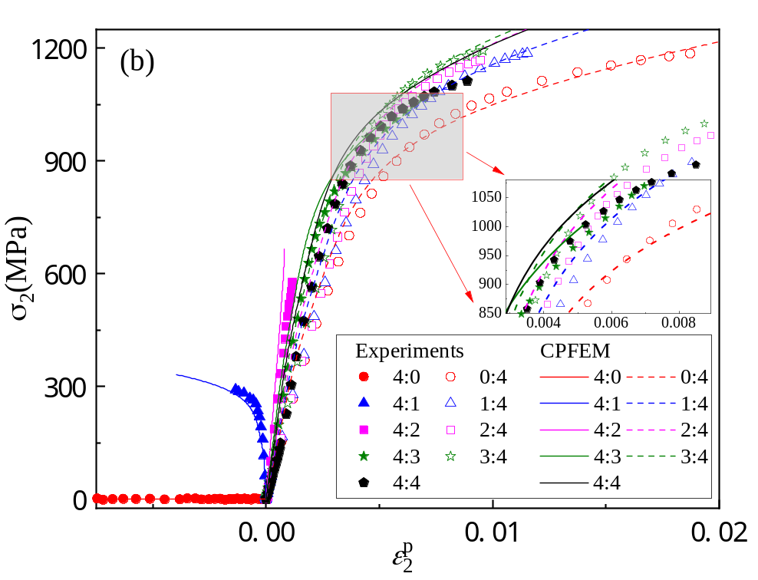
Results and discussion
The comparisons of biaxial tensile stress-strain curves
Fig. 17 The microstructure of DP980 (up) and DP1180 (down)
Fig. 18 The microstructure of DP980 (up) and DP1180 (down)
Notes:
The comparisons of biaxial tensile stress-strain curves based on the CP-RVE model are shown as the Figures above.
Relatively speaking, the predicted results of the CP-RVE model are in good agreement with the experimental results.

Slide 15
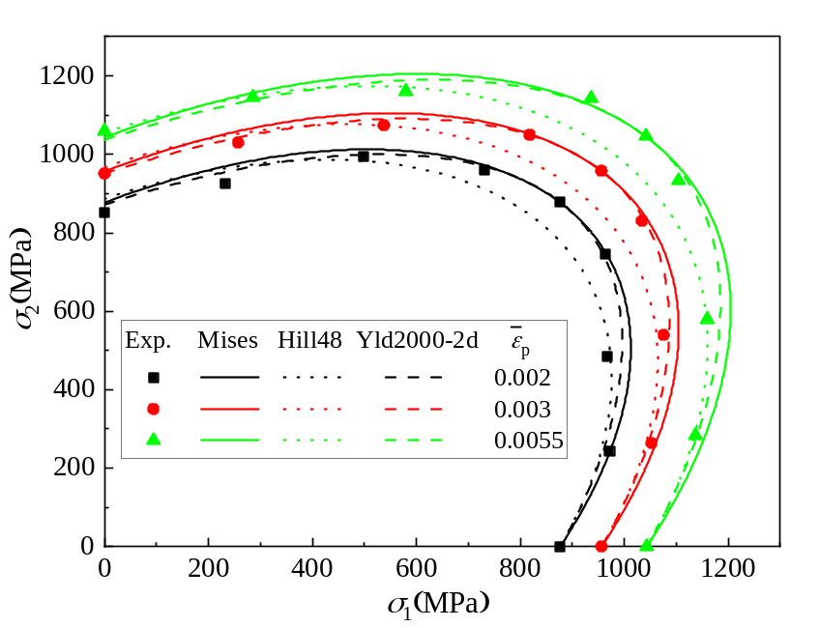
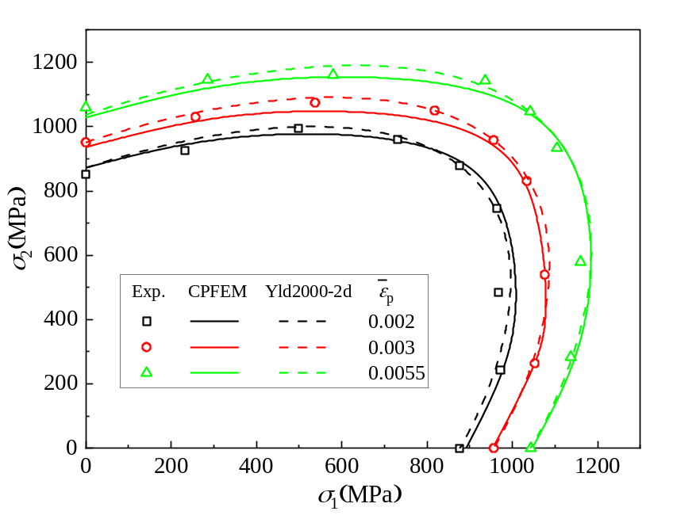
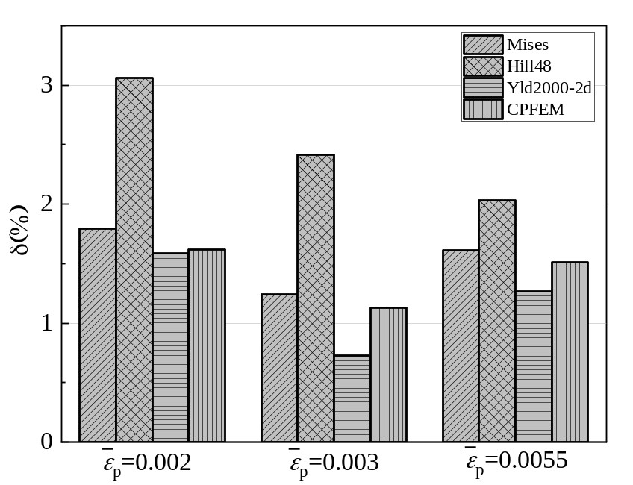
Results and discussion
The predictions of yield loci of DP1180 steel sheet
Fig. 19 The predictions of yield loci by Mises, Hill48, and Yld2000-2d yield criterions
Fig. 20 The predictions of yield loci by CPFEM and Yld2000-2d yield criterions
Fig. 21 The errors of predictions by general yield criterions and CPFEM
Notes:
The yield loci were obtained by the plastic work per unit volume principle. The yield points calculated by CPFEM were treated with B-splines, and the smooth yield loci were obtained. By the errors histogram of predictions, It can be clearly seen that the prediction accuracy of CPFEM ranked second only to Yld2000-2d, and better than Mises and Hill48 yield criteria.
B-spline fitting

Slide 16
Contents
1. Introduction
2. Materials and experiments
3. CPFEM modeling
4. Results and discussion
5. Conclusions
6. Recent works
Notes:
Then, the next are our conclusions.

Slide 17
Conclusions
As for the phenomenological yield criterions, compared with the experimental yield loci of DP1180 steel sheet, the Yld2000-2d has the highest prediction accuracy, followed by Mises, and Hill48 is the worst.
After the calibration of crystal plastic parameters, the predictions of yield loci by the CPFE simulations have a higher accuracy than Mises, Hill48, and little lower than Yld2000-2d.
Notes:
The following conclusions can be drawn out:
As for the phenomenological yield criterions, the Yld2000-2d has the highest prediction accuracy, followed by Mises, and Hill48 is the worst.
After the calibration of crystal plastic parameters, the predictions of yield loci by the CPFE simulations have a higher accuracy than Mises, Hill48, and little lower than Yld2000-2d.

Slide 18
Contents
1. Introduction
2. Material and experimental procedure
3. CPFEM modelling
4. Results & discussion
5. Conclusions
6. Recent works

Slide 19
Recent works
How to use CPFEM to reveal the microscopic mechanism of the anisotropic behavior of AHSS?
How to study the strengthening behavior of AHSS with CPFEM?
How to study damage and fracture behavior of AHSS with CPFEM?
Notes:
Our recent research has focused on the following three questions:
How to use CPFEM to reveal the microscopic mechanism of the anisotropic behavior of AHSS?
How to study the strengthening behavior of AHSS with CPFEM?
How to study damage and fracture behavior of AHSS with CPFEM?

Slide 20

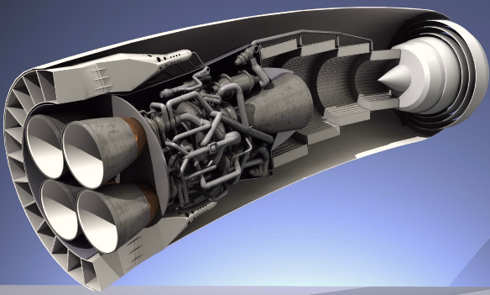
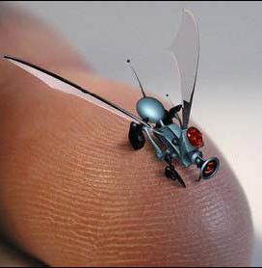
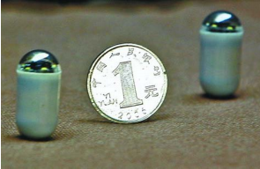
Thank you for your attention!
If there were any questions or suggestions, we would be very grateful!
20
Notes:
That is all. Thank you for your attention！
If there were any questions or suggestions, we would be very grateful!

