Slide 1




A uniform method for the characterization of shear fracture strain for high-strength steel sheets under quasi-static and crash loading
Silke Klitschke*, Sebastian Westhäuser, Matthias Schneider, Andreas Heitzmann, Andrew Pearce, Harald Friebe
* Presenter

Slide 2
Agenda
Introduction
Experimental investigations
  Materials and specimen geometries
  Variation of specimen clamping
Evaluation method for shear strains by digital image correlation (DIC)
Influence parameters on the shear deformation and fracture behavior
Summary and conclusions

Slide 3
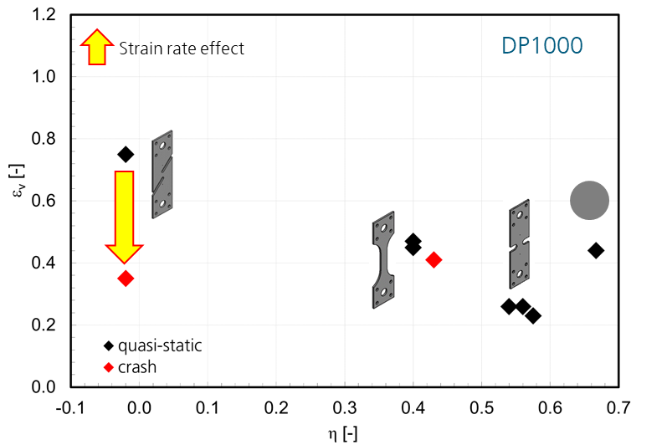
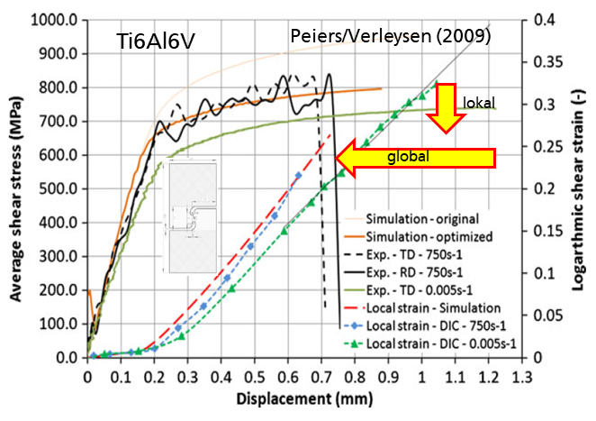
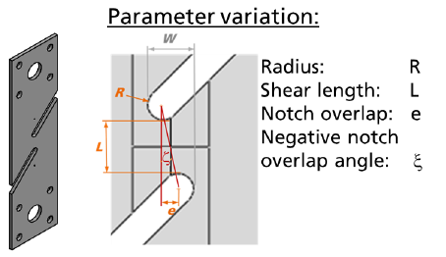
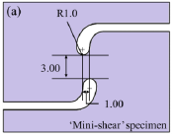
Introduction
Strain rate effect on failure strain (AHSS):
High rate shear characterization:
  mainly shear tensile specimens
  tendency to previous notch failure
  negative notch overlap (ductility)
Peiers/Verleysen 2009 Roth/Mohr 2018 Narayana/Abedini 2021
„ASTM-like“ geometry (ASTM Standard B 831-14) Huberth/Klitschke, Fraunhofer IWM, 2019

Slide 4
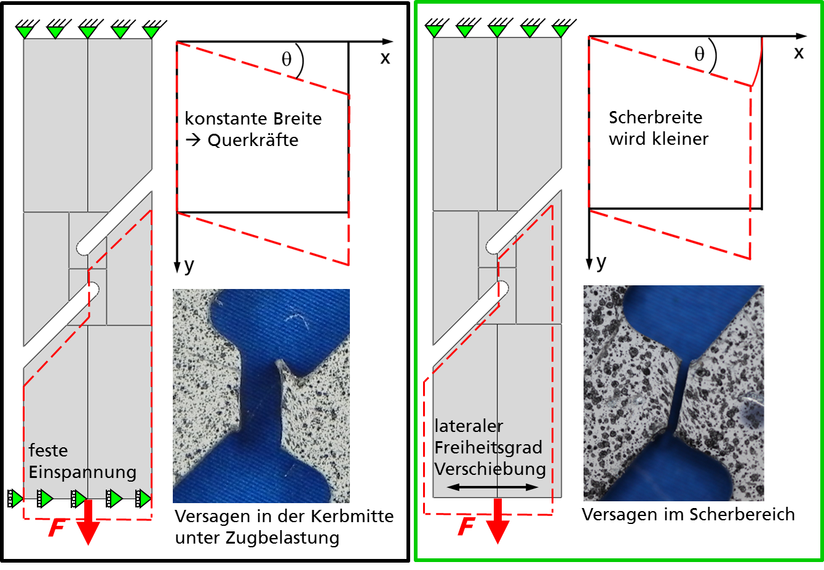
Introduction
many laboratories use
  ASTM-like specimens
  fix clamping with hydraulic gripping
  different free clamping lengths
fracture behavior dependent on the clamping situation is observed
evaluation of shear failure strains especially by DIC is not consistent
constant width -> lateral forces
width of shear zone decreases
fix clamping
lateral mobility
tensile failure initiation in the notch region
failure initiation in the shear region
Huberth/Klitschke, Fraunhofer IWM, 2019
Project WipaNORMetall "Determination of characteristic values for metallic sheet materials under quasi-static up to dynamic shear stress"

Slide 5
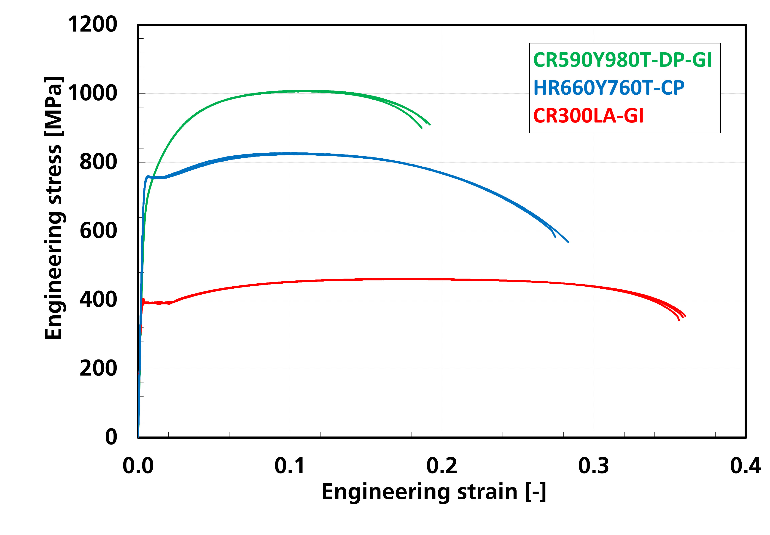
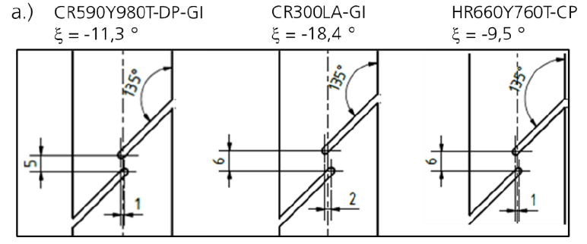
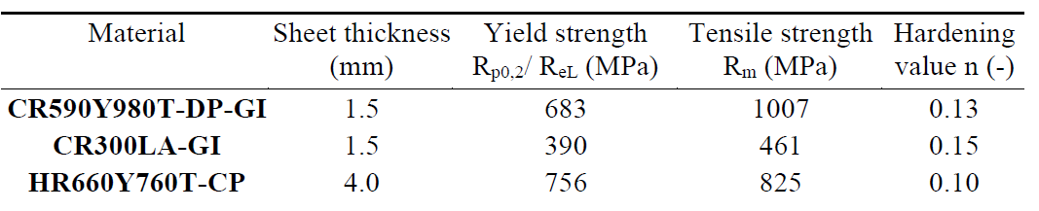
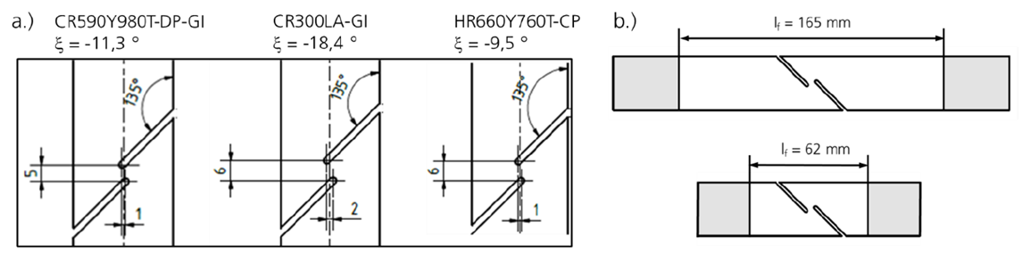
Experimental investigations – Material and specimen geometries
Investigated materials:
Notched shear tensile specimens:
n = 0,13
n = 0,15
n = 0,10
Dual phase steel
Bainitic steel
Microalloyed steel
90°
negative notch overlap dependent on hardening value
Free clamping length:

Slide 6
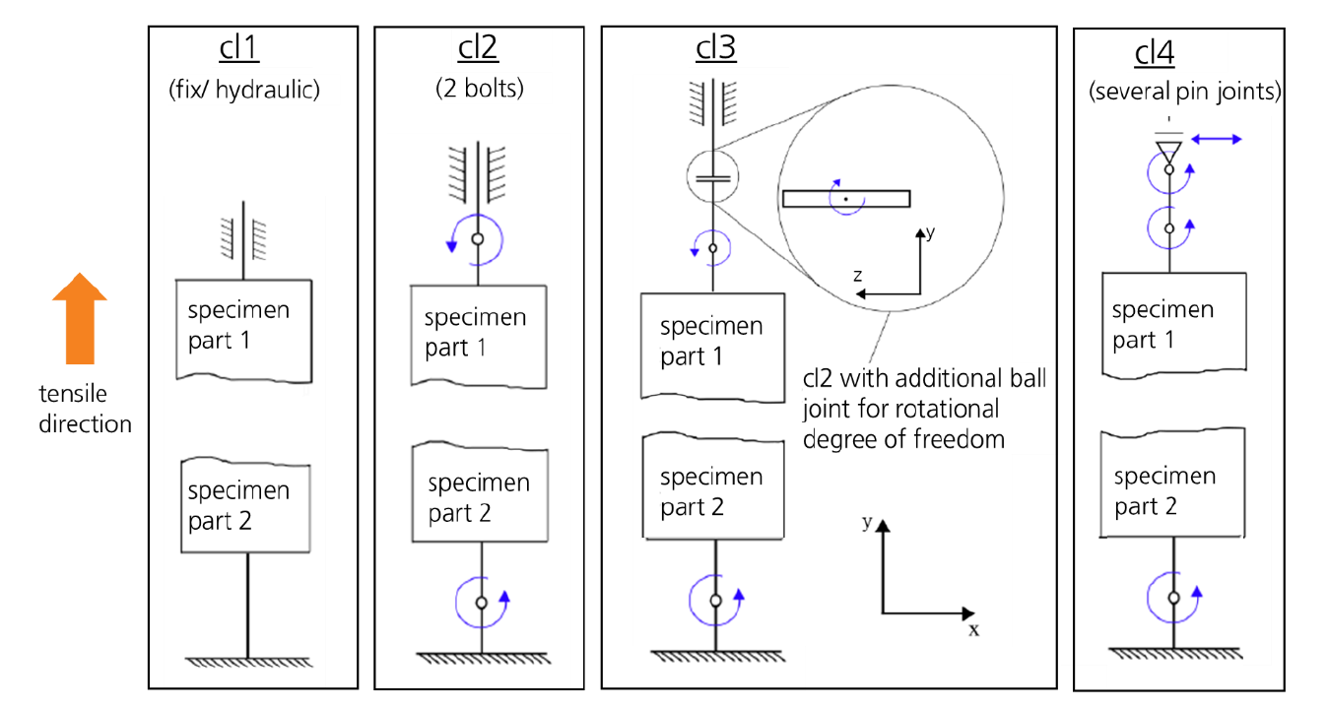
Experimental investigations – Variations of specimen clamping
3 test labs with individual clamping situations:
quasi-static
L_{f} = 165 mm
L_{f} = 62 mm
quasi-static
L_{f} = 62 mm
quasi-static
L_{f} = 62 mm
quasi-static, dynamic
L_{f} = 62 mm

Slide 7
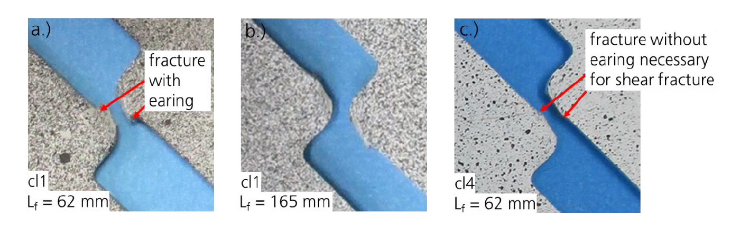
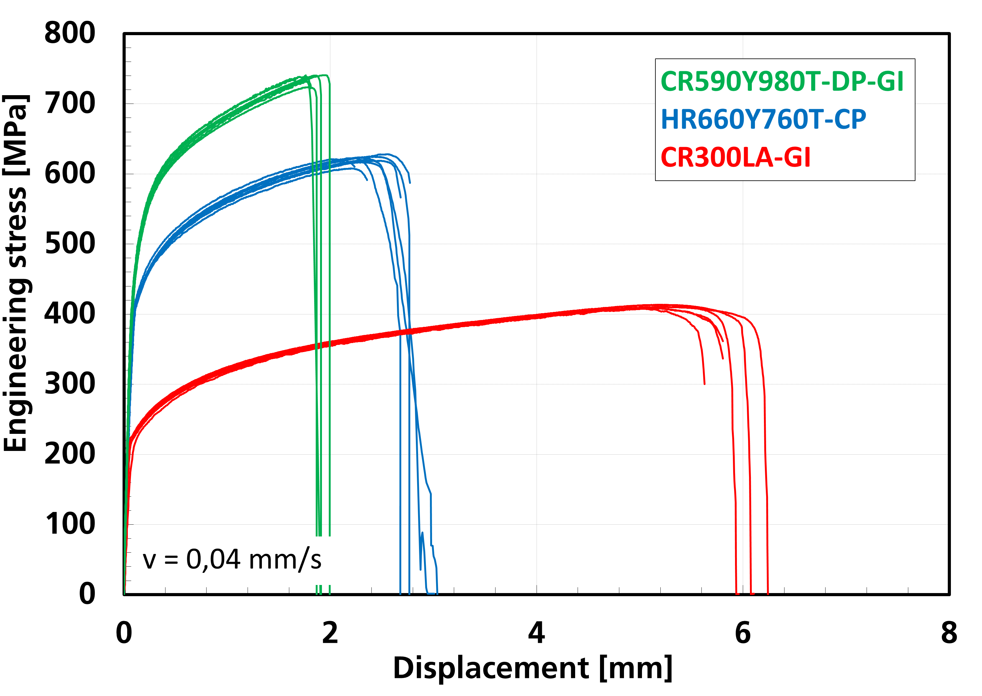
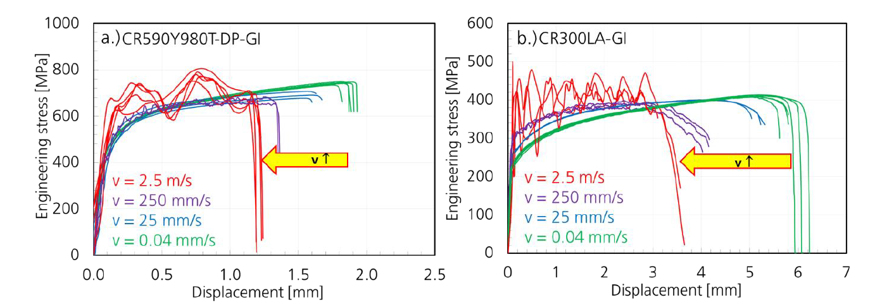
Experimental investigations – Results
(CR300LA-GI)
Shear zone of tested specimens with partly earing(hint of notch failure)
no significant influence of clamping on stress-displacement curves
Continous negative strain rate effect on displacement up to fracture

Slide 8
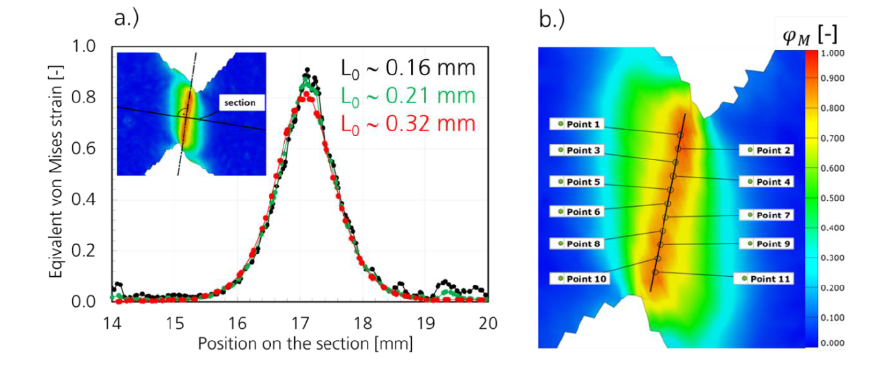
Evaluation method for shear strains with digital image correlation (DIC)
Determination of characteristic gauge length L₀ of about 0.2 mm is used
The choice of relevant evaluation points
  at least 10 points in the central part of the shear zone
  points should be positioned along a line (anchored in the specimen center following maximal shear strains)
Average values for major and minor strain
Development of a user independent evaluation procedure of shear strains by DIC is in progress!

Slide 9
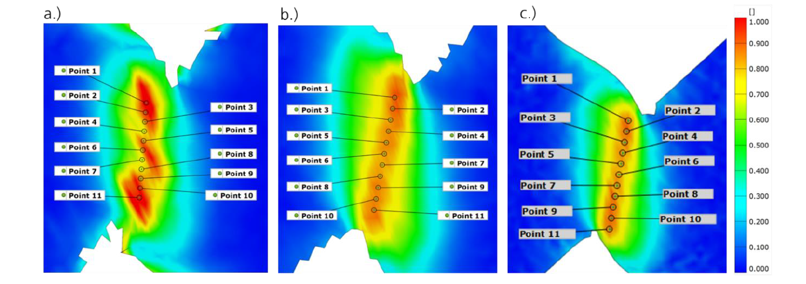
Influence parameters on the shear deformation behavior
Last DIC-image before fracture (CR590Y980T-DP-GI):
Equivalent von Mises strain [-]
cl1 (fix clamping)
L_{f} = 62 mm
cl3 (rotational clamping)
L_{f} = 62 mm
cl1 (fix clamping)
L_{f} = 165 mm
Fix clamping with short free clamping length leads to an uneven strain localization immediately before fracture!

Slide 10
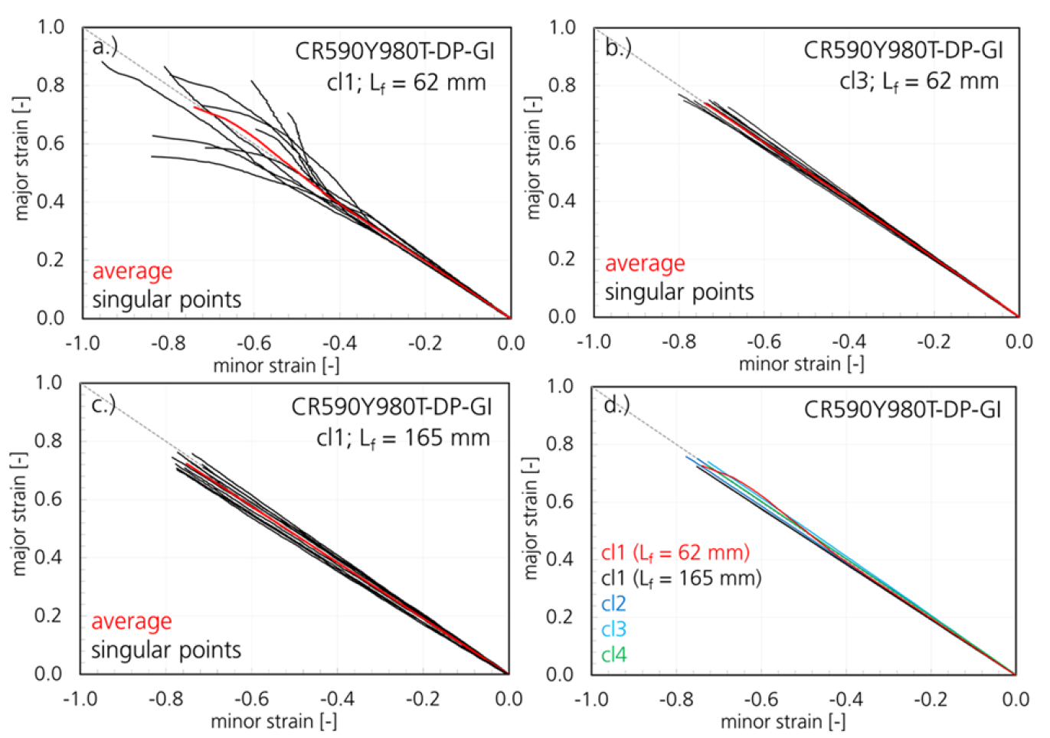
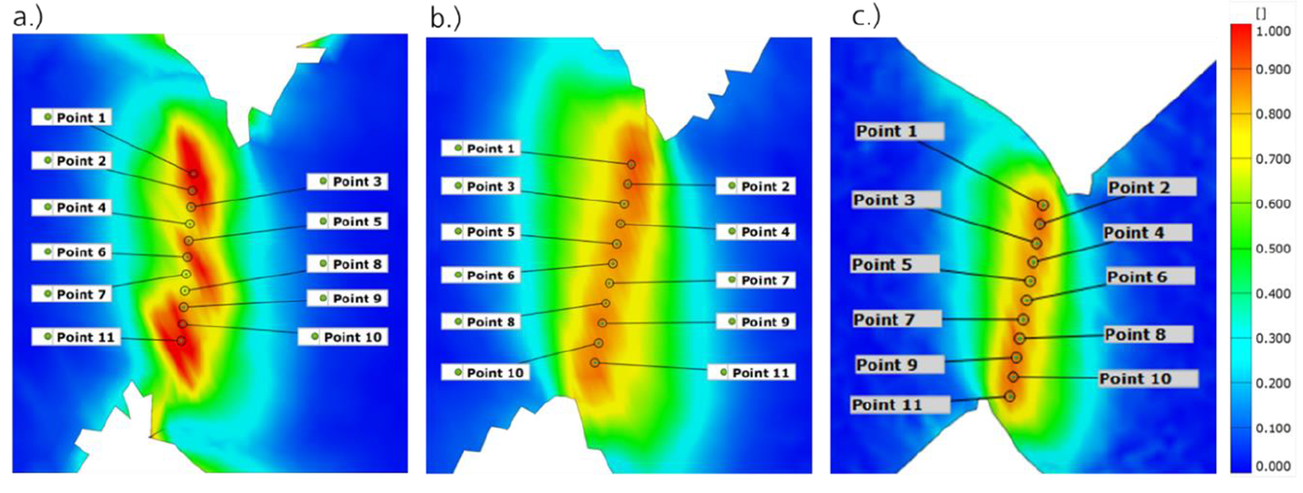
Influence parameters on the shear deformation behavior
Fix clamping and
  short free clamping length -> non-linear strain paths
  long free clamping length -> linear strain paths
Clamping variations with at least rotational mobility
  linear strain paths
critical combination: cl1 + short L_{f}
ideal shear strain path

Slide 11
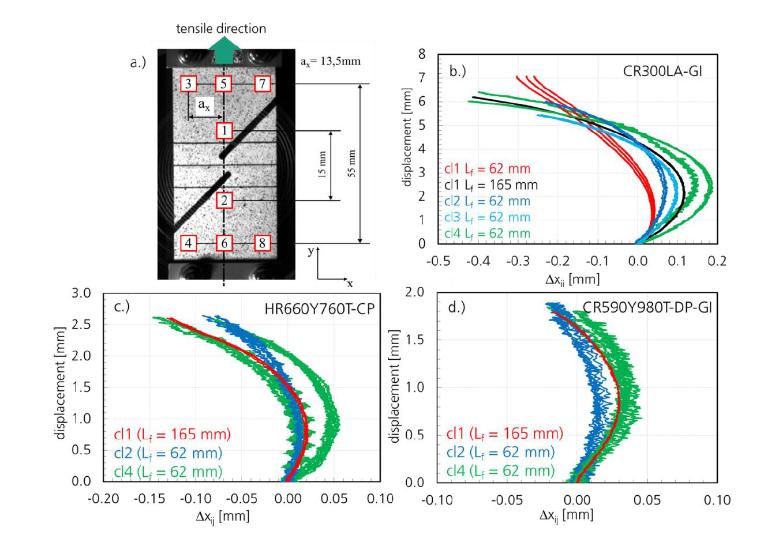
Influence parameters on the shear deformation behavior
Relative horizontal movement of the specimen parts: Δx_{ij} = x_{j} – x_{i}
specimen parts get closer to each other
(j = 3,5,7 and i = 4,6,8)
less horizontal movement
specimen
parts move
apart
A material dependent horizontal degree of freedom should be necessary for linear shear strain paths

Slide 12
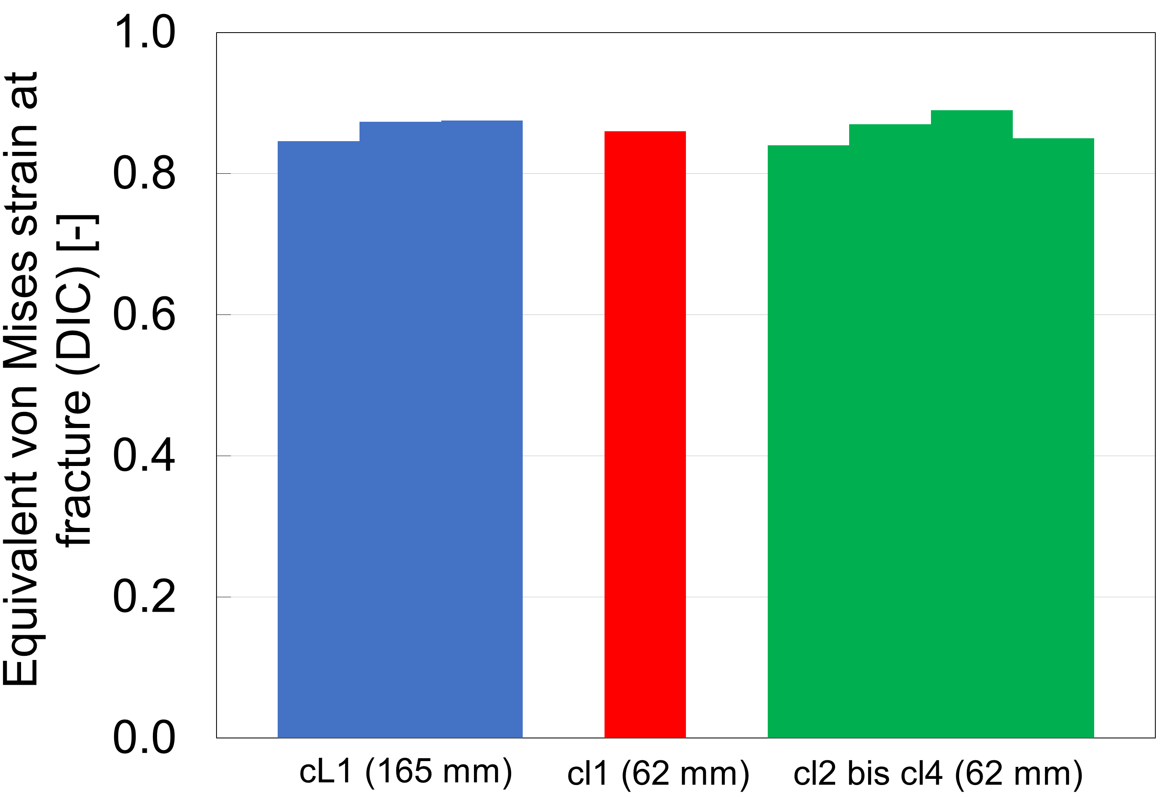
Influence parameters on the shear fracture behavior
First results for shear fracture strains evaluated by DIC with the proposed method:
CR590Y980T-DP-GI
DP1000: no significant influence of clamping type and free clamping length on the shear fracture strain observed
microalloyed and bainitic steels fail at higher strains -> evaluation in progress
Fix clamping
clamping with horizontal mobility

Slide 13
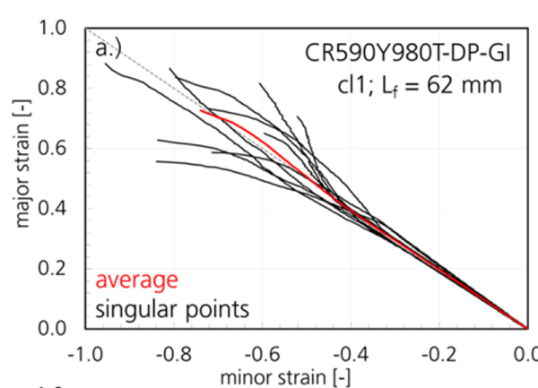
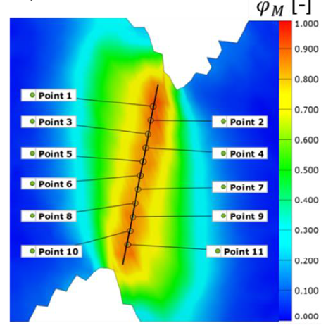
Summary
The influence of the clamping type and free clamping length L_{f} on the shear deformation and fracture behavior was investigated for AHSS
Fixed clamping with
  L_{f} ∼ 62 mm leads to non-linear strain paths
  L_{f} ∼ 165 mm balances this disadvantage
Short shear tensile specimens should be tested with a clamping providing horizontal mobility (yielding characterization -> other recommendations)
Evaluation of shear strains by DIC: appropriate gauge length; average strain values

Slide 14
Summary and outlook
With increasing strain rate up to 100 s⁻¹ failure strain seems to decrease continuously.
Outlook:
Further evaluations of strain path and fracture strain for microalloyed and bainitic steel as well as for dynamic shear tests
Comparison of the results for other shear tests (disk torsion, Verleysen etc.)
Development of a user independent DIC-evaluation procedure of shear strains
Development of a draft standard: “Characterization of metallic sheet mate-rials under dynamic shear stress for the determination of shear failure strains”

Slide 15



Acknowledgement
Much thanks for your attention!
The research project WipaNORMetall "Determination of characteristic values for metallic sheet materials under quasi-static up to dynamic shear stress" is funded by the Federal Ministry of Economic Affairs and Climate Action as part of the funding guideline “Wipano - transfer of R&D findings by standardization” (Funding Code: 03TN0023A).
Much thanks to all associated partners for supporting this project:
ThyssenKrupp AG, Tata Steel, Daimler AG, Volkswagen Osnabrück GmbH, ZwickRoell GmbH & Co. KG, Kirchhoff Automotive, BILSTEIN GmbH, EDAG Engineering GmbH, GDA e.V., MPA Stuttgart, Novelis, ZF TRW Automotive, GDA e.V., KEY TO METALS AG, 4a engineering GmbH

