Slide 1
Optimization of the physical scaling approach through the adaption of the inverted membrane stresses
Philipp Zimmermann*, Arndt Birkert, Moritz Nowack and Tobias Kraft
Notes:
Hello everybody,
I am pleased to welcome you to my presentation today.
My name is Philipp Zimmermann.
I‘m a scientific assistant at the university of applied sciences in Heilbronn, Germany.
There I work at the Center for Forming Technology and car body engineering under the leadership of Professor Birkert.
One of our central research topics is the springback compensation of complex body parts.
Today I will present you the content of our Paper, „Optimization of the physical scaling approach through the adaption of inverted membrane stresses“.

Slide 2
AGENDA
Introduction
State of the art scaling approaches and belonging issues
Optimization of the stress-based scaling approach
Results
Summary
Notes:
Let's have a short look to my agenda.
I will start by giving you a short introduction into the topics „springback“ and „springback compensation“.
Then we will have a look on state-of-the-art scaling approaches and after that I will show the optimization of the stress-based scaling approach.
Finally, I will show some results of a study where we have tested the optimized scaling approach.
At the end will summarize the content.

Slide 3
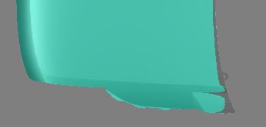
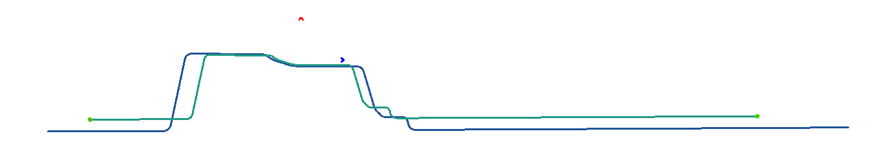
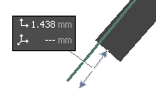
INTRODUCTION: GEOMETRICAL DEVIATIONS CAUSED BY SPRINGBACK EFFECTS
The dimensional deviations caused by the elastic springback can be divided in two categories. On the one hand bending ups, distortions etc. – on the other hand contraction of the part.
root causes for springback
geometrical effect / dimensional deviations
compensate dimensional deviations
bending stresses
deviation in normal sheet direction
overbending
part after springback
part after springback
target part
target part
compensated tool
membrane stresses
in-plane deviation
scaling
A
A
scaled geometry
A - A
zero geometry
Notes:
Springback is the change of geometry which occurs in stamped parts during the opening of the tools, due to the release of elastic energy.
The consequences are dimensional deviations between the present part and the target part.
The springback itself can be split up into two different categories.
On the one hand there are bending-ups & distortions of the part which can be characterized and quantified by the normal distance between the part and the target geometry.
To compensate this type of deviations the forming tools can be modified in the opposite direction of the springback.
On the other hand, the part contracts, which means that the surface area changes during springback.
This effect occurs especially after the drawing operation and because the responsible stresses are mainly tensile stresses, the part shrinks.
To compensate this kind of deviations, the tool surfaces area are increased.
This doing is the so-called scaling of the tools.
Root causes: Membrane Stresses – Bending Stresses
Geometrical effect: Shrinkage -

Slide 4
AGENDA
Introduction
State of the art scaling approaches and belonging issues
Optimized stress-based scaling approach
Results
Summary
Notes:
Now we came to the state-of-the-art scaling approaches.

Slide 5
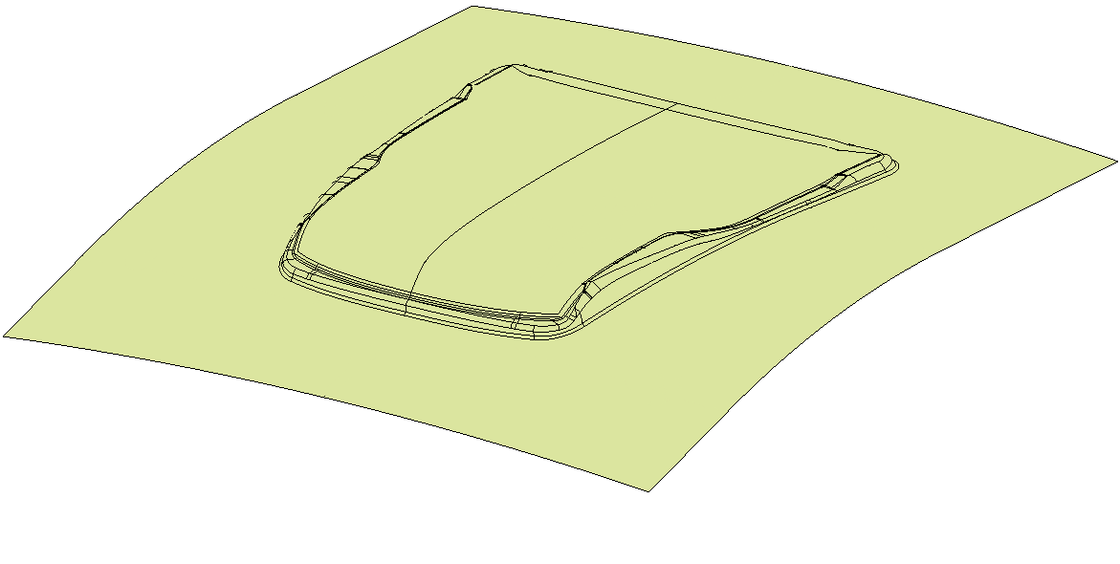




STATE OF THE ART SCALING APPROACHES: GLOBAL SCALING
By global scaling a homogeneous shrinking of the part is being assumed during springback. To compensate this, the tool dimensions are increased by a constant factor or different factors for different axes.
one scaling factor
one scaling factor for each axes
l_{1-scaled}
scaling centre
z
l₁
x
y
scaling factors:
X-Direction: 1.002 (+0.2%)
Y-Direction: 1.0017 (+0.17%)
Z-Direction: 1.001 (+0.1%)
scaled geometry
zero geometry
l₂
l_{2-scaled}
calculation of the scaling factor
$$σ$$
Calculation example for aluminium:
$$σ_{biax}$$
$$\left(1\right) F_{scale}=1+\frac{σ_{biax}}{E}$$
$$σ_{biax}=150 MPa$$
$$E=70 000 MPa$$
$F_{scale}=1+\frac{150 MPa}{70000 MPa}=1.002$
$$l_{0}=1000 mm→l_{scaled}=1002 mm$$
assumed part contraction
$$ε$$
Notes:
As mentioned before, the responsible stresses for the part contraction are mainly tensile stresses which causes a shrinking of the part.
In the assumption, that the part shrinking is more or less constant, the tool surfaces can be increased by one constant factor.
Also, the tools can be increased by different factors for the different space axes. Both approaches are named „Global Scaling“.
Tool makers often have their own scaling factors defined due to their experience with different part geometries and materials.
To define a scaling factor also mechanical parameters of the part material can be used. In the shown formula these are the biaxial yield stress and the Youngs Modulus.
In the shown example for an aluminium sheet metal this results in an increase of the tool length of two millimetres per meter.

Slide 6
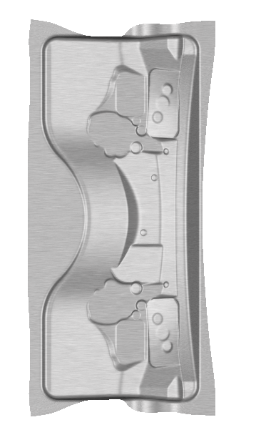
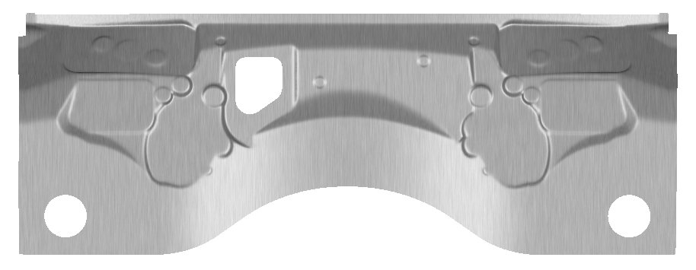
STATE OF THE ART SCALING APPROACHES: local contraction values
By FEM simulation the local contraction values can easily be evaluated. The results show that the contraction values can vary significantly. Here in some areas there is even an increase in dimensions.
increasing length
←→
contraction
→←
assumed part contraction (global scaling)
Notes:
On this slide you can see, why the global scaling approach often cannot compensate the part contraction sufficiently.
In contrast to the assumption, that the part contraction is more or less constant, the contraction behaviour can vary significantly across the part.
In this example the contraction values was evaluated along a part section.
As you can see, in this section there is not only a varying shrinking but also an increase of the section length.
This means, a scaling approach is needed which can generate local different scaling values.

Slide 7



STATE OF THE ART SCALING APPROACHES: stress-based local scaling
In order to generate local correct scaling values Birkert and Zimmermann have presented a stress-based local scaling approach. Therefore, the membrane stresses before springback have been inverted.
$$σ$$
$$σ$$
$$σ$$
$$σ$$
$$σ_{bSB_0}$$
1
$$σ_{bSB_0}$$
1
5
5
local scaling values
0
2
$$ε$$
4
$$ε$$
4
$$ε$$
0
6
$$ε$$
local contraction values
$$σ_{scal}$$
=
3
$${−σ}_{bSB_0}$$
0→1: | drawing with unscaled tools
1→2: | springback
1→3: | inverting membrane stresses
3→4 | „inverse“ springback
4→5 | scaling tools with „inverse“ springback vector field
0→5 | drawing with locally scaled tools
5→6 | springback
Notes:
In 2020 we have presented a stress-based local scaling approach.
To visualize the procedure of this approach it is useful to do this at a stress-strain-diagram.
In a first step an unscaled forming simulation with springback calculation is done.
After springback the part shows locally different contraction values.
In a next step the membrane stresses before springback are inverted.
With these stresses an “inverted” membrane springback is calculated.
With the resulting displacement vector field, the tools are scaled.
After forming the part with this so scaled tools, the part after springback should have the same local lengths as the target geometry.

Slide 8
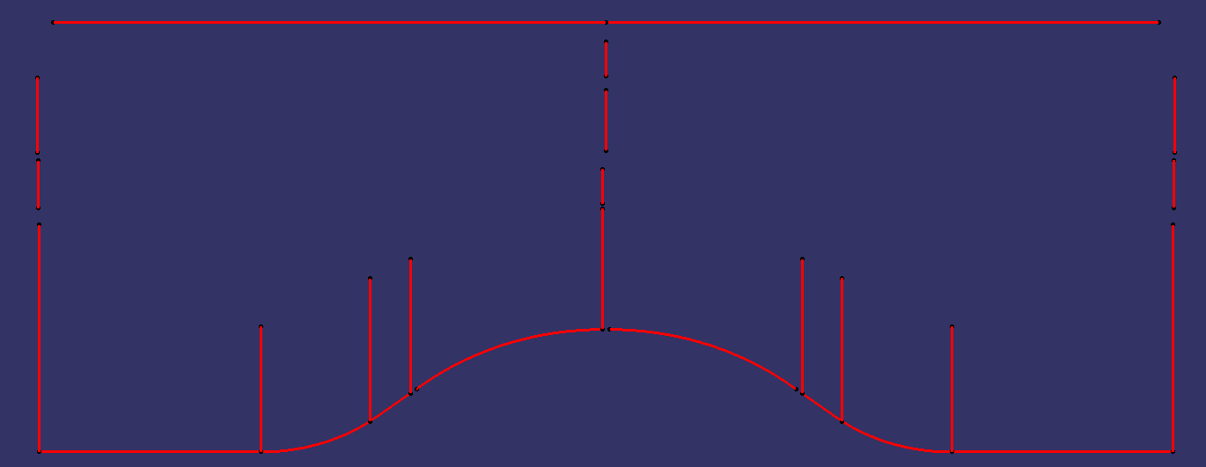
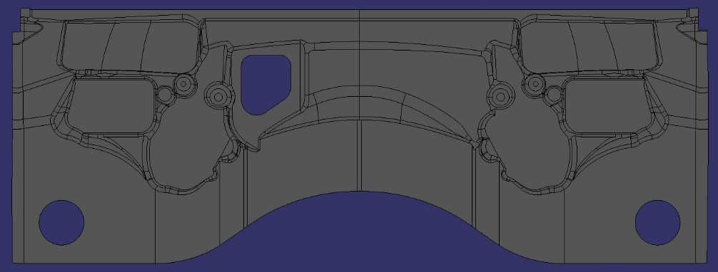
STATE OF THE ART SCALING APPROACHES: Deficit of local scaling approach
The scaled tool geometry should have the inverse lengths of the unscaled part after springback. But by simply inverting the membrane stresses this can not be reached due to a non-linear springback behaviour.
16
15
14
10
22
2
9
21
20
8
7
26
25
24
23
6
1
19
5
18
4
17
3
13
12
11
Notes:
On this slide you can see the deficit of the stress-based local scaling approach.
The red dots shows the local contraction values during springback after forming with unscaled tools.
The desired local scaling values have the same amount with inverse signs and are represented by the green circles.
By simply inverting the membrane stresses as mentioned before, the locally scaled lengths (blue crosses) differs from the desired ones.
This difference can also be seen in the part after springback which was formed with these locally scaled tools.
From these results, it can be concluded that an adjustment of the membrane stresses is needed to bring the scaling values closer to the desired values.

Slide 9
STATE OF THE ART SCALING APPROACHES: Deficit of local scaling approach
The scaled tool geometry should have the inverse lengths of the unscaled part after springback. But by simply inverting the membrane stresses this can not be reached due to a non-linear springback behaviour.
16
15
14
10
22
2
9
21
desired scaled tool
20
8
7
26
25
24
23
6
1
19
5
18
4
17
3
13
12
11
Notes:
On this slide you can see the deficit of the stress-based local scaling approach.
The red dots shows the local contraction values during springback after forming with unscaled tools.
The desired local scaling values have the same amount with inverse signs and are represented by the green circles.
By simply inverting the membrane stresses as mentioned before, the locally scaled lengths (blue crosses) differs from the desired ones.
This difference can also be seen in the part after springback which was formed with these locally scaled tools.
From these results, it can be concluded that an adjustment of the membrane stresses is needed to bring the scaling values closer to the desired values.

Slide 10
STATE OF THE ART SCALING APPROACHES: Deficit of local scaling approach
The scaled tool geometry should have the inverse lengths of the unscaled part after springback. But by simply inverting the membrane stresses this can not be reached due to a non-linear springback behaviour.
16
15
14
10
locally scaled tool
22
2
9
21
desired scaled tool
20
8
7
26
25
24
23
6
1
19
5
18
4
17
3
13
12
11
Notes:
On this slide you can see the deficit of the stress-based local scaling approach.
The red dots shows the local contraction values during springback after forming with unscaled tools.
The desired local scaling values have the same amount with inverse signs and are represented by the green circles.
By simply inverting the membrane stresses as mentioned before, the locally scaled lengths (blue crosses) differs from the desired ones.
This difference can also be seen in the part after springback which was formed with these locally scaled tools.
From these results, it can be concluded that an adjustment of the membrane stresses is needed to bring the scaling values closer to the desired values.

Slide 11
STATE OF THE ART SCALING APPROACHES: Deficit of local scaling approach
The scaled tool geometry should have the inverse lengths of the unscaled part after springback. But by simply inverting the membrane stresses this can not be reached due to a non-linear springback behaviour.
16
15
14
10
locally scaled tool
22
2
9
21
desired scaled tool
20
8
7
26
25
24
23
simulated part after springback (locally scaled tool)
6
1
19
5
18
4
17
3
13
12
11
Notes:
On this slide you can see the deficit of the stress-based local scaling approach.
The red dots shows the local contraction values during springback after forming with unscaled tools.
The desired local scaling values have the same amount with inverse signs and are represented by the green circles.
By simply inverting the membrane stresses as mentioned before, the locally scaled lengths (blue crosses) differs from the desired ones.
This difference can also be seen in the part after springback which was formed with these locally scaled tools.
From these results, it can be concluded that an adjustment of the membrane stresses is needed to bring the scaling values closer to the desired values.

Slide 12
AGENDA
Introduction
State of the art scaling approaches and belonging issues
Optimized stress-based scaling approach
Results
Summary
Notes:
Now we will have look on the optimization of the stress-based scaling approach.

Slide 13










Optimized stress-based scaling approach
The desired local scaling values result from the inverted contraction values of the unscaled simulation. This cannot be achieved by simply inverting the membrane stresses.
process simulation with unscaled tools
necessary scaling value = neg. contraction value
local scaling by simply inverted stresses
→ dev. between achieved and necessary scaling
$$σ$$
$$σ$$
$$σ$$
$$σ_{bSB_0}$$
1
$$σ_{bSB_0}$$
5*
contraction during springback
scaling result
w/o optimization
necessary scaling
0
2
0
2
4
$$ε$$
0
6*
4*
4
$$ε$$
$$ε$$
part after springback
(no scaling)
part after springback
(no scaling)
$∆ε$*
$∆ε$*
target geometry
target geometry
$$σ_{scal_0}$$
3*
target geometry
Notes:
As before, I will show the procedure of the optimized scaling approach at stress-strain diagrams.
In a first step the part is being formed with unscaled tools and the springback is being calculated.
The resulting local contraction values are used to define the desired local scaling values which have the same amount with inverted signs.
By only inverting the membrane stresses, the achieved local scaling values differs from the desired ones.
This difference is represented by the strain difference and can also be measured between the part after springback and the target geometry if the tools was scaled in this way.
That means, that the membrane stresses must be adjusted to bring the achieved scaling values closer to the desired ones.

Slide 14















Optimized stress-based scaling approach
To bring the local scaling values closer to the target values, the stresses are adjusted based on the present deviation.
calculating correction stresses
scaling with optimized (corrected) stresses
Forming with (optimized) locally scaled tools
$$σ$$
5*
$$σ$$
$$σ$$
scaling result
with optimization
=
necessary scaling
5
scaling result
w/o optimization
0
6*
4*
4
$$ε$$
0
2
4
$$ε$$
$∆ε$*
$∆ε$*
part after springback
(no scaling)
0
6
4
$$ε$$
$$ε_{scal_0}$$
$$σ_{scal_opt}=σ_{scal_0}+σ_{corr}$$
$$ε_{scal_{t}}$$
part after springback
=
target geometry
$$σ_{scal_opt}=σ_{scal_0}+∆ε\text{∗}∙E$$
$$σ_{scal_opt}=σ_{scal_0}+\left(ε_{scal_0}−ε_{scal_{t}}\right)∙E$$
Iterative stress-strain optimization:
$$σ_{scal_0}$$
3*
$$σ_{scal_i+1}=σ_{scal_i}+\left(ε_{scal_i}−ε_{scal_{t}}\right)∙E$$
$$σ_{corr}$$
$$σ_{scal_opt}$$
3
Notes:
To calculate the correction stresses, the existing strain differences are multiplied with the Youngs Modulus of the part material.
If there is still an unacceptable high strain difference after the first stress adjustment, the process is repeated until this differences falls under a given threshold.
After the stress optimization the tools are scaled with the resulting scaling vector field.
The formed part after springback should have the same lengths as the target geometry.

Slide 15
AGENDA
Introduction
State of the art scaling approaches and belonging issues
Optimized stress-based scaling approach
Results
Summary
Notes:
Now let's have a look on results on an investigation, where we have tested the optimized approach.

Slide 16
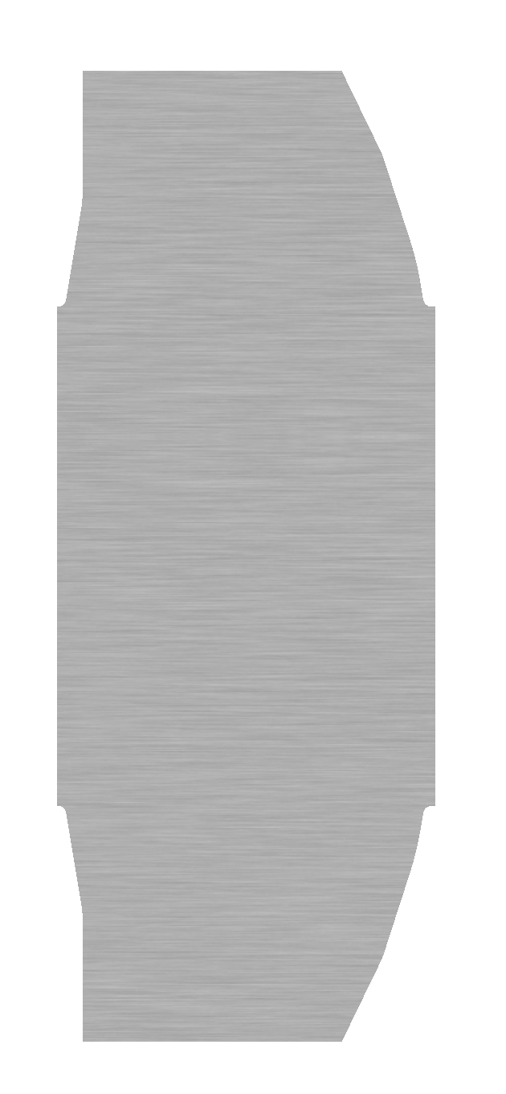
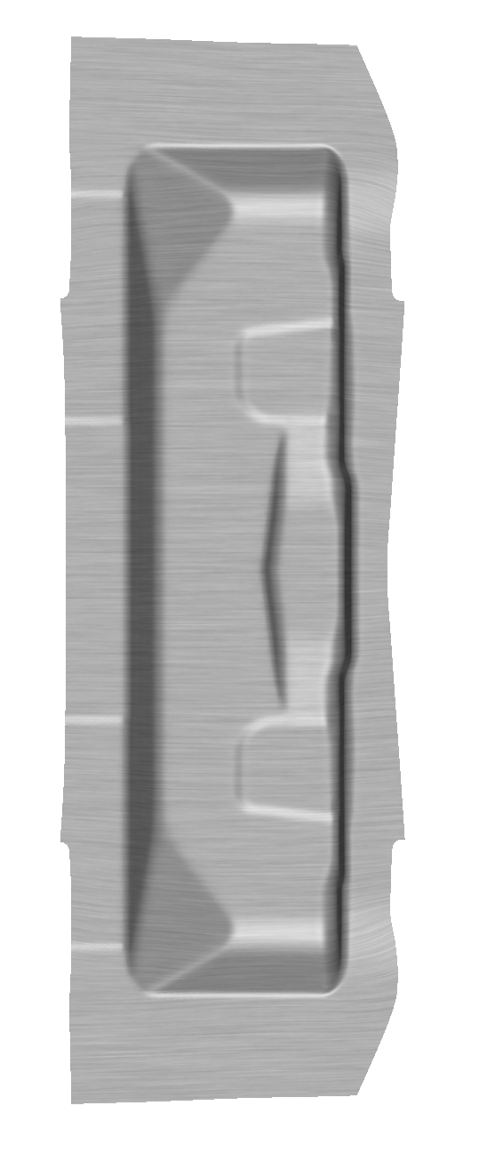
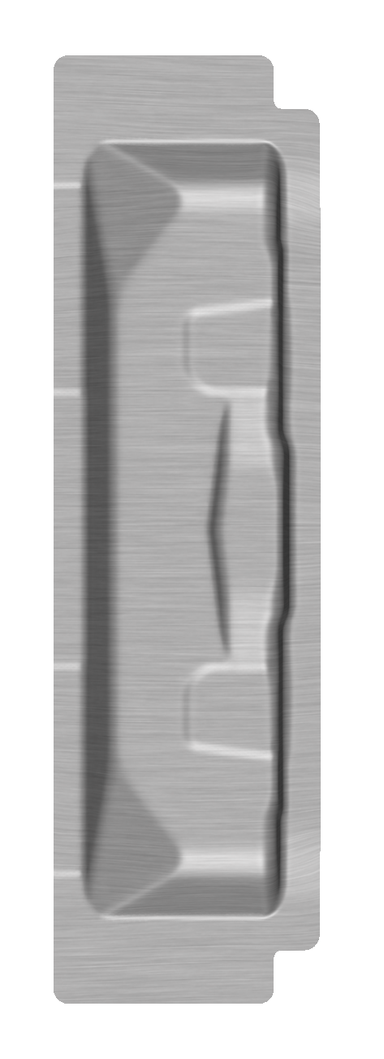
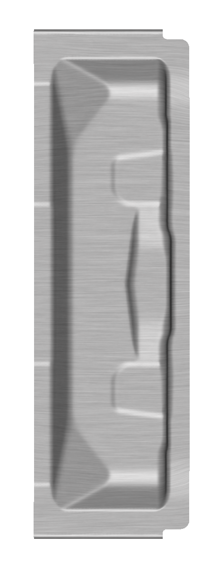
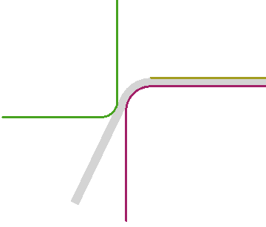
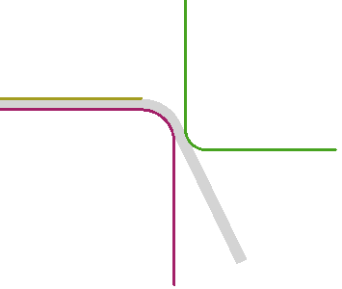
RESULTS: Manufacturing process of the testing part
The optimized local scaling approach has been validated on a structural body part. For comparison, the manufacturing process has also been simulated without any scaling and by using the global scaling approach.
A
Drawing
(D20)
Cutting
(T30)
Flanging
(F40)
F40 Tool
A
A A
Notes:
We have tested the optimized scaling approach on the simulated manufacturing process of a structural component.
To simulate the manufacturing process, the simulation software AutoForm was used.
The process consist of a drawing operation, a laser cutting and a flanging operation.
For comparison, the manufacturing process was also simulated without and with global scaling.

Slide 17









RESULTS: Convergence behaviour using the optimized approach
The behaviour of the average strain deviations during stress optimization shows that it is not possible to eliminate them completely. Therefore, a useful compromise must be made between the effort and the result quality.
$$σ$$
$$σ_{bSB_0}$$
5*
achieved scaling
no optimization
0
6*
4*
4
$$ε$$
$∆ε$*
$∆ε$*
$${∆ε}_{xy}$$
y
$${∆ε}_{yy}$$
x
$${∆ε}_{xx}$$
$${∆ε}_{xx}$$
$${∆ε}_{yy}$$
$${∆ε}_{xy}$$
$${∆ε}_{xx}$$
$${∆ε}_{yy}$$
$${∆ε}_{xy}$$
Notes:
As already mentioned, the desired scaling values cannot be achieved by adjusting the stresses once.
In the diagram you can see the averaged strain differences referring to the local element coordinate system over thirty iteration loops.
At the beginning the average strain differences decreases significantly.
But the decrease reduces from iteration to iteration.
This behaviour suggests that it is not possible to eliminate the strain differences completely.
Because of this, a useful compromise must be made between the effort for the iteration loops and the increase in the result quality.

Slide 18
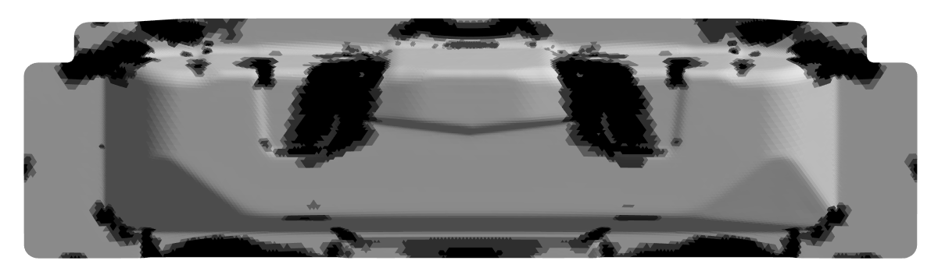
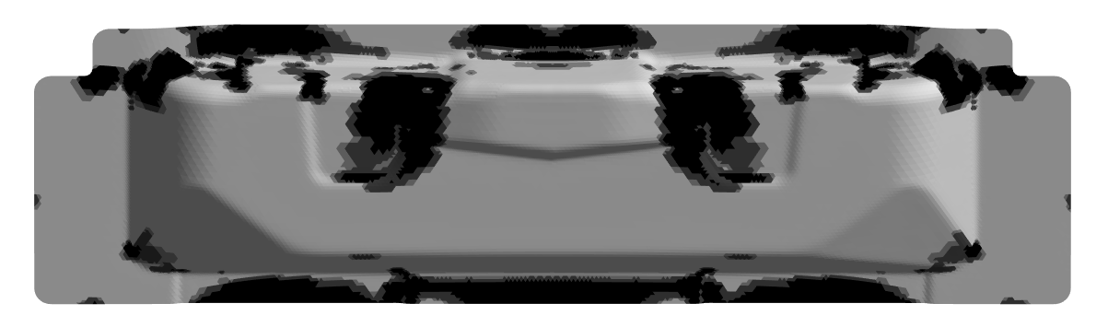
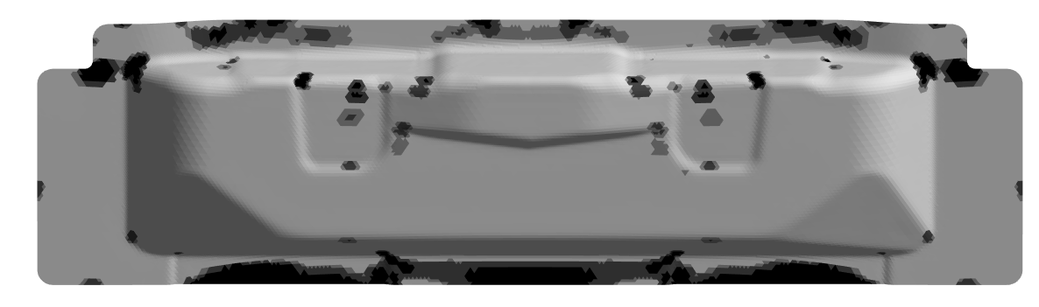
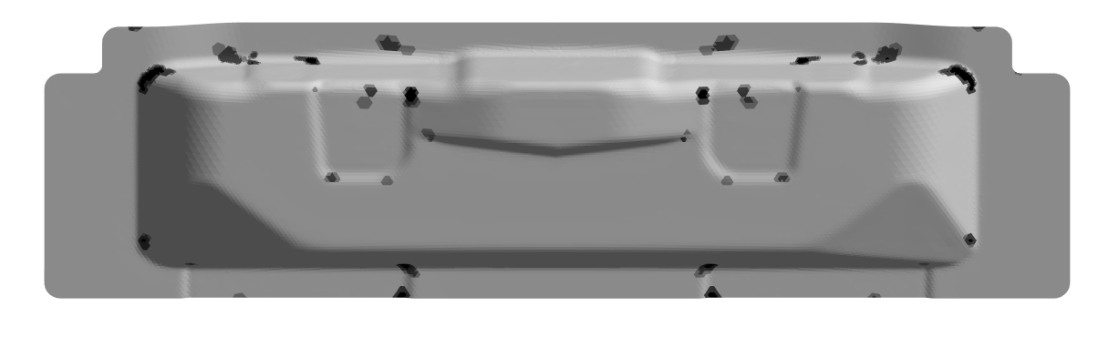
RESULTS: Plastic strain rate
The local scaling without stress optimization already leads to less unwanted plastic deformation in contrast to the setups without any and with global scaling. By the new approach the unwanted deformations can be further reduced.
No Scaling
Global Scaling
Local Scaling Opt 0
(without stress optimization)
Local Scaling Opt 30
11.6%
14.2%
4.3%
3.6%
1.0%
0.3%
3.0%
0.8%
8.1%
8.1%
4.0%
3.5%
76.3%
74.2%
89.1%
97.9%
Plastic Strain Rate
0
0.001
0.01
0.1
max
Notes:
At this slide you can see the plastic deformations of the part during closing the blankholders in the flanging operation.
The evaluation of the plastic deformations has been done by using the AutoForm evaluation variable plastic strain rate.
The setup local scaling without stress optimization already leads to less plastic deformation in contrast to the setups without and with global scaling.
After optimize the stresses in thirty iterations the plastic deformations can further be reduced.

Slide 19
RESULTS: Correlation between PSR and Dimensional Accuracy
Less unwanted plastic deformations during blankholder closing are expected to have a positive impact on the springback compensation results.
Global scaling
No scaling
Average dimensional deviation
Opt 0
Opt 5
Opt 10
Opt 20
Opt 30
state of art scaling
local scaling
optimized scaling approach
Notes:
Here you can see the correlation between the average plastic strain rate and the average dimensional deviation.
For this investigation, the part after drawing and laser cutting was compared to the part after the flanging operation.
In the flanging operation only the blankholder closing was simulated without forming the flanges.
Therefore, we get the isolated influence of the plastic deformations during blankholder closing on the dimensional deviation of the part.
As you can see, lower average plastic strain rate results in less dimensional deviation between the incoming and leaving part.
This reduced influence on the dimensional deviation should have a positive effect on the springback compensation.

Slide 20
COMPARISON OF THE RESULTS: Correlation between PSR and Blankholder force
A reduced average plastic strain rate usually results in a lower blankholder closing force. Other influencing factors of the blankholder force are the elastic part deformation and the local distribution of the plastic deformations.
No scaling
Opt 0
Global scaling
blankholder force
Opt 5
Opt 10
Opt 20
Opt 30
state of art scaling
local scaling
optimized scaling approach
Notes:
On this slide you can see the influence of the average plastic strain rate on the blankholder force in the flanging operation.
A reduced average plastic strain rate usually results in a lower blankholder force.
But as you can see this is not a continuous correlation.
Other influencing factors could be the elastic deformation or the local distribution of the deformations.

Slide 21
AGENDA
Introduction
State of the art scaling approaches and belonging issues
Optimized stress-based scaling approach
Results
Summary

Slide 22
Summary
An appropriate scaling is important to reduce unwanted plastic deformations
Global scaling approaches cannot perfectly compensate the locally varying part contraction
The former local scaling approach leads to better results, but also delivers a relevant deviation from the necessary scaling values
To optimize the local scaling, the stresses are adjusted depending on the strain deviations
With the optimized local scaling, the plastic deformations could be further reduced
Less plastic deformations result in a lower negative impact on the dimensional accuracy and a lower blankholder closing force

Slide 23

Thank you for your attention!
Philipp Zimmermann, M. Eng.
University of applied sciences Heilbronn
Scientific assistant at centre for forming technology and car body manufacturing
Mail: philipp.zimmermann@hs-heilbronn.de

Slide 24
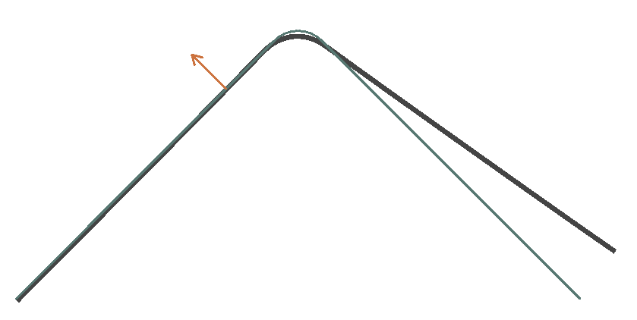
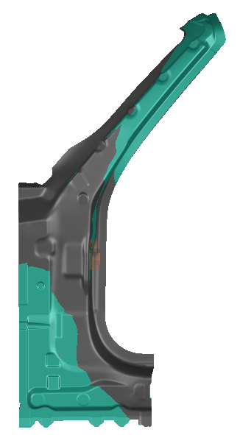
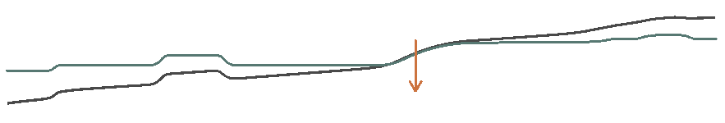
INTRODUCTION: GEOMETRICAL DEVIATIONS CAUSED BY SPRINGBACK EFFECTS
The dimensional deviations caused by the elastic springback can be divided in two categories. On the one hand bending ups, distortions etc. – on the other hand contraction of the part.
Bending-ups & Distortions
Contraction
A
A
A - A
A - A
A
A
compensate
compensate
Modify tool geometry in the opposite direction of the deviation → Springback compensation
Increase tool dimensions
→ Scaling
Notes:
Springback is the change of geometry which occurs in stamped parts during the opening of the tools, due to the release of elastic energy.
The consequences are dimensional deviations between the present part and the target part.
The springback itself can be split up into two different categories.
On the one hand there are bending-ups & distortions of the part which can be characterized and quantified by the normal distance between the part and the target geometry.
To compensate this type of deviations the forming tools can be modified in the opposite direction of the springback.
On the other hand, the part contracts, which means that the surface area changes during springback.
This effect occurs especially after the drawing operation and because the responsible stresses are mainly tensile stresses, the part shrinks.
To compensate this kind of deviations, the tool surfaces area are increased.
This doing is the so-called scaling of the tools.
Root causes: Membrane Stresses – Bending Stresses
Geometrical effect: Shrinkage -

Slide 25
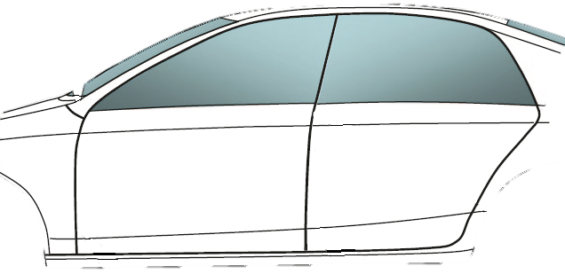
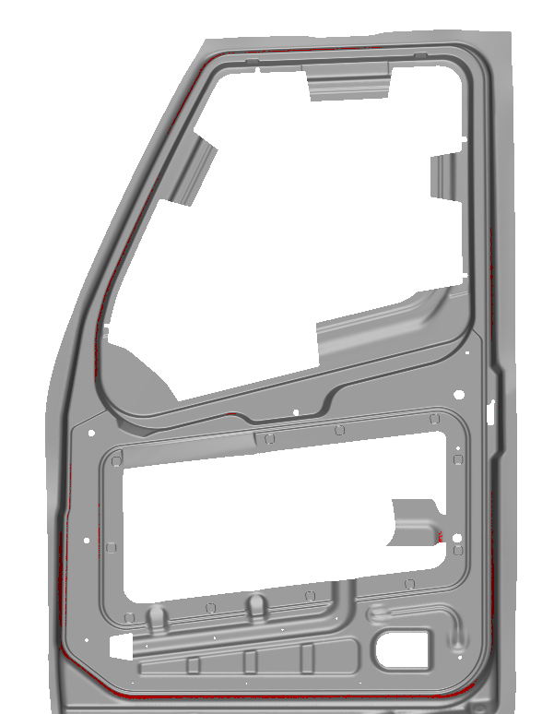
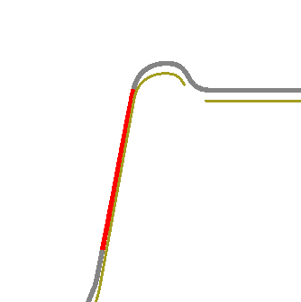
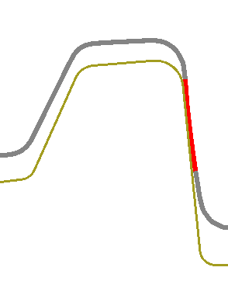
INTRODUCTION: PROBLEMS CAUSED BY AN INADEQUATE SCALING
An inadequate scaling can cause unwanted plastic deformations in subsequent forming operations and quality problems in the assembly process.
Problems in subsequent forming operations
Problems in the assembly process
A
incoming part
A - A
subsequent forming tool
A
plastic deformation of the part (radii) caused by bad fit between the incoming part and the receiving forming tool
→ this plastic deformations can only be represented insufficiently with finite shell elements
→ real springback differs from simulated springback
→ virtual springback compensation effect not as desired
Different distances between styling edges
Absolute part dimensions (length doors vs. sidewall)
Notes:
If the scaling of the tools does not compensate the part contraction sufficiently, there are two main problems.
At first, an inadequate scaling results in a bad fit between the incoming part and the receiving forming tool.
This can result in plastic deformations of the part during the closing of the blankholders.
With mostly used finite shell elements in the forming simulation, this plastic deformations cannot be represented sufficiently.
As a consequence of that, the simulated springback differs from the real springback.
Finally, the virtual springback compensation effect is not as desired.
Another problem is the absolute part dimension.
For example, styling boarders between different parts does not fit to each other or the lengths of the doors does not fit to the sidewall.

Slide 26
STATE OF THE ART SCALING APPROACHES: Deficit of local scaling approach
The scaled tool geometry should have the inverse lengths of the unscaled part after springback. But by simply inverting the membrane stresses this can not be reached due to a non-linear springback behaviour.
16
15
14
10
locally scaled tool
22
2
9
21
desired scaled tool
20
8
7
26
25
24
23
simulated part after springback (locally scaled tool)
6
1
19
5
18
4
17
3
13
12
11
Notes:
On this slide you can see the deficit of the stress-based local scaling approach.
The red dots shows the local contraction values during springback after forming with unscaled tools.
The desired local scaling values have the same amount with inverse signs and are represented by the green circles.
By simply inverting the membrane stresses as mentioned before, the locally scaled lengths (blue crosses) differs from the desired ones.
This difference can also be seen in the part after springback which was formed with these locally scaled tools.
From these results, it can be concluded that an adjustment of the membrane stresses is needed to bring the scaling values closer to the desired values.

