Slide 1
Forming of a cylindrical cup in 7075-T6 under warm temperature conditions
Sylvain Royne*, Hervé Laurent, André Maillard
* Speaker

Slide 2
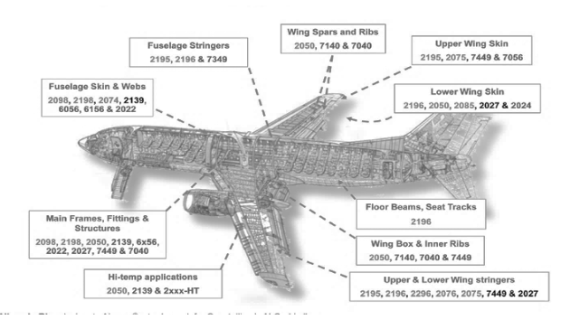
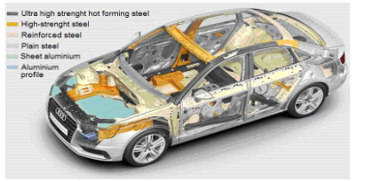
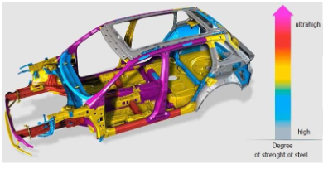
Context
Cost production
Weight
Security
Warm forming of Aluminium alloy 7075-T6
[R. Jini Raj et al.]
Possibilities of application of ultra-high-strength
alloys of new generation for parts of the car
[Hovorun et al. 2017]

Slide 3
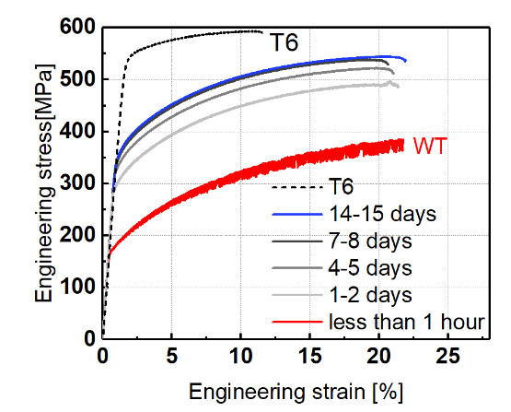
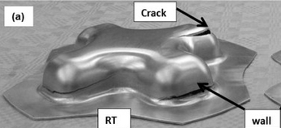
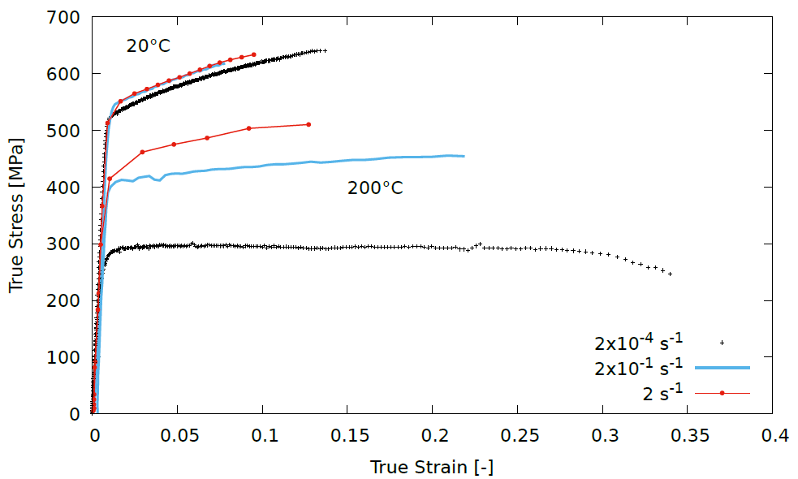
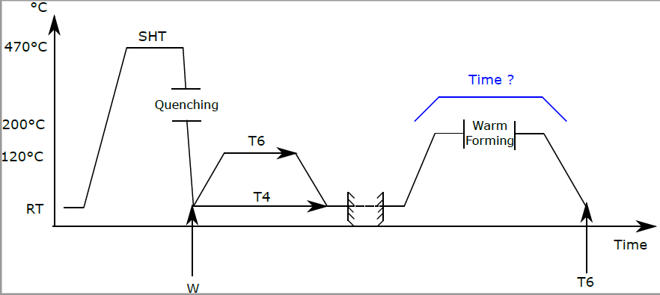
Warm-forming of AA7075-T6
Best mechanical characteristics in T6 condition but low formability at
room temperature
[Kumar et al. 2014]
[Choi et al. 2019]
Warm forming of AA7075-T6
250°C
150°C
Tensile tests performed at 20°C and 200°C for different strain rates
Heat treatment step
Warm forming step
Notes:
Interet warm forming comparer au hot forming

Slide 4
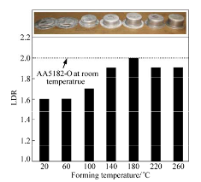
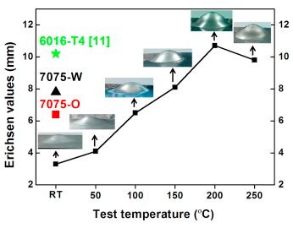
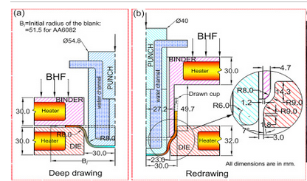
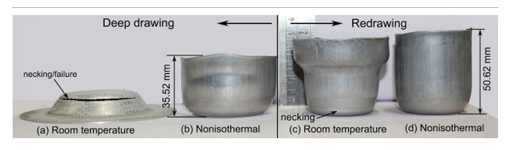
Review of warm forming process
Warm forming of 7075-T6
Increase in formability with the temperature
Temperature limit at which formability decreases (220°C)
Best temperature of warm forming is around 200°C
One-step production processes
Warm forming of 6082-O in two-steps
No-isothermal condition
[Wang et al. 2016]
[Huo et al. 2016]
Heating methods are not compatible with industry (between 5 and 10min heating time)
Study an industrial warm forming process in two-steps with AA7075-T6
[Panicker et al. 2016]
Notes:
Preciser pourquoi en 2 steps

Slide 5
Contents
Experimental warm forming of a cylindrical cup in two steps
  Industrial warm forming device
  Experimental results
Numerical simulations of the forming
Results
Conclusion

Slide 6
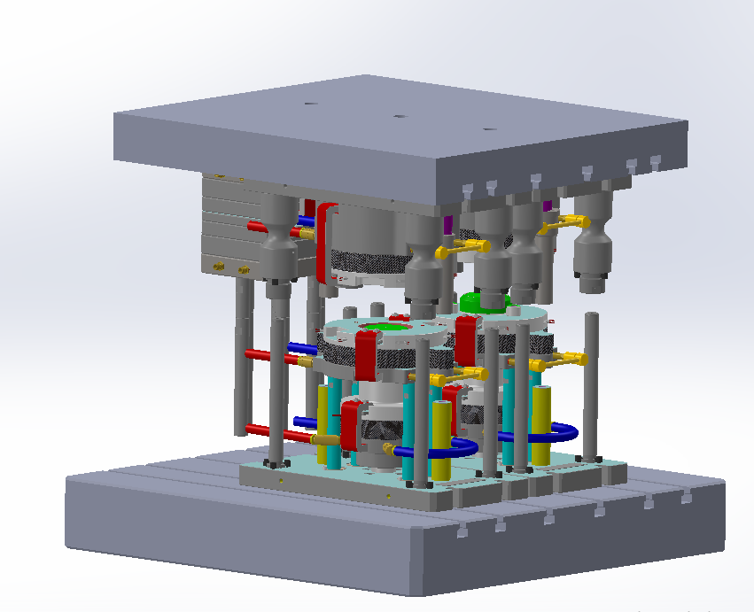
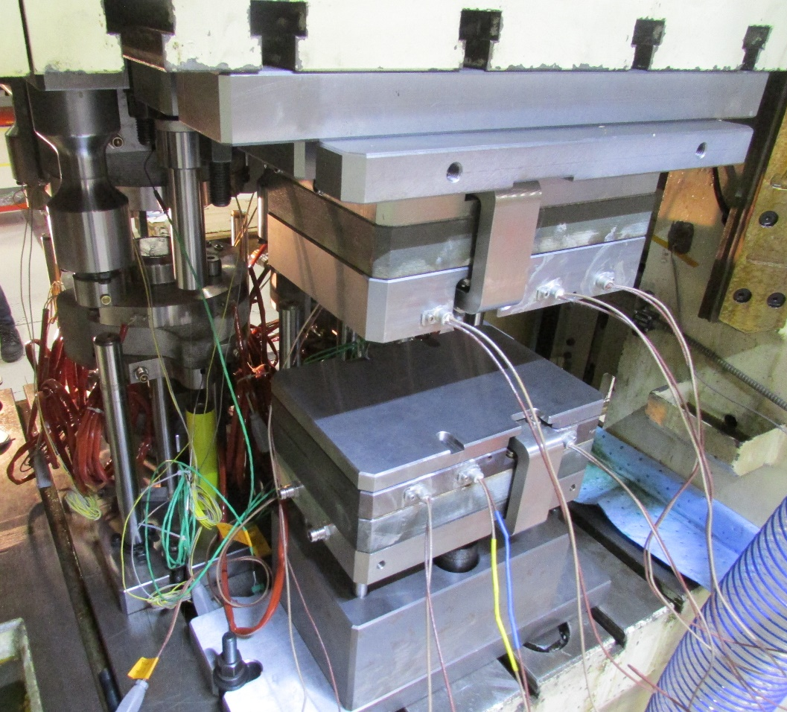
Industrial warm forming device : Blank heating tool
Back of the press
Moving part of heating tool
Blank
heating tool
Tool step 2
Ø157mm
Blank h0 = 0.8mm
Tool step 1
Front of the press
Fixed part of heating tool
Heating rate : 400°C/s
Time to reach 200°C : 0.5s max

Slide 7
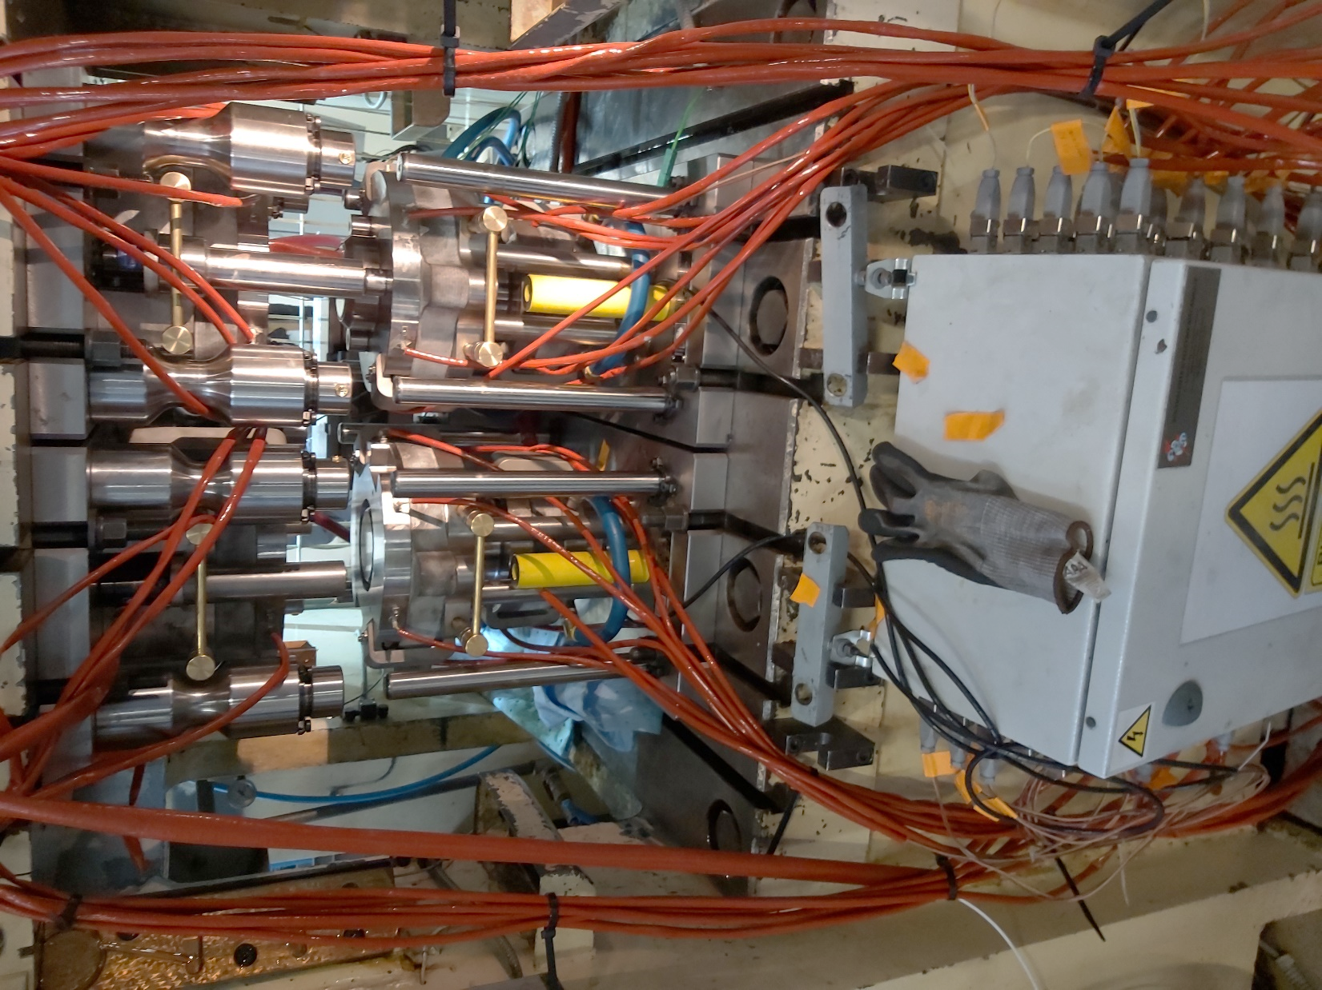
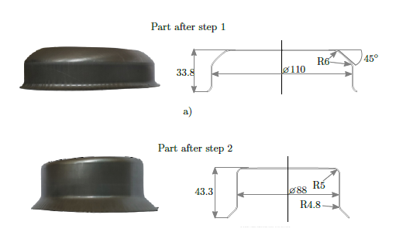
Industrial warm forming device : Tool step 1 and 2
Back of the press
Die
Manual transfer
Punch
Stamped guide
Blank holder
Front of the press
Force sensor
Tool step 1
Tool step 2
Pyrometer on the die to control the temperature of the blank during step 1 and 2
Thermocouple in all tools to control temperature
Clearance impose between the die and stamped guide

Slide 8
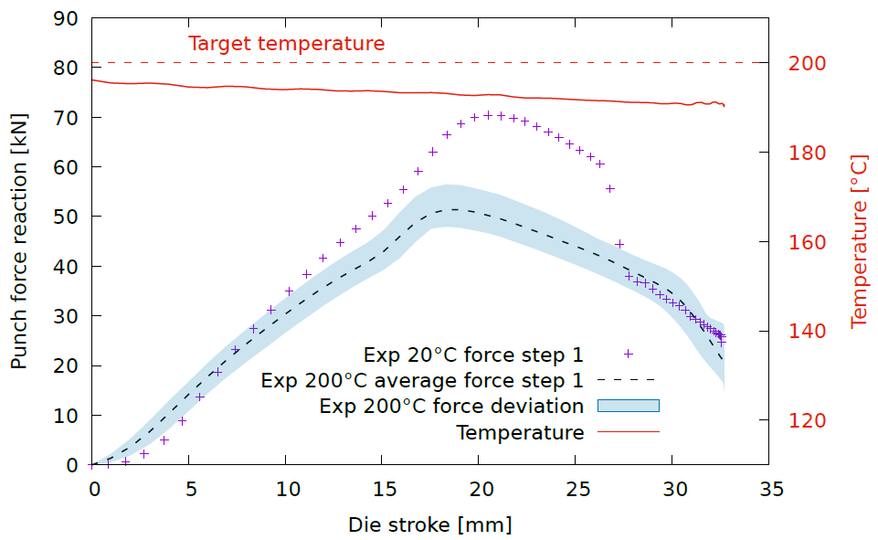
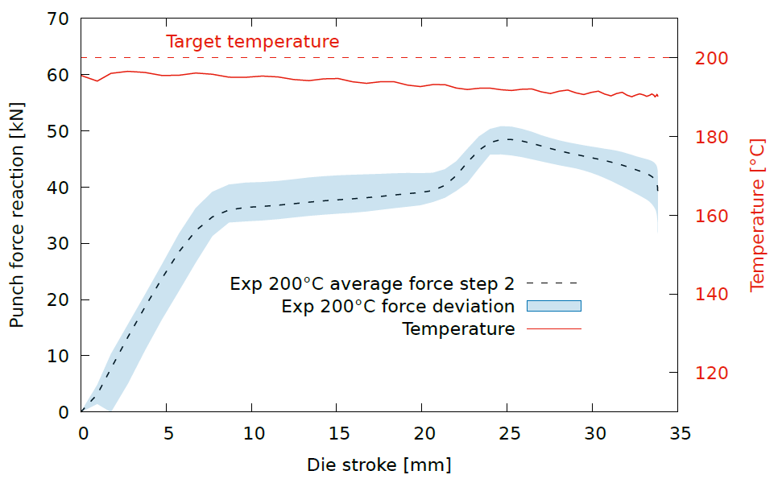
Experimental conditions and results of punch reaction
Experimental step 1
Temperature of 20°C and 200°C
Clamping force of 41kN during step 1
Experimental step 2
Temperature of 200°C
No clamping force during step 2
Crack at 20°C
Decrease in force reaction at 200°C
Temperature of the blank : -5°C from target temperature
Force deviation between +7kN and -2kN from the mean
Temperature of the blank : -6°C from target temperature
Force deviation between +5kN and -2kN from the mean

Slide 9
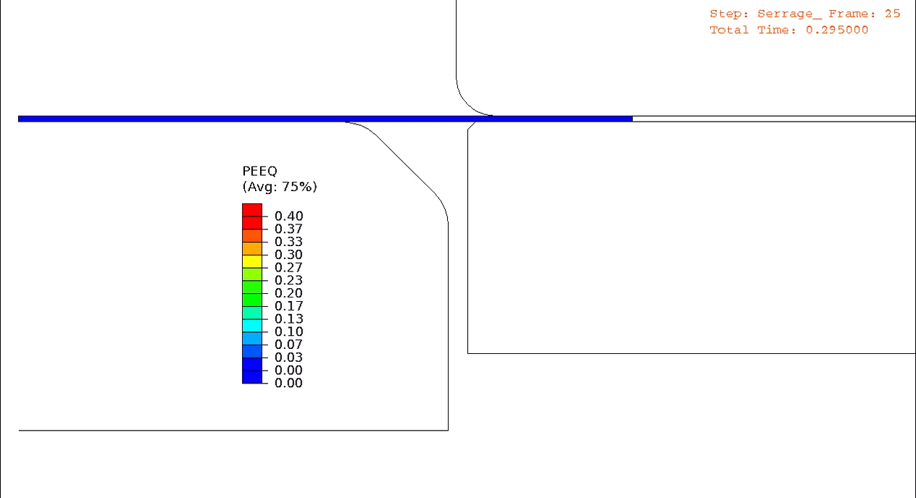
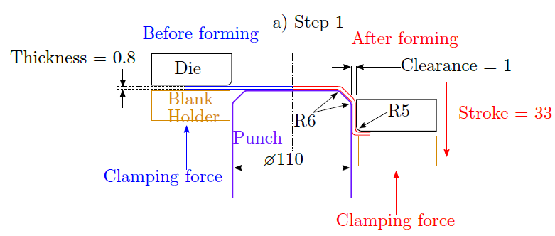
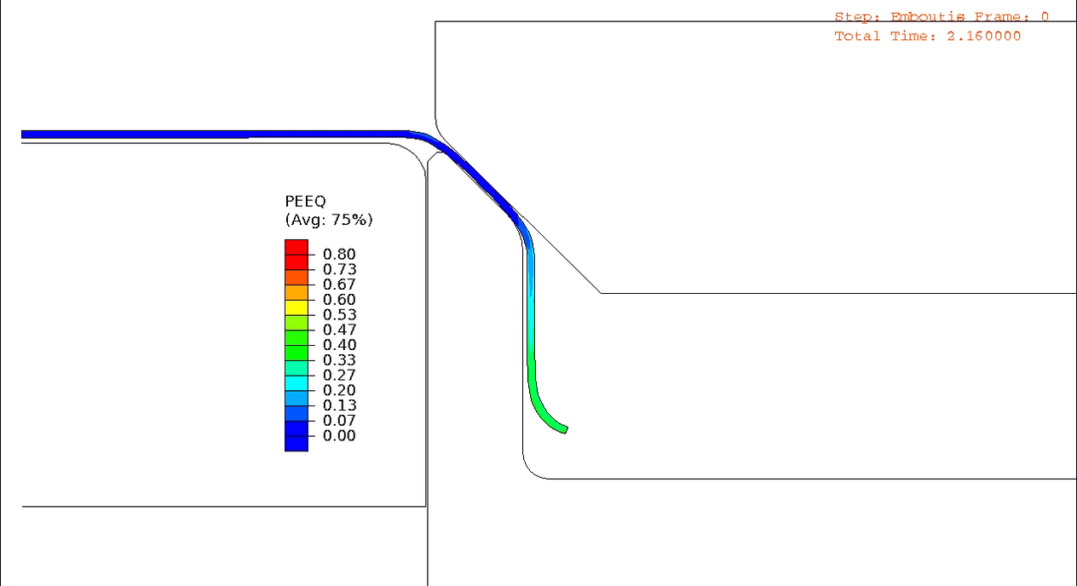
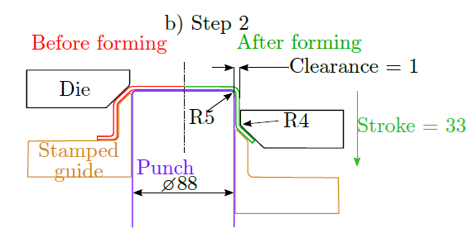
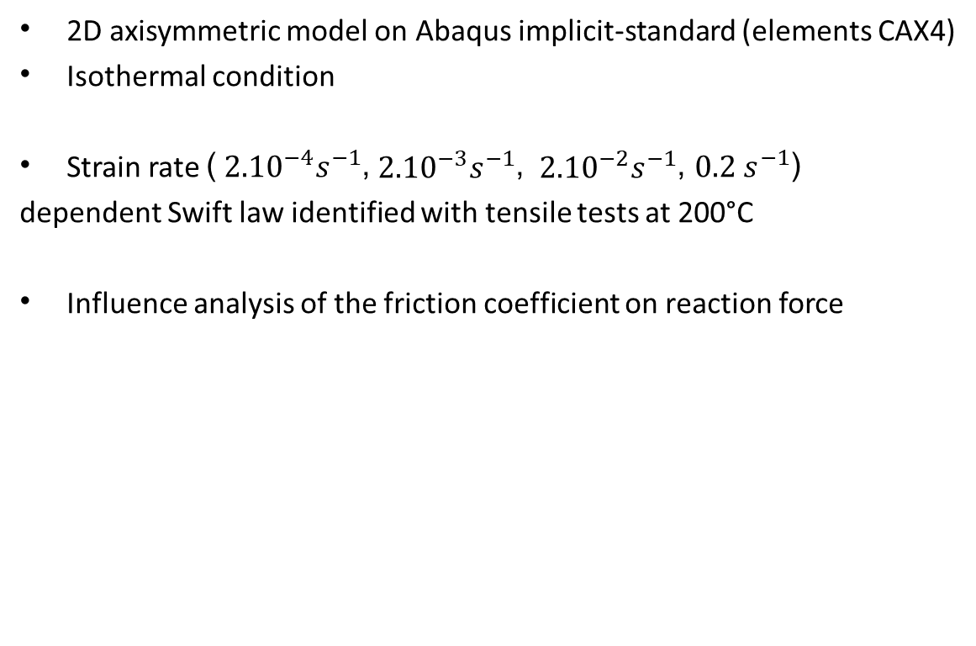
Numerical conditions of the warm forming process
Step 1
Die
2D axisymmetric model on Abaqus implicit-standard (elements CAX4)
Isothermal condition
Strain rate (${ 2.10}^{−4}s^{−1}$,${ 2.10}^{−3}s^{−1}$, ${ 2.10}^{−2}s^{−1}$, $0.2 s^{−1}$)
dependent Swift law identified with tensile tests at 200°C
Influence analysis of the friction coefficient on reaction force
Blank holder
Punch
Step 2
1mm
Die
Punch
Fixed clearance
Stamped guide

Slide 10
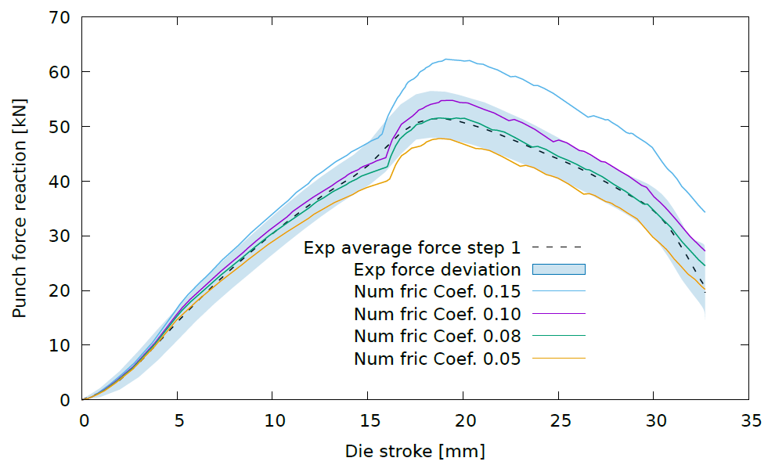
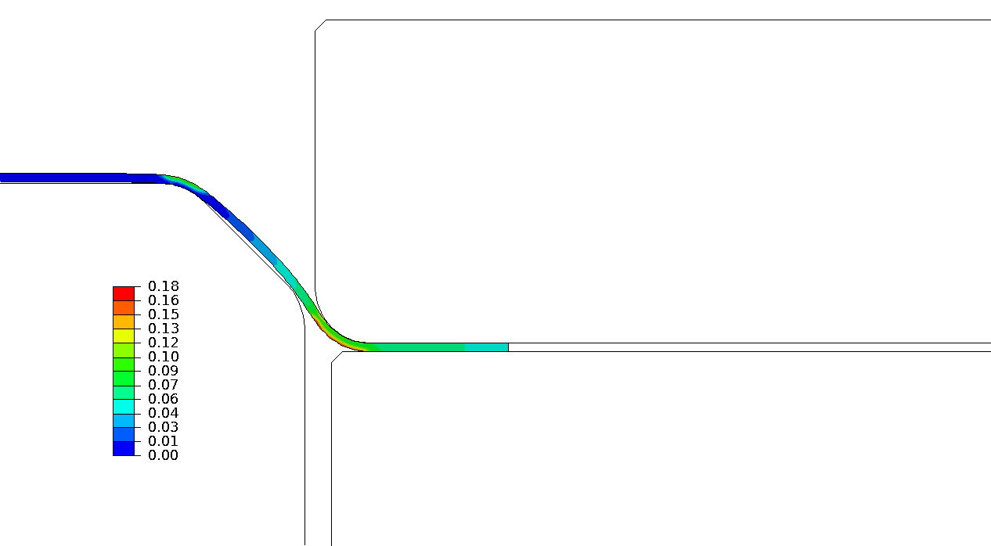

Forming step 1 results
Friction coefficient of 0.08 seems to be the closest to experimental results
Friction coefficient of 0.10 can also be correct due to the deviation
Change in force direction observed numerically around 16mm of die stroke
Contact of the blank on the second punch radius
$$\overline{ε_{p}}$$
Die
1st punch radius
2nd punch radius
Blank holder
Notes:
Mettre photo godet passe 1

Slide 11
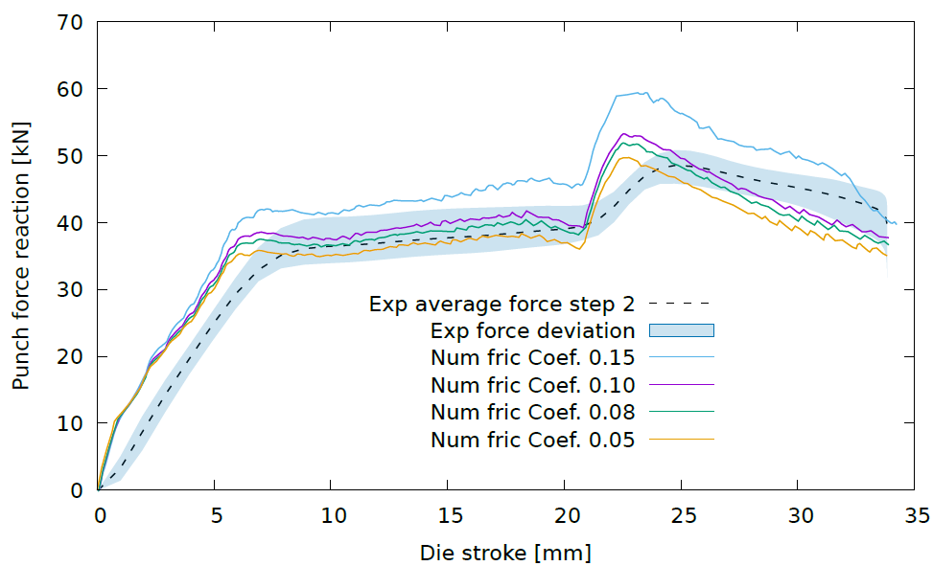
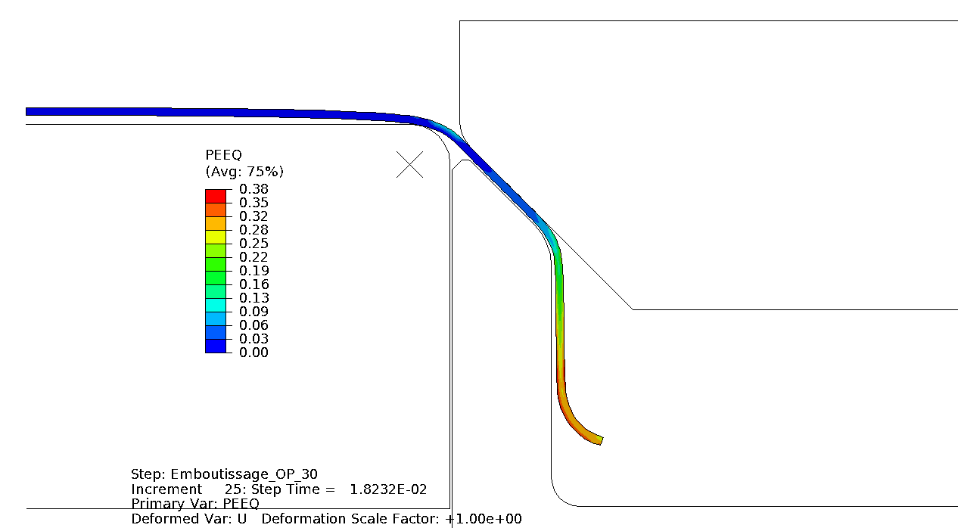
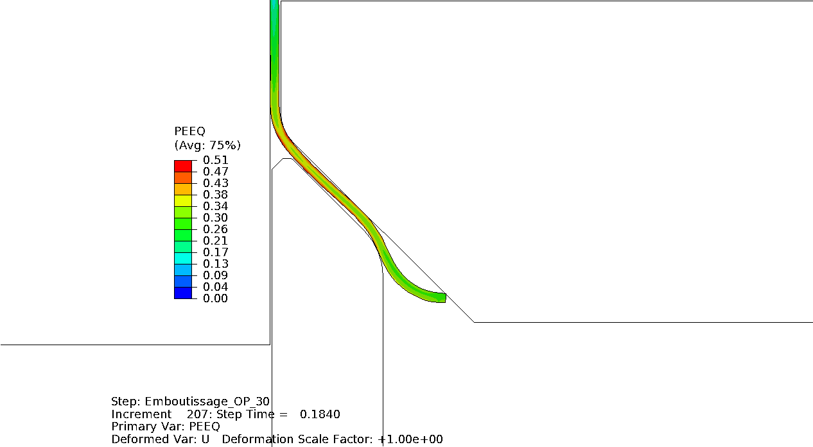
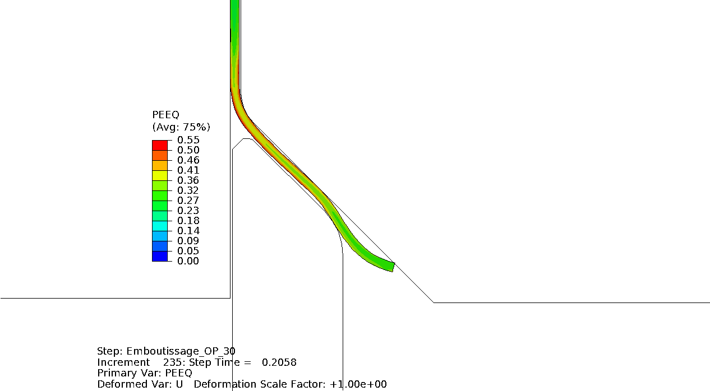



Forming step 2 results
Friction coefficients of 0.08 and 0.10 are in the force deviation
The start and end of the numerical reaction force is less consistent with the experimental results
Third change in the curve : Blank radius is almost completely reduced to a straight line
First change in the curve : Die radius below the punch radius
Second change in the curve : Blank radius comes into contact with the die.
Die
$$\overline{ε_{p}}$$
$$\overline{ε_{p}}$$
$$\overline{ε_{p}}$$
Die
Die
Punch
Punch
Punch
Stamped guide
Stamped guide
Stamped guide
Notes:
Mettre photo godet passe 2

Slide 12
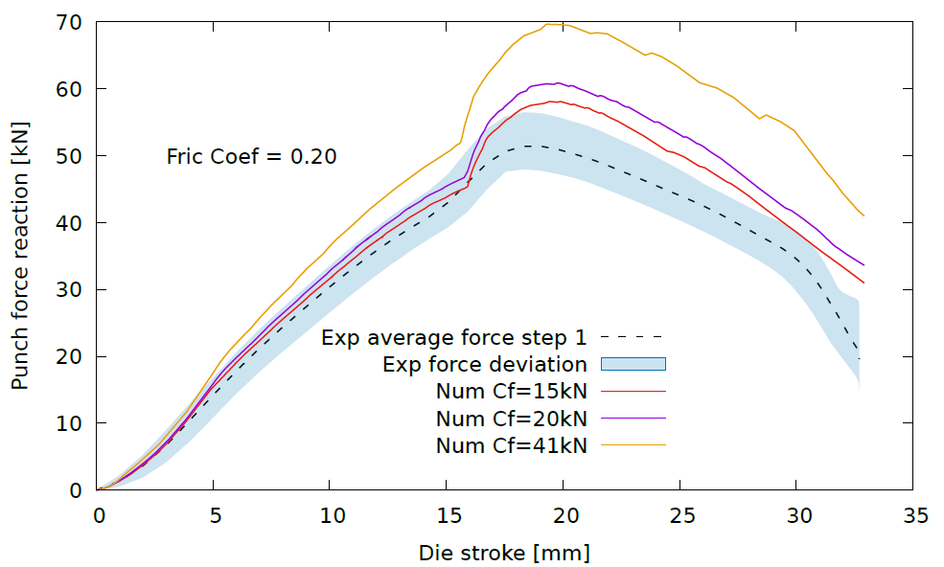
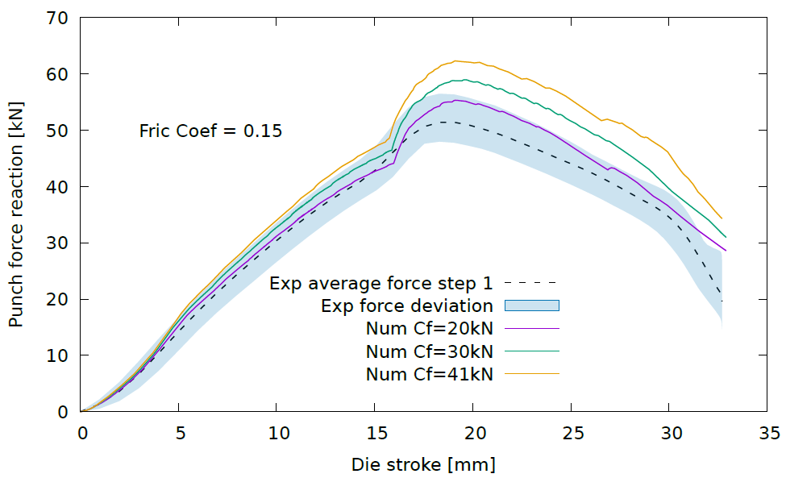
Analyze
Friction coefficients of 0.10 or 0.08 is not good for the simulation
The coefficients found are low compared with those used in warm forming (0.15 – 0.20 or more)
Numerical simulations with a coefficient of 0.15 and 0.20 with variation of clamping force
  Hypothesis : interference between tool 1 and tool 2 due to the clearance imposed on tool 2 and all the clamping force is not applied
Clamping force of 20kN is the best fit with experimental result with a friction coefficient of 0.15
Clamping force of 15kN or less is the best fit with experimental result with a friction coefficient of 0.20
Variation of the friction coefficient depend of the pressure, velocity,…
Swift law is not representative of the behavior

Slide 13
Summary
2 steps cylindrical cup forming possible at 200°C but crack at 20°C
Difficult to estimate the friction coefficient due to the force deviation
Change of reaction force direction more pronounced numerically
Outlook
  Measure experimental cylindrical cup thickness and strain to verify numerical simulations
Implement a friction model
Implement a new behavior law ( Voce, Mixed,…)

Slide 14
Thank you for your attention
sylvain.royne@univ-ubs.fr herve.laurent@univ-ubs.fr andre.Maillard@cetim.fr

Slide 15
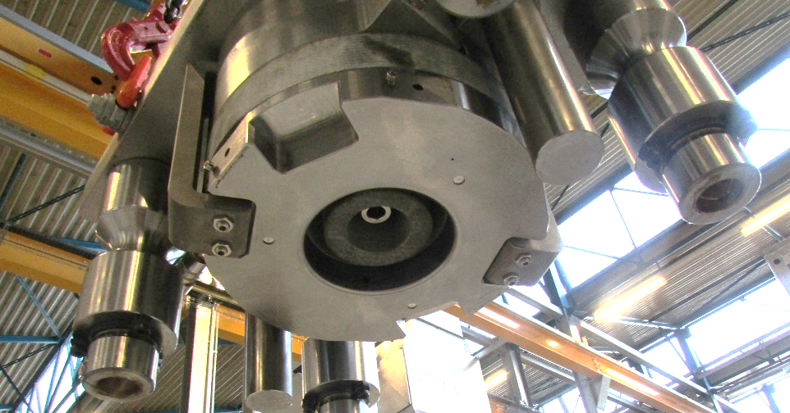
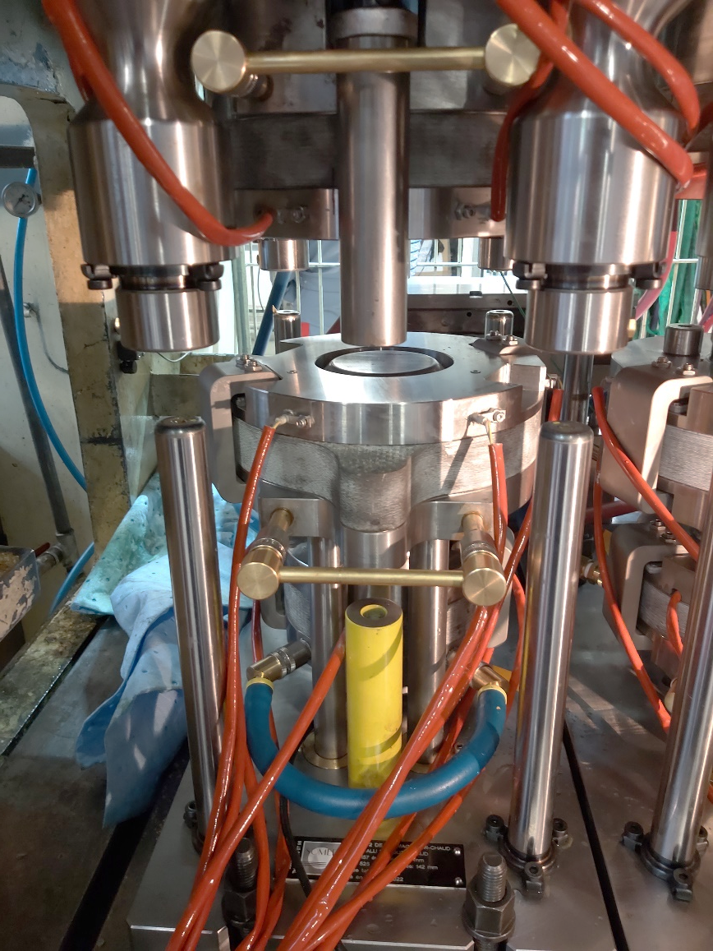
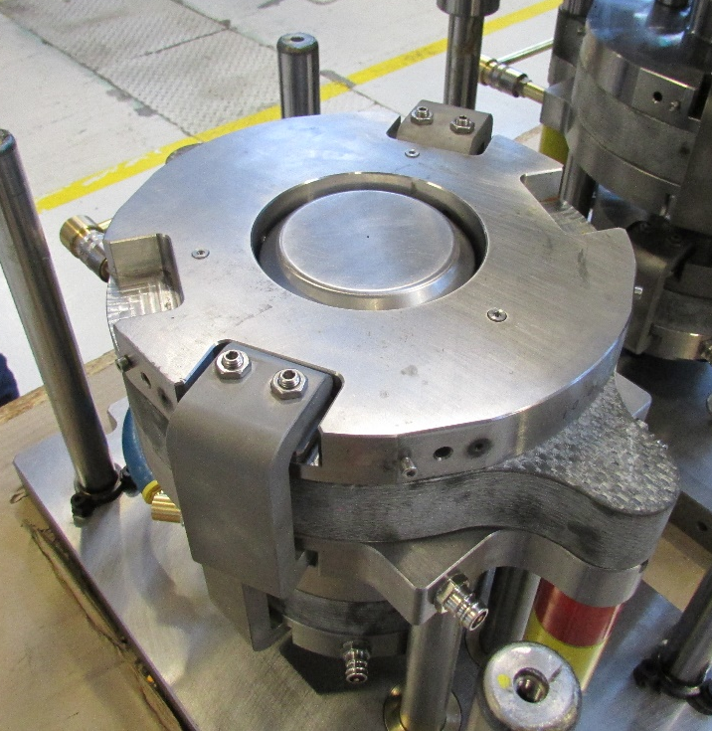
Industrial warm forming device : Tool step 1
Die
Cartridge-heated tools
Thermocouple in every tool for control
Pyrometer to control blank temperature during forming
Pyrometer
Punch
Blank-holder
Force sensor

Slide 16
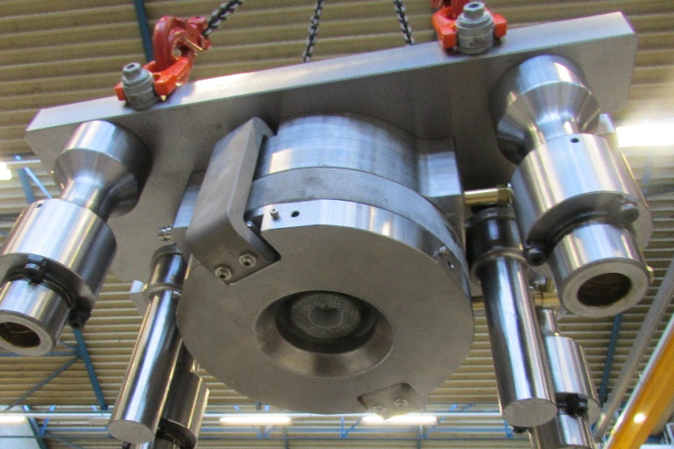
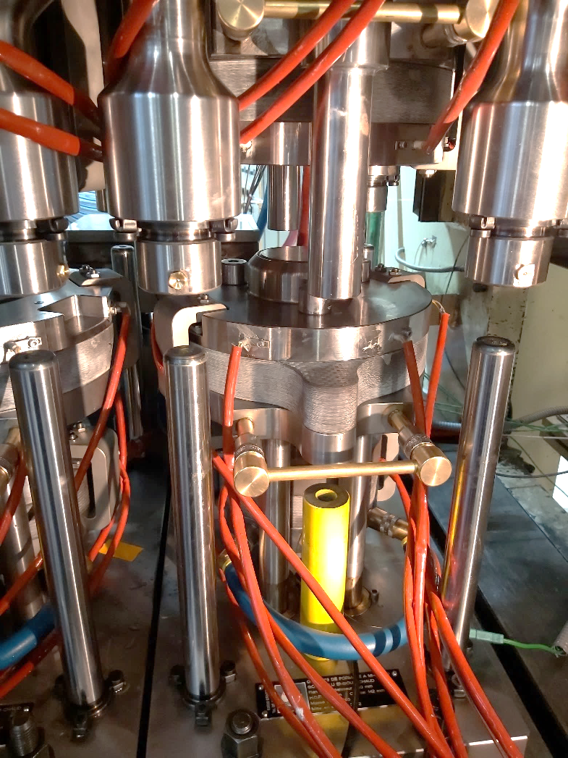
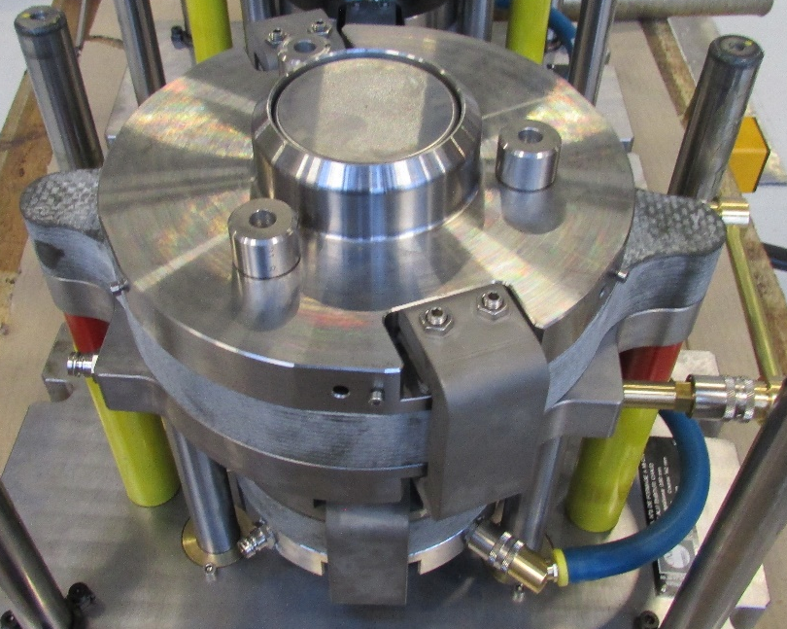
Industrial warm forming device : Tool step 2
Cartridge-heated tools
Themocouple in every tool for control
Pyrometer to control blank temperature during forming
No blank holder force applied during step 2
Die
Pyrometer
Poinçon
Stamped guide
Force sensor

Slide 17
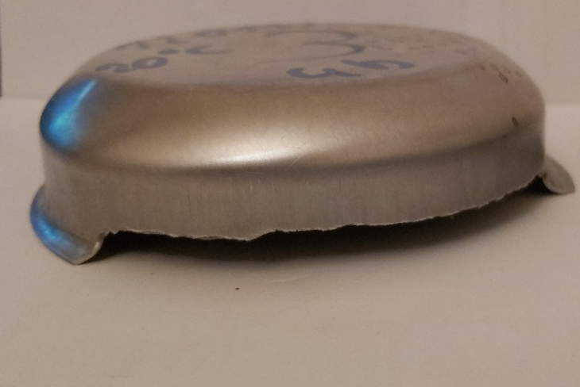
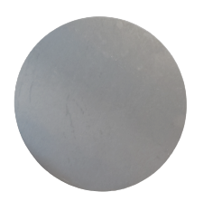
Industrial warm forming device : Stamping range
157 diameter circular blank

Slide 18
250°C
150°C
T6 heat treatment
Warm forming step

