Slide 1
Influence of process and material parameters on the twist springback prediction of a panel
Marta C. Oliveira*, Cátia Gomes, Diogo M. Neto, José L. Alves and Luís F. Menezes
* Presenter

Slide 2
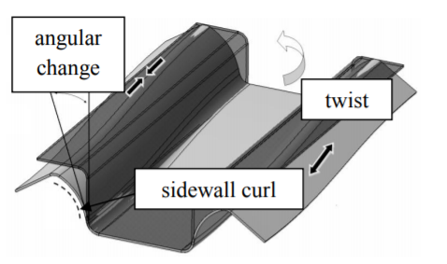
Introduction
There are several forms of springback commonly categorized into:
angular distortion;
side wall curl and
twisting.
Angular distortion: results from the difference in stresses in the sheet thickness direction.
Side wall curl: caused by the stress gradient in the thought-thickness direction, due to bending and unbending under tension.
Twisting: caused by torsional moments of two cross sections of the part.
Angular distortion
Twisting
Side wall curl
Different forms of springback
[M. Dezelak, A. Stepisnik, I. Pahole, and M. Ficko, “Evaluation of twist springback prediction after an AHSS forming process,” Int. J. Simul. Model., vol. 13, no. 2, 2014]

Slide 3
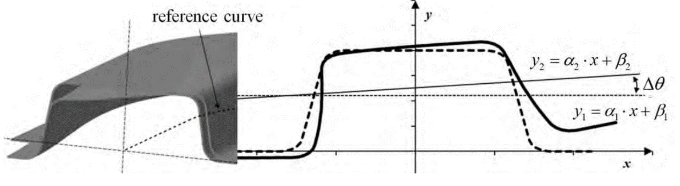


Introduction
The quantification of the twist springback can be ambiguous. One approach is to determine the line that best fits the transversal section using the least squares method, before:
and after springback:
The angular distortion is defined as:
The twist springback requires the comparison between
different sections of the profile.
Quantification of the twist springback using the least squares method
[M. Dezelak, A. Stepisnik, I. Pahole, and M. Ficko, “Evaluation of twist springback prediction after an AHSS forming process,” Int. J. Simul. Model., vol. 13, no. 2, 2014]

Slide 4
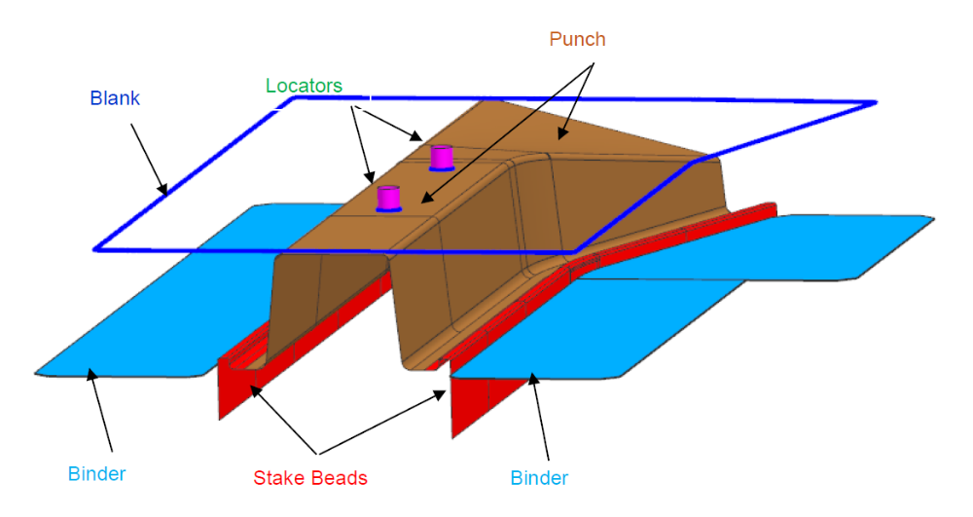
Introduction
Numisheet 2022 Benchmark #1: Springback Prediction of Twist Die Panel
The benchmark committee selected:
a tool used by the Auto/Steel Partnership for several years;
a steel and an aluminium alloy;
two processing conditions:
  a blank-holder force to constrain the material flow into the die;
  a draw-bead like feature, known as stake bead. This feature is machined on an expansion of the punch, acting like a miniature one. Therefore, it contacts the metal sheet only in the last increments of the punch stroke.
Tools assembly highlighting the stake bead
[Qin Z G, Stoughton T, Anderson D, Zhou D J, McCarty E, Smith E and Park P 2020 NUMISHEET BENCHMARK 1 ─ Springback Prediction of Twist Die Panel, accessed 4 May 2023]

Slide 5
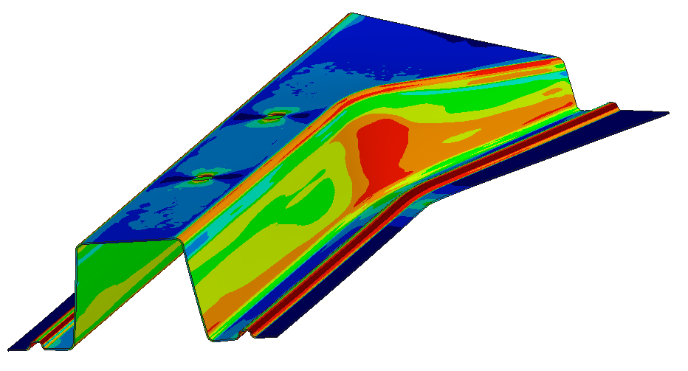
Finite Element Model
All numerical simulations were performed with the in-house finite element code DD3IMP.
The mechanical model adopted considers:
elastic properties described by the Hooke’s law
plastic properties combine an associated flow rule with a hardening law and an orthotropic yield criterion.
The two materials selected for the benchmark are:
DP980 steel, with an initial thickness of 1.4 mm;
6xxx series aluminium alloy, with an initial thickness of 1.5 mm.
The benchmark committee provided the experimental raw data:
uniaxial tension-compression tests along the rolling direction (RD);
hydraulic bulge test with a circular die;
uniaxial tension tests in 15º increments to the RD, from 0º to 90º.
Example of a drawn part using the stake bead

Slide 6
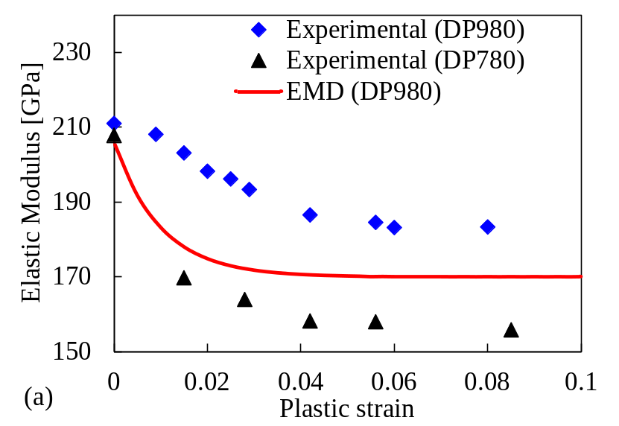

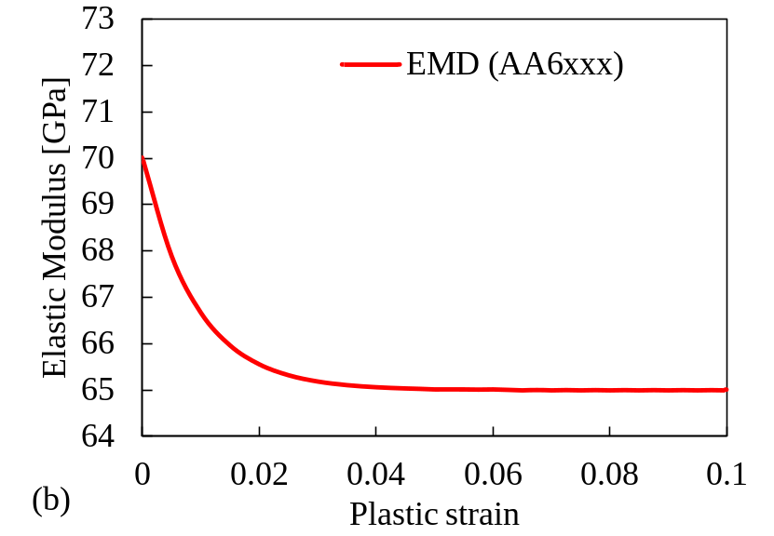
Finite Element Model: Constitutive model
The benchmark committee also provided the parameters for the model proposed by Yoshida, which suggests that the elastic modulus degradation with the plastic strain, follows an asymptotic behaviour, given by:
Comparison between the elastic modulus degradation predicted by the numerical model (EMD) and the one reported in other studies for: (a) DP980 steel and (b) 6xxx aluminium alloy

Slide 7
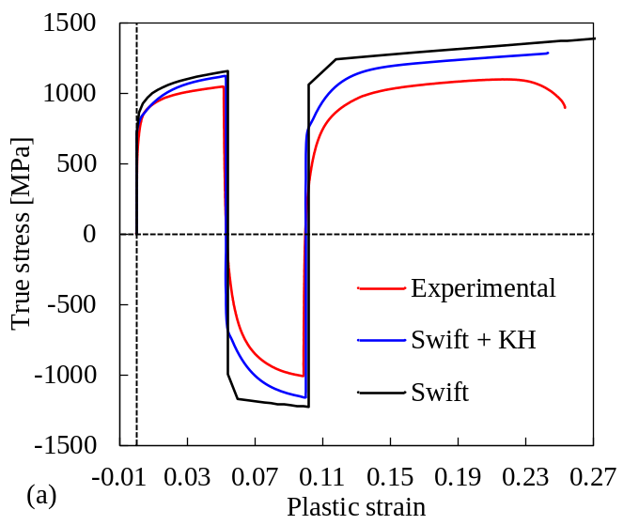
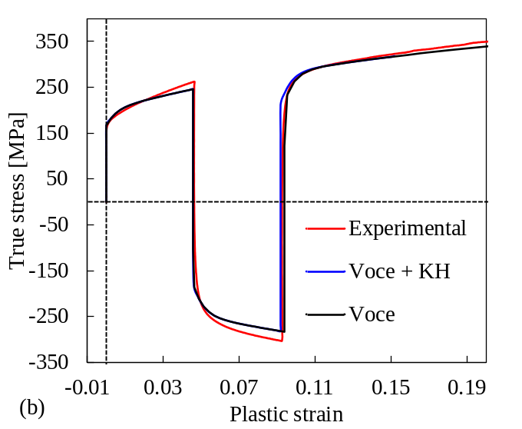
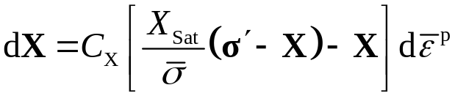


Finite Element Model: Constitutive model
The stress-strain curves highlight that the steel presents a much higher flow stress and lower ductility; the former only for the uniaxial tensile tests.
Both materials show a negligeable variation of the in-plane distribution of the flow stress.
The analysis shows that the steel presents a higher Bauschinger effect. The Armstrong and Frederick kinematic law, given by:
was combined with the Swift hardening law, for steel:
and the Voce law, for the aluminium alloy:
Comparison between the experimental and numerical results of the tension-compression test for: (a) DP980 steel and (b) 6xxx aluminium alloy

Slide 8
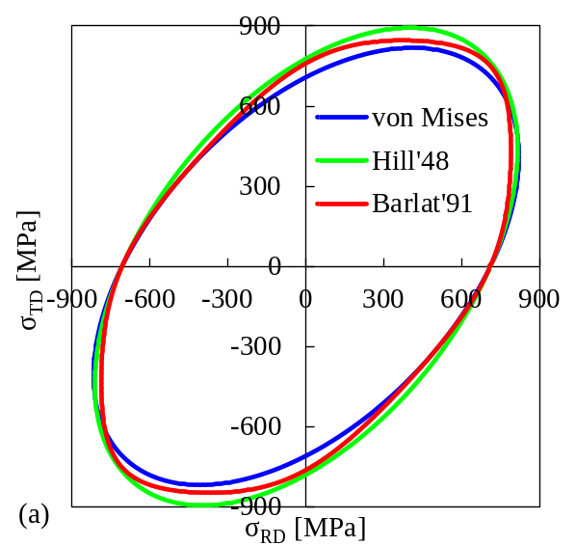
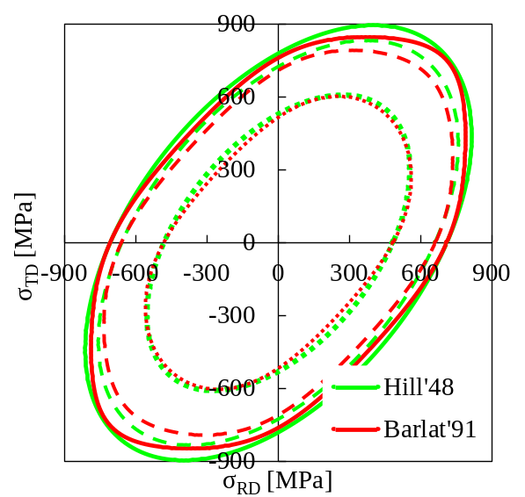
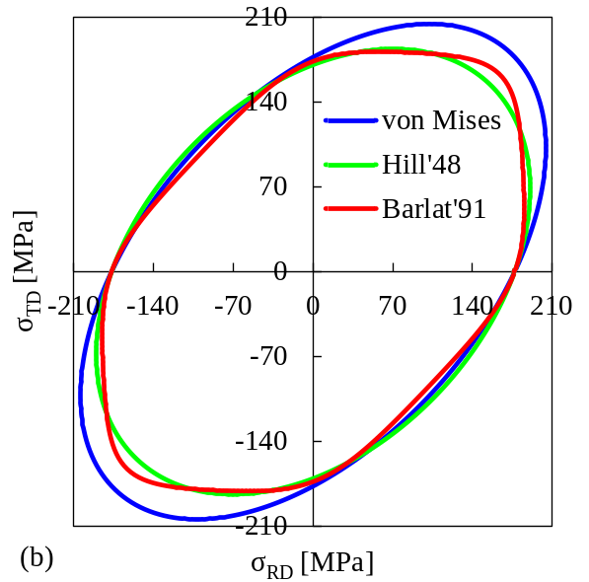
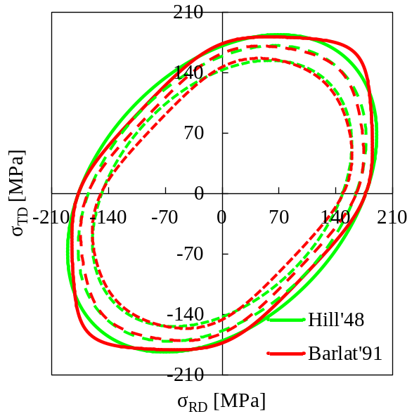
Finite Element Model: Constitutive model
Regarding the plastic strain ratios, both materials present an orthotropic behaviour. For steel, the r-value varies between 0.8 and 1.6, between 0º and 60º to RD. On the hand, the r-value of the aluminium alloy varies only between 0.6 and 0.8.
Three yield criteria were adopted:
von Mises;
Hill’48 and
Barlat´91.
The parameters adopted for the orthotropic yield criteria are the ones supplied by the benchmark committee.
Comparison between the yield surfaces predicted by the three yield criteria adopted for: (a) DP980 steel and (b) 6xxx aluminium alloy

Slide 9
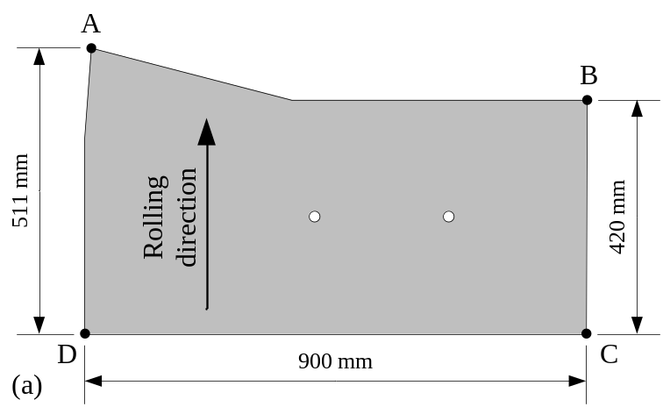
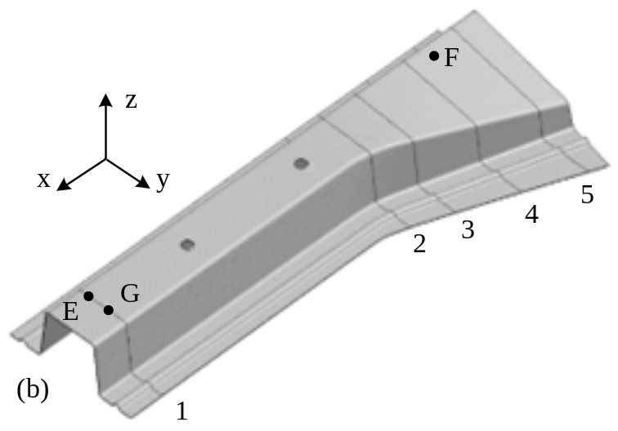
Finite Element Model: Spatial and time discretization
The tools are assumed as rigid and modelled with Nagata patches.
The blank geometry includes holes to maintain its position relatively to the punch.
The blank was discretized with solid 8-node finite elements, combined with a selective reduced integration technique.
To facilitate the modelling, the kinematic conditions of the tooling are different from the experimental ones. The die and the blank-holder are assumed as fixed while the punch moves with the same relative displacement has in the experimental setup.
The springback is performed in a single increment, by simply removing the influence of all tools simultaneously.
(a) Blank geometry and (b) Points with boundary conditions and reference sections for springback analysis

Slide 10
Finite Element Model
Description of the parameter changed in each simulation in relation to the reference one.
DP980 |  | AA6xxx
Description | Label | Description | Label
Reference | Hill’48_E206_μ=0.15 | Reference | Hill’48_E70_μ=0.15
Barlat’91 | Barlat’91 | Barlat’91 | Barlat’91
Isotropic plastic behavior | von Mises | Isotropic plastic behavior | von Mises
Constant friction of 0.01 | μ=0.01 | Constant friction of 0.01 | μ=0.01
Constant of 170 GPa | E170 | Constant of 65 GPa | E65
EMD | EMD | EMD | EMD
Hardening law | Swift + KH | Hardening law | Swift + KH
Tool without draw-bead | wo/bead | Tool without draw-bead | wo/bead

Slide 11
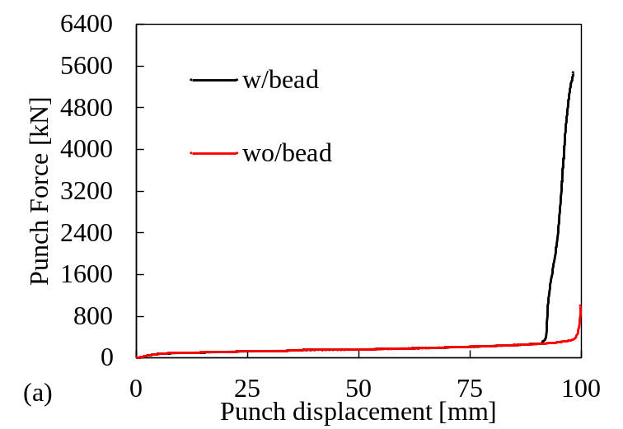
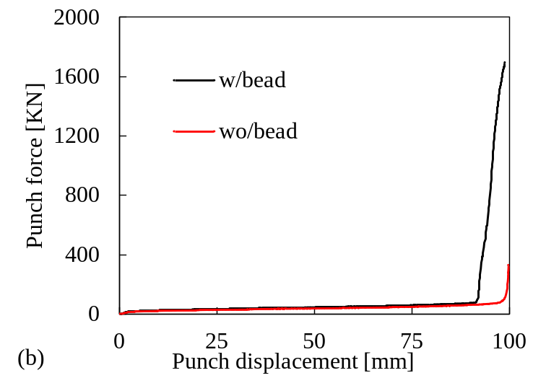
Results and discussion
Punch force:
For both materials, the presence of the draw-bead leads to a strong increase of the force in the last 10 mm of punch displacement. The increase is approximately of 11 times for steel and of 18 times for the aluminium alloy.
Although not shown here, the effect of the:
yield criteria and the elastic modulus is negligeable during the drawing stage, for both materials.
reduction of the friction coefficient leads to a decrease of the stretching force of approximately 25% and 22%, for the steel and the aluminium alloy, respectively.
combined hardening law also leads to a decrease of the maximum value of force, in this case of 6% and 4%, for the steel and the aluminium alloy, respectively.
Comparison of the punch force evolution with or without draw-bead for: (a) DP980 steel and (b) 6xxx aluminium alloy

Slide 12
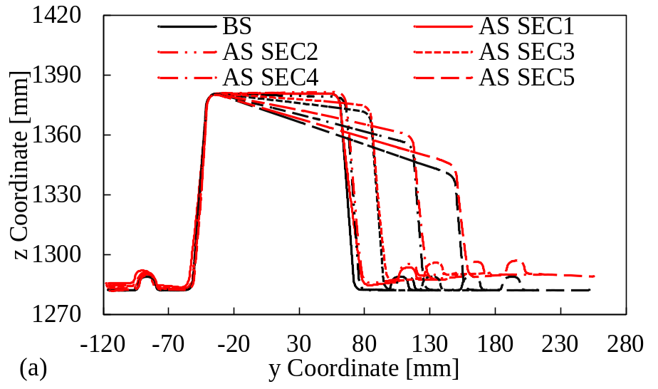
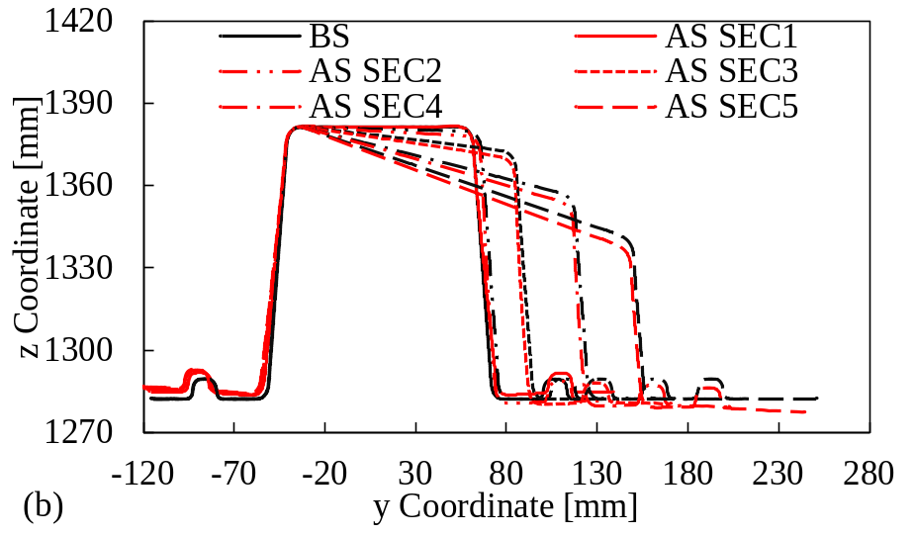
Results and discussion
Draw-in:
Slightly lower values for steel. For both materials, the friction coefficient is the more influential factor, with an impact of approximately 4% of increase.
Springback:
For the steel, the springback corresponds to a counterclockwise rotation of the right part of the component. On the other hand, the aluminium alloy presents a clockwise rotation of the same zone.
Globally, the springback is lower for the Aluminum alloy.
Comparison between the different sections before (BS) and after (AS) springback (reference results) for:
(a) DP980 steel and (b) 6xxx aluminium alloy

Slide 13
Results and discussion
Springback:
The reduction of the friction coefficient leads to the increase of springback, for both materials, with a stronger impact for the steel.
Comparison of SEC5 before (BS) and after (AS) springback for: (left) DP980 steel and (right) 6xxx aluminium alloy

Slide 14
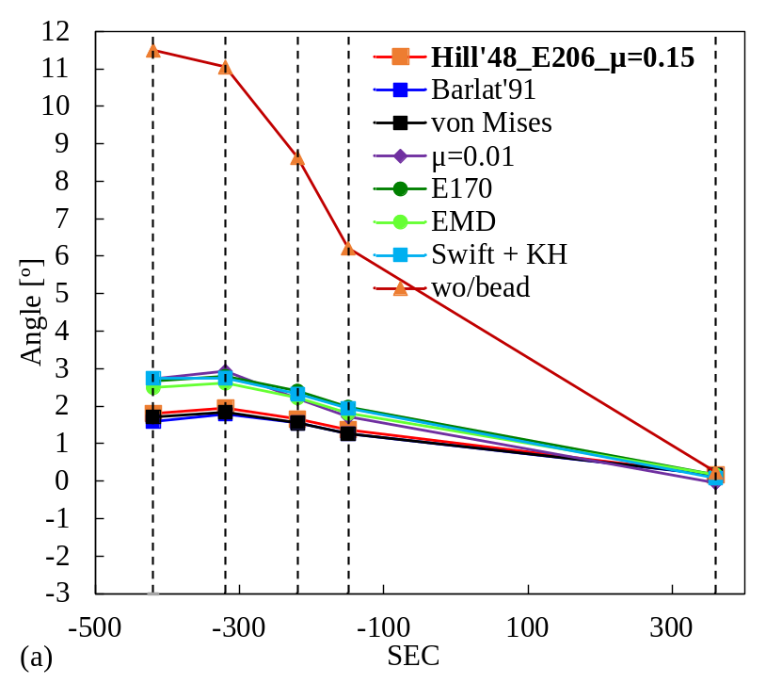
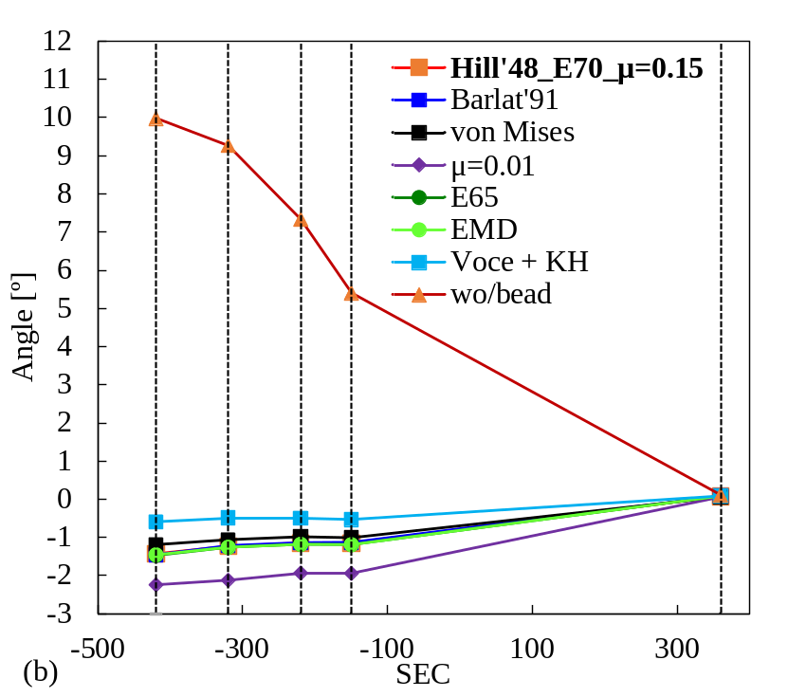
Results and discussion
Torsion angle:
When using the tool with draw-bead, there is a reduced effect of the yield criteria, for both materials, and of the elastic modulus, for the aluminium alloy.
For the aluminium alloy, the friction coefficient is the parameter with higher impact on twist springback.
Effect of each parameter on the torsion angle evaluated on the upper surface of each of the 5 sections of the component for: (a) DP980 steel and (b) 6xxx aluminium alloy

Slide 15
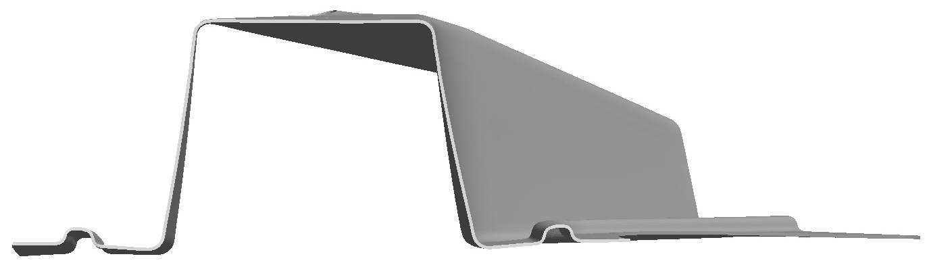

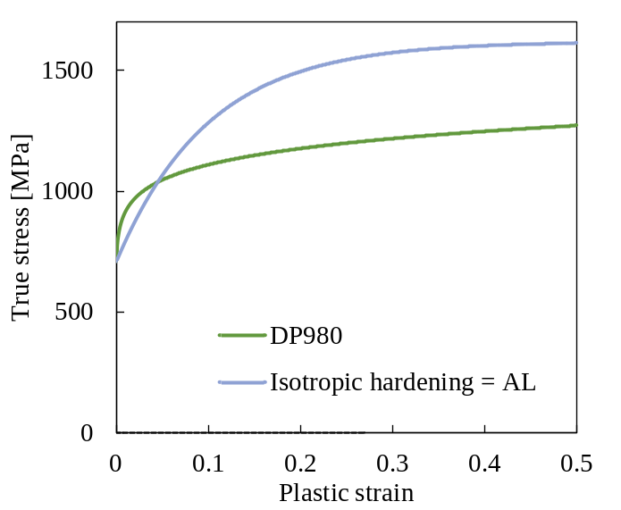
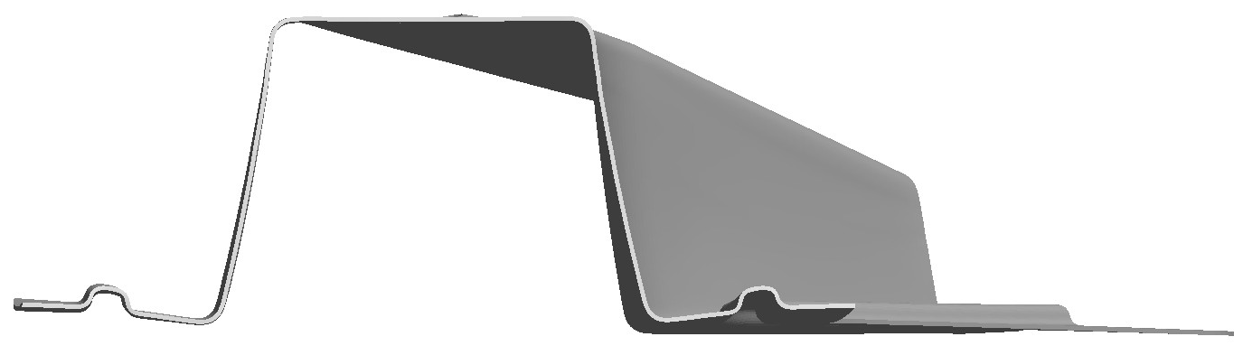
Results and discussion
Hill’48_E206_μ=0.15
The fact that the twist springback is larger for steel in comparison with the aluminium alloy is in good agreement with the experimental measurements.
Nevertheless, the same tool was used to deform a steel and an aluminium alloy, which present different values of initial thickness but also quite different values of yield strength.
Gap = AL
Isotropic hardening = AL
Comparison between the Swift (DP980 steel) and the adjusted hardening law
Effect of the gap and of the isotropic hardening law on the springback of the DP980 steel

Slide 16
Conclusions
The process parameter that most affects the twist springback is the presence of the stake bead, reducing significantly the springback.
The reduction of the friction coefficient and of the elastic modulus also leads to an increase in springback.
The yield criterion has little influence on the springback of this component.
The kinematic hardening also influences the springback, presenting different trends for both materials. The combined hardening law leads to an increase of the springback predicted for the steel and a reduction for the aluminium alloy, in agreement with the fact that only the DP980 steel presents a clear Bauschinger effect.
For the tool with draw-bead, whatever the parameter under analysis the steel component presents a counter-clockwise rotation of the right part of the component, while the aluminium presents a clockwise rotation of the same zone. This different trend seems to result mainly from the different isotropic hardening behaviour.

Slide 17

Acknowledgements
The authors gratefully acknowledge the financial support of the Portuguese Foundation for Science and Technology (FCT) under projects with reference UIDB/00285/2020 and LA/P/0112/2020.

