Slide 1

Experiments and simulations of the drawing envelope of commercially-pure aluminum
Adrian J. Carter, Kelin Chen, Yannis P. Korkolis*
* Presenter

Slide 2
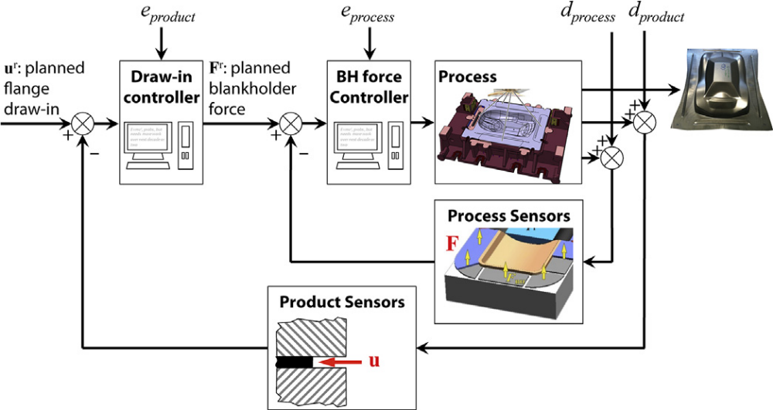
Control in Forming – Industry 4.0
Sensing – Decision Making – Actuating
Allwood, J. M., S. R. Duncan, J. Cao, P. Groche, G. Hirt, B. Kinsey, T. Kuboki, M. Liewald, A. Sterzing, and A. E. Tekkaya. 2016. „Closed-loop control of product properties in metal forming“. CIRP Annals 65 (2): 573–96. https://doi.org/10/f85mbh.

Slide 3
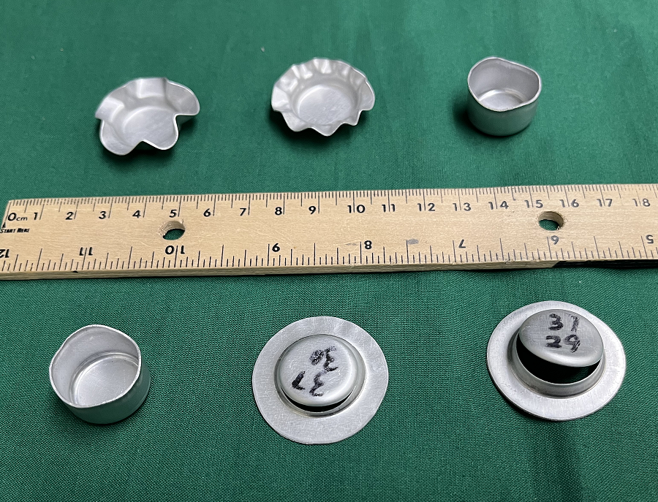
Cup-drawing for different BHF’s
Sample of Specimens AA1100-O, dia. 37mm
BHF = 0 N
56 N
523 N
Wrinkling
Wrinkling
Ideal
978 N
1709 N
2090 N
Ideal
Tearing
Tearing
Optimal BHF = 470 N (Lange 1985)

Slide 4
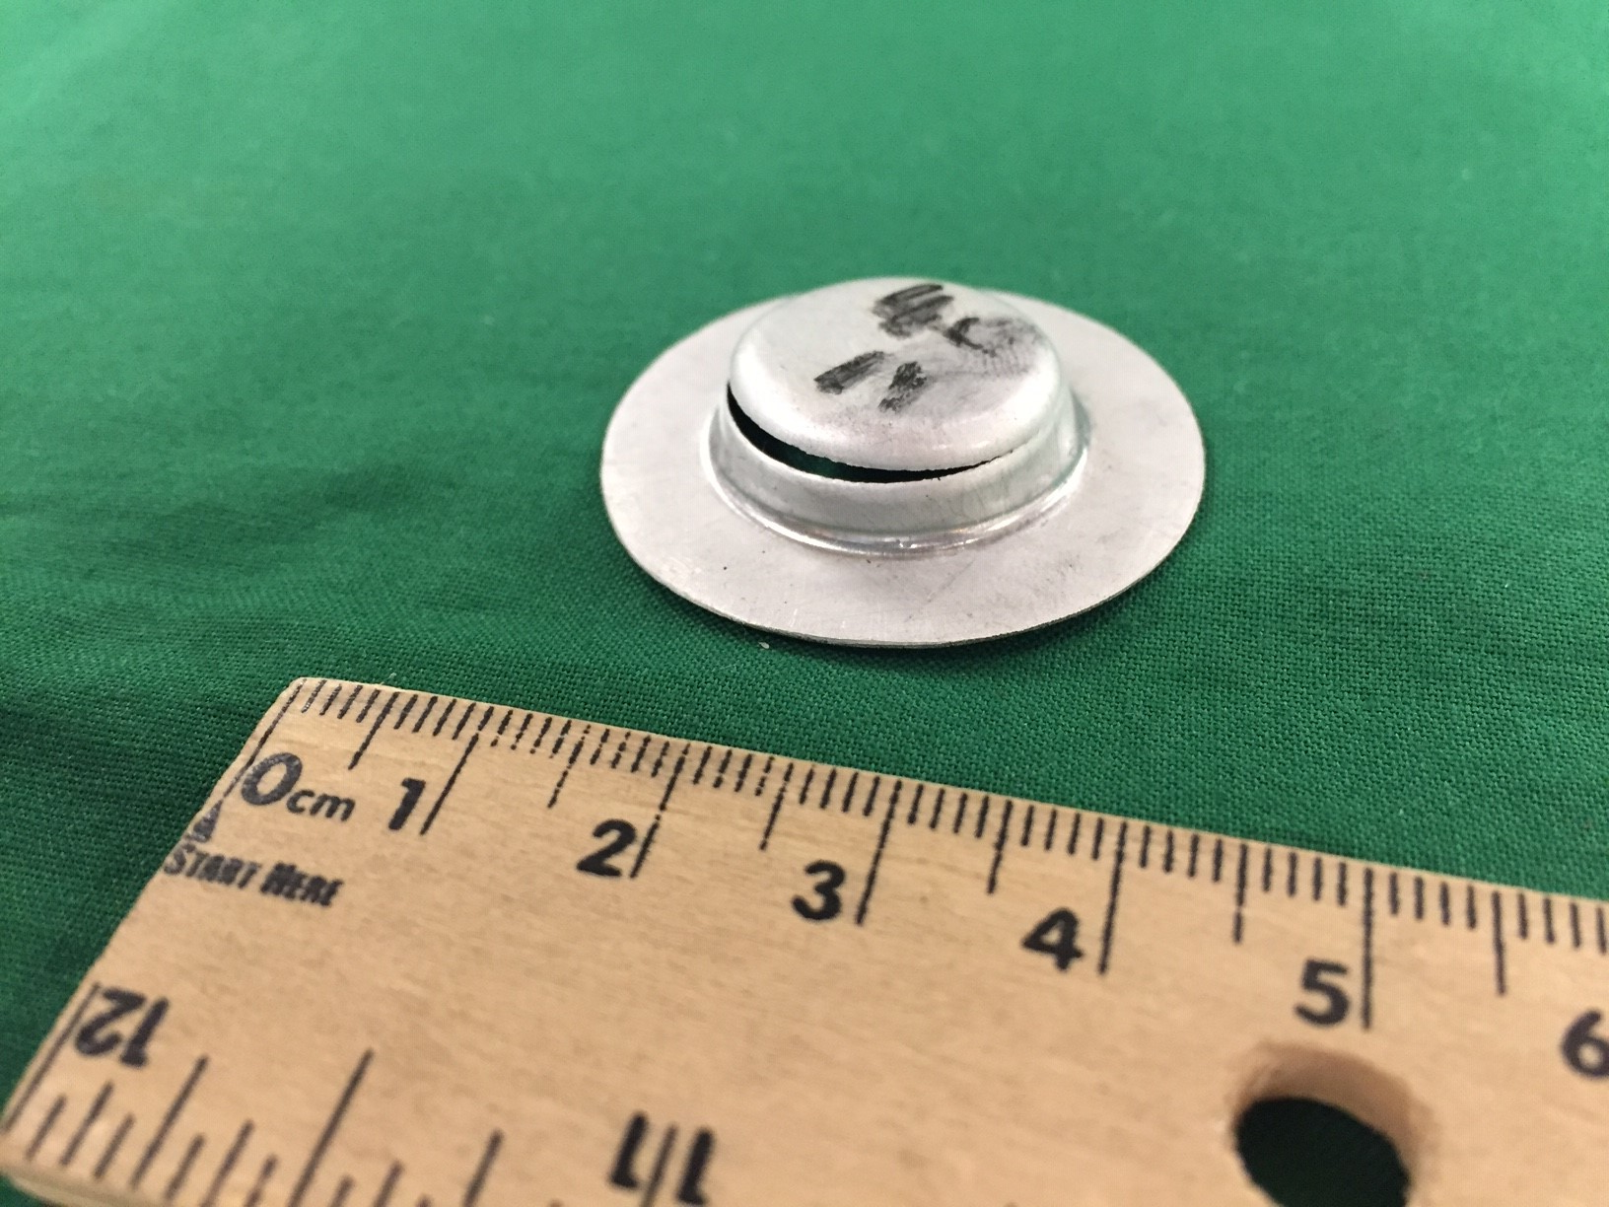
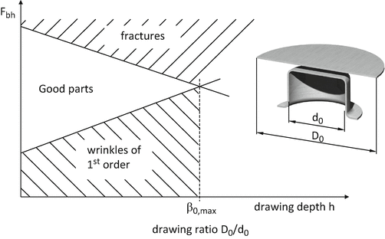
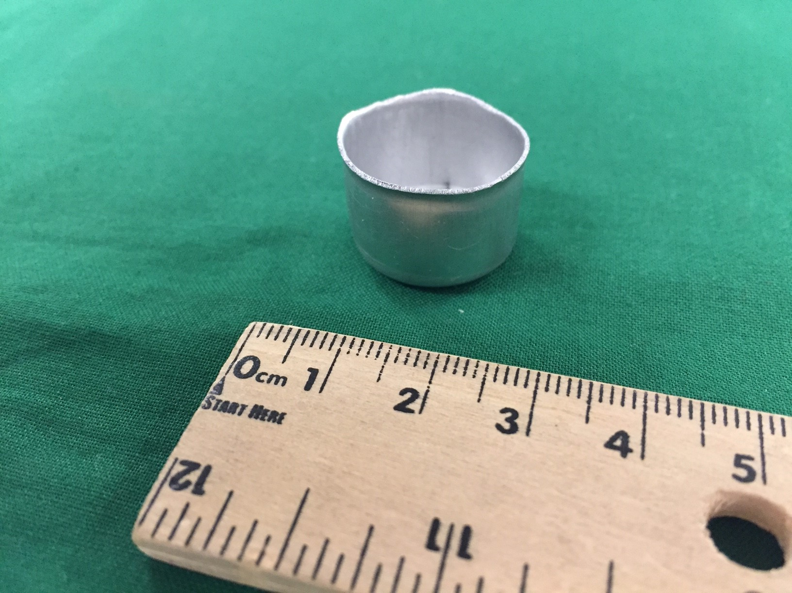
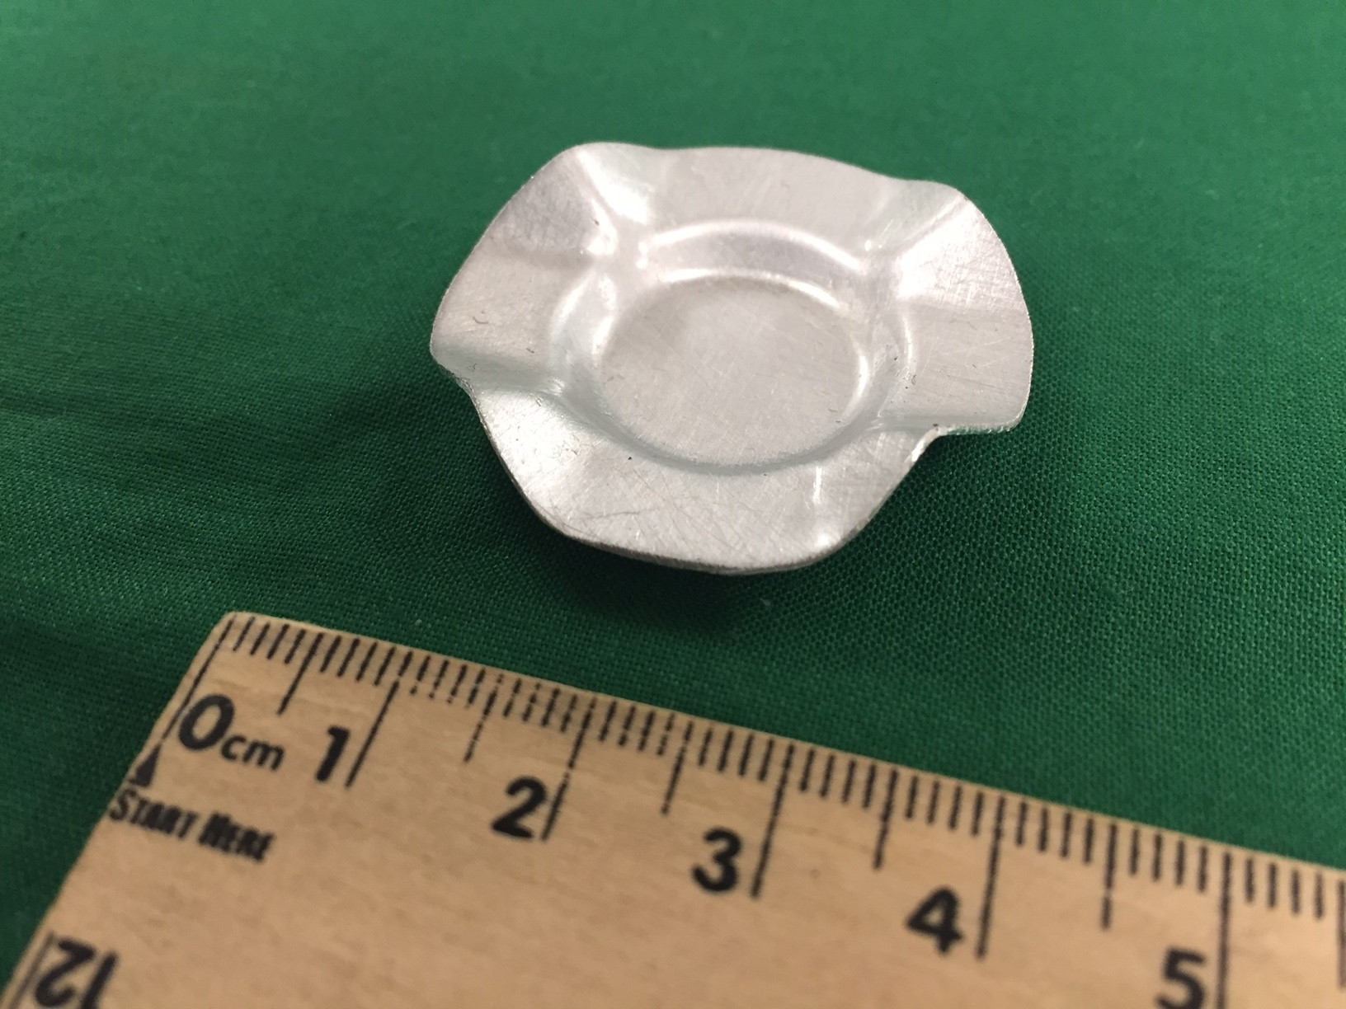
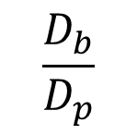


Workability envelope
BHF
tearing
success
$$D_{p}$$
$$D_{b}$$
wrinkling
$$\frac{D_{b}}{D_{p}}$$
Drawing depth or
Adapted from M. Liewald

Slide 5
Contents of this talk
Industry 4.0:
Sensing – Decision Making – Actuating
Identify the working envelope of the work material (AA1100) in 2 tempers
Establish a FE model that reliably predicts the working envelope.
This will identify the features that a “decision-making” model needs to have
(e.g., hardening, anisotropy, friction, element type & mesh, etc.)

Slide 6
Cup-drawing Experiments

Slide 7
Material
Aluminum Alloy AA1100, >99% Al (1% Si+Fe, 0.05-0.20% Cu, 0-0.5% Mn, 0-0.10% Zn)
0.51 mm thick
Blank diameters:
  35, 37 and 40 mm
Tempers:
  -H24 (Half-hard)
  -O (Fully annealed)
Ha et al., Mat’ls, 2020

Slide 8
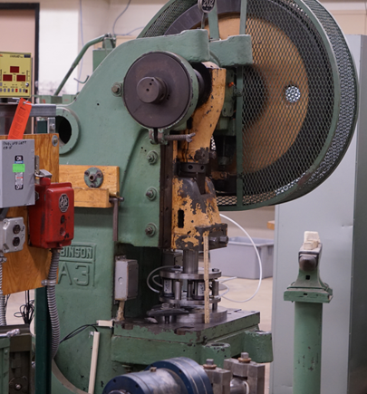
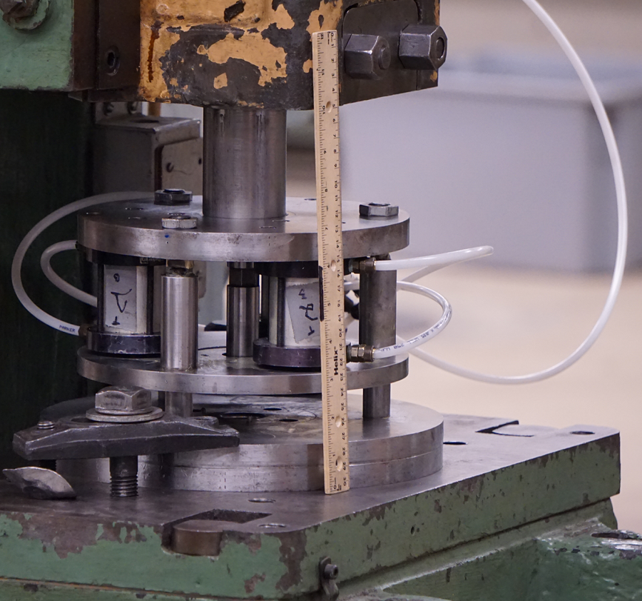
Former experimental apparatus for cup-drawing
1.5-inch pneumatic cylinders (x3)
Ram
Air line
Punch
BH
Die
Table
Close-up of tooling
30-Ton eccentric press (OBI)

Slide 9
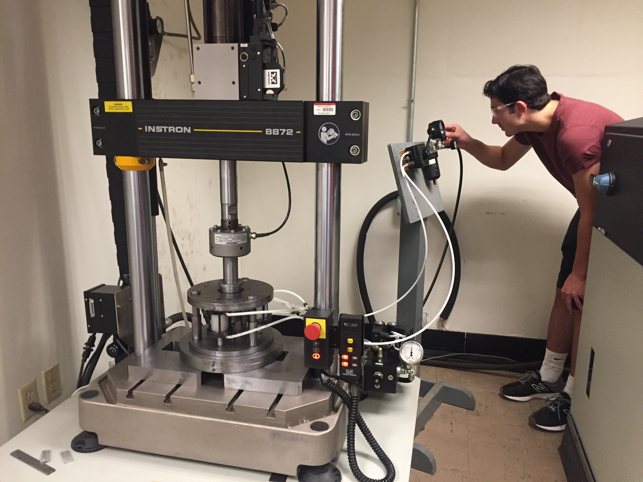
Current experimental apparatus for cup-drawing
Pneumatic pressure regulator
Instron 8872 Servo-hydraulic Machine
25 kN Load Cell
108 mm stroke
Hydraulic actuator
Load
frame
Load cell
Pneumatic cylinders (BHF)
Drawing tooling

Slide 10
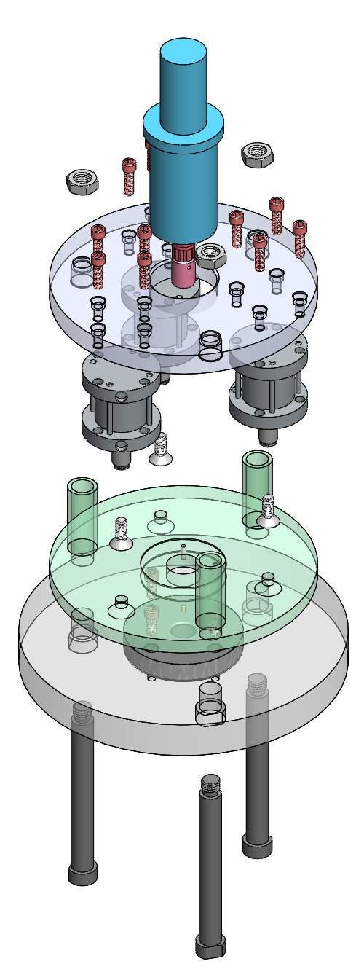
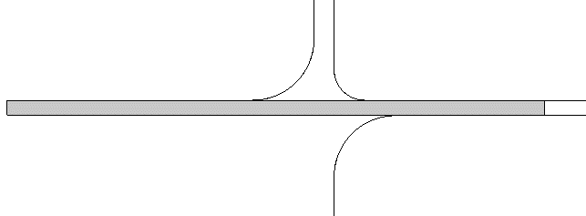
Modular cup-drawing tooling
Exploded view of tooling
Geometry of tooling
Ø 20
Punch
R2
Blank holder
Blank
t_{O}=0.51
R2
Die
Ø 21.3
Ø 37
All units in mm

Slide 11
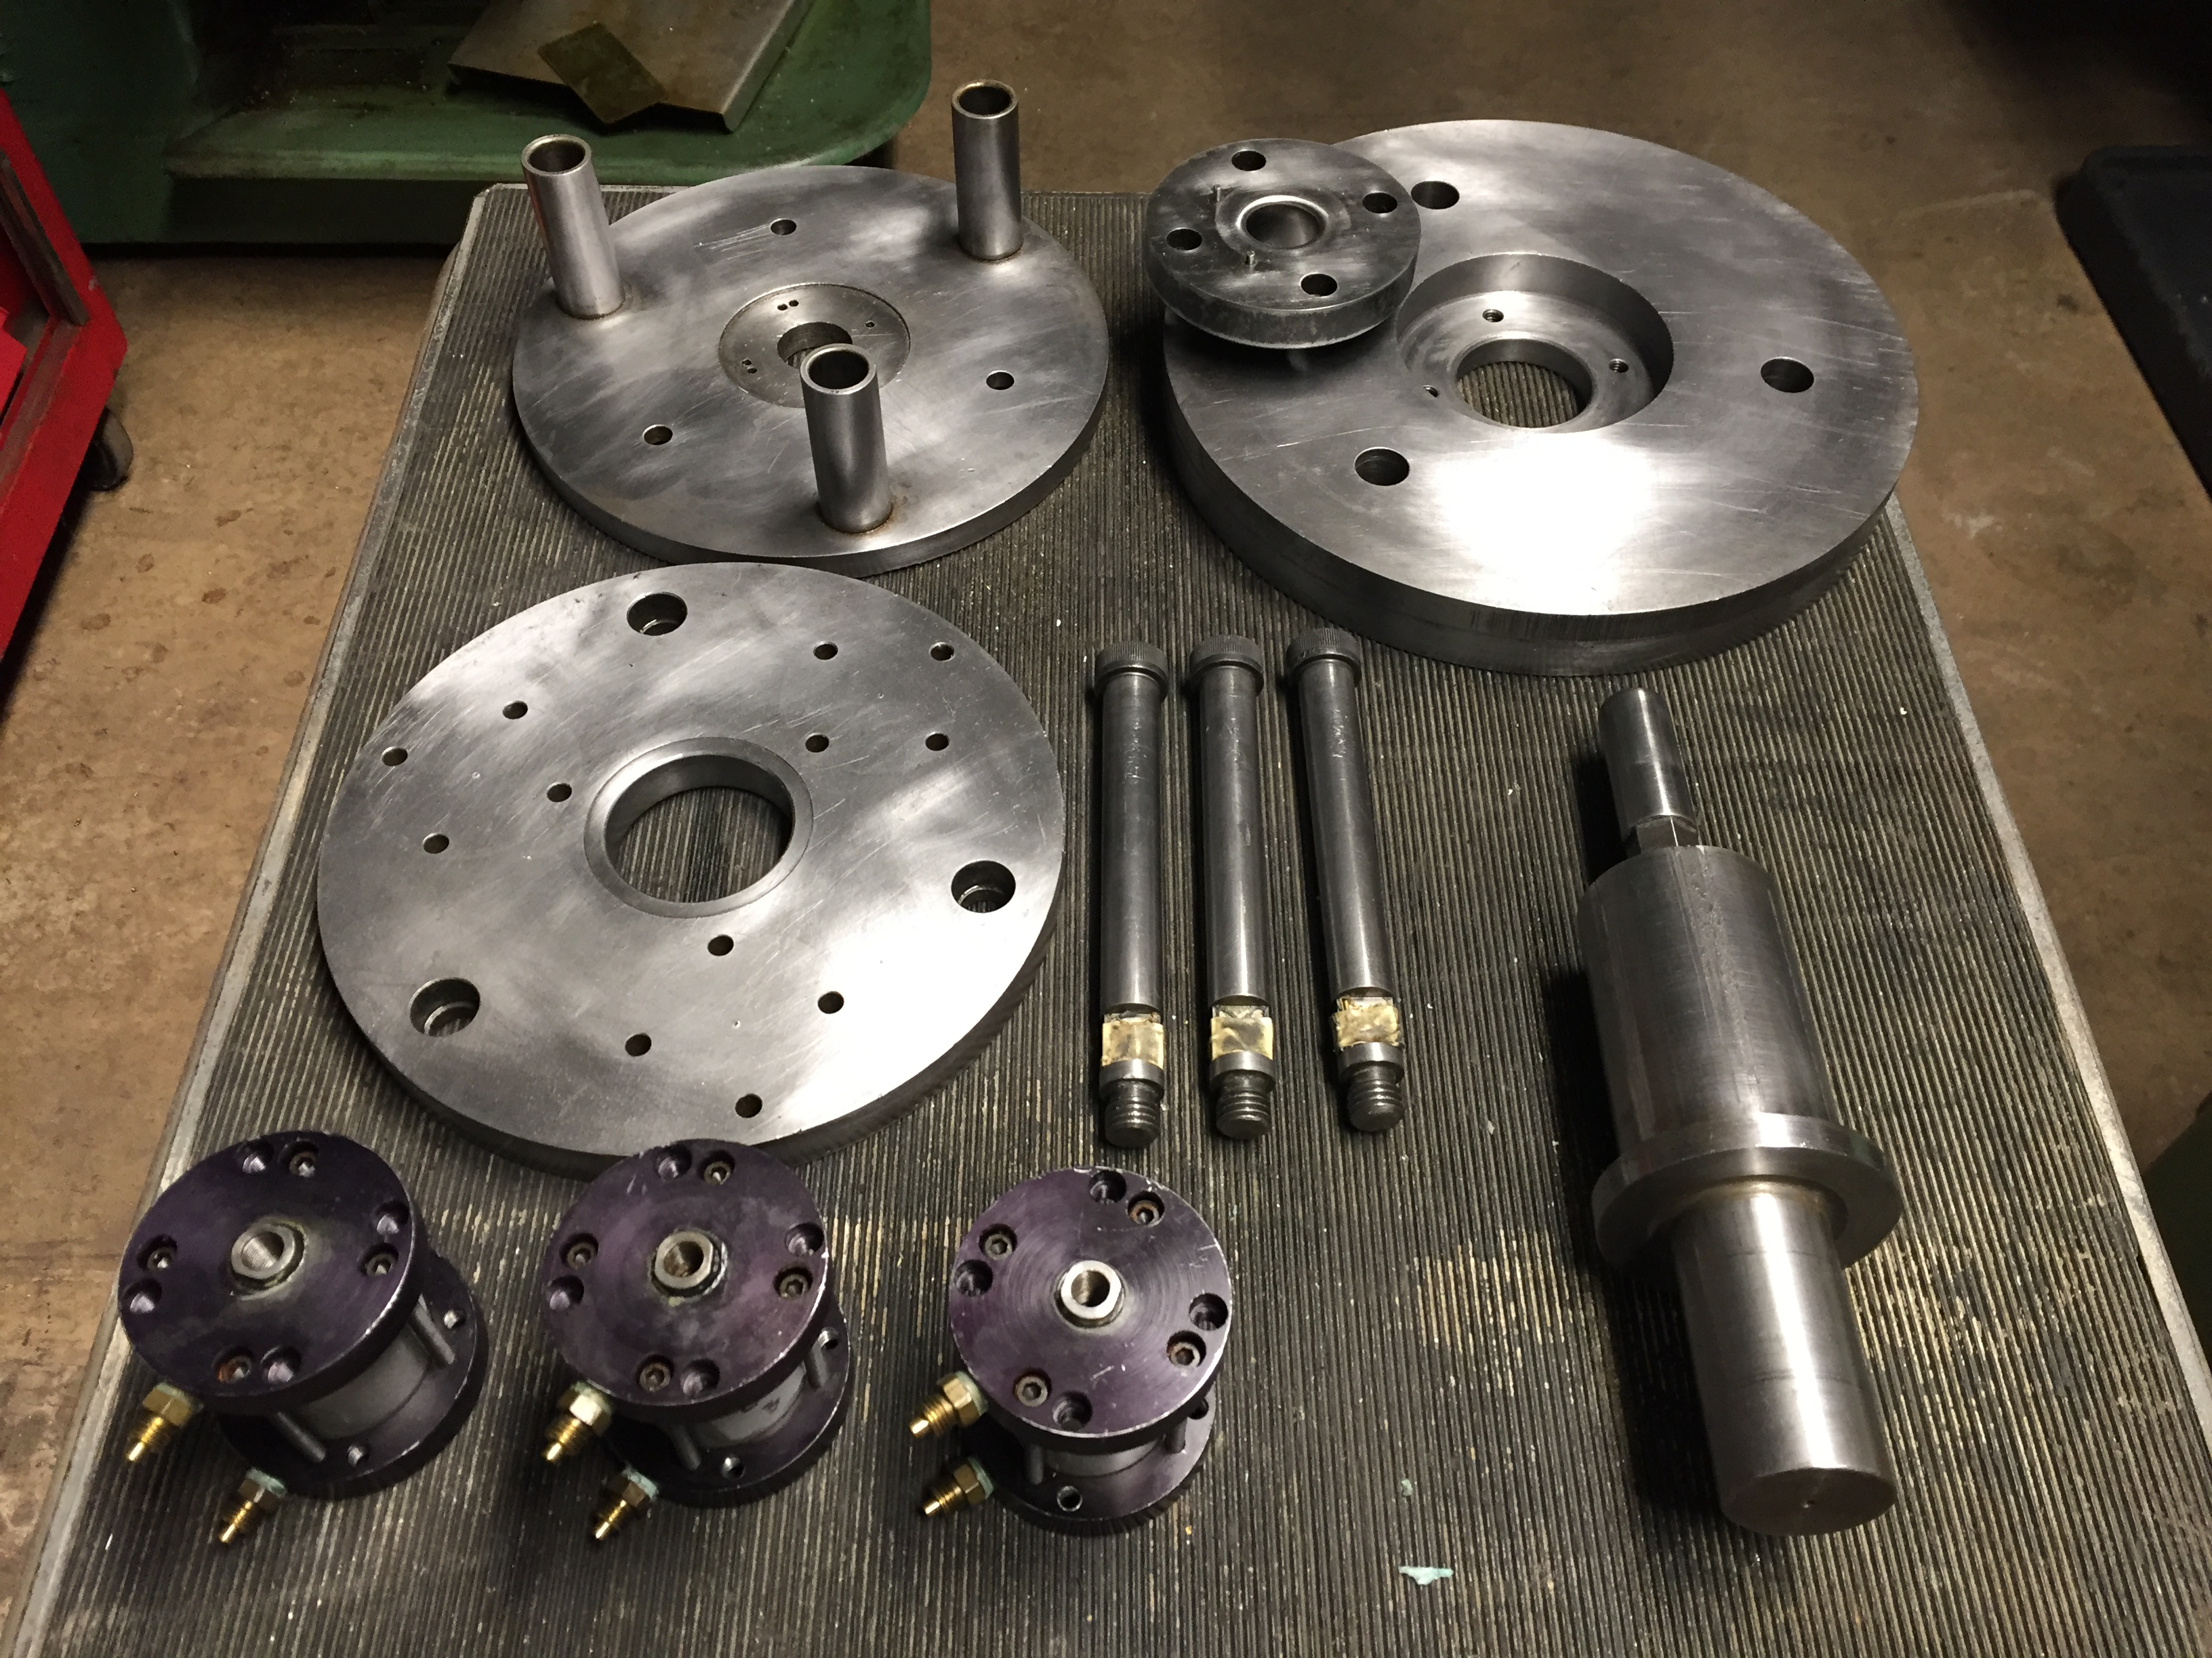
Modular cup-drawing tooling
Die insert
BH
Die holder
Punch
Top plate
Punch holder
1.5-inch pneumatic cylinders

Slide 12
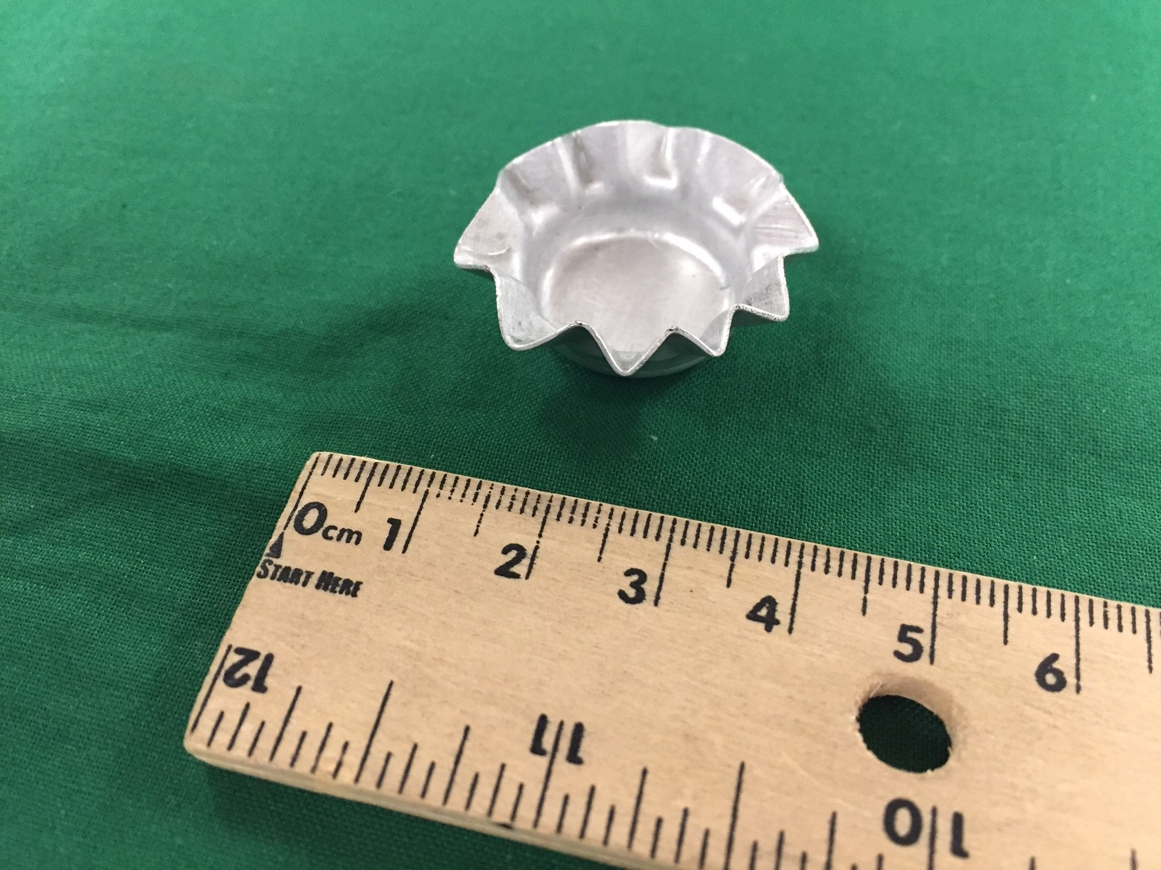
Typical Punch Force-Displacement Curves

Slide 13
37 mm -O Punch Force vs Punch Displacement

Slide 14
Workability envelope
Theoretical cup height

Slide 15
Workability Envelope
SUCCESS

Slide 16
Workability Envelope
SUCCESS

Slide 17
Workability envelope, –O vs. –H24
SUCCESS

Slide 18
Numerical simulations of cup-drawing

Slide 19
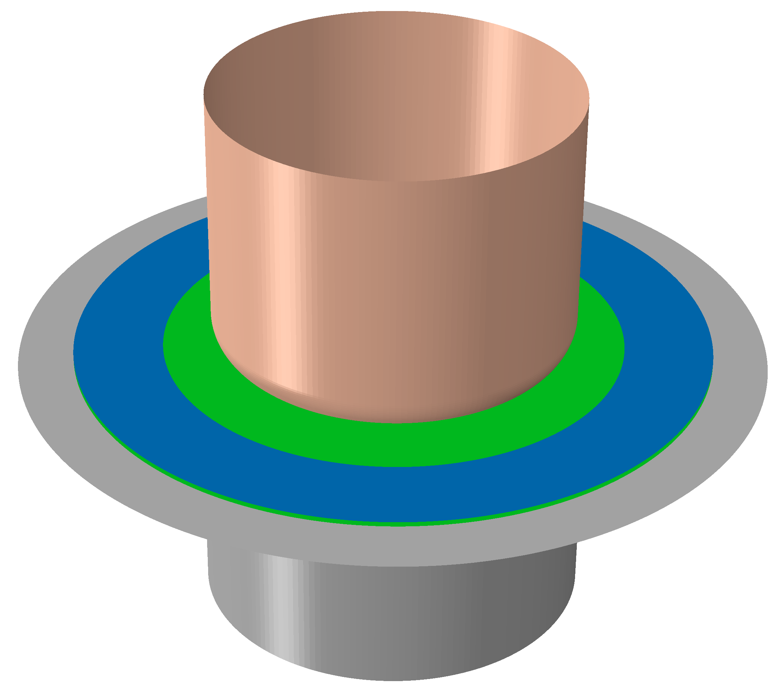
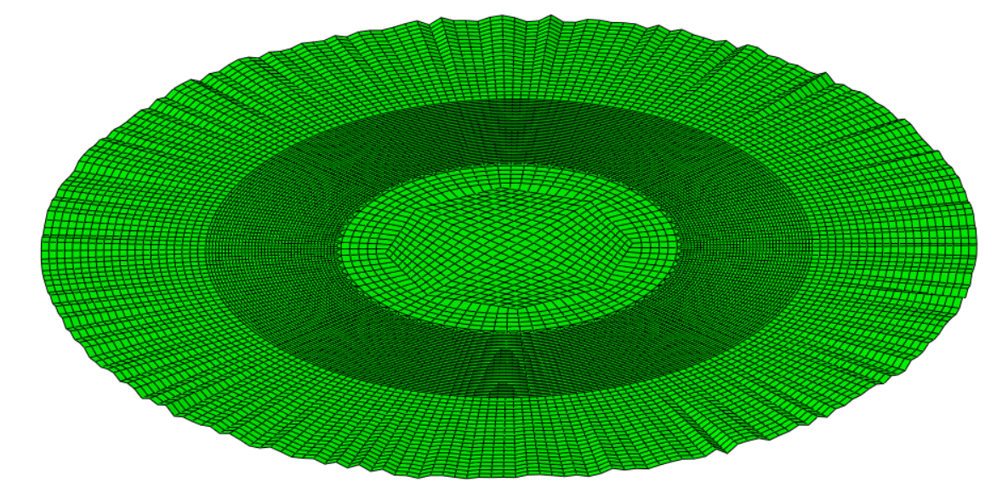
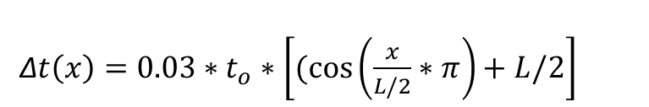
FE Model
Punch
Blank-
Holder
Blank
Die
Amplified out-of-plane coordinates by 15 x
ABAQUS/Standard 2019 (implicit)
15,523 shell elements, linear, reduced integration (S4R)
von Mises (-H24) or Yld2000-2D (-O), Voce extrapolation
Soft contact (exponential) with finite sliding
Friction: punch-blank is 0.04, die-blank-blank holder is 0.17
Random 2% wrinkling imperfection on outer edge
3% imperfection added using cosine equation to facilitate necking
Δ$t\left(x\right)=0.03∗t_{o}∗\left[(cos\left(\frac{x}{L/2}∗π\right)+L/2\right]$

Slide 20
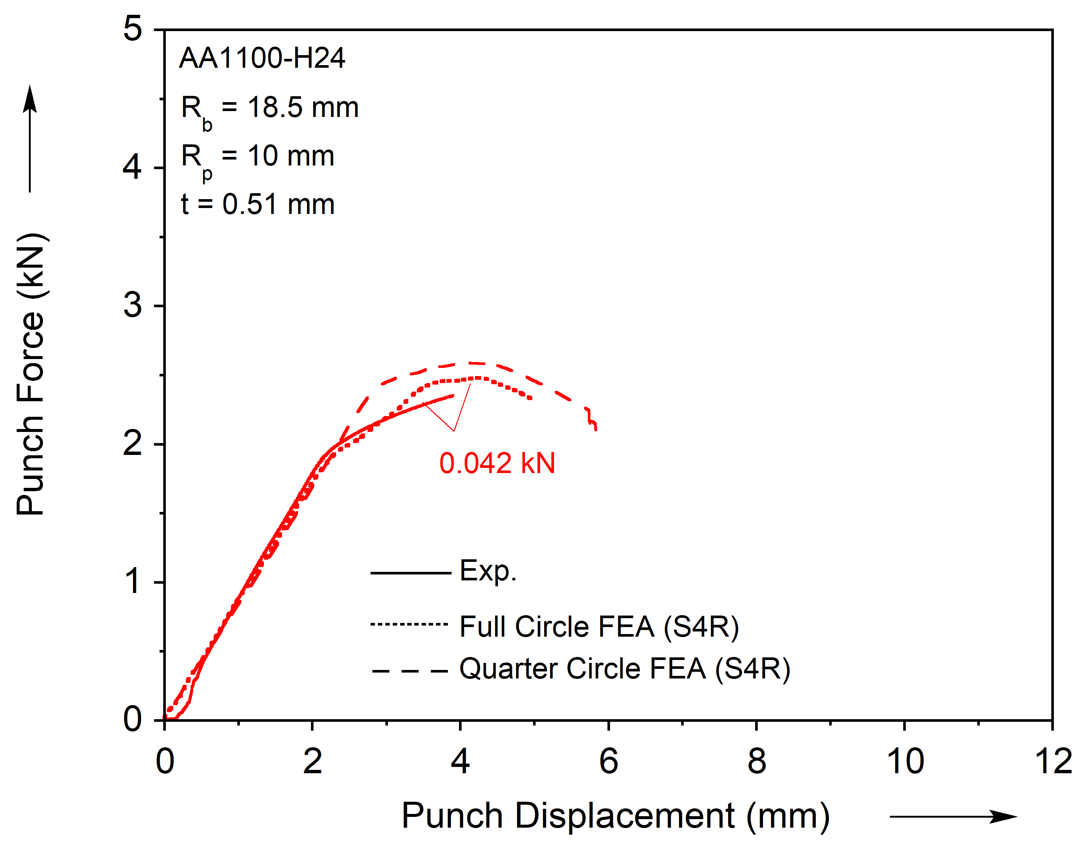
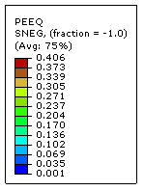
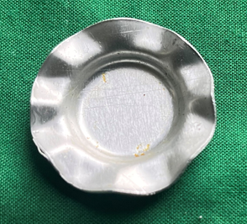
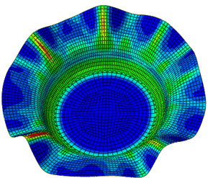
FE prediction, wrinkling case

Slide 21
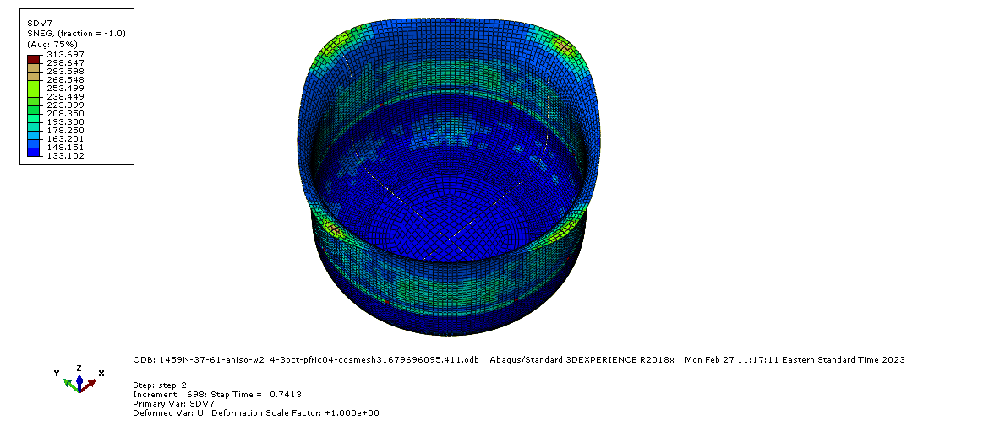
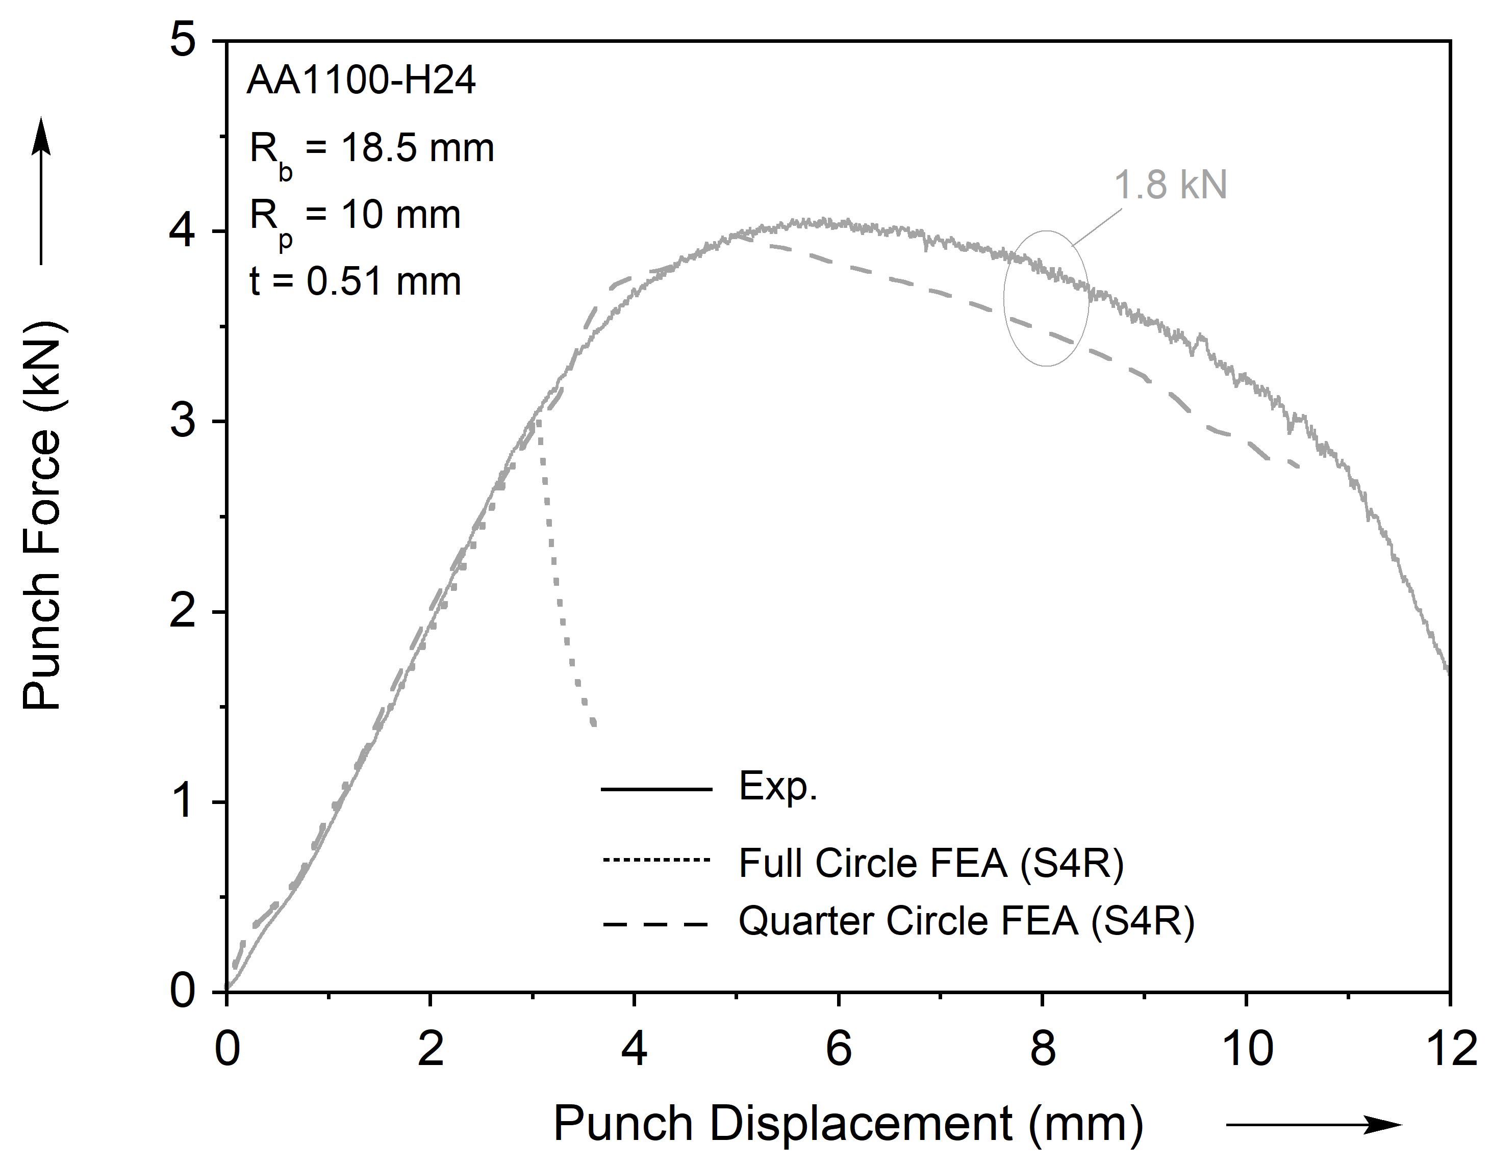
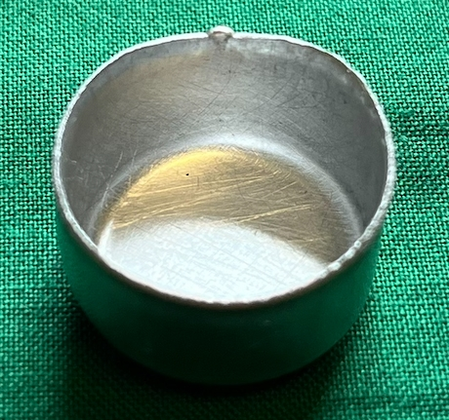
FE prediction, successful case

Slide 22
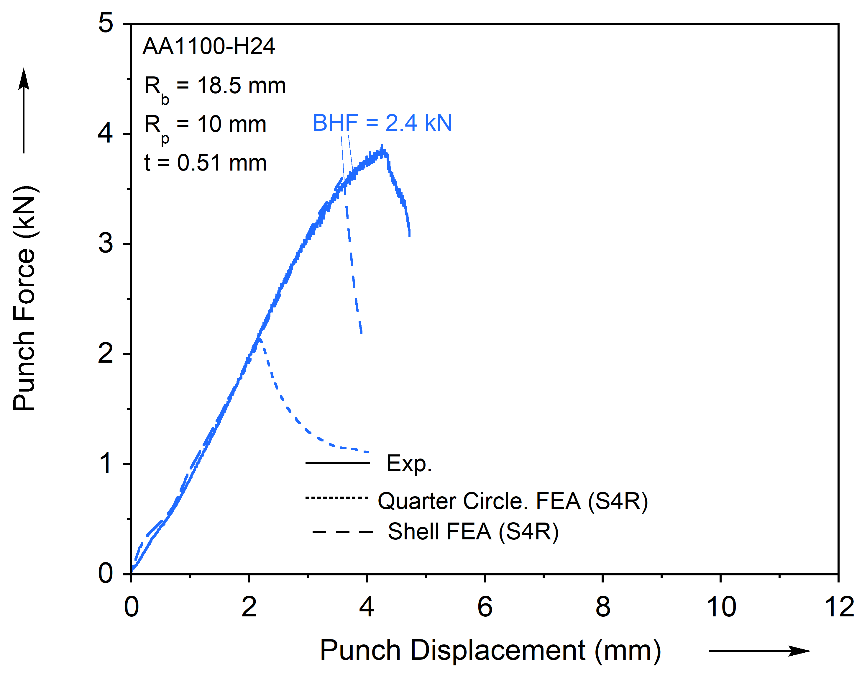
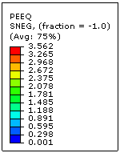
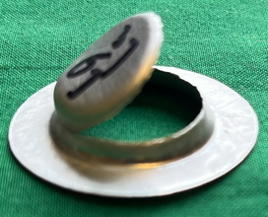
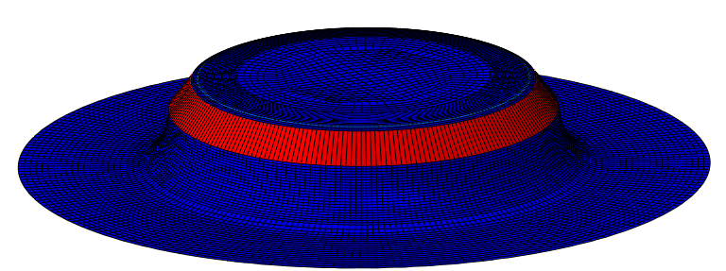
FE prediction, tearing case

Slide 23
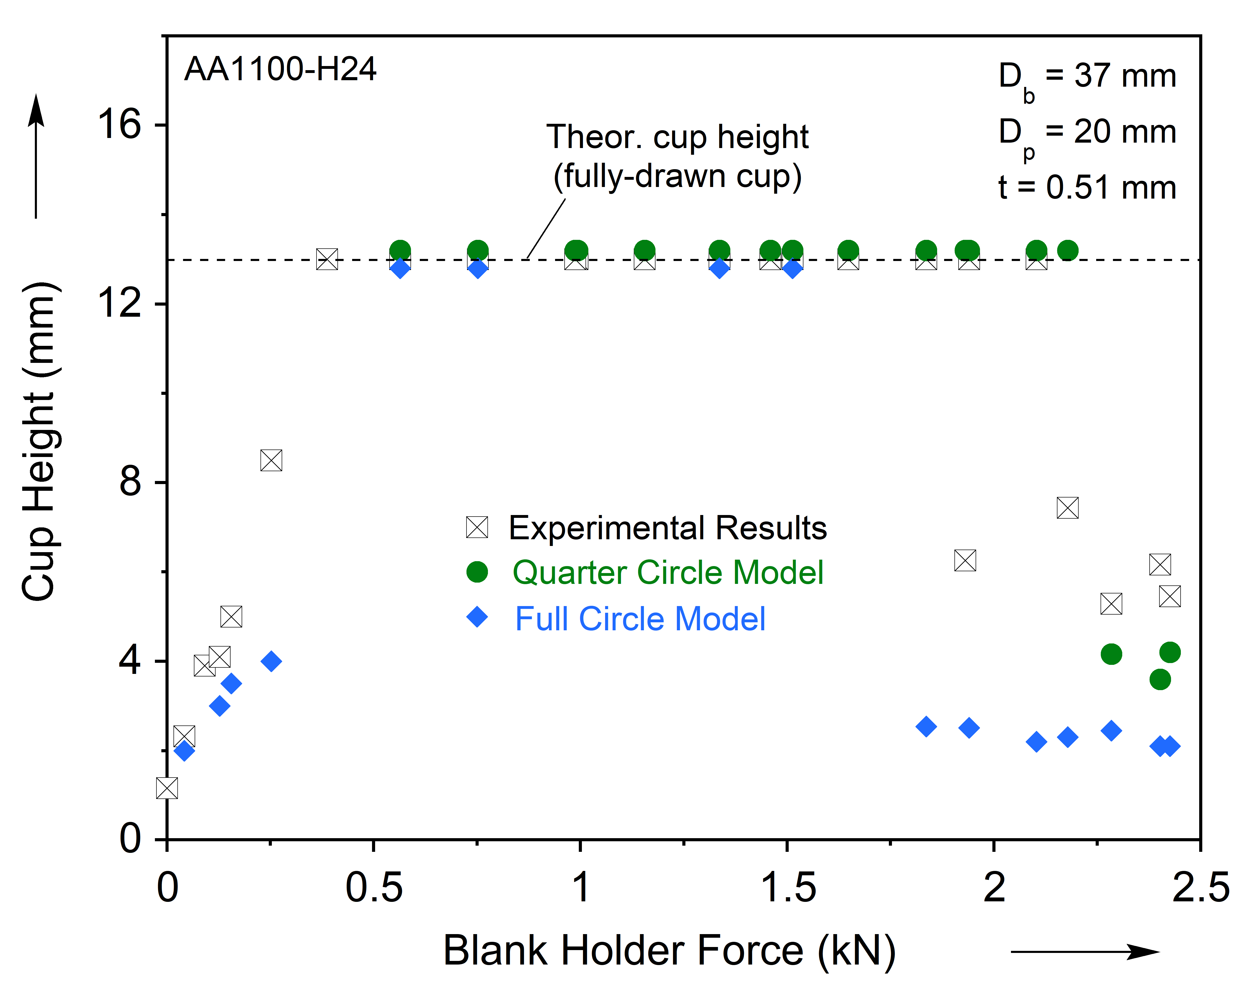
Workability envelope, exp. vs. FEA

Slide 24
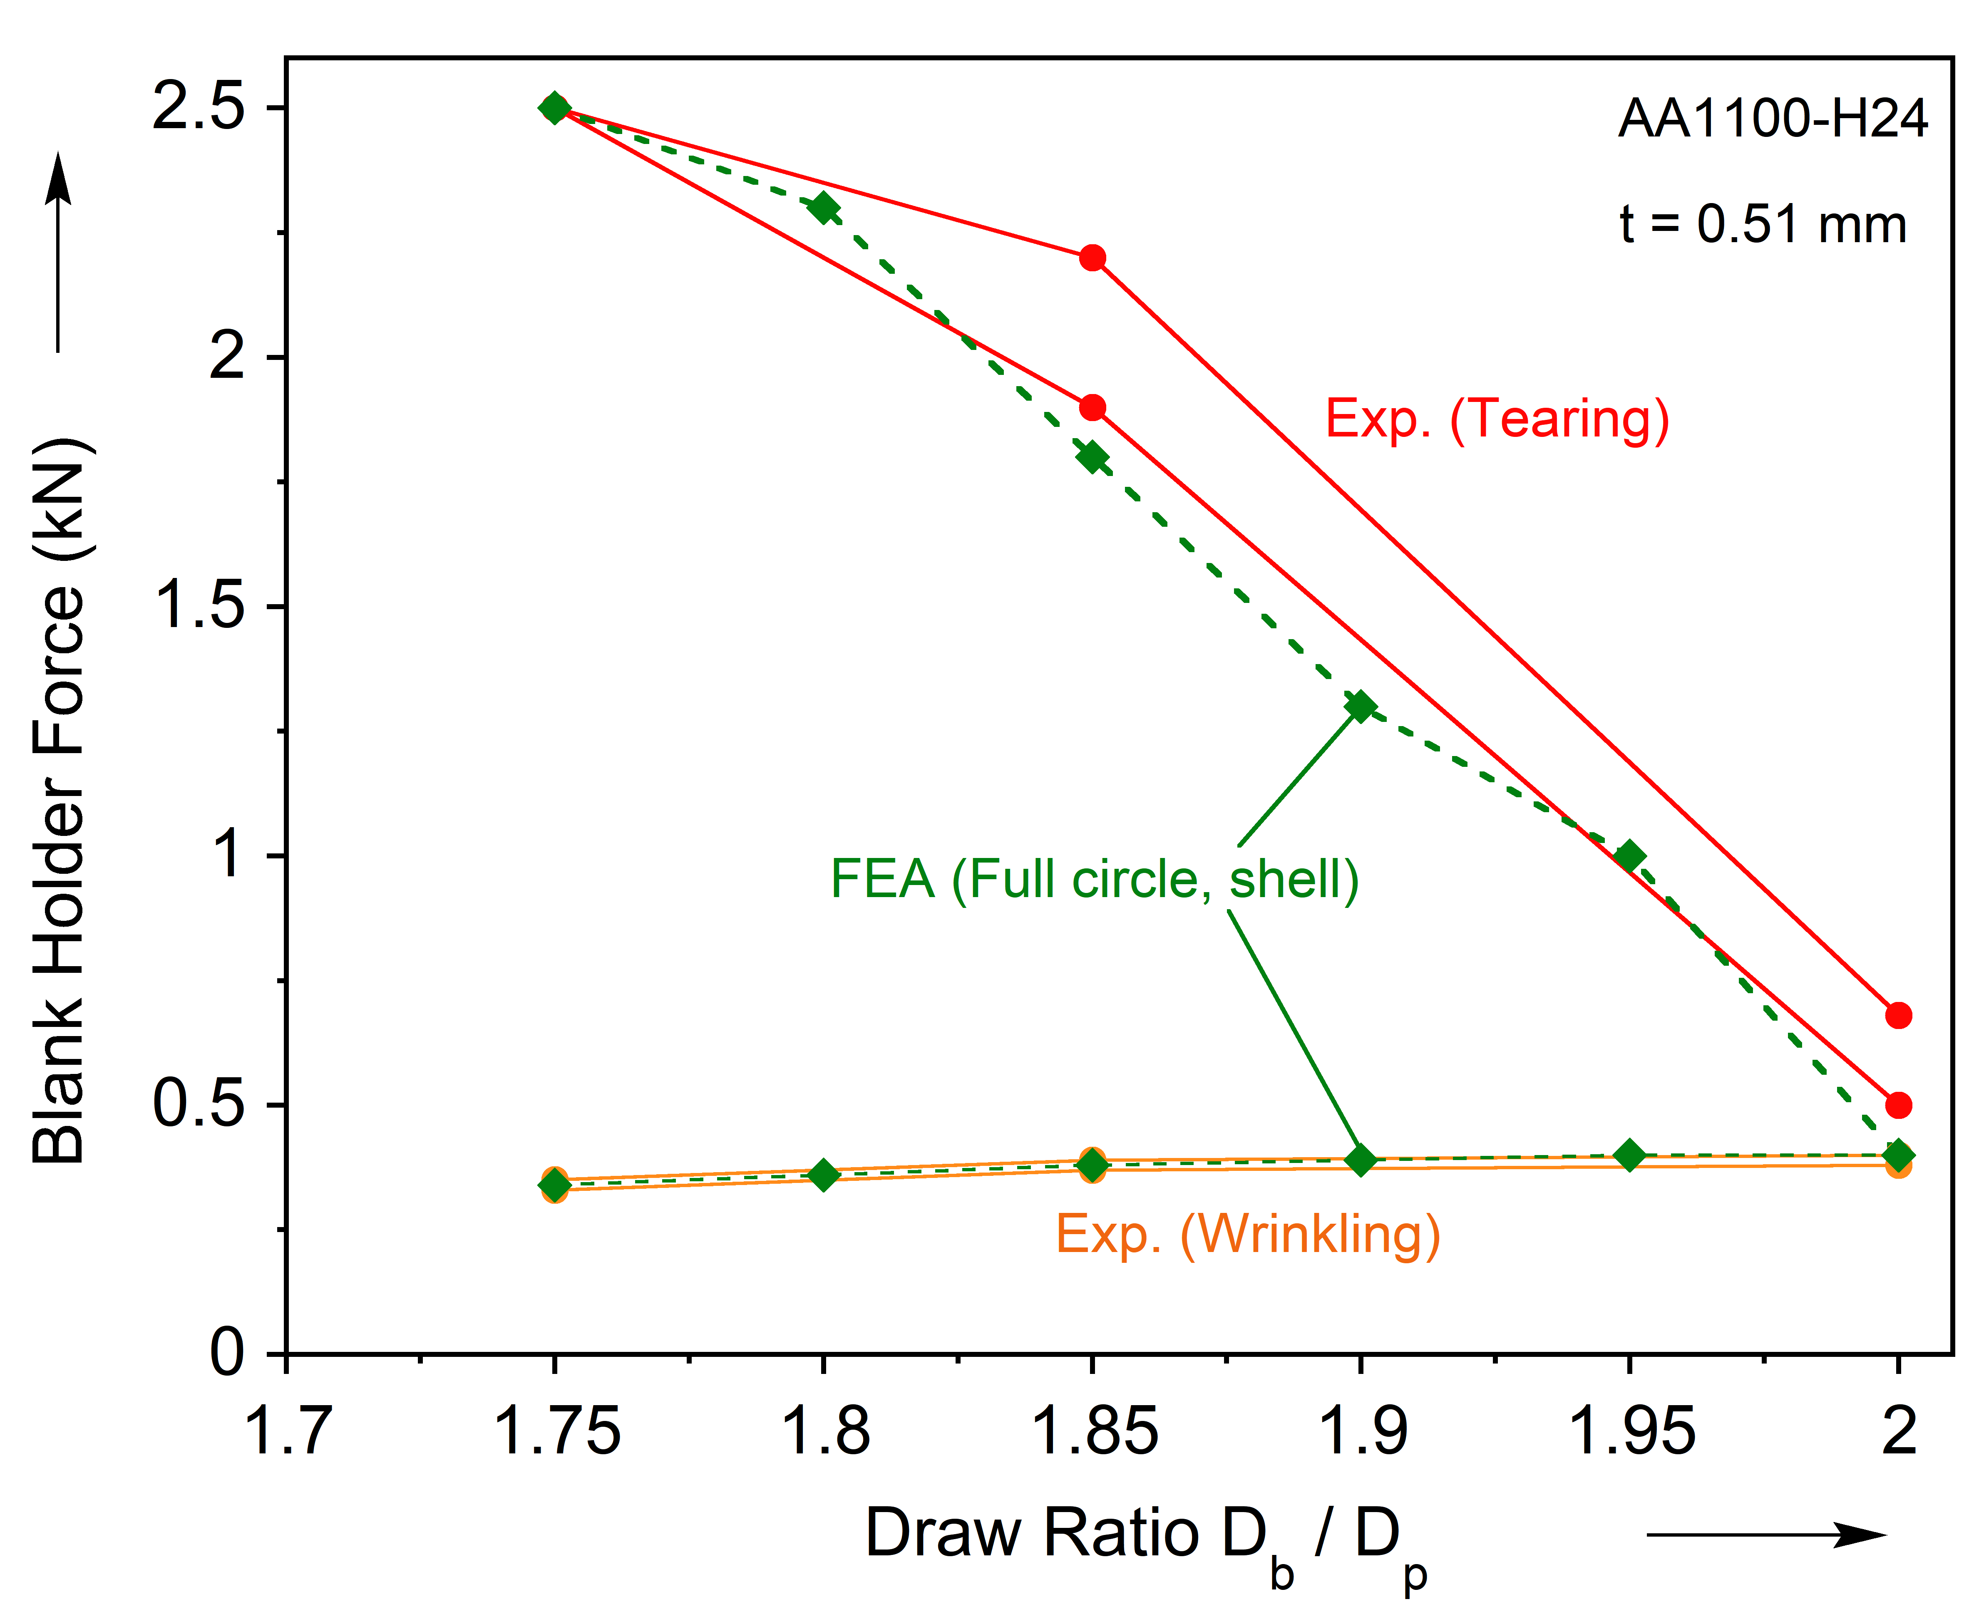
Workability envelope of –H24: exp. vs FEA

Slide 25
Conclusions & Acknowledgements
Workability Envelope
Workability Envelope was established for AA1100-O and -H24 experimentally
Finite Element Modeling
Designed a shell model that can accurately predict wrinkling and tearing of cups
von Mises for –H24, Yld2000-2D for –O (ongoing)
FEA reasonably reproduces similar workability envelope compared to experiments
Acknowledgements
U.S National Science Foundation under award CMMI-1727490 (Joint NSF-DFG project)
Madison Chitwood, Chen Liu, Drew Havrilla, Matt Esser (OSU), Prof. Peter Groche, Alexander Breunig (PtU), Prof. Brad Kinsey, Prof. Jinjin Ha (UNH)

Slide 26
Thank you for your attention.
Questions?

Slide 27
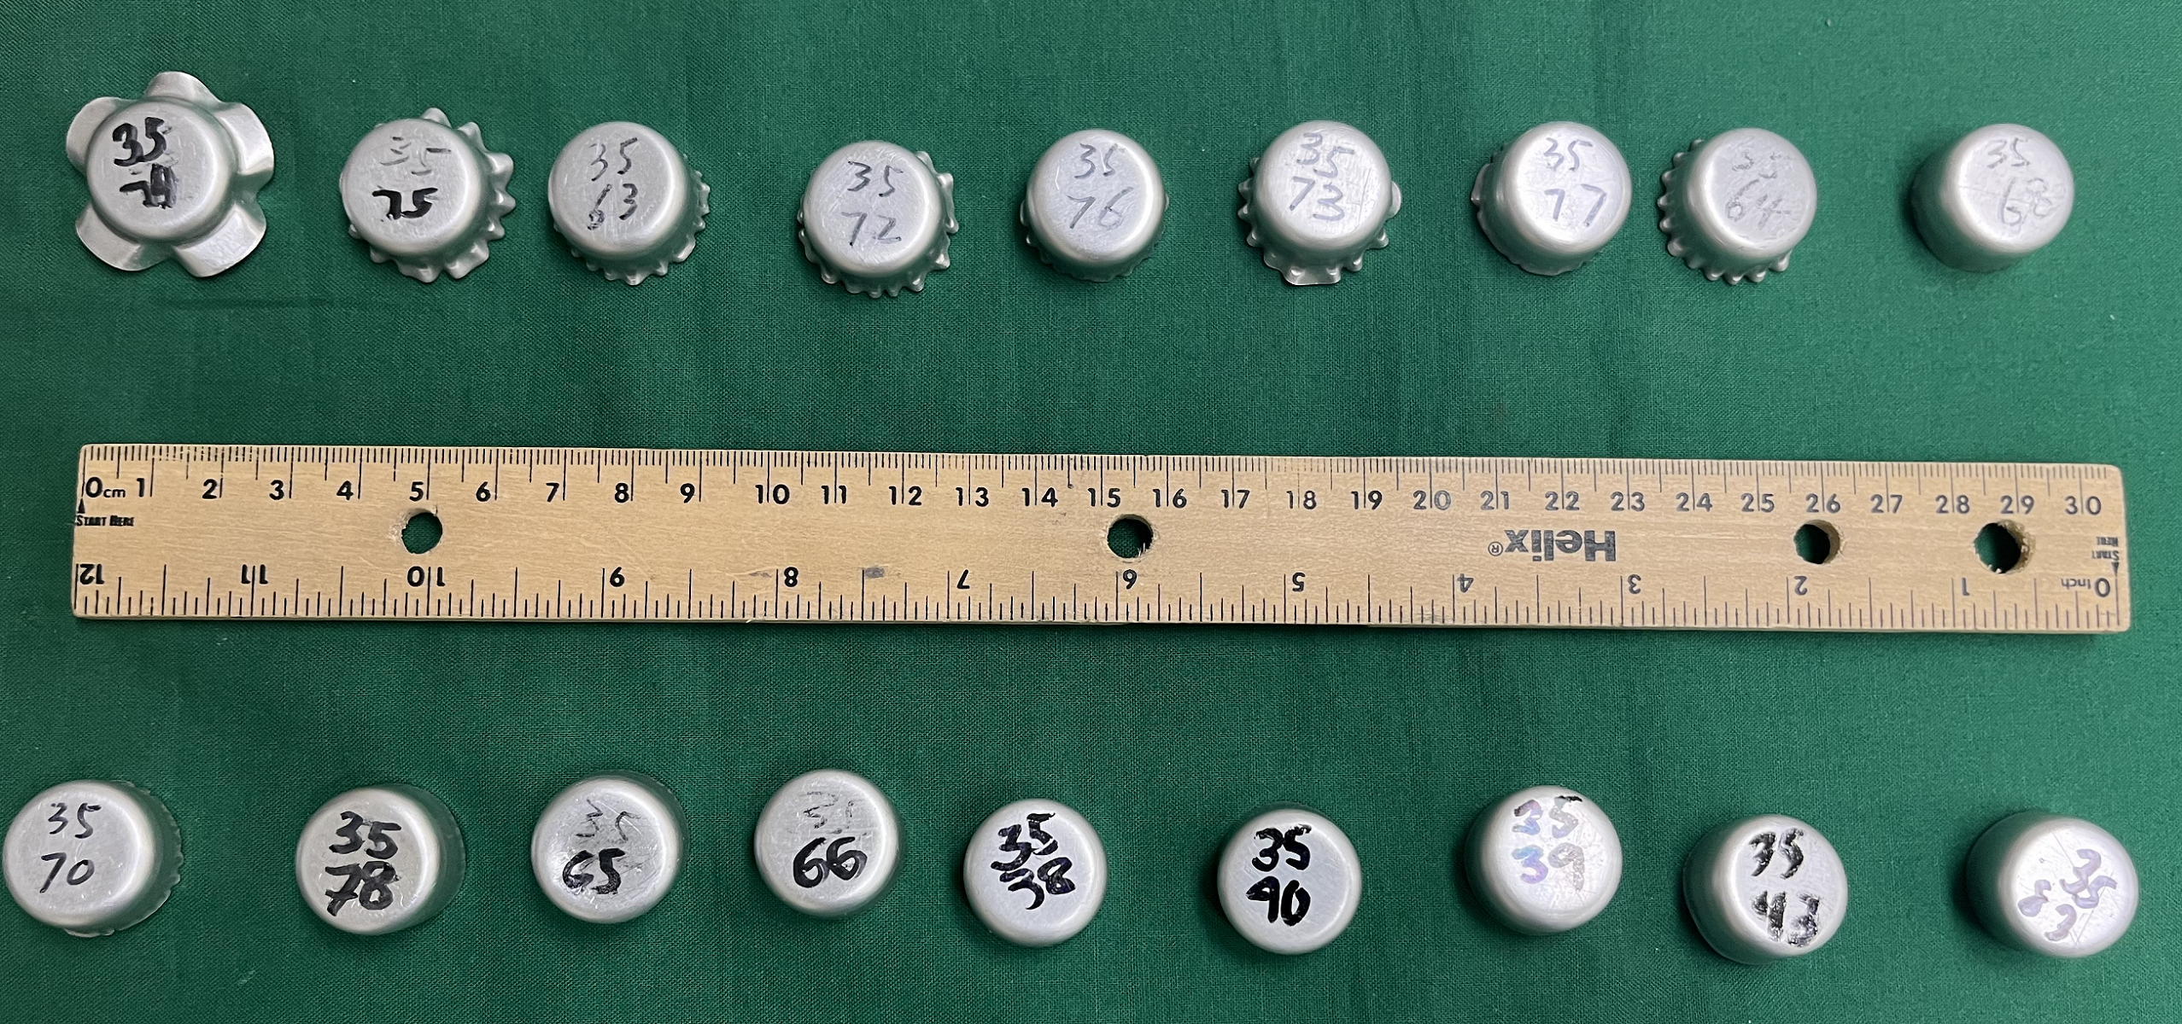
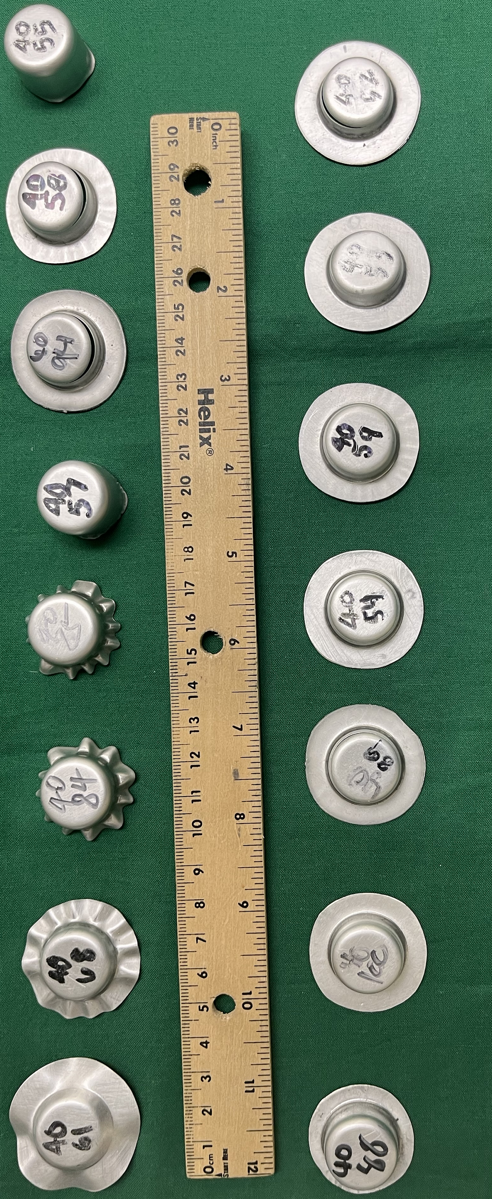
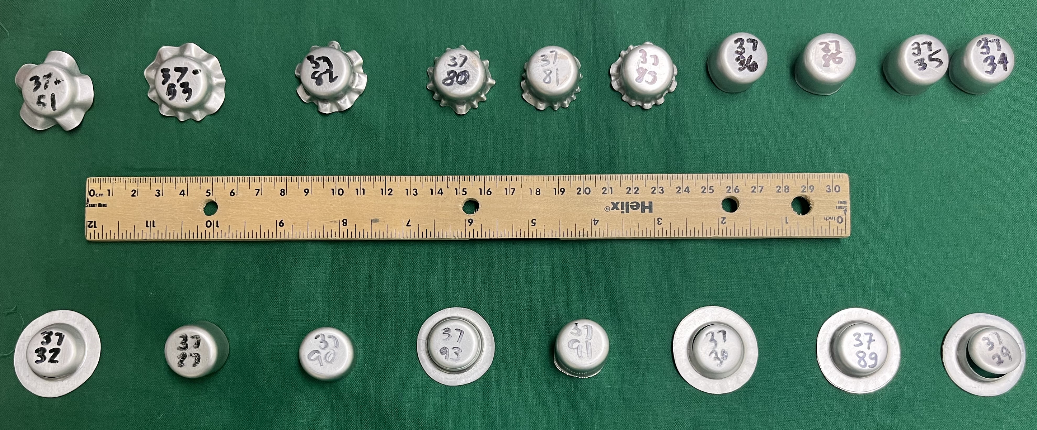
Experiments
35 mm
40 mm
37 mm

Slide 28
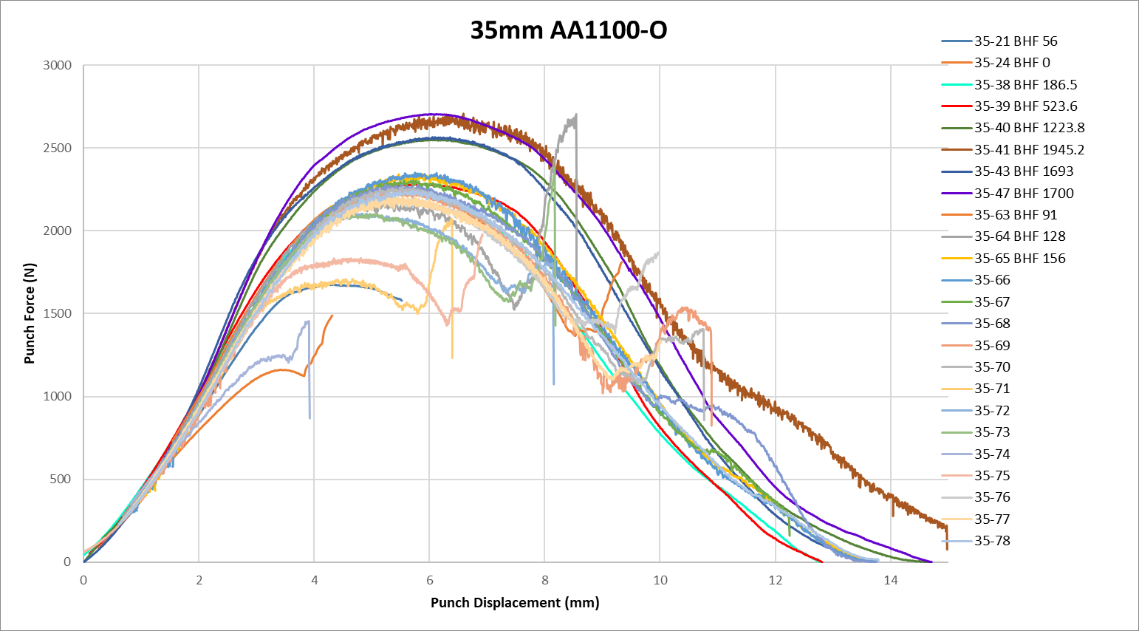

Slide 29
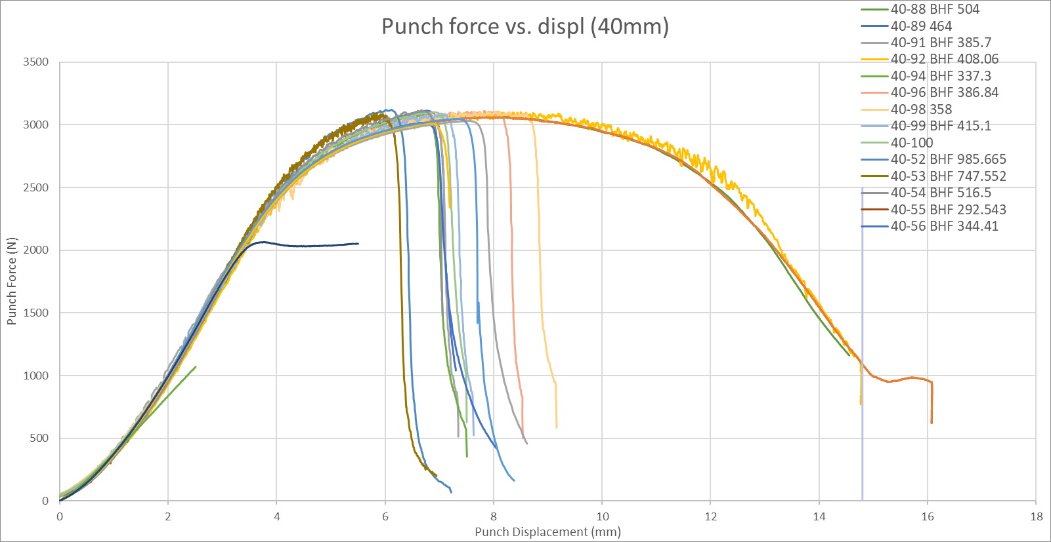

Slide 30
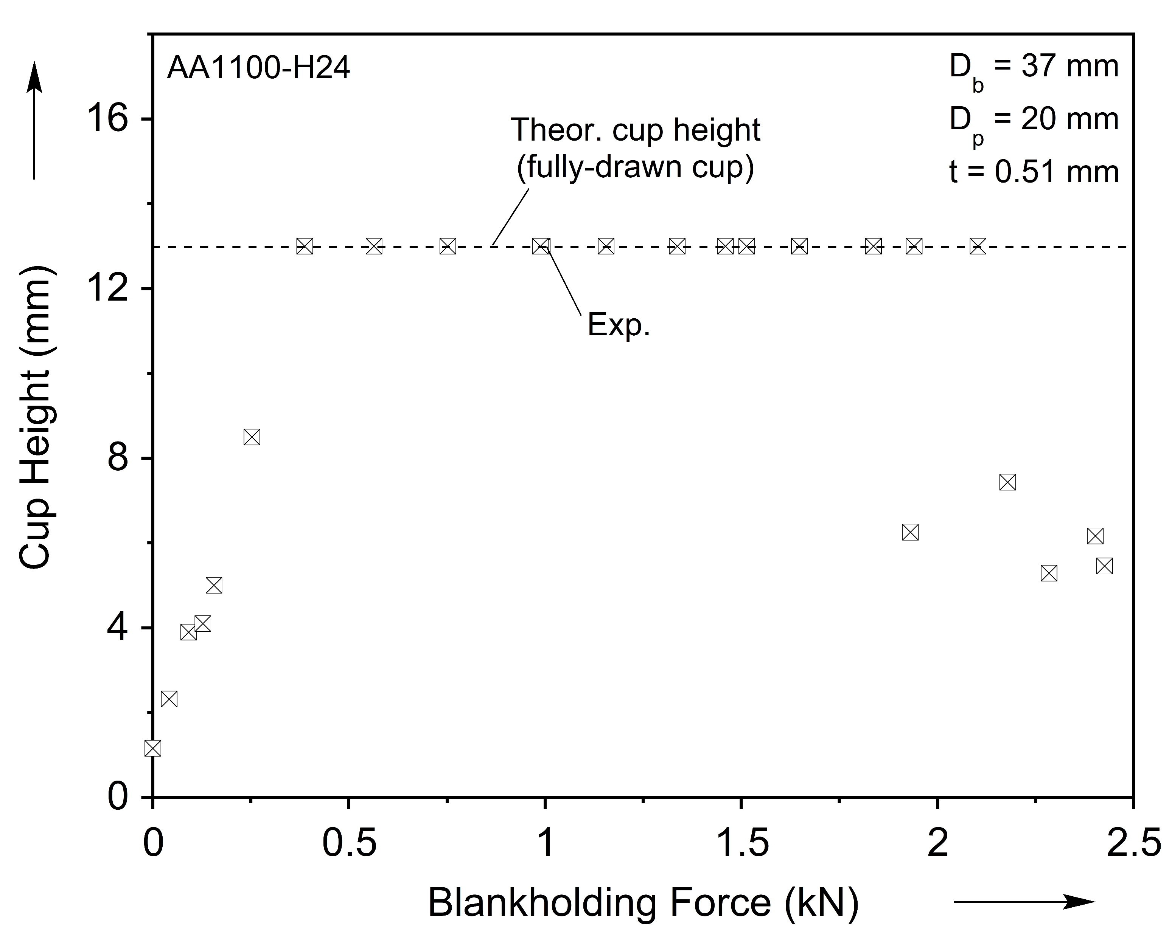
F4 – Workability envelope

Slide 31
Workability envelopes

Slide 32
Workability envelopes

Slide 34
Model Description
Ha et al., Mat’ls, 2020

Slide 35
Onset of wrinkling (punch disp vs BH disp)

Slide 36
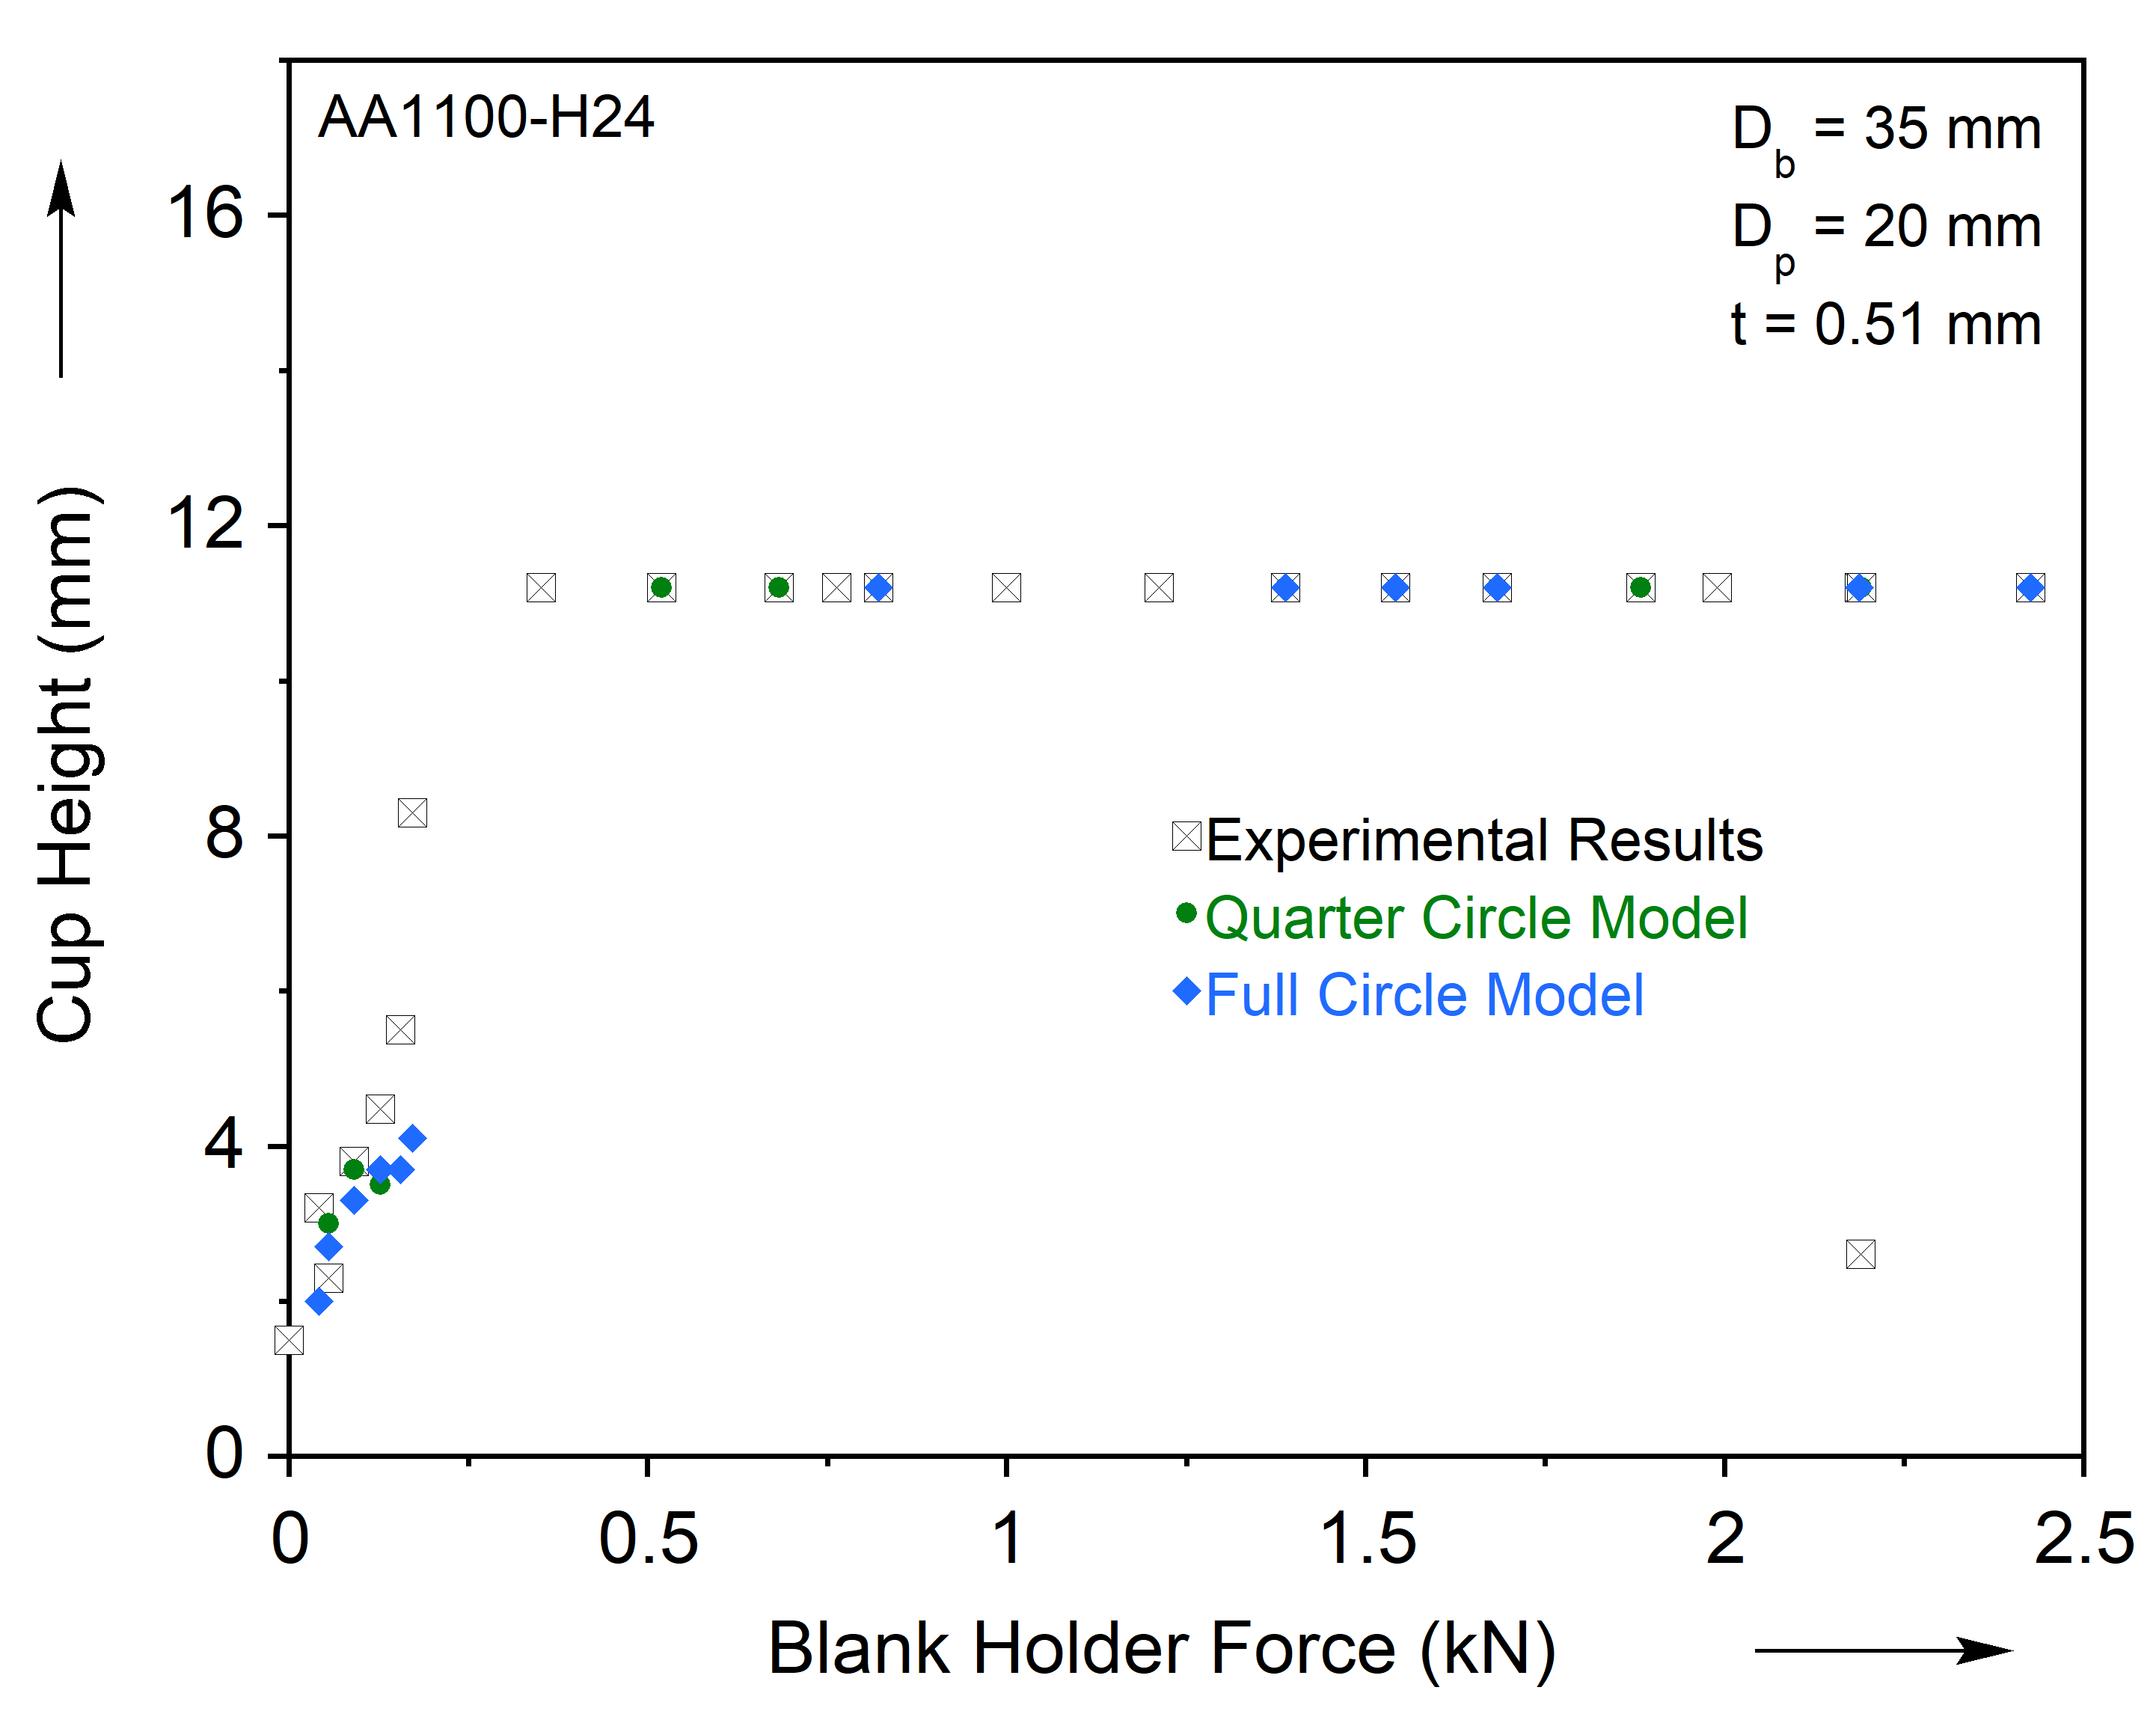

Slide 37
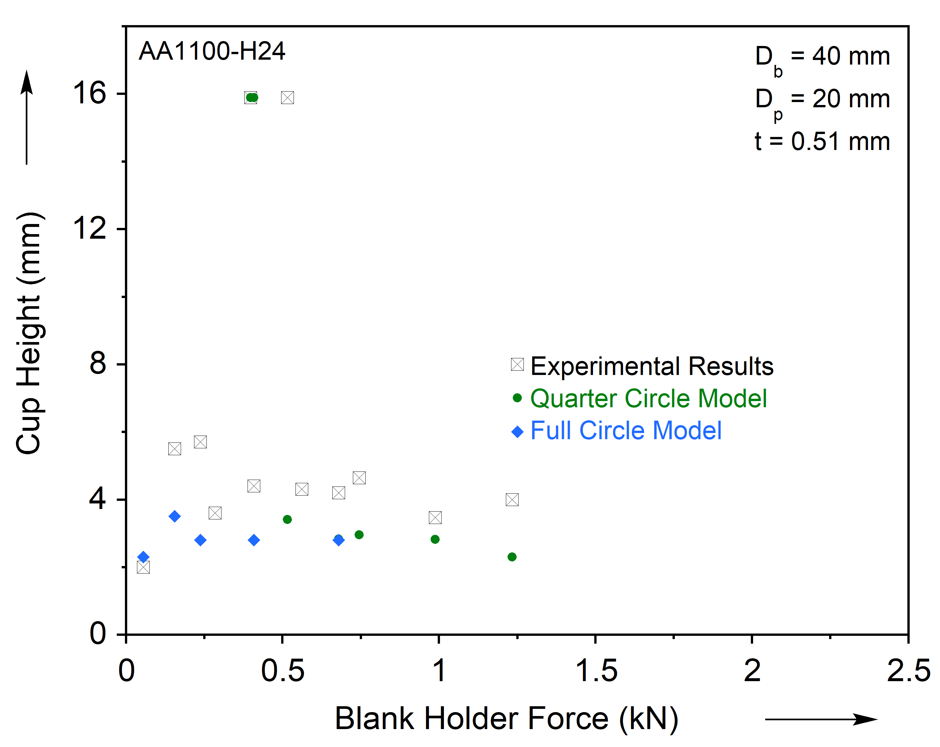

Slide 38
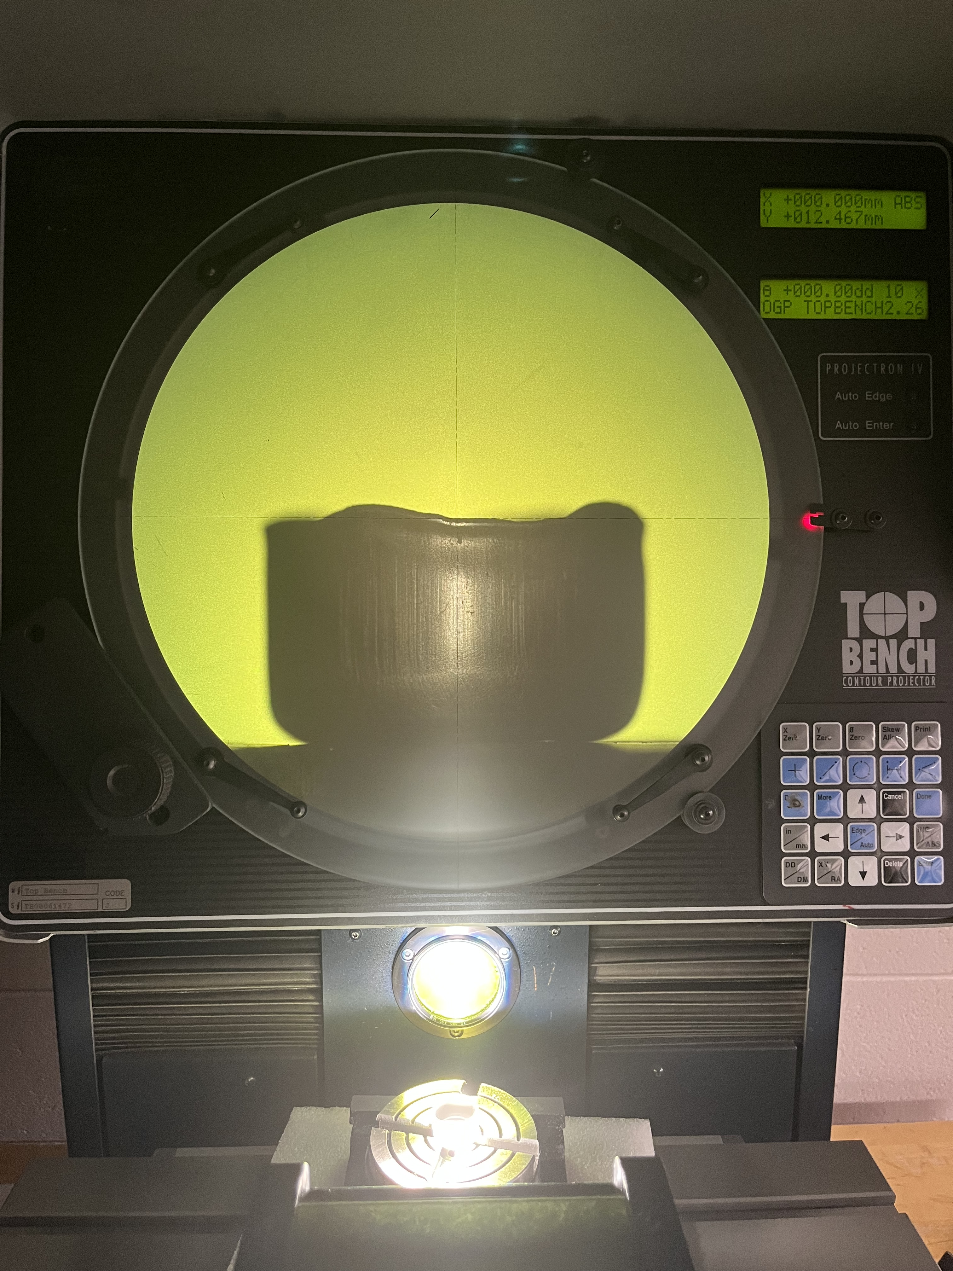
37 mm

Slide 39
