Slide 1
Multi-functional SMC-aluminum battery tray to drive lightweight design
Rico Schmerler¹, Claudia Drebenstedt¹, Michael Machhammer², Guan Gong³, Peter Wolf⁴
* Michael Machhammer

Slide 2





1 - Introduction
Requirments & Reference Case of the Battery tray
Major Element to improve LIGHTWEIGHT DESIGN?
Passive temperature control with PCM
Benefit of thermal management with PCM

Slide 3
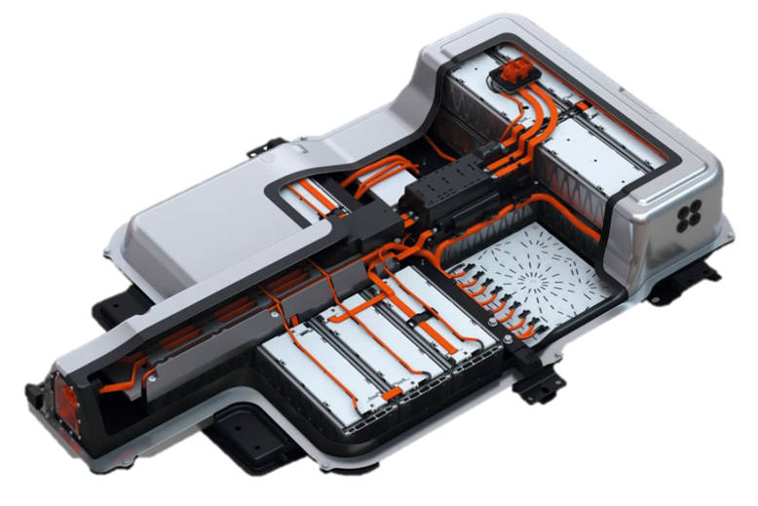
Requirments of the Battery tray
EV battery packs are enclosed in protective casings (battery housings) typically made from lightweight and durable materials that provide adequate strength and rigidity.
The choice of material depends on factors such as weight reduction, cost, and structural requirements.
The battery housing needs to withstand vibrations, impacts, and other mechanical stresses.
EV battery packs require efficient cooling or heating systems to maintain the ideal operating temperature range. Cooling is necessary to prevent overheating during charging or high-power usage, while heating helps maintain performance in cold weather conditions.
© Volkswagen
Notes:
An electric vehicle (EV) battery pack is a collection of individual battery cells that work together to provide power to an electric vehicle. The battery pack is a critical component of an EV as it stores and supplies energy to the vehicle's electric motor, allowing it to move.
Here are some key aspects of an EV battery system pack:
Battery Cells: The battery pack consists of numerous individual battery cells, typically lithium-ion (Li-ion) cells. These cells are connected in series and parallel configurations to achieve the desired voltage and capacity for the vehicle.
Thermal Management System: EV battery packs require efficient cooling or heating systems to maintain the ideal operating temperature range. Cooling is necessary to prevent overheating during charging or high-power usage, while heating helps maintain performance in cold weather conditions.
Packaging and Safety: EV battery packs are enclosed in protective casings typically made from lightweight and durable materials that provide adequate strength and rigidity. Common materials include aluminum, high-strength steel, and composite materials. The choice of material depends on factors such as weight reduction, cost, and structural requirements. They incorporate safety features such as crash protection, fire suppression systems, and measures to prevent short circuits or battery punctures.
Structural Integrity: The battery pack is designed to be robust and often forms part of the vehicle's structure, providing rigidity and support. It needs to withstand vibrations, impacts, and other mechanical stresses.
Battery packs must meet stringent crashworthiness standards to protect the battery cells and occupants in the event of a collision. The pack's structural design should include features such as crush zones, energy-absorbing materials, and reinforcement to maintain the integrity of the battery system and minimize the risk of cell damage or electrolyte leakage.
Thermal Management: Battery pack enclosures require efficient cooling systems to regulate the temperature of the battery cells during operation. This helps maintain optimal battery performance, prevent overheating, and prolong the life of the battery pack. Cooling systems can involve air or liquid cooling methods, depending on the specific design and requirements.

Slide 4
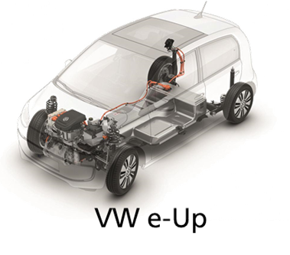
Reference Case of the Battery System
The battery housing of the VW e-Up from Volkswagen was defined as the demonstration structure.
For material and technology demonstration the lower tray of the housing was defined as the reference structure.
It provides most of the housing functionalities and represents a complex curved structure out of one
material type; in this case steel.
The design of the housing lid was not adjusted. Boundary conditions including design space, interfaces for assembly on the car body and positioning of power electronics were adopted from the reference.
© Volkswagen
Notes:
In this specific case, the battery housing of the VW e-Up from Volkswagen was defined as the demonstration structure. The e-Up
housing was of current interest at the time of the project start as the best-selling electric car model in the
first five months of 2021 in Germany [1]. For material and technology demonstration the lower tray of the housing was defined as the reference structure. It is very well suited for technology demonstration, as it provides most of the housing functionalities and represents a complex curved structure out of one material type; in this case steel. The design of the housing lid was not adjusted. Boundary conditions including design space, interfaces for assembly on the car body and positioning of power electronics were adopted from the reference.

Slide 5
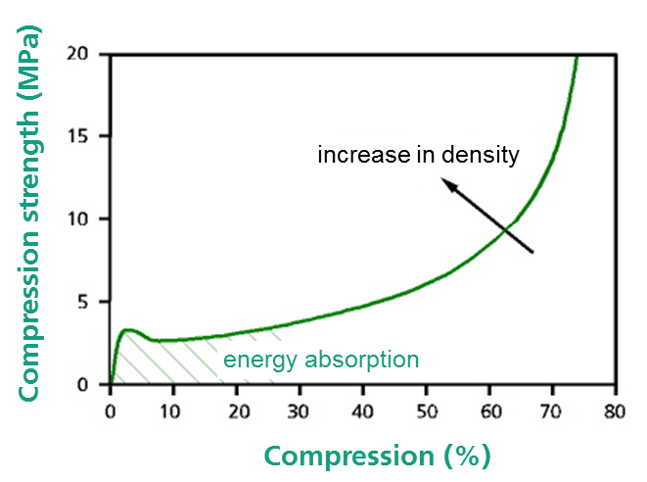
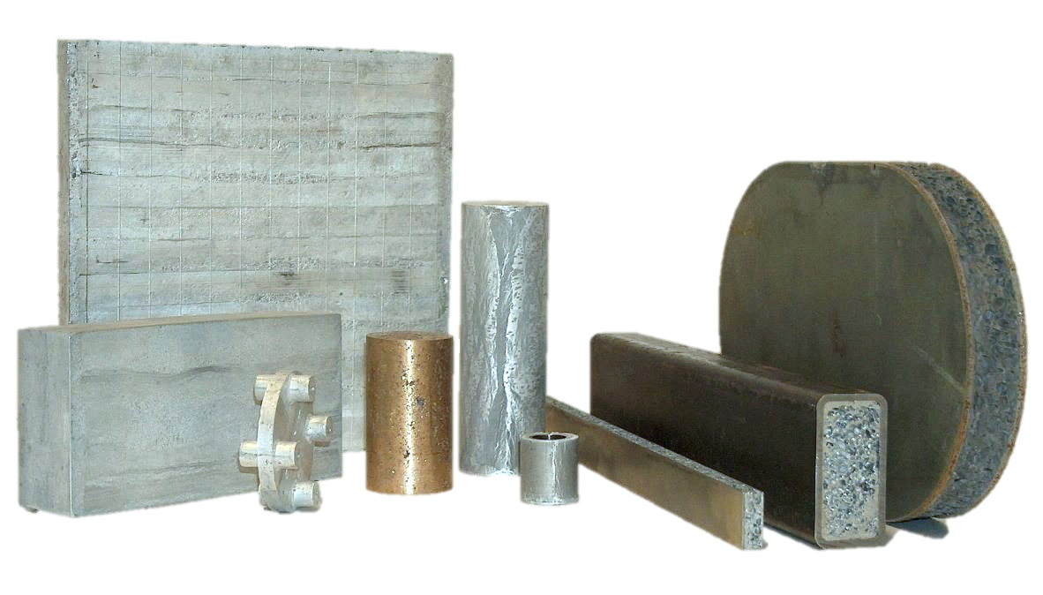
Major Element to improve LIGHTWEIGHT DESIGN?
light
rigid
Metal Foam
energy absorbing
Open porous
Closed porous
recycable
shielding
temperature resistant
METAL FOAM AT FRAUNHOFER IWU
Notes:
Using aluminum foam in the design of an electric vehicle (EV) battery pack can offer several potential benefits, including increased lightweight potential. Aluminum foam is a composite material that combines the lightweight properties of aluminum with the structural advantages of a foam structure. Here's how it can contribute to lightweighting in EV battery packs:
Reduced Weight: Aluminum foam is lightweight, typically weighing about 30-50% less than solid aluminum with similar dimensions. By incorporating aluminum foam into the structural components of an EV battery pack, it can help reduce the overall weight of the pack, resulting in improved energy efficiency and extended driving range.
Strength and Stiffness: Despite its reduced weight, aluminum foam exhibits good strength and stiffness properties. It can provide adequate structural integrity to the battery pack, ensuring that it can withstand mechanical loads and vibrations during vehicle operation.
Improved Crashworthiness: Aluminum foam has excellent energy-absorbing capabilities, making it effective in enhancing crashworthiness. It can absorb and dissipate impact energy during a collision, reducing the forces transmitted to the battery cells and minimizing the risk of damage or thermal events.
[Cellular Structure: Aluminum foam has a cellular structure composed of interconnected voids or pores. These voids act as energy absorbers by compressing and deforming when subjected to external forces. The foam's structure allows for the dissipation of impact energy over a larger area, reducing the concentration of forces and enhancing energy absorption]
[Crushing Behavior: Aluminum foam demonstrates excellent crushing behavior, meaning it deforms plastically under compressive loads. When subjected to impact or crushing forces, the foam undergoes controlled deformation by buckling and folding of its cellular structure. This plastic deformation absorbs and dissipates energy, providing high energy absorption capabilities.]
Thermal Management: Aluminum foam has inherent thermal conductivity, which can aid in the efficient dissipation of heat generated by the battery cells. By incorporating aluminum foam into the battery pack's structure, it can facilitate better heat transfer, helping to maintain optimal operating temperatures and extending the lifespan of the battery cells.
Vibration Damping: Aluminum foam has inherent damping properties, which can help reduce vibrations and noise within the battery pack. This can contribute to improved overall ride comfort and reduced noise levels in the vehicle cabin.
Design Flexibility: Aluminum foam can be molded into various shapes and configurations, allowing for design flexibility and customization. This adaptability makes it easier to integrate aluminum foam components into the specific requirements and space constraints of an EV battery pack.

Slide 6
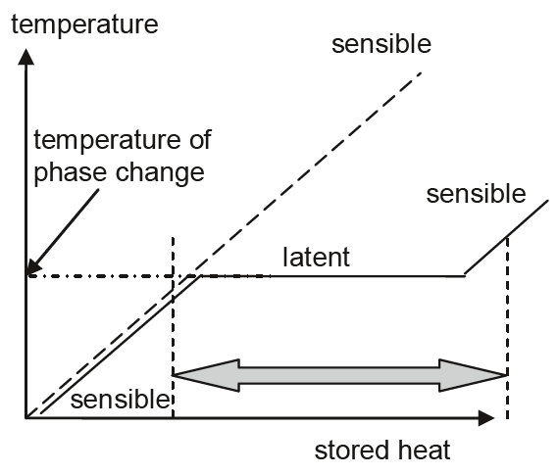
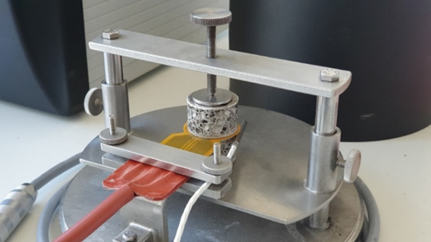
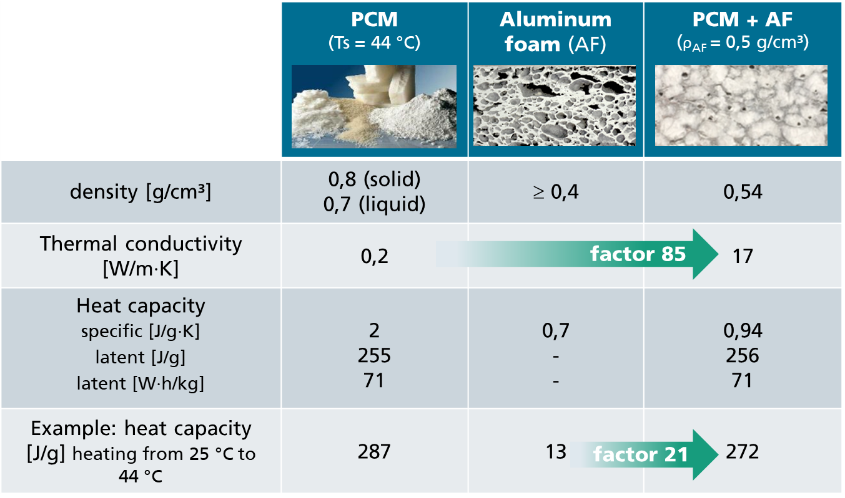
Passive temperature control with PCM
Phase Change Material (PCM) for passive temperature control
Paraffin: storing / releasing high amounts of heat during phase change
  state of aggregation is a reversible process
  adjustable melting range
  physiologically harmless
  dielectric
  high thermal capacity
  but: low thermal conductivity!
© Rubitherm
1) © Heat and Cold Storage with PCM_Mehling_Cabeza_Springer
Notes:
Phase Change Materials (PCMs) can be combined with aluminum foam to create a composite material that offers passive temperature control capabilities. Paraffin is one example of a PCM that is commonly used in such applications. Here's how the combination of PCM (paraffin) and aluminum foam can enable passive temperature control:
Thermal Energy Storage: PCMs, like paraffin, have the ability to store and release thermal energy during phase transitions. Paraffin typically has a melting point within a desired temperature range. When the surrounding temperature rises above the melting point, the paraffin absorbs heat and undergoes a phase change from solid to liquid, storing the thermal energy. Conversely, when the temperature drops below the solidification point, the paraffin releases the stored energy as it solidifies.
Enhanced Heat Transfer: Aluminum foam with its high thermal conductivity and large surface area acts as a medium for improved heat transfer. It can efficiently transfer heat to or from the PCM, enabling faster phase change and enhanced temperature regulation.
Passive Temperature Control: By integrating paraffin PCM within the open cells or pores of aluminum foam, the composite material can passively regulate temperatures. During temperature fluctuations, the PCM absorbs or releases thermal energy, helping to maintain a more stable environment. The aluminum foam aids in distributing the heat or cooling effect throughout the material, enhancing the overall temperature control capabilities.
Applications: The combination of PCM (paraffin) and aluminum foam can be used in various applications, such as building insulation, thermal storage systems, temperature-regulating packaging, and passive temperature control devices. These applications benefit from the ability of the composite material to absorb excess heat and release it when needed, reducing the reliance on active cooling or heating systems.
It's important to note that the performance of the PCM-aluminum foam composite material depends on factors such as the specific PCM formulation, foam density, and geometry. Additionally, proper design considerations, such as optimizing the surface area of the foam and ensuring sufficient contact between the PCM and foam, are crucial for efficient heat transfer and temperature control

Slide 7
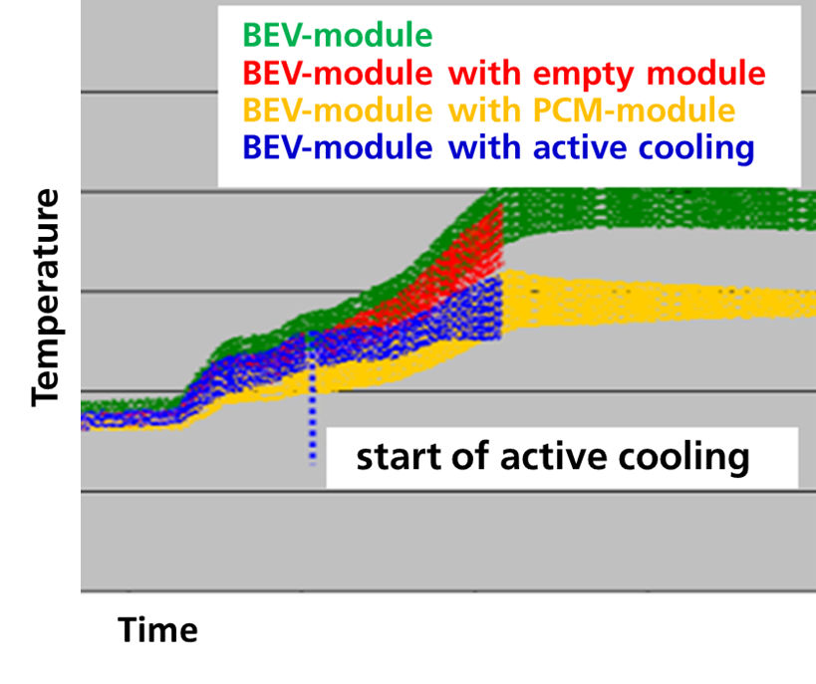
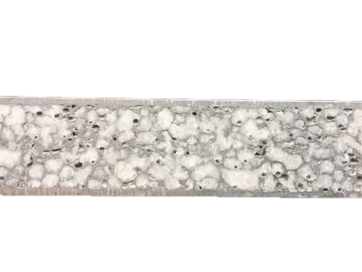
Benefit of thermal management with PCM
Complete passive thermal management
(load case depend, defined temperature area)
Downsizing/supporting active systems
Flatten thermal load peaks
Increasing of temperature homogeneity
Preventing / mitigation thermal runway
Infiltration with pressure and/or vacuum into a mold or direct into a part
Notes:
Beside structural aspects a proper thermal design of the battery structure is essential for secure and efficient operation. The battery cells, dissipating heat while charging or discharging, needs to be kept in a defined temperature range. For the often used lithium ion batteries the upper temperature limit is in the range of 50 - 60 °C [3]. Exceeding these temperatures is a high risk for passengers as it can lead to thermal runaway and propagation [4]. The approach of the SafEBat design is a passive temperature control using the phase change material paraffin with a melting area around 40 °C, storing or rather releasing a high amount of energy during their phase change liquid to solid and reverse. This thermal energy storage material (PCM) is integrated into the structural aluminum foam sandwich core. The closed cell aluminum that is produced via powder metallurgical rout has micro cracks and partly small holes in the cell walls enabling the infiltration. The foam acts as a thermal conductive matrix, increasing the low thermal conductivity of PCM with 0.2 W/(m٠K) by factor 85 for the PCM-aluminum foam composite. By integrating around 5 kg of the PCM a heat of circa 360 W٠hr can be stored. Additionally, to the maximum temperature limitation, thermal load peaks should be flattened and the temperature homogeneity increased. Integrating and using the PCM is a design feature with the purpose of using high power battery cells that most likely dissipate more heat than high capacity cells. Depending on the environmental conditions a heat exchange with the environment is desired.

Slide 8
2 - SafEBat Project
Project - Project consortium & Funding
Project goal

Slide 9




SafEBat – Project consortium & Funding
Goals and value
  Increase in passenger safety
  Improved system health monitoring
  Saving of manufacturing steps / costs
  Flexibility (focus thermal behavior)
  Use of high-performance cells, faster charging

Slide 10
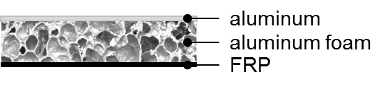
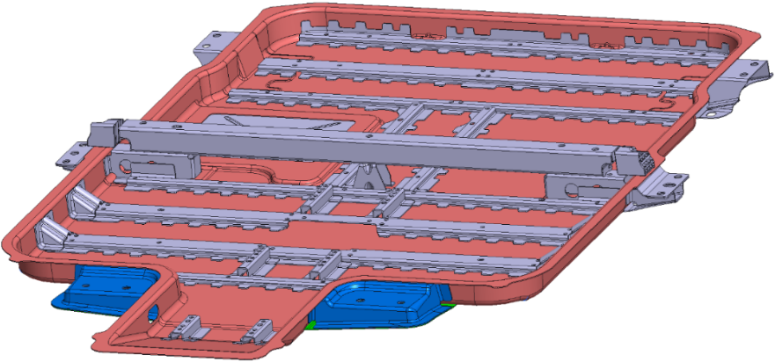
SafEBat – Project goal
Weight reduction of 15-20%
Thermal functions: switchable temperature control and passive temperature control
Sensor integration for health monitoring of the housing / system
Increase in underbody protection and proof on experimental stage
→ at least 20% reduction in penetration depth in the bollard test
→ Development and process design of an FRP-aluminum foam sandwich battery housing with integrated sensors and thermal management in true scale
Reference

Slide 11
3 – SafEBat / Battery Box Concept
Design lower tray
Acoustical behavior
Structural analysis (Side pole test results)
Structural analysis (Bollard test)
Thermal concept
Notes:
The structural and mechanical design of the SafEBat battery housing was developed taking the four load cases into account that are illustrated schematically in Figure 1. For the quasi-static load case no deflection of the housing structure was allowed while being loaded by the weight of the battery modules, which could be achieved. Furthermore the acoustical behavior of the SafEBat design in terms of the first bending and torsion natural frequency should be at least as high as for the reference. Two dynamic load cases completed the structural requirements: Two critical dynamic load cases were chosen for evaluating the mechanical performance: The side pole impact test according to the Euro NCAP regulations [2] and the bollard test, which is an original equipment manufacturer (OEM) test concerning intrusion protection from underneath the vehicle.

Slide 12
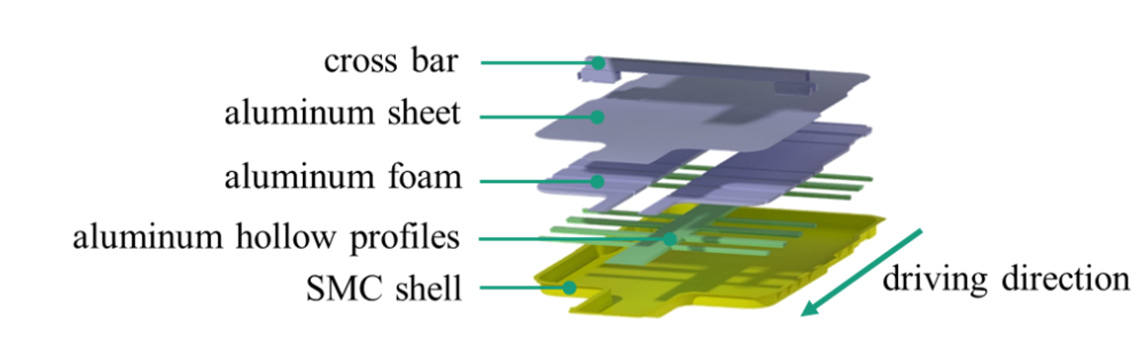
SafEBat – Design lower tray
Reference
  Cross bar
  Aluminium sheet
  Aluminium foam
  Aliminium hollow profiles
  SMC shell
driving direction
Steel sheet 1.5mm
Steel cross bars welded on steel sheet
Steel crash bars
Steel crash mounting parts
Separate steel car body mounting
SMC sheet 1.5mm
Aluminium foam 15mm
Aluminium cover sheet 2.0mm
Aluminium cross bars integrated into sandwich core
1 big air channel @ middle
Aluminium crash bar
Aluminium crash mounting parts
Separate steel car body mountings
→ Weight reduction of ca. 15% o.r. 5 kg
Notes:
Before presenting the performance comparison between the reference and SafEBat structure for these load cases, the component structure will be explained. The reference lower tray is based on a deep drawn 1.5 mm thick steel sheet stiffened with welded steel bars and mounting elements. In contrast to the multi-unit reference, the SafEBat design consists out of less parts, illustrated in Figure 2. Its outer shell is a carbon fiber reinforced sheet molding composite (SMC) with a thickness of 1.5 mm. The SMC contains 50 wt. % of 25 mm 12K carbon fibers (CF). An aluminum foam core of 15 mm thickness with integrated aluminum hollow profiles in combination with a 2 mm thick aluminum top sheet completes the sandwich. The foam density is 0.6 g/cm³. With this multi-material lightweight design, the weight of the reference lower tray could be reduced by 15 %. As mentioned before the housing lid for both variants is the same, consisting mainly of fiber reinforced plastics (FRP). The central crash bar was kept as well in the new design.

Slide 13
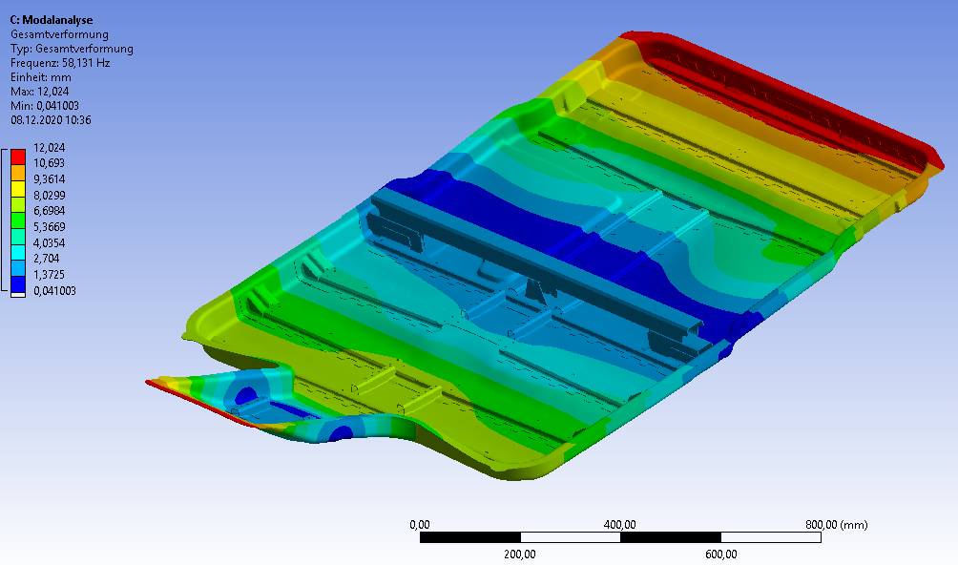
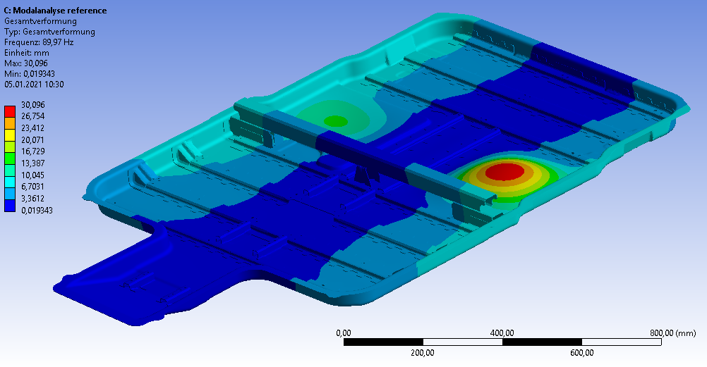
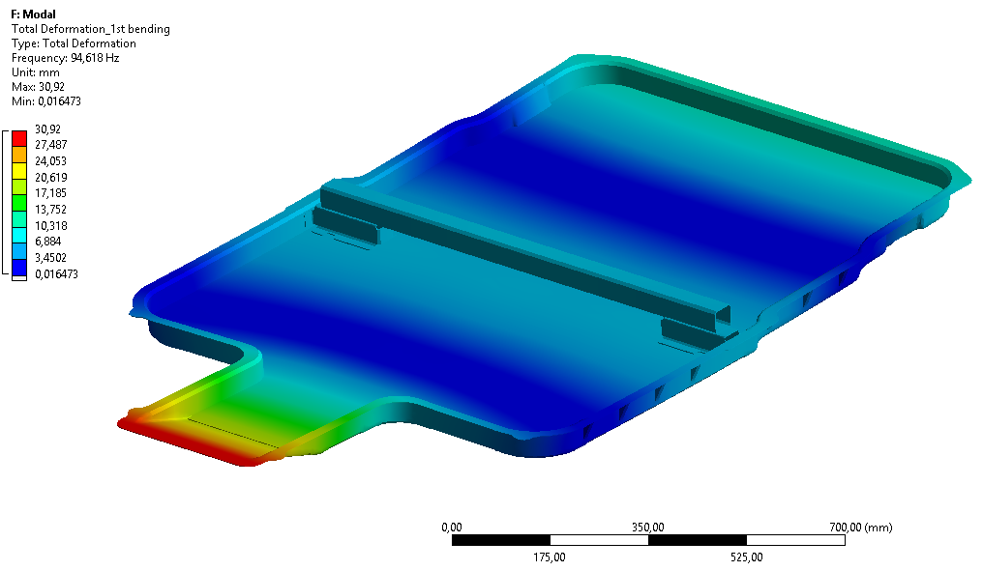
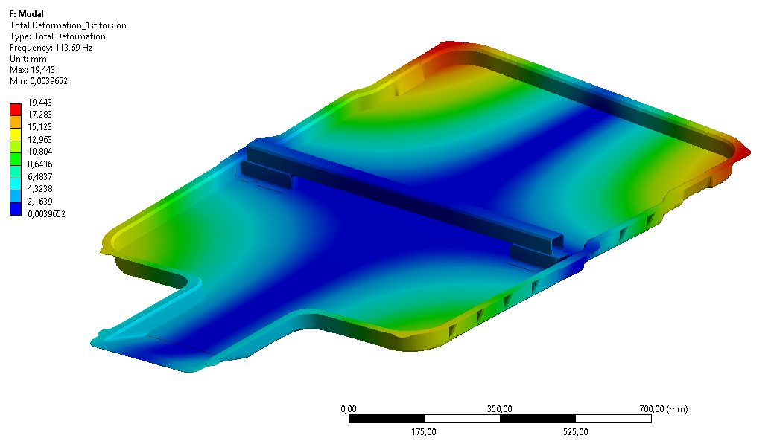
SafEBat – Acoustical behavior
Lid and car body mountings were not taken into consideration so far
Results for acoustical behavior indicate higher global bending stiffness of the lower tray
1st bending mode
1st torsion mode
Reference
Reference
 | Reference | SafEBat | Comp. ref
1st bending | 58,1 Hz | 94,6 Hz | + 63 %
1st torsion | 90,0 Hz | 113,7 Hz | + 26 %
SafEBat
SafEBat
Notes:
A natural frequency analyses with a free-free boundary condition was simulated. For this setup of the
lower tray the first bending natural frequency was 63 % higher than for the reference. Besides the first
torsion natural frequency was increased by 26 %. These values meet the requirements with achieving at
least the first natural frequencies as the reference and indicate a higher global bending and torsion
stiffness.

Slide 14
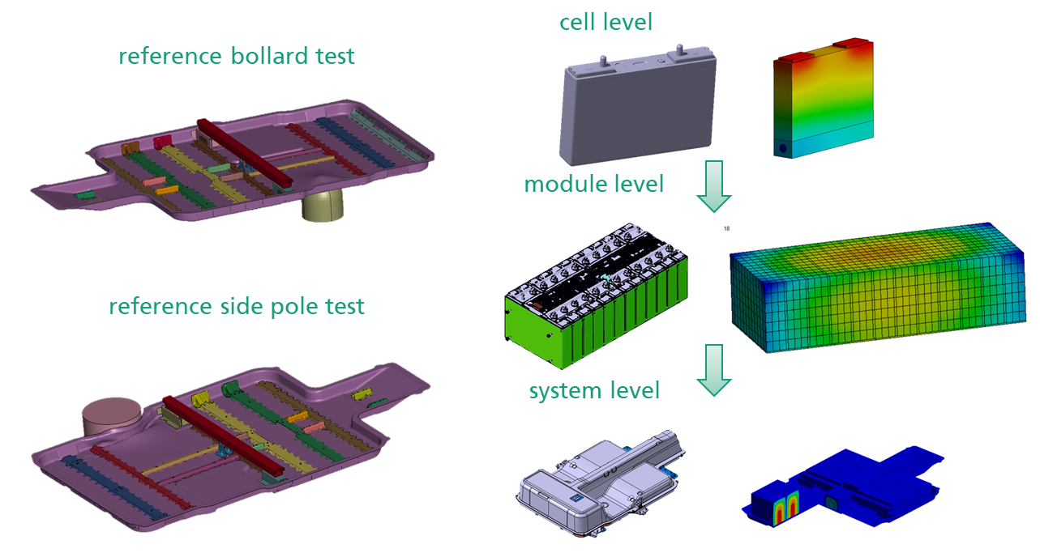
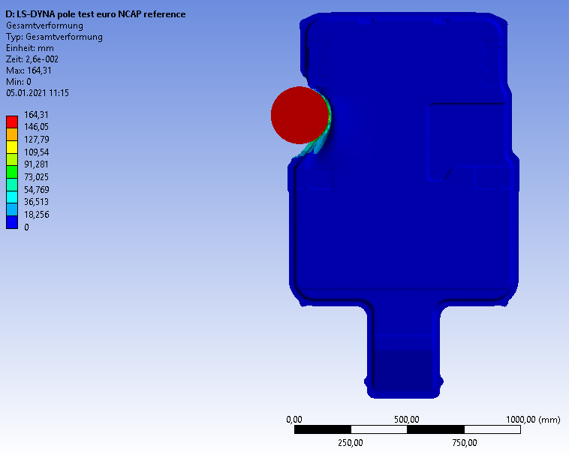
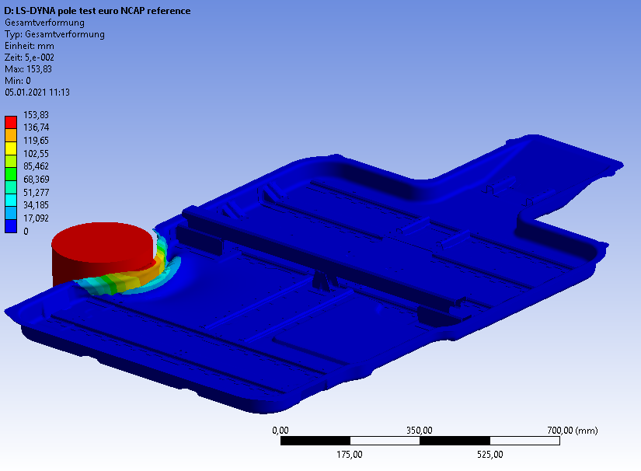
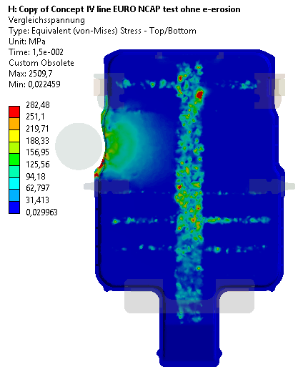
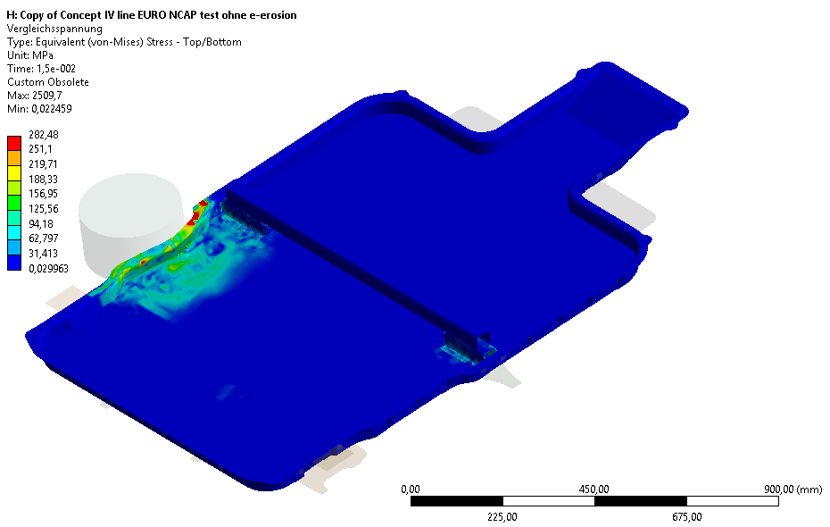
SafEBat – Structural analysis (Side pole test results)
Acc. Pole impact according Euro NCAP
Results for new design:
-75% deformation
Brittle damage behavior most likely reduced through sill load distribution, but issue
→ thickening & supporting flange area with ribs
Reference
SafEBat
Notes:
With regard to the dynamic load case of the side pole impact, a bollard with a diameter of 254 mm was impacting under an angle of 15° from the side und a velocity of 32 km/hr at the weakest position of the battery. For all mechanical simulations ANSYS Workbench and for dynamic load cases the extension of LS-Dyna was used. In a real car crash for this scenario the main energy is absorbed through the sill that was not available and hence not considered. Since, with the goal of comparing the SafEBat with the reference design, the impact energy of the pole was limited to 2.3 kJ. An unstiffened area on the left side of the tray was defined as a local structural weak-point and thus chosen as the impact area. The simulation results show a deflection decrease of 75 % for the SafEBat structure, going ahead with a maximum force peak increase of 192 %. Consequently, the intrusion into the battery housing could be reduced significant. With focus on damage the new design behaves more brittle than the more ductile steel reference. Most likely this effect can be reduced through sill load distribution, thickening, and supporting the flange area for instance with ribs.

Slide 15
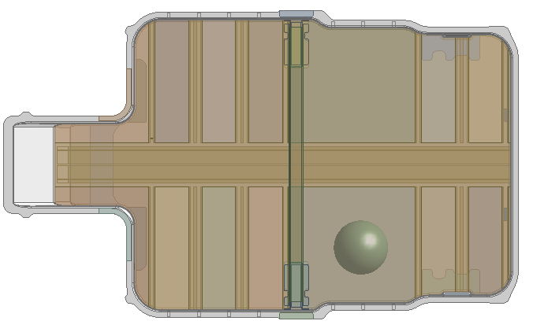
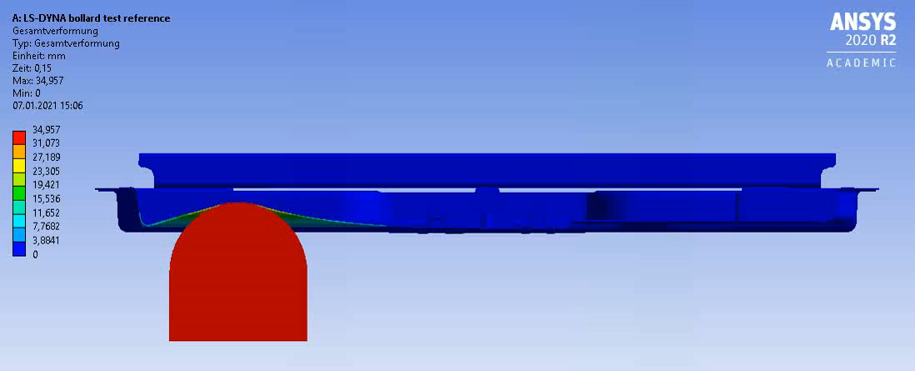
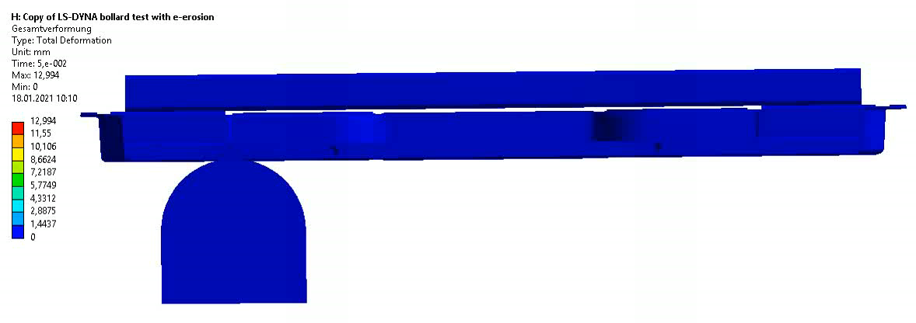
SafEBat – Structural analysis (Bollard test)
OEM-specific bollard test: Re-positioning of bollard for weakest area
Results for new design:
  -73% max. deformation
  -28% s_intrusion
Reference
Reference:
SafEBat:
s_total = 35mm
s_total = 10mm
Notes:
One of the main project goals was to increase the under-body protection for a higher battery safety. With the help of the bollard test this should be investigated. In this load scenario a bollard hits the battery housing at an angle of 90° from underneath. The impact energy for design comparison was set to 150 J according to a vehicle weight of 1,600 kg. The local, structurally weak impact area is indicated in Figure 1. Under the defined boundary conditions the maximum deformation of 35 mm for the reference could be reduced by 73 % using the new sandwich design. Taking into account the required design space in z or rather thickness direction, the intrusion was reduced by 28 %.

Slide 16
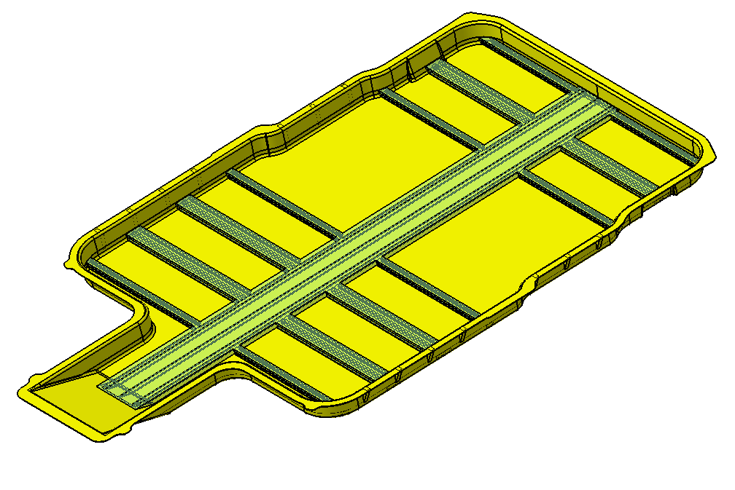

SafEBat – Switchable temperature control
Flap / valve closed → isolation
Flap / valve open → cooling
Air
Air
scenario isolation
scenario cooling
Notes:
Depending on the environmental conditions a heat exchange with the environment is desired. In Figure 3 two scenarios are sketched. In case of an environmental temperature that is above the necessary battery temperature condition the thermally low conductive SMC has an isolating function, see Figure 3 (a). In the second scenario a heat exchange with the colder environment is desired for battery cell cooling, see Figure 3 (b). In Figure 3 the foam and sandwich top layer are hidden for better visualization of the concept. In this case flaps positioned in the front of the central hollow profiles open enabling a flow through the channels and with this dissipating heat from the battery system.

Slide 17
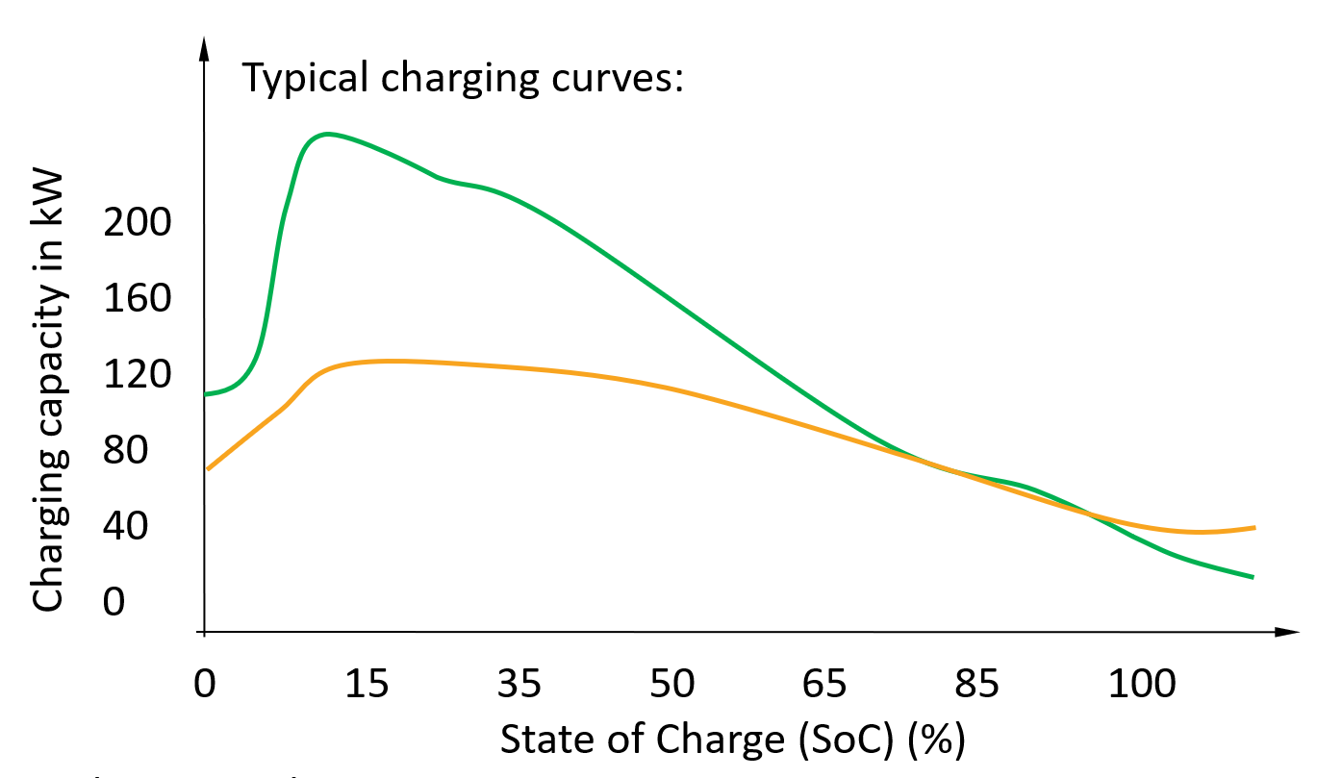

SafEBat – Heat storage
Implementation of approx.: 6 kg PCM (e.g.: Paraffin)
Passive storage (latent heat) capacity through PCM: approx.: 0.425 kWh
20 % * 2 kWh = 0.444 kWh
approx ~10% is dissipated as heat = ~2 kWh
Approximately 20% energy can be stored through utilizing the latent heat which is required for the Paraffins phase change !
(80% - 20%) * 37 kWh
22 kWh
20%
80%

Slide 18
4 – SafEBat / Manufacturing of the Battery Box
Production process aluminum foam part
Embroidered Sensors for CMS
Test tool
Demonstrator tool

Slide 19
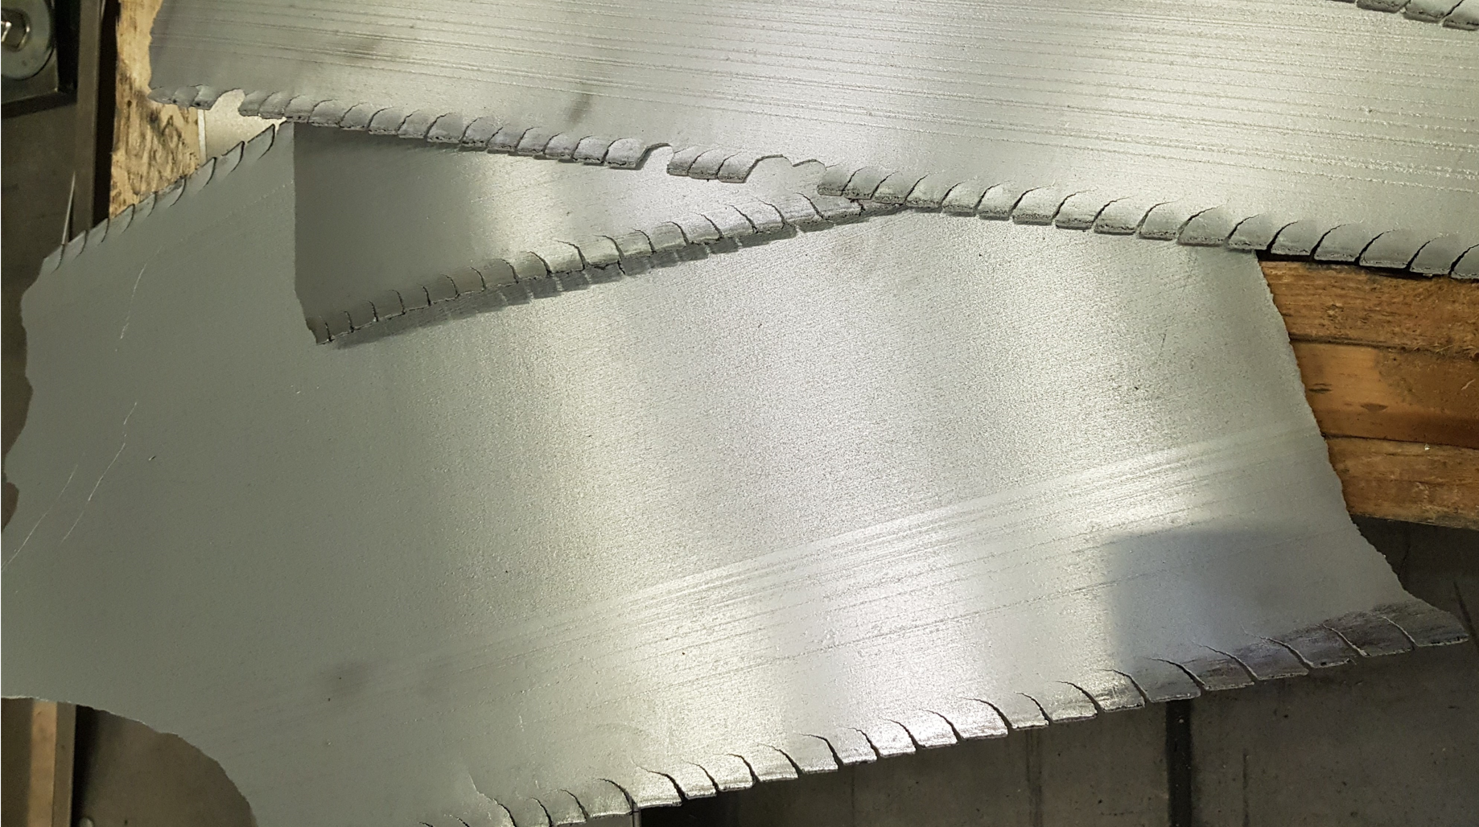
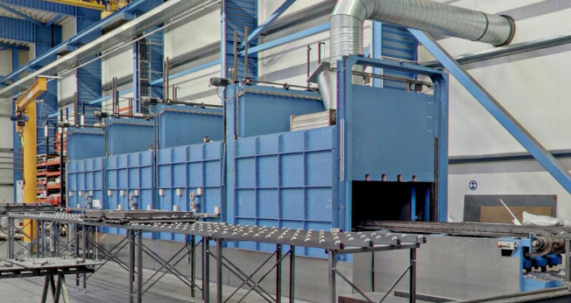
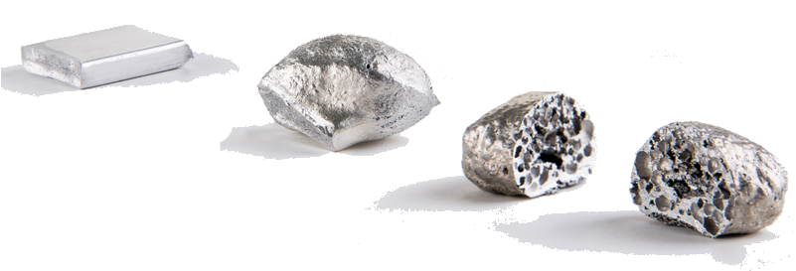
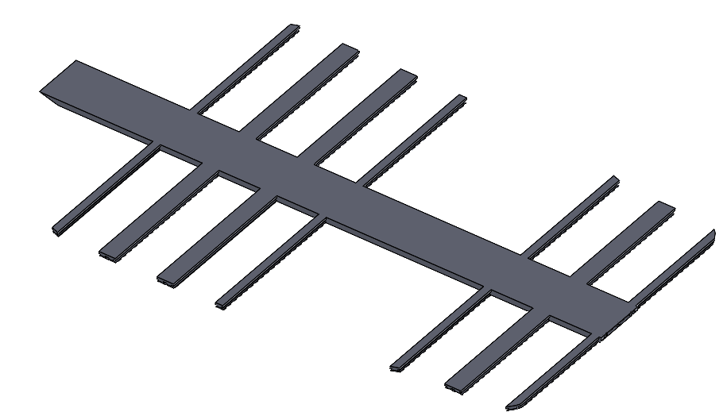
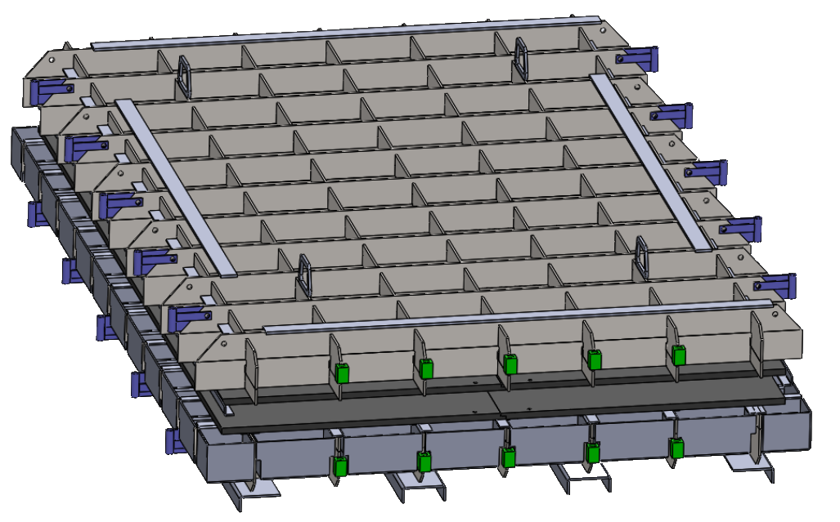
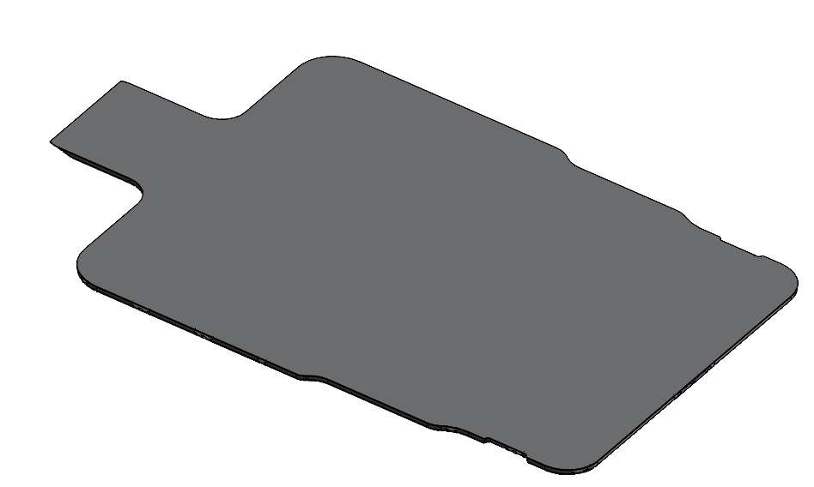
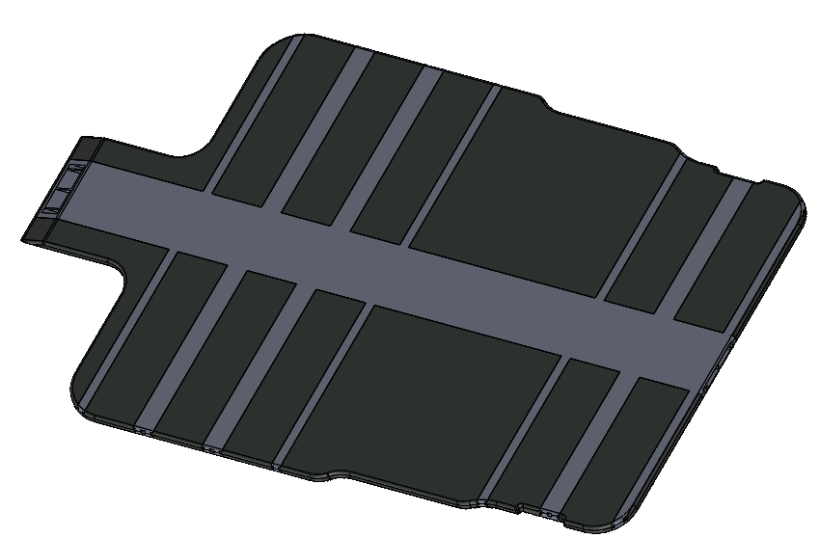
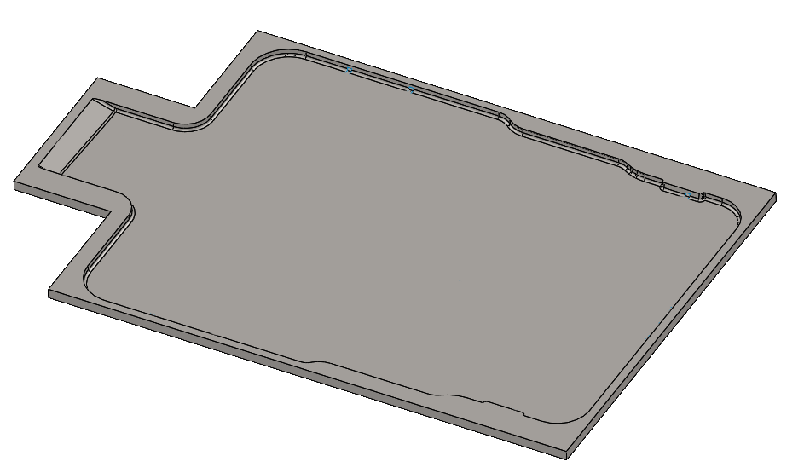
SafEBat – Production process aluminum foam part
Foamable rolled aluminum band
Multi chamber foaming oven
Extruded aluminum profiles
and cover sheet
Standard carrier for molds
up to 2.000mm x 1.000mm
→ Foamable material expands in hollow sections
→ Connection between cover sheet, foam and
profiles
Mold for foaming process
© HMF
Notes:
The precursor for the foam consists of the aluminum alloy AlSi10 that was mixed with titanium di-hydride (TiH2) in portion of about 0.8 weight-% and further additives. TiH2 serves as the foaming agent. The TiH2 splits into titanium and hydrogen beginning at temperatures around 400 °C [5]. At temperatures around 600 °C the released hydrogen in combination with the molten aluminum builds up the pore structure. The mixed powder can be pressed into required shapes with extrusion or rolling, like
the flat aluminum band shown in Figure 4. After the precursor cutting into desired portions it is placed into a foaming mold of graphite or steel. The mold is closed in the next step and positioned on a supporting carrier structure, before it is positioned in an oven, where the foaming is processed under
temperature.

Slide 20

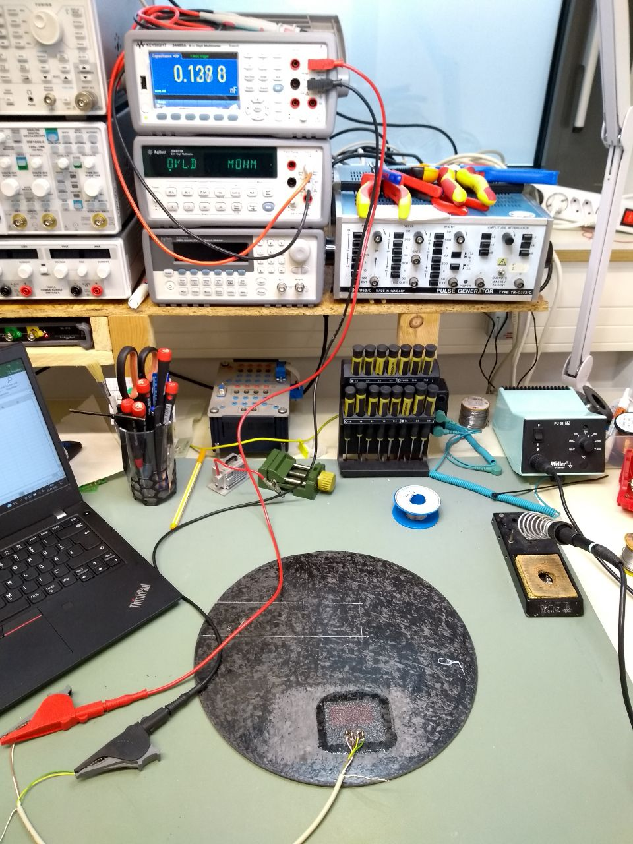
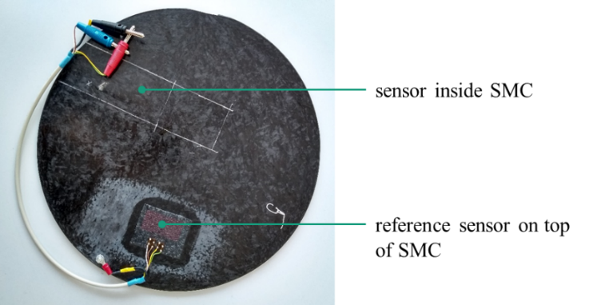
SafEBat – Embroidered Sensors for CMS
FiberCheck - Condition-Monitoring-System (CMS) for Fiber reinforced components with sensors integrated inside composite
Sensor: 120 ohms (industrial Standard for strain sensors)
Goal: 1 Layout for 3 Measurements
  Strain
  Temperature
  Moisture
Embroidery involves stitching or functional designs onto fabric or other materials using thread or yarn. In the case of embroidered strain sensors, conductive threads or yarns are incorporated into the embroidery process to create sensing elements.
© FiberCheck
Notes:
As an intended technological advancement, the existing embroidered strain sensor was taken as a base
and further developed according to the requirements of the battery tray. Conventional sensors of this
type have so far only been manufactured for wind power applications. These sensors formed the starting
point for this project. The layout of the sensors was optimized iterative.
This included a variation of the area of the sensors and the resistance value that can be applied to them.
Sensors that are too large form an antenna structure and are therefore susceptible to electromagnetic
influences. Sensors that are too small can no longer be evaluated electrically and therefore do not display
a measured value. As a final solution for battery case monitoring, the following characteristics were
identified for the sensors. The basic resistance is 120 ohms, so that the best compromise between antenna
and electrical properties is chosen. In addition, the sensors with this resistance value are industry compatible, so that evaluation via existing control units is easily possible. About 0.5 m of wire was
embroidered for the sensor. With the necessary embroidery thread spacing of 1 mm, this creates a
sensitive area of 4.2 cm² with side dimensions of 21 x 20 mm
3.1.4. Sensor integration. The sensors were adapted for the battery housing and integrated into the SMC manufacturing process. A test sample is shown in Figure 8. During the first integration, it was also possible to gain insights into practical implementation, such as ensuring contact and fixing the position of the sensors as well as cable routing from the floor area. When handling the sensors, it also became clear that they require an insulating layer in the conductive SMC material. Glass fiber mats were used for this, which at the same time protect the wire structure from damage.
The sensor excitation experiments were carried out on a test stand press. A metal stamp was chosen for stimulation. In the test, the stamp position and the occurring strains were measured directly on the press and compared with a reference sensor on top. The tests were carried out in a path-controlled manner and the sensor data was recorded with a measuring amplifier.
Embroidered strain sensors can be used in Sheet Molding Compound (SMC) materials or battery housings to monitor strain and deformation. Here's how they can be applied in these specific contexts:
SMC Materials: SMC is a composite material that consists of a thermosetting resin matrix reinforced with chopped fibers. Embroidered strain sensors can be integrated into SMC components during the manufacturing process. The conductive threads or yarns are stitched into the SMC material, either on the surface or embedded within the layers. As the SMC component undergoes strain or deformation, the embroidered strain sensors detect the changes in electrical resistance, providing real-time strain measurements.
Battery Housings: Battery housings, whether for electric vehicles or portable electronics, can experience mechanical stress and deformation during operation or external impacts. Embedding embroidered strain sensors within the battery housing allows for monitoring the strain levels and detecting any potential structural issues or excessive deformation. The strain sensors can be applied directly onto the surface of the housing or integrated into the material layers during the manufacturing process.
Benefits of using embroidered strain sensors in SMC materials or battery housings include:
Real-Time Monitoring: The strain sensors provide continuous monitoring of strain levels, enabling the detection of potential failures or fatigue in the material or structure.
Non-Intrusive Integration: Embroidered strain sensors can be seamlessly integrated into the material or housing without significantly affecting the overall design or functionality.
Flexibility and Conformability: The flexibility of the conductive threads or yarns allows the strain sensors to conform to complex shapes and contours, ensuring accurate strain measurement in various locations.
Lightweight and Space-Efficient: Embroidered strain sensors add minimal weight and thickness to the SMC material or battery housing, making them suitable for applications where weight and space constraints are critical

Slide 21
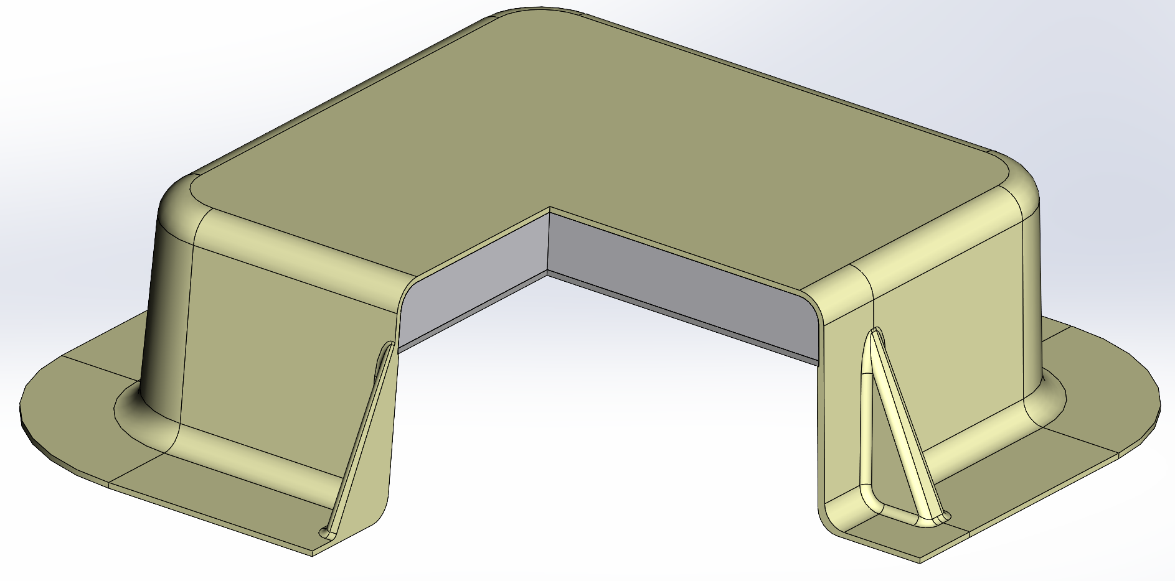
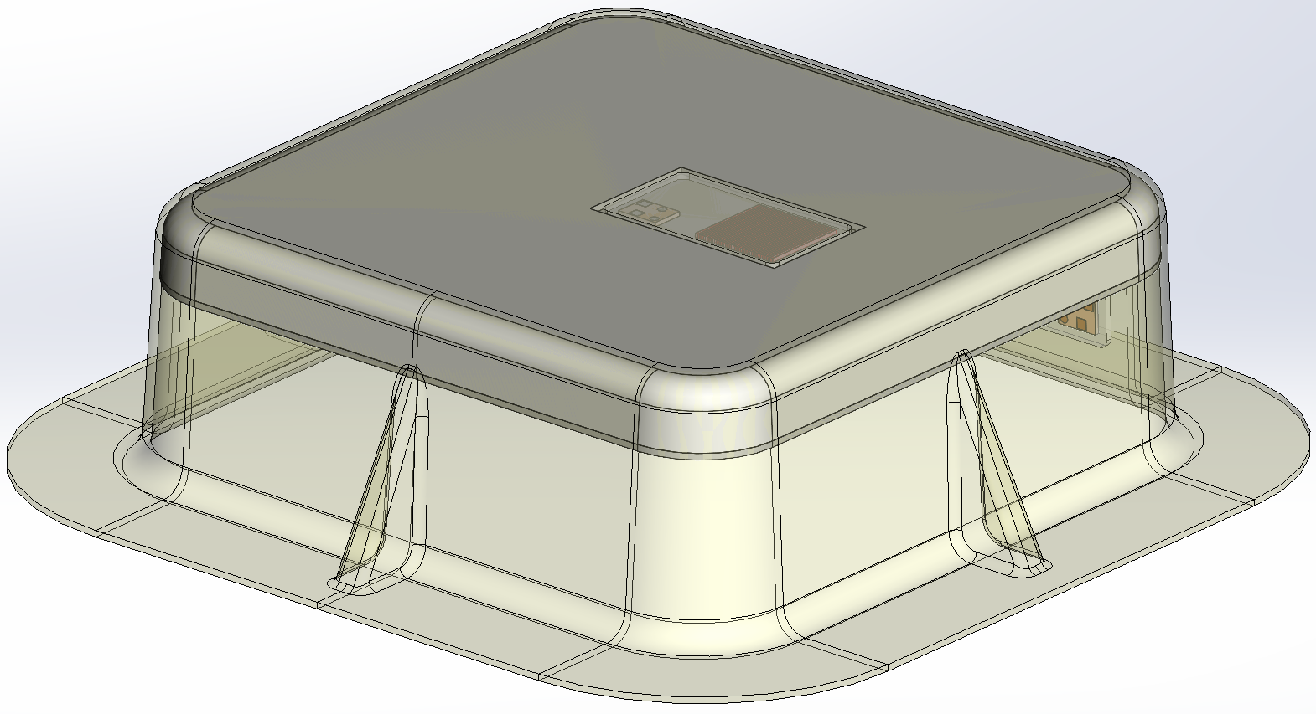
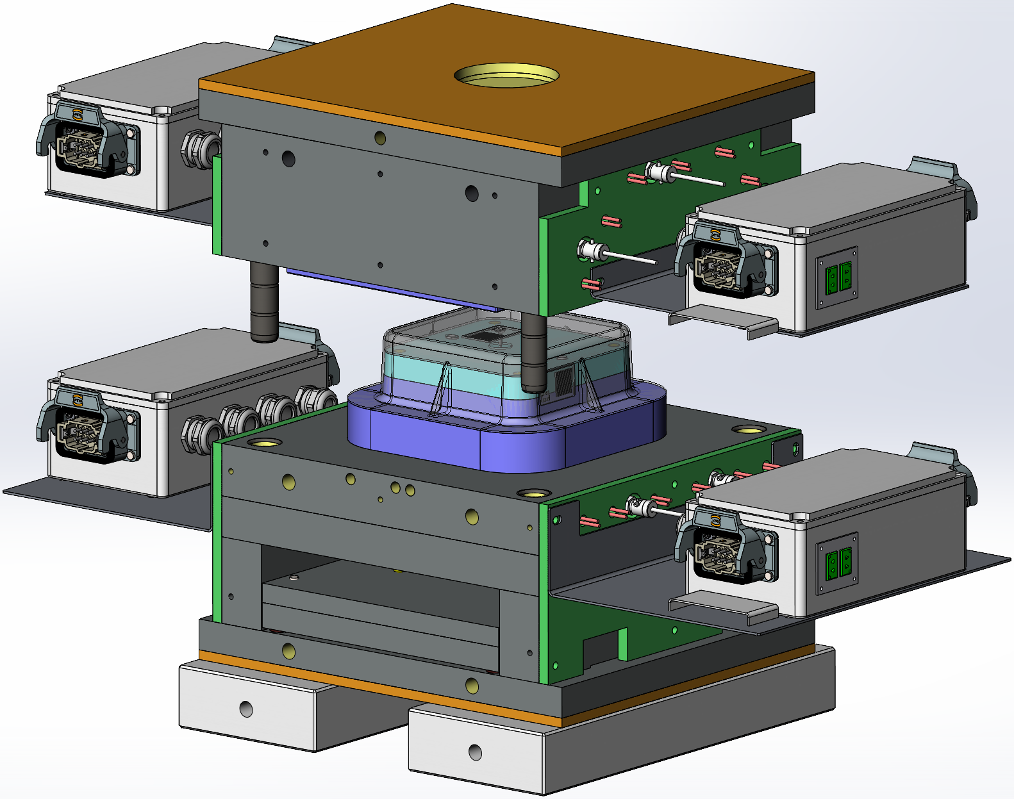
SafEBat – Test tool & Pre-study
SMC material
Aluminum foam
Aluminum sheet metal
Selection of CF-based SMC
Study the impact of the Al foam density under the moulding pressure
To test the influence of CTE difference between CF-SMC and Al foam on structural integrity
To test the method of integrating sensor in the manufacturing and structure without being damage
Sensor
Junction box- for heaters
Upper tool
Lower tool
© RISE
Notes:
3.1.3. Manufacturing verification and process simulation. A testing tool (Figure 5) with the same profile and components as in the final demonstrator was designed and manufactured in order to:
1) test how aluminum sandwich will withstand the compression molding conditions,
2) test how the selected CF-SMC will flow in the tool,
3) test the tolerances of the tool,
4) test the influence of CTE difference between the selected CF-SMC and aluminum sandwich on structural integrity,
5) test the method of integrating sensor in the manufacturing and structure without being damaged, and
6) facilitate the process simulation.
Based on this testing tool, a process simulation using 3D Timon was performed. The process parameters include a mold temperature of 140 °C and a clamp force of 300 tons. According to the simulation results, the CF-SMC charge should be placed on top of the aluminum sandwich, covering almost 100 % of the sandwich’s surface, in order to avoid any weld lines and no resin rich areas in critical parts of the geometry, as well as enable a fairly even fiber distribution. Simulation results in Figure 6 show a strong alignment of the fibers in z-direction at the side walls.

Slide 22
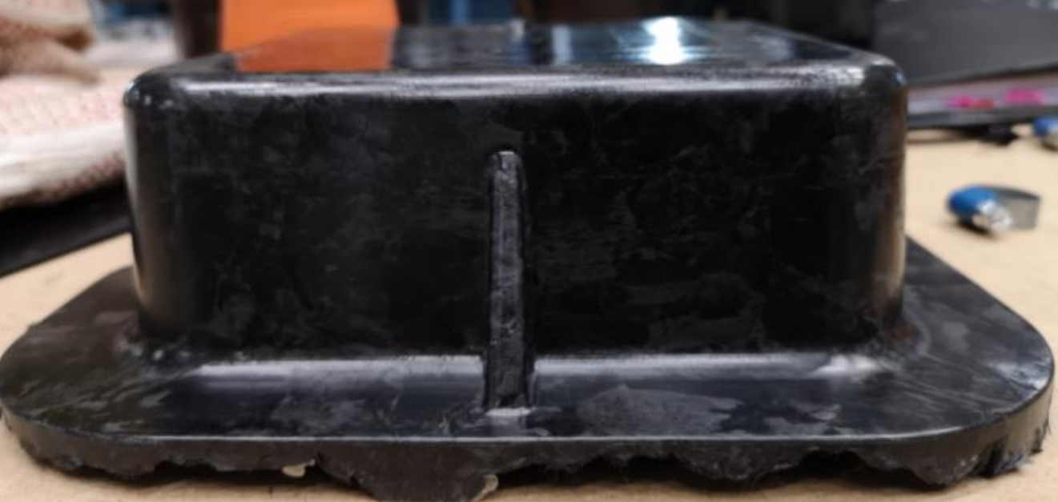
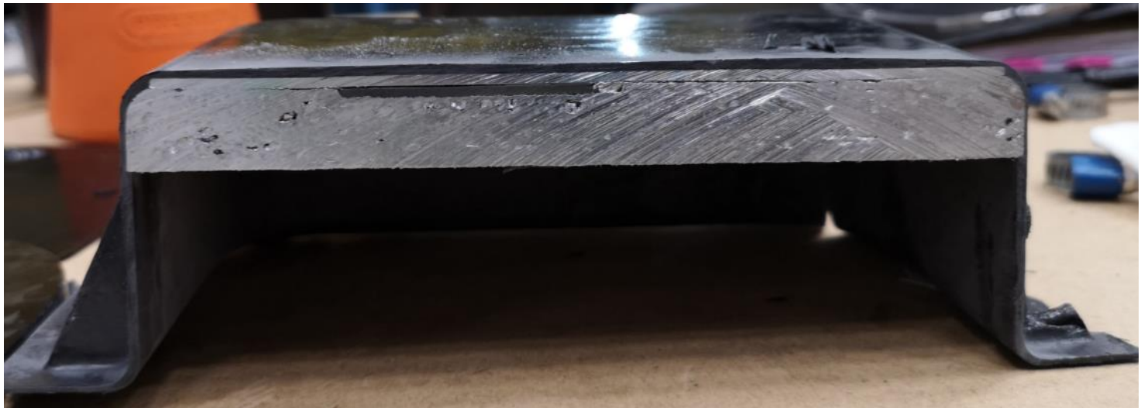
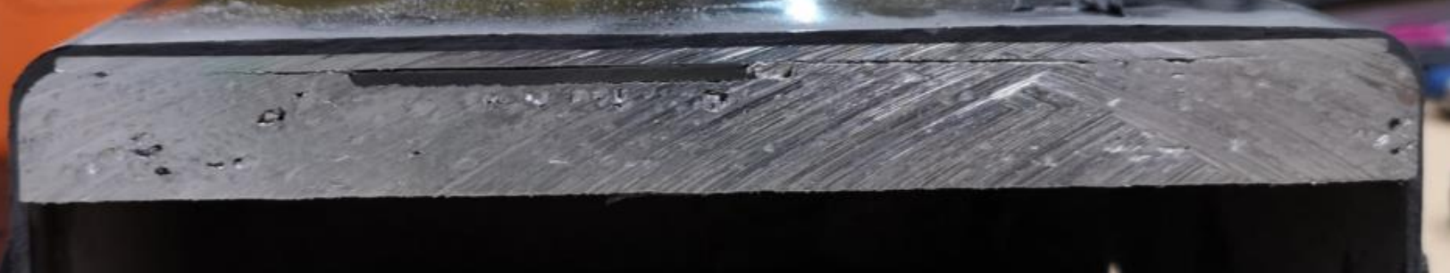
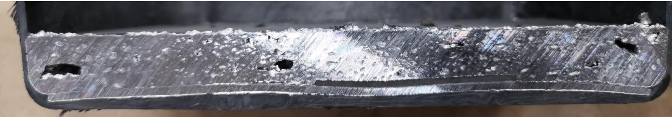
SafEBat – Test tool: Aluminum foam density
a.)
b.)
FRP-aluminum hybrid structure manufactured using the testing tool (a) and cross section with sensor cavity filled with SMC (oval mark) in the process tests (b).
Density alu foam: ~900 [kg/m³]
Density alu foam: ~400 [kg/m³]
SMC Material: AMC 85590
SMC Material: AMC 85590
Notes:
Several hybrid structures using this testing tool with pressing conditions, including pressure, tool temperature, press cycle time, and weight of SMC as well as aluminum sandwiches with different densities of the aluminum foam were manufactured. The manufactured hybrid structure using an optimal condition is shown in Figure 7. It was manufactured in a one stroke compression molding using the testing tool. The cross section in Figure 7 (b) shows the aluminum sandwich status in the hybrid structure after compression molding. The area marked with a red oval is the sensor cavity that was filled with the SMC in the test sample. The best process performance was achieved for a pressure of 45 bar at a temperature of nearly 120 °C. The cycle time was 15 min, with potential of being decreased.
AMC® 85590 from LyondellBasell is a chopped carbon fiber reinforced molding compound. It is easily moldable and provides parts that are high strength, fatigue resistant and
a low density. The carbon fiber is standard modulus PAN based 12K tow.

Slide 23
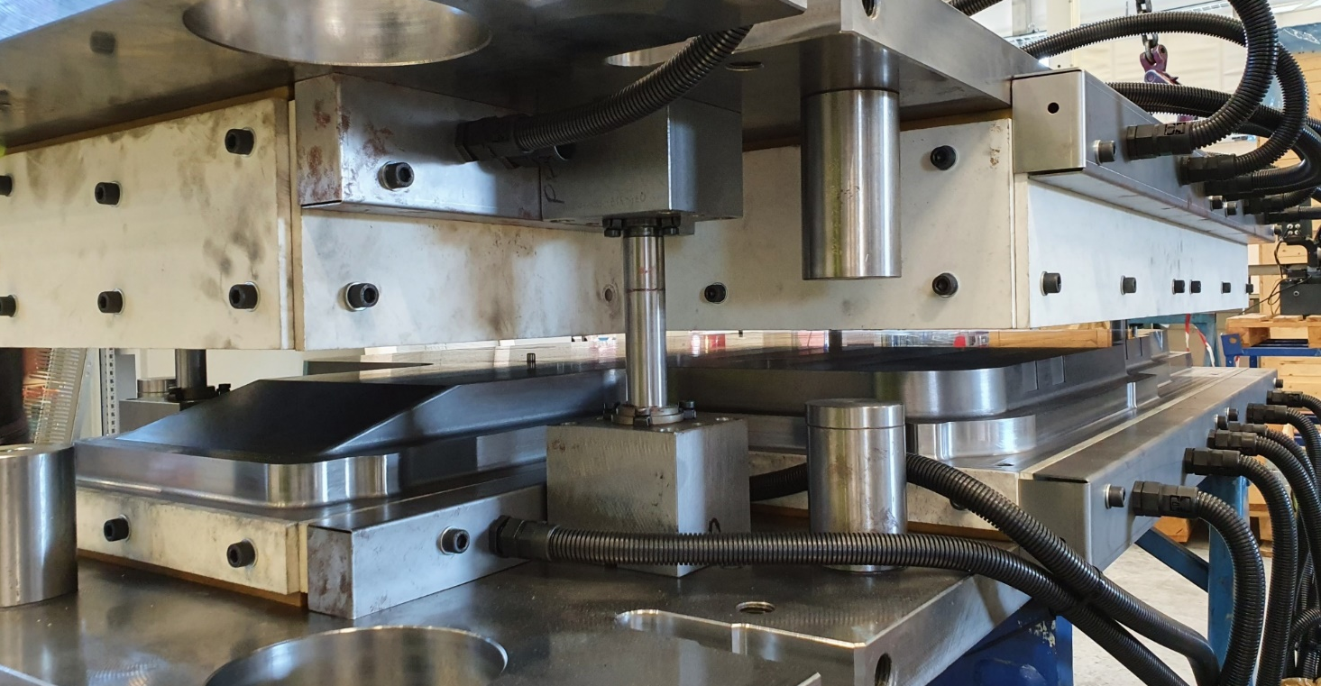
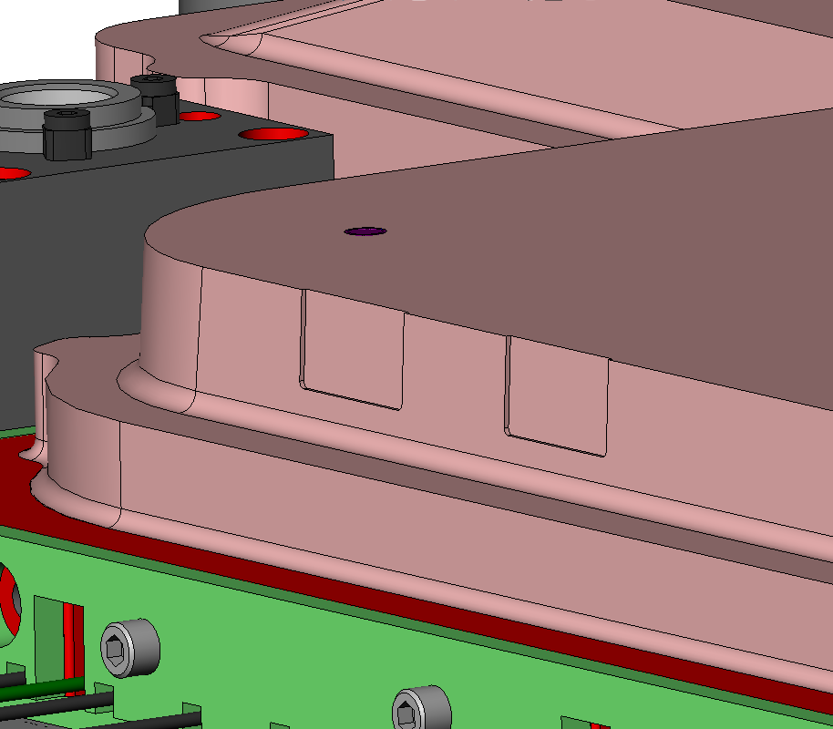
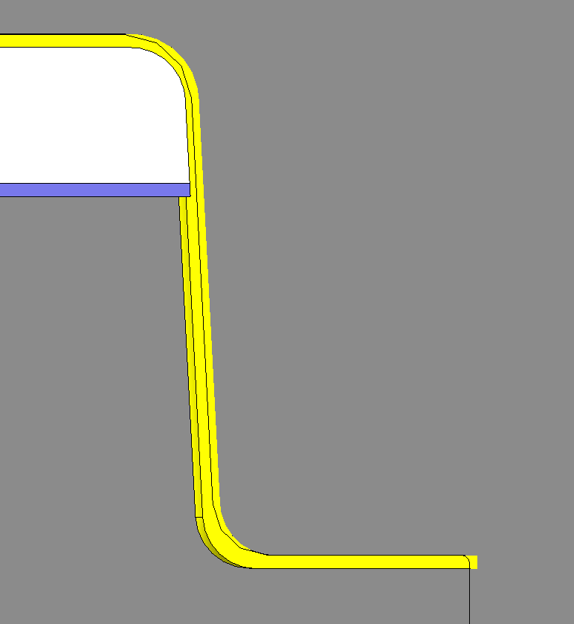
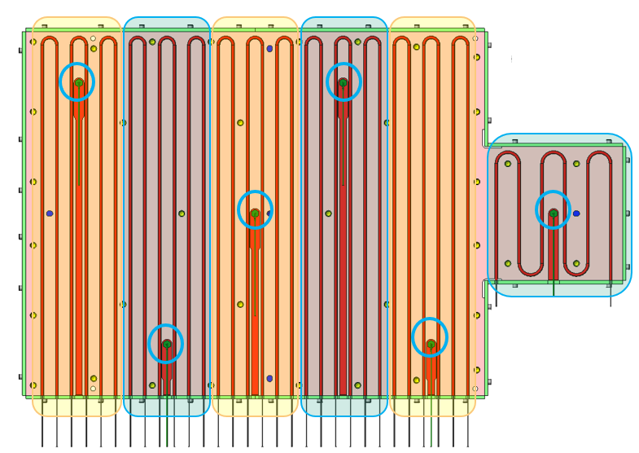
SafEBat – Tool to manufacture the demonstrator
12 individual heating zones to achieve temperature deviations of ± 10 °C.
Tolerances of 0.05mm in the wall area was considered
Multi-material demonstrator formed in one step: 3 different materials with different CTE’s are processed in one operation (Steel, Alu, SMC)
In-mould sensor integration
© AP&T
Insulating material
Sensor pocket
Cables for the heating cartridges
Tolerance < 0.05
Milled patches (16x) in the tool for sensor placement prior to forming

Slide 24
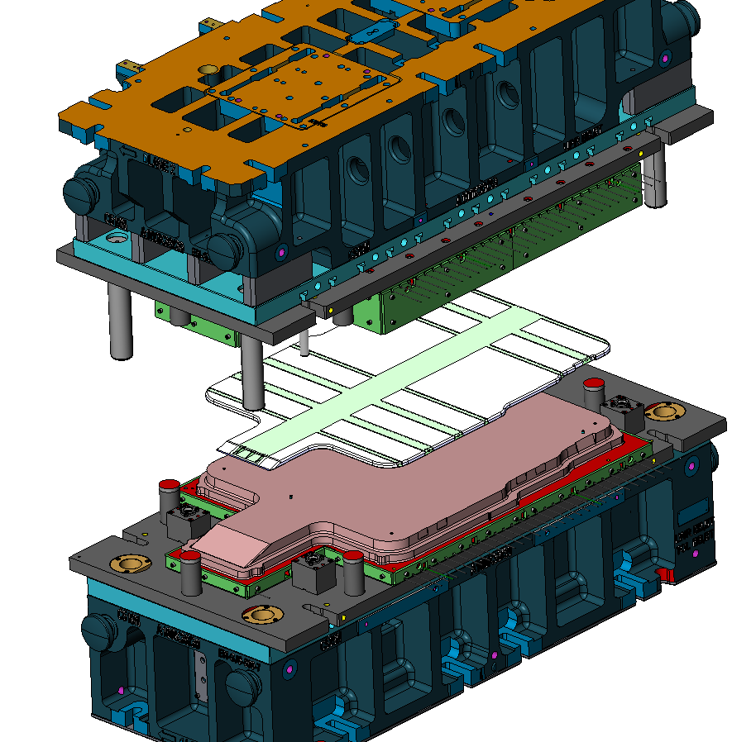
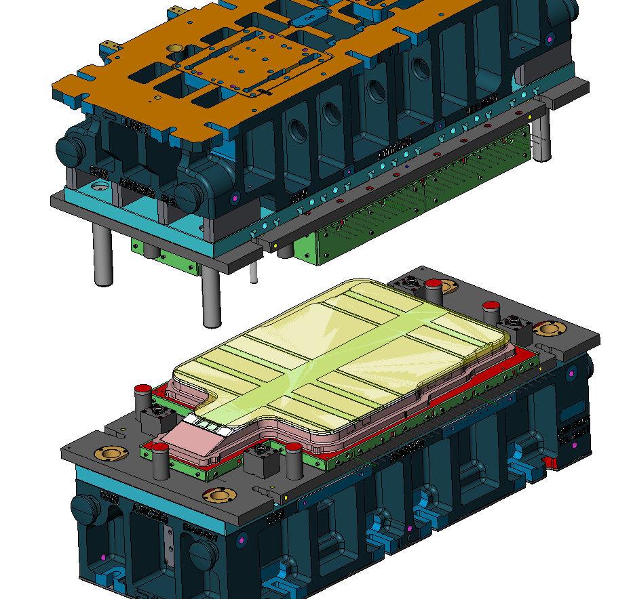
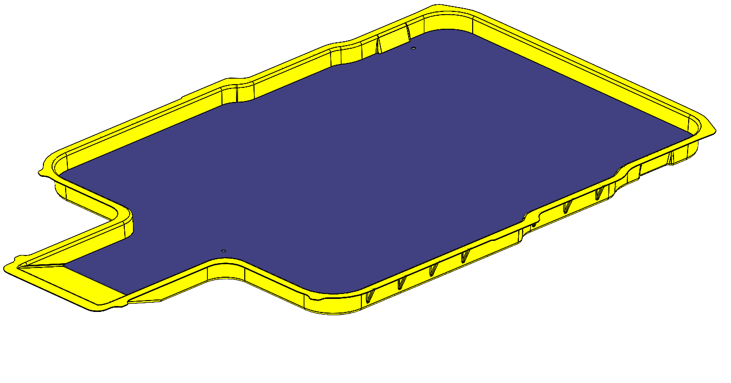
SafEBat – Manufacturing Procedure
1:
Tool temperature: 145°C
ALU component pre-heated to 145°C and positioned in the tool
2:
SMC is placed on top of ALU component
(80-90% coverage)
Tool closes, SMC fills the cavity and is cured under pressure
3:
Demonstrator is ejected.
ALU component is over moulded (mechanically joined) by the SMC
© AP&T
© AP&T

Slide 25
5 – SafEBat / Outlook and next steps
2020
2021
2022
2023
Structural design
Structural analysis
Thermal design
Sensor design
Tool design
Manufacturing verification and process simulation with a test tool
Demonstrator Tool manufacturing
Demonstrator manufacturing
Perfromance validation test

