Slide 1

An efficient pre-hardened cryogenic forming process for AA7075 aluminum alloy sheets
B Feng*, H Y Jiang, B Gu, S H Li, Y T Qi
* Presenter

Slide 2
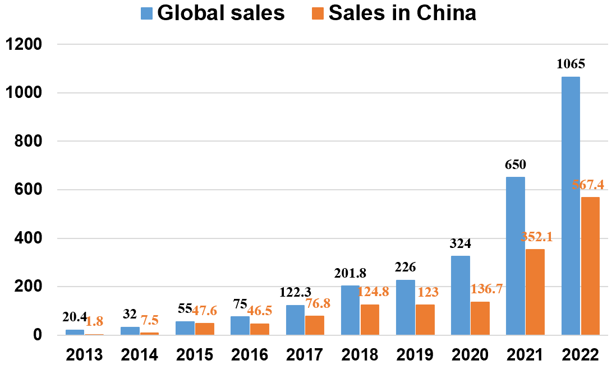
(1) The development and lightweight demand of new energy vehicles
Sales of new energy vehicles
Development of Lightweight Technology for New Energy Vehicles in China

Slide 3


(2) Future Development Trends of Lightweight Materials
Key Materials for Light Weighting
Material | Density (kg/cm³) | Compressive Strength (MPa) | Material Cost | Development in China | Outlook
Steel | 7.8 | 552 | Very Low | Widely used | ★
High strength Steel (HSS) | 7.85 | 1,379 | Low | Increasing | ★★★★
Al Alloy | 2.7 | 310 | Mid | Slow | ★★★★★
Mg Alloy | 1.74 | 275 | Mid | Slow | ★★
Carbon Fiber (CF) | 1.5 | 2,069 | High | Very Slow | ★
Application of high-strength aluminum alloy to the B-pillar of NIO and Audi
NIO ES8
96.4% aluminum usage
Aluminum alloy is a promising lightweight material for car bodies
Audi e-tron

Slide 4
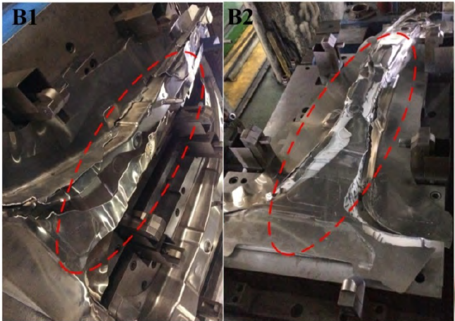
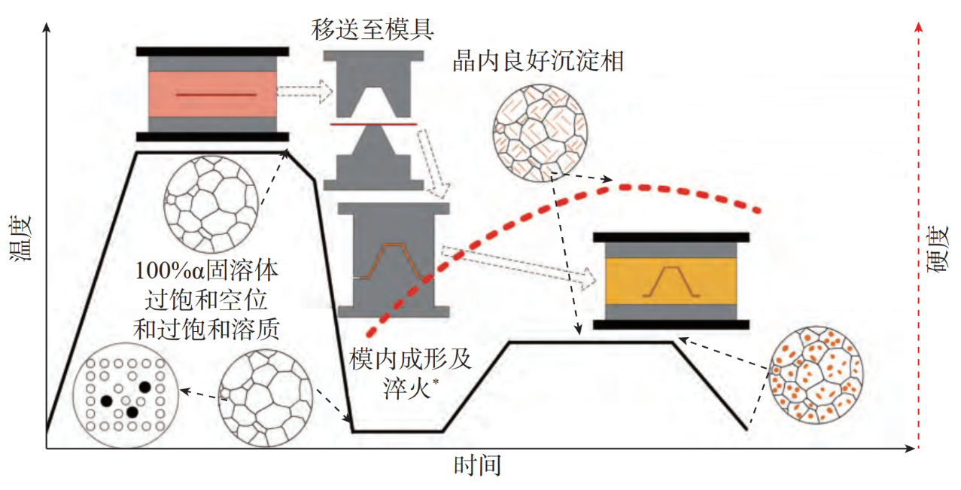
(3) The Challenge of Forming Process for high-strength aluminum alloy
Cold stamping
HFQ®
Solution(40min)
Aging(12-24h)
Coarse precipitate within grains
Low efficiency and difficult organizational regulation
Severe cracking
Unable to balance “high plasticity”, “high strength”, and “high efficiency” !

Slide 5
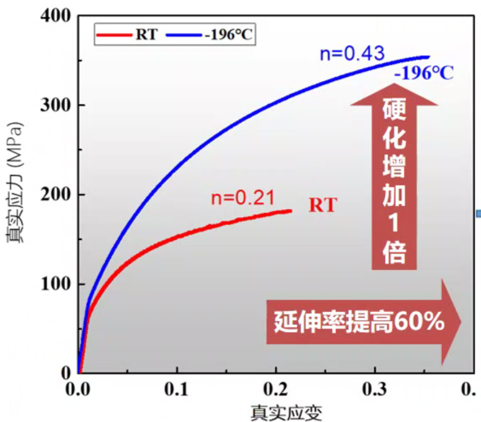

(4) Potential development direction – cryogenic forming
Hardening doubled
Blank holder
Punch
True stress (MPa)
Area B
60% increase in elongation
Area A
Die
True strain
Cryogenic properties of 2219 aluminum alloy
The principle of cryogenic forming for aluminum alloy thin-walled components

Slide 6
(5) Process principle of pre-hardened cryogenic forming
Pre-hardened cryogenic forming process (PCF)

Slide 7
(6) Analysis of pre-aging system for PCF process
Pre-aging temperature / ℃ | Pre-aging time / Symbol
100 | 1h / PA-100-1h | -
120 | 1h / PA-120-1h | 3h / PA-120-3h
140 | 1h / PA-140-1h | -
Pre-aging process system of AA7075 aluminum alloy
DSC curves

Slide 8
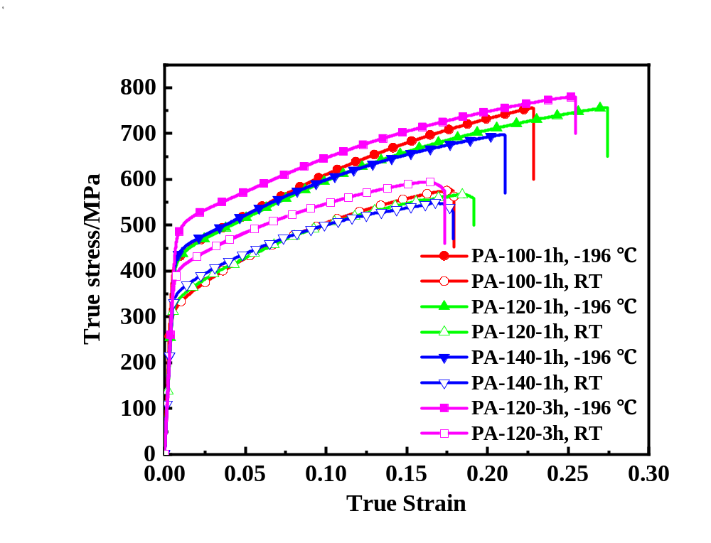
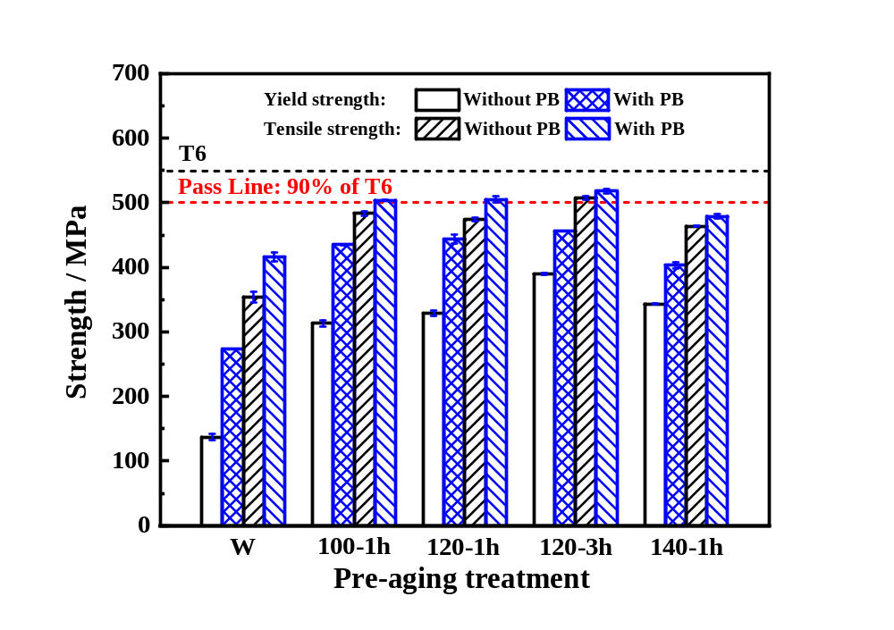
(6) Analysis of pre-aging system for PCF process
Influence of pre-aging system on cryogenic formability
Influence of pre-aging system on post-baking strength

Slide 9
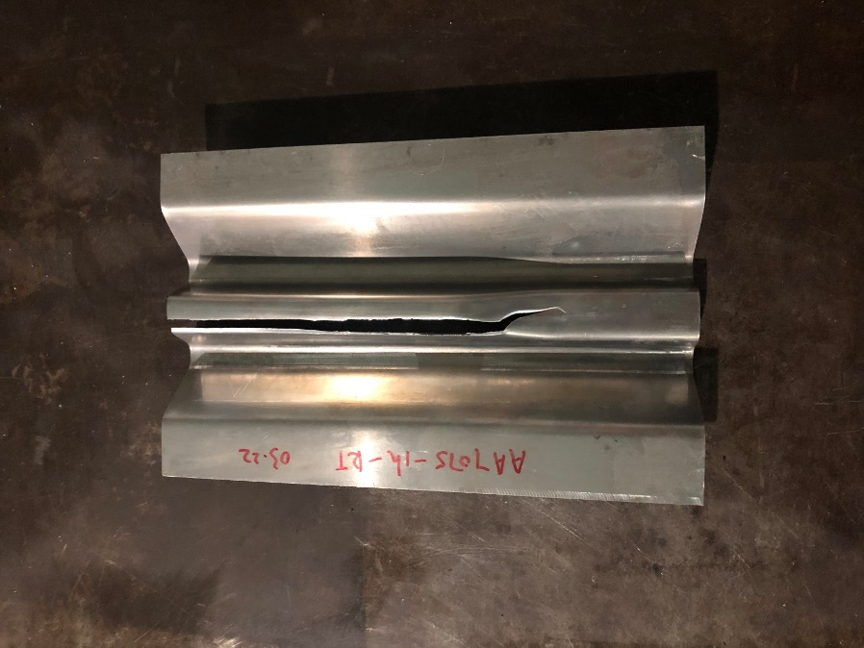
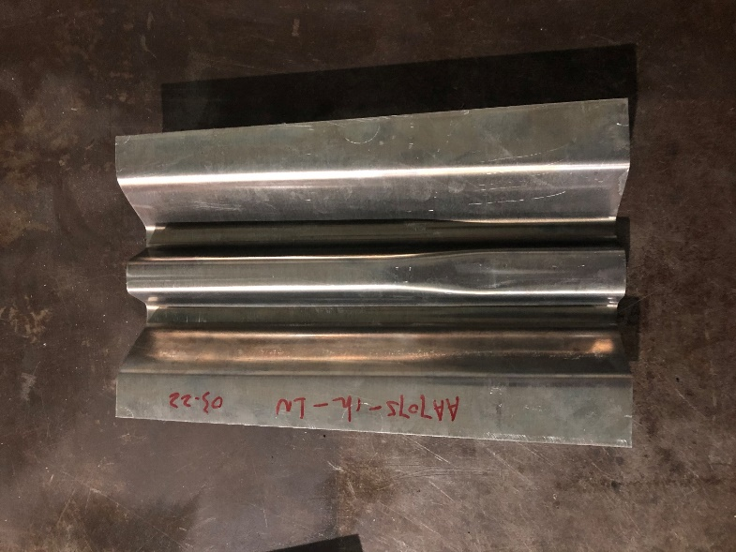
(7) PCF setup and procedure for W-shaped beam component
RT
PCF
Cryogenic stamping system
W-shaped components

Slide 10
(8) Mechanical properties and thickness distribution
Post-baking strength
Thickness distributions

Slide 11
(9) Conclusion
The plastic capability of pre-aged AA7075 alloys is improved at cryogenic temperature.
The mixed fine precipitates of GP zones and η' phases are relatively suitable for cryogenic deformation and PB process.
The W-shaped automotive component is successfully produced by PCF process, and the components exhibit good surface quality and thickness uniformity.

Slide 12
Thanks!

