Slide 1
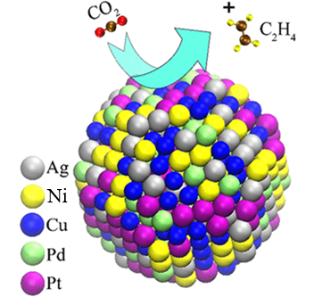

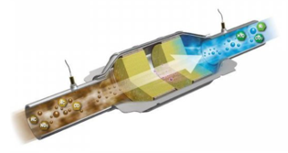
Microstructural analysis of the casted and melt spun high entropy noble alloy Ag20Pd20Pt20Cu20Ni20
Lidija Simić¹, A. C. Kneissl² Ivan Anžel¹
¹University of Maribor, Faculty of Mechanical Engineering, Smetanova 17, SI-2000 Maribor, Slovenia,
²University of Leoben, Franz Josef-Strasse 18 A-8700 Leoben, Austria
Faculty of Mechanical Engineering
Leoben, 13.09.2023
University of Maribor

Slide 2
Content of my lecture:
Introduction in High Entropy Alloys (HEA);
Motivation for research of new HEA;
Motivation for production of new HEA;
Experimental procedure;
Results and Discussion;
Conclusion;
Notes:
Good day everyone. This is a summary of my lecture in which I will present the motivation of my work or lecture, experimental work, results and discussion as well as the proposed model of solidification of complex concentrated noble alloy and new melt spuned ribbons with liquid phase separation at nano-level.

Slide 3
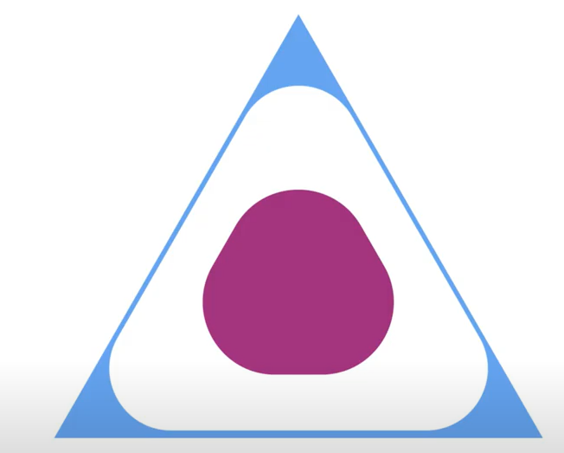
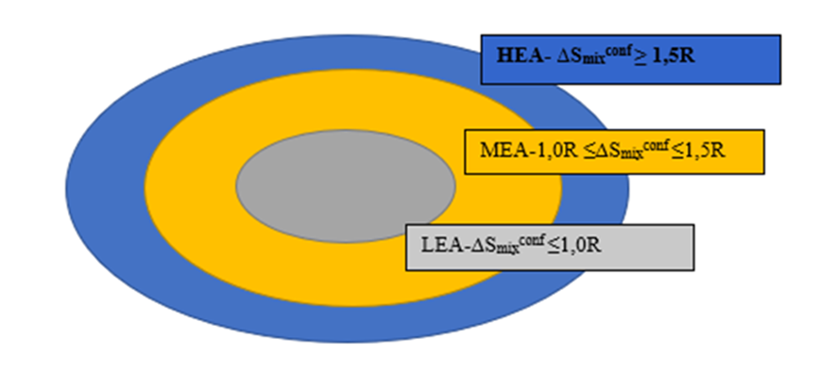
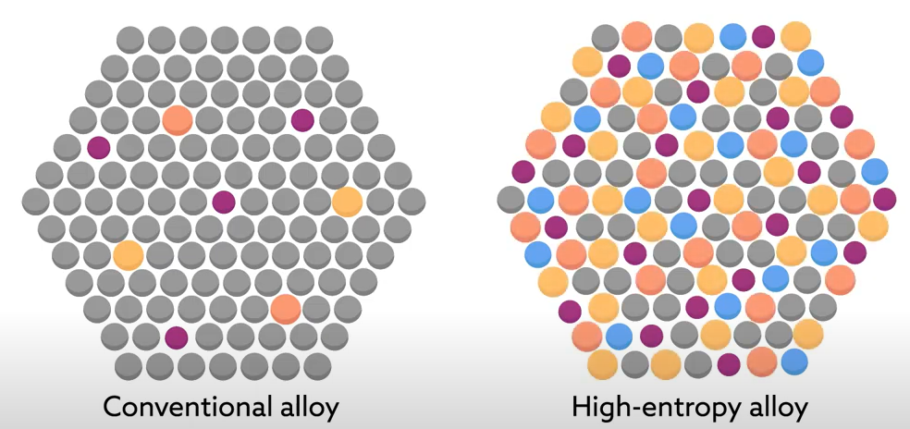

Introduction in High Entropy Alloys:
Phase diagram
$$∆S_{mix}^{conf}=−R\sum_{i=1}^{n}{C_{i}\ln\left(C_{i}\right)}$$
Complex concentrated alloys
High Entropy Alloys
5 and more elements (5-35 at. %)
Conventional alloys
Notes:
Complex c. a are complex multicomponent alloys. Unlike conventional alloys and materials, complexly concentrated alloys occupy the center of phase diagrams. They are usually multi-phase, they do not have special design requirements. A special subgroup of CCAs are high-entropy alloys (HEA), into which they are classified according to the calculated configurational entropy of mixing, CCA can be classified into HEA if its configurational entropy of mixing is greater than or equal to 1.5R. HEAs are constructed of 5 or more elements with at. % of 5-35 and represents a new group of materials of potential high performance as well as functionality.

Slide 4

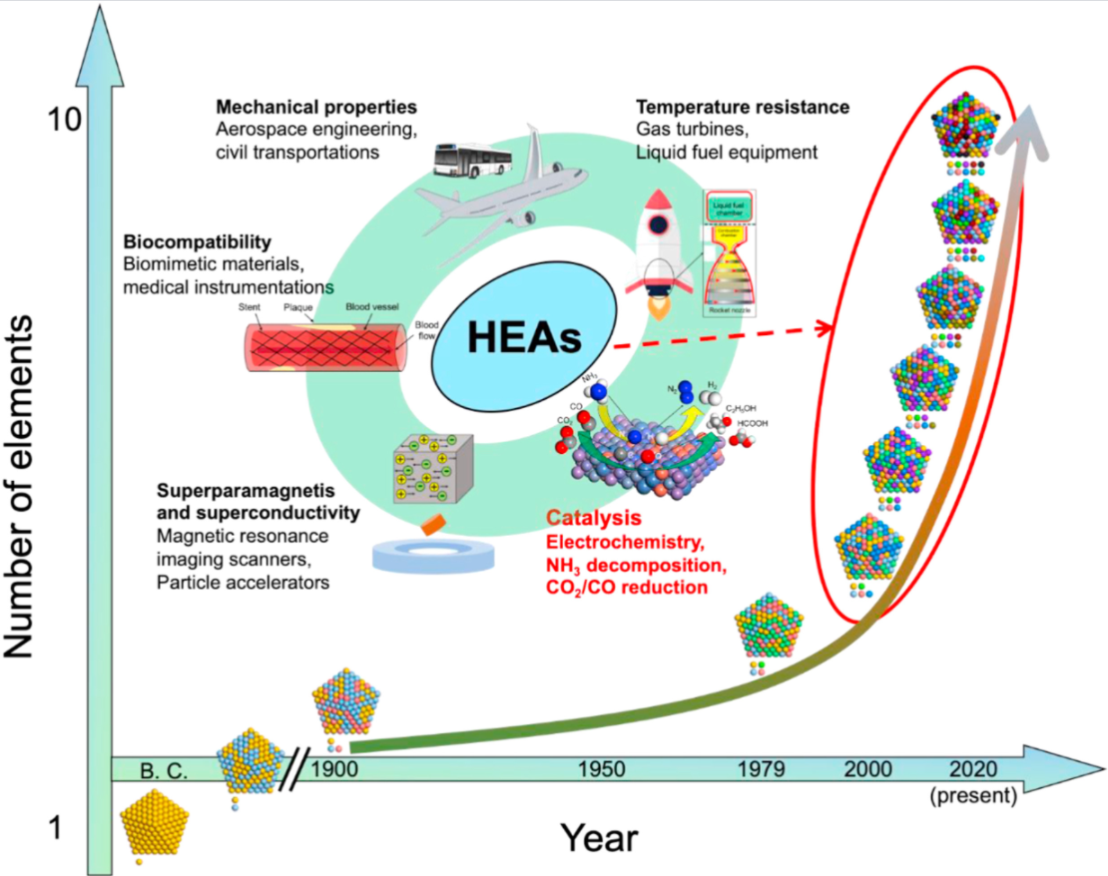
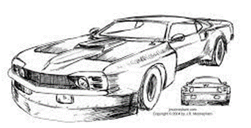
Motivation for research of new HEA;
Notes:
This diagram shows the change in properties and functional properties with age with increasing number of elements in HEA.
Special attention to HEA was observed in the field of catalysis.
Their catalytic activity is controlled by chemical composition, surface atomic coordination, electronic configuration and degree of microstructural metastability.
Single–phase HEAs or microstructural homogeneticly multiphase HEA are of particular importance, because they possess a uniform microstructure that is useful for designing and prediction of mechanical and potential functional properties. Motivation for my production of HEA with Ag, Cu, Pd, Pt and Ni. is to create a cost-effective material that can be used as catalytic material, providing a more economically viable alternative to the expensive PdPt catalysts.
Also, by monitoring the degree of metastability with the help of different synthesis techniques, we will try to synthesize a single-phase high-entropy alloy or a microstructurally homogeneous multi-phase high-entropy alloy.

Slide 5
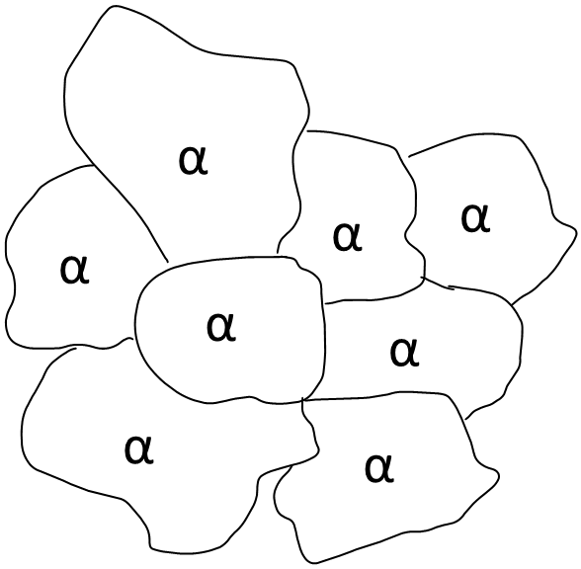
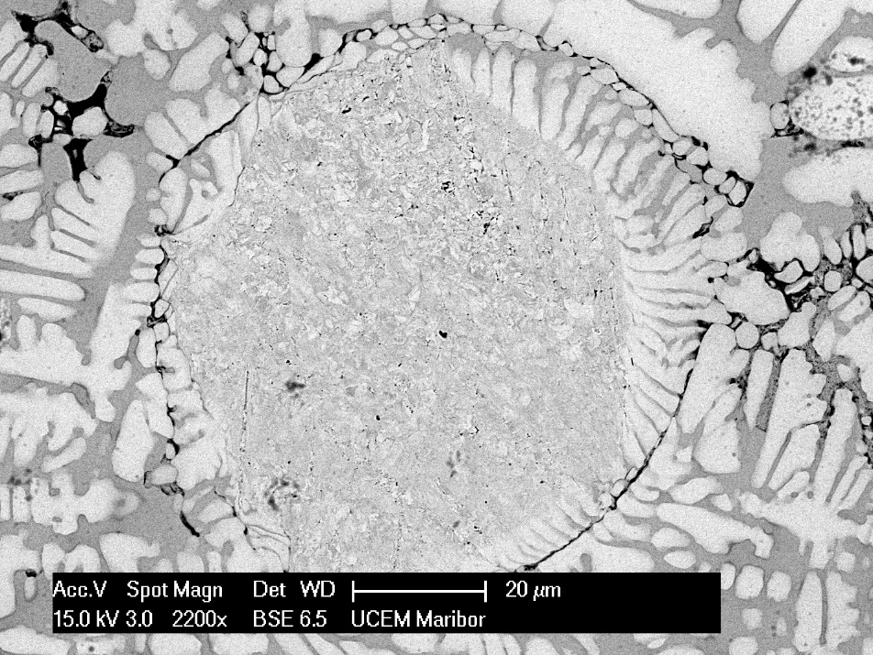
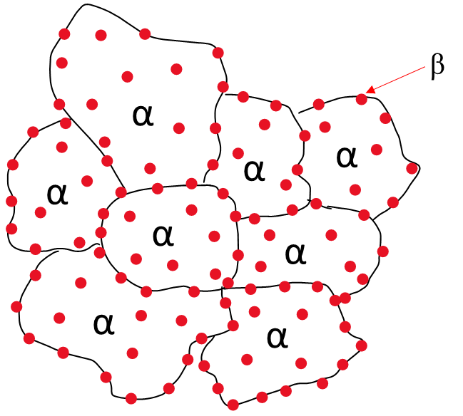
Motivation for production of new HEA;
Single phase solid solution
Multiphase High Entropy Alloy
Microstructurally homogeneous distribution of secondary phase
Notes:
As the most HEA are multiphase and are not suitable for catalysis. With the goal of achieving a finer microstructure or even single-phase solid solution or microstructurally homogenus distribution of secondary phase, we will use rapid solidification. This technological route can be used to improve the efficiency of the catalytic reaction by increasing the surface area and optimizing the distribution of active centers.

Slide 6
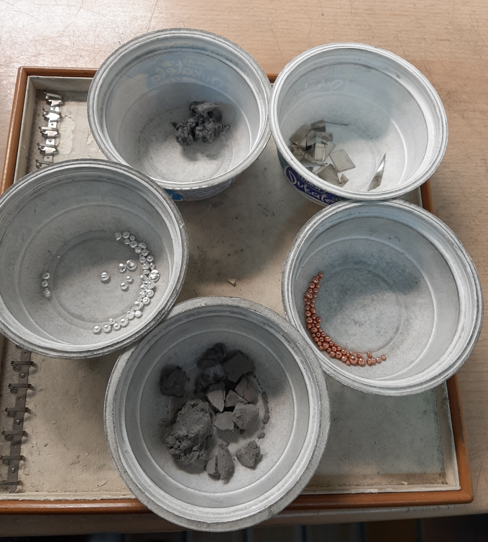
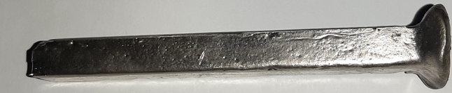
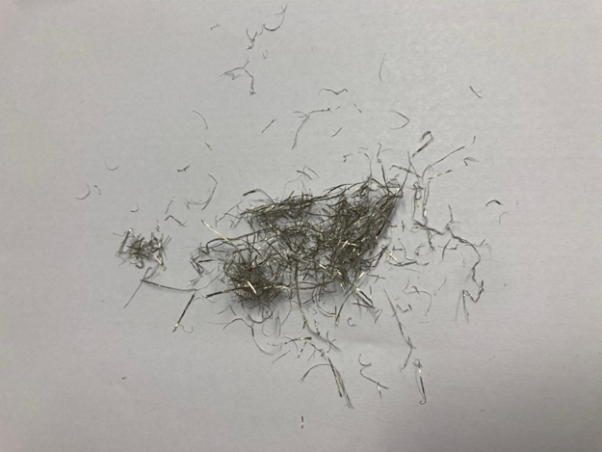
Experimental procedure:
Casted High Entropy Alloy
Pure components (Ag granules - 99,99%; Pd sponges - 99,99%; Pt sponges - 99,99%; Cu granules - 99,9%; Ni tiles - 99,99%).
Melt spun ribbons Ag20Pd20Pt20Cu20Ni20
Notes:
We constructed an alloy in the eqyatomic percentage, because the highest configurational entropy of mixing is achieved. The alloy was prepared in an induction furnace by melting pure components with a purity of over 99.9%, under atmospheric pressure.
Smaller pieces of the cast sample were used for melt spinning. Trakice su proizvedene putem melt spinnninga sa a circumferential wheel speed of of 37.5 m/s.
We used cold and warm etching at 70 C to reveal the microstructure of the cast CCNA. Cast sampe was caracterised by optical microscopy and Scanning Electron Microscopy, equipped with EDS detector, and XRD analysis. Melt spuned ribbons were pripered using cross section polisher, then was characterize using SEM, equipped with EDS.

Slide 7
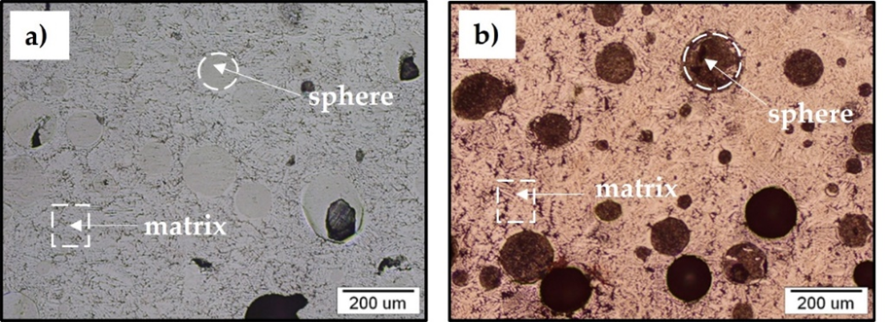
Results and Discussion:
Casted microstructure of Ag₂₀Pd₂₀Pt₂₀Cu₂₀Ni₂₀ (20at%) a)
cold etching (sphere and matrix) b) hot etching (spheres and matrix)
Notes:
The microstructure of the cast specimen after cold and hot etching, is shown in figures 1a and 1b. In both cases the microstructure is composed of spheres and a matrix, however, many holes are also present as some spheres fell out of the matrix during metallographic preparation.

Slide 8
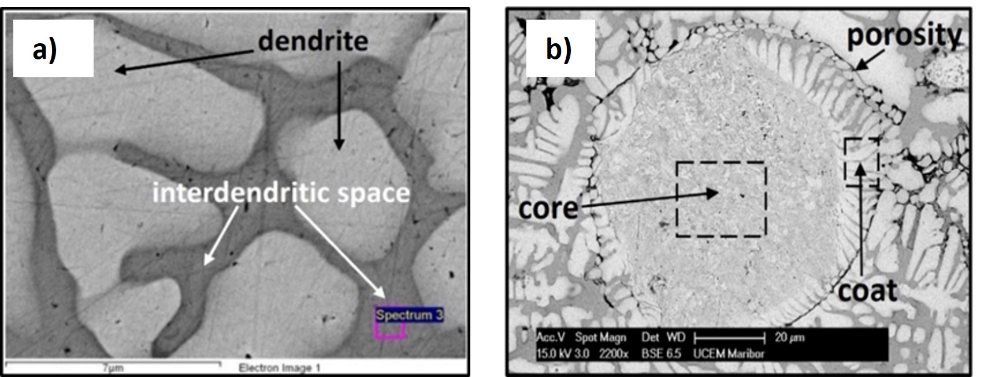
Results and Discussion:
Cast microstructure of CCNA, a) the matrix (dendrites and interdendritic space) b) coated sphere with porosity.
Notes:
The realized microstructure of cast CCNA is made up of matrix and spheres. The matrix is ​ made up of dendrites and interdendritic space. The spheres are complex porous composition. A coat is formed around the spheres, which is composed of dendrites and interdendritic space, where a porosity was observed between the coat dendrites and the matrix dendrites.
The matrix and coat both had the same chemical composition. While the dendrites were depleted of Ag but enriched in Ni and Pt, the interdendritic space and core of the sphere were enriched in Ag.

Slide 9
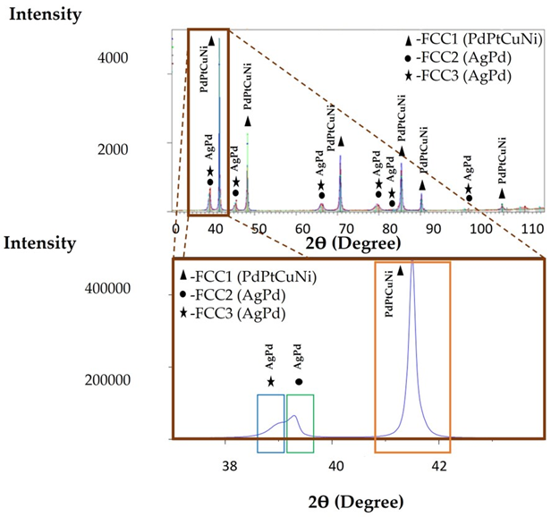
Results and Discussion:
Field lattice parameters obtained by XRD analysis and calculated analysis- Vegard's law
area | XRD- lattice parameter a=[Å] | Calculated-lattice parameter a=[Å]
yellow area | 3,765 | 3,8137
blue area | 3,996 | 3,9766
green area | 3,968 | 3,8301
XRD analysis of HEA plate
Notes:
XRD analysis shows the presence of 3 crystallographic phases. By comparing the calculated lattice parameter (Vegards low) and the obtained XRD analysis, we came to the conclusion that the yellow phase corresponds to the dendrite, the green phase to the spheres, and the blue phase to the interdendritic space.

Slide 10
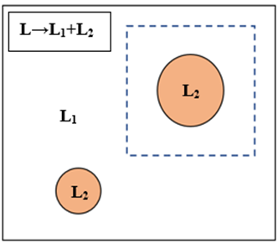
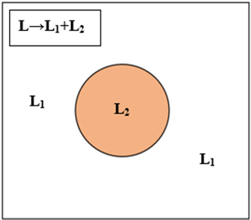
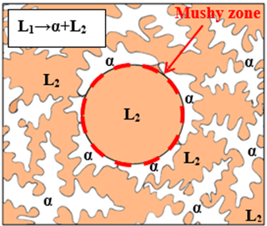
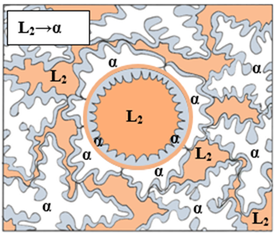
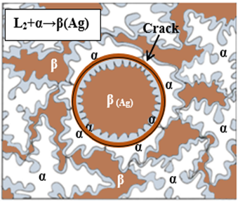
Results and Discussion:
Proposed model of solidification of cast HEA:
a) Liquid phase separation (L → L1 + L2) b) Monotectic reaction L1 → α (Ni) + L2 (Ag)
c) L2 → α solidification of coat d) Peritectic solidification.
Notes:
Microstructure of cast CCNA is thermodynamically metastable [2]. The results of the EDS analysis and the formed spheres in the microstructure indicate that during melting and solidification, liquid phase separation (L→L₁+L₂) with monotectic reaction (L₁ → α + L₂) takes place, during which the dendrites of the matrix (rich in Ni) solidify first, closing the space around the spheres. Since in alloys of this type the mixing enthalpy plays an important role in phase formation, the high concentration of Ni and Pt in the dendrite region in the cast CCNA alloy can be explained by the positive mixing enthalpy, where Ni and Pt repel Ag, and conversely. Based on the achieved results, [2], CCNA can be classified into hypermonotectic alloys. In these alloys, the phase separation takes place in the first step when the temperature of miscibility gap is being reached and continues with a monotectic reaction (L₁ → α + L₂) in the temperature range where three—phase equilibrium is the source of considerable difference in chemical composition between dendrites (α phase) and the interdendritic space (L₂). We believe that the solidification pathway of hypermonotectic CCNA is closely related to the binary systems Ag-Ni and Ag-Pt [2], [10]. The porosity that causes the drop of the sphere from the matrix during metallographic preparations was caused by the lack of melt during shrinkage, due to the complete solidification of the core (peritectic reaction L₂ +α→ β(Ag)) of the sphere and the matrix.

Slide 11
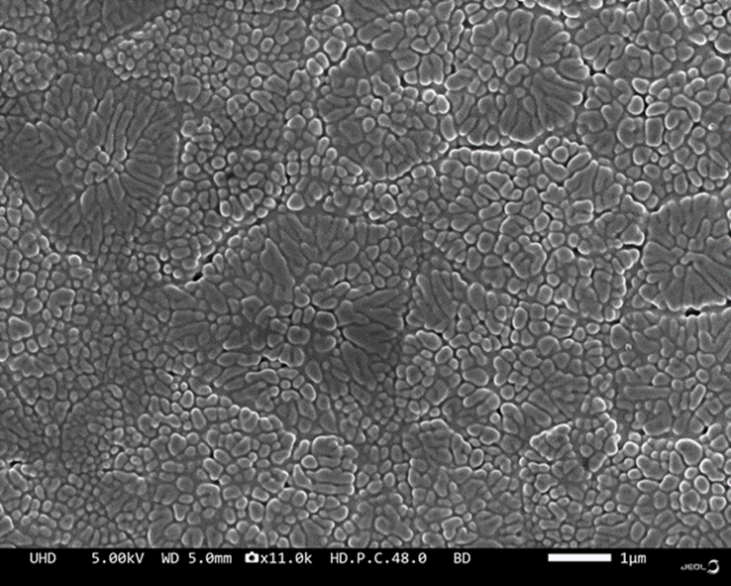
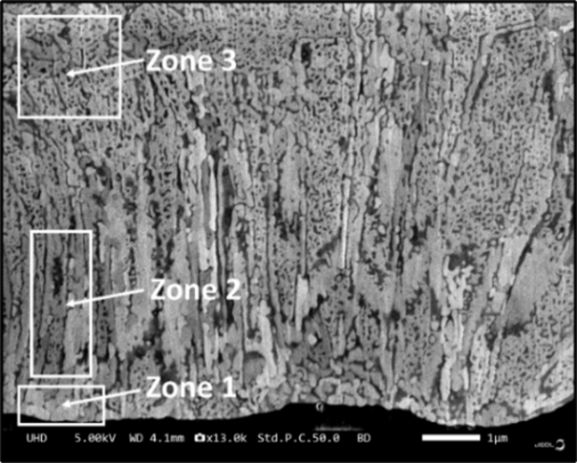
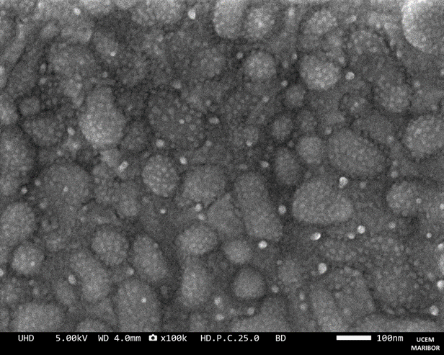
Results and Discussion:
a)
b)
Cross-section of rapidly solidified ribbon (SEM)
Free surface of the ribbon (SEM) a) upper free surface b) lower free surface
Notes:
As cast CCNA with spheres is not suitable for catalysis. With the goal of achieving a finer microstructure or even single-phase solid solution, rapid solidification was performed. This technological route can be used to improve the efficiency of the catalytic reaction by increasing the surface area and optimizing the distribution of active centers.re ranges.
The microstructure of the entire cross-section of the ribbons is shown in figure 3. The cross-section analysis reveals three microstructural zones: Zone 1 with fine grains indicating efficient nucleation, Zone 2 characterized by segregation-free transcrystals growing perpendicularly, and Zone 3 consisting of dendrites with visible secondary branches connected to Zone 2, (figure 3).
Smaller grain sizes in catalyst materials offer advantages such as increased surface area, improved mass transport, enhanced dispersion of active sites, higher catalytic activity, and improved thermal stability. SEM analysis of both ribbon surfaces (upper and lower, figure 4a and b), provided further insight.
The microstructure on the lower free surface of the ribbons consists of globular grains approximately 100 nm in size decorated with very fine particles, few nm in size which could be the result of liquid separation into two melts (L → L₁ + L₂) on the nano-scale during melt spinning.
This phase separation probably occurs due to high mixing enthalpy (Ag-Ni; Pd-Ag). Nano sized particles are observed on both free surfaces of ribbons and are densely distributed. On the upper free surface, dendrites with secondary dendrite arms indicate slower cooling and lower solidification velocity. EDX analysis confirmed the enrichment of Ni and Pt in dendrites and Ag in the interdendritic space. These findings again support the thesis of liquid phase separation at nano-scale which still results in a homogeneous microstructure.

Slide 12
Conclusion:
Microstructural analysis of the HEA Ag20Pd20Pt20Cu20Ni20 revealed the following findings:
The cast alloy is highly metastable with three crystallographic phases.
During the solidification of the cast alloy, liquid phase separation takes place followed by a monotectic reaction.
The solidification process of cast alloy forms dendrites and sphere (with core and coat).
Melt-spun ribbons exhibit a microstructure with three zones: fine globular crystals, transcrystals, and dendrites.
Liquid phase separation in melt spuned ribbons occurs at the nano-scale level, which have a homogeneous microstructure, indicating potential catalytic properties.
Positive enthalpy of mixing has the greatest influence on liquid phase separation in both cast alloy and rapidly solidified ribbons.

Slide 13
Thank you for your attention!

