Slide 1







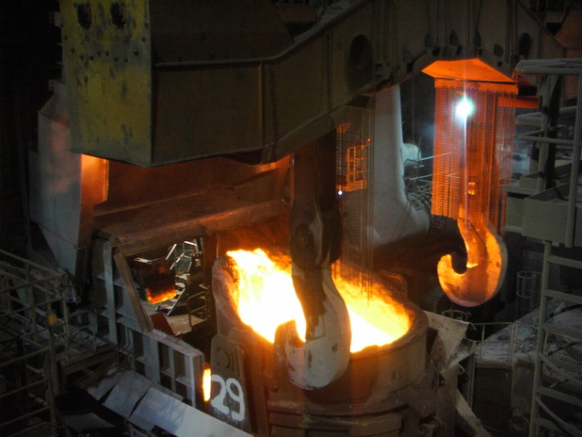
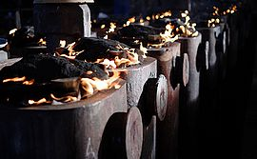
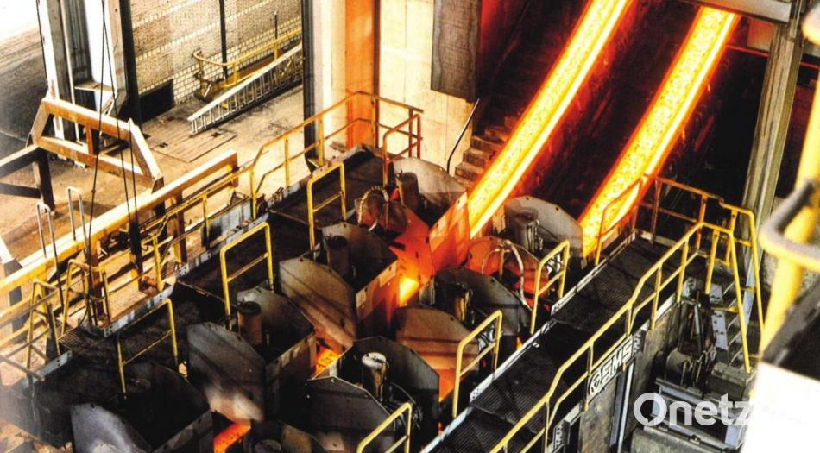

57. Metallographie Tagung 2023
Austenite grain growth observation by HT-LSCM for parametrization of solute drag effect and pinning forces in Fe-X-systems
Leoben, Sept. 13-15th, 2023 Maximilian Kern, Michael Bernhard and Christian Bernhard

Slide 2
Table of contents
Introduction and theoretical input
HT-LSCM: Experimental device
Methodology and sample production
Investigation of retarding pressures (solute drag, pinning) in Fe-X systems
Conclusion

Slide 3
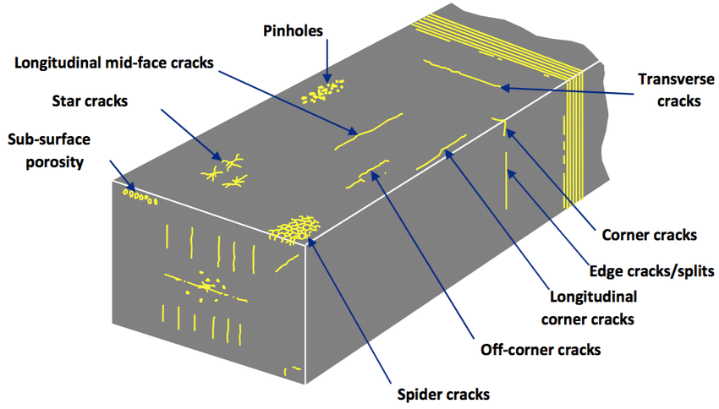
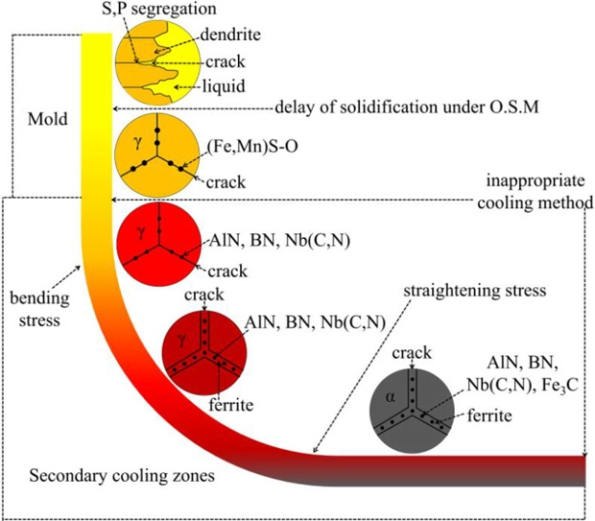
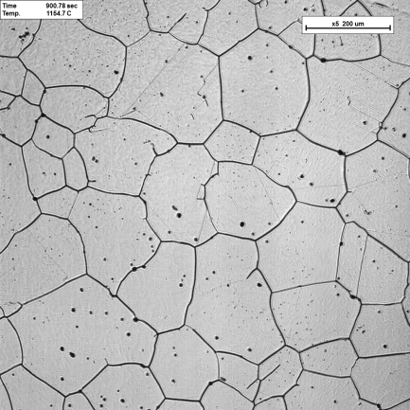
Introduction
Motivation for controlling austenite grain size in metallurgical processes
  Important parameter for final mechanical properties in product
  Essential for metallurgical processes (Continuous casting, particle dissolution, e.g., non-metallic inclusions, heat treatment)
  Investigation of AGS associated mechanisms in these processes:
    Phase transformation & nucleation
    Grain growth
    GB pinning by second phase precipitation
    stopping grain growth
    Solute drag effect: decelerating grain growth
    Recrystallization
Source: Yang et al. steel research international, Vol. 89, Issue 5, 1700480, 2018

Slide 4
Table of contents
Introduction and theoretical input
HT-LSCM: Experimental device
Methodology and sample production
Investigation of retarding pressures (solute drag, pinning) in Fe-X systems
Conclusion

Slide 5
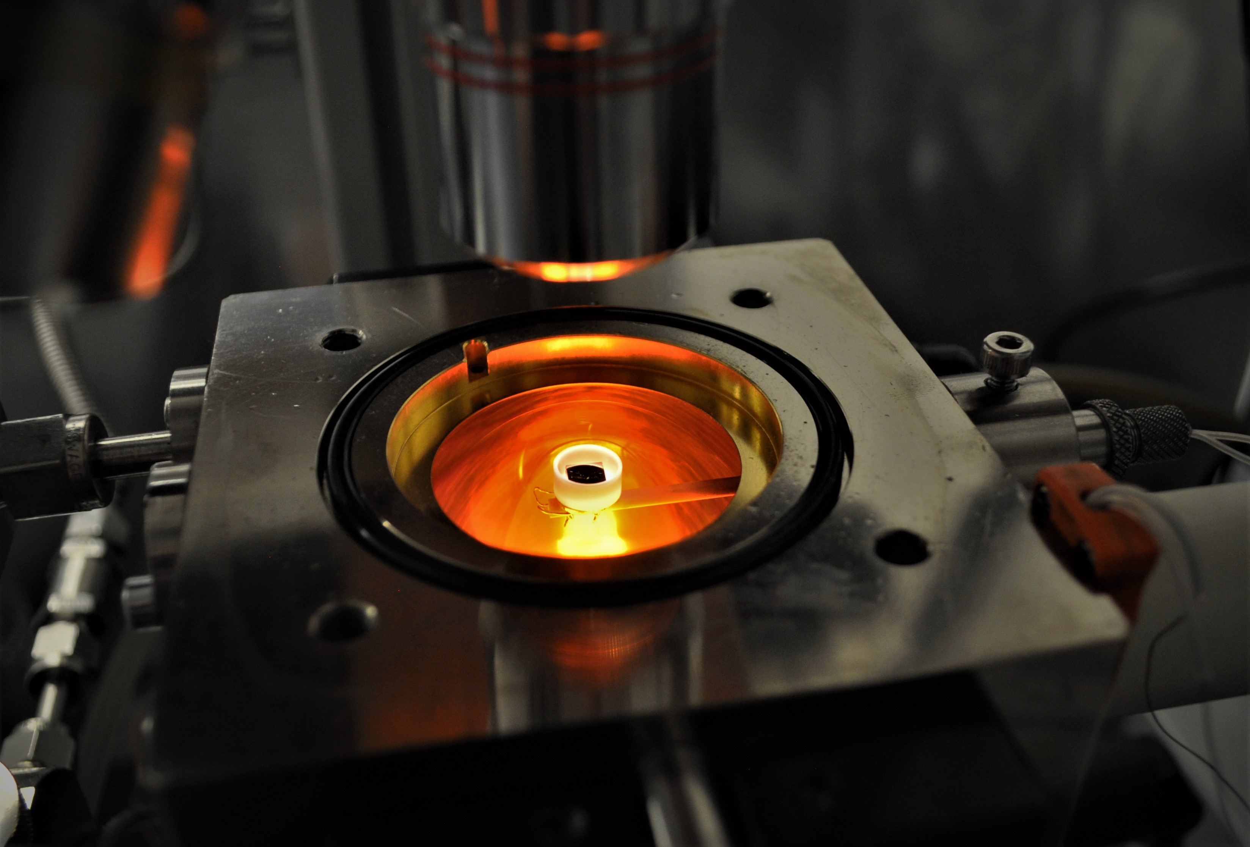
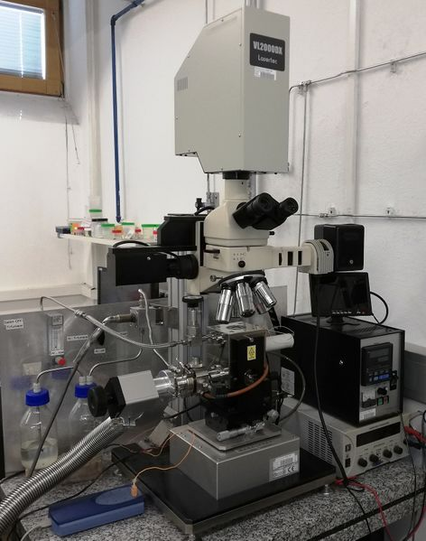
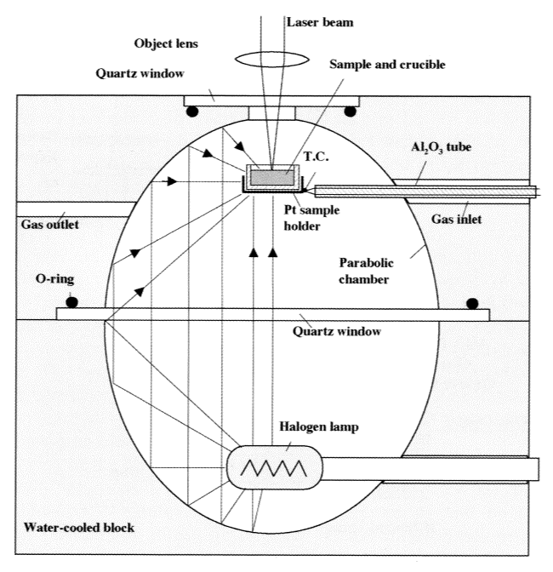
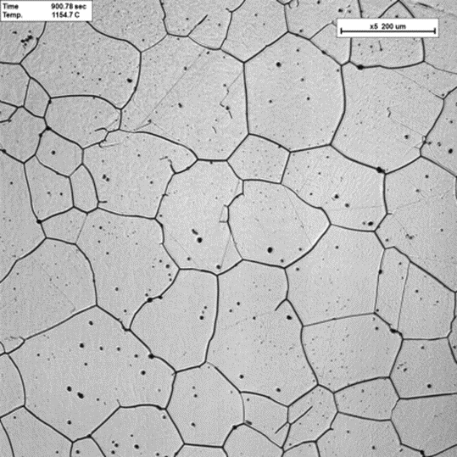
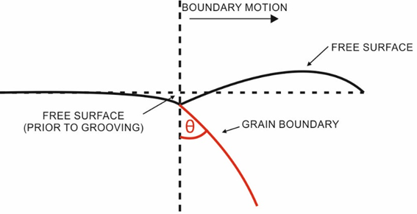
HT-LSCM: Experimental device
  HT-LSCM = High temperature laser scanning confocal microscopy
  Surface investigation for various materials at high temperatures e.g.: steel, Si semi conductor, Ni- based alloys, ceramics and slags;
  Qualitative and quantitative analysis of phase transformations, crystal growth, particle dissolution
  Relies on thermal etching effect
  Quick and economical method for investigating qualitative and quantitative physical-metallurgical phenomena

Slide 6
Table of contents
Introduction and theoretical input
HT-LSCM: Experimental device
Methodology and sample production
Investigation of retarding pressures (solute drag, pinning) in Fe-X systems
Conclusion

Slide 7
Methodology and sample production
Workflow:
  From an idea to results
Sample preparation
HT-LSCM experiments
+
quantitative evaluation of
HT-LSCM and digital microscope images
Mathematical modeling
Database
Comparison
Agreement?
Yes
Editing data for further utilization
No

Slide 8
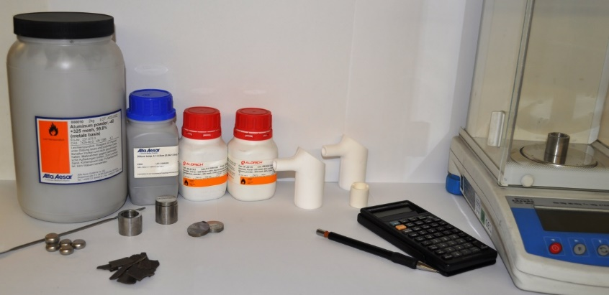
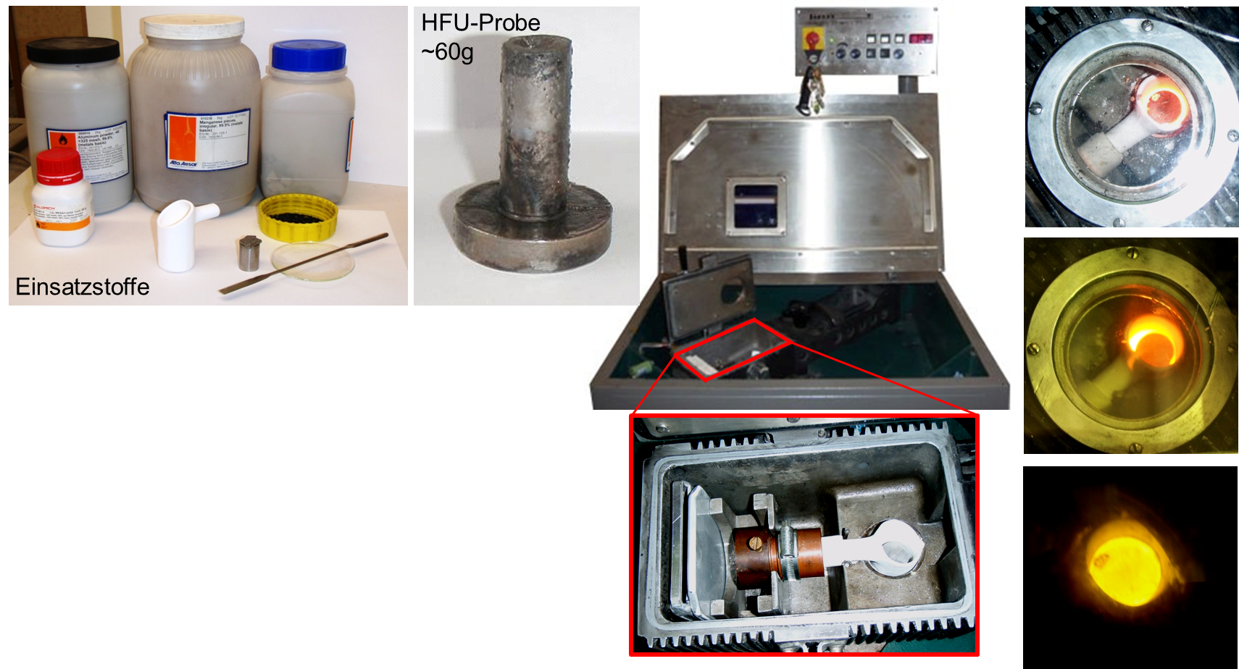
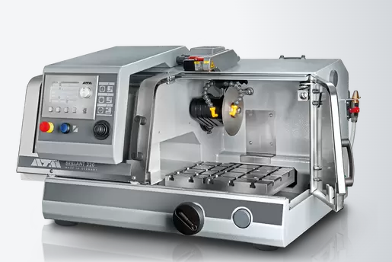
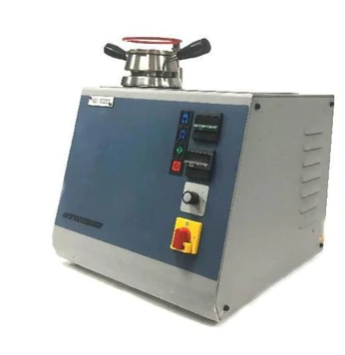
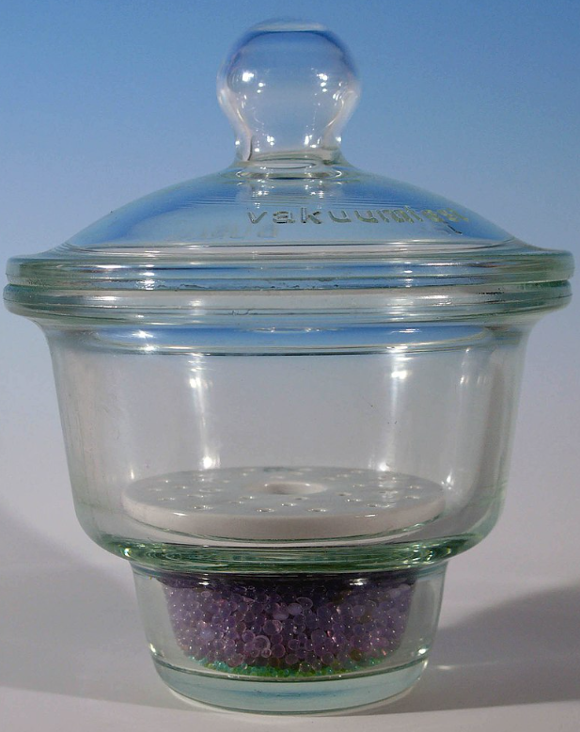
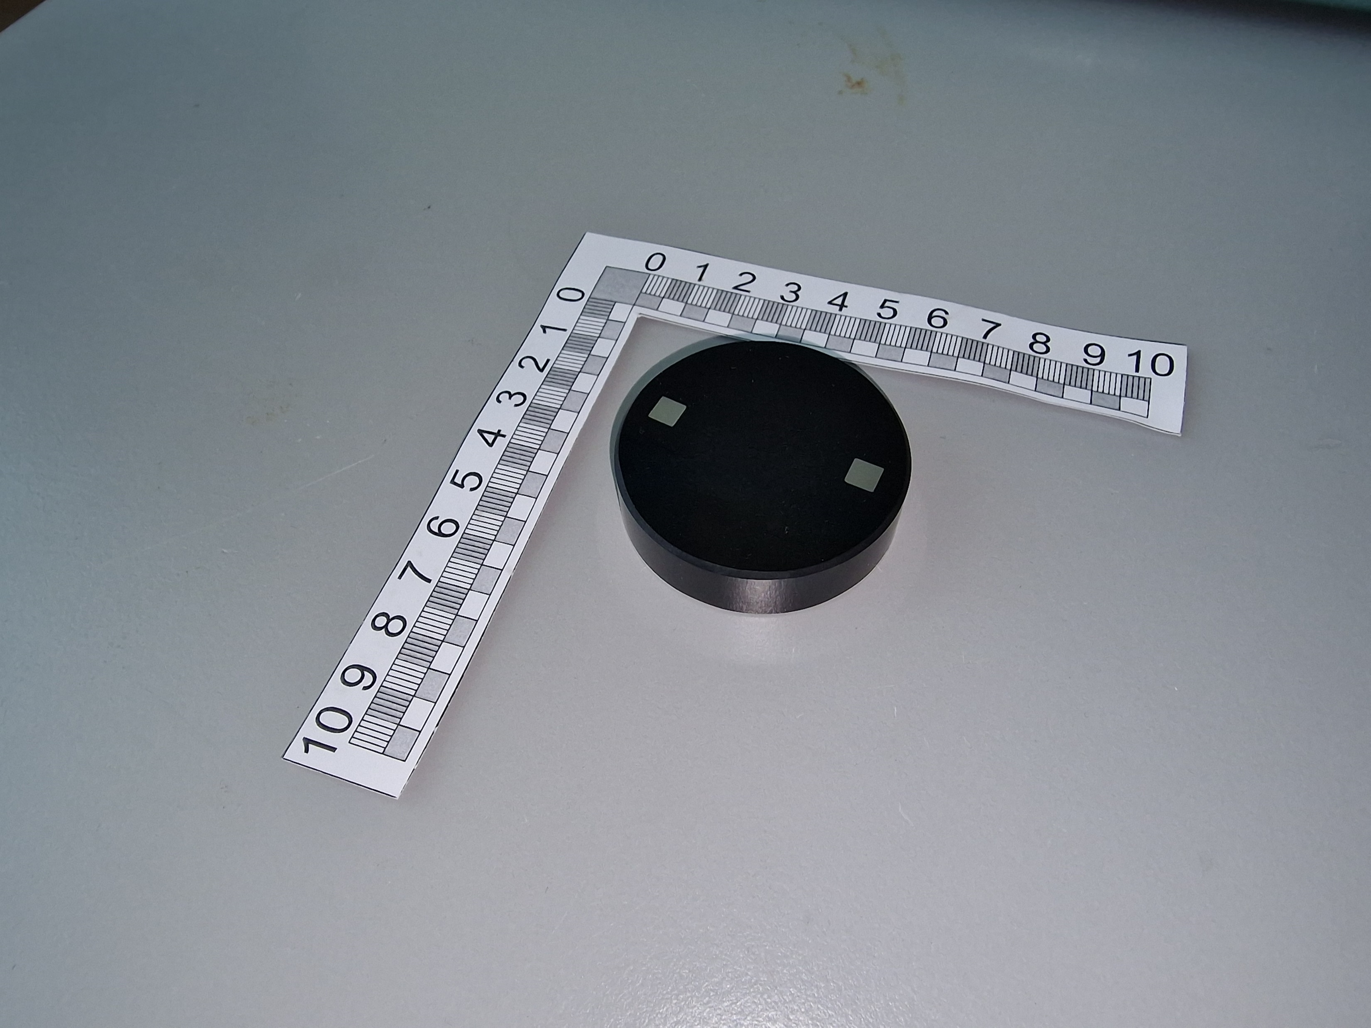
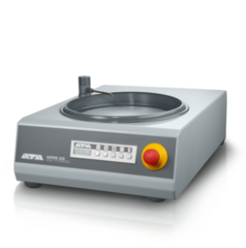
Methodology and sample production
Casting steel grades
  Use of high-purity alloying elements
  Production of high purity samples by induction melting
  and spin casting under protective atmosphere (Ar)
  Efficient production of alloys to be investigated
  Rapid solidification due to the spin casting in a
  copper mould
  Homogenous microstructure of as-cast samples
  Chemical analysis (OES, LECO)
Preparation for HT-LSCM experiments
  Cutting: ATM Brillant 221
  Embedding: Opal 450 Embedding Machine
  Grinding & Polishing: SAPHIR 350:
  1200, 600, 320, 180 mesh size & 9 µm, 6 µm, 3 µm
  1 µm and OPS
  Quality control at optical microscope (scraps, pores etc..)
  Storage of samples in desiccator
ATM Brillant 221
Source: https://www.qatm.de/de/produkte/nass-trenn-schleif-maschinen/tischgeraete/brillant-220/funktion-merkmale/
LINN High Therm GmbH
“Lifumat-Met-3.3-Vac”, 60 g sample mass
Source: https://de.wikipedia.org/wiki/Exsikkator
SAPHIR 350
Source: https://ocean-alf.com/qatm/grinders-polishers/manual-grinderpolisher/
Opal 450 Embedding Machine
Source: https://spectrographic.co.uk/products/atm-opal-450-mounting-press

Slide 9
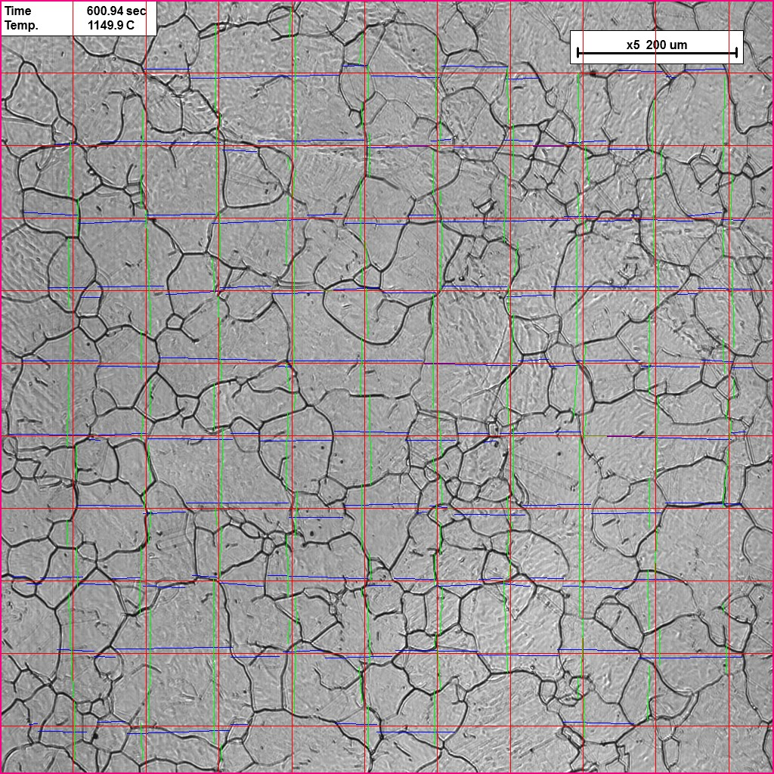
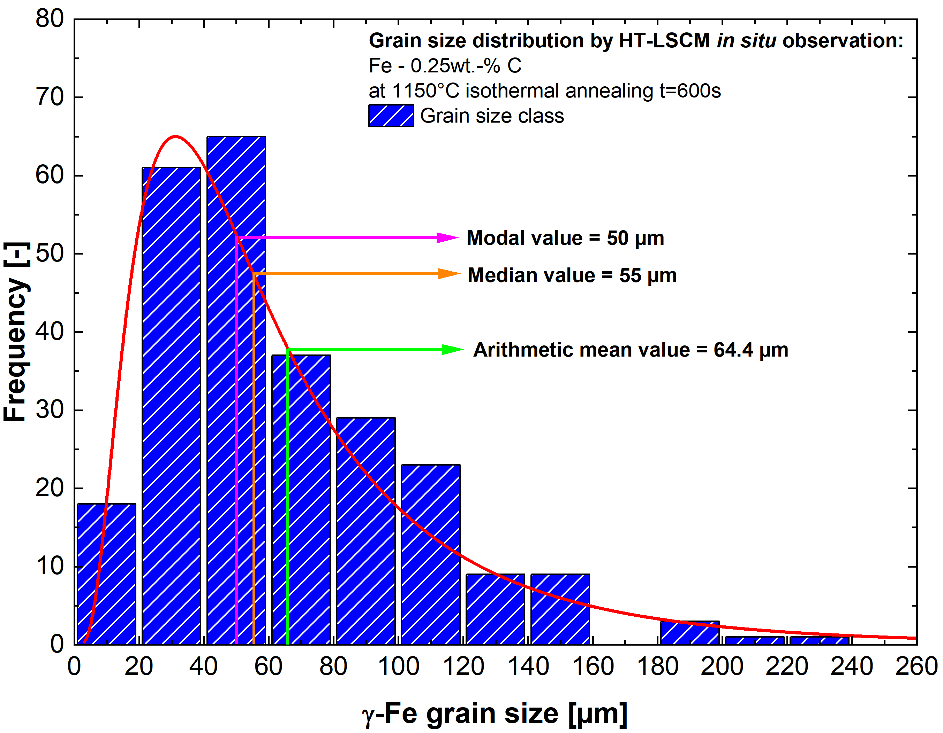
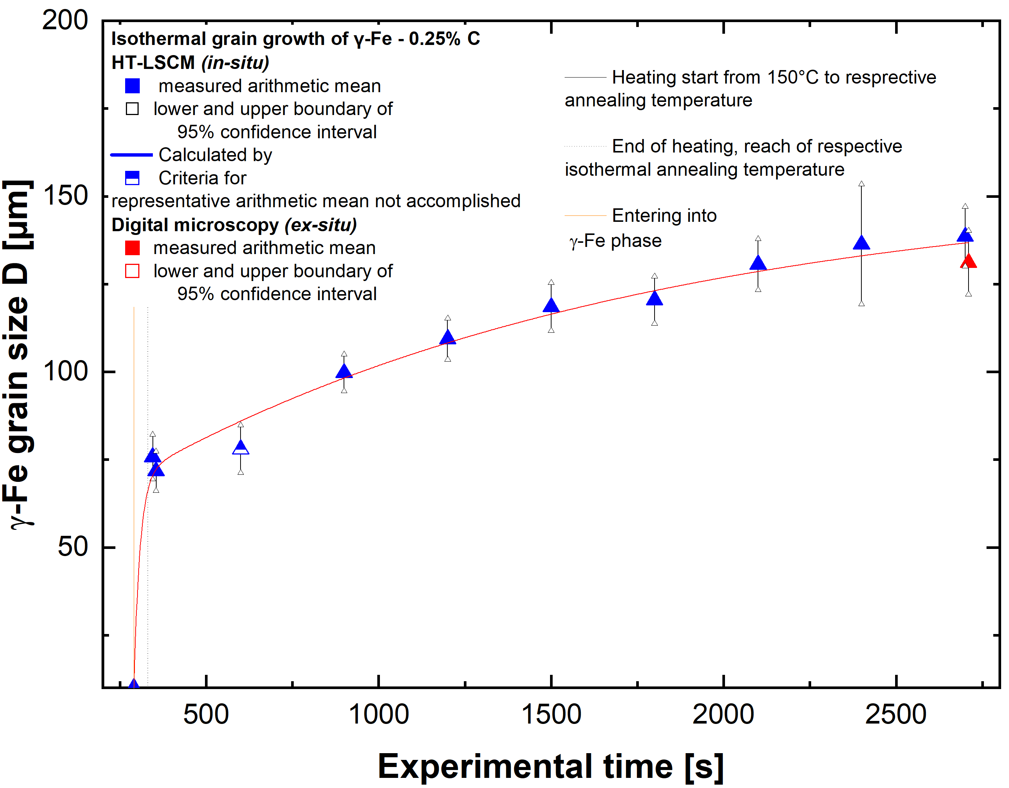
Methodology and sample production
HT-LSCM experiments and subsequent evaluation:
  Defining properties of experiment (T-t, gas selection), video analysis and image capturing
  Example: HFR alloy of Fe - 0.25 wt.-%C: isothermal annealing at 1150 ºC for 2700 s
Time: 300s
Temperature: 1150°C
x5 200µm
1
2
3
4
5
6
7
8
9
10
Evaluation:
Heyn linear intercept procedure for quantitative data
Statistical evaluation:
Mean, median modal value, confidence interval, lognormal distribution
Grain growth function:
Mean value and confidence interval of combined HT-LSCM and DM data

Slide 10
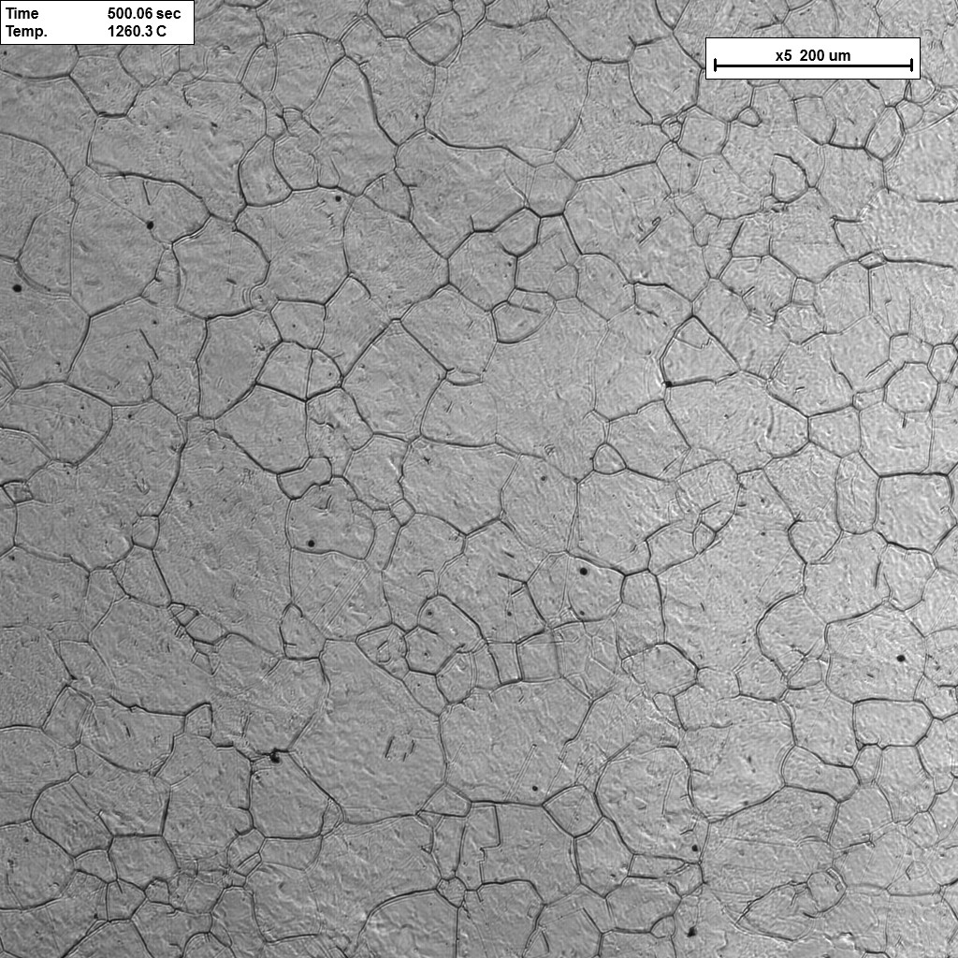
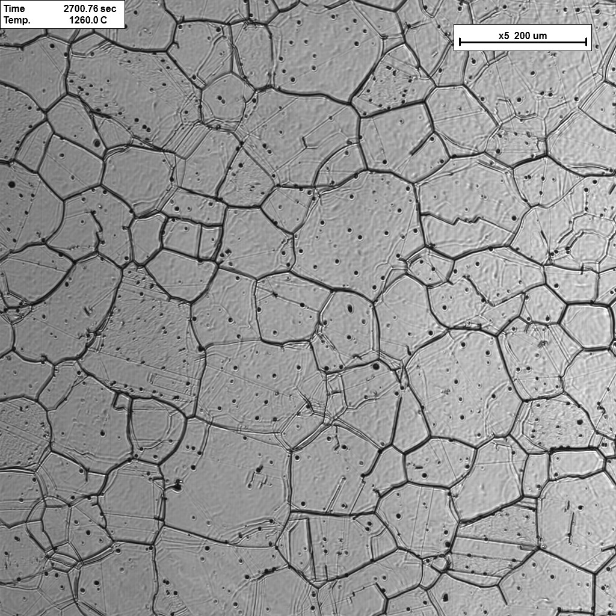
Methodology and sample production
HT-LSCM experiments and subsequent evaluation:
  Image analysis at different times
  Example: HFR alloy of Fe - 0.25 wt.-%C: isothermal annealing at 1150 ºC for 2700 s
Time: 300s
Temperature: 1150°C
Time: 2700s
Temperature: 1150°C
x5 200µm
x5 200µm
Fe - 0.25 wt.-%C
Grain growth function:
Mean value and confidence interval of combined HT-LSCM and DM data
Fe - 0.25 wt.-%C

Slide 11
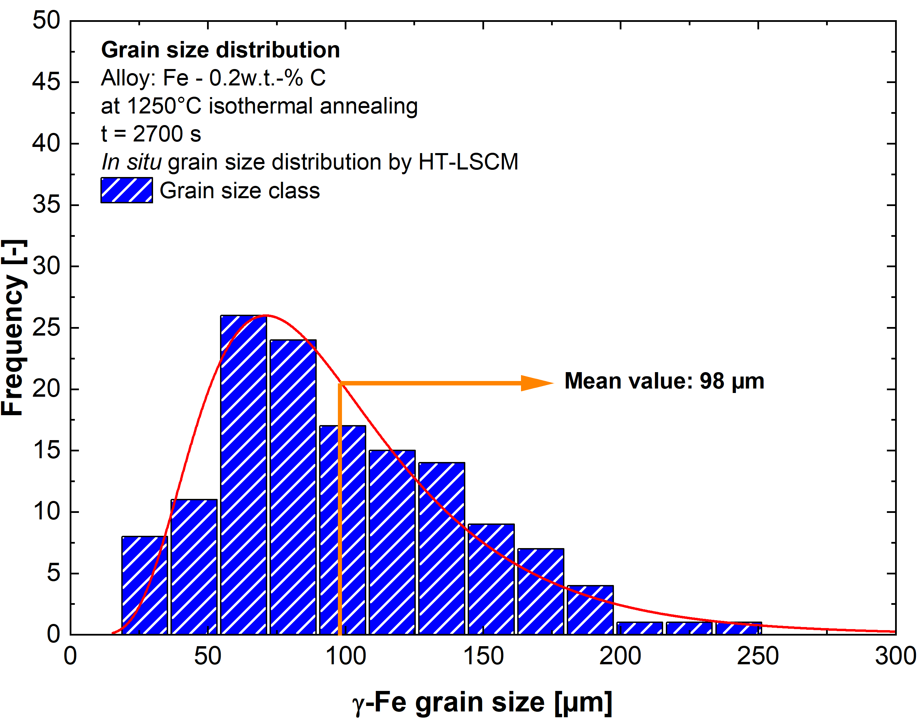
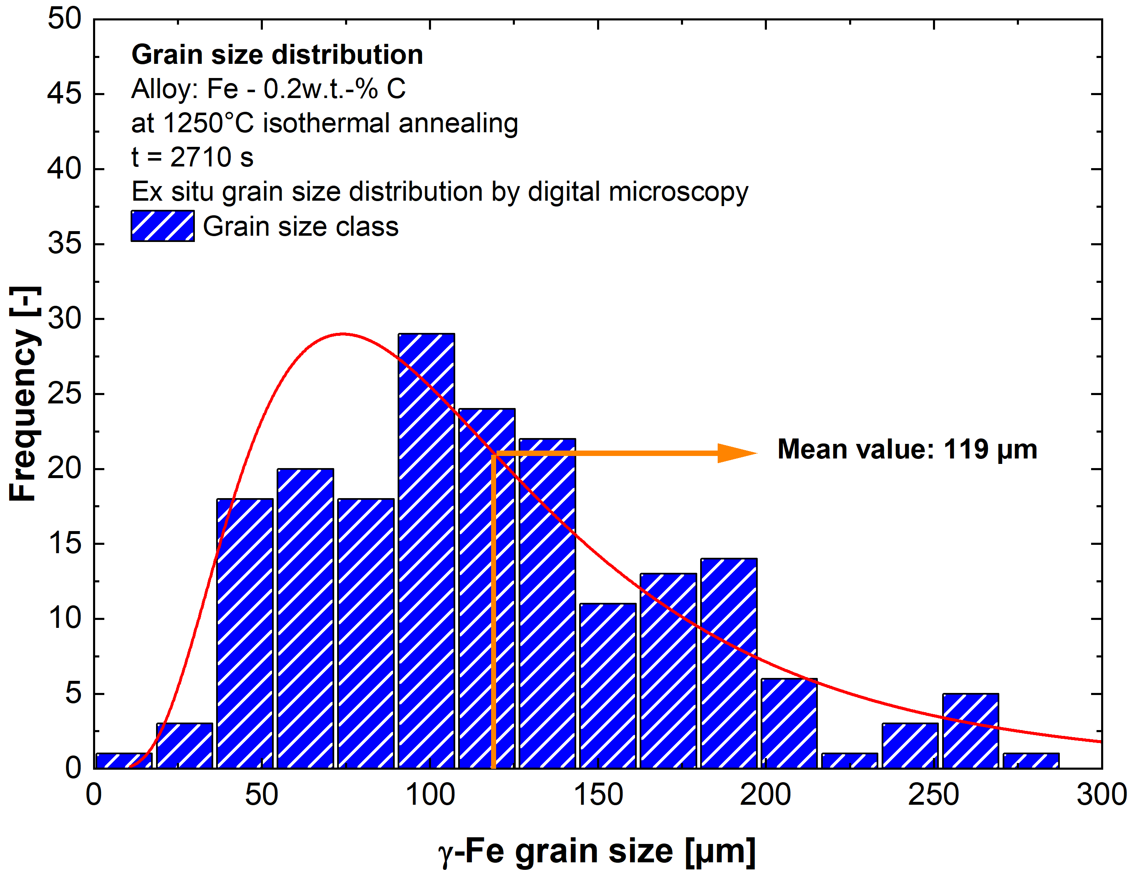
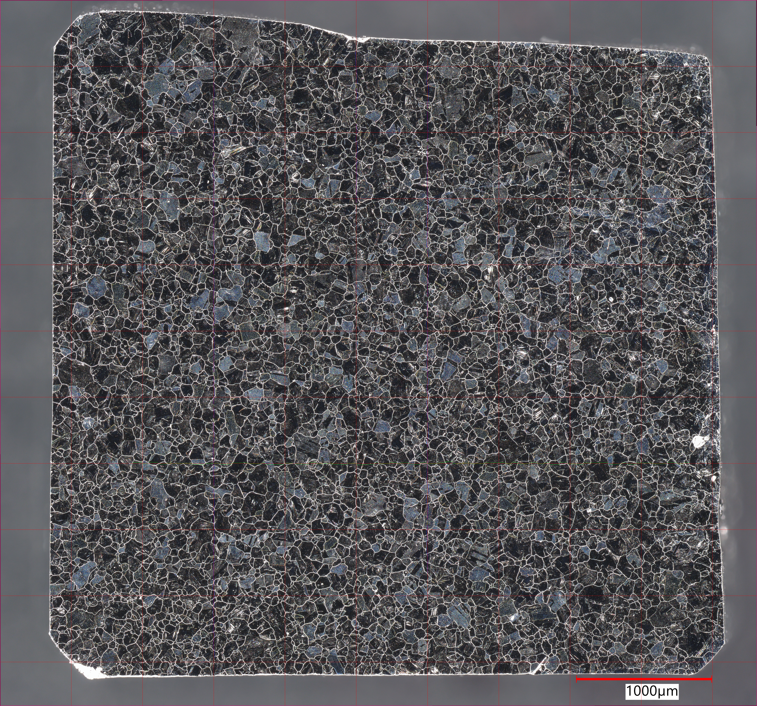
Methodology and sample production
Grain size evaluation and analysis
  HFR alloy of Fe - 0.25 wt.-% C: Isothermal annealing at 1150 ºC for 2700 s
  Evaluation includes lognormal distribution for each time step to prove normal grain growth
  Comparison ex situ image by digital microscope with last time step of in situ confocal microscope image
  Improved statistical security by digital microscopy evaluation due to possibility of access to the whole sample surface with prior austenite grain boundaries
HT-LSCM
Time: final
Temperature: 1250°C
x5 200µm
HT-LSCM
DM
DM
1000 µm

Slide 12

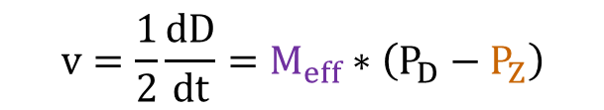



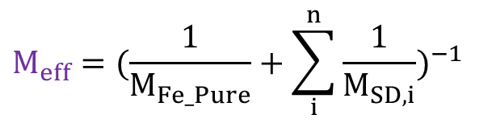

Methodology and sample production
Mathematical modeling
  Desing as a system of ordinary differential equation to predict normal austenite grain growth by combining classic theory of normal grain growth and more recent approaches
  Consideration of impurities induced solute drag effect and second phase particles precipitation pinning
  Grain growth equation:
  Solute drag effect:
  Zener pinning pressure:
$$v=\frac{1}{2}\frac{dD}{dt}=M_{eff}∗\left(P_{D}−P_{Z}\right)$$
$$γ$$
$$M_{eff}={(\frac{1}{M_{Fe_Pure}}+\sum_{i}^{n}{\frac{1}{M_{SD,i}}})}^{−1}$$
$$γ$$
TiC, TiN, Nb(C,N), AlN, V(C,N)
$$γ$$
$$P_{Z}=\sum_{i}{\sum_{j}{\frac{f_{i,k}}{r_{i,k}}}}$$
$$γ$$
P, Nb, Mo

Slide 13
Table of contents
Introduction and theoretical input
HT-LSCM: Experimental device
Methodology and sample production
Investigation of retarding pressures (solute drag, pinning) in Fe-X systems
Conclusion

Slide 14
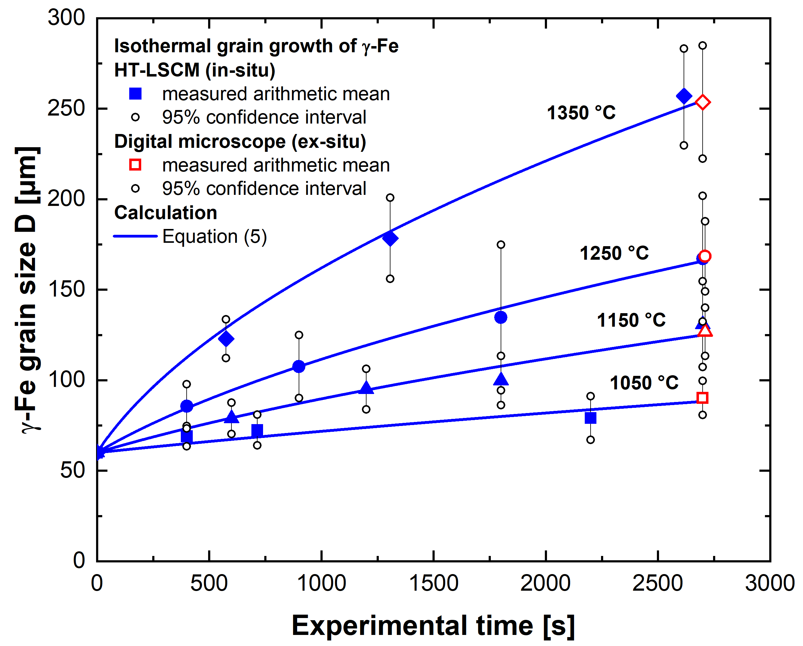
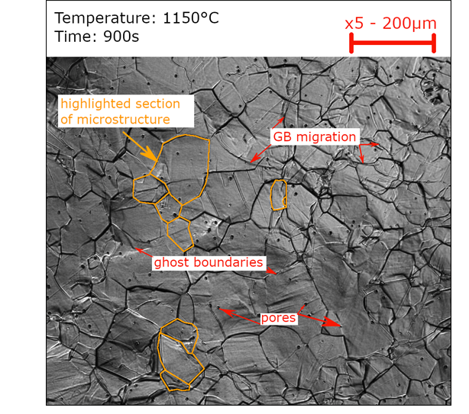
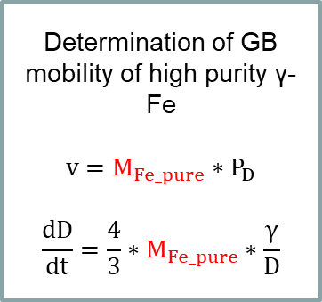
Investigation of retarding pressures (solute drag, pinning) in Fe-X systems
Grain growth: High-purity Fe (99.98 wt.-%Fe)
  Grain growth analysis for reference material as a starting point
Determination of GB mobility of high purity γ-Fe
$$v=M_{Fe_pure}∗P_{D}$$
$$\frac{dD}{dt}=\frac{4}{3}∗M_{Fe_pure}∗\frac{γ}{D}$$
Source: Kern et al., Scripta Materialia, Vol. 230 (2023), pp. 115431

Slide 15
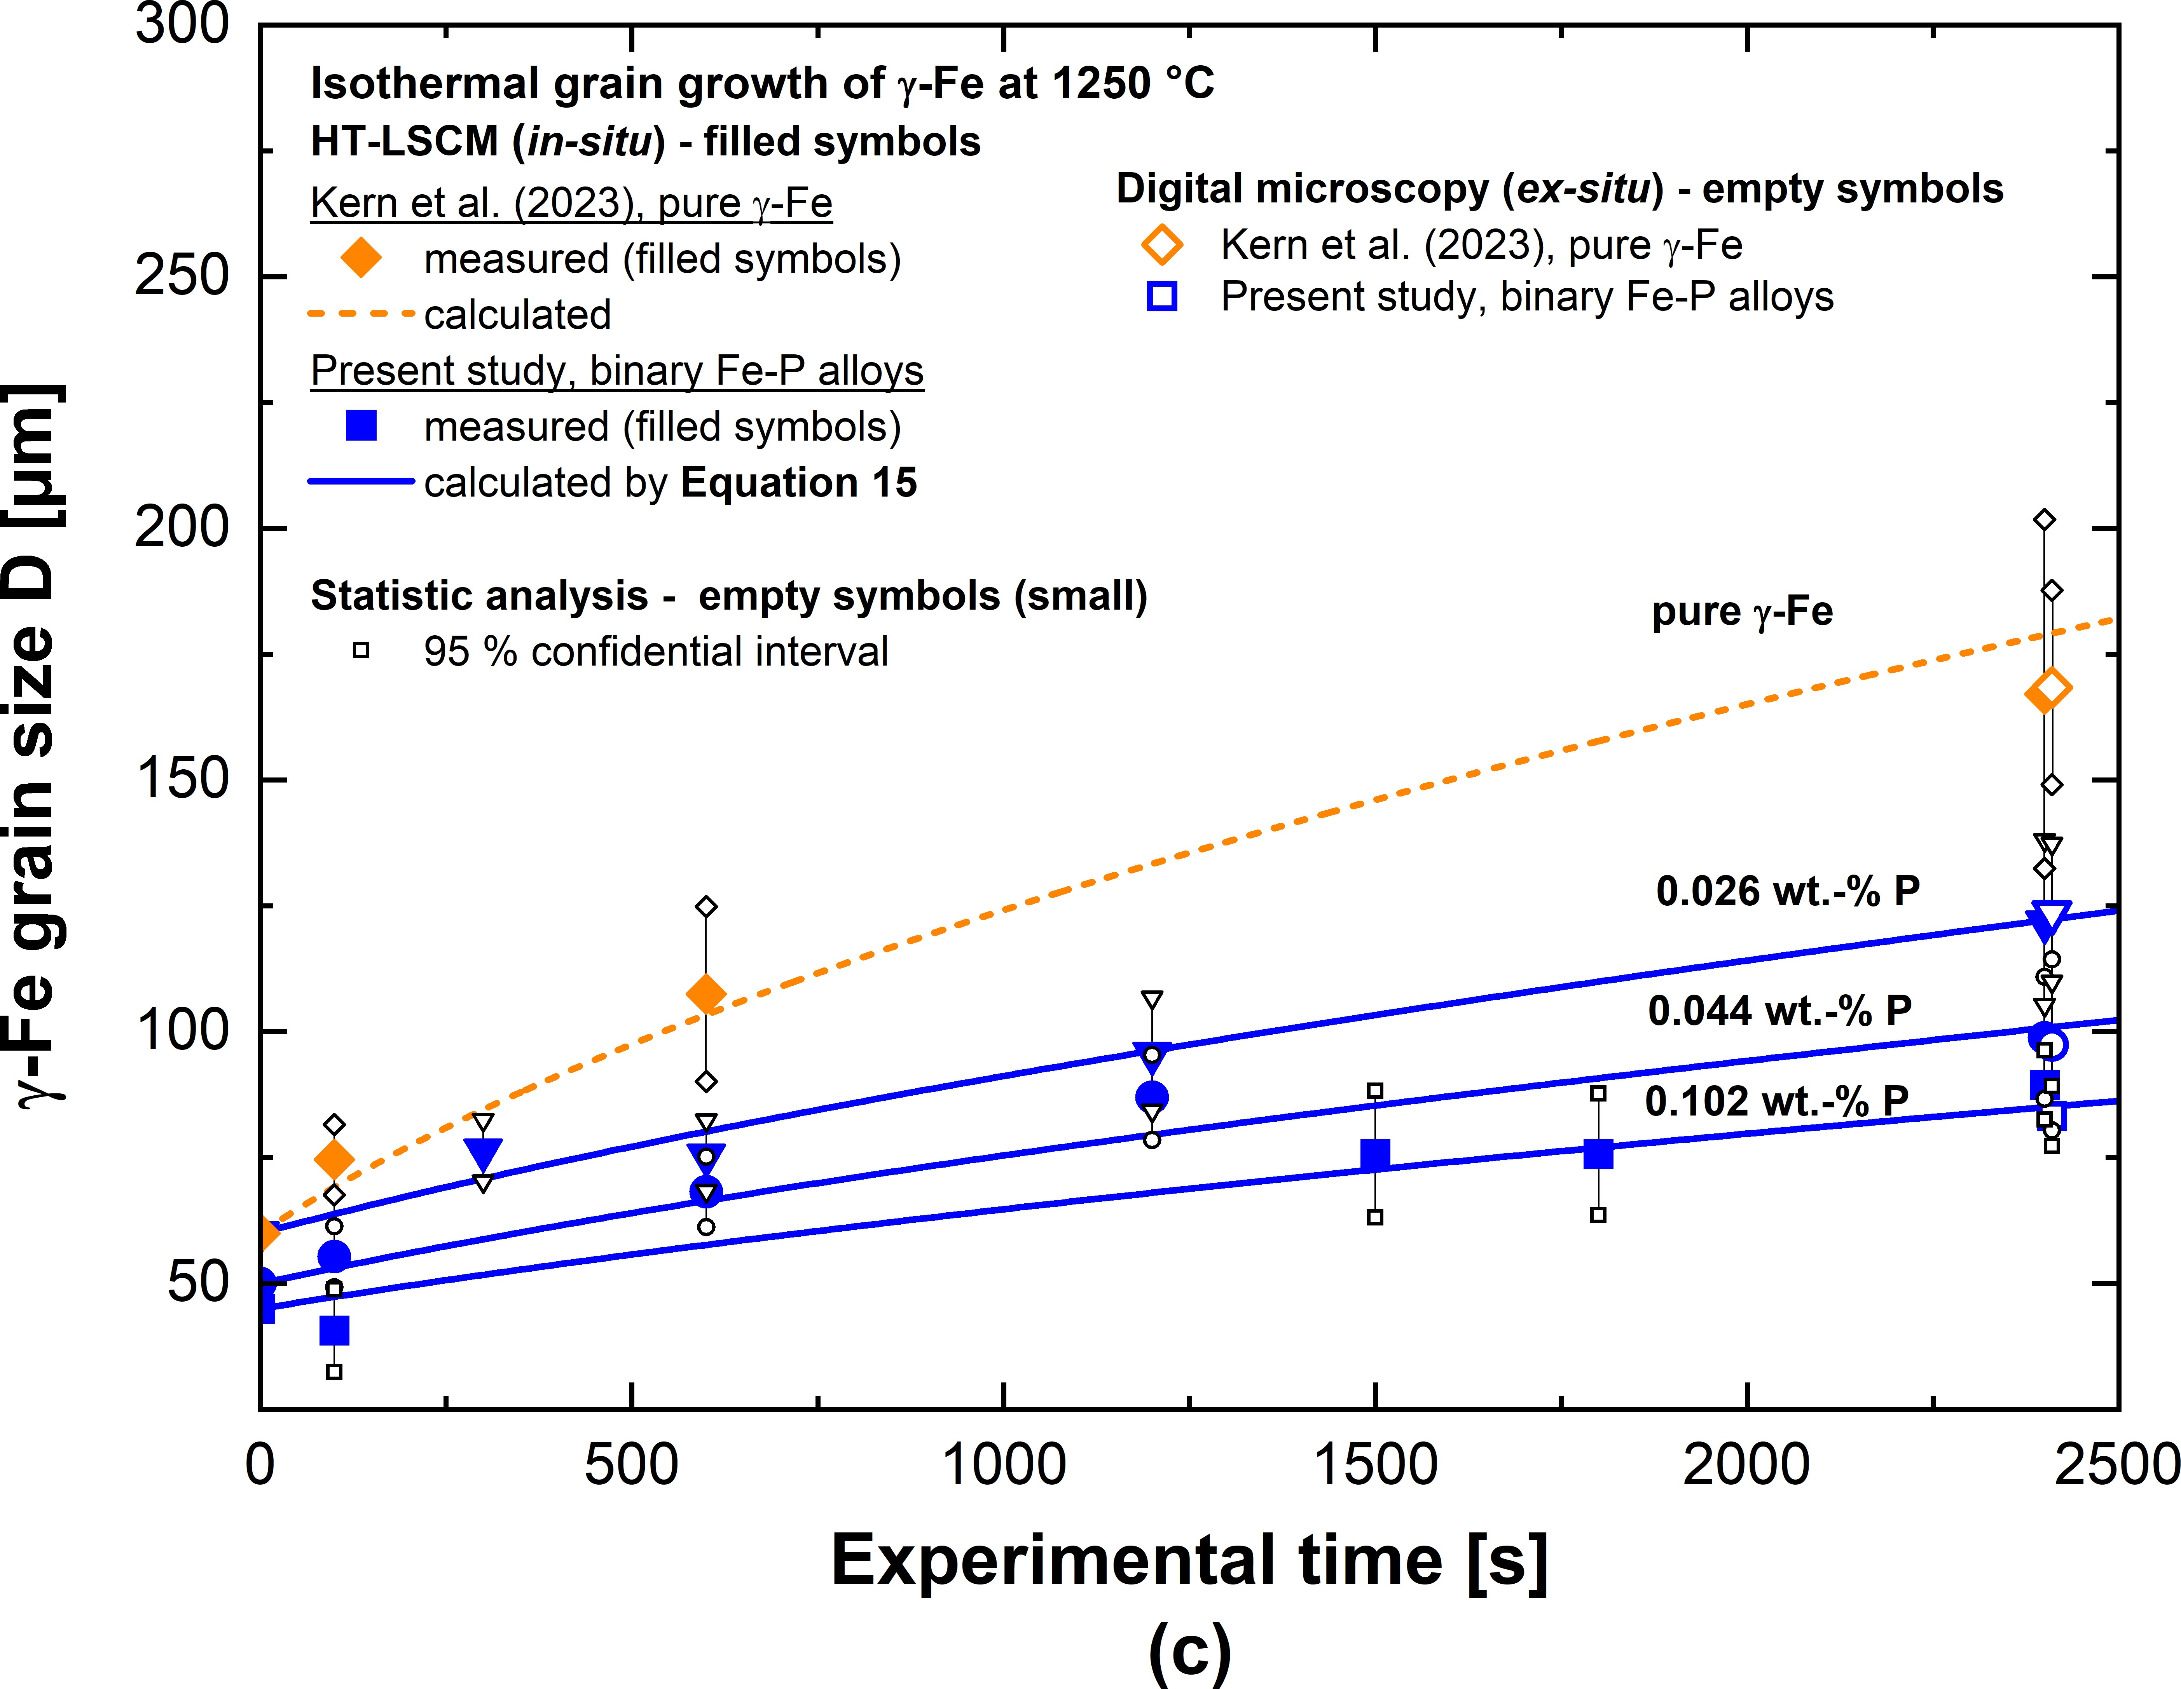
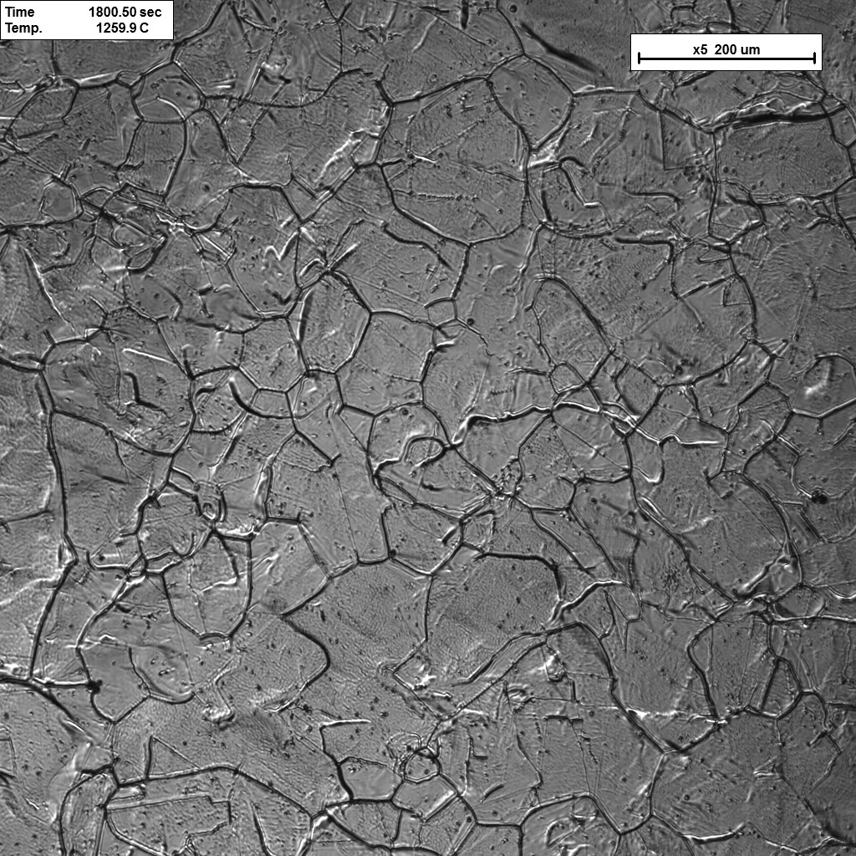
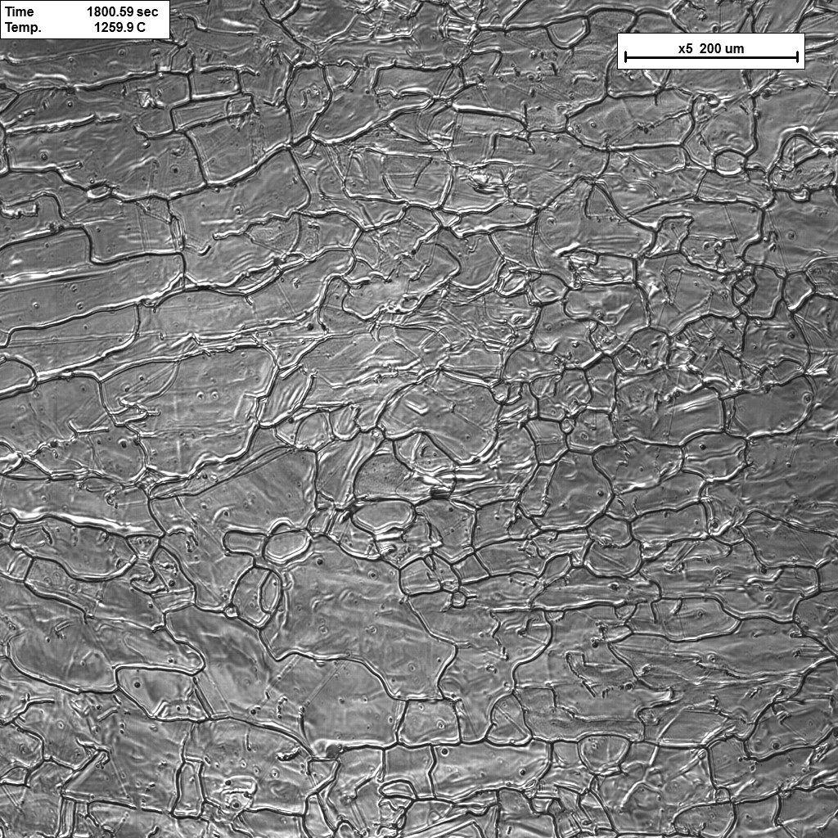
Investigation of retarding pressures (solute drag, pinning) in Fe-X systems
Grain growth: Influence of P on grain boundary migration by solute drag effect
  Comparison of isothermal γ-Fe grain growth: high purity γ-Fe and 3 different Fe-P alloys at 1250 ºC
  Images of isothermal γ-Fe grain growth: 2 different Fe-P alloys at 1250 ºC, t = 2400 s:
Time: 2400s
Temperature: 1250°C
Time: 2400s
Temperature: 1250°C
x5 200µm
x5 200µm
Fe - 0.026wt.-%P
Fe - 0.102wt.-%P

Slide 16
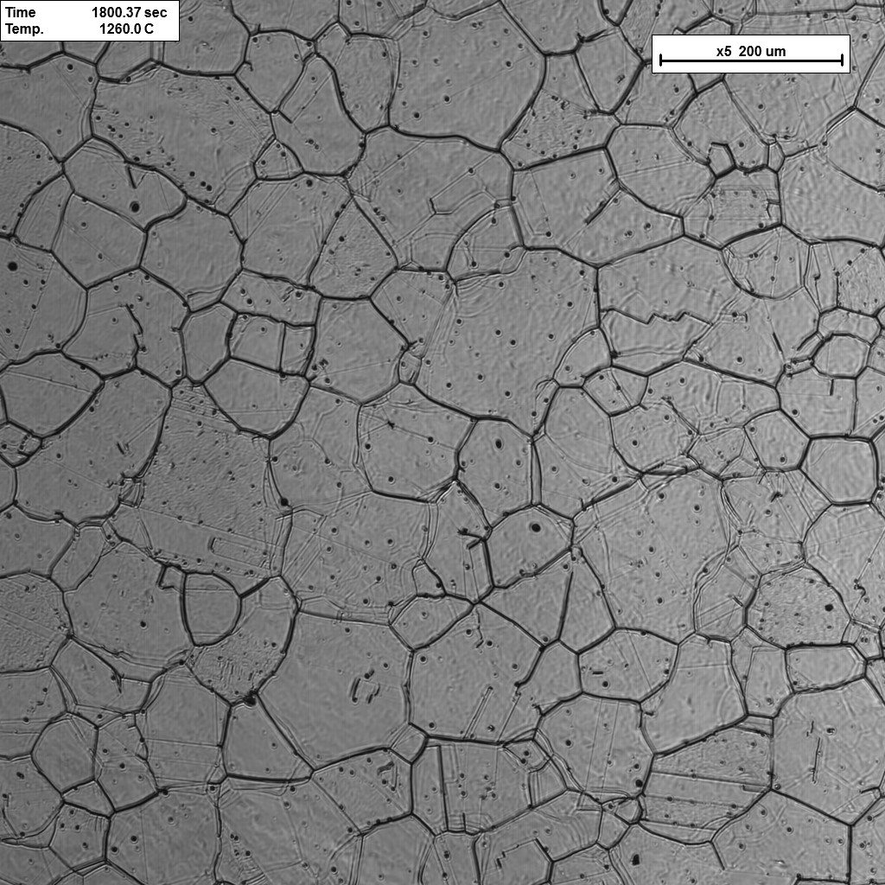
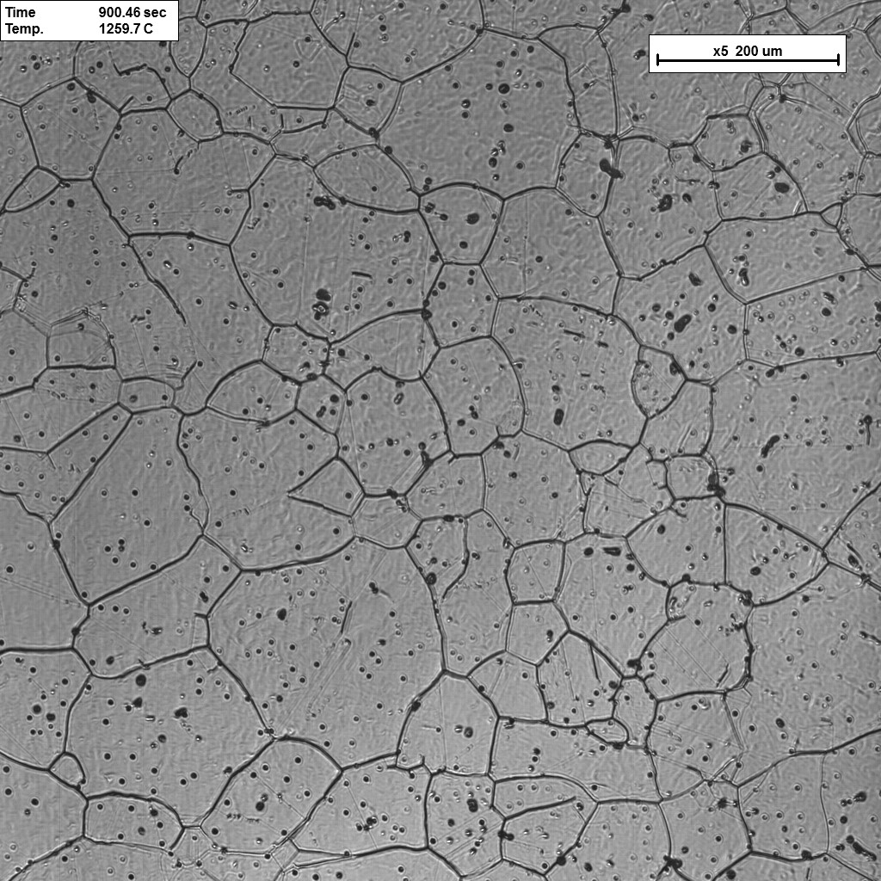
Investigation of retarding pressures (solute drag, pinning) in Fe-X systems
Grain growth: Influence of P and co-segregation of C on grain boundary migration by solute drag effect
  Comparison of isothermal γ-Fe grain growth: Fe-C; Fe-P and Fe-C-P alloys at 1250 ºC at t=1800 s
  Change in grain boundary migration rate and topology by chemical composition, especially carbon
Time: 1800s
Temperature: 1250°C
Time: 1800s
Temperature: 1250°C
Time: 1800s
Temperature: 1250°C
x5 200µm
x5 200µm
x5 200µm
Fe - 0.2 wt.-%C
Fe - 0.1wt.-%P
Fe - 0.2wt.-%C - 0.1wt.-%P

Slide 17
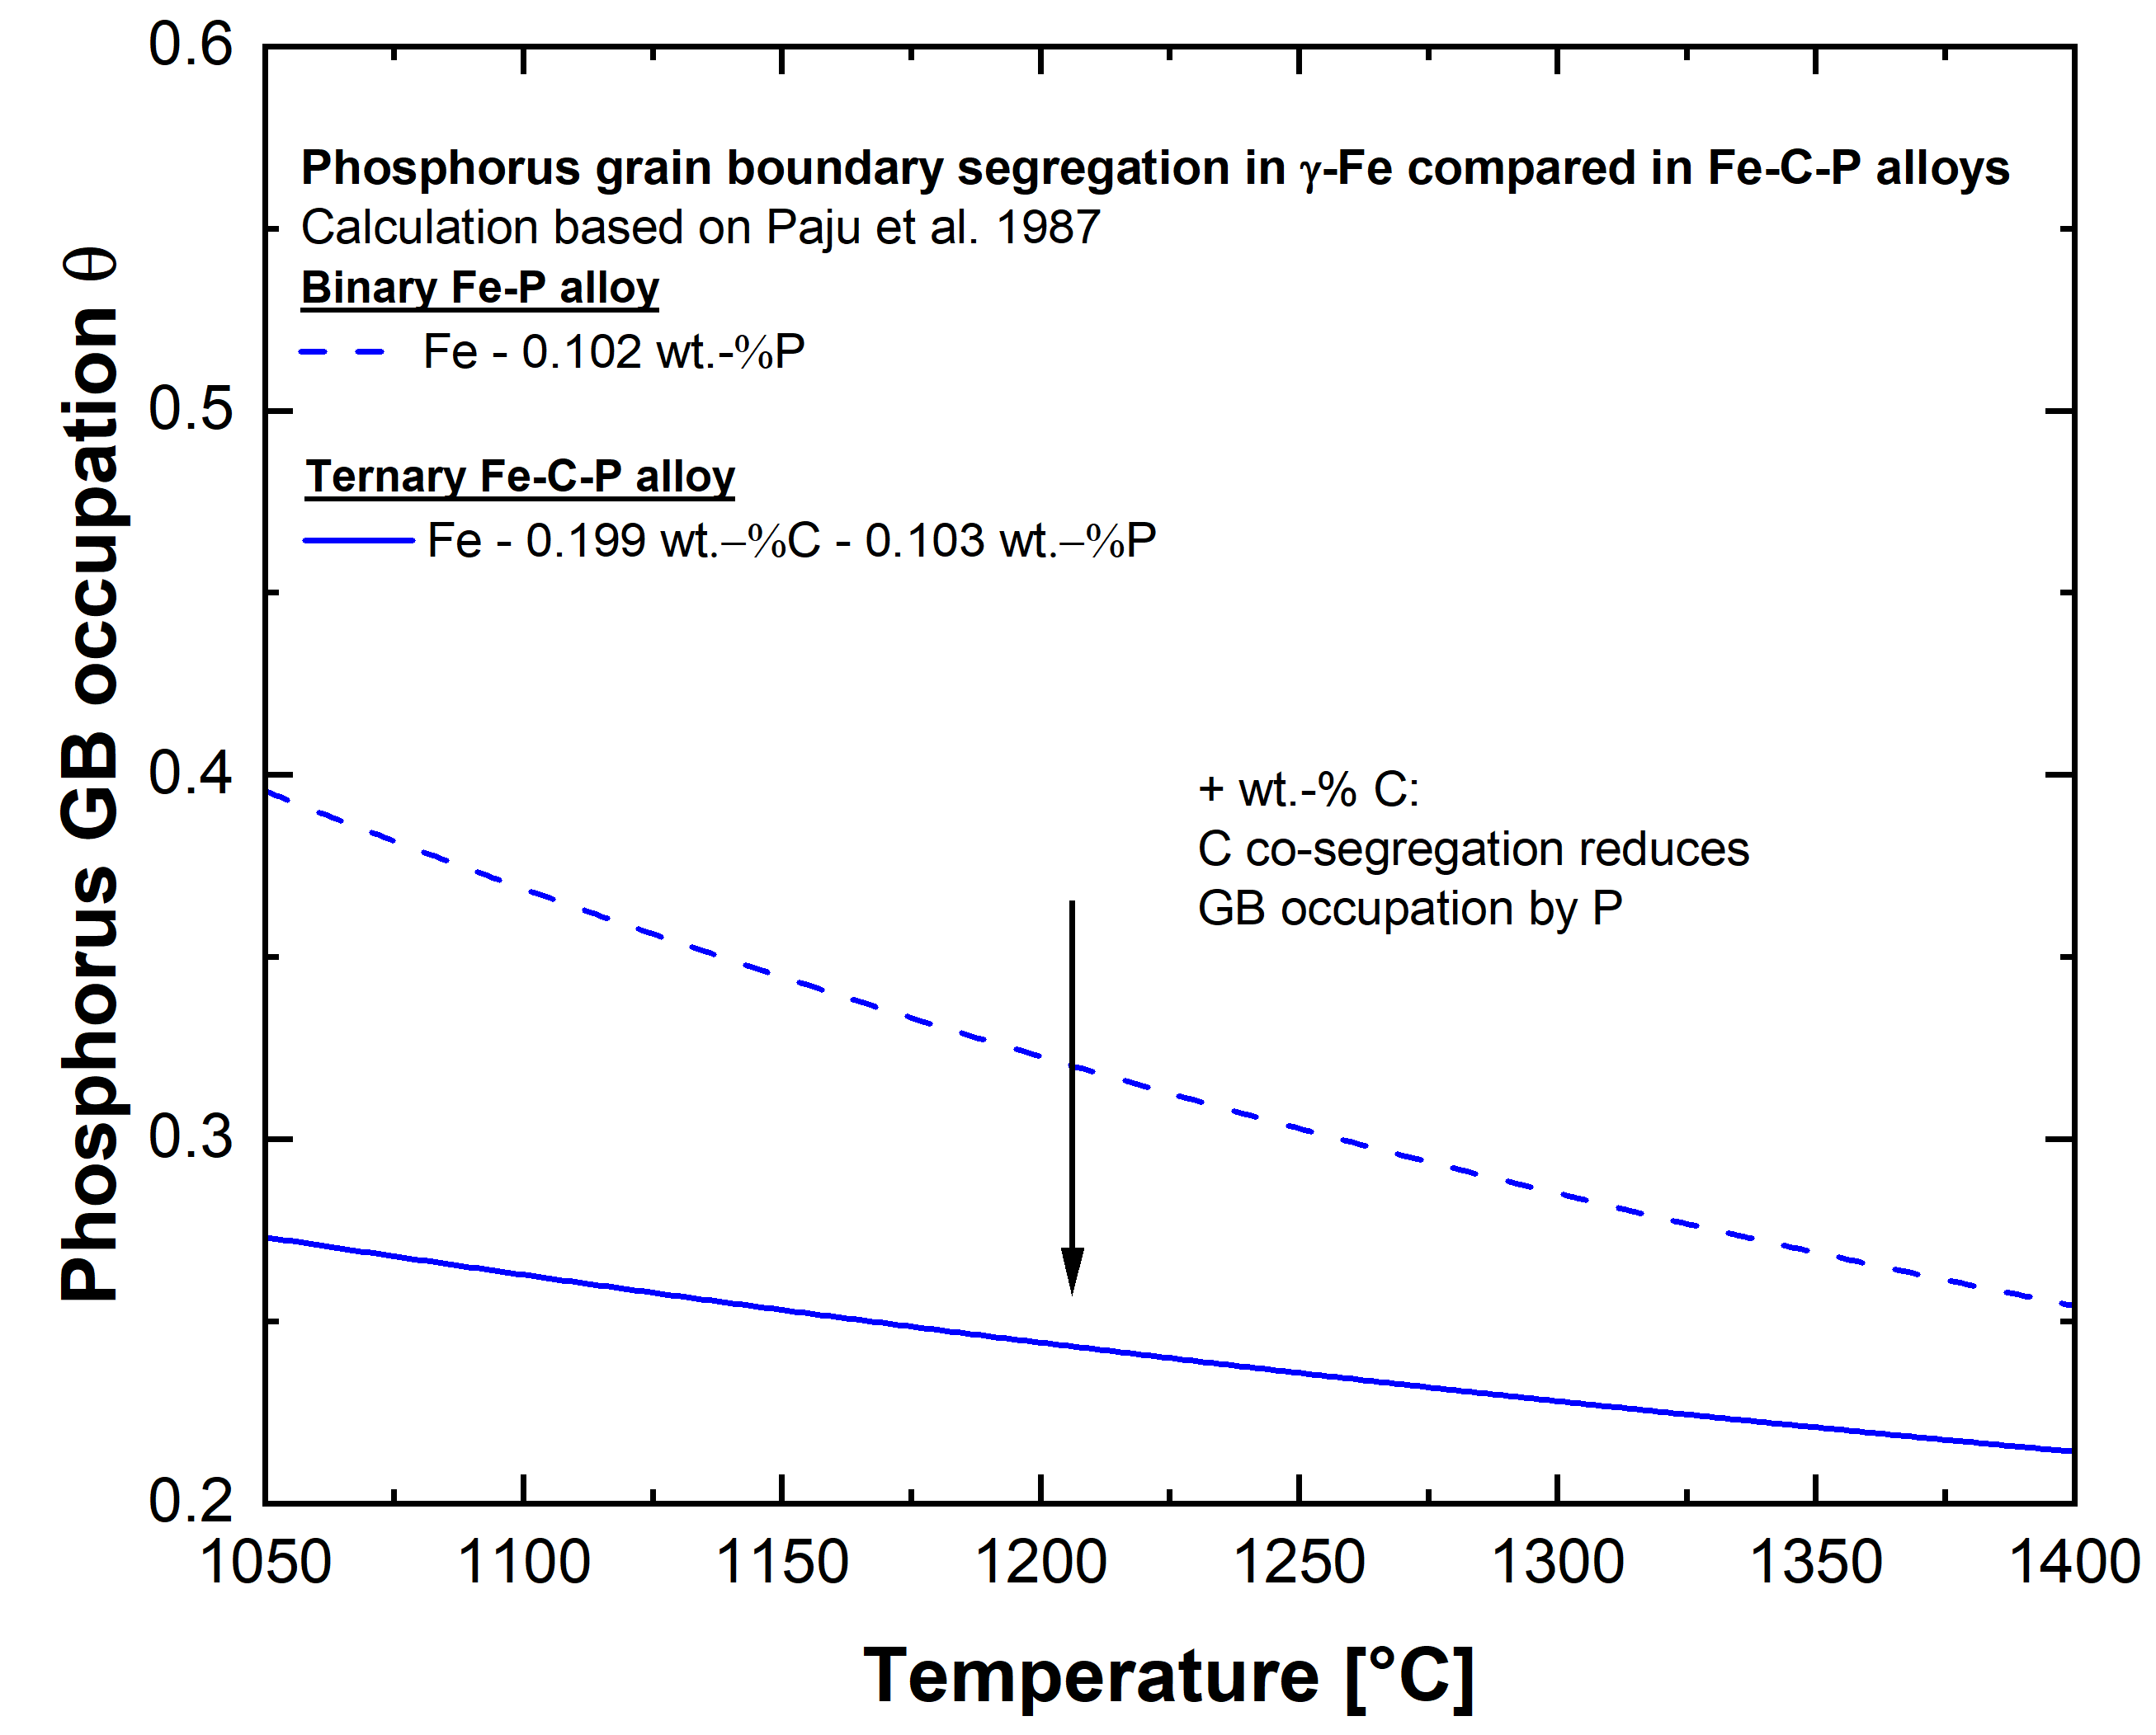
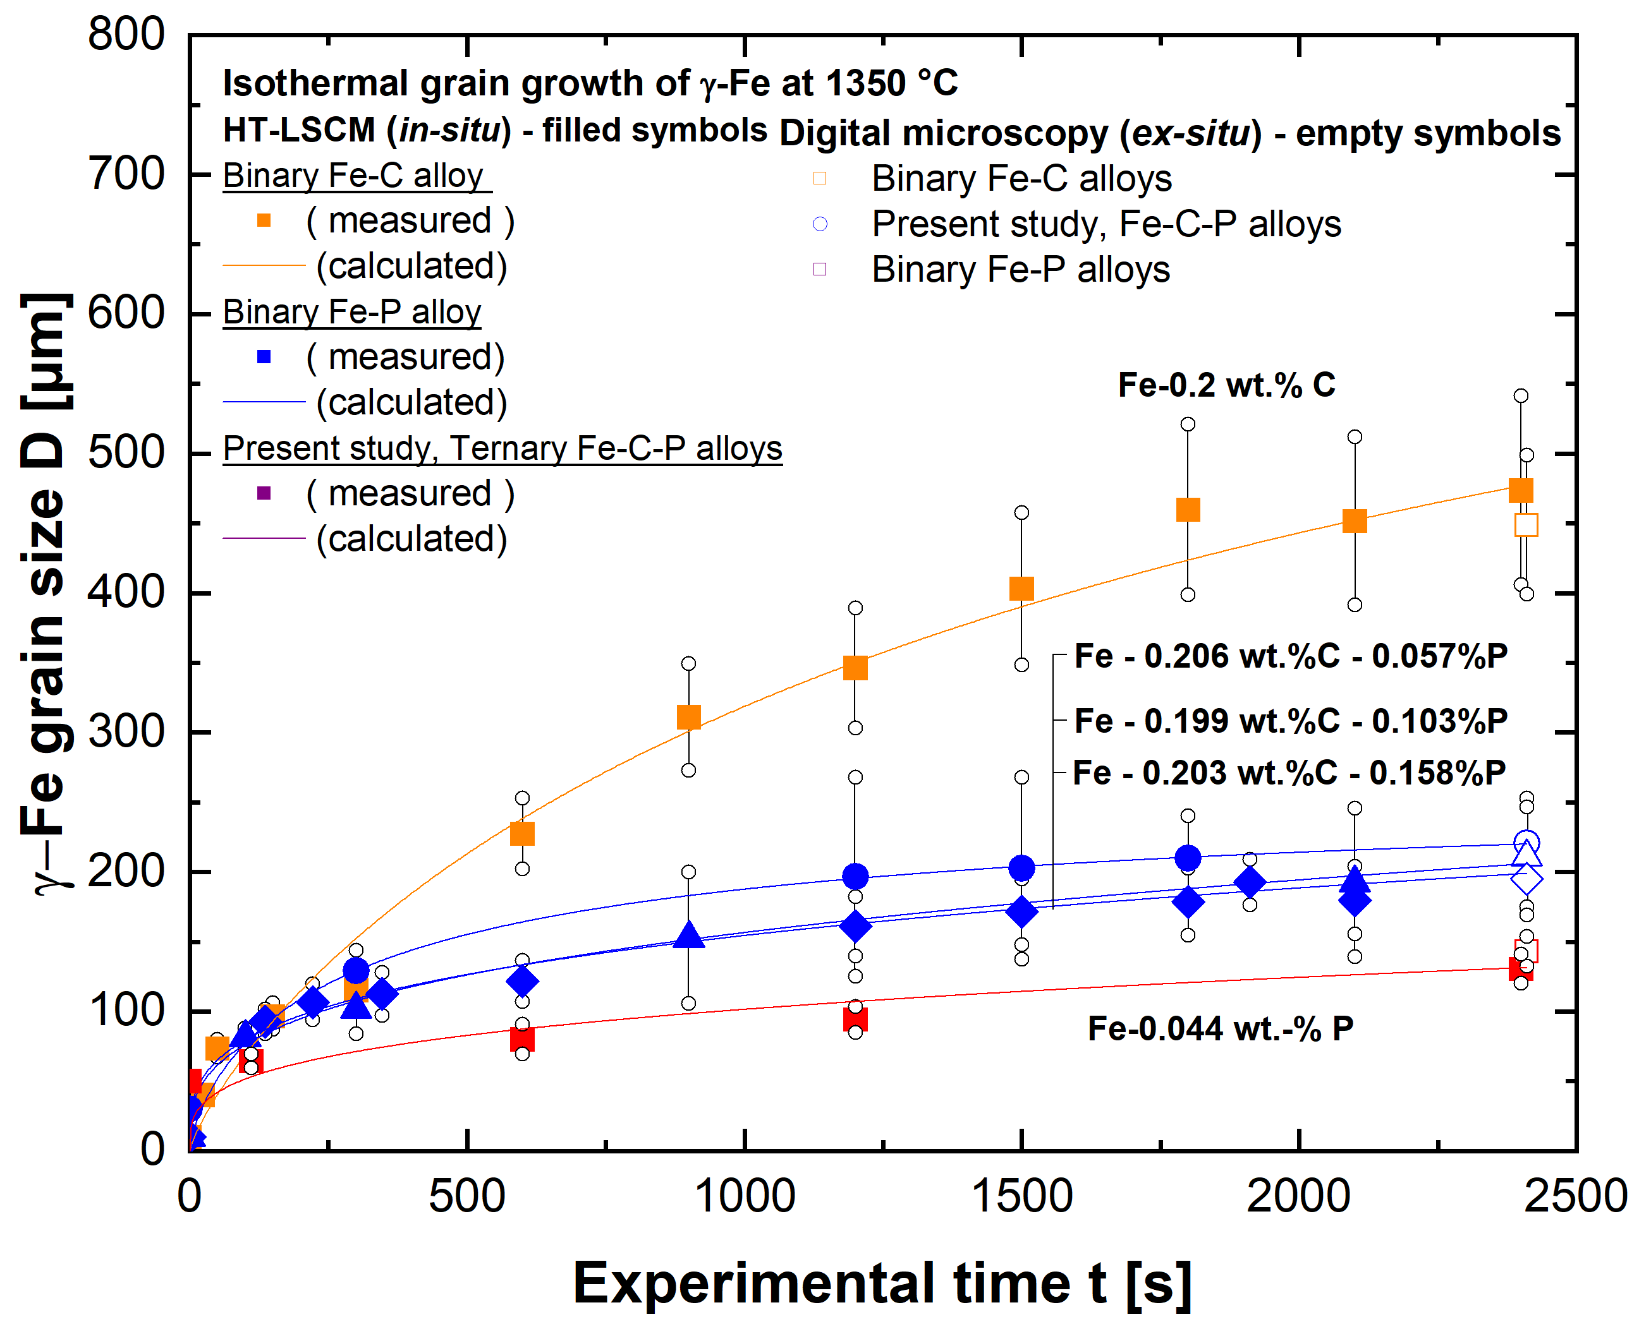
Investigation of retarding pressures (solute drag, pinning) in Fe-X systems
Grain growth: Influence of P and co-segregation of C on grain boundary migration by solute drag effect
  Change in P grain boundary occupation by addition of carbon

Slide 18
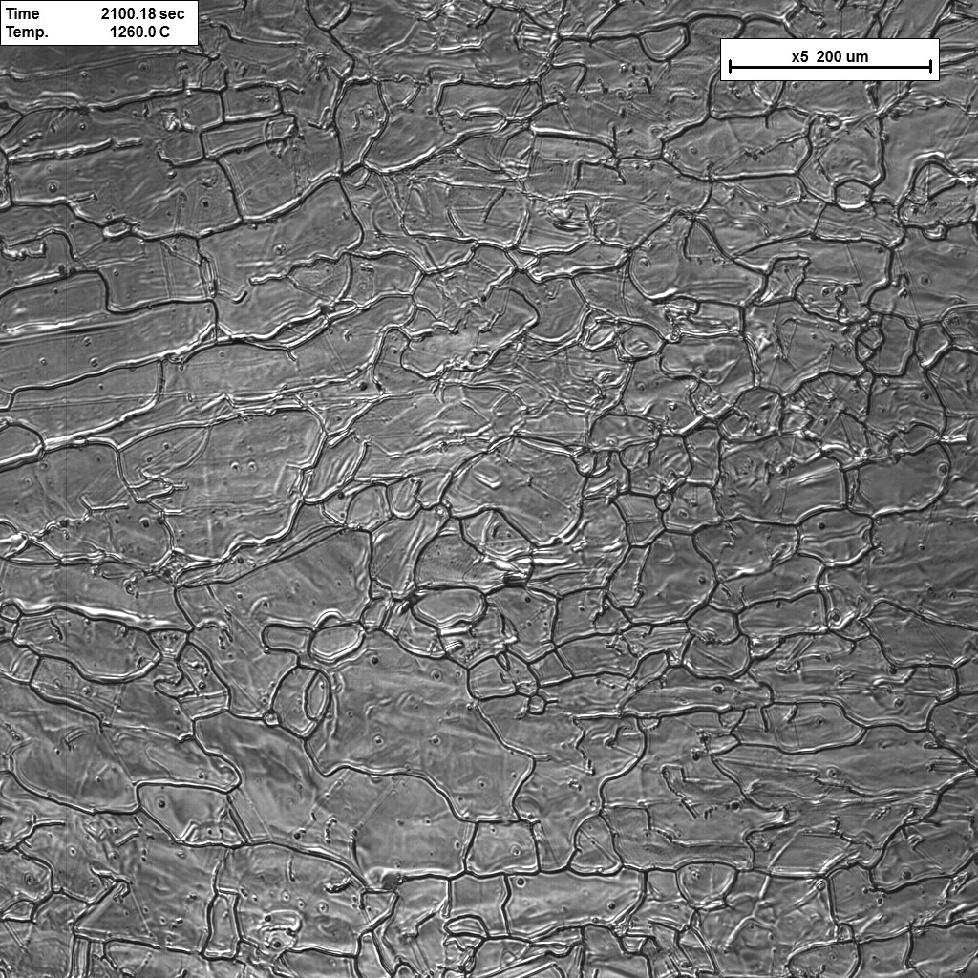
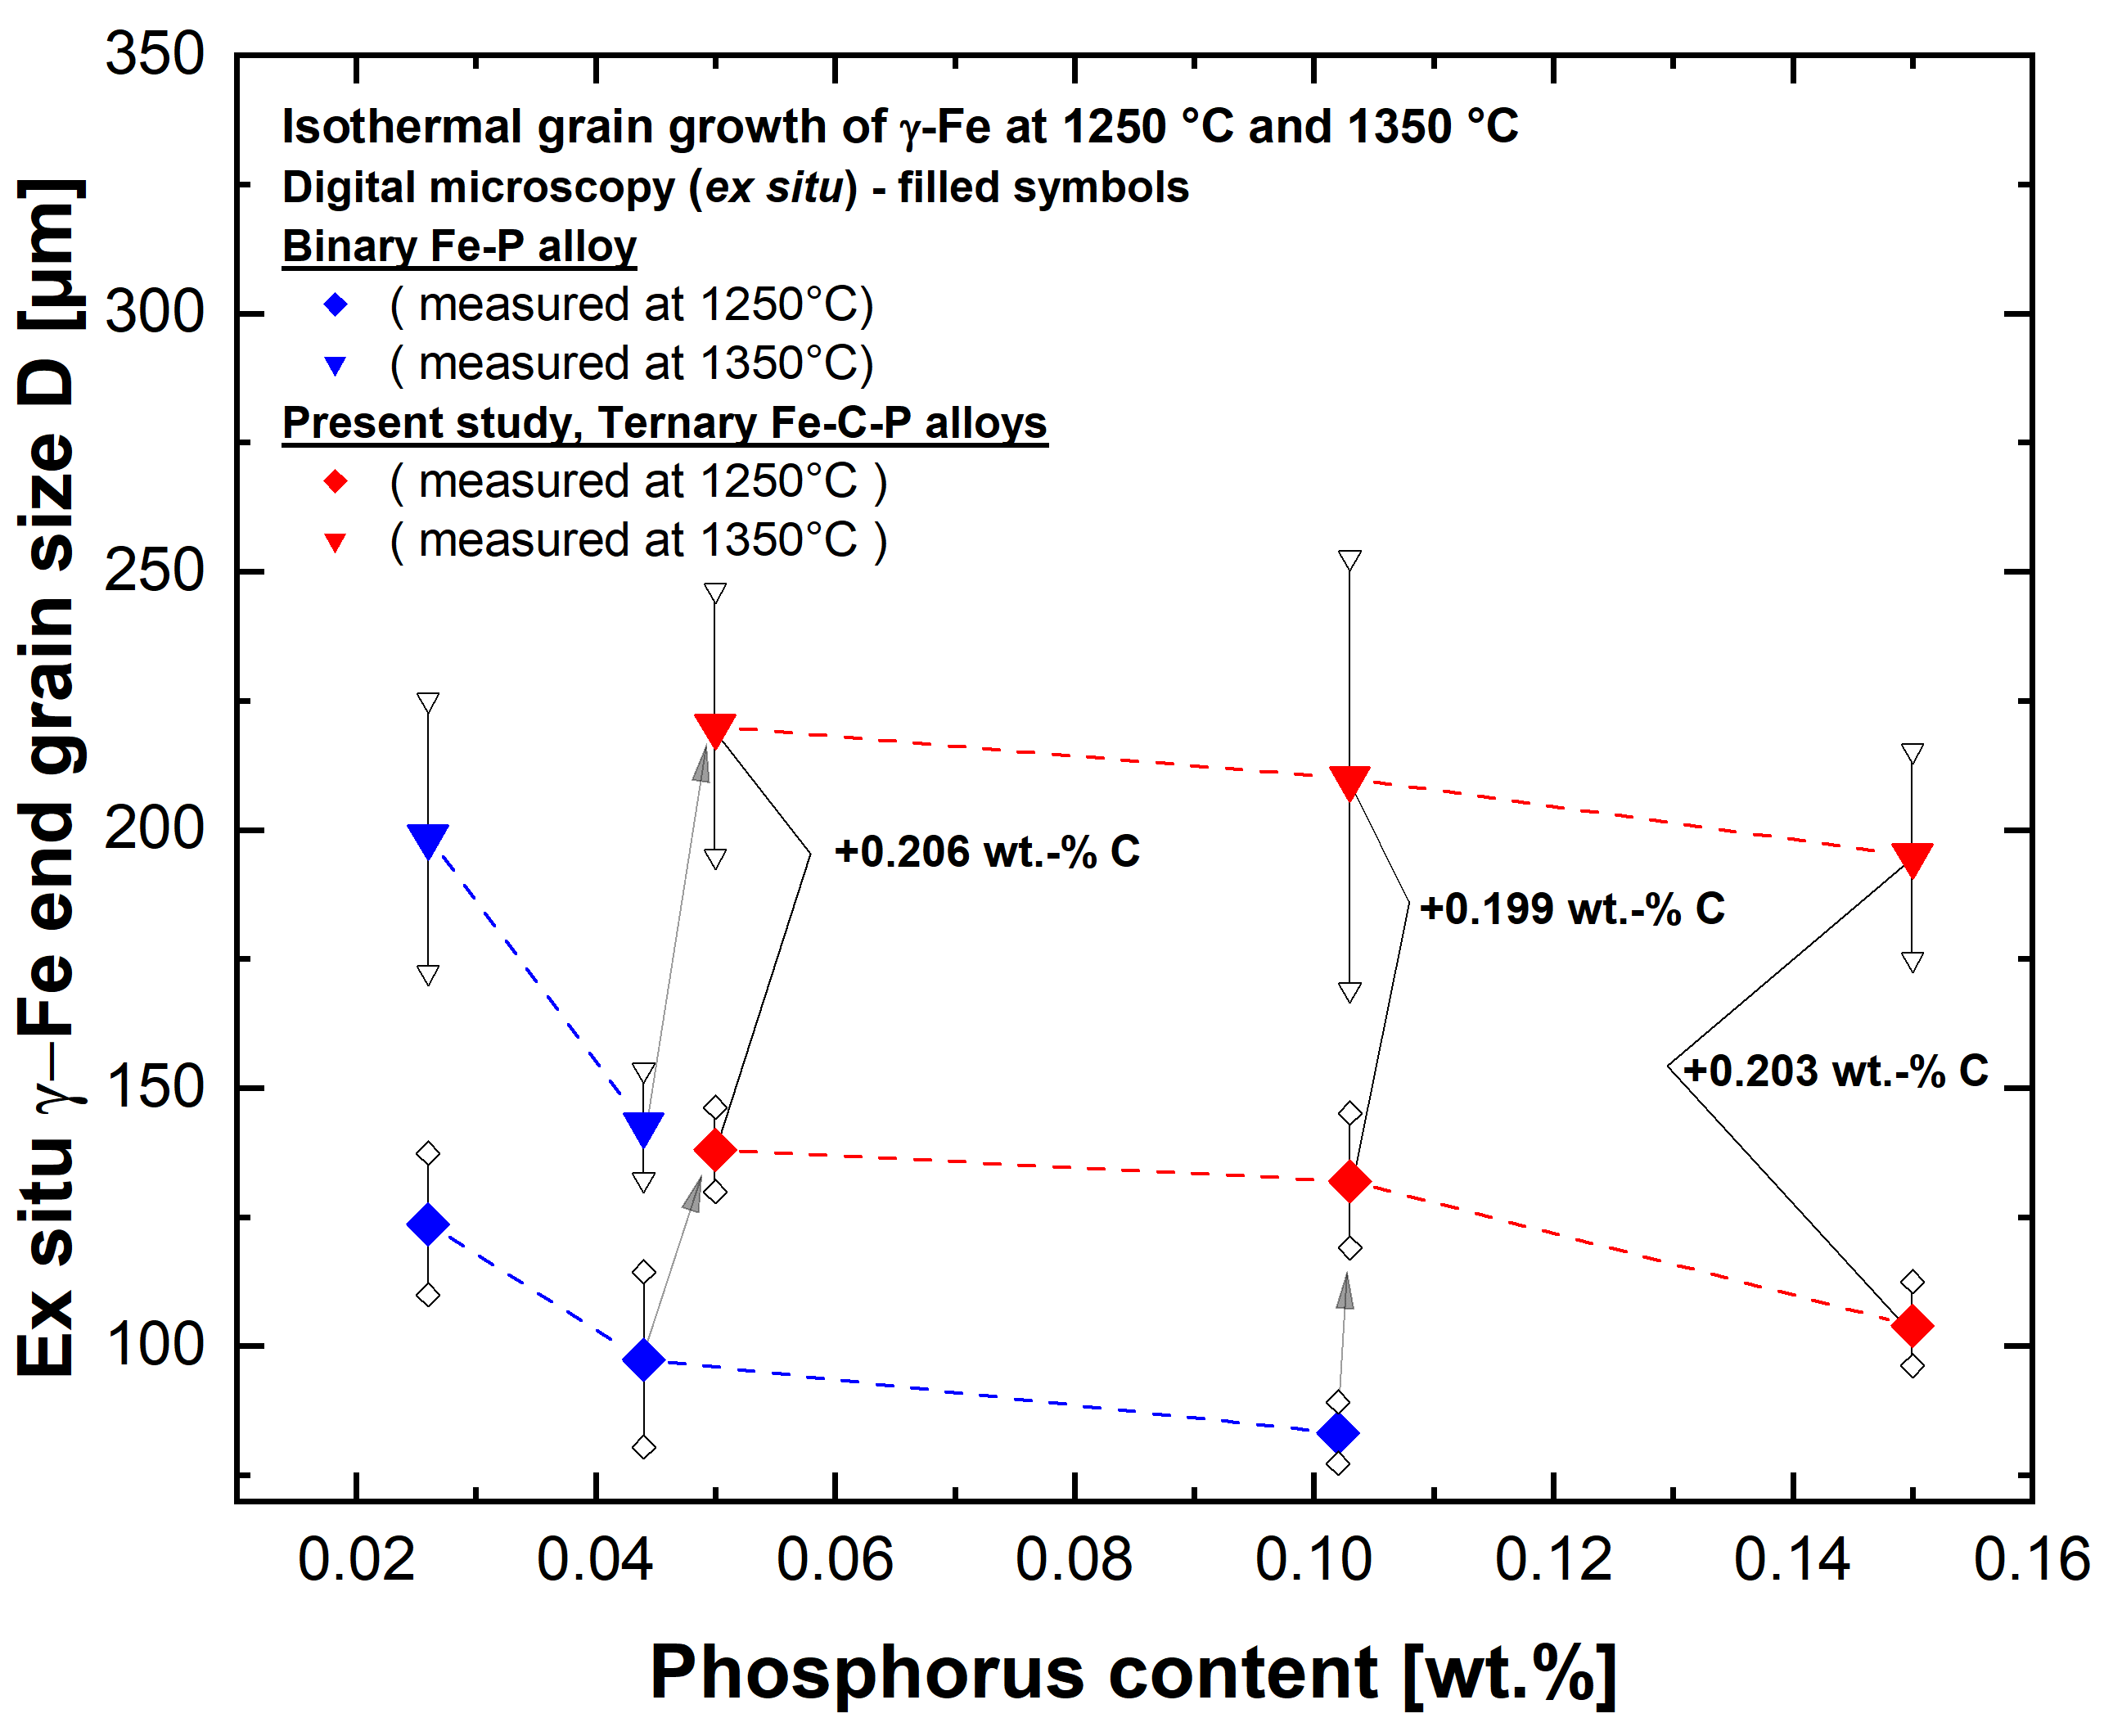
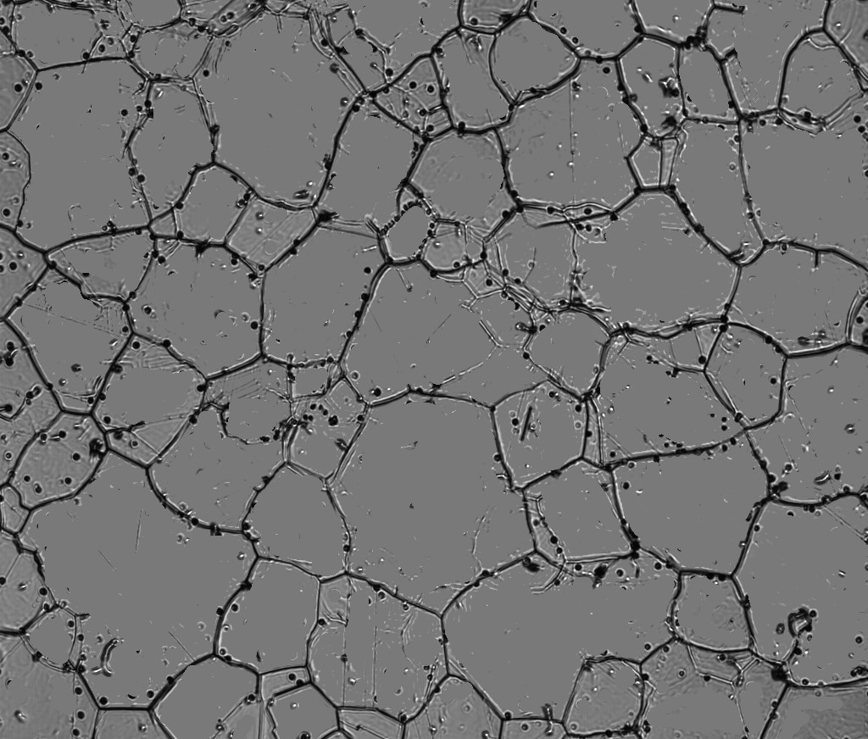
Investigation of retarding pressures (solute drag, pinning) in Fe-X systems
Grain growth: Influence of P and co-segregation of C on grain boundary migration by solute drag effect
  HT-LSCM images of isothermal grain growth:
  2 different alloys at 1250 ºC at t = 2400 s
  Fe-P – Fe-C-P alloy comparison of end grain size
Time: 2400s
Temperature: 1250°C
Time: 2400s
Temperature: 1250°C
x5 200µm
x5 200µm
  Fe - 0.199 wt.-%C - 0.1wt.-%P
  Fe - 0.102wt.-%P

Slide 19
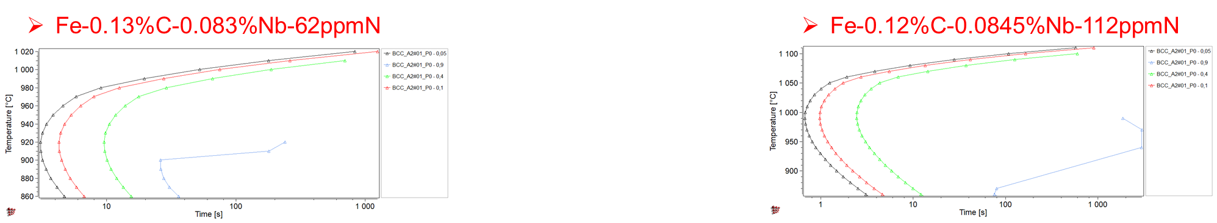
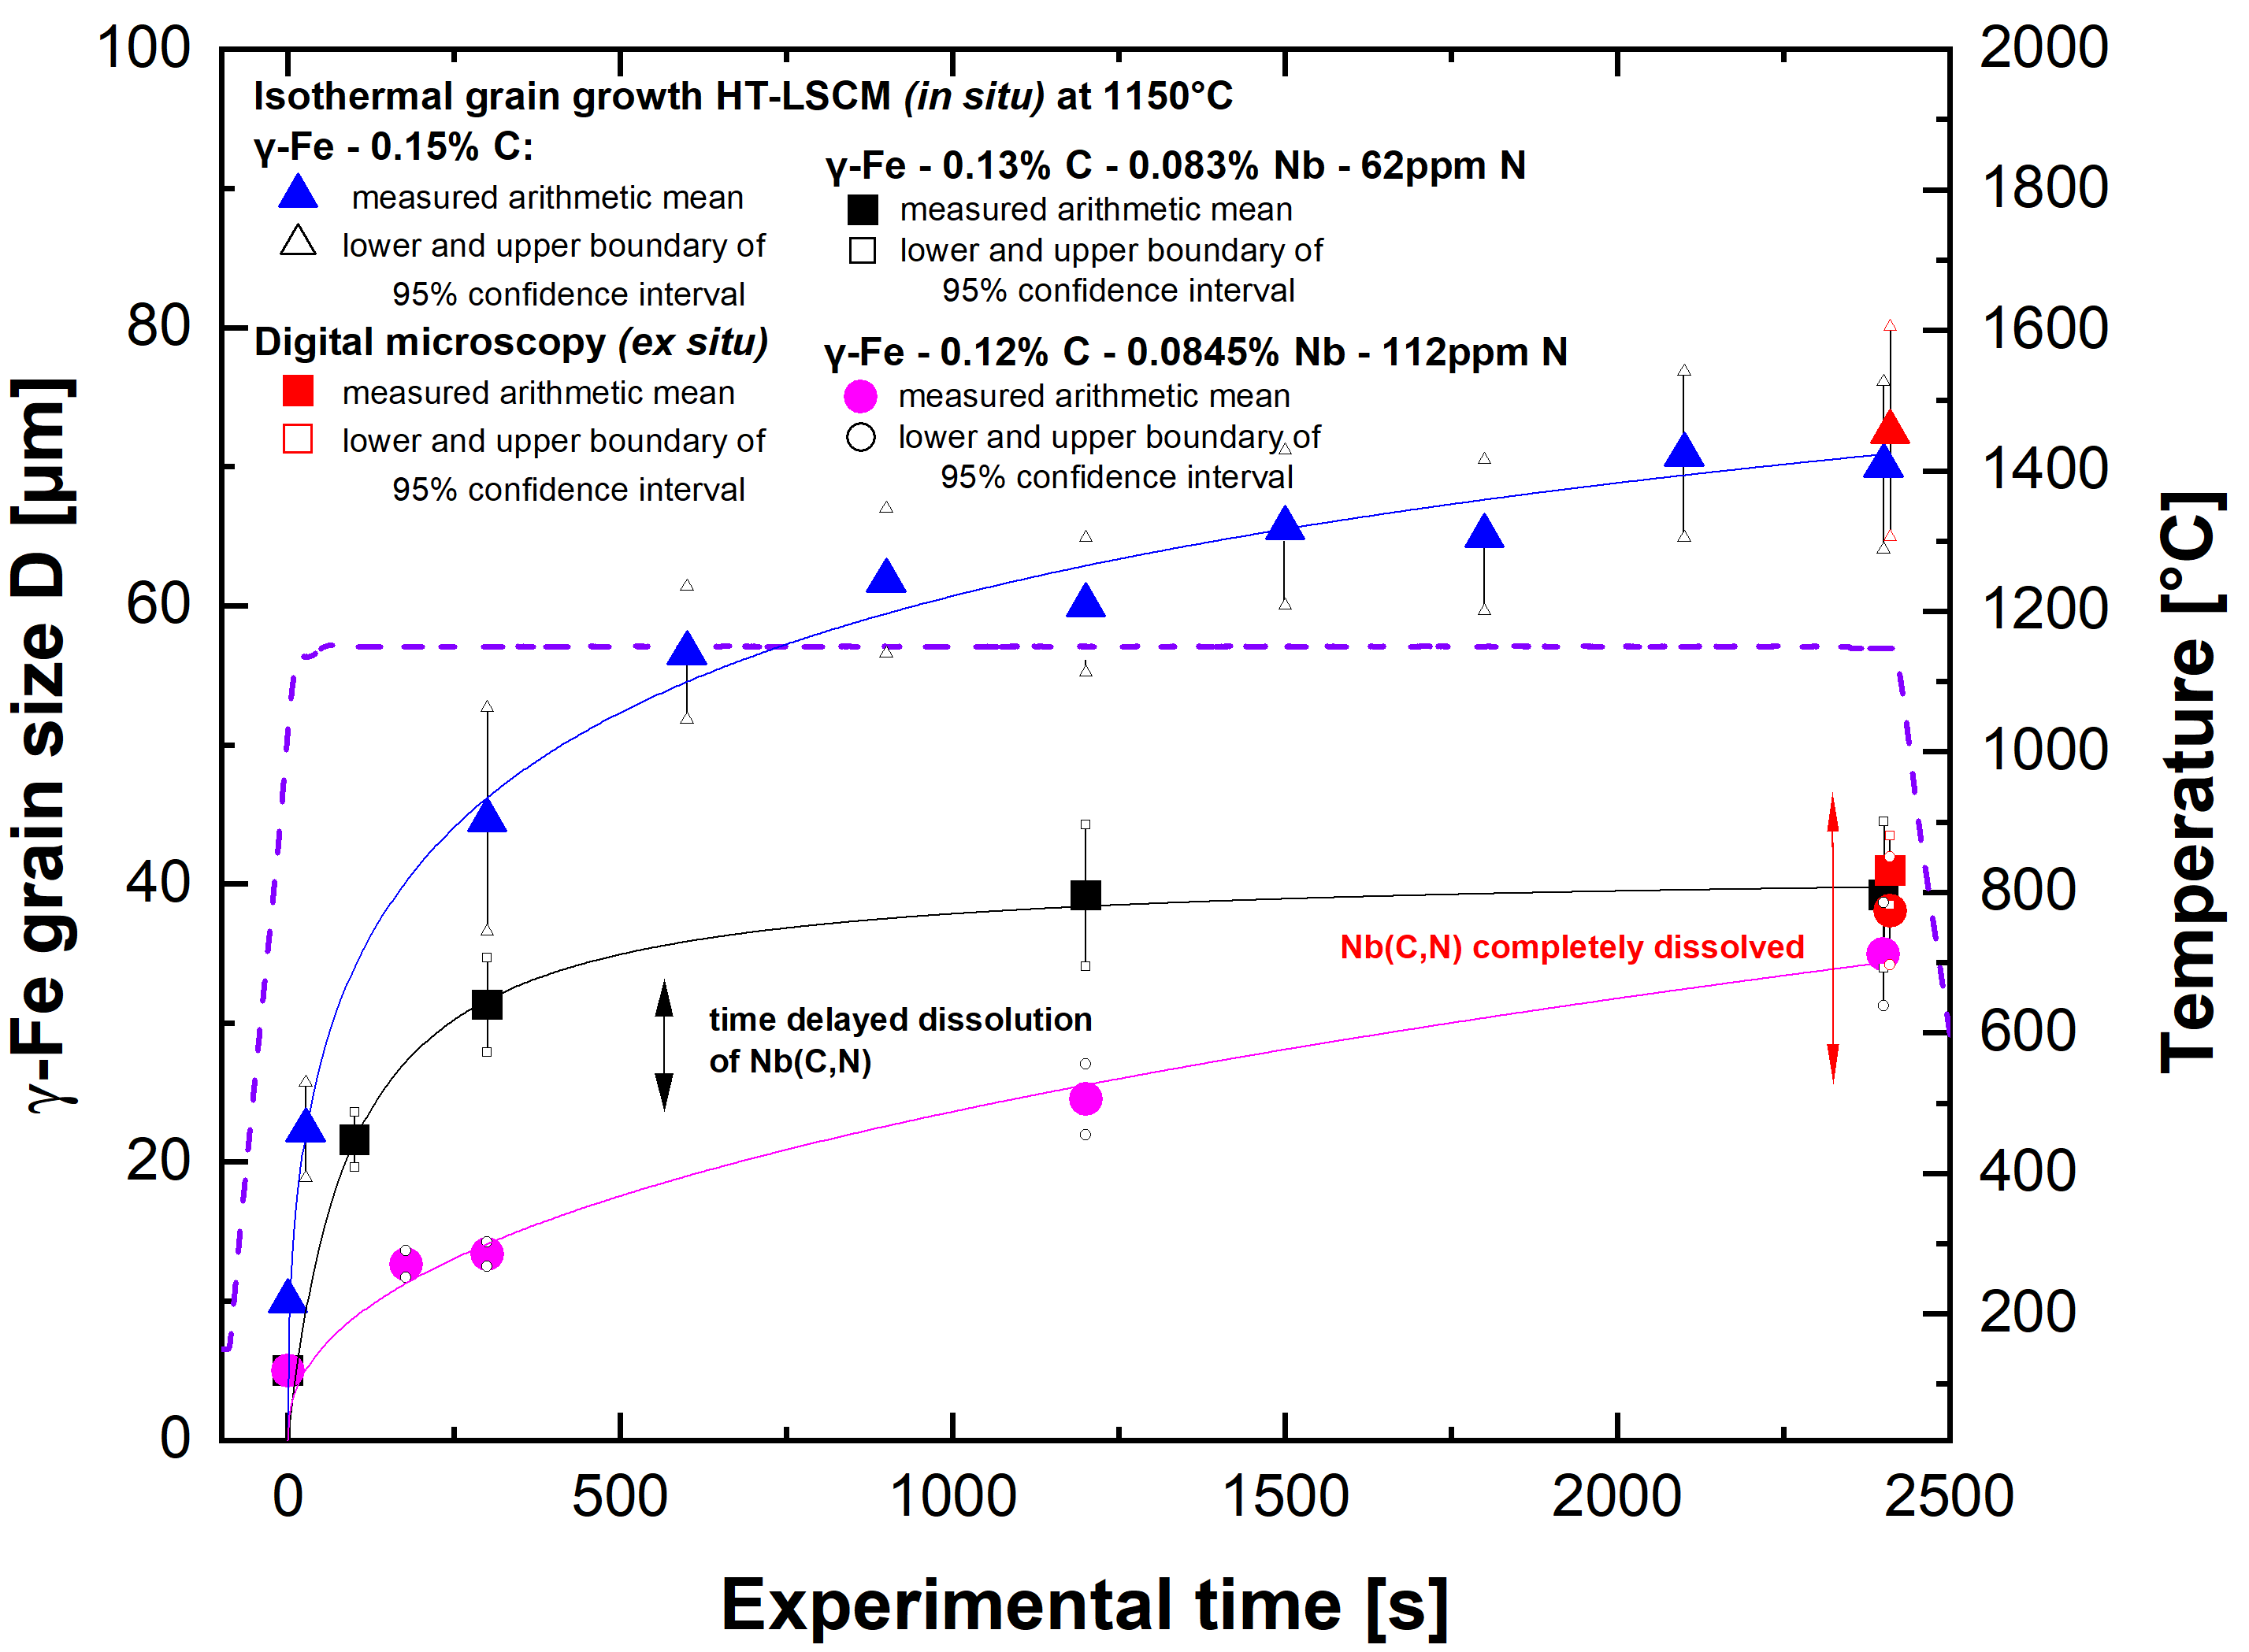
Investigation of retarding pressures (solute drag, pinning) in Fe-X systems
Grain growth: Influence of Nb(C,N) precipitation on grain boundary migration by Zener pinning forces and Nb induced solute drag effect
Comparison of isothermal γ-Fe grain growth: Fe-C and Fe-C-Nb-N alloys at 1150 ºC
MatCalc TTP calculation
5 vol.-% Nb(C,N)
10 vol.-% Nb(C,N)
40 vol.-% Nb(C,N)
90 vol.-% Nb(C,N)
5 vol.-% Nb(C,N)
10 vol.-% Nb(C,N)
40 vol.-% Nb(C,N)
90 vol.-% Nb(C,N)
T-t course:

Slide 20
Table of contents
Introduction and theoretical input
HT-LSCM: Experimental device
Methodology and sample production
Investigation of retarding pressures (solute drag, pinning) in Fe-X systems
Conclusion

Slide 21
Conclusion
Conclusion:
  HT-LSCM valid fast method for quantitative grain size and growth evaluation
  Coupled with digital microscopy to ensure validation of HT-LSCM data
  Production of case specific as-cast alloys for more variety in experimental matrix
  Evidence of solute drag effect by phosphorus in γ-Fe by comparison of grain growth with high purity iron
  Change in P grain boundary occupation by addition of carbon, evidence of co-segregation of C and P to the γ-Fe GB
  Carbon reduces the GB occupation of phosphorus. Consequence is enhanced grain growth in presence of C
  The selection of temperature plays a major role in the impact of the solute drag effect
Economic and flexible
method!

Slide 22
57. Metallographie Tagung 2023
Austenite grain growth observation by HT-LSCM for parametrization of solute drag effect and pinning forces in Fe-X-systems
Leoben, Sept. 13-15th, 2023 Maximilian Kern, Michael Bernhard and Christian Bernhard

